Slide 1
Notes:
In Isaiah 40 - 48, Isaiah is giving us a glimpse into the future Jewish condition under Babylonian captivity. This would be an extremely challenging time for God’s people, because they’re captives in an inhospitable land w/seemingly insurmountable obstacles – the nation of Babylon, their rulers, their religion, and there was also the obstacle of their own discouragement which we read in Isa 40:27 – “Why do you say, O Jacob, and assert, O Israel, ‘My way is hidden from the Lord, and the justice due me escapes the notice of my God’?”
And so, this first part of Isaiah 40 – 48 is to answer that very concern, in which God offers reassurance by providing consolation to the Jews. In 40:1-11, we learned God wants to deliver the Jews. In 40:12-27, we learn He is able to deliver the Jews, and in the last few verses of chapter 40 He assures them He absolutely will deliver them, and that His nature and His promises are more powerful than their discouragement.
As we begin chapter 41, we’re going to conclude this section on God’s consolation to the Jews by now considering the question of “How?” Exactly “how” will God deliver them from Babylonian captivity? And how will the Gentiles respond to God’s sovereign display of power? This study will conclude the section on God’s consolation to the Jews and but also serve as a segway for the next section in which God will surprisingly give consolation to the idolatrous Gentiles.

Slide 2
Consolation of the Jews
God Addresses Idolators
Isa 41:1 – “¹Coastlands, listen to Me in silence, and let the peoples gain new strength; let them come forward, then let them speak; let us come together for judgment.”
Notes:
Isaiah 41 begins similarly to chapter 1 in which we’re invited to observe a courtroom scene. But rather than the Jews being called to task, now it is the coastlands who are the defendant, whom the charges are made against. God, who the coastlands have replaced w/idolatry, is the plaintiff, Isaiah himself serves as the attorney to prosecute the case, and maybe most significant to the context, Israel is called on to be the courtroom observer.
Isa 41:1 – Who do the coastlands represent? The Gentiles, those distant, idolatrous lands. God is calling on them to render a judgment regarding what He is about to accomplish for Israel. And as they’re being ushered into this courtroom, they are advised to basically suck it up because they’re approaching the Sovereign God, and they’re going to need all the strength they can muster. And when God has finished laying out His case, His evidence for Hid sovereignty will be so irrefutable, even though they will be called on to speak, they’ll ultimately be silenced into shame.
Now, notice the contrast to 40:31, that those who wait on the Lord will gain new strength. God gives limitless strength to His people. But what we’re going to see from this chapter is that the nations are not currently relying on God, but rather their idols; and those false gods won’t be able to help them when they are called to task.

Slide 3
Consolation of the Jews
God Addresses Idolators
Isa 41:2-4 – “²Who has aroused one from the east whom He calls in righteousness to His feet? He delivers up nations before him and subdues kings. He makes them like dust with his sword, as the wind-driven chaff with his bow. ³He pursues them, passing on in safety, by a way he had not been traversing with his feet. ⁴Who has performed and accomplished it, calling forth the generations from the beginning? ‘I, the Lord, am the first, and with the last. I am He.’”
Notes:
It’s as if God is going to present His case first, and here is the evidence He gives:
Isa 41:2-3 – So, here is “how” God will rescue His people, through a coming judgment not yet known in specificity, in which God will arouse some anonymous conqueror to His feet from the east. This conqueror will deliver up nations, subdue kings, and though leaving havoc in his wake, he’ll do so completely unhindered. This conqueror will act w/such completeness, he need not return. That phrase “traversing w/his feet” could mean he travels so speedily that it seems as if his feet don’t even touch the ground, or it could mean brand new roads were carved out previously not traveled by former conquerors. Either way, this conqueror will destroy the nations w/ease, and God is predicting this way before it happens.
Now, at this point in Isaiah, this conqueror is anonymous, but we know from later on that this is referring to Cyrus the Persian. But what’s the point of explaining all of this so long beforehand? It is to ask the Gentiles this “Who commissioned this guy, Who is ultimately his master, and Who determined what he should do and how he should do it? Who has authority and ultimately rules over the course of world events?”
Isa 41:4 – So, this is the “Who” – it’s God. And this event would not occur for some 150 years down the road from when Isaiah is writing it, yet it might as well be a done deal. But notice how Isaiah expands this to an even broader consideration of generations from bygone days. Meaning, “Who has always been behind the rising and falling of nations?” God – and He was w/the first generation and will be there w/the last. He is both the Author who starts the story and the Finisher of it. And this means He has authority over everything in between. All this being true, God not only deserves the worship and admiration of Israel, but of the entire world.

Slide 4
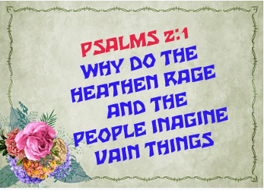
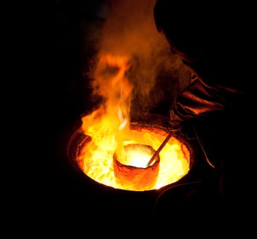
Consolation of the Jews
God Addresses Idolators
Isa 41:5-7 – “⁵The coastlands have seen and are afraid; the ends of the earth tremble; they have drawn near and have come. ⁶Each one helps his neighbor and says to his brother, ‘Be strong!’ ⁷So the craftsman encourages the smelter, and he who smooths metal with the hammer encourages him who beats the anvil, saying of the soldering, ‘It is good’; and he fastens it with nails, so that it will not totter.”
Notes:
Yet, as He predicts this coming conqueror, He will also predicts how the coastlands will initially react to this coming invasion:
Isa 41:5-6 – So, the effect of Cyrus’ advance, as well as the might and speed at which he’ll destroy nations, will inevitably provoke fear in the Gentiles. And so, in a similar vein to Psa 2, they come together to plan. They move to prop up one another’s courage, knowing something must be done to prep for invasion.
But notice what their solution is – Isa 41:7 – So what is their answer to the coming distress? “Let’s build even larger, more elaborate idols to help us!” It’s like the deficit problem. The government’s solution? “Let’s borrow more money!” Idolatry is a very common response to human fear. Fear doesn’t drive everyone toward God, for some it drives them further away. Each workman encourages the other, patting one another on the back for their vain, completed works. And here is the futility of it all – when finished, the idol is fastened to ensure it cannot fall over. They’re not only serving God’s made w/human hands, but they are having to fasten their gods down so wind won’t make it totter. What does the phrase “it is good” remind you of? When God created the heavens and the earth. But here, it is the idols passing human inspection, and does our society not continue to do this today regarding deity? If someone doesn’t like what the bible says about God, they’ll fashion their own version of God in the mind and say, “This one is good, I’ll serve this god.” What an arduous task the idolator has to go through to create something so empty. Wouldn’t it be much simpler to just trust the sovereign Lord? (stop for questions)

Slide 5
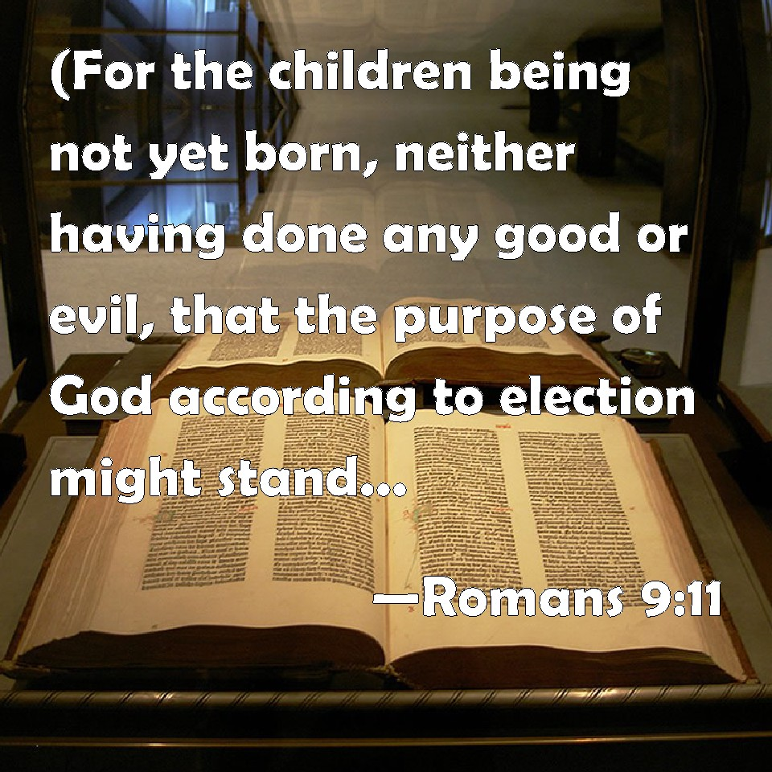
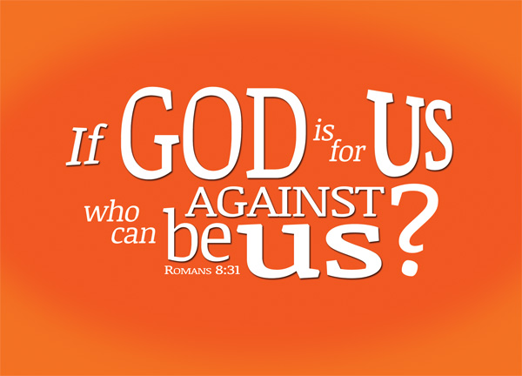
Consolation of the Jews
God Addresses Israel
Isa 41:8-10 – “⁸But you, Israel, My servant, Jacob whom I have chosen, descendant of Abraham My friend, ⁹you whom I have taken from the ends of the earth, and called from its remotest parts and said to you, ‘You are My servant, I have chosen you and not rejected you. ¹⁰Do not fear, for I am with you; do not anxiously look about you, for I am your God. I will strengthen you, surely I will help you, surely I will uphold you with My righteous right hand.’”
Notes:
In contrast to the nations frantically hustling about to construct idols to meet the coming threat, God changes from addressing the gentiles to addressing the courtroom observer Israel:
Isa 41:8-9 – Israel enjoyed a special status as God’s servant. This began w/God’s sovereign, divine choice. But lest they become puffed up by their selection, He also refers to them as “Jacob”, who early in his life was a conniving, untrustworthy man just as Israel had been. And so, though they began w/God’s sovereign, divine choice, they were only sustained through sovereign, divine faithfulness. Despite years of Israel’s unfaithfulness, the commitment God showed to his friend Abraham extended to His seed. They “are” His servants. And keep in mind that word “but”, because a servant of God should never attempt to make God in their own image as the coastlands did.
In addition, since they are His servants, they don’t have to be fearful over this coming conqueror as the coastlands were – Isa 41:10 – Anyone who God is with has no reason to fear – He is the “I am” from vs. 4. Remember what we read in chapter 40 – He is the one who marks off the heavens w/a span. While the coastlands fasten their idols so as not to fall, God upholds Israel w/His righteous right hand so that we won’t totter. This is yet another way of saying “God is with us.” And as Rom 8:31 says, “If God is for us, who is against us?” And if Israel could find the strength not to fear things the way the Gentiles do, they would indeed show themselves as distinct servants of God.

Slide 6
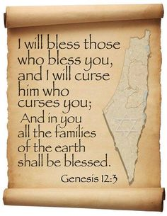
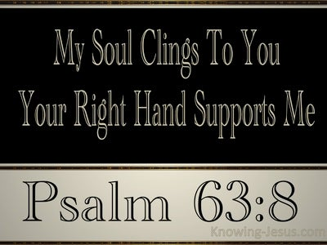
Consolation of the Jews
God Addresses Israel
Isa 41:11-13 – “¹¹Behold, all those who are angered at you will be shamed and dishonored; those who contend with you will be as nothing and will perish. ¹²You will seek those who quarrel with you, but will not find them, those who war with you will be as nothing and non-existent. ¹³For I am the Lord your God, who upholds your right hand, Who says to you, ‘Do not fear, I will help you.’”
Notes:
And this will cause the nations to regret the day they ever messed w/God’s people.
Isa 41:11-12 – From rage to shame; from contention and warring to obliteration. Remember from 40:17 when Isaiah said that the nations are regarded by God as less than nothing and meaningless? He will prove this because the nations dared to mess w/the servant of the Master. This is an outworking of God’s promise to Abraham in Gen 12:3 – “I will curse him who curses you.”
Any why should He do this? – Isa 41:13 – He does this because He is their God. Not only does He use His right hand to uphold them, as we saw in vs. 10, He also upholds their right hand in that He gives them strength (40:31). So, when you combine the 2 images, we’re seeing a powerful Father defending His child w/His right hand while holding His child’s hand w/the left, leading him through dangerous terrain unhindered. He does not merely defend; He is personally involved w/His children. And remember, this is the hand which can measure the waters in the hollow of His hand, which can mark off the heavens w/a span, and can lift up the islands like fine dust. That same powerful, powerful hand, upholds us and takes us by our hand to protect and defend us.

Slide 7
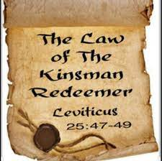
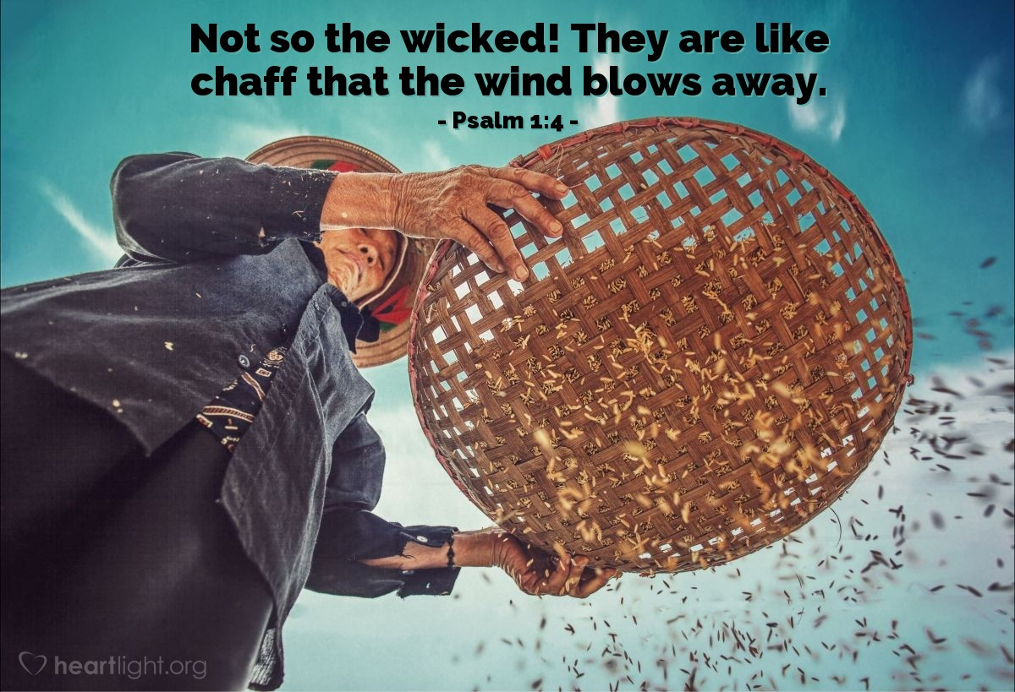
Consolation of the Jews
God Addresses Israel
Isa 41:14-16 – “¹⁴‘Do not fear, you worm Jacob, you men of Israel; I will help you,’ declares the Lord, ‘and your Redeemer is the Holy One of Israel. ¹⁵Behold, I have made you a new, sharp threshing sledge with double edges; you will thresh the mountains and pulverize them, and will make the hills like chaff. ¹⁶You will winnow them, and the wind will carry them away, and the storm will scatter them; but you will rejoice in the Lord, you will glory in the Holy One of Israel.”
Notes:
But keep in mind that while they are held captive, Israel doesn’t yet feel this protection. They feel weak and feeble. But God is going to say, “That doesn’t matter”, and now He’s going to show how He’ll make the feeble dominant:
Isa 41:14 – In our culture, calling someone a worm isn’t the most flattering thing. But here, it simply symbolizes Israel’s inferiority and helplessness before the nations. But despite their incapacity, they are still Israel, and so God Himself will help them.
This is the first appearance of the word Redeemer in this section of Isaiah and it will definitely not be the last. We’re going to see this word appear 23 more times before we get to the end of the book. Usually when we’re teaching kids about the concept of redemption, we use the “coupon” illustration. While that is a simple way to explain it, it does not do justice to the idea. Rather, we really need to understand the OT law of the kinsman redeemer, which obligated a person’s next-of-kin to deliver them from enslavement or a lost property as a result of indebtedness toward someone. And as we see in the book of Ruth, which shows this concept in action, sometimes marriage was involved. And what we need to take away from God being Israel’s Redeemer in this section, is He is going to do it all. He is going to deliver them from their enslavement, give them back the land that is theirs by covenant, and as we’re going to learn later on in chapter 62, that land will be called “Beulah Land”, which means “Married”. More on that in just a few weeks.
How will God get them out of “worm” status? – Isa 41:15 – Sounds like He’s going to give that worm some teeth by turning them into a threshing sledge. This was an instrument used in ancient agriculture to separate wheat from chaff. The “mountains” likely represent the strong nations, and the “hills” the smaller nations. Israel will triumph over them.
But in what way? When that worm Israel gets their teeth, what will they do to the nations that used to hurt them? – Isa 41:16a – So the threshing sledge becomes a winnower. The idea is that anyone who refuses to be conquered by the gospel will be separated and removed from the nations by God Himself. Not only will Israel be all that is left, when it happens, they will know that God was the cause of the victory, and that all glory is due Him.
Isa 41:16b – They wouldn’t rejoice in their own strength, because only God could take a weak worm and give it such sharp teeth. (stop for questions)

Slide 8
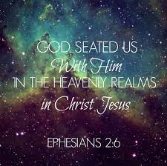
Consolation of the Jews
God Addresses Israel
Isa 41:17-19 – “¹⁷The afflicted and needy are seeking water, but there is none, and their tongue is parched with thirst; I, the Lord, will answer them Myself, as the God of Israel I will not forsake them. ¹⁸I will open rivers on the bare heights and springs in the midst of the valleys; I will make the wilderness a pool of water and the dry land fountains of water. ¹⁹I will put the cedar in the wilderness, the acacia and the myrtle and the olive tree; I will place the juniper in the desert together with the box tree and the cypress”
Notes:
And now, in order to provide for the needy in their adversity, He will transform their environment, reminiscent of the wilderness journey.
Isa 41:17 – As we saw in chapters 1 – 39, one of the biggest downfalls of God’s people was that their prosperity lured them into complacency and self-sufficiency, causing God to take everything away from them. And now, while in captivity, Israel is in a situation in which they are powerless to do anything about, they will learn to depend on God again. And now all their needs will be satisfied through prayer.
Isa 41:18 – Water and shade are the two great needs of the desert traveler (Ex 15:27). Notice how in providing them water, God will innovate by opening rivers on the bare heights (Ex 17:1), He will multiply by placing springs in valleys in which they’d already be present, and then He will transform the wilderness and dry land into pools and fountains (35:6-7). And only a person who discerns the message about God in chapter 40 could believe God is capable of such wonders.
Isa 41:19 – So this would refer to shade or perhaps even building material. All these trees are all common to Syria and Palestine, but they wouldn’t normally be found together, which clearly indicates that his is God’s work. He lists 7 trees, which could indicate God’s perfect provision for His needy, and the emphasis on water and trees also reminds us of the Garden of Eden. Sin forfeited the garden and introduced thorns and thistles, man laboring by the sweat of his brow. But when you read this, it’s almost as if God is promising a bit of heaven is going to come down to earth. Eph 2:6 does mention that God’s people are seated in the heavenlies w/Christ Jesus.

Slide 9
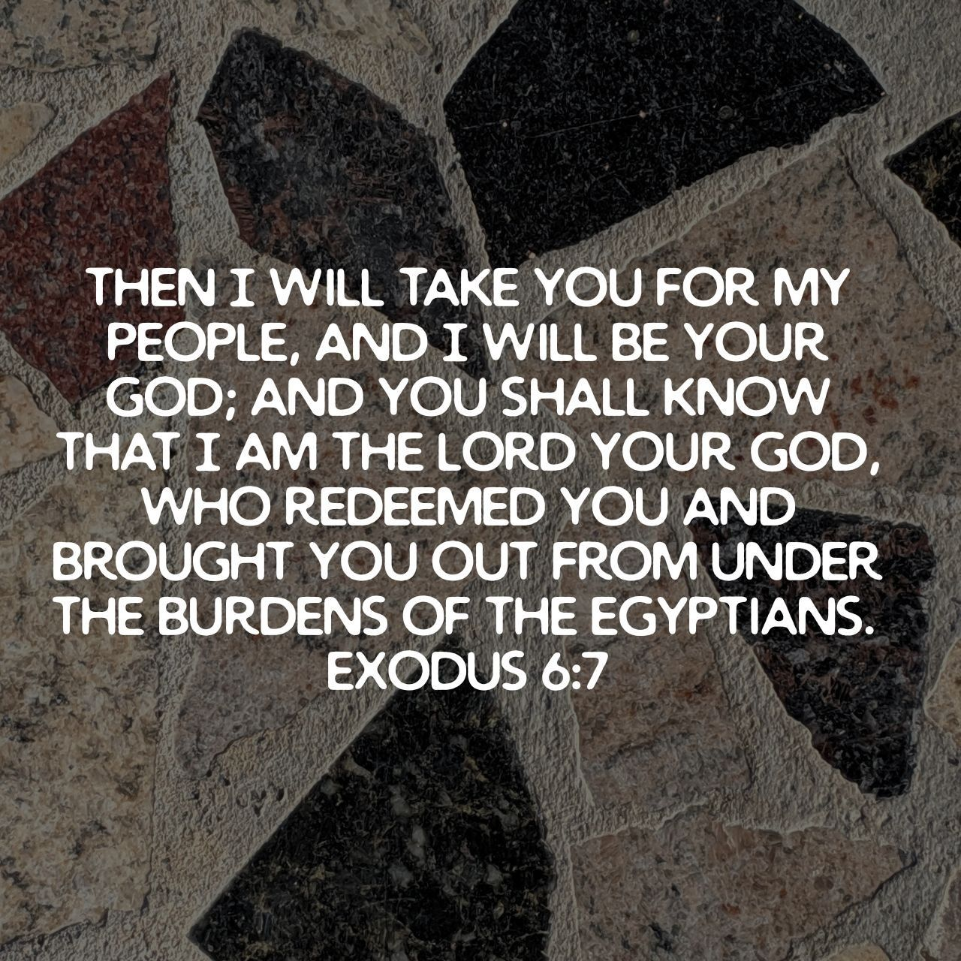
Consolation of the Jews
God Addresses Israel
Isa 41:20 – “²⁰that they may see and recognize, and consider and gain insight as well, that the hand of the Lord has done this, and the Holy One of Israel has created it.”
Notes:
And then in vs. 20, God reveals 4 purposes for why He put them through this entire experience in the first place.
Isa 41:20 – 1) To see, meaning that they would discern and comprehend God. 2) To recognize that Israel’s God is in another class altogether from the idols. 3) to consider, meaning to assign to God a new position in their thinking. 4) To gain insight, that while the coastlands are frantically creating vain gods, God created this situation. This verse tells is that the experience of Israel’s captivity and rescue was that “they” would become evidence to “all” the world of God’s unique deity. And where this becomes consolation to the Jews is to assure them that despite the coming ordeal, He would still care for them throughout it. (stop for questions)

Slide 10
“I Will” – Chapters 14 vs. 41
Babylon (chapter 14) | God (chapter 41)
“ascend above heights of the clouds” (13) | “strengthen you” (10)
“raise my throne above the stars of God” (13) | “help you” (10,13-14)
“sit on the mount of assembly” (13) | “uphold you” (10)
“ascend above heights of the clouds” (14) | “not forsake them” (17)
“make myself like most high” (14) | “[bring water/shade]” (18,19)
None came to pass | All came to pass
Notes:
Back in May, David preached a sermon called “I Will” from Psalm 101. In Isaiah, there are a lot of “I wills”, too, and one of the more interesting ones is to compare what Babylon said back in chapter 14 to what God said He would do in chapter 41. You get one guess as to whose “I will” came to pass and who was full of hot air.

Slide 11
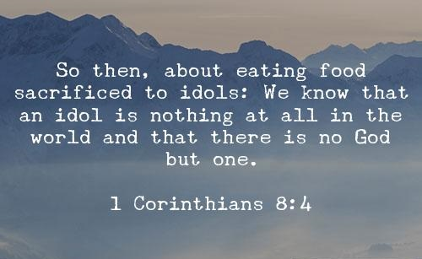
Consolation of the Gentiles
God Addresses the Idols
Isa 41:21-24 – “²¹‘Present your case,’ the Lord says. ‘Bring forward your strong arguments,’ the King of Jacob says. ²²Let them bring forth and declare to us what is going to take place; as for the former events, declare what they were, that we may consider them and know their outcome. Or announce to us what is coming; ²³declare the things that are going to come afterward, that we may know that you are gods; indeed, do good or evil, that we may anxiously look about us and fear together. ²⁴Behold, you are of no account, and your work amounts to nothing; he who chooses you is an abomination.”
Notes:
Now, in vs. 21, God is going to start shifting His consolation from the Jews toward the very Gentiles He has called to court, and He’s going to begin this by directly addressing that thing that was such a hang-up for the Gentiles – the idols.
Isa 41:21-22 – In other words, it’s as if God wants to sit down w/the idols themselves, man to man, and argue out their cases, and see who has the better argument. “Can you idols declare the future?” When you hire a stockbroker, you want the guy who has a track record of correct predictions. That’s who we listen to about future things. So, “Can you idols explain the flow of history in such a way as to make sense of the present? Can you foretell the future in such a way as to make its developments intelligible? Can they look at an event w/discernment and declare where it will lead?” He doesn’t even challenge them to control the future, merely to state what it will be. Too bad they’re mute! Not doing so shows they are not independent of the universe and its functioning and are merely a consequence of the universe of one’s imagination.
Isa 41:23 – He’s inviting the the idols to show the power of prediction – this would prove they are gods. This is the ultimate stare down. That phrase “do good or evil” implies “Just do something, anything!” God is putting His reputation on the line by announcing the coming of a conqueror from the east and that He will rescue His people. Now it’s the idols turn to proclaim something equally shocking, a radical break from the norm. If they’re so powerful, surely they can perform some act that will produce terror in the nations. But the bottom line is that all idols can do is take credit for past events God that caused/allowed, and that doesn’t make them special or unique because anyone can take credit for another’s work.
And so, knowing they can do/say nothing, He gives a verdict of contempt – Isa 41:24 – In other words, “Yeah, that’s what I thought!” (1 Cor 8:4). And the people who follow them become like them, a contemptible abomination. Since God is holy and the idols are nothing, choosing them above Him is not a mistake, it’s a perversion.

