Slide 1
Notes:
The first of two times where God says He will fight for Israel. If the previous verses seem so negative, perhaps it’s only to make these verses sound that much more positive.

Slide 2
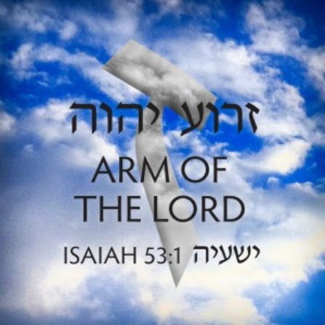
The Lord Intercedes
Dressing For Battle
Isa 59:15c-16 – “Now the Lord saw, and it was displeasing in His sight that there was no justice. ¹⁶And He saw that there was no man, and was astonished that there was no one to intercede; then His own arm brought salvation to Him, and His righteousness upheld Him.”
Notes:
Isa 59:15c-16a – Divine reaction to 58:1 – 59:15b, and covers through 63:6. He is the divine Warrior who comes to defeat Israel’s biggest enemy – sin. Our great hope is that God does actually see (58:3; 59:2; Ex 2:23-25). He sees no justice because they are unable to do justice. “displeasing” = He took it badly, was appalled, was devastated. “astonished” = expression over the horror of sin and His compassion for the people. “intercede” = no one to stand as champion between the people and the consequences of their moral collapse (53:12). You’re in big trouble, and you can’t dig yourself out of it. God will intervene.
Isa 59:16b – “arm” = His personal power and resource, in which He submitted to the death what was their due (51:9; 52:10; 53:1; 63:5). “righteousness” = His changelessly righteous character wherein He must be true to who He is and faithful to what He has pledged. His arm works salvation because He has promised to save His people, and so it acts in ways to satisfy His righteousness. What came to Isaiah’s unclean lips in 6:5 now comes to the nation.

Slide 3
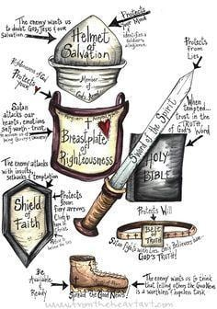
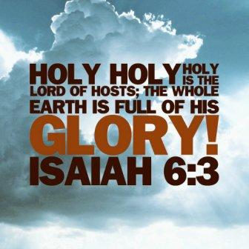
The Lord Intercedes
Dressing For Battle
Isa 59:17-19b – “¹⁷He put on righteousness like a breastplate, and a helmet of salvation on His head; and He put on garments of vengeance for clothing and wrapped Himself with zeal as a mantle. ¹⁸According to their deeds, so He will repay, wrath to His adversaries, recompense to His enemies; to the coastlands He will make recompense. ¹⁹So they will fear the name of the Lord from the west and His glory from the rising of the sun”
Notes:
Isa 59:17-18 – Clothing a metaphor for character, and righteousness, salvation, vengeance, and zeal are all aspects of God’s character; a prototype to Eph 6:13-17, in which we put on His armor so He can work through us. After all, He is looking for someone to fight for His causes (vs. 15c-16). He is fully clothed as a warrior (42:13; Ex 15:3; Deut 1:30). He will satisfy His righteousness, save His people, repay His foes, and carry it through to completion driven by His zeal (9:6-7; 26:11; 37:32; 42:13; 63:15). No offensive weapons are mentioned – all God needs is His mighty arm. Vengeance is fundamental to this section, in which things are settled in absolute justice between the Lord and all who oppose Him. “wrath” = burning hostility toward sin. “repay” = pacifying a debt, a word very similar to “shalom” (peace), implying God will give peace to those who love Him (57:19) and “pacify” all accounts w/His enemies, even those as far as the coastlands.
Isa 59:19b – Result? Reverence toward God throughout the entire world, from the remotest regions (west to east). His glory is an inescapable reality which fills the earth (6:3; Psalm 106:8). It makes everything pale in comparison (2:10,19,21).

Slide 4
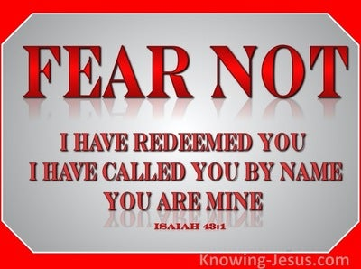
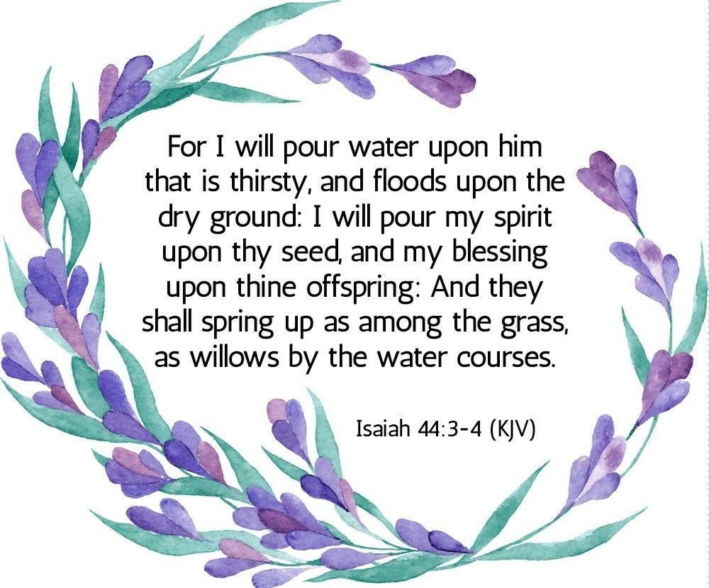
The Lord Intercedes
Dressing For Battle
Isa 59:19c-21 – “For He will come like a rushing stream which the wind of the Lord drives. ²⁰‘A Redeemer will come to Zion, and to those who turn from transgression in Jacob,’ declares the Lord. ²¹‘As for Me, this is My covenant with them,’ says the Lord: ‘My Spirit which is upon you, and My words which I have put in your mouth shall not depart from your mouth, nor from the mouth of your offspring, nor from the mouth of your offspring’s offspring,’ says the Lord, ‘from now and forever.’”
Notes:
Isa 59:19c-20 – The Lord will act like a pent-up flood suddenly released by a driving wind. Second half of verse is difficult to translate. As our Warrior, He redeems Zion, securing a worldwide result (35:9). “Redeemer” = Hebrew “goel” (Lev 25:25,48; Num 35:19; Deut 25:5-10). No matter how horrible sin is to Him, salvation is available to those who turn from their rebellion (Rom 11:26-27). “rebellion” = 53:5. While nothing/no one can change God’s grace, one thing can block it – an unrepentant spirit. “Jacob” must want it enough to choose God’s way (Gen 32:26; 1 Thes 1:10).
Isa 59:21 – “covenant” = 42:6; 49:8; 54:10; 55:3-5. Accomplished through the Servant (49:8; 54:10). The Servant is the Anointed One (42:1; 61:1-3), and He secures the covenant blessing to His seed (53:10). It can’t depart from His mouth because He has the tongue of disciples (50:4). “offspring” = 44:3; 54:3; Gen 3:15; 22:18. He wants His Spirit to take up resident w/them (32:15-19; 44:3-5). Then we will declare Him (Psa 22:30-31). This is emphatic due to the double “says the Lord”. “from now and forever” = 9:7.

Slide 5
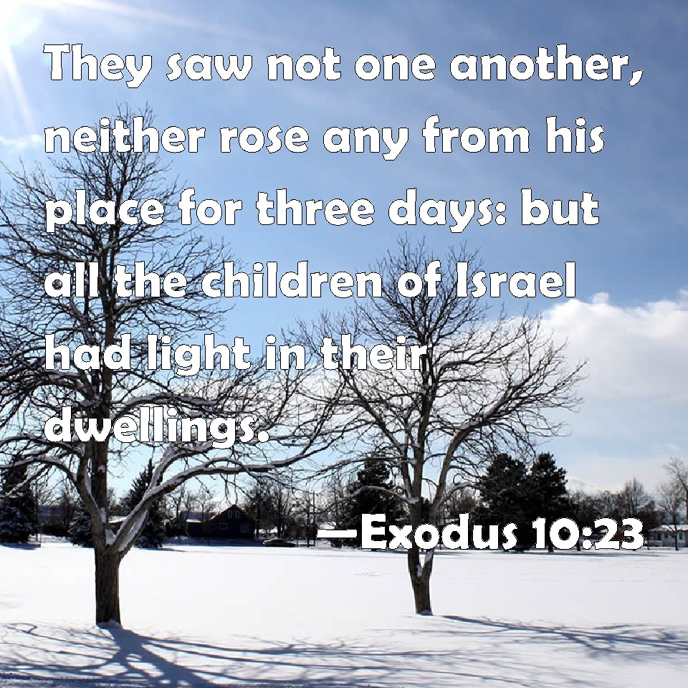
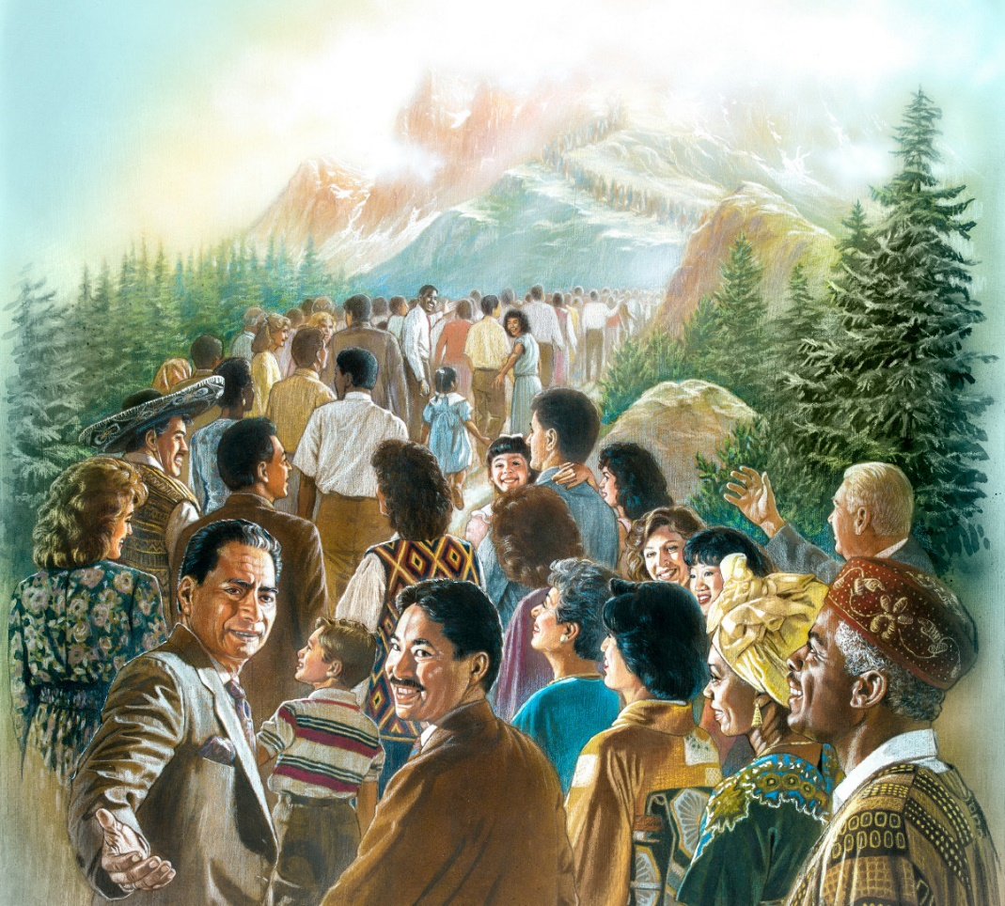
Zion’s Alluring Light
The Light of the World
Isa 60:1-3 – “¹Arise, shine; for your light has come, and the glory of the Lord has risen upon you. ²For behold, darkness will cover the earth and deep darkness the peoples; but the Lord will rise upon you and His glory will appear upon you. ³Nations will come to your light, and kings to the brightness of your rising.”
Notes:
Isa 60:1-3 – Poem centers on promises of Gen 12:3 (blessing and curse), climaxing themes from 2:2-4; 4:2-6; 25:6-10; 26:1-6; 35:1-10. “rest” = 45:14-15; 49:16-26. Zion summoned to embrace the light that is hers from God and to observe as the nations gather to the same light. Redeemer of 59:20 has come like the rising of the sun after a long anxious night (59:9-10), and the result is that Zion is inwardly “charged” (1 Sam 14:27-29). God’s glory would be reflected from Israel, a contrast w/chapters 2 and 3. This new light has put new life in her limbs of a Zion prostrate in the dust because of sin such that she can “arise”. Vs. 2 is the explanation: the Lord’s light/glory, through Israel, will magnetize the nations (2:3; 49:7; 55:5). “The solution for the world’s spiritual and moral darkness is what happens to you, Zion” (Ex 10:23). This will rescue those entrapped in the darkness of Jewish tradition and prejudice, idolatry, or Grecian/Roman philosophy (Matt 17:2; John 1:14,16; 8:12; 1 John 1:2). Vs. 3: the ruled and the rulers = total response (49:7; 52:15). The Light is the reason why Gentiles come, the brightness of the presence of God will be irresistible (2:3-4; 4:5; 40:5).

Slide 6
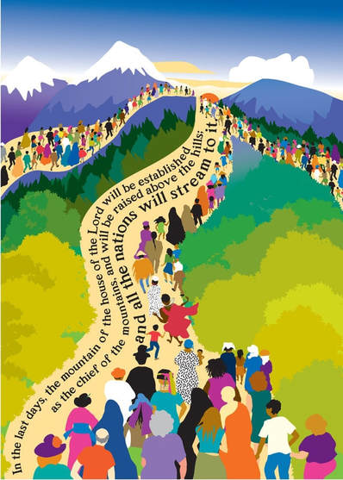
Zion’s Alluring Light
Nations stream
Isa 60:4-9 – “⁴Lift up your eyes round about and see; they all gather together, they come to you. Your sons will come from afar, and your daughters will be carried in the arms. ⁵Then you will see and be radiant, and your heart will thrill and rejoice; because the abundance of the sea will be turned to you, the wealth of the nations will come to you. ⁶A multitude of camels will cover you, the young camels of Midian and Ephah; all those from Sheba will come; they will bring gold and frankincense, and will bear good news of the praises of the Lord. ⁷All the flocks of Kedar will be gathered together to you, the rams of Nebaioth will minister to you; they will go up with acceptance on My altar, and I shall glorify My glorious house. ⁸Who are these who fly like a cloud and like the doves to their lattices? ⁹Surely the coastlands will wait for Me; and the ships of Tarshish will come first, to bring your sons from afar, their silver and their gold with them, for the name of the Lord your God, and for the Holy One of Israel because He has glorified you.”
Notes:
Isa 60:4-5 – Start of verse identical to 49:18. For years, she was the butt of other nations aggression, violence, and envy. Now she looks w/amazement as they acquiesce to her (49:22; Rom 8:15). The nations will not come empty-handed. The nations and the children of Zion march homeward together to join the church. “afar” = no barrier. “carried” = no hindrance due to frailty. Same picture as 2:2-4. The very sight of it will cause Zion to beam in wonder. The reason is because it is all for her enrichment (Ex 12:35-36). “sea” = Dan 7:1-8, either lands that can only be reached by water or all that oppose God (51:10; Psa 93), implying former enemies will turn to her. They have “turned” because they have been won over by the gospel. “thrill” = Jer 33:9, but is almost always used elsewhere of “terror”. The wonder of what God will do will provoke awe and fearful rejoicing. “wealth” could be the resources they bring or the people themselves (1 Cor 3:21).
Isa 60:6-7 – Cities were all far away: Midian = far south, Ephah = east of Persian Gulf, Sheba = deep south, Kedar and Nebaioth = east in the northern reaches of Arabia. Creates sense of world-wide surge from faraway places. In Judg 6:1, Midian was hostile; now they’re a welcome worshipper. “cover” = 11:9; camels cover the ground around Jerusalem like flies. “bear good news” = 40:9. Gold formerly used to create idols will now go to God (Matt 2:11). Heartfelt devotion. Flocks not offered as they were in Ezra 6:9-10, but in their own right as partaking of the benefits of the altar. And by this, it will lead to more glory, in contrast w/the vain attempts man made to glorify himself (3:18,20; 10:12,15; 13:19; 20:5; 28:1,4; 44:13). He instead shares His glory (55:5), through the word of the Servant (49:3). His house will be a house of prayer for all people (56:7). Nations from all extreme directions will come. Nations related to Gen 25:2,4,13 - Abraham’s extended family.
Isa 60:8-9 – The ships, w/their white sails likely casting a shadow, fly as the clouds, hurrying toward shore. “doves to their lattices” = to the place where their young are. They’ve been waiting, and now that they’ve heard of His victory, they are off. They don’t come looking to contribute their own insight to religion. They come to hear the truth from the God of Israel (2:3). This is the idea behind the subservience – they are submitting to Israel’s God, moved by the beauty of Zion. Tarshish, being in the west, completes the world-wide gathering picture of begin in vs. 6-7. They bring everything (Ex 10:26).

Slide 7
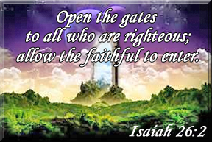
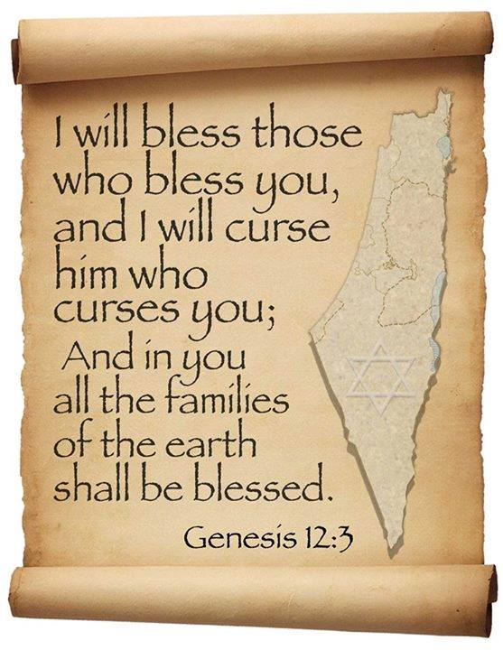
Zion’s Alluring Light
Oppressed Exalted
Isa 60:10-13 – “¹⁰Foreigners will build up your walls, and their kings will minister to you; for in My wrath I struck you, and in My favor I have had compassion on you. ¹¹Your gates will be open continually; they will not be closed day or night, so that men may bring to you the wealth of the nations, with their kings led in procession. ¹²For the nation and the kingdom which will not serve you will perish, and the nations will be utterly ruined. ¹³The glory of Lebanon will come to you, the juniper, the box tree and the cypress together, to beautify the place of My sanctuary; and I shall make the place of My feet glorious.”
Notes:
Isa 60:10-11 – Heart of the poem. “Foreigners” = “sons of foreigners” (56:3,6), inclusio matching “sons of those who afflicted” in vs. 14. “build” and “minister” are not menial tasks, but represent zeal to play a citizen role as an expression of gratitude to God and His people through whom God’s light had reached (19:21-25). “build up your walls” = commitment to make Zion secure and strong. Zion’s walls = salvation (26:1; 49:16; 60:18). “minister” same verb for Levitical service (56:6-7; 66:21). While the anger of God was real, and led to the walls being broken down to begin with, the nations could now look at Zion and judge God’s compassionate nature despite that. Why have walls if the gates are left open? While open gates may refer to security (Neh 7:3; Zech 2:4-5), implying nations are no longer at enmity w/Zion, here it is due to the unending stream of those bearing gifts around the clock (26:2; Rev 21:25). Security is assured, availability is certain. “kings led in procession” could mean “led as captives” (20:4; 45:14), the rightful submission of the incomer (2 Cor 2:14; 10:5). Or it could represent a victory parade (66:15-16).
Isa 60:12-13 – Zion is the key. To enter it is to be blessed. To not enter it is to be cursed (Gen 12:3; 27:29). Zion alone is where divine wrath has become divine compassion (Mic 5:15). Therefore we must enter the “straight gate” (Matt 7:13-14). Analogy of Solomon’s temple, how he enrolled the Gentile Sidonians because nothing but the best would do for God’s house (1 Kings 5:2-9). “glory of Lebanon” = 35:2, which speaks of the desert created by human pride blossoming like a rose. Characterizes the fruitfulness of a redeemed life in contrast w/the desert created by sin. But Lebanon also associated w/pride (2:13; 10:34; 37:24). Point? The glory of Lebanon only available if we will solely bow at God’s feet and receive it as a gift. The trees will beautify God’s sanctuary (41:19). “place of my feet” = His temple, footstool, where the transcendent God touches earth (66:1; Psa 99:1; 132:7; Lam 2:1; Ezek 43:6-7. 1 Chron 28:2).

Slide 8
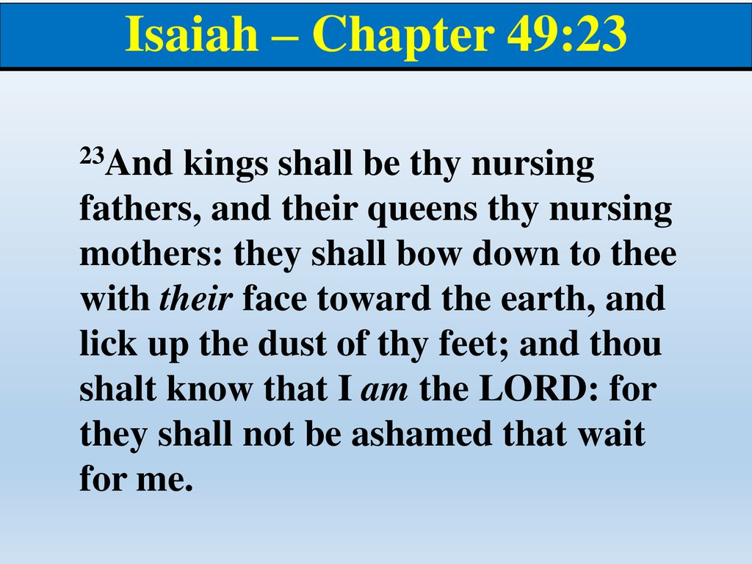
Zion’s Alluring Light
Oppressed Exalted
Isa 60:14-16 – “¹⁴The sons of those who afflicted you will come bowing to you, and all those who despised you will bow themselves at the soles of your feet; and they will call you the city of the Lord, the Zion of the Holy One of Israel. ¹⁵Whereas you have been forsaken and hated with no one passing through, I will make you an everlasting pride, a joy from generation to generation. ¹⁶You will also suck the milk of nations and suck the breast of kings; then you will know that I, the the Lord, am your Savior and your Redeemer, the Mighty One of Jacob.”
Notes:
Isa 60:14 – Stress is now on reversal of roles, opposite of 39:7. Those who seek citizenship must come humbly and w/submissiveness. Top dogs gladly take 2nd place. It’s not Zion in and of itself that creates this role reversal, but a recognition of it being the city of the Lord, the Holy One of Israel. Only by the Lord being there will the city be a magnet for the nations (45:14; 49:23). Only God’s grace could cause the church’s most rabid enemies to have a change of heart and become its biggest champions. 1st century Jews misinterpreted to think that Israel would be raised materially above all other nations (Matt 2:11).
Isa 60:15-16 – Vs. 15-22 similar to Rev 21:1-27 (new Jerusalem). Contrasts former condition w/latter. Three items of rejection: forsaken, hated, no one passing through. Three items of acceptance: pride, joy, milk. “everlasting” = continuance in time and experience throughout all generations. “forsaken and hated” = Hebrew idiom relating to marriage (49:14-15,21; 50:1; 54:6-7; 62:4). “milk/breast” = intimate, maternal care by nations, the life of royalty flowing through to the despised slave Israel, cared for and supported by the great nations of the earth (49:23; Deut 33:19). This experience by Zion proves who God is, providing intimate knowledge of the sheer power of their Redeemer working to save them. This is the point since chapter 40. Chapters 1 – 39 prove He is Sovereign; chapters 40 – 66 prove He is Savior. Chapters 40 – 48 shows this by predicting deliverance from Babylon, chapters 49 – 55 the real deliverance needed all along was sin, and chapters 56 – 66 shows that Israel is to be a witness of God to the world that He is Savior. The transcendent Creator wants His lowly creation to actually know Him!

Slide 9
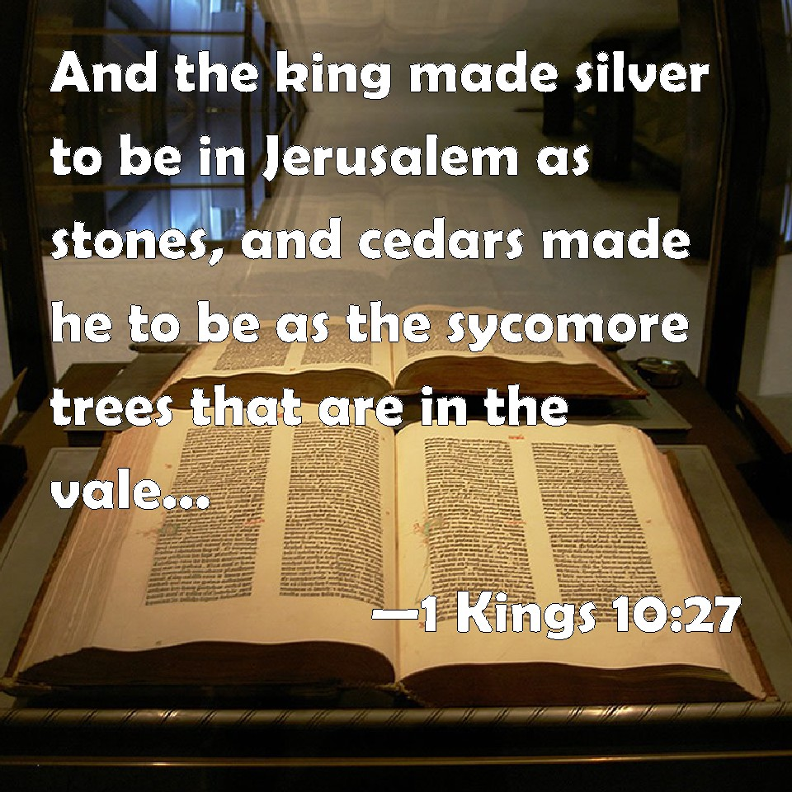
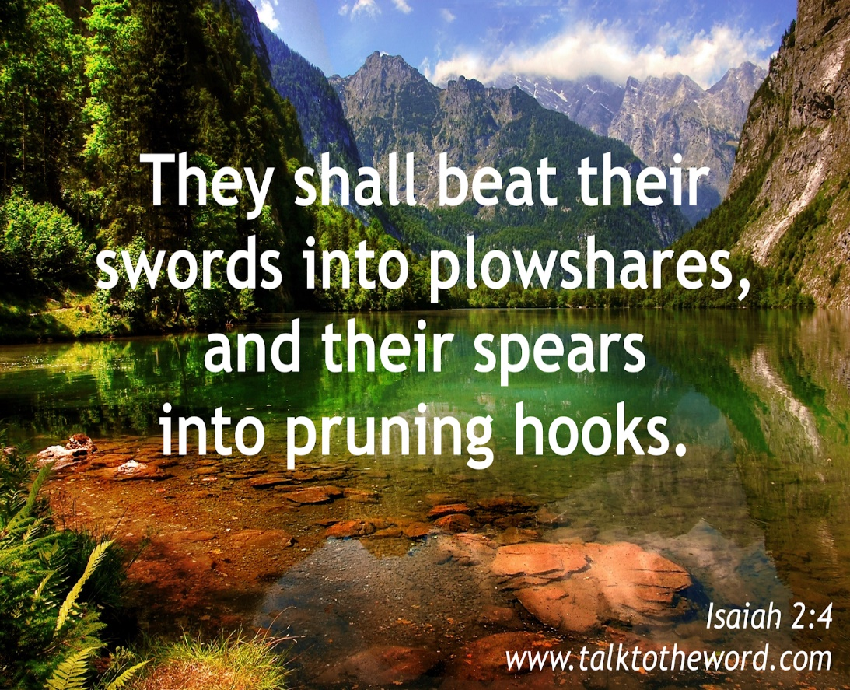
Zion’s Alluring Light
Zion Transformed
Isa 60:17-18 – “¹⁷Instead of bronze I will bring gold, and instead of iron I will bring silver, and instead of wood, bronze, and instead of stones, iron. And I will make peace your administrators and righteousness your overseers. ¹⁸Violence will not be heard again in your land, nor devastation or destruction within your borders; but you will call your walls salvation, and your gates praise.”
Notes:
Isa 60:17 – Transformation phrases continue to build in order to paint a picture of abundant riches of the finest quality, replacing the better w/the best (1 Kings 10:21,27; 14:26-27). The materials represent permanency and security. Who brings it? “I will bring”. Gold, silver, bronze, and iron same metals in Nebuchadnezzar’s statue, possibly to represent the people once hostile to them now being an integral part pf Zion. “administrators” typically negative (26:14). “overseer” used of Egyptian oppressors (Ex 3:12; 9:3; 14:2,4). But now peace and righteousness will be your slave driver and administrator, worst becoming the best (Col 3:15; Heb 1:8). They confessed they were incapable of producing these qualities (59:9-13). Only by God’s grace will they exist.
Isa 60:18 – Every force of disorder is abolished (2:4; 11:6-9; 59:6-8; Gen 6:13; Heb 12:18-24; Rev 21:9-22:5). Walls once provided security, now salvation will be her security, protecting her from sin, securing her redemption. Gates once shut out intruders, now praise comes through it and goes out of it as newcomers join in songs of praise, and evangelists take the good news to the world.

Slide 10
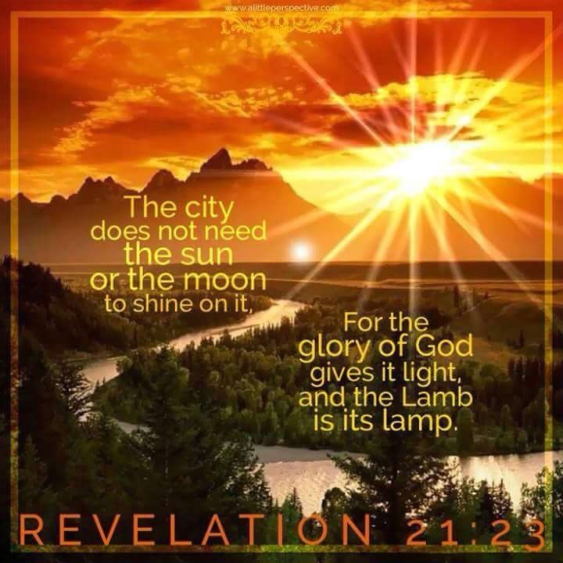
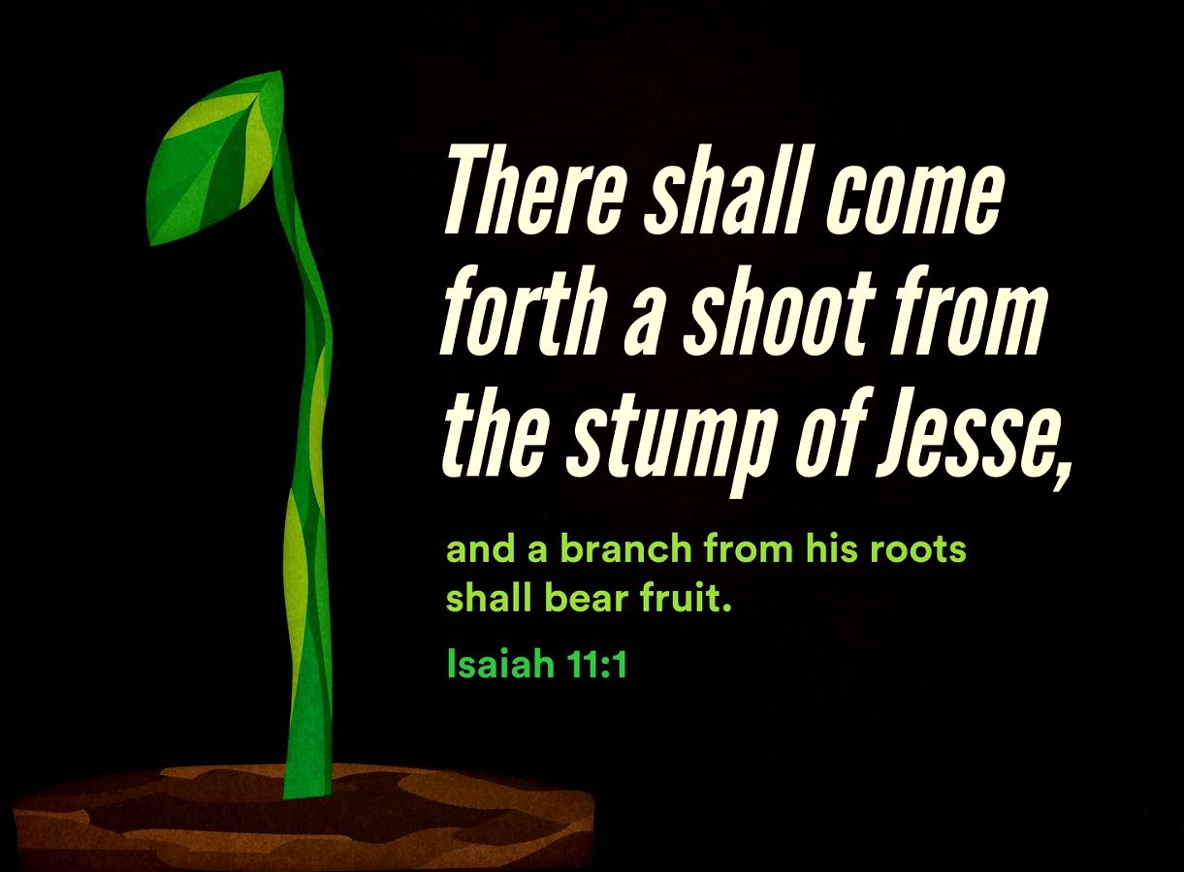
Zion’s Alluring Light
Zion Transformed
Isa 60:19-22 – “¹⁹No longer will you have the sun for light by day, nor for brightness will the moon give you light; but you will have the Lord for an everlasting light, and your God for your glory. ²⁰Your sun will no longer set, nor will your moon wane; for you will have the Lord for an everlasting light, and the days of your mourning will be over. ²¹Then all your people will be righteous; they will possess the land forever, the branch of My planting, the work of My hands, that I may be glorified. ²²The smallest one will become a clan, and the least one a mighty nation. I, the Lord, will hasten it in its time.”
Notes:
Isa 60:19-20 – The old order of an alternating sun and moon are replaced by a new order of spiritual light of the changeless presence of the Lord (24:23; 30:26; 1 John 1:5; Luke 1:76-79; 2:32; Mal 3:19; John 1:5,9; 3:19; 8:12; 12:35-36). Not only will we be bathed in His light, but changed into His likeness. The fluctuations of sun and moon, which brought darkness and mourning, are past (35:10; 40:2; 61:2; 65:19; Psa 30:6; Rev 21:4). The perpetual presence of God will bring everlasting joy (Rev 21:23; 22:5).
Isa 60:21-22 – Full of the “land, nation, seed” promises of Gen 12:1-3. God expects His people to do right (1:21,26; 56:1; Rev 14:1-5). But they could not do it apart from God, hence the righteousness of faith. “possess the land forever” = 57:13; Gen 17:8; 2 Sam 7:10, contrasting Deut 6:18; 28:63 and their prior dispossession of the land. Righteousness leads to tenure. “branch” = 11:1,10; 14:19, in which all in Zion will be like the Messiah. “My planting” and “work of My hands” = the new creation is entirely His work (5:1-7; 27:2-6; 61:3; Psa 1:3). He is the vine, we are the branches (John 15:5). Abrahamic promise fulfilled in which from one would become many. Our influence will be out of proportion to our size, contrasting 30:17; 1 Cor 1:26-31 – the power of the weak, triumph of the unlikely, fruitfulness of the barren (Mic 4:7; 5:1). “I the Lord” = God putting His reputation on the line (9:7), expediting it, to ensure this happens in the “fullness of time” (Gal 4:4; Mark 1:14-15; Acts 1:7).

