Slide 1
Notes:
In Isaiah 7 & 8, we studied the consequences that unfaithful kings have on the nations they lead. Because of unfaithful Ahaz’s alliance w/Tiglath-pileser III, the nation of Judah was greatly afflicted by them. And because of Pekah’s alliance w/Syria and his bullying of the nation of Judah, he plunged the Northern Kingdom of Israel further into darkness.
But as we begin chapter 9, we’re going to learn that God never intended to leave them in this darkness. He never intended to permanently allow the terrible decisions of wicked kings to keep the nations from being what they could be. His answer to the great darkness they find themselves in is to bring light, through a child, who would one day be the ideal King, bringing an end to all wars, and establishing justice and righteousness in the land. And as a child, He is the culmination of Isaiah’s use of children as signs to indicate God’s sovereignty over history. But instead of the names of this child expressing some future event, as we saw with Shear-jashub and Maher-shalal-hash-baz, or expressing the relationship Judah would have w/God through Immanuel and thus being their protection, chapter 9 is simply going to show us the remarkable nature of this child, and how despite the coming judgment, His coming was not intended to bring our destruction, but our liberation.

Slide 2
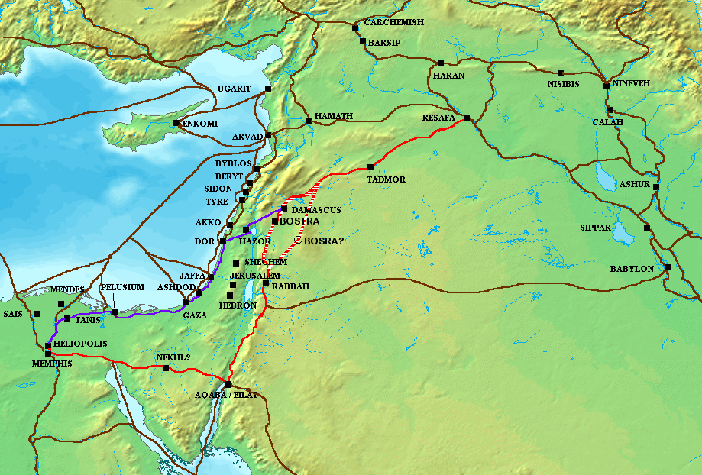
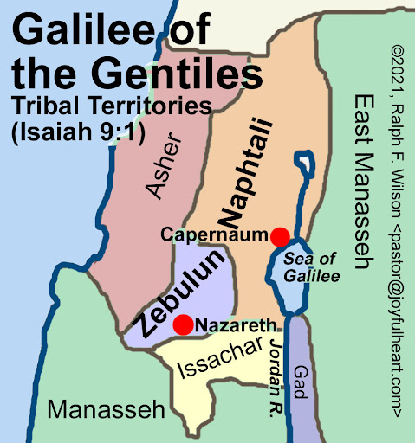
Dawn of the Messiah
Isa 9:1-5 – “But there will be no more gloom for her who was in anguish; in earlier times He treated the land of Zebulun and the land of Naphtali with contempt, but later on He shall make it glorious, by the way of the sea, on the other side of Jordan, Galilee of the Gentiles. ²The people who walk in darkness will see a great light; those who live in a dark land, the light will shine on them. ³You shall multiply the nation, You shall increase their gladness; they will be glad in Your presence as with the gladness of harvest, as men rejoice when they divide the spoil. ⁴For You shall break the yoke of their burden and the staff on their shoulders, the rod of their oppressor, as at the battle of Midian. ⁵For every boot of the booted warrior in the battle tumult, and cloak rolled in blood, will be for burning, fuel for the fire.”
Notes:
Now, chapter 8 ended on a very solemn note. Rather than the people relying on the law and the testimony, they trusted in mediums and spiritists, and it plunged them into seemingly inescapable darkness. And had God not been with them, there would be no dawn. But 700 years later, God would bring liberation – Isa 9:1-2. Who is “her who was in anguish”?
It’s Zebulun and Naphtali. When Tiglath-pileser III took Ahaz’s bounty, he came along a trade route that in the ancient world was called “way of the sea”, and today is called “Via Maris” (Latin for “way of the sea”), then proceeded on down the coastland and took out the northern tribes of Asher, Zebulun, Naphtali, and the Transjordanian tribes of Gad, Reuben, and the half-tribe of Manasseh. And after taking them captive back to Assyria, they settled foreigners there, hence “Galilee of the Gentiles”. But just because Israel experienced the fruit of their rebellion did not mean God was ultimately satisfied. When they failed to bring the light, God brought it Himself, bursting upon them in the blackest night in which there seemed to be no dawn. Jesus Christ was the fulfillment of this prophecy – Matt 4:12-17 – But, at this time, they do not understand the light in terms of the gospel. They are simply seeing it in terms of there physical suffering and oppression. This is a theme that is developed throughout the book of Isaiah. He will introduce the problem of their suffering, but as the book goes on, he makes it evident that their physical captivity and suffering is only a symptom of a much bigger issue – sin. And Jesus came to fix the root of the problem.

Slide 3
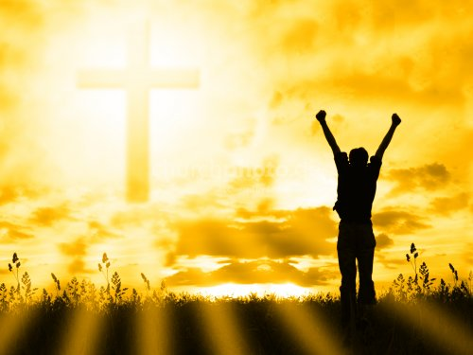
Dawn of the Messiah
Isa 9:1-5 – “But there will be no more gloom for her who was in anguish; in earlier times He treated the land of Zebulun and the land of Naphtali with contempt, but later on He shall make it glorious, by the way of the sea, on the other side of Jordan, Galilee of the Gentiles. ²The people who walk in darkness will see a great light; those who live in a dark land, the light will shine on them. ³You shall multiply the nation, You shall increase their gladness; they will be glad in Your presence as with the gladness of harvest, as men rejoice when they divide the spoil. ⁴For You shall break the yoke of their burden and the staff on their shoulders, the rod of their oppressor, as at the battle of Midian. ⁵For every boot of the booted warrior in the battle tumult, and cloak rolled in blood, will be for burning, fuel for the fire.”
Shear-jashub
Maher-shal-hash-baz
Harvest joy
A new Exodus
Gideon
No more war
Notes:
Isa 9:3 – Now in 7:3, we were reintroduced to one of Isaiah’s children, Shear-jashub, which means “a remnant shall return”. But when Christ’s kingdom comes, He will multiple the nations, because as we learned in 2:2, “all nations will stream to it”.
Then in 8:1, we were introduced to Maher-shal-hash-baz, which means “swift is the booty, speedy is the prey”. But when the Messiah comes, no longer will Israel be the spoil, they would divide the spoil amongst themselves and rejoice over it.
They will be glad as w/the gladness of harvest, and why shouldn’t they? Isa 2:4c - “they will hammer their swords into plowshares and their spears into pruning hooks”.
Isa 9:4 – They will be free from bondage and slavery and the yoke and rod…what story does that remind us of? Exodus. Except this will be a new Exodus unlike any before it, and chapter 11 is going to add to this imagery so stay tuned.
What’s the connection w/the battle of Midian? Well, in Judg 6:35 , we read that Gideon called on men from Manasseh, Asher, Zebulun, and Naphtali to come fight in the battle against Midian, which are the same nations in gloom, so there may be a connection there. Yet when God allowed them to defeat Midian, how many men did he do it with? Just 300, to show that God was the one who brought the victory and not them. And notice the pronouns from vs. 3. Who is bringing this light and joy? God, and He’s going to do it from a humble, seemingly insignificant area in which Nathanael would later say in John 1:46, “Can any good thing come out of Nazareth?
How will God put an end to the oppression? By putting an end to the warfare that brings oppression – Isa 9:5 – This is a scene you’d find at the end of a victory on the battlefield, except they did not fight the battle, they simply arrived after the fighting was done. God fought the battle, and His liberated people are enjoying the fruits of their victory. And while military boots and cloaks would often be considered spoil, in this situation they are fuel for burning. Why? Think back again to what we just read in Isa 2:4 – military gear will not be a part of the strength of God’s people, and from this text, we learn that those who insist on wielding them are not going to make it.

Slide 4
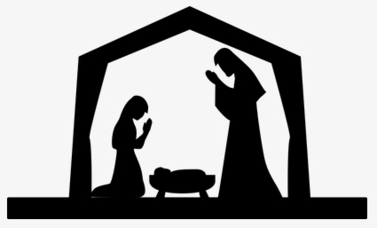
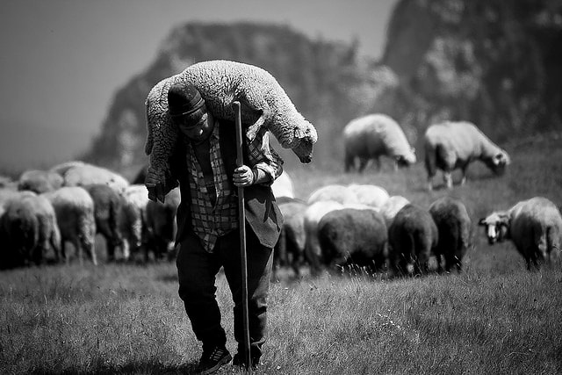
Reign of the Messiah
Isa 9:6-7 – “⁶For a child will be born to us, a son will be given to us; and the government will rest on His shoulders; and His name will be called Wonderful Counselor, Mighty God, Eternal Father, Prince of Peace. ⁷There will be no end to the increase of His government or of peace, on the throne of David and over his kingdom, to establish it and to uphold it with justice and righteousness from then on and forevermore. The zeal of the Lord of hosts will accomplish this.”
Notes:
How can all this be? Isa 9:6 – Meaning, in place of that failure of a king named Ahaz and that failure of a king named Pekah, whose policies plunged the nation into further darkness, an ideal king will come, who will bring an end to all wars and will establish a kingdom based on justice and righteousness. This King is God’s answer to the arrogance and oppression of that day. But did He answer it by bringing more arrogance and oppression? By browbeating mankind with that mighty hand?
No, deliverance came w/a childlike presence, because God is so strong, He can overcome the enemy w/humility and vulnerability. Here is the basis of our joy. Who is the one to bring us victory? The child Immanuel, in all His weakness, helplessness, and dependance. He is showing us that there is great strength in weakness, victory in defeat, life in death. This is the paradox of the Christ seen all throughout scripture, and it is the culmination of Isaiah’s use of children as incarnate signs, except He is a child “to us” in contrast w/Isaiah’s children being “to him”. God’s truth was always meant to be incarnated.
But this child would become a man, because men rule, and He would shoulder a new government, though as a servant leader. What a breath of fresh air for people being ruled by the likes of Ahaz and Pekah, who were weak, corrupt, immoral, and led the people to the same, that this king will rule by a higher, nobler standard. What a relief for an era where men were killing each other to gain the throne, to see One who will rule in such a noble way.

Slide 5
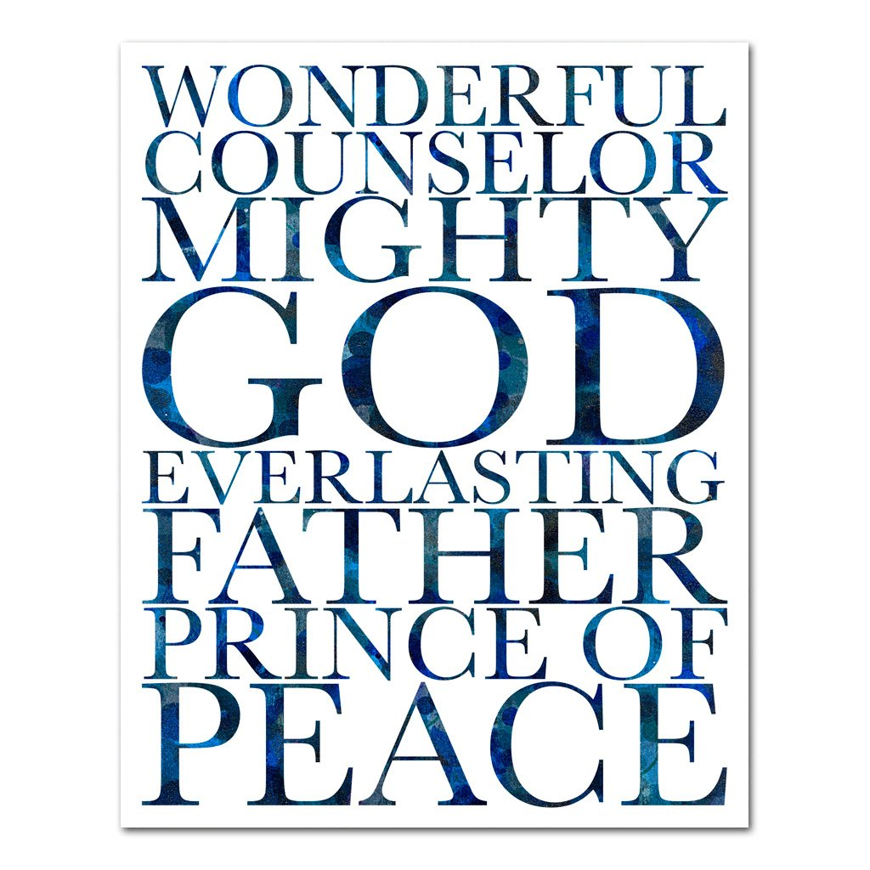
Reign of the Messiah
Isa 9:6-7 – “⁶For a child will be born to us, a son will be given to us; and the government will rest on His shoulders; and His name will be called Wonderful Counselor, Mighty God, Eternal Father, Prince of Peace. ⁷There will be no end to the increase of His government or of peace, on the throne of David and over his kingdom, to establish it and to uphold it with justice and righteousness from then on and forevermore. The zeal of the Lord of hosts will accomplish this.”
Notes:
There is a list of four names given for Him. “I thought His name was going to be Immanuel. How many names was He going to have?”. In antiquity, names were reflections of who a person was – qualities of character. “He made a name for Himself”. These are not names or titles, but descriptions and realities of who the Messiah is, and this should carry greater weight than what a man chooses to call Himself. And in these names, His character is described, what makes the Branch of Isa 4:2 so beautiful and glorious:
Wonderful Counsellor – Literally, this would read “wonder-counsellor” or “wonder-of-a-counselor”. This child who was to come would be the epitome of a child prodigy, so remarkable in His humanity that it evokes awe and amazement in those who encounter Him. And part of what makes Him so wonderful is His counsel. As Zech 6 teaches, He would hold the offices of both High Priest and King and is perfectly able to fulfill both roles because of the unfailing depth of His wisdom and knowledge. Every single problem of this life is solved through Him.
Mighty God – This is deity, a fact stressed again in 10:21. Heb 1:3 claims He would be the “exact representation of His nature”. In other words, we are to take seriously the “el” of Immanuel.
Eternal Father – Again, this is not a name or a title, it is a description. Kings were often referred to as fathers. In 2 Kings 16:7, Ahaz said to Tiglath-pileser, “I am your servant and your son”. But this fatherhood would not last – God’s does. And true fathers don’t sacrifice their sons, as Ahaz did to his sons and Tiglath-pileser did to Ahaz. True fathers sacrifice themselves for their children. And the Christ’s “fatherhood” to us, by virtue of being our Author, Creator, and Sustainer, is everlasting.
Prince of Peace – As seen in vs. 5, He does not conquer by the sword, but by His gospel, and the gospel brings peace. Notice how He is never explicitly referred to as “king” in this passage, and that is startling because these verses are dripping w/His kingship. Perhaps this is a slap in the face to the kings of that day, suggesting that what they are in name only, He will truly be in character.

Slide 6
Reign of the Messiah
Isa 9:6-7 – “⁶For a child will be born to us, a son will be given to us; and the government will rest on His shoulders; and His name will be called Wonderful Counselor, Mighty God, Eternal Father, Prince of Peace. ⁷There will be no end to the increase of His government or of peace, on the throne of David and over his kingdom, to establish it and to uphold it with justice and righteousness from then on and forevermore. The zeal of the Lord of hosts will accomplish this.”
Notes:
Now, Judah and Israel were used to rulers rising and falling, not knowing what to expect in the next. So as great as all this sounds, for how long will it be? – Isa 9:7
This reign will last forever; complete and lasting peace. A universal government defined by righteousness. Almost sounds good to be true, and I was taught that if something sounds too good to be true, it probably isn’t.
But see, the Lord’s zeal will accomplish this. He has a consuming concern for His people. And as many verses as we could reference, we find this truth in one of the most commonly quoted of all time – “For God so loved the world…” (John 3:16). God would not rest until He restored them, and this was to provide hope for those of that generation who were looking forward to the seed promise.

Slide 7
Pride
Isa 9:8-12 – “The Lord sends a message against Jacob, and it falls on Israel. ⁹And all the people know it, that is, Ephraim and the inhabitants of Samaria, asserting in pride and in arrogance of heart: ‘¹⁰The bricks have fallen down, but we will rebuild with smooth stones; the sycamores have been cut down, but we will replace them with cedars.’ ¹¹Therefore the Lord raises against them adversaries from Rezin and spurs their enemies on, ¹²the Arameans on the east and the Philistines on the west; and they devour Israel with gaping jaws. In spite of all this, His anger does not turn away and His hand is still stretched out.”
Israel
Prideful optimism
Adversaries
Inclusio
Notes:
Now, as we begin vs. 8, the pendulum is going to swing right back to judgment, this time giving us detail on why God is judging the northern kingdom of Israel, and we’re going to see a refrain repeated 4 times through the beginning of chapter 10 – “In spite of all this, His anger does not turn away and His hand is still stretched out.” This refrain, what is called an inclusio, is almost like a chorus in a hymnal, but this one hasn’t made it into Hymns for Worship yet, but it’s made it into Isaiah, and its purpose is to help bracket and outline this section of scripture. We see it at the conclusion of each main point in vs. 12, 17, 22, and 10:4. The first section talks about Israel’s pride.
Isa 9:8-9a – Now “Jacob” can refer to “Judah” or “Israel”, but God wants there to be no misunderstanding that He is referring here to the northern kingdom of Israel, and His word will drop on Israel like a bomb. It will be a direct hit. And the point is that Assyria is not the real threat, just an instrument in God’s hands, and they must contend w/Him.
Isa 9:9b-10 – They had heard the message before, through Amos and Hosea. They should know why judgment is happening. But rather than humble themselves in repentance, they hold on to prideful optimism. They’re dreaming of better, more luxurious days in the future. They’re independent, trusting in their own responses to judgment and depend on their own resources and policies. Pride was the sin that led to every other sin, which is why it is mentioned first. Why are their bricks falling down? Perhaps the earthquake Amos refers to in Amos 1:1. Or it just mean “things are falling apart.” Either way, in the face of catastrophic judgment, their attitude was, “Big deal, we’ll rebuild it even better than before”. They were breezy and blasé. By her own reliance and resourcefulness, Israel thought it could turn disaster into accomplishment, pretty much saying “bring it!”.
Isa 9:11-12a – This is better translated “adversaries of Rezin”, which would be the Assyrians. Most believe that this is when Tiglath-pileser had already conquered Philistia and that he was sending small bands from there and rebel Aramean tribes in the east to create a judgment sandwich on Israel, stymying their boastful promise to rebuild. And these adversaries will fight over Israel’s spoil like dogs over a bone.
Did God’s judgment work? Nope. They were too prideful to accept his discipline and repent – Isa 9:12b – There are more judgments to come because God’s anger has not yet been spent. His hand is still stretched out in discipline.

Slide 8
Corrupt leadership
Isa 9:13-17 – “¹³Yet the people do not turn back to Him who struck them, nor do they seek the Lord of hosts. ¹⁴So the Lord cuts off head and tail from Israel, both palm branch and bulrush in a single day. ¹⁵The head is the elder and honorable man, and the prophet who teaches falsehood is the tail. ¹⁶For those who guide this people are leading them astray; and those who are guided by them are brought to confusion. ¹⁷Therefore the Lord does not take pleasure in their young men, nor does He have pity on their orphans or their widows; for every one of them is godless and an evildoer, and every mouth is speaking foolishness. In spite of all this, His anger does not turn away and His hand is still stretched out.
Stubborn
Head & tail
Marginalized
Inclusio
Notes:
Isa 9:13 – Remember 1:5? “Where will you be stricken again?” Each episode of rebuke and judgment is followed by Israel’s refusal to turn back to God.
What does God do now? – Isa 9:14-15 – “Head and tail” represents the leaders and the prophets respectively. As the head directs the tail and it wags in submissive approval, the leaders instruct the prophets to teach falsehood so as to promote their elitist agenda. The prophets are happy to do it, like giddy dogs. Isaiah is using humor, but it is veiled contempt for those who sold their integrity in service to their leaders. The phrase “in a single day” means their fall will be quick.
Why is He judging them? – Isa 9:16-17a – This is interesting because in almost every verse where widows and orphans are mentioned, God is defending them. But here, they are judged for their rebellion just like everyone else. This is what Jesus said in Matt 15:14 – “if a blind man guides a blind man, both will fall into a pit.” One of the problems w/social justice is that it assumes that just because you belong to a marginalized class, you deserve special treatment irrespective of your character. But here, class is irrelevant; socio-economic class is irrelevant. God cares most about their spiritual status, and they’re going down just as much as the wealthy because they are impenitent sinners.
The inclusion appears again – Isa 9:17b – Yes, He is a God of love. But He is just as much a God of justice and where there is injustice, His response is anger and wrath. And once again, it is not quite spent.

Slide 9
Devour one another
Isa 9:18-21 – “¹⁸For wickedness burns like a fire; it consumes briars and thorns; it even sets the thickets of the forest aflame and they roll upward in a column of smoke. ¹⁹By the fury of the Lord of hosts the land is burned up, and the people are like fuel for the fire; no man spares his brother. ²⁰They slice off what is on the right hand but still are hungry, and they eat what is on the left hand but they are not satisfied; each of them eats the flesh of his own arm. ²¹Manasseh devours Ephraim, and Ephraim Manasseh, and together they are against Judah. In spite of all this, His anger does not turn away and His hand is still stretched out.”
Fire of sin
Fire of wrath
Devouring
Inclusio
Notes:
Isa 9:18 – Wickedness is compared to a raging wildfire, which begins w/the easily combustible underbrush, then proceeds to larger combustible material until the smoke rises to heaven, where God sees and must act. Why is sin such an apt comparison to fire? Because both are unstoppable, swift, uncontrollable, and devours everything it touches. Prov 6:27 – “Can a man take fire in his bosom and his clothes not be burned?”
Isa 9:19 – And so God will send His fury, which is also like a fire. So, there are 2 fires in this text – the consuming fire of sin and the fire of God’s wrath. This is God fighting fire w/fire, burning up the land, and the people will be fuel for the fire.
Why? – Isa 9:20-21a – Civil war. People taking advantage of one another, indifferent to the others’ feelings, and consuming themselves in the process. This is not just hatred against neighbors, but against brothers of the same covenant. When Jeroboam II died, 6 kings reigned over the course of 30 years before Samaria’s fall, and 5 of them were through assassinations. And it wasn’t enough for them to consume one another because vs. 21 says those who hated one another were still willing to gang up on their neighbor Judah who they hated even more. When the only thing that unites us is a common enemy, we’ve reached our low point.
Isa 9:21b – Even after God’s judgment by fire, it wasn’t enough. God still has wrath to expend.

Slide 10
Injustice
Isa 10:1-4 – “Woe to those who enact evil statutes and to those who constantly record unjust decisions, ²so as to deprive the needy of justice and rob the poor of My people of their rights, so that widows may be their spoil and that they may plunder the orphans. ³Now what will you do in the day of punishment, and in the devastation which will come from afar? To whom will you flee for help? And where will you leave your wealth? ⁴Nothing remains but to crouch among the captives or fall among the slain. In spite of all this, His anger does not turn away and His hand is still stretched out.
Woe
Oppress needy
Punishment
Inclusio
Notes:
The fourth stanza begins with the ever familiar “woe”. What is it about this section that Isaiah would say, “you are as good as dead”?
Isa 10:1-2 – The civil leaders were unjust, particularly preying on the weak, denying them their rights. Why? Because the marginalized have no leverage, and that can be taken advantage of for personal gain, to enrich themselves, if they’re so inclined. So, while it is true that even the marginalized are judged based on their character, this did not let the civil leaders off the hook in their obligation to deal fairly and honestly w/the needy. They did not look at widows and orphans as opportunities to show love and kindness, but as spoil to be plundered. It simply wasn’t enough to violate God’s law for themselves; they had to take away the rights of others.
Isa 10:3-4a – In other words, these masters served a greater Master, and He would come to judge their stewardship. 3 questions are posed that demand serious reflection: what will you do, whom will you flee to, and where will you leave all that wealth when the Assyrians come knocking? Judgment is such a monumental event, all the security blankets we have set up to protect us in the here and now will be a moot point. There will be nothing we can do, no one to turn to, and nowhere to run. They would “fall” before the Assyrians who took pleasure in humiliating and subjugating their captives. And these so-called great men will suffer the same fate as everyone – huddling among the captives and lying among the slain. Because before God, wealth and status means nothing.
Isa 10:4b – The repetition of the chorus reminds us God is persistent to judge until we repent. So, does it not make sense for us to repent now? If physical death doesn’t satisfy God’s wrath, it makes sense why hell is the punishment that it is. It is not Assyria’s power they need to fear, but God’s. God is with us, for good or ill. As we read in chapter 8, He’ll either be our sanctuary or a rock to stumble over.

Slide 11
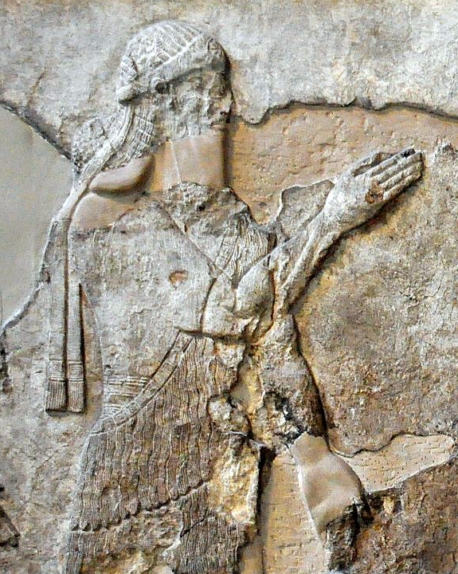
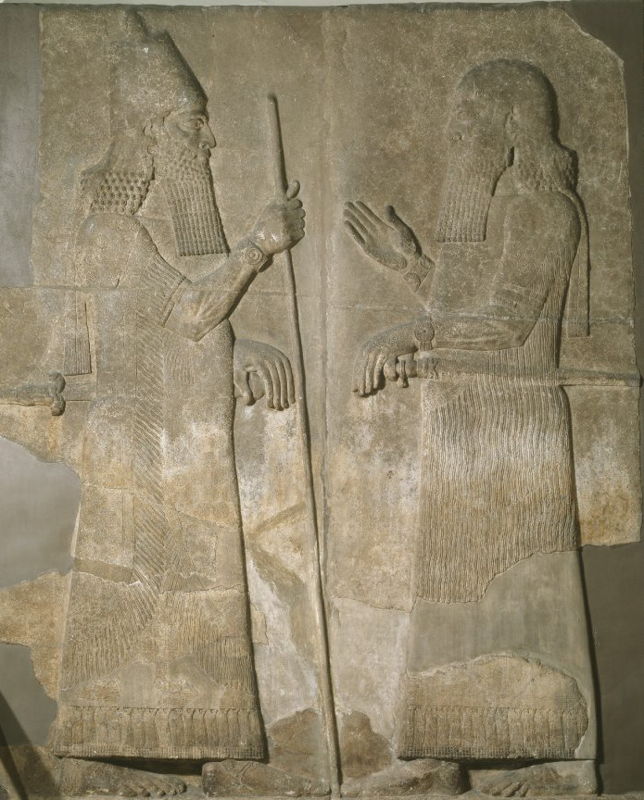
2 Kings 17:1-6 – “¹In the twelfth year of Ahaz king of Judah, Hoshea the son of Elah became king over Israel in Samaria, and reigned nine years. ²He did evil in the sight of the Lord, only not as the kings of Israel who were before him. ³Shalmaneser king of Assyria came up against him, and Hoshea became his servant and paid him tribute. ⁴But the king of Assyria found conspiracy in Hoshea, who had sent messengers to So king of Egypt and had offered no tribute to the king of Assyria, as he had done year by year; so the king of Assyria shut him up and bound him in prison. ⁵Then the king of Assyria invaded the whole land and went up to Samaria and besieged it three years. ⁶In the ninth year of Hoshea, the king of Assyria captured Samaria and carried Israel away into exile to Assyria, and settled them in Halah and Habor, on the river of Gozan, and in the cities of the Medes.”
Annals of Sargon II – “At the beginning of my royal rule, I…the town of the Samarians I besieged, conquered (2 Lines destroyed) [for the god…] who let me achieve this my triumph… I led away as prisoners [27,290 inhabitants of it (and) equipped from among them (soldiers to man)] 50 chariots for my royal corps… The town I rebuilt better than it was before and settled therein people from countries which I had conquered. I placed an officer of mine as governor over them and imposed upon them tribute as is customary for Assyrian citizens.”
Notes:
How did the Northern Kingdom of Israel eventually fall completely? The details are in 2 Kings 17. You’ll remember when Tiglath-Pileser III took out the northern part of the Northern Kingdom of Israel, practically only leaving Samaria, an Israelite named Hoshea killed King Pekah and Tiglath-pileser III installed Hoshea as king under the condition he continue to pay tribute.
But 4/5 years into Hoshea’s reign over the Northern Kingdom of Israel, Tiglath-pileser III died in 727BC. His son reigned in his place and took on the name Shalmaneser V, depicted in the relief in the upper right. Typically, when an Assyrian king died, this caused the nations they had previously subjugated to rebel. Well, we read in 2 Kings 17 that at first, Hoshea paid his tribute. But then Hoshea stopped paying tribute as he had done so year by year, and Shalmaneser V uncovered the fact that Hoshea had been in secret correspondence w/Egypt. And so, Shalmaneser V threw Hoshea in prison and began a three-year siege of Samaria, but he died shortly before taking it.
The details are sketchy, but it appears he was deposed, and the Assyrian throne was taken by a man named Sargon II, depicted in the relief in the lower right. And in 722BC, Sargon II completed the siege of Samaria and deported its inhabitants. The Northern Kingdom of Israel is no more.
In the Assyrian annals, Shalmaneser indicates that he deported 27,290 people from Samaria. This number only includes the inhabitants of the city, and that number could be extrapolated to 200,000 when you consider the people who were deported from the countryside. Sargon II then rebuilt Samaria and filled it w/deported people from other areas: “At the begi[nning of my royal rule, I . . . the town of the Sama]rians [I besieged, conquered] [for the god... who le]t me achieve (this) my triumph . . . . I led away as prisoners 27,290 inhabitants of it (and) [equipped] from among [them (soldiers to man)] 50 chariots for my royal corps . . . . [The town I] re[built] better than (it was) before and [settled] therein people from countries which [I} myself [had con]quered. I placed an officer of mine an governor over them and imposed upon them tribute as (is customary) for Assyrian citizens.”

