Slide 1
Notes:
We conclude our study of Leviticus by considering chapters 26 and 27. Chapter 26 is a conglomeration of blessings and penalties that God promises to bestow on Israel – blessings if they obey His commands and penalties if they do not. One might say this is God’s “carrot and the stick” passage, alluding to a common treatment of horses or donkeys. When the animal obeys, you reward them with a carrot. If the animal disobeys, the owner applies a stick.

Slide 2
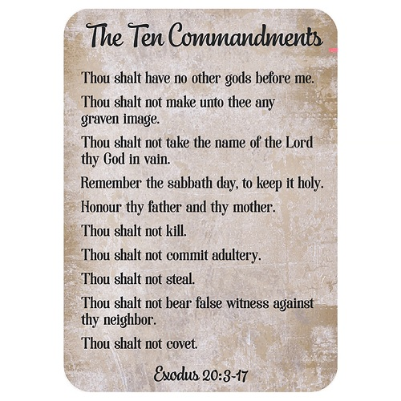
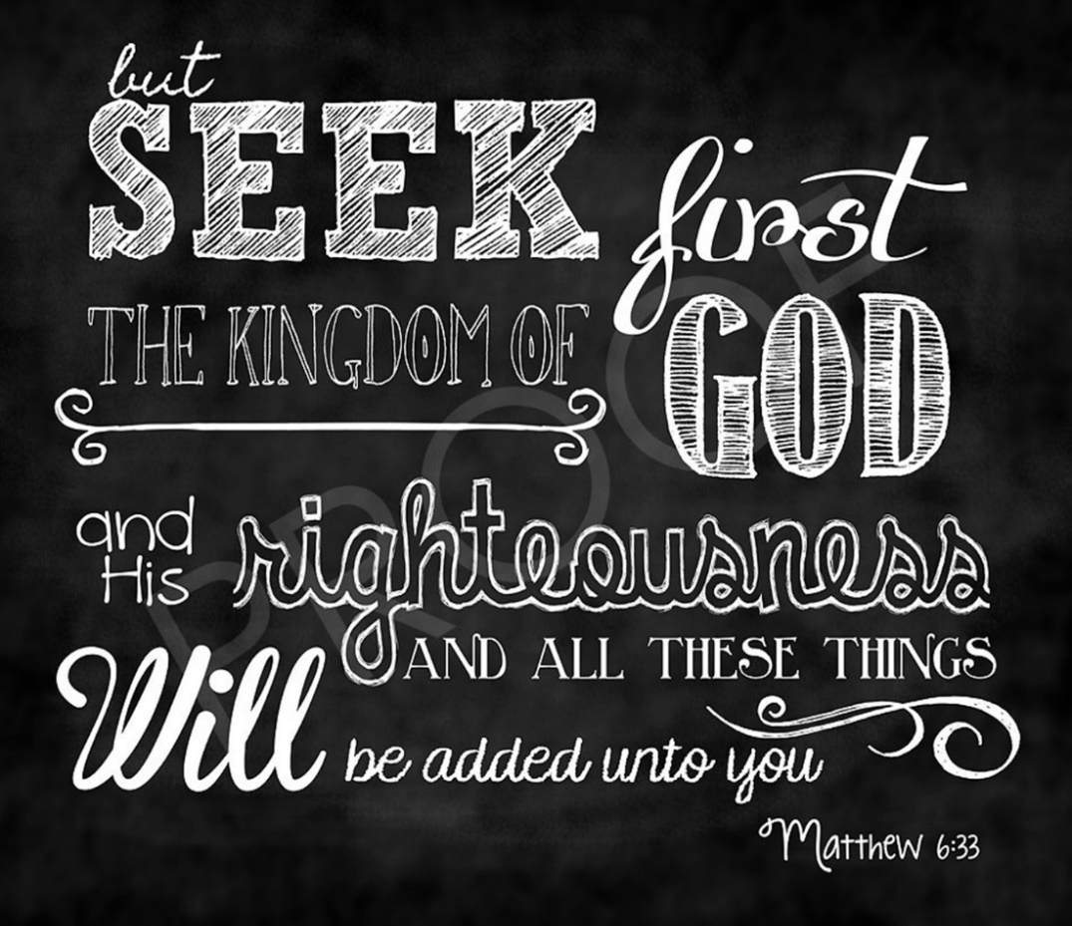
Blessings of Obedience
Lev 26:1-2 – “¹You shall not make for yourselves idols, nor shall you set up for yourselves an image or a sacred pillar, nor shall you place a figured stone in your land to bow down to it; for I am the Lord your God. ²You shall keep My sabbaths and reverence My sanctuary; I am the Lord.”
Notes:
You have to remember that Israel was a small country surrounded by much bigger countries. It was also a desert climate and if rain didn’t come, there would be no crops. What this means is that Israel absolutely had to depend on God for their survival. But God had conditions for His blessings, which we’ll sum up from the first 13 verses:
Verses 1 & 2 restate commandments #2 (don’t worship other Gods) and #4 (keep the Sabbath) of the Ten Commandments, but also adds the commands to not bow down before these gods and also to respect God’s sanctuary. Why just these two commandments before getting into the list of do’s and don’ts? Because our obedience stems from God and not one’s ability to keep all the commandments on their own. If we focus on our relationship with God, everything else is downhill from there – Matt 6:33 – What are the “things” Jesus mentions here? It’s the things we desire. But interestingly, if we’re truly putting God first, our desire for material things will diminish. Instead, God will bless us with spiritual things we desire that will bring Him glory.

Slide 3
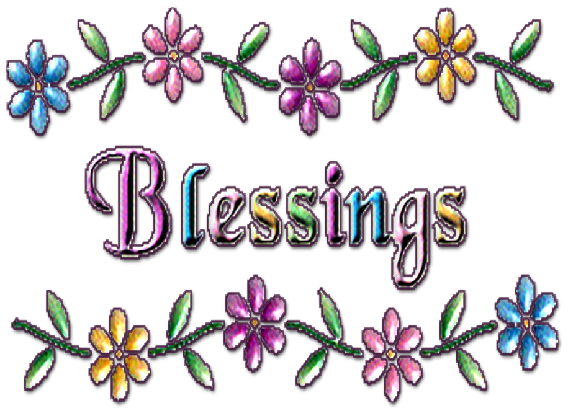
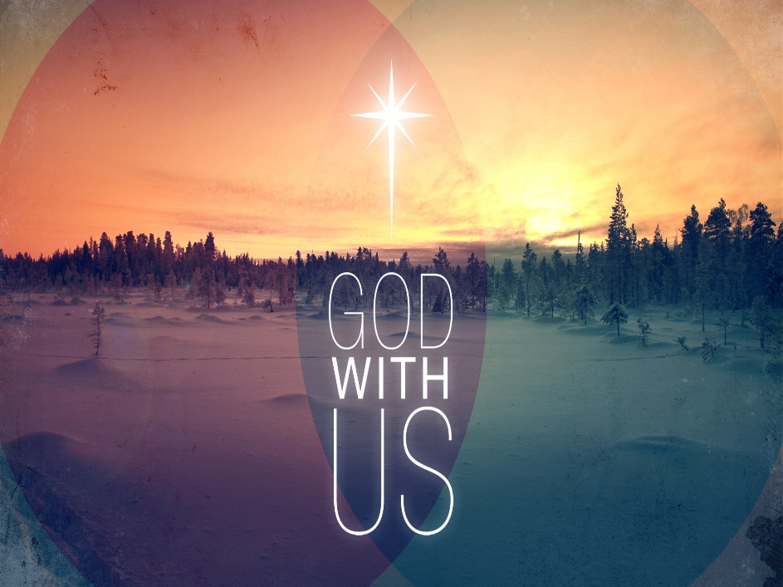
Blessings of Obedience
Rain – vs. 4-5
Peace From Enemies – vs. 6a
Safety From Animals – vs. 6b
Victory – vs. 7-8
Numbers – vs. 9
Excess – vs. 10
God’s Presence – vs. 11-13
Notes:
The first blessing he promises is rain. Israel had no pipelines importing water from distant sources, nor automatic sprinklers. They depended on rain for survival because good rain produces good soil which produces good crops. He promises enough food to make them all feel secure from harvest to harvest.
The second blessing is peace from their enemies. Again, Israel was a small country surrounded by much larger countries and it was a natural land bridge between these countries. Much of Israel’s warfare was due to these larger countries fighting each other and Israel being caught in the middle (literally) and some armies might be tempted to attack Israel to raid its food supply. God promises protection.
This promise of peace also extended to wild animals, which roamed free in this area at that time. A bountiful harvest would attract predators. God promises this protection as well.
The fourth blessing is victory against its enemies, and we see example after example of this in the OT. In Judg 7 & 8, Gideon, with only 300 men, slayed thousands upon thousands of Midianites. In 1 Sam 14:12, Saul’s son Jonathan killed 20 Philistines singlehandedly. One thing to keep in mind is that it was God’s intention for Israel to be a witness to the world that God was with them. Small Israelite armies giving the business to larger armies provided plenty of evidence.
The fifth blessing is that he would multiply their numbers. Keep in mind that this is a farming community. A large family had practical benefits, more labor for farming and would also help the nation stay strong.
The sixth blessing is excess. God tells them they’ll have so many left overs, they won’t have enough refrigerators to store them, so to speak.
The seventh blessing is the best one, God would continue to dwell in their presence. This is somewhat of a return of how it used to be in the Garden of Eden when God dwelt with Adam and Eve. The only difference now is that sin has entered the world. However, if they will follow God’s guidelines as laid out in this book, this will keep God with them and it is the greatest of all the seven blessings He has listed. God saved the best for last!

Slide 4
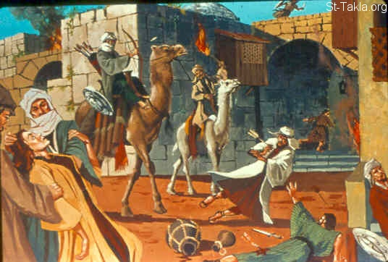
Curses For Disobedience
Phase 1: vs. 16-17
Deterioration of Health
1 Cor 11:30
Enemies Consume Harvest
Judg 6:3-6
Struck Down By Enemies
Josh 7:1-5
Enemies Will Rule Over You
Judg 3:8, 12-14; 4:2; 6:1; 10:7; 13:1
Flee: When No One Pursues
Prov 28:1; Gen 3:8; 2 Kings 7:7
Notes:
The remainder of the chapter describes curses God will render upon Israel should they not observe all these commandments. These are penalties for national apostasy, not individual apostasy. Interesting to note is that God punished them in stages, hoping initial phases would get their attention enough to produce repentance. If the initial phase didn’t produce repentance, the text tells us God would punish them “seven times more” or “seven times over”. Seven being the number for perfection, it is the idea of not only stepping up the penalty, but administering the perfect amount of punishment to garner a penitent spirit from a penitent nation.
Phase 1 begins with promising deterioration of health. You’ll remember in 1 Cor 11:30, one of the consequences of the brethren not judging the body of Christ rightly was sickness and death. God does this sometimes to get one’s attention. That is not to suggest that everyone who gets sick or dies is being explicitly judged by God, simply that it is one tool God uses to get the attention of an impenitent person.
Enemies consume harvest. Judges 6 described what it was like for Israel to live under Midianite oppression , how they would come in like locusts and consume Israel’s harvest until nothing was left and how low this brought Israel.
Struck down by enemies. Even during the days of Joshua, God used Ai to punish a previously victorious Israel when items under the ban were stolen from Jericho.
Enemies will rule over you. The book of judges provides numerous examples of the cycle of apostasy and how God frequently placed Israel under subjection to the surrounding nations.
Flee when no one pursues. The Proverb writer also mentions this in Prov 28:1. Adam and Eve felt so guilty for sinning against God, they hide from Him when He isn’t chasing them. God also caused the Arameans to do so during the days of Elisha in 2 Kings 7.

Slide 5
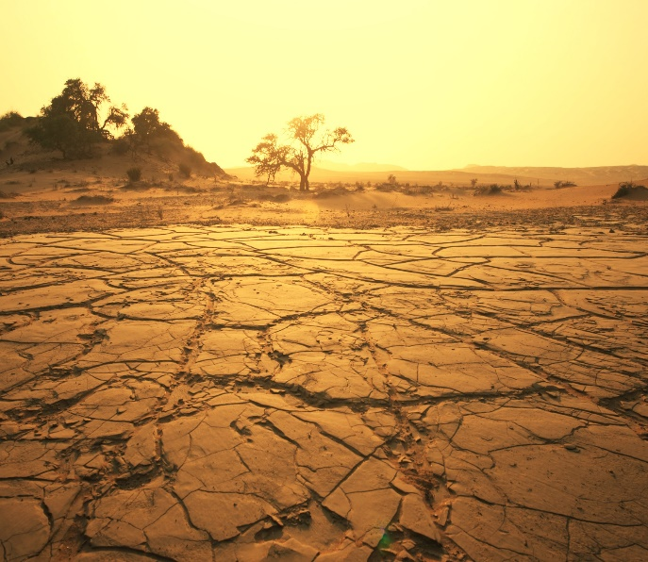
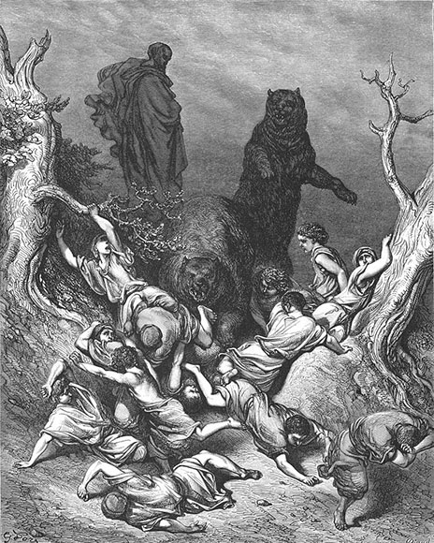
Curses For Disobedience
Phase 2: vs. 19-20
Drought
1 Kings 17:1; Hag 1:10-11; Jer 14:1-6
Fruitless Land
Hag 1:9; 2:16; Psa 107:34
Phase 3: vs. 22
Wild Beasts Devour Livestock
Jer 15:3
Wild Beasts Devour Children
2 Kings 2:24; 2 Kings 17:25
Deserted Roads
Judg 5:6; 2 Chron 15:5; Lam 1:4
Notes:
In phase 2, God promises drought. The previous phase indicated there would be growth but the enemies would eat it. Now God is saying no harvest will even grow because no rain will come which in turn makes the ground dry and hard. God called for this during the days of Elijah, the days of Haggai, and during the days of Jeremiah.
The consequence of drought is that the land becomes fruitless. Meaning, the their sowing and cultivating will be futile which means as an agrarian society it will bring about starvation and poverty. Again, this occurred during Haggai’s day when God was attempting to prod them to get to work on His temple.
If phase 2 didn’t bring them to repentance, God’s plan for phase 3 was to send wild beasts to devour their livestock. Without live stock, there would be no tractors, no meat, no wool for clothes….this would be a tragic thing that could set Israel back years.
God also said that He would go as far sending wild beasts to devour their children. God eventually did this to the Samaritans that settled in the northern kingdom because they worshipped idols, but He also did this through Elisha’s hands to children that mocked the prophet.
This would lead to deserted roads. The activity on a nation’s roadways reflected the well-being of a country. With the kind of economic collapse occurring so far, there would be few messengers, few merchants, and few people traveling.

Slide 6
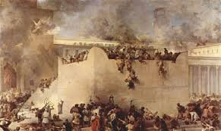
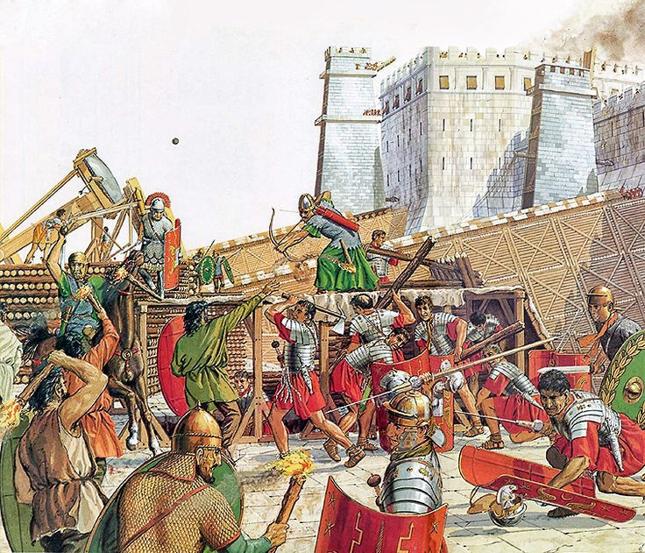
Curses For Disobedience
Phase 4: vs. 25-26
The Sword
Jer 14:12; Lam 2:21; Ezek 6:3
Pestilence
Jer 14:12; 2 Sam 24:15; Amos 4:10a
Famine
Jer 14:12; Ezek 4:10,16; 5:16
Notes:
In phase 4, God describes the 3 curses that come about as a result of being besieged. A siege is when an army captures a city by surrounding it and starving it out. This last months if not years depending on how vast the food and water supply in the city happens to be. The language used in Leviticus is vivid as it describes 10 women breaking bread in one oven and only bringing back rationed amounts. Pestilence is also described because being walled up in a city limits your ability to quarantine disease. Finally, once the wall is breached, the enemy would devour its inhabitants with the sword.
This occurred when Babylon took down Jerusalem in 586BC as well as when Rome took Jerusalem in 70AD.

Slide 7
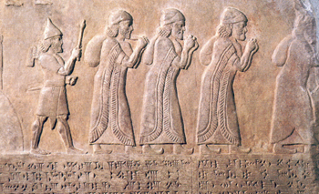
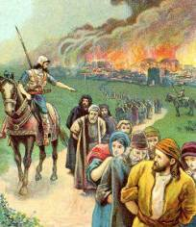
Curses For Disobedience
Phase 5: vs. 29-33
Resort to Cannibalism
2 Kings 6:28-29; Lam 4:10
Ashes of Idols Mixed w/Remains
2 Kings 23:8; Jer 8:1-3
Cities/Sanctuaries Destroyed
2 Kings 25:4-10; 2 Chron 36:19
Enemies Settle In Land
2 Kings 17:24; Lam 5:18
Scattered Among Nations
2 Kings 17:6; Lam 1:3
Notes:
Phase 5 is the final stage of judgment. One of the most horrid affects of starvation in a siege was that some would resort to cannibalism in order to survive. This is graphically portrayed in 2 Kings 6:28-29 and also depicted as occurring during Babylon’s siege on Jerusalem. Josephus also gives an account of this occurring at Rome’s siege of Jerusalem where a woman was discovered by the soldiers who entered the city eating part of her baby which she had roasted in the fire.
One of the most shameful repetitions in the chronicles of the kings is how often the new kings allowed the high places to remain. God assures Israel in this final stage of judgment that not only would they all be destroyed, but that the ashes of some of them would be heaped on their remains. Josiah is the king most prominently known for doing so though his son Manasseh rebuilt them.
The last 3 judgments all occurred when Assyria captured Israel, when Babylon captured Judah, and when Rome captured Jerusalem. Respectively, the cities of Israel were destroyed, Jerusalem and its temple was burned to the ground, and then again when Rome took it. Those exiled were taken to Assyria when Israel was destroyed and to Babylon when Jerusalem was destroyed. Assyria brought in people from other lands to settle in Israel and they eventually grew into the people known as the Samaritans of Jesus’ day.

Slide 8
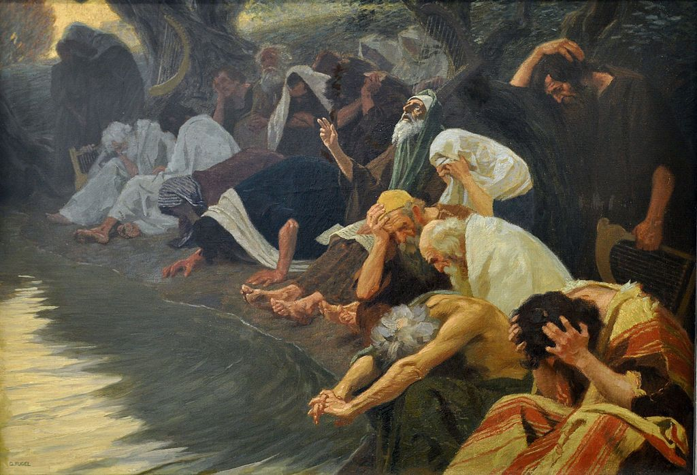
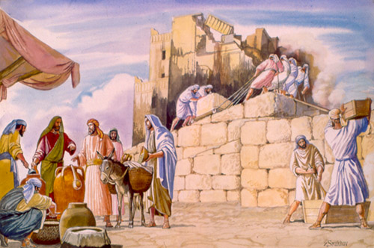
Curses For Disobedience
Exile: vs. 34-39
Land Will Enjoy Its Sabbaths
2 Chron 36:21; Isa 24:5-6; Rom 8:22
Exiles Will Experience Fear
Ezek 21:7, 12 15
Exiles Will Perish Among Nations
Jer 42:17-22; 44:12-14
Return: vs. 40-45
Repentance
Jer 31:18-20; Ezek 36:31;
They Will Return
Ezek 16:60; 2 Chron 36:22-23
Notes:
Stage 6 is a judgment, but also a result of the previous judgment. The first result was if they insisted on not giving the land its Sabbath rest every 7 years, God would force it upon them. Interestingly, if you count back 7 * 70 years from the time of Judah’s captivity, it lands on he beginning of King Saul’s reign. This may suggest that they had not observed this rest since that time and God was making up for it during the Babylonian captivity.
While in exile, the Jews would not be on vacation. They would experience fear in every direction as strangers in a foreign land. In Ezekiel’s day, the exiles held out hope they would return at any moment because false teachers were prophesying so. But when news came to Babylon that the temple had been destroyed, the Jews were deflated like they had never been before.
While God was waiting for the Jews in Babylon to repent, those few who remained in Judah resolved to go back to Egypt and take Jeremiah with them. They once again served idols and died in the very place God had rescued them from hundreds of years prior.
However, stage 7 gives good news. If the people repent, they will be allowed to return. A big part of Ezekiel’s work was to bring the people in captivity to this repentance because God intended to use them to as his remnant to come back and rebuild Jerusalem. But he could not do so while their hearts remained uncircumcised. Fortunately, Ezekiel’s work was fruitful, which is why we have his letter, and the people repented and God remembered His covenant with Abraham, Isaac, and Jacob.

Slide 9
Difficult Vows
Vs 1-8 | Vs 9-13 | Vs 14-15 | Vs 16-21 | Vs 22-25 | Vs 26-33
People | Animals | Houses | Family Land | Non-Family Land | Illicit
Notes:
The final chapter of Leviticus is about the making of vows and keeping them. What is under consideration in this chapter are not compulsory vows. I don’t know of a single place in scripture where God ever commands that we make vows. But they were made by people all the same, voluntarily, which logically would bring up the question of what one should do if he were not able to keep them.
The chapter is divided up into 6 sections. The first eight verses pertain to vows made with people followed by animals and then houses. Starting in verse 16, we read of vows connected to family land that was part of one’s tribal inheritance as well as non-family land that was not. Verses 26 – 33 deal with illicit vows.
Why is this chapter here? God wants the Israelites to understand that making a vow is a serious thing and if you’re going to make one, you better put your money where your mouth is. Because if you make a vow, and don’t keep it, there is going to be an upcharge. God was not going to play “Indian Giver” with Israel and let them get away with it without their being consequences.
People who were vowed could be redeemed back by a market amount that depended on their gender and their age. If an animal was vowed that could not be offered as a sacrifice, it could be redeemed back by a value set by the priest plus 20%. But no animal that could be offered as a sacrifice could be redeemed back. If you tried to substitute it, both animals became dedicated. To redeem a house that was vowed, you paid a value set by the priest plus 20%. If land was vowed, you could redeem it back by a price set according to how much seed it took to plant the land. The number of years remaining until the Jubilee would also determine the cost plus 20%. The chapter concludes with those things which could not be vowed. This included the first born among animals because they already belonged to God (Ex 13:2), things already devoted to the Lord, things already devoted to destruction, and tithes.

Slide 10
Difficult Vows
No intention of fulfilling
Forgetting to fulfill
Underestimating the cost
Having a change of heart
Not able to fulfill
Emotional experiences
Notes:
This begs the question of why someone might make a difficult vow? There are several reasons why this may be the case:
Not intending to fulfill as you make it – one might do this in front of others for self-glorification without ever intending to fulfill it
Forgetting to fulfill – it could be that the hustle and bustle of life distracted one from fulfilling a previously made vow.
Underestimating the cost – it could be one underestimated how costly the vow would be and is not able to fulfill it and therefore needs to get out of it.
Having a change of heart – it could be that one simply changed his mind.
Not able to fulfill – This would be where one vowed something he was not able to fulfill for one reason or another.
Emotional experiences – “Lord, if you get me out of this, I promise to…”. These are vows made in the heat of the moment, but once that heat cools those vows can be easy to forget.

Slide 11
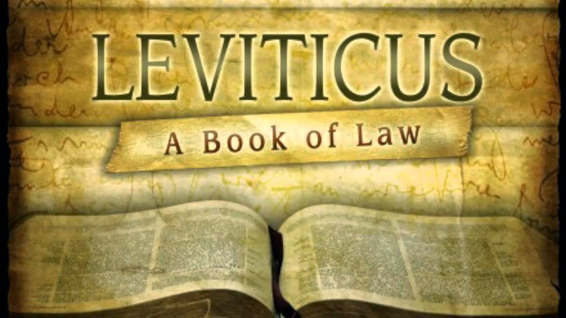
Difficult Vows
Notes:
Now, why does Leviticus end this way? A few thoughts:
After the blessings and curses of Lev 26, God was done with what was required to be holy, to be fully pleasing to God. The only thing left for people to even do was go above and beyond what God has asked for. So should one feel like doing this, God is laying out what to do if you vow something but later will not or cannot fulfill it.
These vows are purely voluntary – a response of love. This shows the high level of conduct the law was to produce in man, that of voluntary obedience and not obedience under compulsion. A person who has arrived to the point in his or her faith where they are voluntarily devoting themselves to God rather than doing things under compulsion has reached a spiritual maturity God is aiming for in us all.
Keep in mind that they promised to keep the laws in this book (Ex 19:8; 20:19; 24:3,7). Perhaps this is God’s way of showing that He knew they wouldn’t be able to do despite their vow to do so.

