Slide 2
What Is Hope?
“hope” = “elpizó”
“to expect, trust, anticipate, actively wait, fully confident”
Confidence In Salvation
1 Tim 4:10 – “For it is for this we labor and strive, because we have fixed our hope on the living God, who is the Savior of all men, especially of believers.”
John 5:45 – “Do not think that I will accuse you before the Father; the one who accuses you is Moses, in whom you have set your hope.”
Human Affairs
Rom 15:24 – “whenever I go to Spain—for I hope to see you in passing, and to be helped on my way there by you, when I have first enjoyed your company for a while”
Phil 2:19 – “But I hope in the Lord Jesus to send Timothy to you shortly, so that I also may be encouraged when I learn of your condition.”
Notes:
The Greek word for “hope” is the word “elpizó” and is used 32 times in the NT. It literally means “to expect, to trust, to anticipate, to actively wait, or to be fully confident.” This is not the finger-crossing, wishing upon a star kind of hope in which we might say something like, “I hope it doesn’t rain tomorrow.” This is a certain expectation that God’s people have.
It’s generally used in two ways in scripture. First, it is used to refer to one’s confidence in their salvation.
1 Tim 4:10 – “For it is for this we labor and strive, because we have fixed our hope on the living God, who is the Savior of all men, especially of believers.”
A Christian’s hope is so strong, so secure, it is the fuel by which we labor, by which we strive, by which we push on, by which we press forward. We serve not a dead God or a disconnect God, but a living God who went to great lengths in order to save us and so our hope is a secure hope.
John 5:45 – “Do not think that I will accuse you before the Father; the one who accuses you is Moses, in whom you have set your hope.”
The Jews tragically set their hope in the wrong person – Moses. It wasn’t that Moses wasn’t trustworthy or credible. But Moses’ words accused them through the scripture he wrote and in which they were not abiding. And he was probably accusing them from heaven no less. So it is possible to have a hope that will not save you because it is in the wrong person or the wrong faith. This hope feels the same to the one being saved and the one who will not be saved.
This word for hope is also used relative to human affairs:
Rom 15:24 – “whenever I go to Spain—for I hope to see you in passing, and to be helped on my way there by you, when I have first enjoyed your company for a while”
Paul had confidence, fully anticipated seeing these brethren. It wasn’t wishful thinking. He was setting his plans, so far as he could, to come to them. Interestingly, God had other plans as his persecution by the Jews at the end of his 3rd missionary journey stalled this coming. And when he did arrive in Rome, he arrived in chains. But his hope was no less anticipated.
Phil 2:19 – “But I hope in the Lord Jesus to send Timothy to you shortly, so that I also may be encouraged when I learn of your condition.”
That he “hoped in the Lord Jesus” seems to be a fancy way of saying, “I have confidence that I’ll be sending Timothy if it is in the Lord’s will.” This may suggest that while our hope is no less in strength than the confidence we have in our salvation, we cannot know God’s as certain in situations such as this when we don’t have an explicate promise from Him as we do regarding our salvation.

Slide 3
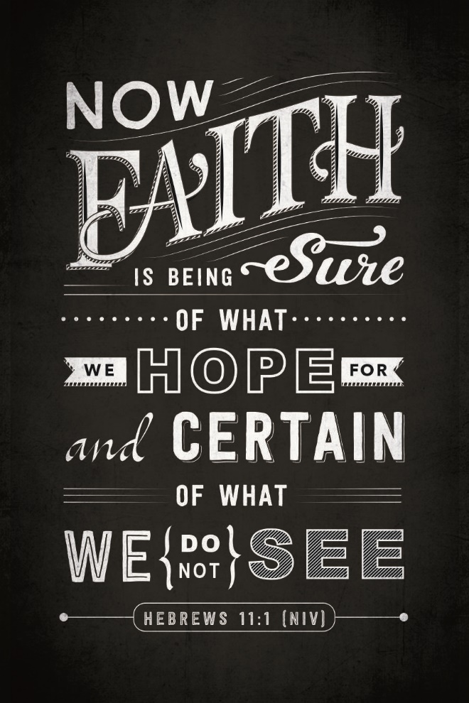
Faith, Hope, Love
1 Cor 13:13 – “But now faith, hope, love, abide these three; but the greatest of these is love.”
Col 1:4-5a – “⁴since we heard of your faith in Christ Jesus and the love which you have for all the saints; ⁵because of the hope laid up for you in heaven”
Notes:
Now, faith, hope, and love are often intimately connected in Scripture – 1 Cor 13:13 – “But now faith, hope, love, abide these three; but the greatest of these is love.” In fact, hope is closely connected to the previous clause that “love believes all things”, yet it is distinct in its own way. Believing all things has an eye to the present. To hope all things has an eye to the future. This is what is expressed in Heb 11:1 – “Now faith is the assurance of things hoped for, the conviction of things not seen.” Faith is what we know today. Hope is what we long for in the future. However, love is greater. There will come a day when faith will not even be necessary because we’ll be walking by sight. Hope will not be necessary because our greatest expectations will be fulfilled. But love will still be just as necessary and as wonderful and that will never change.
Col 1:4-5a – “⁴since we heard of your faith in Christ Jesus and the love which you have for all the saints; ⁵because of the hope laid up for you in heaven”. So we can see that there is a relationship between these two ideas and it shouldn’t surprise us that since love is the greatest, expressing faith and hope towards another is a means to love them.
1 John 4:8 defines Jesus as “love” and 1 Tim 1:1 calls Him our “hope”. Heb 12:2 describes Jesus as the author and finisher of our faith. Therefore if Christ lives I us, His hope will be seen in how we treat others.

Slide 4
Love Hopes All Things
It frees us to love
Rom 5:5 – “and hope does not disappoint, because the love of God has been poured out within our hearts through the Holy Spirit who was given to us.”
2 Cor 3:12 – “Therefore having such a hope, we use great boldness in our speech”
1 Pet 3:15 – “but sanctify Christ as Lord in your hearts, always being ready to make a defense to everyone who asks you to give an account for the hope that is in you, yet with gentleness and reverence”
Notes:
Now how does this hope tie in with loving others? First, it frees us up to love.
If all of our hope and confidence is in God and His promise, it means we are a people who are free to reach out to our brethren and our neighbors and put our lives on the line for them, take risks on their behalf, give ourselves to serving them, because we have what they need most (neighbors) and what we need most is taken care of already. This very moment, we have what we need in Christ as well as for tomorrow and also for the days ahead. We serve a God who is faithful today and will continue to be faithful tomorrow, a God who works all things together for our good, and who regulates everything that enters the realm of our lives.
Rom 5:5 – “and hope does not disappoint, because the love of God has been poured out within our hearts through the Holy Spirit who was given to us.”
There is a direct connection between the hope we have in God and His love being in our hearts through His Spirit, whom we are encouraged to walk by. The fruit of the Spirit produces a quality of character in every Christians indicative of the hope within him.
2 Cor 3:12 – “Therefore having such a hope, we use great boldness in our speech”
Why be so bold toward others? Why overcome the fears that keep us from evangelizing and from loving one another as wholly and completely as we’re called to do? Because we serve a risen Savior who will do what He promised us He will do. This should remove all anxieties and doubts that so often plague us in our relationships with others, both of the world and the church.
1 Pet 3:15 – “but sanctify Christ as Lord in your hearts, always being ready to make a defense to everyone who asks you to give an account for the hope that is in you, yet with gentleness and reverence”
Biblical hope is supposed to enhance our ability to share Christ with others. It is to produce a strength and resolve so mighty that nothing will stop us from saying to someone “for edification according to the need of the moment.” (Eph 4:29) Christ is Lord. He’s won the victory. And through Him we are always victorious. Therefore, a living hope is one of the most powerful evangelistic tools at our disposal for sharing Christ with others. Hope frees us to love.

Slide 5
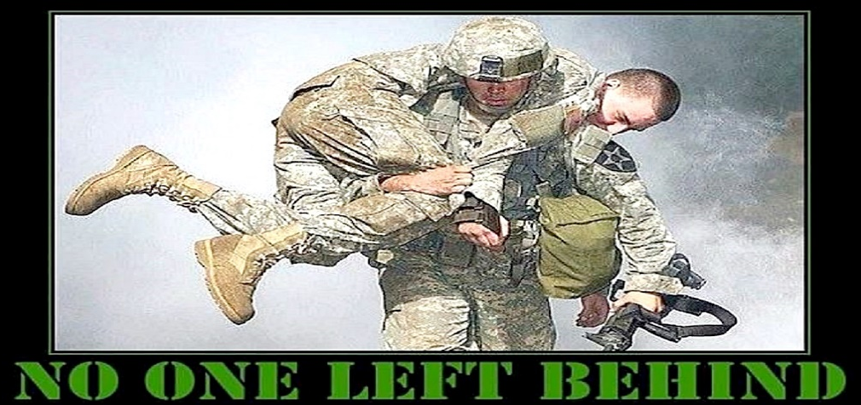
Love Hopes All Things
It frees us to love
No one is a lost cause
Luke 22:31-32 – “³¹Simon, Simon, behold, Satan has demanded permission to sift you like wheat; ³²but I have prayed for you, that your faith may not fail; and you, when once you have turned again, strengthen your brothers.”
1 Cor 1:2 – “To the church of God which is at Corinth, to those who have been sanctified in Christ Jesus, saints by calling, with all who in every place call on the name of our Lord Jesus Christ, their Lord and ours”
Notes:
Also, it means we never consider another to be a lost cause. It means that even when we see another Christian fall hard, we never give up on them. Christians are determined that nobody is ever left behind. Hoping all things cultivates a willingness to encourage each other as fellow runners of the same race. We understand that we are all works in progress and have confidence that we all are becoming more like Christ, even if some days it’s pretty hard to see. This does not rule out confrontation or the reparation of wrong-doing; it means that the impact of a positive attitude in the life of another person is incalculable.
Love never says die. Peter failed Jesus, yet the Lord had confidence in his restoration:
Luke 22:31-32 – “³¹Simon, Simon, behold, Satan has demanded permission to sift you like wheat; ³²but I have prayed for you, that your faith may not fail; and you, when once you have turned again, strengthen your brothers.”
The Corinthians failed Paul in many ways, yet the apostle, in love, patiently corrected them and called them “sanctified”:
1 Cor 1:2 – “To the church of God which is at Corinth, to those who have been sanctified in Christ Jesus, saints by calling, with all who in every place call on the name of our Lord Jesus Christ, their Lord and ours”
When we fail to “hope all things” in others, we separate. We separate because we feel we have to move on, as if the offender has fallen out of our boat and won’t recover. Think about ho often this lack of hope becomes silent. We usually won’t even bother to confront them in hopes of producing repentance, simply withdrawing and receding from them, quietly. Like failing to “believe all things”, failure to “hope all things” is unbelief; it is unbelief in the power of God’s work to transform another. It is unbelief that God finishes what He starts, as though He forget or walks away. This making God in our image, right? Because walking away is what we do, not God.

Slide 6
Love Hopes All Things
It frees us to love
No one is a lost cause
Expects the best of another
Mic 7:8 – “Do not rejoice over me, O my enemy. Though I fall I will rise; though I dwell in darkness, the Lord is a light for me.”
Notes:
Finally, if love truly “hopes all things” it means that we invest the same kind of confident expectation that we usually reserve for God, Himself, toward the people of God. To “hope all things” means to confidently expect the long-term spiritual growth of our fellow brothers and sisters in Christ. Love always points to a brighter day ahead. Love is the lifeline that the hurting can hold on to.
When we fail to “hope all things” we consider failures of sin to be a final judgment. It is betrayed in quickness to write other off. We have critical notions of others and when they meet our expectations of their weakness, we cross them off our list and push them out of our lives. Are you like me? Do you make your mind up about some people? Do you get tired of others doing the “same old things” and just “move on”, too? Are your negative opinions of others hardened and resistant to change? Do you see everything some people do through the same critical filter?
Mic 7:8 – “Do not rejoice over me, O my enemy. Though I fall I will rise; though I dwell in darkness, the Lord is a light for me.”
If you have ever had a person believe in you and share a hopeful attitude for your future, then you have experienced some of what 1 Corinthians 13:7 teaches. As long as there is love, there will be hope.

Slide 7
What Is Endure?
“endure” = “hypoménō” = “to stay behind, await, endure”
literally: “remaining under, bearing up”
1 Pet 2:20 – “For what credit is there if, when you sin and are harshly treated, you endure it with patience? But if when you do what is right and suffer for it you patiently endure it, this finds favor with God.”
2 Tim 2:10 – “For this reason I endure all things for the sake of those who are chosen, so that they also may obtain the salvation which is in Christ Jesus and with it eternal glory.”
Matt 10:22 – “You will be hated by all because of My name, but it is the one who has endured to the end who will be saved.”
Notes:
The word “endure” comes from the Greek word “hypoménō” which means “to stay behind, to await, endure”. It is a compound word, combining the words for “under” and “to remain, abide or continue”. So in a strict literal sense this word “endure” means “to remain under”, as if remaining under a load, or bearing up as if you’re enduring a load. Sometimes it even means to remain in a place instead of leaving it, the implication being that there are great difficulties in that place.
John MacArthur says that this word was a military term used for an army that was holding a vital position at all costs, in which every hardship and suffering was to be endured patiently in order to hold fast. Why? Because holding that position is important to the success of the battle. So it is with As Christians – we must hold our positions with others in love for their good and for the glory of God.
In the Scriptures is it often used of enduring to the end of life, awaiting our eternal prize, and also of living through long-term trials. It bears some similarity to “bears all things”. However, whereas to “bear all things” seems to refer to patience in the face of provocation, to “endure all things” takes a longer view.
Other verses where this same word is used:
1 Pet 2:20 – “For what credit is there if, when you sin and are harshly treated, you endure it with patience? But if when you do what is right and suffer for it you patiently endure it, this finds favor with God.”
Like 1 Cor 13:7, this endurance is what we have towards others. In this case, it will be toward those who mistreat us. The endurance must be more than simply “taking it”. God would have us to endure patiently as if we recognize that though they are ambivalent towards us now, life’s circumstances may soften their attitude toward us. Having endured they’re prior mistreatment, it will boost our credibility in their eyes in which we can now help them.
2 Tim 2:10 – “For this reason I endure all things for the sake of those who are chosen, so that they also may obtain the salvation which is in Christ Jesus and with it eternal glory.”
Who Paul endure all things for? Those who are chosen. And he ties that loving endurance directly with their ability to obtain salvation. Our willingness to endure others’ may very well be the deciding factor on whether or not they come to Christ.
Matt 10:22 – “You will be hated by all because of My name, but it is the one who has endured to the end who will be saved.”
This is on the heels of Jesus sending His followers out on the “Limited Confession”. He is brutally honest with them, holding nothing back. They will be delivered to the courts, scourged in the synagogues, brought before governors and kings. Their own families would come against them and cause them to be put to death. They will be hated. In the middle of all this explanation is when he says what he does in vs. 22. In other words, while under pressure and trial, we are to remain faithful, obedient, and continue to do what we know is right in spite of what others are throwing our way or what obstacles exists. He is saying that we as followers of Christ are called to endure others’ mistreatment, for their good. It is not an option.

Slide 8
What Does Enduring Look Like?
A Long Time
Matt 24:13 – “But the one who endures to the end, he will be saved.”
Notes:
What does enduring look like? First, it looks like a long time.
In the context of 1 Cor 13, to endure all things word means that we are willing to remain in difficult situations for the sake of one another, rather than seeking an easy escape. When our fellow brothers and sisters in Christ are making life difficult for us, we don’t look for a way out. To endure is to approach things from a long term perspective and so “hoping all things” is not enough. Enduring all things requires that we take a front row seat, taking some abuse in the name of seeing each other through to the end.
Matt 24:13 – “But the one who endures to the end, he will be saved.”
In the wedding vows, a husband and wife take each other “for better or for worse, for richer, for poorer, in sickness and in health, to love and to cherish; from this day forward until death do us part.” The basis of this pledge is the fact that enduring love goes on for a long, long time. God never intended for divorce to be a substitute for enduring love. And nowhere can enduring love be practiced and cultivated than in the marriage relationship.

Slide 9
What Does Enduring Look Like?
A long time
Consistent
Prov 17:17 – “A friend loves at all times, and a brother is born for adversity.”
Notes:
Secondly, enduring love is consistent.
This is the opposite of being a fair weather friend. A fair weather friend is your friend as long as things are easy and pleasant and there are no problems, no trouble on the horizon, no storms brewing in your life. God says to us that if we are going to really love, we must endure with one another.
All of our positive expectations don’t mean much when we essentially plan to pop back into the picture when things are a little less rocky. If our fellow Christians are going to grow, it isn’t God’s design that they do it alone. And let’s face it: some Christians lives are train-wrecks. Being close to these people means hassle, heartbreak, and offense…but a true Christian buys a ticket for a train he knows will wreck.
Prov 17:17 says, “A friend loves at all times, and a brother is born for adversity.”
At all times a friend loves. This means that when we get hurt and are tempted to say, “I’m done with you, I’ve had enough, I will not be in your life anymore or help you as a friend or find help for you”, we “bear up” to that, brushing off that kind of thinking, replacing it the thinking, “I will endure with you!” Enduring love doesn’t throw people aside like a worn shirt.

Slide 10
What Does Enduring Look Like?
A long time
Consistent
Painful
Heb 12:2-3 – “²fixing our eyes on Jesus, the author and perfecter of faith, who for the joy set before Him endured the cross, despising the shame, and has sat down at the right hand of the throne of God. ³For consider Him who has endured such hostility by sinners against Himself, so that you will not grow weary and lose heart.”
Notes:
Third, enduring love is painful.
There is an element of trouble, of pain, that requires a steadfast love or a courageous love to endure with people. We don’t give up on people. We don’t walk away when things get hard or complicated. Love compels us to stick it out, to endure, no matter how hard it gets. Because its not about us and our pain. Its about the person who needs our love. Jesus is the ultimate example of this:
Heb 12:2-3 – “fixing our eyes on Jesus, the author and perfecter of faith, who for the joy set before Him endured the cross, despising the shame, and has sat down at the right hand of the throne of God. For consider Him who has endured such hostility by sinners against Himself, so that you will not grow weary and lose heart.”
Therefore endurance has to do with patently loving someone who is not so patiently loving you. Jesus’ instruction in Matthew 10, sending disciples out to minister to those who were hateful and cruel. Hosea going after his wife who was doing evil against him. Paul loving people even if it meant enduring prison, beatings, and many other trials. Each of these had special opportunities to love with endurance because they were in circumstances where they were being harmed and not really loved by others. We wouldn’t call it endurance if it were easy. The very fact is in endurance means its hard. It hurts.

Slide 11
What Does Enduring Look Like?
A long time
Consistent
Painful
God
Notes:
In Psa 136, we see a phrase repeated in all 26 verses: “His lovingkindness endures forever”. And so God is the ultimate example of enduring love. When we endure in love towards others, we become more like Him.
“Well, this person doesn’t deserve that kind of love.” None of us did either.
“But she is not loving me back the way I want to be loved.” Well, we aren’t loving God as fully as we should either.
“But I have been hurt really, really bad by him; he has really hurt me by his sin.” God is hurt by our sin also.
Aren’t you glad He endures with us in love?

