Slide 1
Notes:
The prophet Micah begins his ministry during a time of great economic and material prosperity. But the downside was that it gave rise to spiritual complacency and greed and injustice. Despite the reformations of several good kings, idolatry also continued to be a problem. And as we noted in our last class, the evidence is clear that God’s patience w/His people is wearing thin – something is going to have to be done. And so, Micah, along w/his contemporary Isaiah, exposes both the problems as well as the solution, and the solution can even be divided into what would be temporary and a more permanent solution. The temporary solution is they have a future captivity to look forward to that will not be very pleasant, but it will fix some of the short-term issues they’re dealing with. But the longer-term solution will come in the form of that seed that has been promised since Gen 3:15. And so, it’s important to note that the prophets are not solely negative in their addresses – they also offer a lot of hope. And Micah is no different
Micah is a name which means, “Who is like…?”, an incomplete sentence, but the purpose of this book is to complete the sentence so that by the time we get to the end, it is clear that the object of that sentence is God. “Who is like God?” Let’s begin drawing that picture from vs. 1.

Slide 2
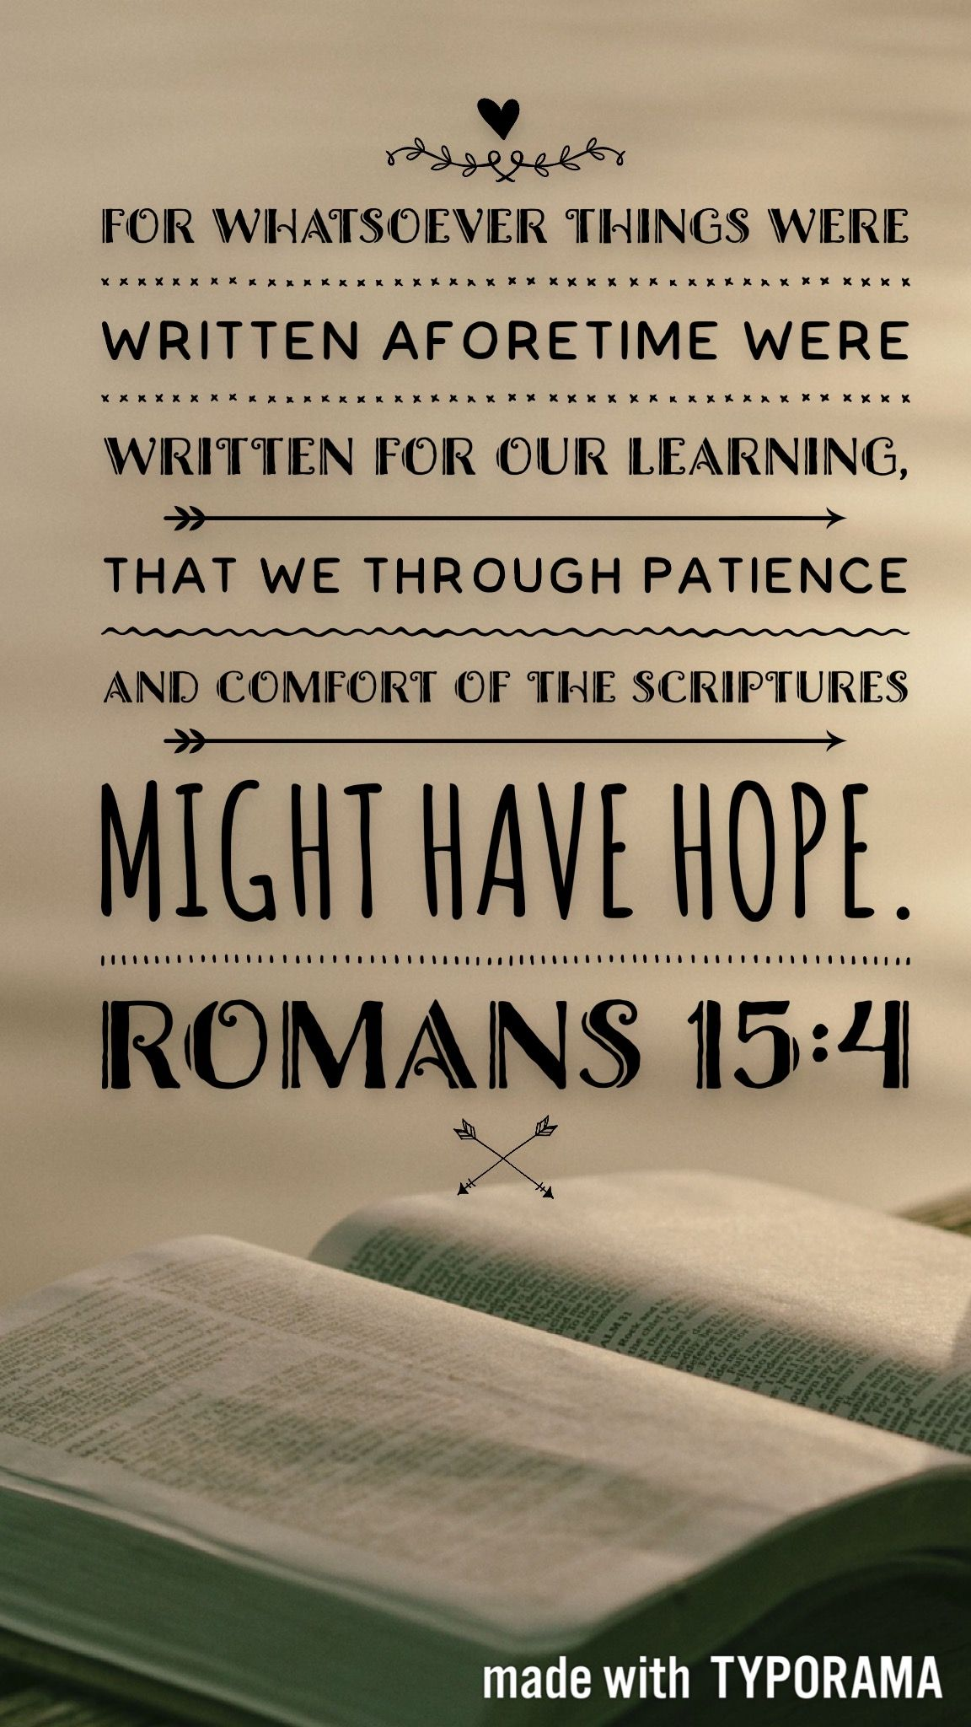
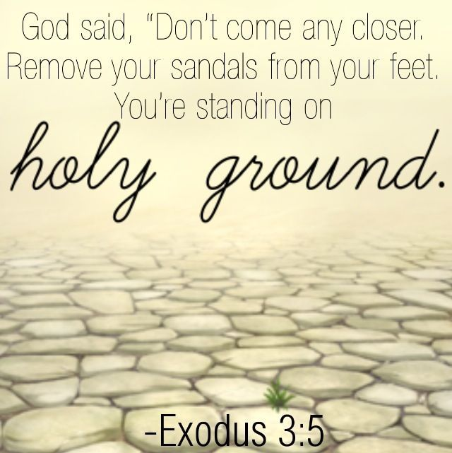
God Witnesses Against Them
Mic 1:1-2 – “¹The word of the Lord which came to Micah of Moresheth in the days of Jotham, Ahaz and Hezekiah, kings of Judah, which he saw concerning Samaria and Jerusalem. ²Hear, O peoples, all of you; listen, O earth and all it contains, and let the Lord God be a witness against you, the Lord from His holy temple.”
Notes:
Mic 1:1 – Notice that word “saw” – it’s not just that God gave Him message, there were things Micah saw. This would suggest part of the prophetic inspiration came by vision. This is why prophets were sometimes referred to as “seers” – God would cause them to “see” things. And what Micah saw was of such magnitude, it needed to be shared:
(CLICK) Mic 1:2 – “peoples”, the covenant name for Israel is used here. Before giving the specific message about Samaria and Jerusalem, Micah wants the reader to see this pronouncement against the backcloth of world judgment. So, the OT was not just for the Jews – it’s for us, too. (CLICK) Not as an authoritative law, but for learning – Rom 15:4 – “For whatever was written in earlier times was written for our instruction, so that through perseverance and the encouragement of the Scriptures we might have hope.” So, Micah’s message is for us, the nations, as well, and the “nations” will appear again in chapters 4 and 5 and at the end of the book. Because Him being not just the God of Israel, but the God of all the world, and given the fact He is going to judge His own people, how much more should we pay attention? Hence why we need to know this book.
Micah says that the Lord has witnessed some things going on. And so, though in his temple/palace, He is not disconnected from happenings on Earth. He sees and hears everything – this is not good news for sinful man. Because what makes His temple “holy”? (CLICK) It’s God. Just as He told Moses at the burning bush, “Remove your sandals – you’re standing on holy ground.” And this holy God is witnessing some things going on at his footstool called Earth that is going to provoke a negative response from His heavenly temple.
PRAYER

Slide 3
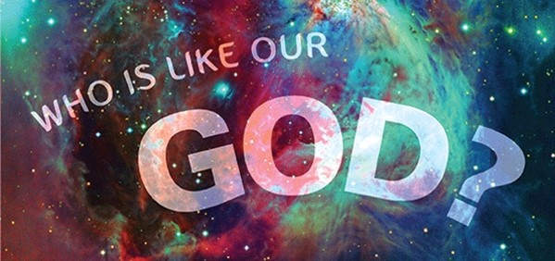
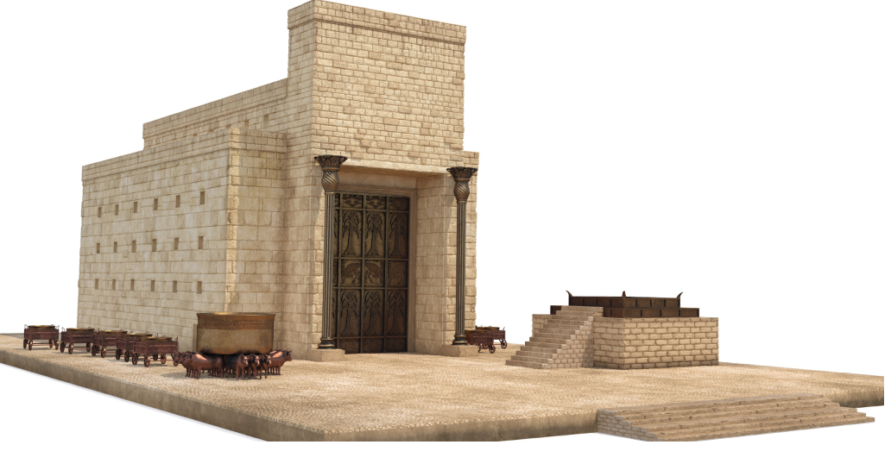
God To Visit Them
Mic 1:3-4 – “³For behold, the Lord is coming forth from His place. He will come down and tread on the high places of the earth. ⁴The mountains will melt under Him and the valleys will be split, like wax before the fire, like water poured down a steep place.”
2 Chron 2:6a – “But who is able to build a house for Him, for the heavens and the highest heavens cannot contain Him?”
Notes:
What response? This next scene provides an unforgettable introduction to the question, “Who is like God?” – Mic 1:3 – Now, what does it say about God that He has to “come down” to tread on our “high places”? (CLICK) Who is like God? He is transcendent above all Creation. The throne from which He descends is the highest of the high places.
And what’s the effect? (CLICK) Mic 1:4 – Now we see language like this all throughout scripture, and it’s generally always symbolic. I would suggest that “mountains” represent everything that is high, and that “valleys” represents everything that is low, and regardless of which it is, it will be thrown into convulsions at God’s very presence. This is nothing less than irresistible power in which the seemingly most enduring elements of our material reality cannot contain His presence. Isaiah saw a similar thing in chapter 6 of his book. When Isaiah saw the Lord sitting on His throne, lofty and exalted, vs. 4 says, “And the foundations of the thresholds trembled at the voice of him who called out…”.
And so, who is like God? Solomon said it this way in (CLICK) 2 Chron 2:6 – “But who is able to build a house for Him, for the heavens and the highest heavens cannot contain Him? So, who am I, that I should build a house for Him, except to burn incense before Him?”

Slide 4
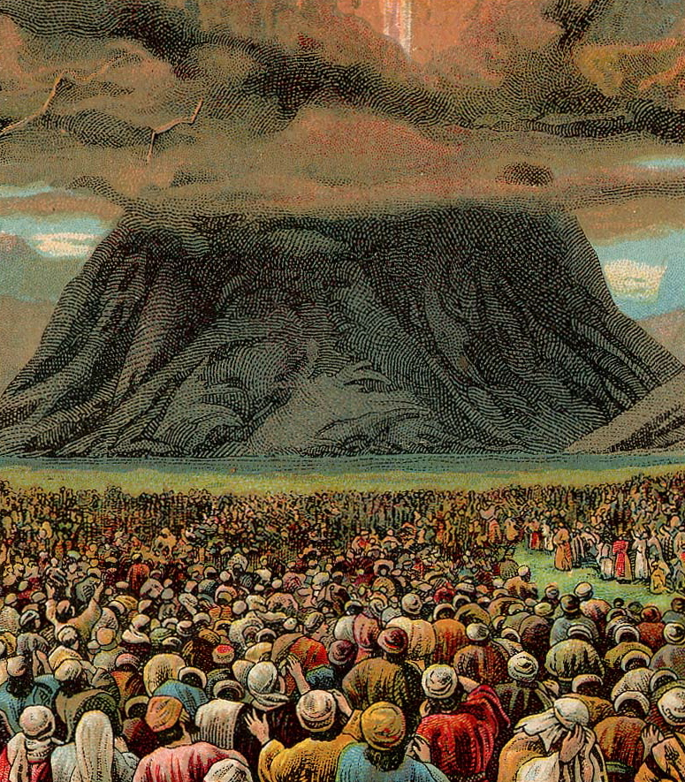
The Reason
Mic 1:2-5ab – “²Hear, O peoples, all of you; listen, O earth and all it contains, and let the Lord God be a witness against you, the Lord from His holy temple. ³For behold, the Lord is coming forth from His place. He will come down and tread on the high places of the earth. ⁴The mountains will melt under Him and the valleys will be split, like wax before the fire, like water poured down a steep place. ⁵All this is for the rebellion of Jacob and for the sins of the house of Israel.”
“peoples” (Ex 3:7)
“Yahweh” (Ex 6:2-3)
“theophany” (Ex 19 & 20)
Notes:
Now, it’s one thing if He’s coming down to make a covenant w/them, but this is not the purpose of His visit. Rather, it’s this (CLICK) – Mic 1:5a – This is huge. Because if the earth He created cannot contain His presence, how much more a cursed, sinful earth?
Now, I put all of vs. 2 – 5a up here for a reason because there is an interesting pattern that can go unnoticed. (CLICK) That word in vs. 2 “peoples” is derivative of the covenant name God would use for His people Israel, especially in the book of Exodus. The word “Lord” in vs. 3 is “Yahweh”, which was the name of God made famous when God introduced Himself to Moses at the burning bush. So, we’ve got two Exodus allusions, and now we’re told that God is going to come down on high places of the Earth in which creation itself could barely contain His presence. Does this sound like another story in Exodus? (CLICK) God’s descent on Mt. Sinai (Ex 20). And you’ll recall from Ex 20 that despite the awesome display of power, God came to make a covenant w/them, to give them a Law, to make them His special people. But how did the people respond to God speaking the 10 Commandments? Ex 20:18-19 – This was their reaction when God wasn’t coming to punish them, but to make them His people. He did a lot to get them out of Egypt, and they’re still scared to death, right? But now He’s coming back because they’d broken His Law. That’s what “rebellion” means – “breaking the covenant”. That word “sin” means they hadn’t kept its stipulations. And Micah is going to get detailed about these sins in chapters 2, 3, and 6.
But just try to appreciate that when God was on their side, Creation could barely contain His presence, and they were terrified. But now, He’s having to come back because they promised Him that they’d obey, but they broke that promise, and now when He comes, Creation will not be able to contain His presence. Imagine what that will mean for sinful people who dwell in this Creation?
COMMENTS

Slide 5
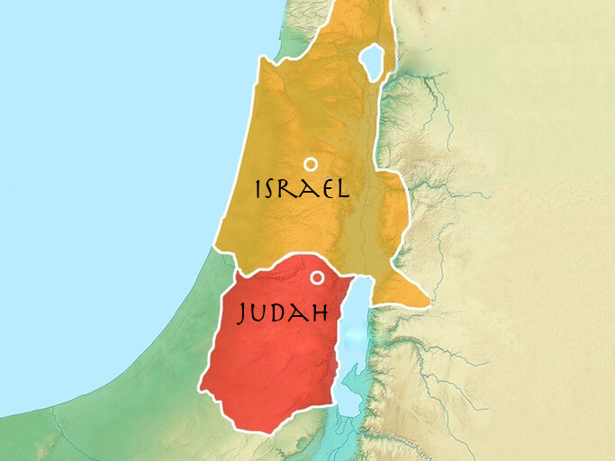
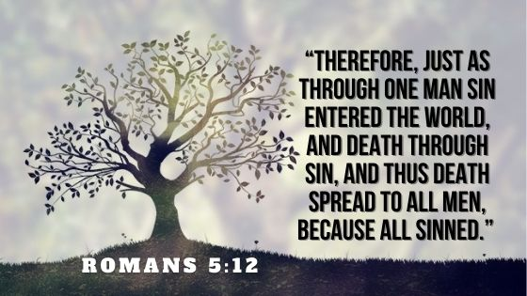
The Cancer Spread
Mic 1:5 – “⁵All this is for the rebellion of Jacob and for the sins of the house of Israel. What is the rebellion of Jacob? Is it not Samaria? What is the high place of Judah? Is it not Jerusalem?”
Notes:
Now, often when we see the words “Jacob” or “Israel”, the writer will qualify that through synonymous parallelism – meaning, who He is specifically referring to. (CLICK) Because during this time, God’s people were divided up into two separate nations – the northern kingdom of Israel and the southern kingdom of Judah. But He leaves it rather ambiguous here, and here’s why:
(CLICK) Mic 1:5 – And so, at first, “Israel” and “Jacob” are ambiguous, which could be deliberate. But in the end, it’s made clear both kingdoms are equally guilty, and he specifically calls out their capitals, Samaria and Jerusalem, likely as a metonymy that represents capital leadership, because later on in the book, Micah is going to hammer the leadership. And while we know from history that the northern kingdom of Israel would be judged first, (CLICK) it seems that all of the filth of her social injustices had spread to Judah, who the majority of the book is aimed at. And something must be done to cut off the cancer at its source.

Slide 6
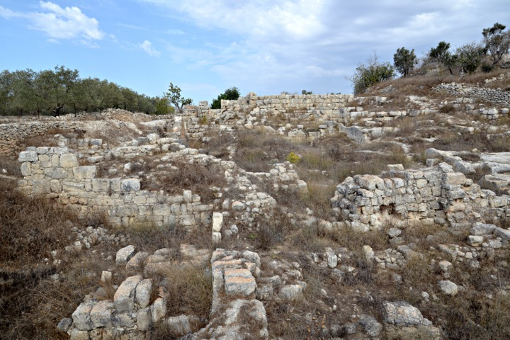
Samaria Judged
Mic 1:6-7 – “⁶For I will make Samaria a heap of ruins in the open country, planting places for a vineyard. I will pour her stones down into the valley and will lay bare her foundations. ⁷All of her idols will be smashed, all of her earnings will be burned with fire and all of her images I will make desolate, for she collected them from a harlot’s earnings, and to the earnings of a harlot they will return.”
Notes:
And so, that graphic picture of vs. 3? I suspect that is just behind-the-scenes of what will actually occur in more material terms – meaning, here is what God will do from an earthly perspective – Mic 1:6 – So before Micah starts in on Judah, he says God is going to cut the cancer out at the source. God dissolving the mountains is actually going to be Samaria’s structures collapsing into the valley before his eyes. The cascade of water down the slopes from vs. 4? In reality, this would be an avalanche of Samaria’s stones to the foot of the hills until all is left are its foundations, (CLICK) and as you can see from this picture here which shows ancient Samaria, God keeps His promises.
And it’s not that these stones did anything wrong. It’s what they did w/other “stones”. It’s what their structures housed – (CLICK) Mic 1:7 – So this is stonework of a different kind – idols, which were the tangible symbols that led to all the unethical conduct that Samaria practiced and that had infiltrated Jerusalem. Much of what Micah is going to hit on in chapters 2 and 3 is “injustice”. But “injustice” and “idolatry” are twin sins, as both entice the flesh and demand no morality. But Micah’s message here is that far from those idols saving them, they themselves will be beaten to pieces.
“from a harlot’s earnings, and to the earnings of a harlot they will return” – idols were constructed from the wages of the cult prostitutes. The idea may be that the money used to pay for the services of the temple prostitute, which they’d then turn around and use to finance their images, will be taken by a military enemy and used to pay harlots when the soldiers return home, but this time in a nation far away from Israel.

Slide 7
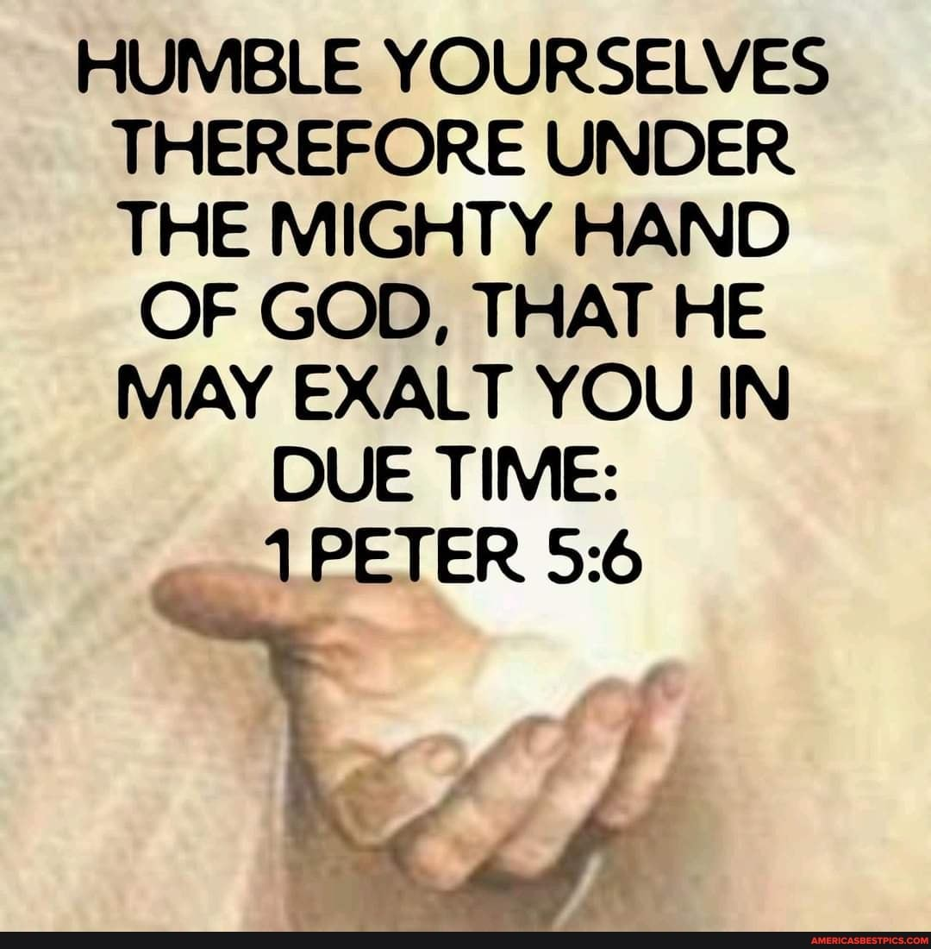
Micah’s Lamentation
Mic 1:8-9 – “⁸Because of this I must lament and wail, I must go barefoot and naked; I must make a lament like the jackals and a mourning like the ostriches. ⁹For her wound is incurable, for it has come to Judah; it has reached the gate of my people, even to Jerusalem.”
Notes:
Now, this begins Micah’s lamentation. Notice Mic 1:8 – This is a good reminder about these OT prophets. As much as we’d like to think of that as impenetrable, unemotional, unempathetic stalwarts, this is not a man preaching from a detached, vengeful, callous spirit. This is heartbreaking for him. He’s concerned. He’s sad. And He felt the weight of the coming judgment, the same we would if even an evil place such as, say, California or Washington DC, were to meet a similar demise. Few of us would boast about this – we’d likely be heartbroken, even as we admitted their sin was out of control.
One of the questions asked last week was, “Are there any internal connections between Isaiah and Micah…?” (CLICK) It’s interesting that in Isa 20, God commanded Isaiah to go naked and barefoot for 3 years as a sign of the coming captivity. That Micah mentions doing the same makes me believe that perhaps he is not doing this as a natural response to His sorrow, but maybe for the same purposes Isaiah did – as a sign of what’s to come (this is only speculative). But however it is to be taken, just as the jackals and ostriches howl in the desert, he too would howl in sorrow over what was about to come to his people.
And why is he mourning? Everyone sins. Why such a scene? Well, their issue had reached a breaking point – Mic 1:9 – Samaria’s wound cannot be mended. The sickness of their sin had gotten so bad, rehabilitation was no longer an option. And this is the point when God brings judgment. And even more, the infection has reached Jerusalem’s gates, which I take to mean that while Jerusalem is certainly being negatively influenced by Samaria (as vs. 5 tells us), Jerusalem had not yet reached the point of no return like Samaria had, which the stories of Hezekiah show.
This is why it’s so important to humble ourselves under the mighty hand of God – because if we don’t humble ourselves, He will come and humble us!

Slide 8
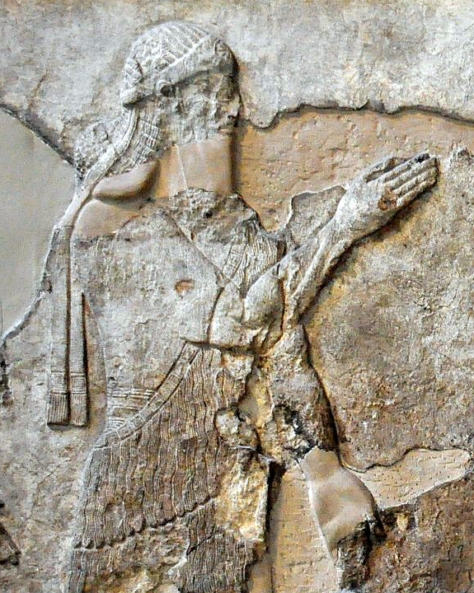
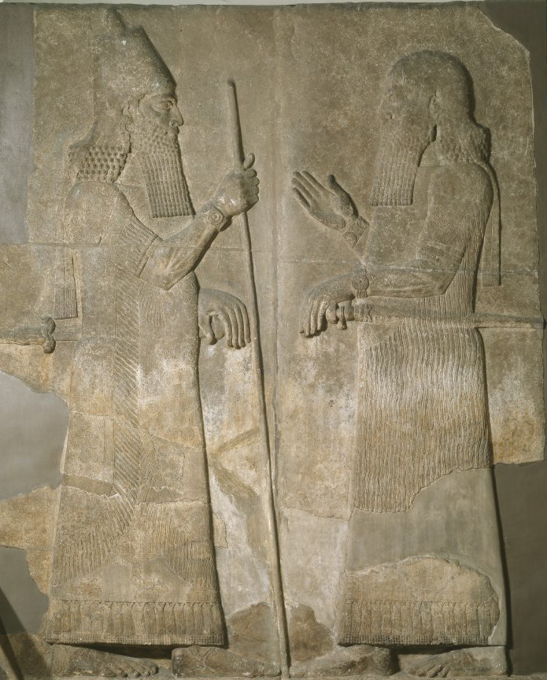
2 Kings 17:1-6 – “¹In the twelfth year of Ahaz king of Judah, Hoshea the son of Elah became king over Israel in Samaria, and reigned nine years. ²He did evil in the sight of the Lord, only not as the kings of Israel who were before him. ³Shalmaneser king of Assyria came up against him, and Hoshea became his servant and paid him tribute. ⁴But the king of Assyria found conspiracy in Hoshea, who had sent messengers to So king of Egypt and had offered no tribute to the king of Assyria, as he had done year by year; so the king of Assyria shut him up and bound him in prison. ⁵Then the king of Assyria invaded the whole land and went up to Samaria and besieged it three years. ⁶In the ninth year of Hoshea, the king of Assyria captured Samaria and carried Israel away into exile to Assyria, and settled them in Halah and Habor, on the river of Gozan, and in the cities of the Medes.”
Annals of Sargon II – “At the beginning of my royal rule, I…the town of the Samarians I besieged, conquered (2 Lines destroyed) [for the god…] who let me achieve this my triumph… I led away as prisoners [27,290 inhabitants of it (and) equipped from among them (soldiers to man)] 50 chariots for my royal corps… The town I rebuilt better than it was before and settled therein people from countries which I had conquered. I placed an officer of mine as governor over them and imposed upon them tribute as is customary for Assyrian citizens.”
Notes:
Now, before we continue in the text, when did this happen, literally and historically? The details are in 2 Kings 17. Tiglath-Pileser III took out the northern part of the Northern Kingdom of Israel, so that all that practically remained was Samaria. An Israelite named Hoshea killed Israel’s king who Tiglath-pileser III then installed as king under the condition he pay Assyria tribute regular tribute.
And Hoshea paid tribute for the first 4/5 years of his reign. But then Tiglath-pileser III died in 727BC and his son Shalmaneser V reigned in his place, depicted in the relief in the upper right. Typically, when an Assyrian king died, the nations they had previously subjugated would try to rebel. Shalmaneser V learned that not only did Hoshea stop paying tribute, but that Hoshea had been secretly corresponding w/Egypt. And so, Shalmaneser V throws Hoshea in prison and began a siege of Samaria that would last for 3 years, but he died shortly before taking it.
The details are sketchy, but it appears Shalmaneser V was deposed, and the Assyrian throne was taken by a man named Sargon II, depicted in the relief in the lower right (guy on left). And in 722BC, Sargon II completed the siege of Samaria and deported its inhabitants. The Northern Kingdom of Israel is no more.
In the Assyrian annals, Sargon II indicates that he deported 27,290 people from Samaria. This number only includes the inhabitants of the city, and that number could be extrapolated to 200,000 when you consider the people who were deported from the countryside. Sargon II then rebuilt Samaria and filled it w/deported people from other areas.
So, again, who is like God? He is a God who keeps His promises. And if we don’t humble ourselves, He will come and humble us!
COMMENTS

Slide 9
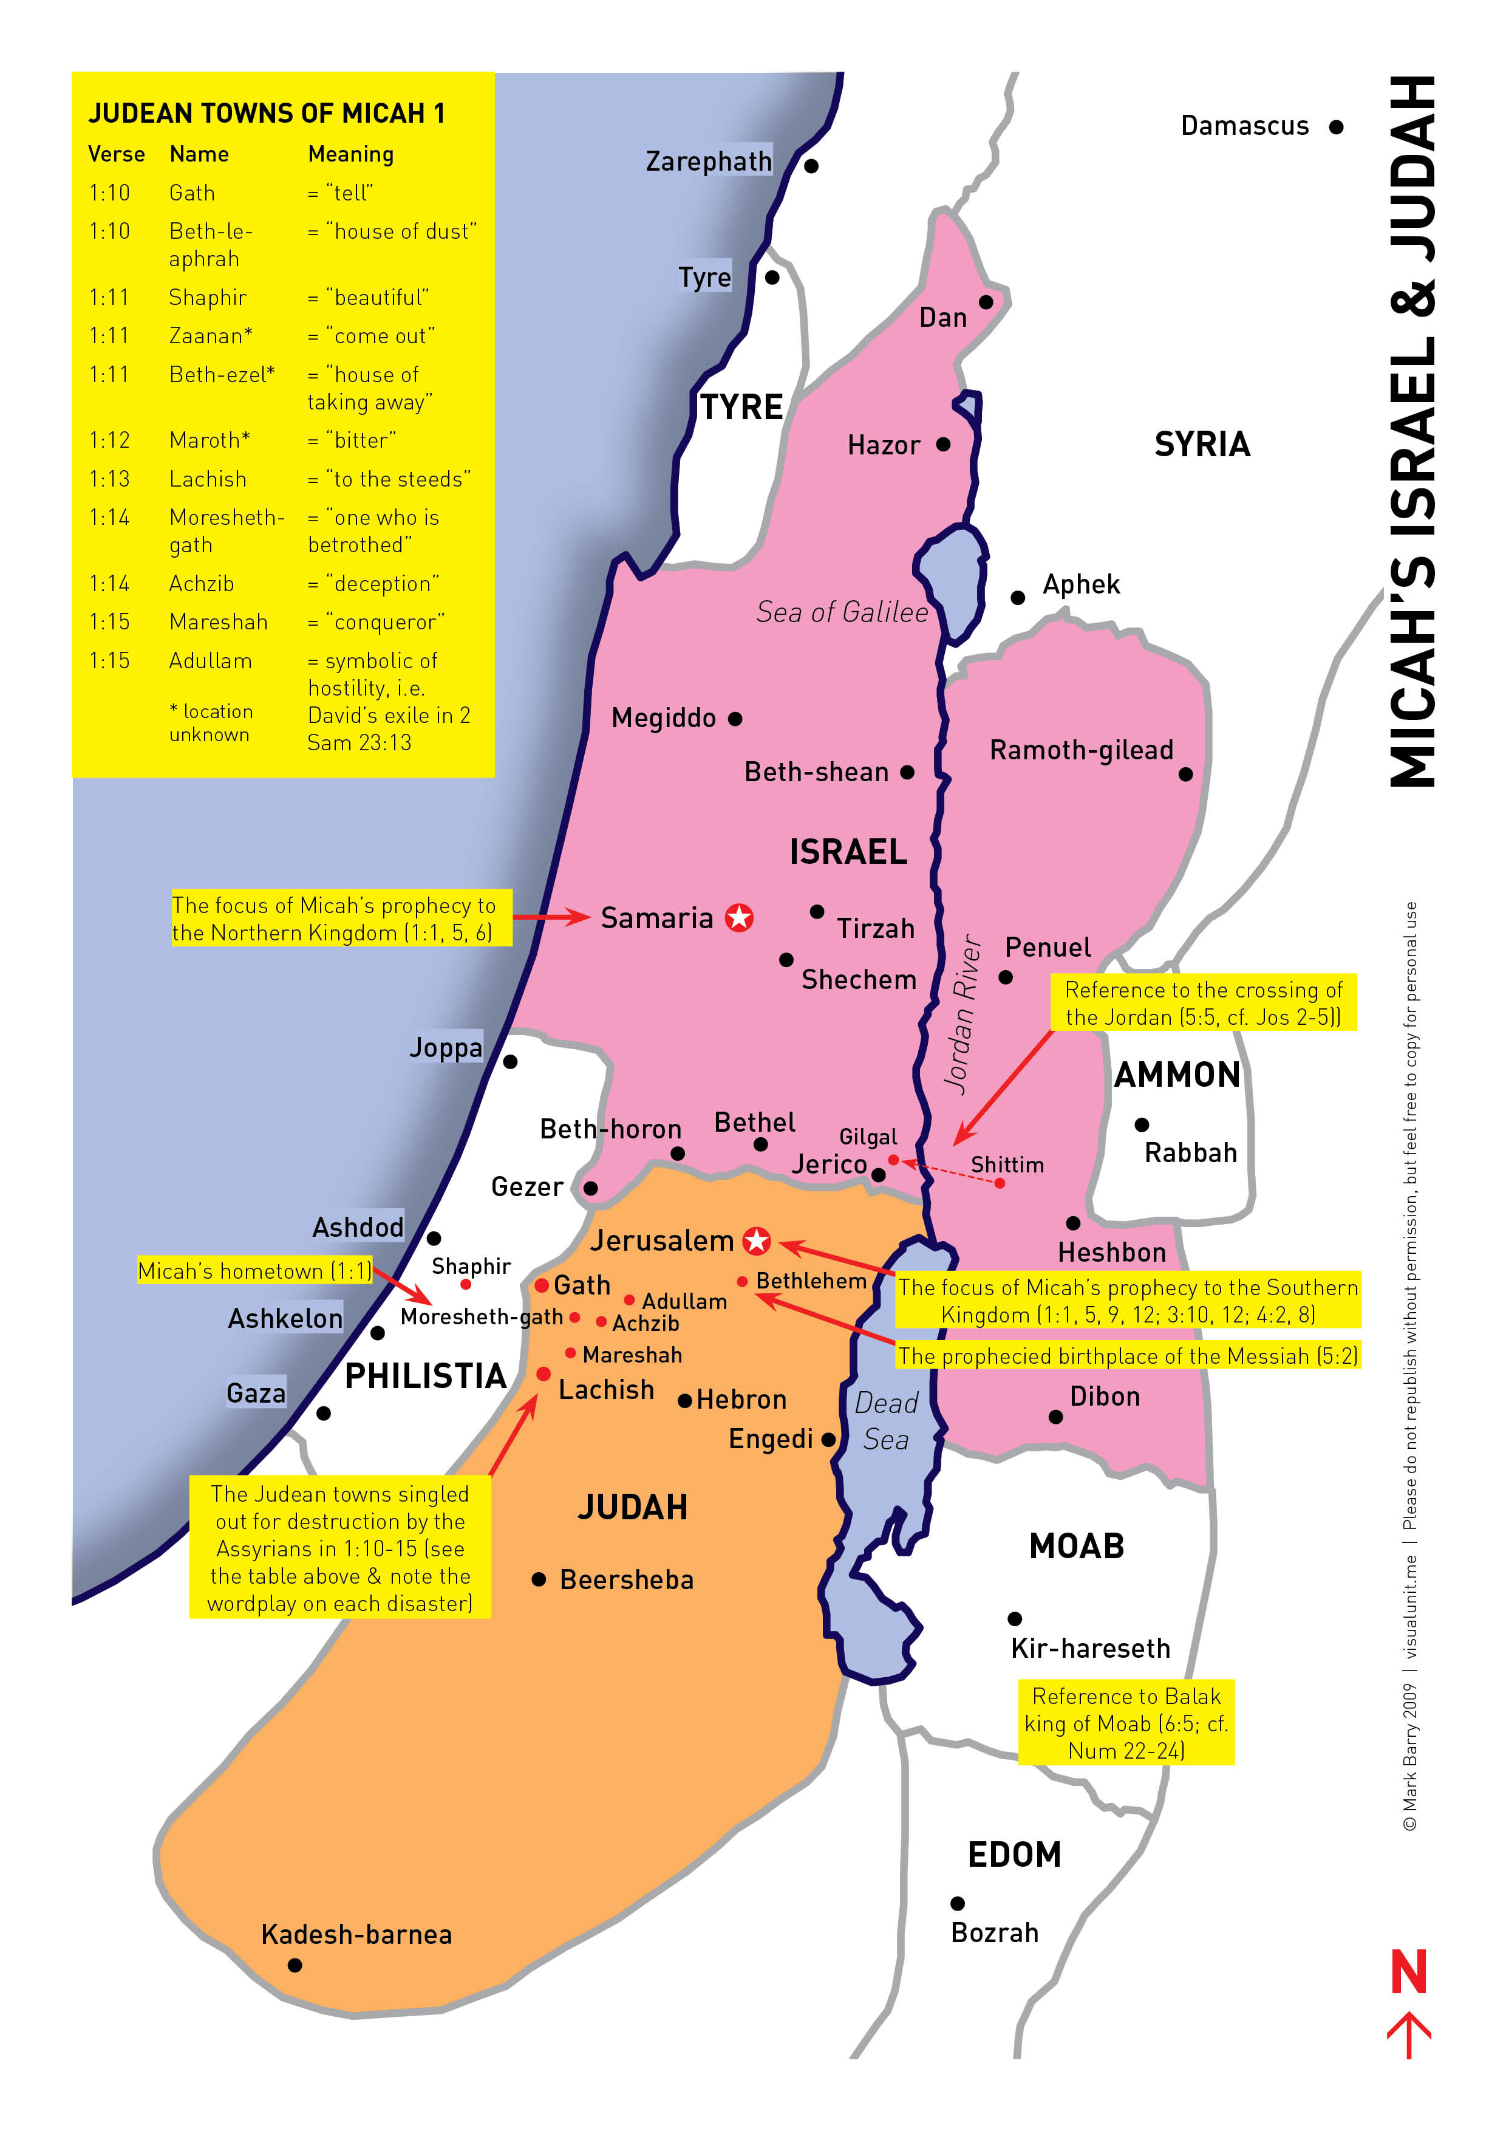
Micah’s Lamentation
“¹⁰Tell it not in Gath, weep not at all. At Beth-le-aphrah roll yourself in the dust. ¹¹Go on your way, inhabitant of Shaphir, in shameful nakedness. The inhabitant of Zaanan does not escape. The lamentation of Beth-ezel: ‘He will take from you its support.’ ¹²For the inhabitant of Maroth becomes weak waiting for good, because a calamity has come down from the Lord to the gate of Jerusalem. ¹³Harness the chariot to the team of horses, o inhabitant of Lachish—she was the beginning of sin to the daughter of Zion—because in you were found the rebellious acts of Israel. ¹⁴Therefore you will give parting gifts on behalf of Moresheth-gath; the houses of Achzib will become a deception to the kings of Israel. ¹⁵Moreover, I will bring on you the one who takes possession, o inhabitant of Mareshah. The glory of Israel will enter Adullam.”
Notes:
As Micah continues his lamentation, the rest of the book will shift mostly toward Judah, and beginning in vs. 10, he’s going to start naming off all kinds of cities that are going to be affected by Assyria’s coming invasion – Mic 1:10-15 – On the surface, there doesn’t appear to be much going on here. Most of the cities he mentions seem to form a circle around his own hometown in that region called the “Shephalah”, those rolling hills that were the “no man’s land” southwest of Jerusalem. But there’s far more to what Micah is doing than meets the English eye.
In these 6 verses, Micah is employing a literary device called “word play”. And this is not apparent unless you know Hebrew or get help from a commentator who knows Hebrew (like I did), but in the original Hebrew, Micah is using sense play, assonances, paronomasias, and other poetic devices, as a clever way of getting the message across to his hearers so that the message would be memorable.

Slide 10
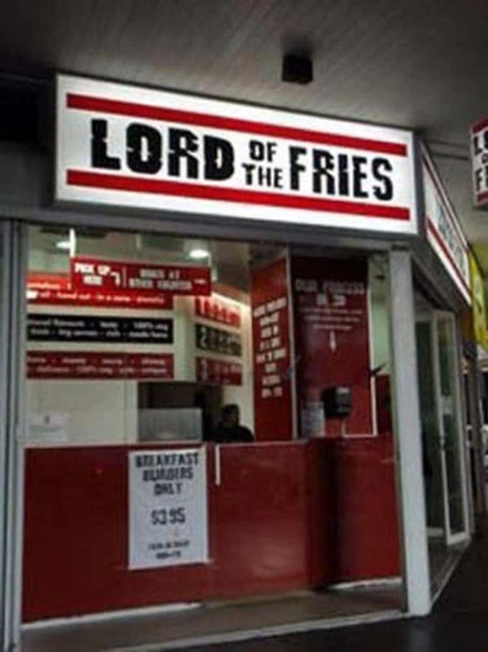
Notes:
Modern-day example – sometimes we’ll run across a business w/a name that was designed to capture people’s attention, while at the same time effectively communicating what their business is about.
.
.
.
This is what Micah is trying to do in his lamentation, minus the humor, because these would all be nations that Assyria would conqueror, and he’s actually doing its citizens a favor by giving them a heads up. And while the word plays unfortunately get lost in translation, it would have been a memorable thing for the Jews of that day.

Slide 11
Micah’s Lamentation
Don’t tell it in “Tell Town” (Gath)
Roll in the dust at “Dust Town” (Beth-le-aphrah)
Be stripped of your beauty “O Beauty Town” (Saphir)
There is no marching from “March Town” (Zanaan)
Mourning in “Neighbor Town” (Beth-ezel) means no more neighbor
“Bitter Town” (Maroth) hoped for better
The “City of Peace” (Jerusalem) awaits war
Bind the racing chariot to the harness, “O Harness Town” (Lachish)
“Betrothed Town” (Moresheth) will give a dowry to the enemy
“Deceptive Town” (Achzib) will be a deception to Judah’s kings
I will bring a conqueror to “Conqueror Town” (Mareshah)
The glory of Israel will find refuge in “Refuge Town” (Adullam)
Notes:
If we were to convert these 12 cities and their puns over into English, here is how they might sound (CLICK):
.
.
.
A good wordplay catches the eye and often communicates an effective message with wit and humor, but especially so that it will be memorable, and this is the biggest thing to get out of this.

Slide 12
Micah’s Lamentation
“¹⁰Tell it not in Gath, weep not at all. At Beth-le-aphrah roll yourself in the dust. ¹¹Go on your way, inhabitant of Shaphir, in shameful nakedness. The inhabitant of Zaanan does not escape. The lamentation of Beth-ezel: ‘He will take from you its support.’ ¹²For the inhabitant of Maroth becomes weak waiting for good, because a calamity has come down from the Lord to the gate of Jerusalem. ¹³Harness the chariot to the team of horses, o inhabitant of Lachish—she was the beginning of sin to the daughter of Zion—because in you were found the rebellious acts of Israel. ¹⁴Therefore you will give parting gifts on behalf of Moresheth-gath; the houses of Achzib will become a deception to the kings of Israel. ¹⁵Moreover, I will bring on you the one who takes possession, o inhabitant of Mareshah. The glory of Israel will enter Adullam.”
Notes:
So, let’s just walk through them quickly.
(CLICK) Mic 1:10a – The word “Gath” means “wine press”, but spelled backwards, it sounds like our English word “tell”. The idea may be that the Philistines would have likely rejoiced over Assyria coming through Judah, so it may be that Micah is saying, “I don’t want to see any crocodile tears from you”. Silence would be a more fitting response given the suddenness of the invasion.
(CLICK) Mic 1:10b – “Beth-le-aphrah” means “house of dust”, and rolling in the dust was a vivid way of express in grief over a humiliating defeat.
Here, Micah plays on the “sense” of the word (CLICK) – Mic 1:11a – “Shaphir” means “beautiful”. The idea is this town which once prided itself in splendor will go forth captive and stripped in shame.
(CLICK) Mic 1:11b – “Zanaan” sounds like the Hebrew word for “do not come out”. The idea is that instead of stepping up to the front lines, they will cower behind the walls.
(CLICK) Mic 1:11c – “Beth-ezel” means “house of taking away”, the idea being that it will have its protection of Judah “taken away” due to being annexed by Assyria.

Slide 13
Micah’s Lamentation
“¹⁰Tell it not in Gath, weep not at all. At Beth-le-aphrah roll yourself in the dust. ¹¹Go on your way, inhabitant of Shaphir, in shameful nakedness. The inhabitant of Zaanan does not escape. The lamentation of Beth-ezel: ‘He will take from you its support.’ ¹²For the inhabitant of Maroth becomes weak waiting for good, because a calamity has come down from the Lord to the gate of Jerusalem. ¹³Harness the chariot to the team of horses, o inhabitant of Lachish—she was the beginning of sin to the daughter of Zion—because in you were found the rebellious acts of Israel. ¹⁴Therefore you will give parting gifts on behalf of Moresheth-gath; the houses of Achzib will become a deception to the kings of Israel. ¹⁵Moreover, I will bring on you the one who takes possession, o inhabitant of Mareshah. The glory of Israel will enter Adullam.”
Notes:
Mic 1:12a – “Maroth” means bitter – you may recall from the book of Ruth that Naomi asked to be referred to as “Mara” because of her bitterness. The idea seems to be that they were waiting for something good, perhaps military aid from Jerusalem, but the enemy marched right up to the gate of Jerusalem, and so Maroth would not be able to escape the fate of its name.
And this is the center of the poem, which ironically happens to be about Jerusalem (CLICK) – Mic 1:12b – “Jerusalem” means “city of peace”, and it was an expected source of strength for the smaller towns in its vicinity. But it will prove impotent when God’s wrath is full because, as we saw in the beginning of the chapter, wrath has come down from God.
(CLICK) Mic 1:13 – The Hebrew word “Lachish” sounds like “to the horses” or “team of horses, the horses being racing horses. The irony is that they are commanded to harness their war chariots to racing horses, symbolizing their retreat rather than their fight. Micah says she was “the beginning of sin” – it may be that since she was the first Judean outpost from Egypt, Lachish would receive Egypt’s horses and chariots before anyone else, and would put too much trust in them (something we see alluded to later in the book). And we do know that Lachish’s might was renowned as Sennacherib’s palace reliefs in Nineveh make them prominent, their capture being a great sense of pride.

Slide 14
Micah’s Lamentation
“¹⁰Tell it not in Gath, weep not at all. At Beth-le-aphrah roll yourself in the dust. ¹¹Go on your way, inhabitant of Shaphir, in shameful nakedness. The inhabitant of Zaanan does not escape. The lamentation of Beth-ezel: ‘He will take from you its support.’ ¹²For the inhabitant of Maroth becomes weak waiting for good, because a calamity has come down from the Lord to the gate of Jerusalem. ¹³Harness the chariot to the team of horses, o inhabitant of Lachish—she was the beginning of sin to the daughter of Zion—because in you were found the rebellious acts of Israel. ¹⁴Therefore you will give parting gifts on behalf of Moresheth-gath; the houses of Achzib will become a deception to the kings of Israel. ¹⁵Moreover, I will bring on you the one who takes possession, o inhabitant of Mareshah. The glory of Israel will enter Adullam.”
Notes:
Mic 1:14a – This is linked to the previous verse – while “Moresheth” means “inheritance”, it sounds like the Hebrew word for “betrothed”. I think the idea is that now that Lachish has been conquered, Judah must now pay tribute to keep Sennacherib from taking anymore cities. She must pay a “dowry” to the city once “betrothed” to them. And this interpretation becomes clearer when your read 2 Kings 18:14-16 and find out that Assyria was in the process of conquering Lachish when Hezekiah decided to pay tribute, cutting off gold from the doors of the temple.
Mic 1:14b – “Achzib” sounds like “deceptive” or “disappointing”. This area was known for its factories that produced pottery and was a source of financial gain for Judah. The idea seems to be that once they’re overrun by Assyria and its employees are taken captive, Judah’s expectations for financial gain would end in disappointment – no wonder Hezekiah was taking money from the temple!
Mic 1:15a – This is the first time Micah mentions a human agent behind Judah’s invasion. The phrase “inhabitant of Mareshah” sounds like the Hebrew word for “conqueror”. God is bringing a conqueror to “Conqueror Town”
Mic 1:15b – “to Adullam” means “to their yoke”, or “refuge”. The idea is that this town, once known for being a miliary bastion, will once again be a place where people run for refuge, as it once was for David when he fled from Saul.
COMMENTS

Slide 15
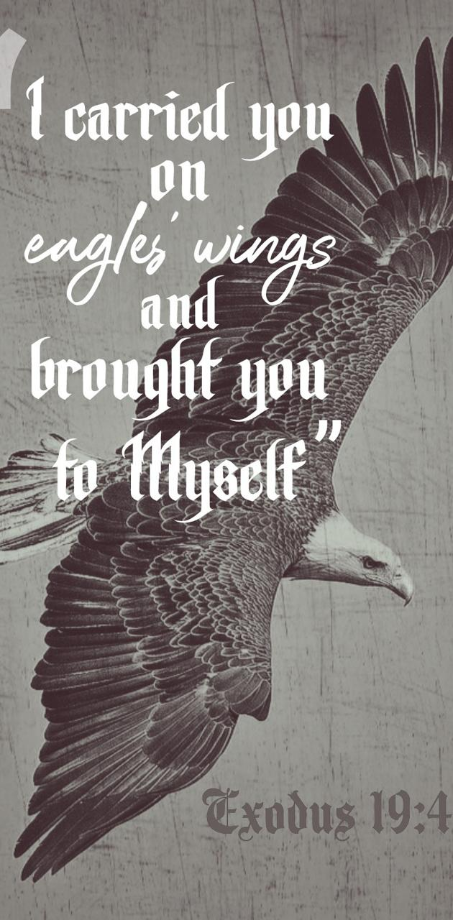
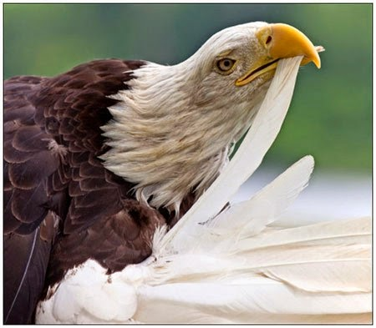
Micah’s Lamentation
Mic 1:16 – “¹⁶Make yourself bald and cut off your hair, because of the children of your delight; extend your baldness like the eagle, for they will go from you into exile.”
Notes:
And so, having spoken of places he’d known since he was a child being ransacked, Micah urges them to mourn as he was mourning – Mic 1:16 – some irony here (CLICK) – God had once rescued them from Egyptians captivity “on eagles’ wings”. Now they’d go into Assyrian captivity as bald as eagles.
The interesting thing about this comparison, though, is that eagles don’t actually go bald. (CLICK) They shed their feathers, a process called “molting”. About every 10 years, when its feathers become too heavy and unfit for flying, it rises high in the sky as close to the sun as it can get, heating its plumage, then it flies as fast as it can into the sea for cooling where its old feathers fall off so that new ones start to come up. This seems to be God revealing the motive behind their coming exile. God’s people are going to happen to shed the bad weight, their sinful habits, through the fire of captivity. And just as the eagle goes through a period of weakness through the shedding of its old feathers until its new feathers come, so would God’s people for a time until they could become new – their descendants would go into exile.

