Slide 1
Notes:
As we begin Mic 5, we’re approaching the heart of the book.

Slide 2
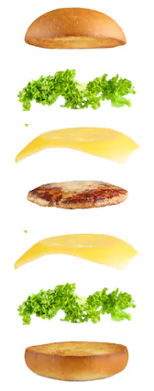
A. Who is like…? (1:1)
B. God’s demolition project (1:2-7)
C. Lamentation (judgment) (1:8-16)
D. Iniquity (coveting) (2:1-6)
E. Misrepresenting God (2:7-11)
F. God will lead them (2:12-13)
G. God strips away (3:1-12)
H. Nations among remnant (4:1-8)
I. Agony in labor (4:9-13)
X. Humiliation & Victory (5:1-2)
I’. Rejoicing in birth (5:3-6)
H’. Remnant among nations (5:7-9)
G’. God strips away (5:10-15)
F’. God led them (6:1-5)
E’. Misrepresenting God (6:6-8)
D’. Iniquity (Omri’s statutes) (6:9-16)
C’. Lamentation (immorality) (7:1-8)
B’. God’s rehabilitation project (7:9-17)
A’. Who is like God? (7:18-20)
Notes:
In our first class, I suggested that Micah can be organized through a chiasm (palistrophe), or “sandwich parallelism”:
The book begins w/the author’s identification (CLICK), Micah, which is an incomplete sentence meaning, “Who is like…?”. But the end of the book completes the sentence (CLICK) in Mic 7:18a – “Who is a God like You…” w/the entirety of the drawing this picture of God. But to complete the picture, (CLICK) we learn that God is planning on a demolition project of both Israel and Judah, (CLICK) prompting a lamentation by Micah. (CLICK) He then mentions the specific iniquity that prompted God’s visit, (CLICK) how the people were misrepresenting God, (CLICK) and that God would inevitably lead His afflicted people to victory against the Assyrian scourge. And the reason is because the current heads were not doing their jobs, (CLICK) and so God would have to strip them completely away along w/the city they had built in bloodshed, reducing the mountain of God’s house to a forest. However, (CLICK) Micah looks into a future in which this mountain would be exalted and all nations among His remnant would stream to it, (CLICK) but that before this plan can be brought to birth, the daughter of Zion is going to have to go through a painful labor process.
(CLICK) And this brings us to the centerpiece, what this labor will ultimately bring about – humiliation, but ultimately victory through the birth of a Savior. And it’s from this centerpiece that all the themes begin to walk back, matching previous sections, which we’ll try to highlight as we finish the book.
PRAYER

Slide 3
Humiliation
Mic 5:1 – “¹Now muster yourselves in troops, daughter of troops; they have laid siege against us; with a rod they will smite the judge of Israel on the cheek.”
Notes:
Now, 4:9-13 ended w/the image of daughter Zion going through a painful labor. The labor would inevitably be successful, but getting there is still going to be a painful process. And when you think about real, physical childbirth, this process is not the most dignifying experience for a woman to go through, is it? Chapter 5 actually begins by acknowledging this (CLICK) – Mic 5:1. Now, what’s the occasion? The text provides us some clues:
Micah uses first-person pronoun “us”, suggesting he’s present.
There’s a siege taking place by an enemy.
And this enemy is using a “rod”, which really helps because in Isa 10:5 (CLICK), God refers to Assyria as the “rod” of His anger, His tool of punishment against Judah to humble them for their sins
So, what biblical event might this be referring to? The same thing we saw at the end of chapter 2 – Assyria’s siege of Jerusalem.

Slide 4
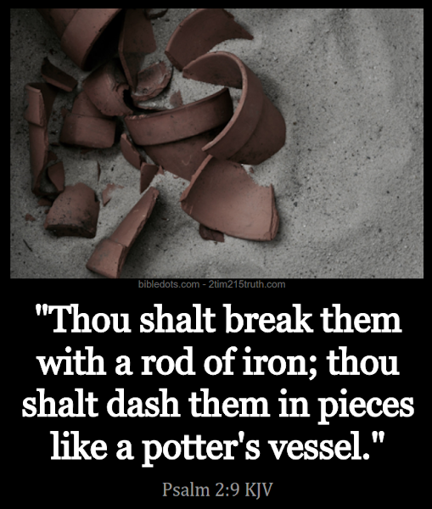
Humiliation
Mic 5:1 – “¹Now muster yourselves in troops, daughter of troops; they have laid siege against us; with a rod they will smite the judge of Israel on the cheek.”
Notes:
That word “troops” denotes a small, remnant army, most likely alluding to that which was gathered behind Jerusalem’s gates. This word suggests the smallness of Zion’s army relative to the host of nations besieging it, and there is an interesting word play going on here that is lost in translation between the words, “rod” and “judge”, which rhyme in the Hebrew. The idea seems to be that the venerable judge of Jerusalem has become Assyria’s whipping boy, shut up behind the city walls w/no one or nowhere left to turn to – this entire scene was an incredibly humiliating situation for Hezekiah and Jerusalem.
And it’s so seemingly backwards. It was the task of Zion’s king to strike the wrongdoer w/the scepter, not the other way around. (CLICK) In Psa 2, God said that He’d be the one to “break the enemy w/the rod of iron” (Psa 2:9). And yet, back in 2:8, God said that it was His people who had arisen as His enemy. So how would Zion recover from this humiliating situation (which they brought on themselves) to all that great stuff we read about in chapter 4 that would come about? What will daughter Zion ultimately give birth to on the other side of all these labor pains?

Slide 5
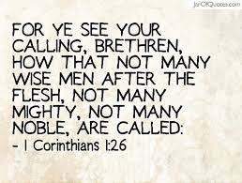
Victory
Mic 5:2-4 – “But as for you, Bethlehem Ephrathah, too little to be among the clans of Judah, from you One will go forth for Me to be ruler in Israel. His goings forth are from long ago, from the days of eternity. ³Therefore He will give them up until the time when she who in labor has borne a child. Then the remainder of His brethren will return to the sons of Israel. ⁴And He will arise and shepherd His flock in the strength of the Lord, in the majesty of the name of the Lord His God. And they will remain, because at that time He will be great to the ends of the earth.”
Born in Bethlehem Ephrathah (Matt 2:5-6; John 7:41-42; 1 Sam 17:12; Ruth 4:11)
Insignificant town
Ruler (1 Cor 1:26-29)
Notes:
It must be someone or something that will make all those labor pains would be worth it. Remember Mic 4:12 – “But they do not know the thoughts of the Lord, and they do not understand His purpose;”. We now arrive at God’s secret strategy (CLICK) – Mic 5:2a.
God’s strategy – Someone special will emerge from Bethlehem Ephrathah. Any guesses who? (CLICK) Jesus Christ, because this verse is attributed to Him in Matt 2:5-6. And John 7 shows that they all knew this is where the Messiah would come from. And that it was the district “Ephrathah” is important because this distinguishes it from another Bethlehem that was in northern Galilee. And several from Jesus’ lineage were from here as well, most notably David and his great grandparents, Boaz and Ruth.
(CLICK) Now, this was a very insignificant town. In Josh 15, after the area parceled out to the tribe of Judah was conquered and Joshua names the cities, Bethlehem Ephrathah wasn’t even in the list, though the Bethlehem in Galilee was named (Josh 19:15). But we know it existed because in Gen 35:19, Jacob and his family were on their way to Bethlehem Ephrathah when Rachel died giving birth to Benjamin. So, it existed since Genesis, but it was a “know-nothing” town.
(CLICK) But God determined it would produce a Ruler of the likes that the world had never seen, showing Israel’s future greatness would only depend on divine intervention to bring greatness out of nothing. Because if God can cause the King of the universe to arise out of the little town of Bethlehem, imagine what he can do for Jerusalem’s present despondent state. Remember, David was considered “least” among His brothers, from the “least” of the clans of Judah, and God made him great (CLICK). That’s God – He specializes in making the unordinary extraordinary.

Slide 6
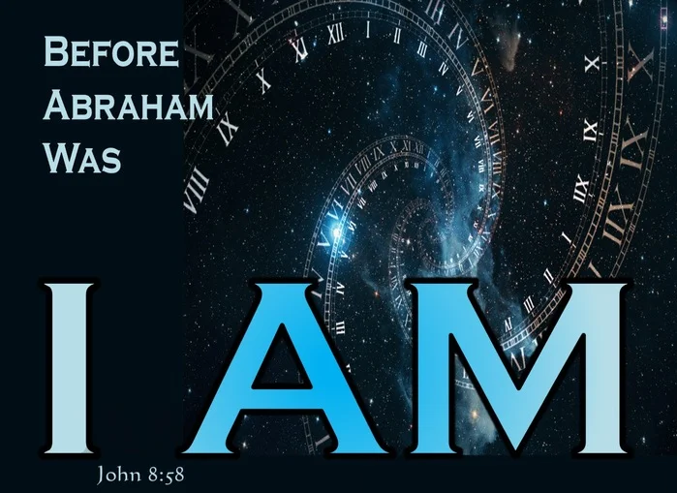
Victory
Mic 5:2-4 – “But as for you, Bethlehem Ephrathah, too little to be among the clans of Judah, from you One will go forth for Me to be ruler in Israel. His goings forth are from long ago, from the days of eternity. ³Therefore He will give them up until the time when she who in labor has borne a child. Then the remainder of His brethren will return to the sons of Israel. ⁴And He will arise and shepherd His flock in the strength of the Lord, in the majesty of the name of the Lord His God. And they will remain, because at that time He will be great to the ends of the earth.”
Born in Bethlehem Ephrathah (Matt 2:5-6; John 7:41-42; 1 Sam 17:12; Ruth 4:11)
Insignificant town
Ruler (1 Cor 1:26-29)
From eternity (John 8:58)
Notes:
But though born in Bethlehem Ephrathah, that isn’t His true origin – Mic 5:2b – There are different terms in the Hebrew language that the Jews use to denote time. One of the terms they use to denote time that can’t be measured is the phrase “yom olam” which means “days of eternity”, but literally translates as the “days beyond the vanishing point”. Meaning, when there is no way to calculate time, they talk about time as “beyond the vanishing point, beyond anything we can understand”. That’s the phrase used here to describe the origin of this Ruler. This is how we know this is no ordinary ruler. Jesus, being God, enters our time space continuum, to be born in the little town of Bethlehem. So, Jesus didn’t begin in Bethlehem; He goes forth from eternity, being preexistent.
This is the centerpiece of Micah – everything in God’s plan, in both administering divine justice and expressing divine love, depends on this Ruler coming forth.
COMMENTS

Slide 7
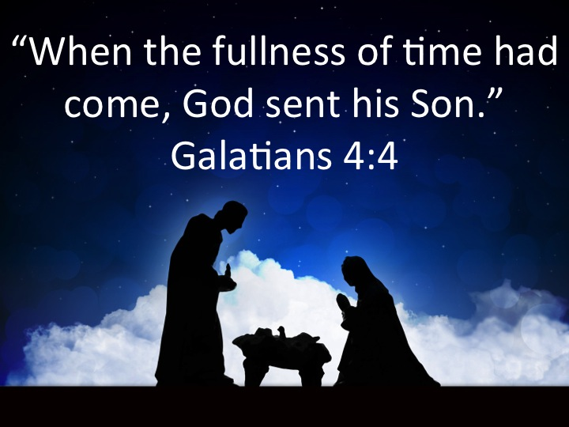
Rejoicing in Birth
Mic 5:2-4 – “But as for you, Bethlehem Ephrathah, too little to be among the clans of Judah, from you One will go forth for Me to be ruler in Israel. His goings forth are from long ago, from the days of eternity. ³Therefore He will give them up until the time when she who is in labor has borne a child. Then the remainder of His brethren will return to the sons of Israel. ⁴And He will arise and shepherd His flock in the strength of the Lord, in the majesty of the name of the Lord His God. And they will remain, because at that time He will be great to the ends of the earth.”
Born in Bethlehem Ephrathah (Matt 2:5-6; John 7:41-42; 1 Sam 17:12; Ruth 4:11)
Insignificant town
Ruler (1 Cor 1:26-29)
From eternity (John 8:58)
From the remnant (Rom 11:5)
Fullness of time (Gal 4:4)
Notes:
Mic 5:3a – He’s continuing the theme from 4:8-10, that Israel will be abandoned to the enemy until this happens, which history confirms, before the remnant that remains would give birth to Jesus. The remnant of Zion would endure labor pains long before Mary ever would.
(CLICK) But then a time would come when the faithful remnant would act as the agent from which the Messiah would come into the world, inaugurating this new Messianic age from 4:1-4. Though from eternity, there was a fullness of time within the space-time continuum in which God determined was the best time to send His Son to the world.

Slide 8
Rejoicing in Birth
Mic 5:2-4 – “But as for you, Bethlehem Ephrathah, too little to be among the clans of Judah, from you One will go forth for Me to be ruler in Israel. His goings forth are from long ago, from the days of eternity. ³Therefore He will give them up until the time when she who in labor has borne a child. Then the remainder of His brethren will return to the sons of Israel. ⁴And He will arise and shepherd His flock in the strength of the Lord, in the majesty of the name of the Lord His God. And they will remain, because at that time He will be great to the ends of the earth.”
Born in Bethlehem Ephrathah (Matt 2:5-6; John 7:41-42; 1 Sam 17:12; Ruth 4:11)
Insignificant town
Ruler (1 Cor 1:26-29)
From eternity (John 8:58)
From the remnant (Rom 11:5)
Fullness of time (Gal 4:4)
Prodigals return (Matt 12:50)
Notes:
And this is when all the agony of labor will turn to rejoicing – Mic 5:3b – So He will have a people, specifically “brethren”. And who are the Messiah’s family? (CLICK) – Matt 12:50. Judah’s problem wasn’t just the presence of its enemy, but the shrinking of God’s true people. How this will happen was explained in 4:9-10. But when the Messiah comes, something about who He is and what He would do will cause people to stream up that mountain from 4:1 just to get to Him and be part of His family.

Slide 9
Rejoicing in Birth
Mic 5:2-4 – “But as for you, Bethlehem Ephrathah, too little to be among the clans of Judah, from you One will go forth for Me to be ruler in Israel. His goings forth are from long ago, from the days of eternity. ³Therefore He will give them up until the time when she who in labor has borne a child. Then the remainder of His brethren will return to the sons of Israel. ⁴And He will arise and shepherd His flock in the strength of the Lord, in the majesty of the name of the Lord His God. And they will remain, because at that time He will be great to the ends of the earth.”
Born in Bethlehem Ephrathah (Matt 2:5-6; John 7:41-42; 1 Sam 17:12; Ruth 4:11)
Insignificant town
Ruler (1 Cor 1:26-29)
From eternity (John 8:58)
From the remnant (Rom 11:5)
Fullness of time (Gal 4:4)
Prodigals return (Matt 12:50)
Shepherd (John 10:11)
Strong (Isa 42:4; 50:9a)
Secure the sheep (John 10:15)
He would be great (Phil 2:9)
Notes:
And He’s more than happy to receive them – Mic 5:4a – Image of a king assuming his new rulership, and it is a “shepherd” leadership which the NT validates.
How will He do it? (CLICK) – Mic 5:4b – He will not be hindered by human weakness. The Messiah’s descendants failed to endure because they put their trust in the wrong “strength” (5:10-11). That won’t happen here.
(CLICK) And that’s why… – Mic 5:4c – That word “remain” literally means “secure”, continuing the theme of 4:4 that the Messiah’s people will each sit under his vine and under his fig tree. The Good Shepherd’s flock dwells safely w/o fear from enemies because of His more than capable leadership.
(CLICK) Mic 5:4d – That confirms what Isaiah said, that kings would shut their mouths on account of Him. How great is Jesus Christ? We calculate time based on his birth, that’s how great to the end of the earth He has become.

Slide 10
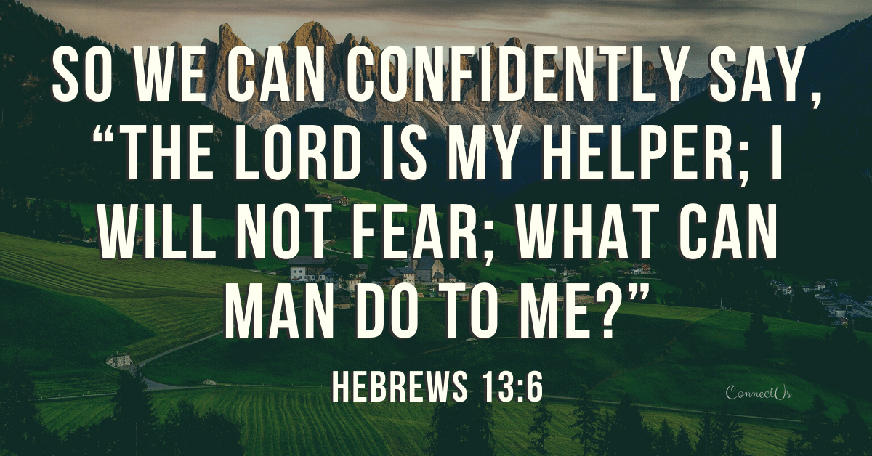
Rejoicing in Birth
Mic 5:5-6 – “⁵This One will be our peace. When the Assyrian invades our land, when he tramples on our citadels, then we will raise against him seven shepherds and eight leaders of men. ⁶They will shepherd the land of Assyria with the sword, the land of Nimrod at its entrances; and He will deliver us from the Assyrian when he attacks our land and when he tramples our territory.”
Born in Bethlehem Ephrathah (Matt 2:5-6; John 7:41-42; 1 Sam 17:12; Ruth 4:11)
Insignificant town
Ruler (1 Cor 1:26-29)
From eternity (John 8:58)
From the remnant (Rom 11:5)
Fullness of time (Gal 4:4)
Prodigals return (Matt 12:50)
Shepherd (John 10:11)
Strong (Isa 42:4; 50:9a)
Secure the sheep (John 10:15)
He would be great (Phil 2:9)
Our peace (Gen 49:10; Isa 9:6)
Produces shepherds
Notes:
Mic 5:5a – Consequent to securing Israel by extending His kingdom to the ends of the earth, the Messiah becomes our source of abiding peace. And this is important, because things are not always easy on this earth, particularly for God-fearers.
Hence, these next verses, which because of its obscurity needs to be read together (CLICK) – Mic 5:5b-6 – Couple issues, especially because of the constant change of pronouns – if this section is talking about the Messiah, why does Assyria reenter the picture? And if it’s talking about the Messianic age, how do you make the “sword” mesh w/4:3 where we’re told they would hammer their swords into plowshares? I think the clue is in the synonymous parallelism employed in vs. 6 in which He qualifies “the land of Assyria” w/ “the land of Nimrod”. It’s in Gen 10 where we learn that Noah had a great-grandson named “Nimrod” who was great in all the earth. Not only did he found Babylon, but he also built Nineveh. It’s safe to say that this guy was the founder of all the major Mesopotamian nations who were the predatorial enemies of the known world. I’d suggest Assyria is only being used as a symbol of the deadliest enemies to God’s people, and projecting that into the future.
Point: No matter who the enemy is or where he comes from, Jesus’ coming is going to cultivate a people just like Him, shepherds. And rather matching blow for blow, I believe this sword will be the word of God. “Swords into plowshares…” – a plowshare cuts turf; it loosens soil. The idea is that now matter how much the enemy attacks us, we ultimately conqueror them the way Jesus conquered us – loving our enemies, praying for them, etc. And He gives us every resource to do it, which is what he means by “seven shepherds, eight leaders” – it’s similar to the expression “infinity plus one”. What God gives us to conqueror the enemy is perfect and then some. (CLICK) And that abiding peace in midst of the enemy’s attack remains because Jesus was raised from the dead – “what can man do to me?”
Point: what comes out of little Bethlehem will be far greater than came out of Nimrod.
COMMENTS

Slide 11
Remnant Among Nations
Mic 5:7-9 – “⁷Then the remnant of Jacob will be among many peoples like dew from the Lord, like showers on vegetation which do not wait for man or delay for the sons of men. ⁸The remnant of Jacob will be among the nations, among many peoples like a lion among the beasts of the forest, like a young lion among flocks of sheep, which, if he passes through, tramples down and tears, and there is none to rescue. ⁹Your hand will be lifted up against your adversaries, and all your enemies will be cut off.”
2 Cor 2:14-16 – “¹⁴But thanks be to God, who always leads us in triumph in Christ, and manifests through us the sweet aroma of the knowledge of Him in every place. ¹⁵For we are a fragrance of Christ to God among those who are being saved and among those who are perishing; ¹⁶to the one an aroma from death to death, to the other an aroma from life to life. And who is adequate for these things?
Notes:
Now, 4:1-8 talked about the many nations among the remnant that would stream up to the mountain of the house of the Lord. Micah will now talk about what it will be like w/the remnant living amongst the nations (CLICK) – Mic 5:7 – The first description is like “dew, showers on vegetation”. If you recall from passages like Isa 35, sin is pictured as turning us into a barren, parched wasteland. But when Christ comes, He would bring “streams of water” (Isa 35:7). This denotes the penetrating and pervasive influence that the remnant would have among the spiritually dehydrated nations, a constant source of refreshing for parched souls. And that it doesn’t wait or delay for men means it is in season and out of season – it’s present whether mankind asks for it or not.
2nd description (CLICK) – Mic 5:8 – This suggests a 2-fold ministry. The remnant will be a source of salvation to some, but they will also be an instrument of destruction to others. God told Abraham this in Gen 12, that He’d bless those who blessed him and curse those who cursed him, (CLICK) but we see this same truth repeated in the NT in 2 Cor 2:14-16. Some will won’t it, others won’t. To some, gospel preaching will save them, to others, it will contribute to their destruction. Either way, God’s word achieves its goal.
And God really wants this last point pressed as a way to encourage His remnant – Mic 5:9 – Meaning, the war is already won. People can either be captured by the cross or cut off completely. Either way, every adversary to Jesus is defeated in some capacity. And if one happens to be on the bitter end of things, God’s judgment will be inescapable.
COMMENTS

Slide 12
God Strips Away
Mic 5:10-15 – “¹⁰‘It will be in that day,’ declares the Lord, ‘That I will cut off your horses from among you and destroy your chariots. ¹¹I will also cut off the cities of your land and tear down all your fortifications. ¹²I will cut off sorceries from your hand, and you will have fortune-tellers no more. ¹³I will cut off your carved images and your sacred pillars from among you, so that you will no longer bow down to the work of your hands. ¹⁴I will root out your Asherim from among you and destroy your cities. ¹⁵And I will execute vengeance in anger and wrath on the nations which have not obeyed.’”
Notes:
Now, notice that phrase “cut off” in vs. 9. Were nations such as Assyria the real issue that needed dealt with? No, they were the punishment sent by God for the sin of His people. The true adversary to God’s people has always been anything and everything that replaced faith in God. This section matches chapter 3, in which God would strip away everything from Judah, rendering them w/nothing, in order to get them to seek Him. In this matching section that concludes the chapter, God will strip away again. But because Micah begins this section w/“in that day”, I’d suggest that rather than stripping away by force, these things will instead be stripped away as a consequence of Jesus’ work.
(CLICK) Mic 5:10-14 – So every element of pride, whether military (offensive security), fortifications (defensive security), and all trust in pagan, spiritual forces – meaning not only does all the hardware need to go, but all the software, too. (CLICK) Everything man constructs w/its hands to replace God has to go, because it all attempts to reduce the transcendent majesty of God and confine Him to some manageable size and measurable certainty. No, if 5:4 is true, that the Messiah will be great to the ends of the earth, everything that competes w/that greatness must go through a liquidation sale, so that all our resources can be used toward serving God’s purposes.
(CLICK) Mic 5:15 – In other words, the real issues were what He lists in vs. 10 – 14. Once they take care of the root problem, only when all barriers between He and His people are cleared away will God then bring judgment on the nations. They wanted this first, of course, but they can’t have their cake and eat it, too. Only when Zion is purged of all distractions to faith.

