Slide 1
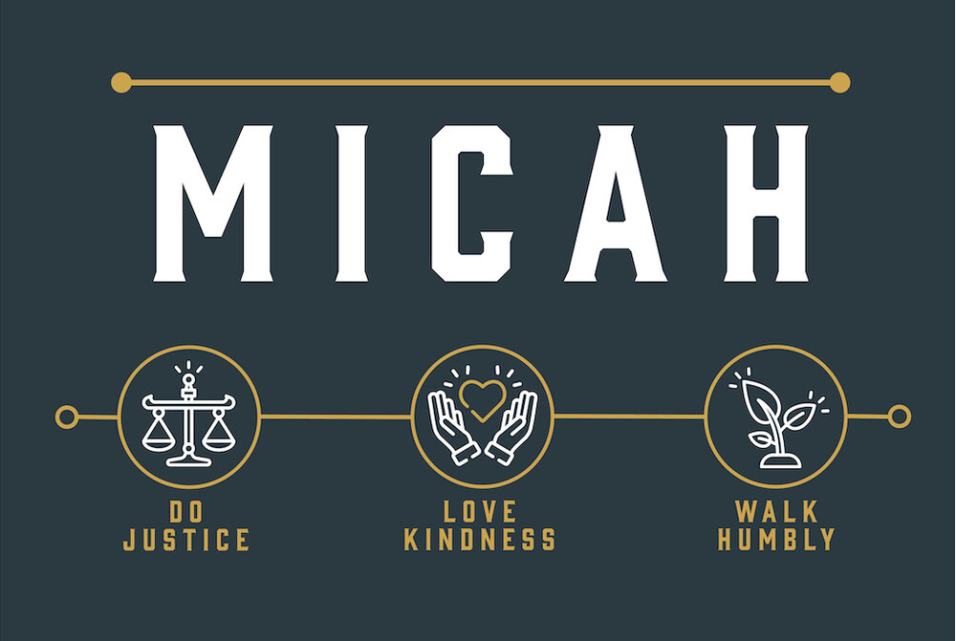
Notes:
As we begin Mic 6, let’s keep in mind what we’ve seen so far. In Mic 1 – 3, we see the nature of the problem. God’s people have become covetous, robbing and defrauding their fellow man of what God had freely given them. The leaders, rather than administering justice, were accomplices. And so, God is going to have to send the Assyrian empire to purge the land of the evil doers, but He won’t allow them to touch His remnant, as God Himself will be their head and shepherd them personally.
Then in Mic 4 – 5, we get a glimpse into the future, that as bad as things are in Zion, there would come a day when all nations would stream to it in order to learn about God, and there’d be peace. But prior this, Zion will go through some pretty significant labor pains. Toward what end? To bring a Ruler into the world who will set everything right and to shepherd a people who’d want to be like Him. And this will usher in a desire to rid themselves of every idol that would compete w/the greatness of this Good Shepherd. This is the centerpiece of the book.
But that would be in the future, because in chapter 6, Micah reminds them that the present crisis of sin remains. And this chapter is going to address one simple question – “Whose fault is it”? Mic 6 begins w/what appears to be a litigation speech designed to prove Judah’s guilt and exonerate God.
PRAYER

Slide 2
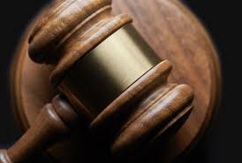
God Led Them
Mic 6:1-2 – “¹Hear now what the Lord is saying, ‘Arise, plead your case before the mountains, and let the hills hear your voice. ²Listen, you mountains, to the indictment of the Lord, and you enduring foundations of the earth, because the Lord has a case against His people; even with Israel He will dispute.”
Notes:
Mic 6:1-2 – “Arise” sounds like a court coming to order, doesn’t it? (“All rise”). That’s exactly what it means, and it is a masculine, singular imperative, and not to be a grammar Nazi, this just means it is being addressed to Micah. (CLICK) So, in this court scene, God is the plaintiff, Israel is the defendant, and Micah is the prosecuting attorney who will plead God’s case.
Also, the mountains/hills are the witnesses. Why? Because the mountains were there when the covenant was originally made. Remember from Ex 20 that it was from Mt. Sinai that the law was originally given. In Josh 8, it was on Mt. Ebal and Mt. Gerizim where the people stood and recited the words of the Law. The idea is that these are the oldest, most enduring objects of the earth who were there when the people promised to serve God and who where also there when they broke the covenant. (CLICK) Joshua did the same in Josh 24:26-27. And so, though inanimate, they serve as the best witnesses to God’s case against Israel, having been silent observers to all their history.

Slide 3
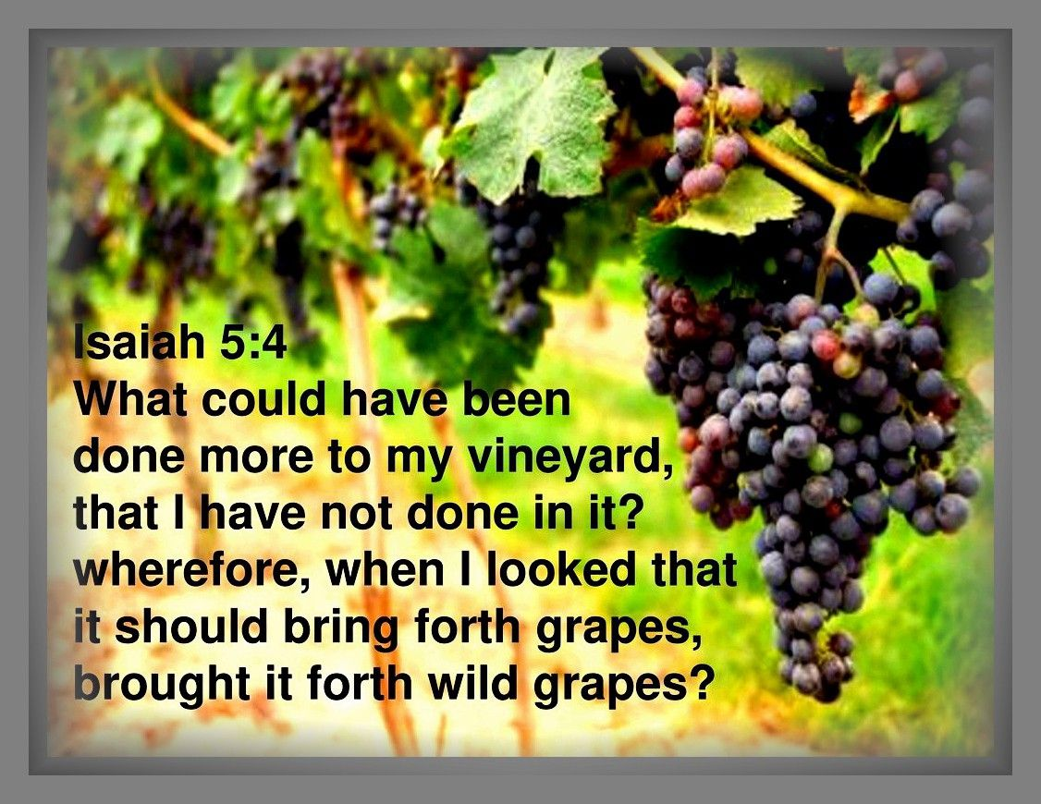
God Led Them
Mic 6:3 – “³My people, what have I done to you, and how have I wearied you? Answer Me.”
Notes:
And so, Micah, as Gods attorney, will present God’s case. And in these next verses, we really get a window into God’s troubled heart as to what to do about His people. The prosecution opens w/two questions:
Mic 6:3a – Answer? Nothing but good – He blessed them and blessed them. So, this is a defensive question designed to protect God’s innocence, as if He needed to. But this is further proof that God is willing to come down to mankind’s level if it means helping them.
The second question is designed to take the initiative away from Israel and put her on the defense – Mic 6:3b – See, Israel likely thought they had a charge against God for the burdens they were experiencing and the rejecting of their sacrifices, but in reality, it was Israel who had wronged the Lord. He’s done everything for them, but they perceive Him as some kind of wearisome burden.
He then says, “Answer Me” – similar to what a parent would say to a child when the child is guilted into silence.

Slide 4
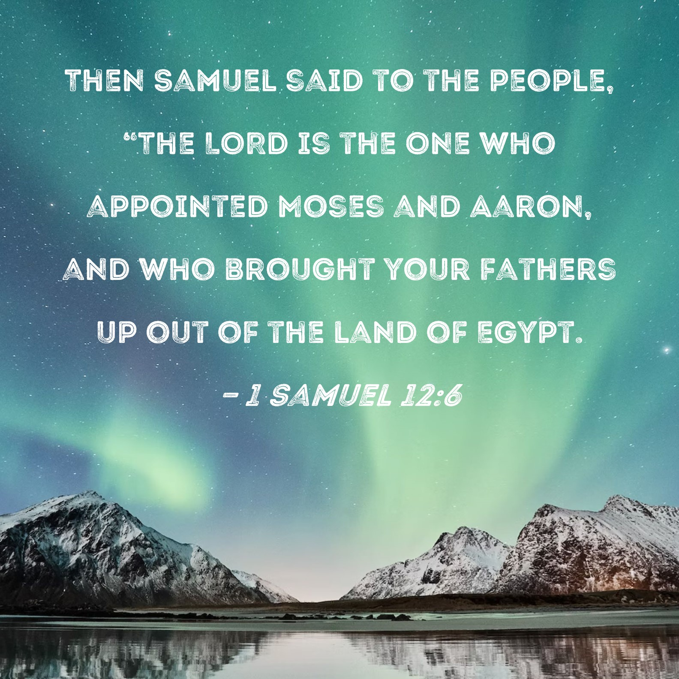
God Led Them
Mic 6:4-5 – “⁴Indeed, I brought you up from the land of Egypt and ransomed you from the house of slavery, and I sent before you Moses, Aaron and Miriam. ⁵My people, remember now what Balak king of Moab counseled and what Balaam son of Beor answered him, and from Shittim to Gilgal, so that you might know the righteous acts of the Lord.”
Notes:
And here’s the evidence why the people have absolutely no case – not only did He not do them evil, He did them an enormous amount of good (CLICK) – Mic 6:4 – 2 benevolent acts:
He rescued them from Israel – The Exodus was the first event of a chain of blessings, the first gift that carried w/it the promise of other blessings to come. God didn’t just bring them “out” of Egypt, but “up”, a prelude to the Promise Land. “ransomed” = redeemed, the act of freeing someone bound by legal obligation by the payment of a price. They were slaves, and He took pity on them and freed them from their chains. What a great God!
He provided them superior leadership – Moses, Aaron, and Miriam – great leaders that were a stark contrast from those leaders/heads we read about in chapter 3. (CLICK) Samuel used this same strategy in 1 Sam 12 when he rebuked the nation for their sin. And what’s so ironic is that as great as these leaders were, each and every one of them were overburdened in leading the people, which led to moments in which their own faith lacked – Moses when he struck the rock instead of speaking to it (Num 20:1-13), Aaron w/the golden calf (Ex 32:1-6), and Miriam when she criticized Moses’ marriage (Num 12:1-15), which though it doesn’t appear on the surface the people’s fault, there had been so much grumbling and criticizing already, it had likely become a contagion. This is further proof that whatever poor leadership existed was not due to a lack of God’s grace and power, but their corrupt hearts and faithlessness.

Slide 5
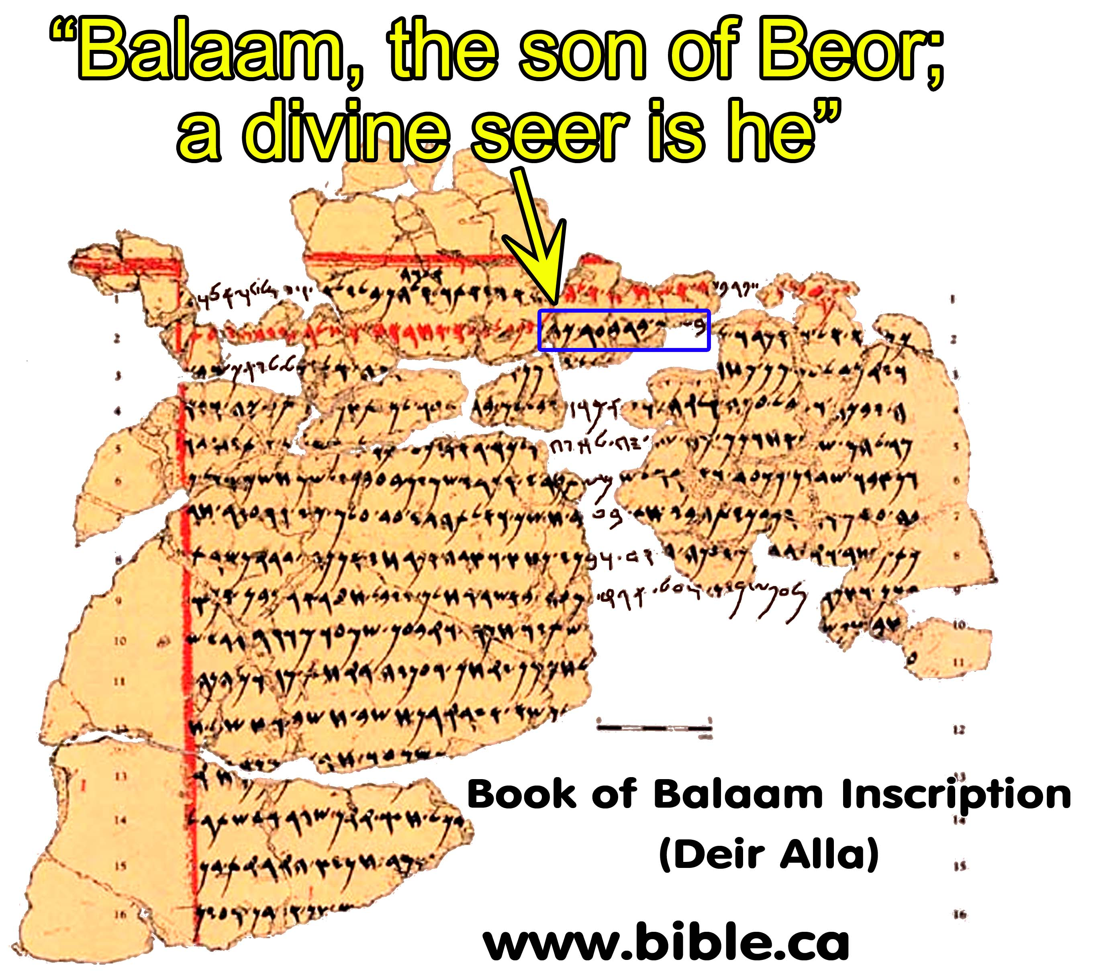
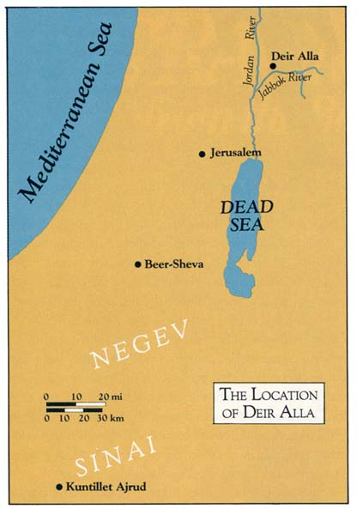
God Led Them
Mic 6:4-5 – “⁴Indeed, I brought you up from the land of Egypt and ransomed you from the house of slavery, and I sent before you Moses, Aaron and Miriam. ⁵My people, remember now what Balak king of Moab counseled and what Balaam son of Beor answered him, and from Shittim to Gilgal, so that you might know the righteous acts of the Lord.”
Notes:
Mic 6:5 – So just as God used three prophets to lead Israel, He denied the prophet Balaam 3 times by turning His curse into a blessing, and three times the angel resisted the donkey. (CLICK) This picture on the left is called the “Balaamite inscription”, and it was found at Tel Deir in 1967, and dates to Micah’s time. According to scholars, it was written by a colony of exiles who had been deported there by the Assyrians from one of the Aramean states in northern Syria. Balaam was a very well-known seer, and the presence of this colony in Transjordania would have caused Micah’s audience to fear Assyria. But God is asking them to think back on the prior centuries when He allowed Israel to prevail over the dreaded Balak and Balaam.
Now, the incident w/Balaam and Balak occurred at Shittim, but we also learn in Num 25:1 that this was where they broke God’s covenant by succumbing to Moabite idolatry. Gilgal was where their crossing at the Jordan occurred. So, not only is it a summary of “slavery to conquest” or “promise to fulfillment”, but “near damnation at the very edge of the promised land to military conquest”.
Point – the issue is not God, but Israel. It was God who save them from Pharaoh, God who saved them from Balaam and Balak, and then God who saved them from their own rebelliousness. These were “righteous” acts of the Lord, meaning God did right by them when Israel was the one not fulfilling its covenant obligations. The issue isn’t that God is guilty of having done them wrong. The issue is their ingratitude and unbelief. The Lord was faithful to them, but they did not reciprocate this faithfulness. And makes them unable and unqualified to broker the kind of peace w/the nations that would lead to the events of Mic 4 and 5. Someone more righteous than they would have to broker that peace.
COMMENTS

Slide 6
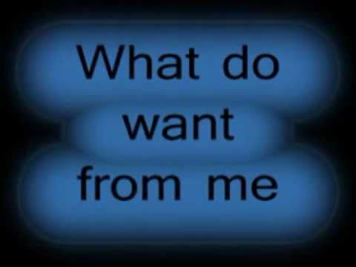
Misrepresenting God
Mic 6:6-7 – “⁶With what shall I come to the Lord and bow myself before the God on high? Shall I come to Him with burnt offerings, with yearling calves? ⁷Does the Lord take delight in thousands of rams, in ten thousand rivers of oil? Shall I present my firstborn for my rebellious acts, the fruit of my body for the sin of my soul?”
Notes:
Now, court is still in session, and here is the people’s defense (CLICK) – Mic 6:6 – ever got into a heated argument w/your spouse or your kids and as you start pointing fingers, they say, (CLICK) “What do you want from me? Just tell me what you want!” I think that’s what’s happening here. “Ok Lord, just tell me what I can do to appease you. What can I bring to a meeting w/you to secure your favor?” But they’re not asking this question as people part of a covenant, but as if part of some generic contract, because these are not sincere questions of how they can love God better or be what they need to be for Him. Rather, (CLICK) “Ok, God, surely you can be bought – just name your price!” Notice what they’re willing to offer:
“Burnt offerings” – this was a real sacrifice because this was a wholly consumed offering, minus the hide. “Yearling calves” – these were highly esteemed due to their tender meat. “What do you want from us, God? Do you the entire animal or just the most valuable/esteemed one?
But then they turn from quality to quantity (CLICK) – Mic 6:7a – Did you notice the increase in hyperbole? We know Solomon offered thousands of sacrifices at the dedication of the temple, but ten thousand rivers of oil? That’s rather absurd, isn’t it? So, again, I’d suggest that rather than these being honest questions, it’s Israel being defensive and trying to paint God as unreasonable in His prosecution of their sin.
And then it turns more exaggerated/extreme (CLICK) – Mic 6:7b – Now they’re getting personal, as that phrase “fruit of my body” is intended in the poetic structure to intensify “firstborn”. “Do you want from us what you took from Pharaoh and Egypt?” Well, no, God saved them so they wouldn’t have to offer their firstborn.
Point: Them raising the price is not reflection of their piety, but rather a veiled complaint that God demands too much. They don’t think they need to change, they think God needs to change – “You just ask so much from us! Nothing will satisfy You! You are unreasonable!”

Slide 7
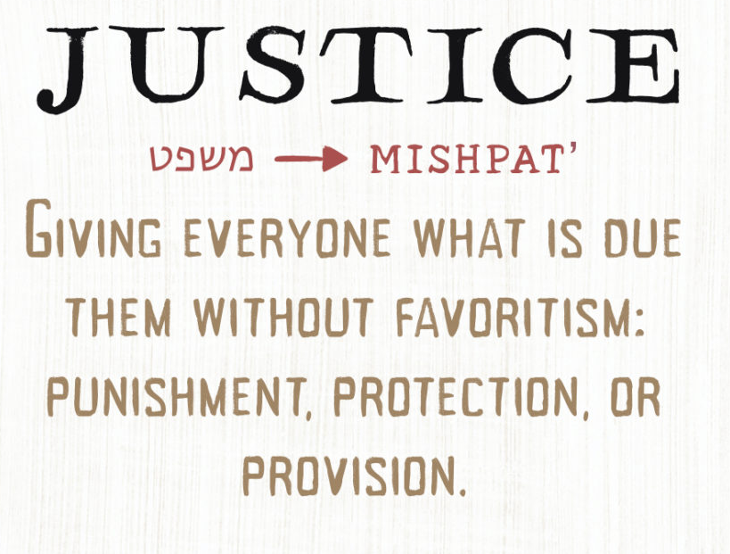
Misrepresenting God
Mic 6:8 – “⁸He has told you, O man, what is good; and what does the Lord require of you but to do justice, to love kindness, and to walk humbly with your God?”
Amos 3:3 – “Do two men walk together unless they have made an appointment?”
Notes:
But here’s the Plaintiff’s response – Mic 6:8a – Meaning, there’s no way Micah is going to let Israel turn the tables or to chalk this thing up to ignorance. The Law was clear in what God wanted. But since the priests were not instructing the people, as we learned in chapter 3, the prophet has to pick up where they miscarried. This word “man” is the same word for “Adam”, which is interesting, because we know from Gen 1 that everything God created in the garden for man was “good”. And how did He pronounce it after creating man on day 6? He said it was “very good”. Point: all God is asking from man is what He has done for man Himself.
Mic 6:8b – “justice”, the Hebrew word “mishpat” – generally speaking, this is to act toward man according to God’s divine standard of righteousness, and w/fairness and equity. This is especially necessary for those in superior, social positions, that they can step in and deliver the weaker/wronged and punish the oppressor. This is one of those “weighty” matters to God – Matt 23:23. Upholding justice in society demands sacrifice in a more personal way than offering animals. Because what do you have to do to show justice? You have to have the courage to put yourself out there, the decency to say no to bribes, you have to be willing to put principle before passion, not allow personal relationships or family relationships to cause you to become partial, etc. That is sacrifice. Interesting how they were more than willing to part w/their animals but not “themselves”.
Mic 6:8c – “kindness” – this is the common Hebrew word “hesed”, which is also translated as “mercy” or “loyalty”. It commonly occurs in contexts where one party finds himself in a weaker position and is utterly dependent upon the stronger party to meet his need. So, these first two terms go together, because while “justice” puts the emphasis on the action, “kindness” puts the emphasis on the attitude behind the action. Those in a weaker position should be helped not reluctantly, but out of generosity and grace, just as Israel herself was delivered by God
Mic 6:8d – “walk humbly” – while the first two are oriented toward their fellow man, this one is oriented toward God. “humbly” means “circumspectly” or “carefully”. It’s the idea of sharing a common set of values, engaging in the same things God does. Being in perfect alignment and agreement together.
Point: Micah isn’t eliminating sacrifice – he’s simply showing what real sacrifice looks like. He wants the life of the worshipper over the animals – 1 Sam 15:21 – “Has the Lord as much delight in burnt offerings and sacrifices as in obeying the voice of the Lord? Behold, to obey is better than sacrifice, and to heed than the fat of rams.”
COMMENTS

Slide 8
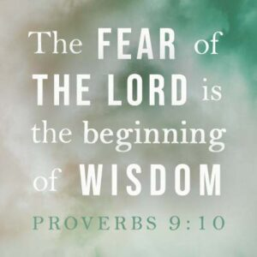
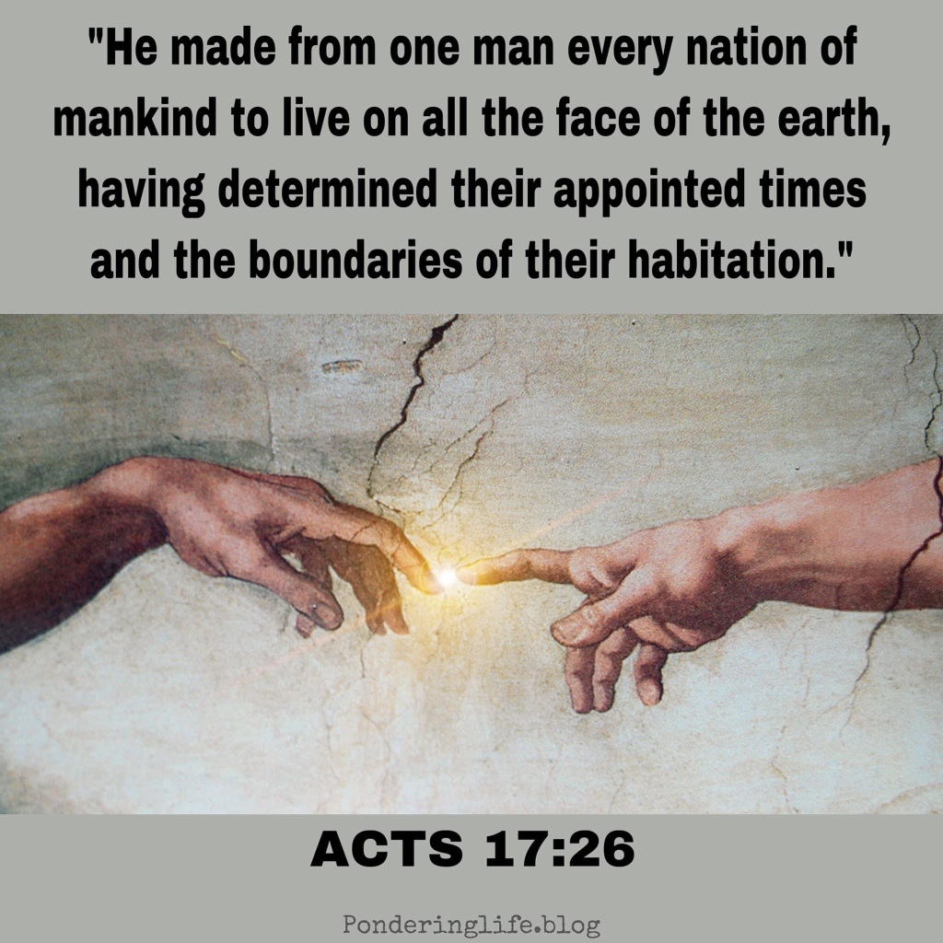
Statutes of Omri
Mic 6:9 – “⁹The voice of the Lord will call to the city—and it is sound wisdom to fear Your name: ‘Hear, O tribe. Who has appointed its time?”
Notes:
So, the previous verses are what He required. These next verses are what they have been doing. They have no case against God whatsoever, and so God now presents His case against His people. (CLICK) – Mic 6:9a – So, again, Micah is the prosecuting attorney acting as the herald for God’s message, proclaiming w/a loud voice to attract attention to bring the audience in contact w/the speaker. And as a parenthetical to exhort them to the seriousness of listening, he tells them (CLICK) – Mic 6:9b – meaning, while the bulk of the population would hear Micah, only the wise would actually heed it.
Mic 6:9c – Meaning, who holds their future in His hands? God. Why is it important the know this first?

Slide 9
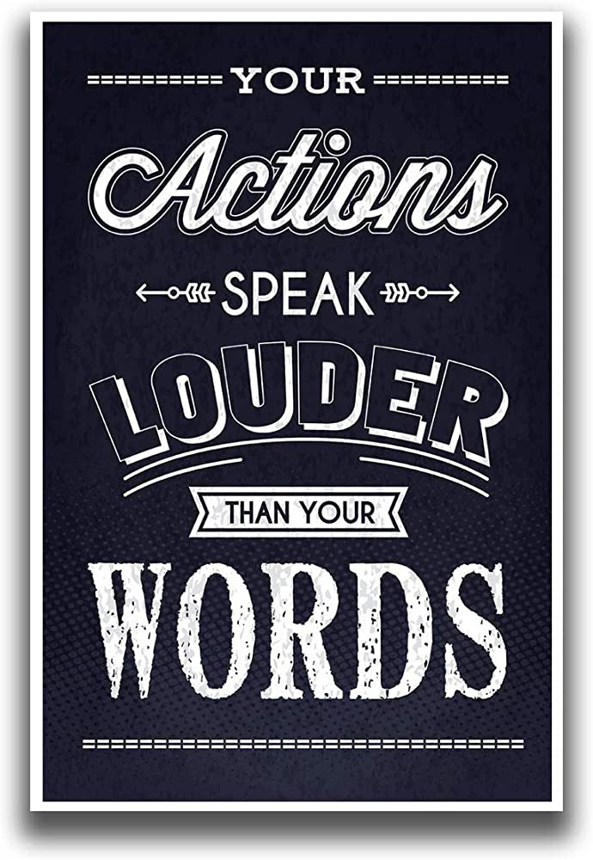
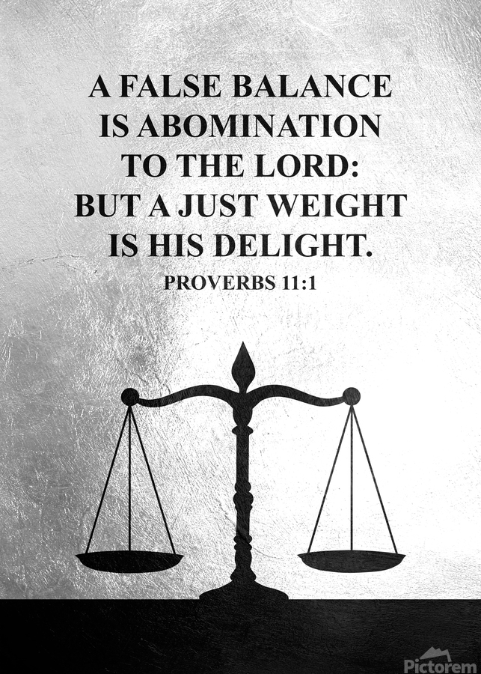
Statutes of Omri
Mic 6:10-12 – “¹⁰Is there yet a man in the wicked house, along with treasures of wickedness and a short measure that is cursed? ¹¹Can I justify wicked scales and a bag of deceptive weights? ¹²For the rich men of the city are full of violence, her residents speak lies, and their tongue is deceitful in their mouth.”
Notes:
Because there’s a huge disconnect between what God demanded of them and their present behavior. Look at their iniquity (CLICK) – Mic 6:10 – Meaning, “Are you continuing to gain wealth by corruption, through scant weights and short measures? You think I ask for too much? You’re taking advantage of giving your neighbor by giving them less than what they paid for!”
(CLICK) – Mic 6:11-12 – Sane issue as we saw in chapter 2 and 3 – unjust commercial practices. Instead of doing justice and loving kindness, they were defrauding their fellow man w/unjust weights. And so, all the wealth they’d accumulated in their houses were stained w/wickedness – it was cursed. And to make matters worse, the residents were aiding and abetting their wealthy patrons, swearing falsely in their favor, at the expense of the defrauded.

Slide 10
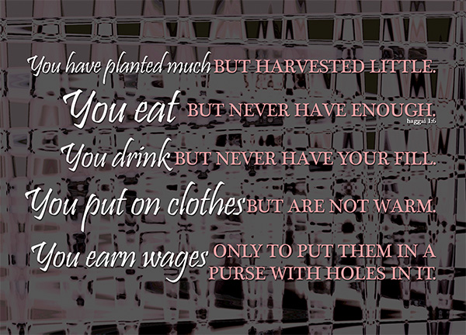
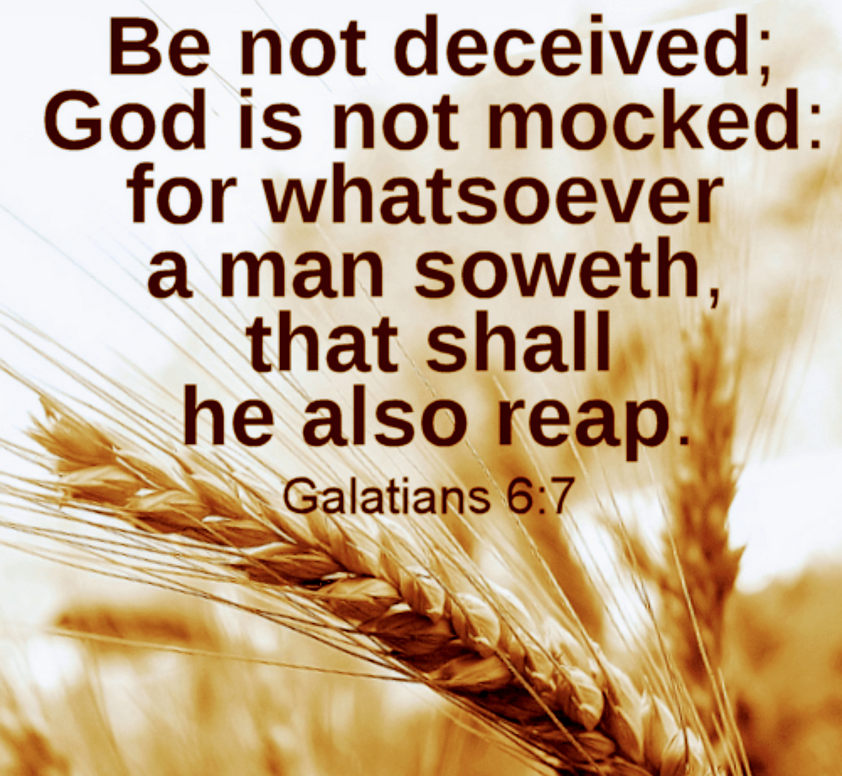
Statutes of Omri
Mic 6:13-15 – “¹³So also I will make you sick, striking you down, desolating you because of your sins. ¹⁴You will eat, but you will not be satisfied, and your vileness will be in your midst. You will try to remove for safekeeping, but you will not preserve anything, and what you do preserve I will give to the sword. ¹⁵You will sow but you will not reap. You will tread the olive but will not anoint yourself with oil; and the grapes, but you will not drink wine.”
Notes:
God cannot stand idle while this behavior continued. They have amassed such liability, the only way He can intervene is w/judgment (CLICK) – Mic 6:13-15 – (CLICK) Remember the futility curses from Lev 26 and Deut 28? Every single one of these is a repeat from those chapters of what God promised He’d do if they continued in sin – plague, a low yield for their labor, dissatisfaction, the sword, and no preservation. The Sustainer of Creation will simply not sustain those who deny sustenance to their neighbor. (CLICK) And in more poetic justice, since they manipulated the economy for selfish gain, God would cause their economy to grind to a halt. The guilty are punished precisely in the area for which they had sinned.

Slide 11
Statutes of Omri
Mic 6:16 – “The statutes of Omri and all the works of the house of Ahab are observed; and in their devices you walk. Therefore I will give you up for destruction and your inhabitants for derision, and you will bear the reproach of My people.”
Coveting & Defrauding (Mic 2:2 vs. 1 Kings 21:23)
Notes:
And Micah has a phrase for all this, to really hit home on just how wicked they had become (CLICK) – Mic 6:16a – This phrase is profound – all throughout Micah, there are references that have come up to some of Ahab’s antics, particularly those antics from 1 Kings 21 – 22.
In 1 Kings 21, we read about the encounter between Ahab and a man named Naboth who owned a vineyard next to Ahab. And Ahab coveted this vineyard. But Naboth wouldn’t sell it to him because that was His family’s land. So, remember what Jezebel did? She hired worthless men to come in and give false testimony about Naboth so that he was killed, at which point Ahab went up and took possession of it. (CLICK) This is the exact same thing the land barons of Judah were doing from what we’ve studied in Mic 2 – 3! So, in a very real way, Judah had begun observing the works of the house of Ahab.

Slide 12
Statutes of Omri
Mic 6:16 – “The statutes of Omri and all the works of the house of Ahab are observed; and in their devices you walk. Therefore I will give you up for destruction and your inhabitants for derision, and you will bear the reproach of My people.”
Coveting & Defrauding (Mic 2:2 vs. 1 Kings 21:23)
Micah (Mic 1:1) & Micaiah (1 Kings 22:8)
Mic 1:2 – “Hear, O peoples, all of you” – exact same phrase used by Micaiah in 1 Kings 22:28 (only place in scripture)
Mic 2:11 - “wind” and “falsehood” same words as “deceiving spirit” in 1 Kings 22:22 to describe false prophets
Mic 2:12 –same imagery of a shepherd-king w/sheep used by Micaiah in 1 Kings 22:17
Mic 3:8 (“courage”) vs. 1 Kings 22:24-28
Mic 4:13 vs. 1 Kings 22:11
Mic 7:10 – Same phrase about Jezebel’s death used in 2 Kings 9:33
Notes:
There’s another story in 1 Kings 22 in which Ahab decides to go to war with Syria and asks Jehoshaphat to go with him. Jehoshaphat insists on inquiring of God first, and do you remember there was only one man there who was a prophet of Jehovah (CLICK) – Micaiah, a very similar name to Micah, ironically enough. And Micaiah speaks the truth while Ahab had gathered together all these false prophets. (CLICK) And all throughout this chapter, we see multiple allusions to things that have been discussed in Micah, even phrases in Micah that are only found in this story. We could spend an entire class comparing Micah w/1 Kings 21 – 22, but suffice it to say, this is a people who if the judgment of Ahab’s house were brought up, they’d say, “Amen!” But they had become the house of Ahab in that they were observing his very works. I don’t think it’s a coincidence that Micah chose this phrase, “statues of Omri” and alludes to the works of the house of Ahab.

Slide 13
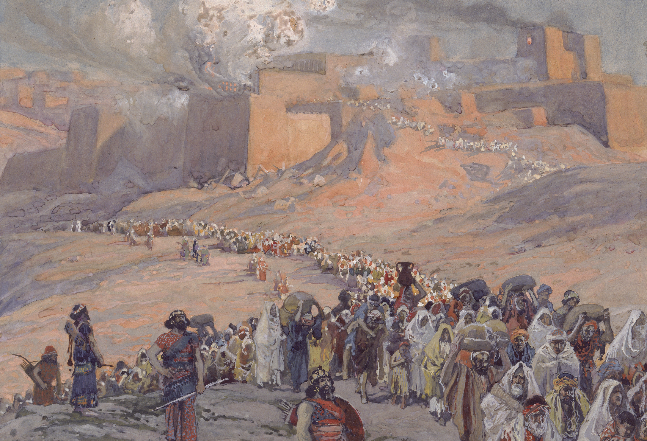
Statutes of Omri
Mic 6:16 – “The statutes of Omri and all the works of the house of Ahab are observed; and in their devices you walk. Therefore I will give you up for destruction and your inhabitants for derision, and you will bear the reproach of My people.”
Notes:
Now, if you recall from 1 Kings 16:24, it was King Omri who purchased and built Samaria, making it the capital of the northern kingdom of Israel. But also recall from 1:6 that Samaria would revert back to its state prior to Omri purchasing it, because God would judge them. So, if Judah has fallen into the same pattern, what would we expect would happen to her? – Mic 6:16b – That word “therefore” means God has no choice. If He judged Israel for Omri and Ahab’s abominable economic practices, what choice does He have w/Judah? The “statutes” of Omri, in which they walked, were directly opposed to the statues of God in which Judah was told to walk in vs. 8.

