Slide 2
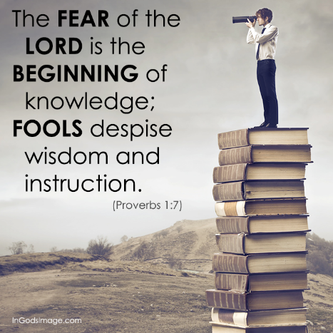
FACTUAL KNOWLEDGE
SITUATIONAL INSIGHT
NECESSARY RESOLVE
Righteous goal
2 Thes 2:10-12 – “¹⁰and with all the deception of wickedness for those who perish, because they did not receive the love of the truth so as to be saved. ¹¹For this reason God will send upon them a deluding influence so that they will believe what is false, ¹²in order that they all may be judged who did not believe the truth, but took pleasure in wickedness.
Notes:
The definition of wisdom that we’ve been evaluating is this – “Wisdom is the combination of factual knowledge, situational insight, and necessary resolve, which, when practiced, has the greatest likelihood of achieving an intended righteous goal”. This is as meaningful of a definition as I’ve been able to find. The necessary resolve is the “fear of the Lord” which we discussed two weeks ago. Having a proper, healthy fear toward God will tone our senses so that when we’re being instructed, that instruction won’t go through one ear and out the other. We’ll listen and retain the instruction because any instruction from God leads to life. And the ultimate goal of instruction is the first part of this definition, the factual knowledge we need so we can begin to use that information in our decision making. The situational insight will be discussed in future lessons.
Prov 1:7 puts it biblically. No knowledge will be had or retained unless we fear the Lord! If we don’t fear the Lord, we will never receive the truth because we won’t love the truth – 2 Thes 2:10 – Not only will we not be saved, but vs. 11 assures us that God will give us over to delusion so that we’ll believe what is false. How He does this is debatable and for this discussion it is irrelevant. Suffice it to say, we cannot believe the truth unless we have the truth. We won’t know the truth unless we receive knowledge. And no knowledge will be retained unless the instruction we receive is accompanied by the fear of the Lord.

Slide 3
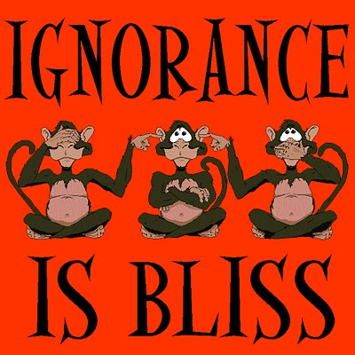
Christianity Is A Religion Of Instruction
John 8:31-32 – “³¹So Jesus was saying to those Jews who had believed Him, ‘If you continue in My word, then you are truly disciples of Mine; ³²and you will know the truth, and the truth will make you free.’”
John 17:17 – “Sanctify them in the truth; Your word is truth.”
Acts 2:42 – “They were continually devoting themselves to the apostles’ teaching and to fellowship, to the breaking of bread and to prayer.”
Acts 17:30 – “Therefore having overlooked the times of ignorance, God is now declaring to men that all people everywhere should repent.”
Notes:
Now I think it can go without saying that Christianity is a religion of instruction – John 8:31-32; 17:17 – And because this is the case, Christians cannot thrive spiritually without it – Acts 2:42 – And as stated last week, we need one another to achieve this goal, teachers who are more studied than us This allows us to benefit from the mutual wisdom of one another.
However, the world also has its own slogans that it uses in order to counter the importance of knowledge – “What I don’t know can’t hurt me” – “Ignorance is bliss”. Just because something sounds poetic doesn’t make it true. The truth is that there was a time when God overlooked ignorance on the part of many, but that time has passed – Acts 17:30. To repent means to turn, not just from something but also to something else, or shall we say to someone else, Jesus Christ. And that is where knowledge comes in.

Slide 4
Surveys Of The American Public
Fewer than half of all adults can name the four gospels
Many professing Christians cannot identify more than two or three of the apostles
60% of Americans can't name even five of the Ten Commandments
12% of adults believe that Joan of Arc was Noah's wife
50% of graduating high school seniors thought that Sodom and Gomorrah were husband and wife
A considerable number of respondents indicated that the Sermon on the Mount was preached by Billy Graham
Notes:
If you research online surveys, you’ll find that most people, from the general public and expanding even to the church, don’t know much about the bible. This is a gallop poll that was taken in 2005, so it’s a little outdated, but I would suggest its probably worse now than it was 14 years ago.
.
.
.
Now several of these are laughable, and some of them are outrageous, especially to assume that someone like Billy Graham could equal the teaching of Jesus in the Sermon on the Mount. But most of this is probably not surprising because many in America are working overtime to keep biblical knowledge away from its citizens.

Slide 5
Freshmen At Evangelical College
80% could not place Moses, Adam, David, Solomon, Abraham in chronological order.
Only 15% could place in order the major events of Jesus' and Paul's lives.
Only 20% knew to look in Acts to read the story of Paul's travels.
Only 60% could locate the Exodus story in the Old Testament.
Only 33% could find the Sermon on the Mount in the New Testament.
80% did not know where to find the Lord's Prayer
Notes:
These are the results of a quiz taken by freshmen at an evangelical college called “Wheaton College” in Wheaton, IL, so this is a place that caters to those who are believers, primarily consisting of Presbyterians and Methodists. This is a quiz given to freshmen every year by a particular professor there and the average grade is typically 50% - 55%. Here are statistics from that exam.
.
.
.
Again, we might not be too surprised by this because even amongst some of the more popular denominations we’re seeing in depth teaching of God’s word being replaced by other activities.

Slide 6
Freshman At College Bible Department
91% were members of the church
33% of the students did not know that Jonah was a prophet who was on a ship bound for Tarshish or that he preached in Nineveh.
17% did not know Romans was the sixth book in the New Testament.
31% did not know that Jude follows 3 John.
55% did not know who wrote 2 Timothy.
45% did not know who wrote Revelation.
21% did not know that Isaiah wrote Isaiah.
56% did not know that Luke wrote Acts.
20% did not know that Lydia sold purple.
92% did not know that Christ's conversation w/Nicodemus on the new birth is found in the gospel of John.
Notes:
But here is a quiz given to freshmen at a college bible department in which 91% identified as members of the Lord’s church.
.
.
.
Now, the point of this is not to make the case that a person who doesn’t know who wrote the book of Acts is not saved or to suggest that those who think Joan of Arc was Noah’s wife is going to hell. But if you don’t know these things, or at the very least the majority of these things, can we really expect that this same person would know the teaching contained in God’s word that leads to life?

Slide 7
Causes
Sound teaching replaced w/activities & programs
Churches watering down teaching
Elders who don’t demand/respect sound teaching
Removing evening services
Shortening gospel meetings
Career preaches who only work Sun & Wed
Preachers who preach to appease the church
Church scoffers who are not held accountable
Notes:
Well, what’s contributing to this? There are several things:
Over the last 100 years, mainstream churches have gradually replaced sound teaching with programs and activities meant to entertain rather than to instruct. If you visit mega churches today, that is what you get. Any teaching that is done from the bible is superficial at best.
There are other churches that do more teaching, but its mostly watered down. There’s an over emphasis on what would be considered the “positive” aspects of scripture with little to no regard for sin and the warnings found throughout. This superficial teaching is designed to make those who attend feel good about themselves but they never leave edified and uplifted with a motivation to pursue greater planes of spirituality.
Much of this can fall on the shoulders of elders. Some, for the sake of “keeping the peace”, don’t want teaching that will rile up the flock. Any teaching done that challenges or steps on toes is discouraged in order to attract more visitors and to prevent those members who want superficial teaching from leaving.
There has been an increase in churches removing their evening services. Disclaimer: some are doing so for legitimate reasons such as when the vast majority of the group is composed of the elderly who have trouble driving at night. Others, however, are doing so for carnal reasons disguised as spiritual reasons. Discussions with other church leaders as well as personal experience as led me to believe the root cause of this is wanting less teaching when we in fact need more.
Gospel meetings have gotten shorter. They went from being weeks long to being a week long to being five days long and now many churches are simply doing weekend studies. I think we can all agree that we’re not doing so because we’re finding that less teaching is a good thing, but rather to accommodate the busy schedules of people who are becoming enslaved to secular activities.
There are career preachers out there who believe the majority of their work revolves around what they feed the flock on Sundays and Wednesdays. Make no mistake…this is an important part of the preacher’s work. But when preachers are not spending quality time with the flock, performing home studies, etc., he does not know the people well enough to know what teaching they need. For many, preaching and teaching is becoming a space filler. We need more preachers who are in this to serve and not to make a career.
Preachers who look at preaching as a job that pays the bills try hard to keep their job. Some try so hard, they’ll preach only what they know the church wants to hear. This may not be watered down, superficial teaching. Instead, it could be teaching that builds our ego…such as teaching that talks about what every other church is doing wrong and how we’re not like them. Some preachers make this a weekly thing. Rather than giving balanced teaching of sound doctrine, they put out the same old rehashed lessons while neglecting other teaching that is needed.
Then there are church scoffers. These are the ones who constantly complain about the elders/preachers in the background. If you go to lunch with them after services, you can be sure they will talk bad about the lesson and the one who presented it, hoping to gain a following to share in their misery. If this kind of behavior is allowed to continue without holding them accountable, it will not only destroy their soul, but the souls of those they influence and has the potential for intimidating weak leaders into giving into their carnal demands. We will talk about scoffers in this class because the Proverbs has a lot to say about them.

Slide 8
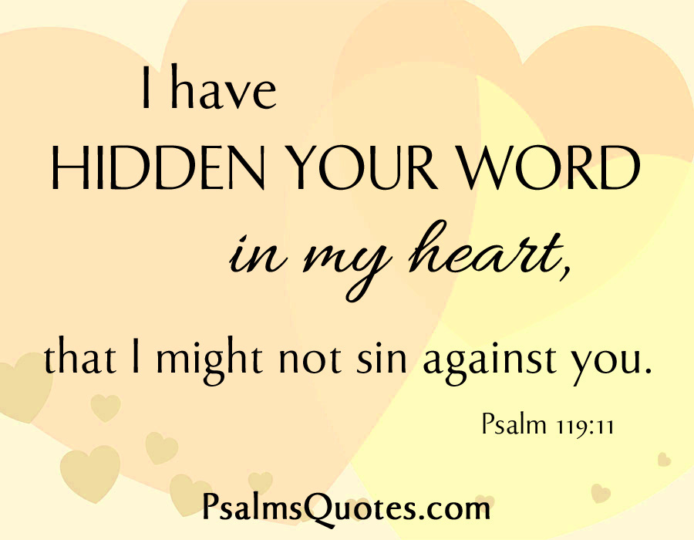
When I Don’t Have Knowledge…
I sin
Notes:
What happens when I don’t have biblical knowledge?
First and foremost, when I don’t have knowledge, I sin – Psa 119:11 – I can’t treasure God’s word if its not in my heart. And it won’t be in my heart if I don’t have knowledge. So knowledge, factual knowledge, is key. Suffice it say, if I don’t have knowledge, not only will it cause me to sin, but my sin, by way of influence, will cause others to sin and this spiritual disease will continue to spread. When a person we work with or go to church with gets the flu, we appreciate it when they stay home. We don’t want them spreading it around. But sin is a disease that infects all of us and we easily spread it from one to another when we don’t have the knowledge of God’s word in our heart.

Slide 9
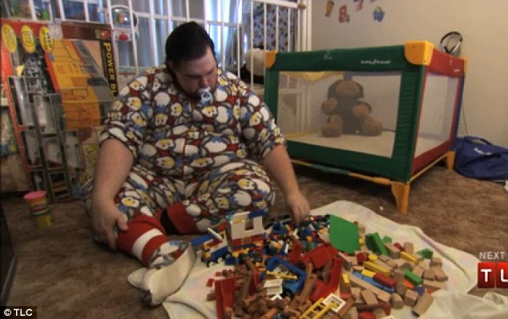
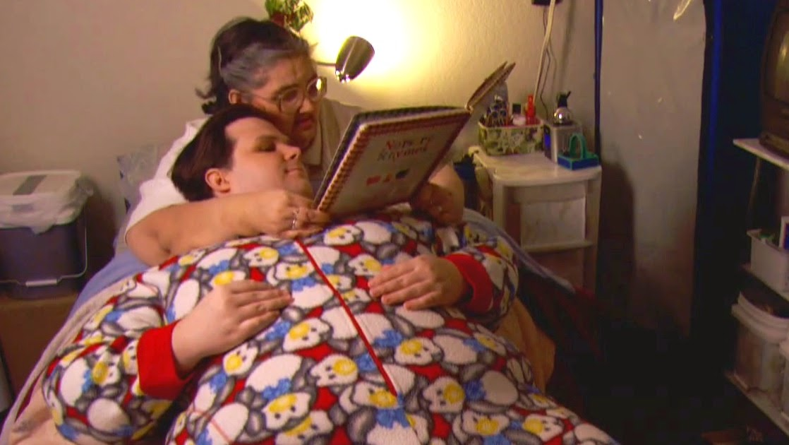
When I Don’t Have Knowledge…
I sin
I don’t grow
Heb 5:12 – “¹²For though by this time you ought to be teachers, you have need again for someone to teach you the elementary principles of the oracles of God, and you have come to need milk and not solid food.”
1 Cor 13:11 – “When I was a child, I used to speak like a child, think like a child, reason like a child; when I became a man, I did away with childish things.”
Notes:
2) Without knowledge, I won’t grow – Heb 5:12 – A few years ago, Jennifer and I were watching a show on TLC, and the show was about a man who had an obsession with dressing up as a baby and sitting in a crib and playing with toys. Now you might be thinking, “Well he obviously has mental issues”. Not in the conventional sense. This guy had a day job in an office at a computer, so this is something he chose to do when he came home from work. He got out of his work clothes, put on baby clothes, put a pacifier in his mouth, and acted like a baby. It was the most ridicules thing I had ever seen, but that was his obsession.
Look at this picture. That is not his mother. This is a woman he hired to baby him and enable this ridicules behavior. She comes over and bottle feeds him, reads stories to him, rocks him, the whole shebang.
Now we think that’s crazy. I’m a Christian, but I want to take this guy to the wood shed! – “Baby want a bottle? Baby want a big dirt bottle?”
But here’s the thing. We become man-babies when we’ve been Christians year after year and we just refuse to up. If we have been in church for years, and we don’t know the bible, and we’re continue clinging to spiritual immaturity and chasing after every carnal lust under the sun, we’re wearing spiritual diapers. Paul said in 1 Cor 13:11 that when he became a man, he put away childish things. Guys, Jesus needs you. You are at the point in your life where childish things need to hit the road. We’ve got to make a conscious decision to grow up and stop allowing people into our lives that enable childish spiritual behavior. And if we’re struggling to do grow, and you need help, seek it out from those who can help you.

Slide 10
When I Don’t Have Knowledge…
I sin
I don’t grow
Misdirected Zeal
Rom 10:2-3 – “²For I testify about them that they have a zeal for God, but not in accordance with knowledge. ³For not knowing about God’s righteousness and seeking to establish their own, they did not subject themselves to the righteousness of God.”
Prov 14:12 – “There is a way which seems right to a man, but its end is the way of death.”
Notes:
3) Misdirected zeal – Rom 10:2-3 – Zeal and confidence and energy are good things to have. Most older Christians wish they had the energy that a lot of you have. But without knowledge, that zeal can make one an unguided missile and can cause you to do more harm then good.
I learned this early on as a younger preacher – Prov 14:12 – Not every “way” that I was convinced was the right way yielded the results I was expecting. As I have grown in knowledge, I look back on times when I thought I was doing the right thing and realized I didn’t know as much as I thought I did. Everyone will experience this. But by gaining knowledge early, we can avoid a lot of these mistakes and spare ourselves and others a lot of grief! I’ll say it again – when you’re young, you don’t know what you don’t know.

Slide 11
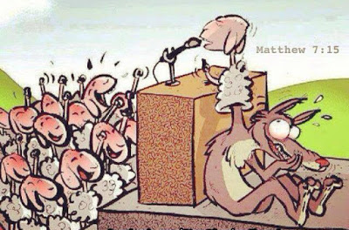
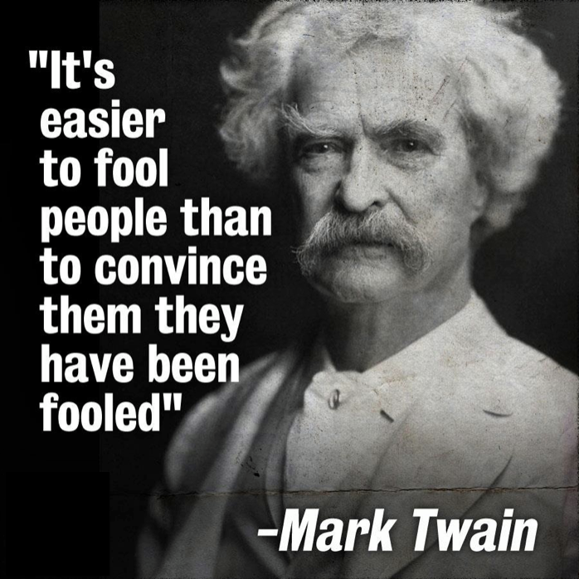
When I Don’t Have Knowledge…
I sin
I don’t grow
Misdirected Zeal
Susceptible To Error
2 Pet 3:17-18a – “¹⁷You therefore, beloved, knowing this beforehand, be on your guard so that you are not carried away by the error of unprincipled men and fall from your own steadfastness, ¹⁸but grow in the grace and knowledge of our Lord and Savior Jesus Christ.”
Notes:
4) Susceptible to error – 2 Pet 3:17-18a – Without knowledge, we’ll be susceptible to false teaching. False teachers are incredibly skilled at making what is wrong sound so right. Satan was a master at mixing just enough truth in with a lie in order to fool Eve into eating the fruit. But knowledge equips us with the information we need to see through the lies. No matter how good the speaker, how eloquent the prose, or how many people are amening, without knowledge, we can never know whether we’re going down the right path or not.

Slide 12
When I Don’t Have Knowledge…
I sin
I don’t grow
Misdirected Zeal
Susceptible To Error
Condemnation
Isa 5:13 – “Therefore My people go into exile for their lack of knowledge”
Hos 4:6a – “My people are destroyed for lack of knowledge.”
2 Thes 1:8 – “dealing out retribution to those who do not know God and to those who do not obey the gospel of our Lord Jesus.”
Notes:
5) Condemnation – notice the transition – Isa 5:13 – some of the Jews had to go into exile because of their lack of knowledge concerning God. But it was worse for others – Hos 4:6a – See, some died in this state. But worse is 2 Thes 1:8 – When Jesus returns, He will judge two groups of people: those who don’t know God and those who don’t obey the gospel. This places knowledge of God at the top of most important things we could ever attain to.

Slide 13
“Gnosis” – “The accumulation of information or facts for remembering and accessing in day to day life”
Rom 11:33 – Oh, the depth of the riches both of the wisdom and knowledge of God! How unsearchable are His judgments and unfathomable His ways!”
Col 2:2-3 – “²that their hearts may be encouraged, having been knit together in love, and attaining to all the wealth that comes from the full assurance of understanding, resulting in a true knowledge of God’s mystery, that is, Christ Himself, ³in whom are hidden all the treasures of wisdom and knowledge.”
Notes:
What is knowledge? It comes from the Greek word “gnosis” which means “The accumulation of information or facts for remembering and accessing in day to day life.” The bible speaks of the knowledge of God has the most valuable knowledge we can ever possess – Prov 8:10; 20:15 – Most things are valuable because they are so rare. And once those things have been consumed, it runs out. But when it comes to the knowledge of God, the bible assures us that it can never be exhausted – Rom 11:33; Col 2:2-3.

Slide 14
2 Tim 3:7 – “always learning and never able to come to the knowledge of the truth.”
1 Cor 1:26-29 – “²⁶For consider your calling, brethren, that there were not many wise according to the flesh, not many mighty, not many noble; ²⁷but God has chosen the foolish things of the world to shame the wise, and God has chosen the weak things of the world to shame the things which are strong, ²⁸and the base things of the world and the despised God has chosen, the things that are not, so that He may nullify the things that are, ²⁹so that no man may boast before God.”
Notes:
The bible uses knowledge and wisdom synonymously in many passages, to suggest that it many cases they are one and the same – Eccl 1:18 – But this is not always the case
There are many people who possess knowledge, but it never gets them anywhere – 2 Tim 3:7 – How does this happen? We can read but never apply. We can memorize, but never synthesize. There are many brethren who will read countless commentaries and theologians looking for something new, like the Athenians of Acts 17. Always asking questions, but never satisfied with answers. This is a bad place to be. The word of God was designed to be understood since it gives us life. But those who are intellectuals will seldom get out of it what the humble can
1 Cor 1:26-29 – In other words, while the gospel of Jesus Christ is God’s drawing power to save mankind, not all mankind can receive it. Why? Because their heart prevents them from receiving the simple truths. God hid true knowledge from people such as this. That phrase “so that no man may boast before God” is to this point. If God’s word was something only the intellectual and physical elite among us could understand, we’d be able to boast that we and only we possess this innate ability to understand it. God, in His wisdom, specifically designed His word so that only those who are not wise according to the flesh would b able to receive it. That’s why humility is so important when we’re receiving instruction. If we sit in these seats or in those pews with a haughty attitude, or as scoffers, or thinking we know better than everyone else, don’t be surprised to find yourself in that “always learning but never receiving the knowledge of the truth” category…and that’s a hard state to get out of.
So what we’re suggesting is that while wisdom and knowledge can be synonymous, they can also be antithetical. They are not always the same thing. Yet we cannot have wisdom without knowledge.

Slide 15
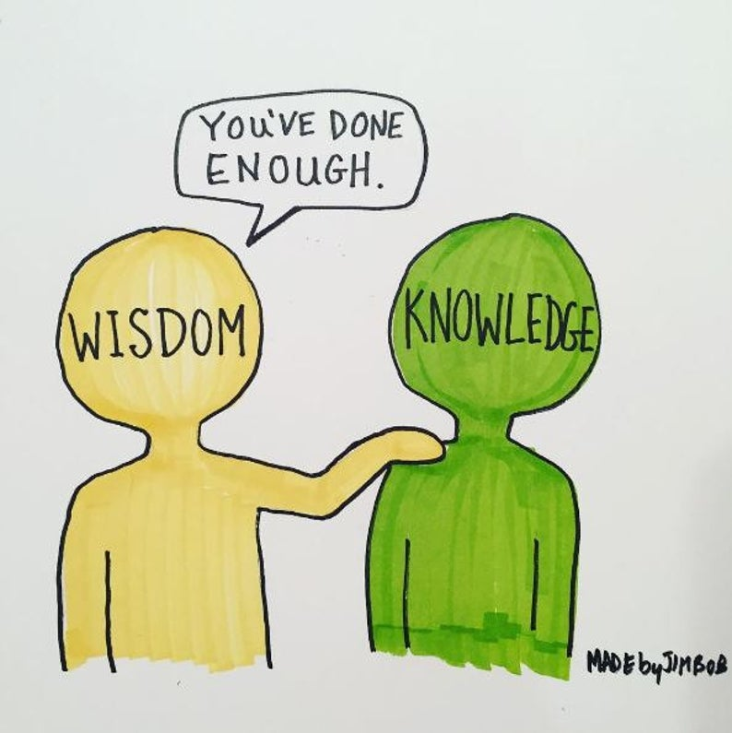
Knowledge is knowing that a tomato is a fruit. Wisdom is not putting it in a fruit salad
Knowledge is knowing how to use a gun. Wisdom is knowing when to use it vs. keeping it holstered
Knowledge is knowing good and evil. Wisdom is knowing good from evil
Knowledge memorizes the 10 Commandments. Wisdom obeys them
Knowledge understands the light has turned red. Wisdom applies the brakes
Notes:
Here are some examples that may help illuminate the difference between wisdom and knowledge:
Knowledge is knowing that a tomato is a fruit. Wisdom is not putting it in a fruit salad
Knowledge is knowing how to use a gun. Wisdom is knowing when to use it vs. when to keep it holstered
Knowledge is knowing good and evil. Wisdom is knowing good from evil
Knowledge memorizes the 10 Commandments. Wisdom obeys them
Knowledge understands the light has turned red. Wisdom understands when to apply the brakes
Think about a hammer; it is an amoral object. Whether a hammer is used for good or evil depends entirely on the one who is wielding it. And that’s the difference. It’s not what you know. It’s what you do with what you know and how you do it that determines wisdom. But without knowledge, you won’t know what or how to do it. So I think its safe to say that a wise person has knowledge, but a person with knowledge may not be wise. The ultimate goal for Christians is the synthesis of that knowledge by which wisdom can be developed.

Slide 16
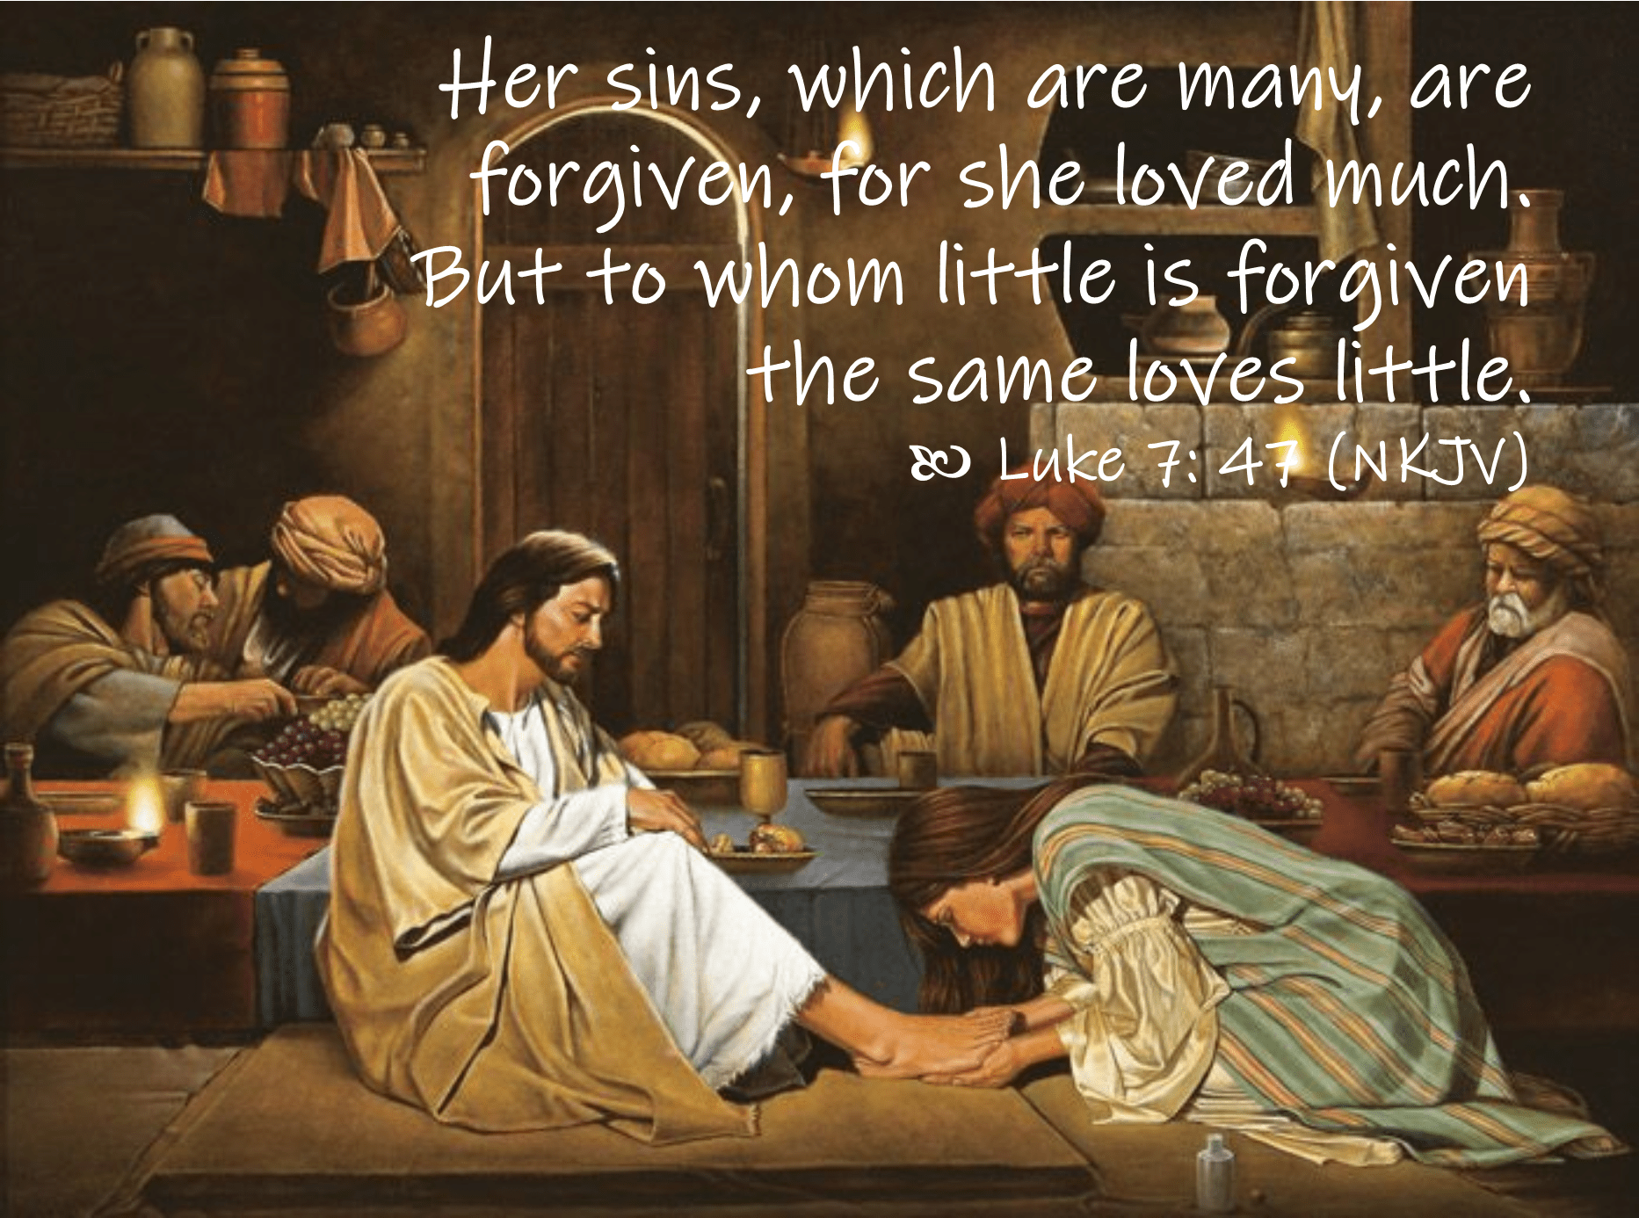
1 Cor 8:1 – “Now concerning things sacrificed to idols, we know that we all have knowledge. Knowledge makes arrogant, but love edifies.”
Puff Up Or Build Up?
Notes:
Practical example: consider the problem with the Corinthian Christians in 1 Cor 8 – 1 Cor 8:1 – Consider the flow. They had knowledge of all things – the one true God, His Son, their plan for mankind, the state of mankind, what they must do to be saved, all the most important knowledge a person can have. And a lot of people in Corinth still did not have that knowledge. They were as idolatrous and immoral as these Corinthian Christians used to be. So this puts the Corinthian Christians in an exalted state compared to their fellow Corinthian citizens. Paul is telling them they can take this knowledge they have and do one of two things with it:
First, they can retain the knowledge, let it lie dormant, and I doing so use it to boost their own egos. They can be puffed about how they know more than everyone else and they can boast about this – “Look at all those people out there in error. Tsk tsk. When will they ever learn? I’m so glad I’m not like them. I’m woke. I’ve got it all figured out unlike these peons.” You can do that. God gives us freewill to use the knowledge we have to make ourselves feel superior and self-righteous.
Or, we can take that knowledge, and because we understand the implications of it, use it to build others up, and that is what “edification” means. “To edify” literally means “to build up”. There is a play on words in this passage that rarely gets noticed. Paul is saying we can the knowledge we have and either puff up, or build up. One route benefits absolutely no one. The other route benefits both parties. Paul would have us to build up and the motivation behind this is that this knowledge we have should teach us to love others – 1 John 4:19 – Where do we get that idea? “For the bible tells me so”. That’s knowledge. Jesus loves us, and that love is meant to inspire us to love others.
The woman in Luke 7 that washed Jesus’ feet. We’re told why she did so – Luke 7:47 – We’ve all been forgiven though. So why do some people respond differently than others? Because this woman knew the implications of her forgiveness….who she was, what Jesus had done for her despite who she was, and it drove her to love in return. “The fear of the Lord is the beginning of knowledge.”

Slide 17
How Do I Acquire Knowledge?
Develop A Passion For It
Psa 1:2 – “But his delight is in the law of the Lord, and in His law he meditates day and night.”
Psa 119:16 – “I shall delight in Your statutes; I shall not forget Your word.”
Psa 119:72 – “The law of Your mouth is better to me than thousands of gold and silver pieces.”
Study With Others
Eccl 4:9 – “Two are better than one because they have a good return for their labor.”
Private Study
Acts 17:11 – “Now these were more noble-minded than those in Thessalonica, for they received the word with great eagerness, examining the Scriptures daily to see whether these things were so.”
Demand It From Your Church
1 Tim 3:15 – “but in case I am delayed, I write so that you will know how one ought to conduct himself in the household of God, which is the church of the living God, the pillar and support of the truth.”
Choose The Right Friends
Prov 14:7 – “Leave the presence of a fool, or you will not discern words of knowledge.”
Notes:
How do I acquire knowledge?
Develop a passion for it – Psa 1:2 – There is a stark contrast between the way the Old Law is viewed by many today and how David viewed it. Many say, “I’m glad we’re not under the old law today with all its rituals and commands and sacrifices. That was not how David looked at it. He delighted in it. It was so inspiring to David, he would meditate on it day and night. He couldn’t stop thinking about it – Psa 119:16; 72 – The key to developing a passion for biblical knowledge is to fully know its implications for your life. Its then no long black ink on white pages, but a blueprint for a joyful fulfilled life with that has purpose.
Study with others – Eccl 4:9 – If you have a hard time developing a passion for God’s book, study with those who do have that passion. They’ll inspire you and show you what you’ve somehow been missing. They’ll build an interest in you for God’s word or maybe they’ll just help renew an interest in the only words that truly matter for my soul.
Private study – Acts 17:11 – The Bereans didn’t just have a passion for the scriptures, but wanted to make sure that when they heard something new, it was the truth, no matter how cool it sounded, not matter how edgy, no matter how much energy emanated from the one presenting it. We dare not be afraid to take a break from the secular carnal activities we’re engaged and open God’s book to see what words I can benefit from and synthesize today.
Demand it from your church – 1 Tim 3:15 – If you are not a part of a church that is preaching the whole counsel of God, demand it. Demand it from your elders, your preachers, your bible class teachers, and anyone else who is responsible for declaring the oracles of God.
Choose the right friends – Prov 14:7 – Just like that baby man, the foolish friends will enable all the wrong behavior and it will literally suck all the knowledge out of us that we need to survive spiritually. Why? Because to stay in those friendships, we’ll have to suppress knowledge we have that leads to life; that’s the only way we’ll be able to engage in that kind of tomfoolery when we should know better. It is impossible to retain and activate the knowledge of God within us while we immerse ourselves with people who stand adverse to spiritual principles – “Do not be deceived, bad company corrupts good morals.”

