Slide 1
Notes:
On the surface, the SOTM sounds philosophical. But it is not designed to fill our heads with philosophy. It designed to instruct those off us who desire a true and right relationship with God. But to be the person Jesus describes in this sermon, we must choose it. And God has done everything that can be done, through Christ, to inspire so to choose to be his follower.
What we’ve seen so far in this sermon is that Jesus hones in on those barriers that can get in the way of us giving our lives to Him. Pride and self-centeredness must go. Worship must place God at the center, whether it is in our giving, praying, or fasting. Our money and our possessions can choke out God’s word within us and prevent us from living completely for Him.

Slide 2
We Cannot Serve Two Masters
Matt 6:24 – “No one can serve two masters; for either he will hate the one and love the other, or he will be devoted to one and despise the other. You cannot serve God and wealth.”
Notes:
We ended last week w/Matt 6:24 – Last week we looked at what Jesus said about money; and He says a lot about it in the gospels. Jesus spoke 38 parables and 16 of them mention money. Almost one out of every ten verses in the NT deal with the subject. The bible contains only ~500 verses on prayer, < 500 verses on faith, but > 2000 verses on the subject of money. So, suffice it to say, it’s important to our Lord that we have a proper estimation of our physical possessions, because as Matt 6:24 says, we can’t serve both God and money. We just can’t do it. It will turn our soil into thorny ground, inevitably robbing us of the energy necessary to bring that single-minded devotion to God that He requires and deserves.
And maybe as we meditate on the evil of covetousness and materialism, recognizing that the love of money is truly the root of all sorts of evil, maybe we’ll be inclined to say, “I’m glad I’m not that person”.

Slide 3
We Cannot Serve Two Masters
Matt 6:24 – “No one can serve two masters; for either he will hate the one and love the other, or he will be devoted to one and despise the other. You cannot serve God and wealth.”
Matt 6:25 – “For this reason I say to you, do not be worried about your life, as to what you will eat or what you will drink; nor for your body, as to what you will put on. Is not life more than food, and the body more than clothing?”
Notes:
But what about anxiety, constant worry? Does that create a wedge between myself and the Lord? Because one of the purposes of Jesus’ teaching in Matt 6 is not to just show us how the love of money hurts us, but also the worry that comes about from not having it.
Matt 6:25 – Some of your translations say “therefore” – this is important. Any time you see a “therefore”, go see what it’s there for. Jesus is making the point that just as we cannot serve both God and wealth, we’re not going to be able serve God while being worried all the time. Being anxious about daily matter takes up just as much energy as being a slave to covetousness. Because no matter which of the two is my struggle, one of them is coming between me and God. I’m always going to be a slave to those things I’m most devoted to. So, let’s talk about anxiety.

Slide 4
Reasons Not To Worry
Matt 6:25 – “For this reason I say to you, do not be worried about your life, as to what you will eat or what you will drink; nor for your body, as to what you will put on. Is not life more than food, and the body more than clothing?”
Notes:
Matt 6:25a – “Therefore I tell you, do not be anxious about your life, what you will eat or what you will drink, nor about your body, what you will put on…” – The point is simply this: if God went to all the trouble to make us living, human beings, and then sent His Son to die for our sins, if He went to all that trouble, why in the world would He allow His faithful die of exposure? That’s illogical. Eph 2:10 says that we are His workmanship, created in Christ Jesus for good works. He’s going to create us as His workmanship only to completely neglect our well-being?

Slide 5
Reasons Not To Worry
Matt 6:25 – “For this reason I say to you, do not be worried about your life, as to what you will eat or what you will drink; nor for your body, as to what you will put on. Is not life more than food, and the body more than clothing?”
Notes:
One way to see where God is coming from on this is to think about it from the standpoint of an earthly parent. Imagine what it would be like to wake your children up to get them ready for the day, only to see them balling their eyes out. And then you ask them what’s wrong, and they say, “I don’t know if I’m going to get anything to eat today. I’m worried you’re not going to give me clothes to wear”. Now, as a patient and understanding parent, you would sit beside your child and say, “Buddy, that’s silly, of course I’m going to feed you and clothe you today, just as I’ve done every other day. I love you, why would you ever think that?” – “No, I don’t believe you’re going to do that”. Now at first, it might seem humorous and make for fun talk between mom and dad over which parent the child got that particular characteristic. But then imagine that as the days go by, you continue to feed and clothe your child, regular reminders of your goodness and love for him, yet still, day after day, all your child does is worry about getting food and being clothed. It wouldn’t be all that cute after a while, would it?

Slide 6
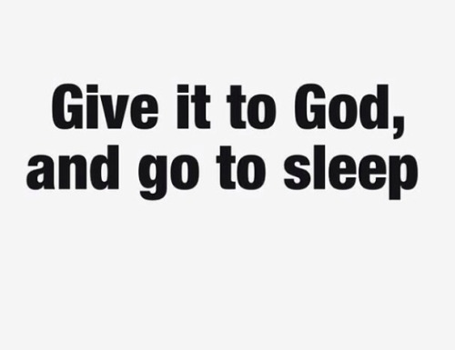
Reasons Not To Worry
Matt 6:25 – “For this reason I say to you, do not be worried about your life, as to what you will eat or what you will drink; nor for your body, as to what you will put on. Is not life more than food, and the body more than clothing?”
Portrays God as untrustworthy
Notes:
So, try to see that from our heavenly Father’s perspective who has far more capacity to provide for us than we even do for our children and who loves us more than we even love our children. How do you think that makes our heavenly Father feel when we do it? This is why Jesus stresses the seriousness of earthly worry. Preoccupation with life’s necessities portrays our heavenly Father as untrustworthy in His word and promises. It shows we do not believe that He alone is enough, and it shows that we don’t believe He’ll really care for us. We won’t say that, but incessant worrying shows it. And that’s exactly why it drives a wedge in our allegiance toward God; it distracts us from a single-minded pursuit of heavenly treasures. Just give it to God and go to sleep!

Slide 7
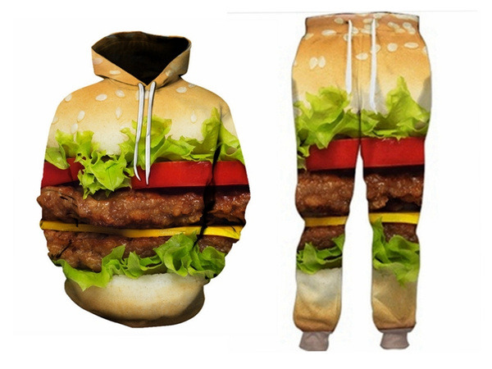
Reasons Not To Worry
Matt 6:25 – “For this reason I say to you, do not be worried about your life, as to what you will eat or what you will drink; nor for your body, as to what you will put on. Is not life more than food, and the body more than clothing?”
Portrays God as untrustworthy
Life is so much more than this
Notes:
So in vs. 25, Jesus mentions three necessities (food, drink, and clothing) all of which are related to the physical body. But then He says this – Matt 6:25b – “Is not life more than food, and the body more than clothing?” Yes, because we have a spirit too. We have an inner man that was made in God’s image which means we’ll never find ultimate fulfillment through material means. Our body is going to die. And if we’re saved, that inner man will go on living with God, and if we’re not saved, we’ll go on to eternal damnation, perpetually separated from God. Jesus is saying that this part of our makeup deserves far more attention than these physical vessels we find ourselves in.

Slide 8
Reasons Not To Worry
Matt 6:25 – “For this reason I say to you, do not be worried about your life, as to what you will eat or what you will drink; nor for your body, as to what you will put on. Is not life more than food, and the body more than clothing?”
Portrays God as untrustworthy
Life is so much more than this
Notes:
But our physical bodies sure are a common obsession with us. We pamper it, decorate it, exercise it, go out of our way to protect it from disease and pain, slim it down, build it up, the whole nine yards. And when balanced properly, this isn’t wrong. In 1 Tim 4:8, the Apostle Paul does says, “bodily training is of some value…”. But then he goes on to say in the same verse that, “godliness is of value in every way, as it holds promise for the present life and also for the life to come.” The issue comes when caring for the body becomes our purpose for living, acting as though life consisted only in food, drink, and clothing and a lot of other things that could be added to that list.
The issue is when our sense of identity and our sense of self-worth becomes inherently connected to sustaining our bodies. When we pursue this course, we’ve not only lost sight of the eternal, but we’ve lost sight of the basic makeup of man as having been created in the image of God. Jesus asks us, “Is not life more than food, and the body more than clothing?” Life is so much more than this, that it’s not worth being constantly concerned over what will happen to our body if we do this or don’t do this. Obviously, it demands nominal attention, just not all of our attention and certainly not even most of our attention

Slide 9
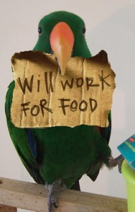
Reasons Not To Worry
Matt 6:26 – “Look at the birds of the air, that they do not sow, nor reap nor gather into barns, and yet your heavenly Father feeds them. Are you not worth much more than they?”
Portrays God as untrustworthy
Life is so much more than this
Example of birds
Notes:
And so, to further press this point, Jesus asks us to consider an example from nature – Matt 6:26 – Think about it. Birds don’t have a job. They don’t clock in. They don’t earn their keep. They don’t save what they accumulate. They fly, eat worms, and build nests. But where do they get the worms? Is it by doing this? (click). No, God provides it to them. Where do they get the brush to build their nests? God provides it to them. For birds, brethren, birds! They don’t reap, they don’t “gather into barns” like we do with all the stuff we accumulate, yet our heavenly Father feeds them.

Slide 10
Reasons Not To Worry
Matt 6:26 – “Look at the birds of the air, that they do not sow, nor reap nor gather into barns, and yet your heavenly Father feeds them. Are you not worth much more than they?”
Portrays God as untrustworthy
Life is so much more than this
Example of birds
Notes:
Jesus liked to talk about birds – Matt 10:29-31 – There are a lot of people that go bird watching, but I have never heard of anyone going sparrow watching. But God goes sparrow watching. He knows every single one of them. So, Jesus’ point is, how much more does He know us? The very hairs of our head are numbered. He knows. He knows us all. He knows what every single one of our needs. I know, when we’re anxious, it may not feel like He knows, but even our feelings must be subjected to the jurisdiction of His Lordship through faith. He’s there, watching and helping us get through it in ways we don’t even realize.

Slide 11
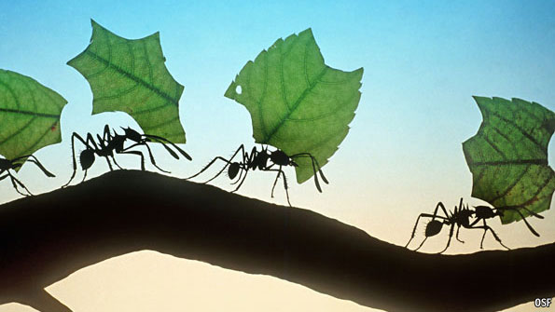
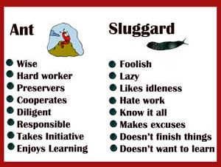
Reasons Not To Worry
Matt 6:26 – “Look at the birds of the air, that they do not sow, nor reap nor gather into barns, and yet your heavenly Father feeds them. Are you not worth much more than they?”
Portrays God as untrustworthy
Life is so much more than this
Example of birds
Notes:
This does not mean we can kick back and take it easy because we don’t have to worry anymore. That’s not the kind of worrying Jesus is talking about. Prov 6:6-8 – So yes, we have to work to provide for ourselves just as the bird has to hunt the worms and build the nest. And there will be mental and physical exertion that we go through as human beings doing so. The kind of worrying Jesus is referring to is living our days consumed with anxiety, constantly worrying and therefore doubting God’s ability and willingness to supply us with our daily needs. When God created us, He assumed the responsibility for providing for His creation. And if God has done that for simply the birds, how much more will He not do it for those He created in His image and who become His spiritual children by faith in Christ?

Slide 12
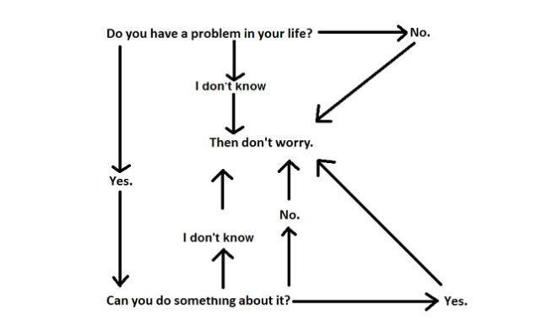
Reasons Not To Worry
Matt 6:27 – “And who of you by being worried can add a single hour to his life?”
Portrays God as untrustworthy
Life is so much more than this
Example of birds
Doesn’t add to life
Notes:
And so now He asks us a rhetorical question in order to deal with the futility of worrying – Matt 6:27 – Did you know that there’ve been studies done that prove the opposite? I’m not talking about articles on social media, I’m talking about studies that have actually been peer reviewed and confirmed. Doctors have found that stress and anxiety are some of the leading problems that contribute to physical ailments and disease. Dr. Charles Mayo of the famed “Mayo Clinic” wrote, “Worry affects the circulation, the heart, the glands and whole nervous system. Though I have never known a man who died of overwork, I have known a whole lot who died of worry.” Some of the leading cancer doctors actually tell their cancer patients that one of the best things they can do in their fight against that dreaded disease is to stop worrying, keep your spirits high, and look for ways throughout the day to get some sunshine. So rather than adding days to our life, stressing about all the “what ifs” can actually take away from our health. There’s not just no gain in it, it drains us emotionally and physically.

Slide 13
Reasons Not To Worry
Matt 6:28-30 – “And why are you anxious about clothing? Consider the lilies of the field, how they grow: they neither toil nor spin, yet I tell you, even Solomon in all his glory was not arrayed like one of these. But if God so clothes the grass of the field, which today is alive and tomorrow is thrown into the oven, will He not much more clothe you…”
Portrays God as untrustworthy
Life is so much more than this
Example of birds
Doesn’t add to life
Examples of lilies/grass
Notes:
But having dealt with the animal kingdom, Jesus now deals with the plant kingdom – Matt 6:28-30 – Now lilies are even lesser than the birds. And then there is the grass which is even lesser than lilies, because one day it’s alive and then the next it’s used for fuel or cut up to die on the fields. And yet God has seen to it that they are well taken care of, that they are clothed with such beauty that not even Solomon himself can relate to. Solomon was the greatest standard of which earthly grandeur could be measured, yet even he is surpassed in splendor by the lily of the field, and that’s saying something.

Slide 14
Reasons Not To Worry
Matt 6:28-30 – “And why are you anxious about clothing? Consider the lilies of the field, how they grow: they neither toil nor spin, yet I tell you, even Solomon in all his glory was not arrayed like one of these. But if God so clothes the grass of the field, which today is alive and tomorrow is thrown into the oven, will He not much more clothe you…”
Portrays God as untrustworthy
Life is so much more than this
Example of birds
Doesn’t add to life
Examples of lilies/grass
Notes:
See, by bringing up the birds and the plants, Jesus is confronting the two personality types as it pertains to concern over physical things. For some people, what drives their worry is a concern for security, and so their thing is to save their money. When an extra $100 comes in, they save it. But for others, their concerns is one of beauty, significance, or enjoyment, and so they spend their money. They upgrade their house, their car, their wardrobe, their lifestyle. Savers and spenders. Jesus addresses the saver by alluding to the birds. The birds don’t gather into barns; that means they don’t save; but they are fine. God takes care of them. And then He addresses the spender by alluding to the flowers; they don’t need to upgrade their lives, because they are beautiful just as God has made them.
Savers and spenders, which one are you? Regardless, both can be prone to worry. One over not having, and the other over losing. And when it gets really fun is when the saver and spender marry one another, and each thinks the other one has the problem. Jesus is encouraging us to devote ourselves primarily to God and let Him be the primary source of both our security and our joy. And if we cannot do that because we’re weighed down by worry, there’s got to be some underlying problem going on with us that needs addressing.

Slide 15
The Real Issue
Notes:
Well, at the end of vs. 30, Jesus puts His finger on that problem. And it stings – Matt 6:30d – The issue is not that I’m a worry wart. That’s just a symptom of the issue. The real issue is a lack of faith in the provisions God supplies to sustain us. It is putting too much emphasis on independent living, of seeking to handle life and find happiness by our own strategies of self-management rather than having faith in the trustworthiness of God. And that’s serious business.
It stings. It’s hard to admit. I think it’s far easier to just say, “I worry too much. I’m just having anxiety, that’s my bad habit” because that deflects from the fact that the real problem is that my faith isn’t where it needs to be right now. But that’s one of the reasons why we love Jesus. As the Great Physician He wants to fix the root cause of our struggles, and to do that He often has to take that surgeon’s knife and cut deep. The real heart of the matter is little faith, saying how we can’t wait for Him to take us to heaven while also thinking He can’t handle us down here on Earth – it’s an issue of faith

Slide 16
The Real Issue
Matt 6:31-32 – “³¹Do not worry then, saying, ‘What will we eat?’ or ‘What will we drink?’ or ‘What will we wear for clothing?’ ³²For the Gentiles eagerly seek all these things; for your heavenly Father knows that you need all these things.”
Notes:
Matt 6:31-32 – I think it’s safe to say that we shouldn’t limit the list to food, drink, and clothing. We could add just about anything. “What if I lose my job? How will I pay my bills? How will I pay my mortgage? What if I deplete my savings? What if I lose my retirement? What if I lose my health?” Gentiles seek after those things. Those are concerns of the world, they are not to be our concern because our heavenly Father sees His faithful; He knows what we need.

Slide 17
The Real Issue
Matt 6:31-32 – “³¹Do not worry then, saying, ‘What will we eat?’ or ‘What will we drink?’ or ‘What will we wear for clothing?’ ³²For the Gentiles eagerly seek all these things; for your heavenly Father knows that you need all these things.”
Notes:
That word “seek”, in the Greek, does not mean to simply seek or search for. It means “to search after”. It actually stresses direction toward an object in mind, of running and striving after some “thing”. Jesus tells us that this is what portrays the rat race of the unbelieving world; position, power, pleasure, possessions, financial security, competition w/others, etc. That is not to be our concern. We are redeemed for a greater purpose than what this physical world has to offer. Our life finds its anchor in 3 remarkable truths: the rejoicing over our salvation from sin, the eternal treasures and heavenly hope kept by the power of God to be revealed at the return of Christ, and the fact that we know we stand under the omniscient, omnipotent care of a loving heavenly Father. Anxious concerns over the details of life are simply distractions, they divide our attention and allegiance, suffocate our service to the Lord, and it hurts our testimony as those who have infinitely more to offer than the cares of this world. And it does beg the question of what being in a relationship with God is even for if we can’t put our trust in Him and have faith that He’ll pull us through times of physical uncertainty.

Slide 18
The Answer
Matt 6:33 – “But seek first His kingdom and His righteousness, and all these things will be added to you.”
Notes:
So, what’s the answer? Jesus hones in on the symptom of worry and the root cause being one of faith. But like a good doctor He doesn’t just walk out the office leaving us guessing on the cure. He gives us that too. He is after all the Great Physician. Verse 33 begins with “But…” – Meaning, in contrast to a world without God that acts like a dog chasing its tail in its mad search for happiness in the details of physical life, there must be a completely different priority for believers – Matt 6:33 – This is the cure, this is the remedy for worry due to little faith. This is the key to a full life, both physically and spiritually. In fact, everything Jesus has been discussing up to this point in the entire Sermon on the Mount is summed up in this one verse.

Slide 19
The Answer
Matt 6:33 – “But seek first His kingdom and His righteousness, and all these things will be added to you.”
His Kingdom – Heb 12:28
Notes:
This seeking consists of two things: God’s kingdom and His righteousness, and the two are connected in the same way as root is to fruit. The word “kingdom” means rule, dominion. So, to seek God’s kingdom is to seek His sovereign rule, His will, and His authority in my life because I have been redeemed. And since His kingdom is made up many servants, to seek His kingdom is also to promote those things that will produce the same mentality in those who share our common faith, to stimulate, support, and work for the edification and growth of believers. It means to evangelize the lost w/the desire to lead others to His kingdom, so that others outside of His kingdom can be brought in. And we also seek the kingdom when we yearn for the realization of His kingdom through the return of the King once and for all. And if we truly yearn for His return, how can kingdom citizens be so distracted with what’s down here? How can we be so easily shaken? Heb 12:28 – we are members of this kingdom. Brethren, nothing is going to happen to God’s kingdom subjects that is outside of His will; we can bank on that.

Slide 20
The Answer
Matt 6:33 – “But seek first His kingdom and His righteousness, and all these things will be added to you.”
His Kingdom – Heb 12:28
His righteousness – Rom 12:1-2
Notes:
Seek His kingdom. But we’re also told by the King to seek His righteousness. These two ideas are not as distinct as they may appear on the surface, because when you consider the character of the one who sits on its throne, it is dripping with a righteousness to be craved and sought after. Coming into Christ’s kingdom not only produces a new relationship with the King and new relationships with other citizens of the same kingdom, but it is to inspire a transformation of character in us all. After all, where your treasure is, there will your heart be also. And Jesus is our treasure, from henceforth and forever more.

Slide 21
The Answer
Matt 6:33 – “But seek first His kingdom and His righteousness, and all these things will be added to you.”
His Kingdom – Heb 12:28
His righteousness – Rom 12:1-2
Result:
God will supply – Mark 10:28-31
Notes:
And what’s more, when we learn to seek God’s kingdom and His righteousness, when that becomes top priority in both our time and our interests, all those material possessions we seek, all those things we worry over, will all be taken care or. They’ll be added (Mark 10). That does not mean He’ll make us filthy rich. But what it does mean is that for every sacrifice we make for the kingdom’s sake, God will see to it we’re not lacking – Mark 10:28-31.

Slide 22
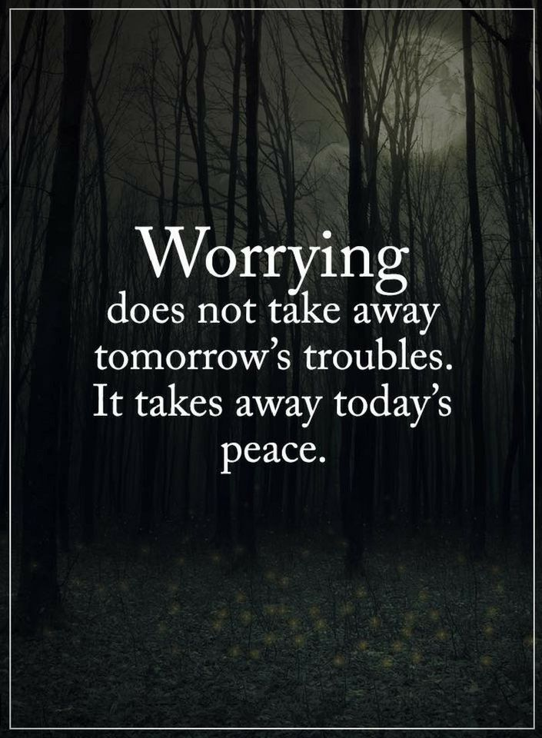
Conclusion
Matt 6:34 – “So do not worry about tomorrow; for tomorrow will care for itself. Each day has enough trouble of its own.”
Notes:
Matt 6:34 – This is not a mandate against planning, practical care for ourselves, or the careless philosophy of the hedonist who lives only for his present enjoyment. He’s saying don’t be preoccupied with it, to think we have to have enough today for the rest of our lives before we can be secure. The child of God knows that tomorrow will take care of itself because it is in the Father’s sovereign hand.
Someone has said that “the average person is crucifying himself between two thieves: the regrets of yesterday and the worries of tomorrow.” If that’s the case, the troubles of today should be the only cross we worry about bearing; today’s temptations, trials, opportunities, and struggles. We must learn to live one day at a time. God promises His grace for tomorrow when tomorrow comes, but He only gives His grace one day at a time. Worrying about tomorrow cannot change tomorrow, but it can ruin today.
So, don’t worry; hasn’t God handled bigger problems than we’re facing today?

