Slide 1
Notes:
In our study of Song of Solomon, we’re taking the 3-character drama approach. Last week, we set the stage – there’s a Shulamite girl who works on her family’s vineyards. She’s modest in her character, but very beautiful. She catches the eye of Solomon’s nobles who then whisk her away to Solomon’s tent where he begins the process of trying to charm her so that she’ll become his next bride. His wing-women are present to seal the deal – the “Daughters of Jerusalem”. But the entire time she’s w/him the Shulamite can’t stop thinking about her beloved shepherd. And so, there’s this conflict going on within her, and the daughters of Jerusalem are now aware of this conflict as much of her monologuing is done out loud in their presence.
Now, in this approach, the first 2 chapters are admittedly the most difficult in which to gain context. Once we start chapter 3, it’ll be mostly smooth sailing, but there is a lot of guesswork in the first two chapters as to where they’re at and who is actually speaking.
Another challenge is that some of our bibles contain headings/titles before sections of the text. These were added by the translator depending on which interpretation they take. Most of the literal translations we use will often insert headings according to either the 2-person literal approach or the anthology approach. And so, the headings in some of your bibles may not match up w/some of the things we’re going to be talking about.
PRAYER

Slide 2
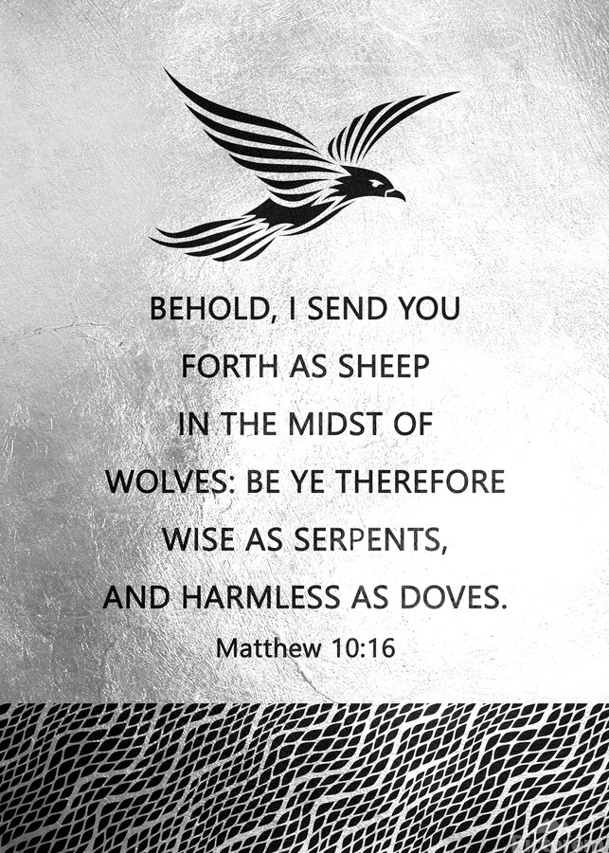
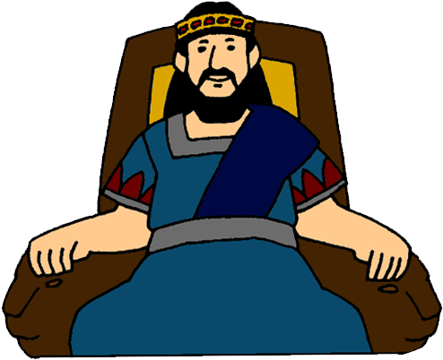
“¹⁵How beautiful you are, my darling, how beautiful you are! Your eyes are like doves.” (Song 1:15)
Shulamite’s Eyes
Inner disposition
Gentle/Innocent
Loyal
Trustworthy
Notes:
When we left vs. 14, the Shulamite is in Solomon’s presence, and he says this – Song 1:15 – Now, my guess is that this is Solomon speaking because he uses this same line in 4:1 where it is apparent that he’s speaking, and Solomon does repeat pick-up lines, so my guess is he’s the one speaking here. What is he saying?
(CLICK) We know from Jesus’ remarks in Matt 6:22 about the eyes being the lamp of the body that the eyes can represent a person’s innermost disposition. Since the eyes are often the initial means of contact w/a person, I‘d suggest Solomon could be giving his first impression of her character.
(CLICK) Jesus also uses the dove to represent harmlessness (Matt 10:16), so it could be that he sees her as a gentle woman w/an innocent, harmless disposition. And given the haughty, insecure, vain women he likely surrounded himself with, someone like the Shulamite would have been a breath of fresh air for him.
(CLICK) And another interesting feature about doves is that they’re known for only having one mate for their entire life. Some have suggested this is because doves don’t have any peripheral vision – they only see what is right in front of them. Ever wondered why when Jesus was baptized, it said the Spirit descended upon Him like a “dove”? Maybe the key to this is what He says about Jesus – “This is my beloved Son in whom I am well pleased” (Matt 3:17). The Father’s affection was focused squarely and narrowly on Jesus because of immutable character.
(CLICK) Point: Solomon believes she’d be different from the vain, materialistic harem in that he could trust that her attention would be squarely focused on him and him alone.

Slide 3
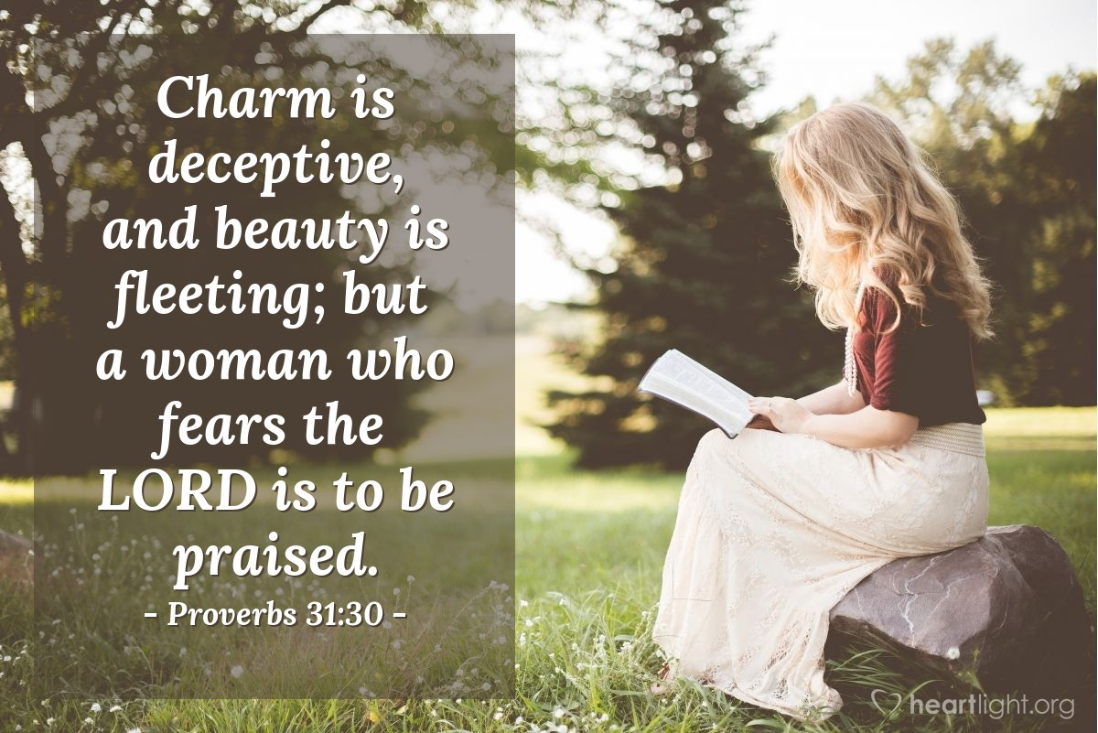
Focus On The Imperishable Qualities
Notes:
PRACTICAL APPLICATION – In romantic relationships, make the imperishable qualities your top priority. Illustration: I read an interesting thing online recently by the CEO of JP Morgan, who responded to an internet ad that a young lady posted on wanting to marrying rich. She’s a very pretty young lady, 25 yrs old, and basically said in the ad that she was looking for a man with a minimal annual income of $500k. She said $1M annually was ideal, though according to her that was only considered middle class in New York city where she was from. The CEO of JP Morgan responded to her ad, basically saying she’s not the first girl he’s seen wanting to marry a guy simply for his money. But then he stated that while he made more than $500k a year, it would be a bad business decision on his part to marry her: “Put the details aside, what you’re trying to do is an exchange of ‘beauty’ and ‘money’: Person A provides beauty, and Person B pays for it, fair and square. However, there’s a deadly problem here, your beauty will fade, but my money will not be gone without any good reason. The fact is, my income might increase from year to year, but you can’t be prettier year after year. Hence from the viewpoint of economics, I am an appreciation asset, and you are a depreciation asset. It’s not just normal depreciation, but exponential depreciation. If that is your only asset, your value will be much worse 10 years later.” – Great response.
(CLICK) Prov 31:30 – “Charm is deceitful and beauty is vain, but a woman who fears the Lord, she shall be praised.” Don’t focus on perishable qualities like looks and charm, rather the spiritual qualities that are within. Example – I married a beautiful woman and I am attracted to her. But when we are fighting, I could care what she looks like. Where her true beauty comes out is her godliness. Her gentleness, her desire to reconcile, to quickly forgive and to quickly ask for forgiveness, etc.
(CLICK) Also consider that those physical qualities fade over time, but the inner qualities for a spiritual person tend to get better and better as we age – 2 Cor 4:16.
COMMENTS

Slide 4
“¹⁶How handsome you are, my beloved, and so pleasant! Indeed, our couch is luxuriant! ¹⁷The beams of our houses are cedars, our rafters, cypresses.” (Song 1:16-17)
“¹⁵How beautiful you are, my darling, how beautiful you are! Your eyes are like doves.” (Song 1:15)
Married Life
Pleasant
Country living
Simple life
Notes:
Her response? – Song 1:16-17 – One the surface, it’d seem she’d be replying to Solomon because she’s standing before him. The problem is she only ever refers to the shepherd as her “beloved” and so it’s hard for me to take this as anything but her still daydreaming about the shepherd while she’s in Solomon’s presence. It’s hard to imagine she’d use that pet name for Solomon, too.
Then what is she doing? (CLICK) Well, while Solomon is trying to imagine what married life would be like w/her, she’s imagining what married life would be like w/the shepherd. She’s thinking about how attractive and pleasant her shepherd is. That term “couch” is not a wedding bed – it’s a day couch. Like most couples in love who dream of what married life would be like, they’d likely already talked about what kind of furniture they’d have, where they’d live, etc. (CLICK) And it would be a simple house w/cedar covered w/pine firs, in stark contrast to the palace Solomon lived in, probably alluding to country living that would be away from the hustle and bustle of city life in Jerusalem should she accept Solomon’s proposal. She seems to be someone who desires the simple life w/her shepherd.

Slide 5
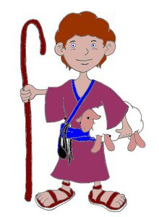
“¹I am the rose of Sharon, the lily of the valleys.” (Song 2:1)
“²Like a lily among the thorns, so is my darling among the maidens.” (Song 2:2)
“³Like an apple tree among the trees of the forest, so is my beloved among the young men. In his shade I took great delight and sat down, and his fruit was sweet to my taste.” (Song 2:3)
The Shepherd Provides Her With:
Exclusivity
Value
Self-worth
Provision
Peace
Protection
Security
Strength
Notes:
And the simple life makes sense, because she views herself as a simple girl – Song 2:1 – The rose of Sharon is a very common flower in Palestine, and lilies of the valley even more common. We’re seeing more of her modesty and humility as she deprecates her value. Yet there is something beautiful about the lily, as Jesus said even Solomon didn’t clothe himself after their glory.
And that’s how the shepherd sees her (CLICK) – Song 2:2 – My suspicion is that Solomon has completely faded from the dialog at this point as she’s remembering how the shepherd had expressed himself to her in the past. However simple she sees herself, when the shepherd compares her beauty to other women, they are like thorns. You know, sometimes ladies can act like “thorns” when they’re competing for a man’s attention, pricking one another which reeks of insecurity. The Shulamite was not like that at all. (CLICK) The Shulamite has a strong sense of self-worth, and the need she feels not to “compete” is admirable to him.
And she doesn’t see him as common either (CLICK) – Song 2:3 – As a lily stands out among thorns, an apple tree stands out amongst other trees. (CLICK) By “shade”, she receives from him peace and protection and security, the opposite of what she got from her brothers. When Ruth asked Boaz to throw his garment over her, she’s asking for the same. She doesn’t want to be vulnerable out in the world w/men chasing her as Solomon was, but someone to provide and protect her who actually loves her – that is the man’s job. Also, while the rose and the lily represent delicacy and fragility, trees represent strength. Women are butterflies and men are buffaloes, and this contrast makes marriages work. Men are to be providers, and to the Shulamite, the Shepherd’s provisions are sweet.

Slide 6
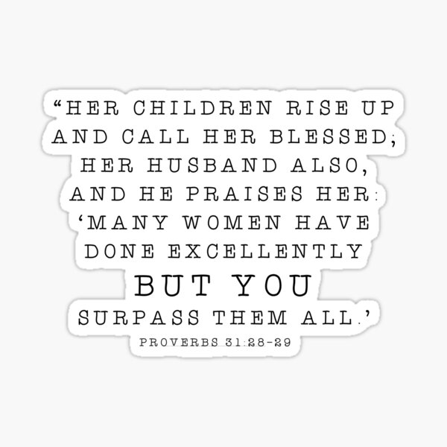
Before You Say
“I Do”
Notes:
PRACTICAL APPLICATION – Before you say, “I do”, ask yourself, “Why do I want to marry this person?”. In other words, “What will this person bring to marriage that is so precious to me that I can’t live w/o them?” “Why do I want to forsake all other people for just this one person?” Because that’s exactly what you’re going to say in the wedding ceremony. (CLICK) By the time that day comes, we better be saying, “I can forsake everybody else because there is no one better for me and more trustworthy and more Christ-like that I’ve found than this person”. (CLICK) The Flamingos – “I only have eyes…”
(CLICK) Prov 31:28-29 – “Her children rise up and bless her; her husband also, and he praises her, saying: ‘Many daughters have done nobly, but you excel them all.’” And if you’ve found someone like that, you better get on your knees and thank the Lord every day for that person.
See, whatever Solomon would give the Shulamite, he could not give her one thing the shepherd gave her, and that is the gift of being “preferred” above everyone else. To him, she’s the only one worth looking at as everyone else pales in comparison. And young people, if you have to wait years for this, don’t settle for anyone less.
COMMENTS

Slide 7
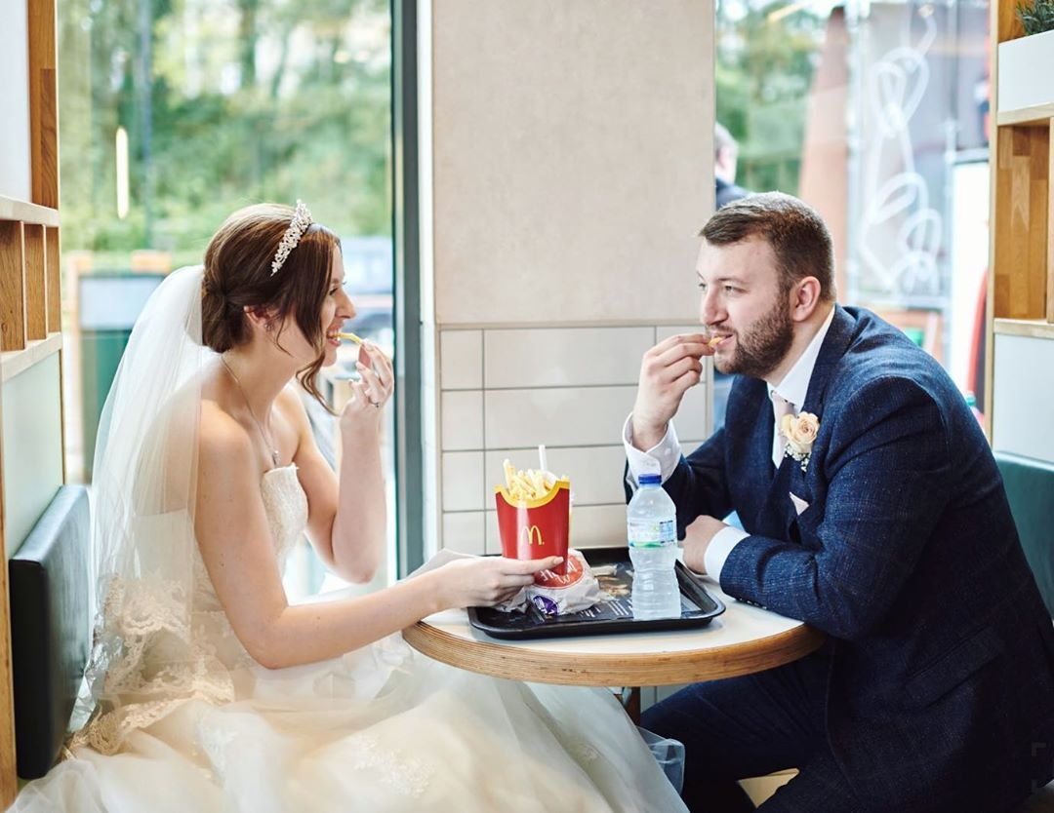
“⁴He has brought me to his banquet hall, and his banner over me is love. ⁵Sustain me with raisin cakes, refresh me with apples, because I am lovesick. ⁶Let his left hand be under my head and his right hand embrace me.” (Song 2:4-6)
The Shepherds Value
She’s drawn to him
She’s content w/him
Exhausts her w/happiness
Heals her w/affection
Notes:
Still daydreaming, she expounds further – Song 2:4-6 – The phrase “banquet hall” means “house of wine”. This was typically a place where people sat around and dined, as she was likely doing in Solomon’s tent. And no doubt there were military banners and tribal insignias surrounding her. Banners were typically used as military rallying points to lead others to. And so, the idea seems to be that just as the perfume she’d been gifted w/in chapter 1 reminded her of the shepherd, so do Solomon’s banners. (CLICK) What leads the Shulamite to the Shepherd’s “banner” wasn’t all the wealth, pomp, and prestige, rather how much the shepherd truly did love her. In contrast to the lavish feast and fancy food she is no doubt engaging in, to her, (CLICK) a simple feast of raisin cakes and apples is enough to sustain her when she’s w/her one true love.
Because when you’re in love, you don’t need an expensive restaurant. A couple sandwiches and some lemonade, a simple picnic, (CLICK) even a trip to McDonalds, is like a banquet to a couple in love.
(CLICK) And as she contrasts where she’s at w/what the Shepherd gives her, it’s making her lovesick – “exhausted w/happiness”. She is faint and disoriented from her desire to be w/him. (CLICK) And the only cure is for her to be w/him, and for him to embrace her as couples in love often do.

Slide 8
“⁷I adjure you, O daughters of Jerusalem, by the gazelles or by the hinds of the field, that you do not arouse or awaken love until she pleases.” (Song 2:7)
Love Must Not Be:
Coerced
Pushed
Rushed
Forced
Pushed
Disturbed
Bought
Misused
Notes:
And so, we’re getting a picture of what real sweetheart love looks right, and the Shulamite knows something about this. And so, she breaks out of her daydreaming to serve some advice to these daughters of Jerusalem (CLICK) – Song 2:7. This statement serves as a chorus within the song, repeated 2 more times.
What’s the point? The gazelles and hinds don’t find a partner through the kind of elaborate ceremony Solomon is putting on. No, it’s natural. Even they become acquainted before they mate. It is interesting she is saying this to the daughters of Jerusalem, because as we’ve already seen, they have a distorted sense of what should inspire marriage – they’re focused on the vain things like money, jewelry, security, the fact he is king, etc.
(CLICK) The idea is that love can’t be coerced, rushed, or forced. It can’t be pushed on someone through outside influence. “Don’t let this one get away!” – love doesn’t work that way. Love has to develop at its own pace; let it take its natural course. The process cannot happen artificially; it must blossom in due season. (CLICK) Love has a “do not disturb” sign on it. Remember, she’s already lovesick, so she knows firsthand that love is nothing to toy with. It takes a toll on a person. Love being such an enormous power, it needs to be handled w/care, and it dare not be misused.

Slide 9
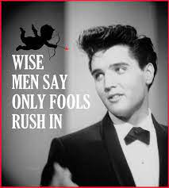
You Can’t Hurry Love
Notes:
PRACTICAL APPLICATION – See, the great danger is that we can be so desperate for love, we’ll rush into marriage for all the wrong reasons – loneliness, desperation (clock is ticking), physical attraction, pressure from others, money, to feel wanted, etc. Dating under these presuppositions is foolish. It will lead to pain, anguish, and broken hearts. (CLICK) As Elvis Presly famously said, “Wise men say only fools rush in”. What’s the rest? “But I can’t help falling in love with you”. You can’t help it. That’s the point! If true romantic love can’t be helped, then it shouldn’t be forced, and that kind of love is worth waiting for.
(CLICK) It’s not a race. And if you treat it like a race, you’re treating it not only as if it’s something that can be won, but something that has a finish line. And then what? On to the next race? And then how many other hearts will be broken?
Love shouldn't be rushed because it's not about a competition w/a finish line. Long is a life of growing together, and this kind of love is worth waiting for.
COMMENTS

Slide 10
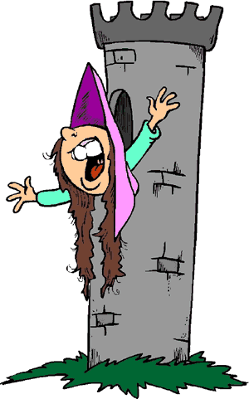
“⁸Listen! My beloved! Behold, he is coming, climbing on the mountains, leaping on the hills! ⁹My beloved is like a gazelle or a young stag. Behold, he is standing behind our wall, he is looking through the windows, he is peering through the lattice. ¹⁰My beloved responded and said to me,” (Song 2:8-10a)
Notes:
Her monologue continues in vs. 8 – Song 2:8-9. When you take the next few verses together, it almost seems as if the Shulamite suspects the Shepherd has heard about her situation and that she’s imagining his reaction. And if he’s like most guys, his response to this situation would be, “uh uh”. So, out of jealousy, he is attempting to close the distance between them (CLICK) and come to the rescue of his damsel in distress. That he’s looking through the windows and lattice is not to suggest he’s a peeping tom, rather that he’s enquiring about her. What we see in the Shepherd is a young man who is full of energy and eager as he pursues her.

Slide 11
“⁸Listen! My beloved! Behold, he is coming, climbing on the mountains, leaping on the hills! ⁹My beloved is like a gazelle or a young stag. Behold, he is standing behind our wall, he is looking through the windows, he is peering through the lattice. ¹⁰My beloved responded and said to me,” (Song 2:8-10a)
“Arise, my darling, my beautiful one, and come along. ¹¹For behold, the winter is past, the rain is over and gone. ¹²The flowers have already appeared in the land; the time has arrived for pruning the vines, and the voice of the turtledove has been heard in our land. ¹³The fig tree has ripened its figs, and the vines in blossom have given forth their fragrance. Arise, my darling, my beautiful one, and come along! ¹⁴O my dove, in the clefts of the rock, in the secret place of the steep pathway, let me see your form, let me hear your voice; for your voice is sweet, and your form is lovely.” (Song 2:10b-14)
Notes:
Song 2:10a – There were no doorbells during this time, so he’s calling out to her – Song 2:10b-13 – The cooing of the turtledove is a very distinctive signs of spring. The idea is, “You don’t want to be where you’re at. Come home, it’s springtime; let’s go spend time together in the open air and talk.” Right now, she’s got herself in a situation in which she’s shut in by a kind of society that is foreign to her, and he might be suggesting that this is suffocating her. He wants to free her from this.
Consider again the contrasts – a life w/the Shepherd is a life in the countryside that offers freedom, adventure, thrill, excitement, new growth, but it comes w/risks. However, the city scene offers security, safety, but requires an acceptance of certain conventions that will be dull and drab and feel like a prison for her free-spirited nature. She’s got to decide what she wants. As we’ve already seen and will see further in chapter 4, Solomon is primarily interested in her body. But the Shepherd is interested in spending time w/her. And vs. 13 hints that there is future blessing if she’ll take the risk.
Song 2:14 – See, right now the shepherd can’t get to her. He wants to be w/her, but he’s inaccessible. Another attribute of doves is that they are shy, timid birds, easily put to flight at the slightest hint of threat. Like a dove a little afraid to “come out” of the rocks, I think she knows that he sees the conflict in her. And if I’m correct that coming from a broken home made the security of palace-life a temptation, it’s causing her to be reluctant to take risks, and the Shepherd sees that about her. He thinks its time they should officially pull the trigger, but she’s vacillating due to insecurities and fears.

Slide 12
Marriage Requires Understanding
Notes:
PRACTICAL APPLICATION – I’d suggest he’s come to understand her a bit, and this is a husband’s job, (CLICK) to live w/his wife “in an understanding way” (1 Pet 3:7). A man must take the time to understand how the woman he loves ticks. Her fears and anxieties, her joys and pleasures, the things that occur that trigger those emotions. This is important for having a healthy, empathetic marriage.
But it’s also important because sometimes a woman can be hesitant to be reveal her innermost insecurities (CLICK) because of the tendency of us men to either be critical of how she’s feeling or want to be “fixers” rather than empathizers and listeners. The Shepherd recognizes a woman who is reluctant to reveal herself, who she really is. So, he’s figured some things out about her, but as we’ll see in the next verses, there’s a ways to go.
COMMENTS

Slide 13
“¹⁵Catch the foxes for us, the little foxes that are ruining the vineyards, while our vineyards are in blossom. ¹⁶My beloved is mine, and I am his; he pastures his flock among the lilies. ¹⁷Until the cool of the day when the shadows flee away, turn, my beloved, and be like a gazelle or a young stag on the mountains of Bether.” (Song 2:15-17)
Solving Relationship Snags:
Remove potential threats
Fight for love
Notes:
The Shulamite’s response to this reveals a bit more – SOS 2:15. Every caretaker of a vineyard knows that the gravest threats is not a storm or a fire or lions/leopards, (CLICK) but those small little foxes that sneak their way in covertly and reek havoc before you even know what’s happened. It’s widely believed from this verse that the Shulamite is referring to those seemingly “small things” that harm a relationship and keep it from being as fruitful as it needs to be. This adds a new dynamic to their relationship. They’re in love, that much is clear. (CLICK) But now it seems there might still be a few lingering things to work out between her and the shepherd, and that he needs to fight to fix those things. This adds another dimension to what possibly brought her to consider Solomon’s proposal. The plot thickens!

Slide 14
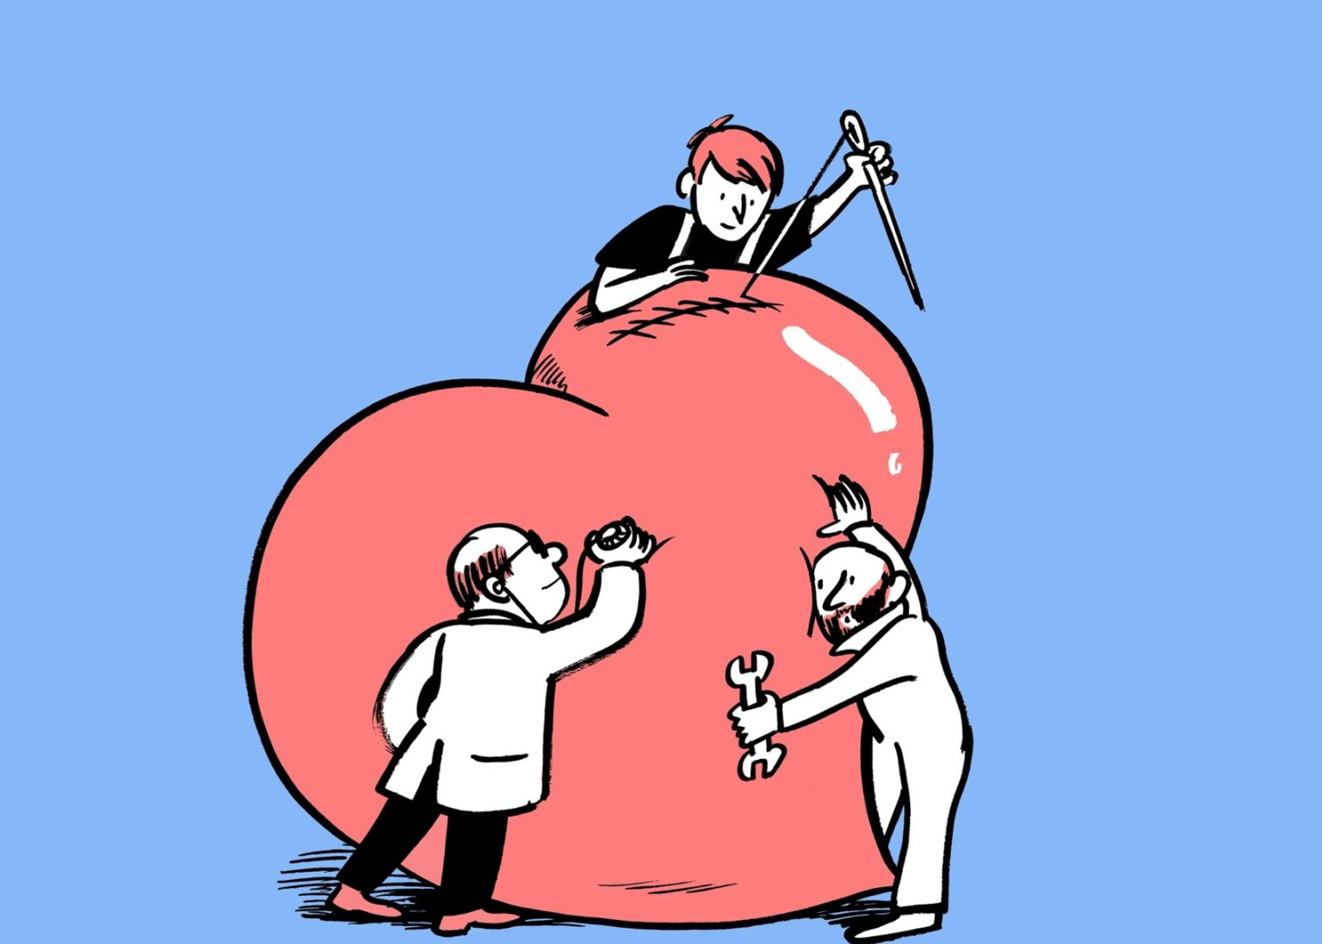
Solving Relationship Snags
Notes:
PRACTICAL APPLICATION – And what are the little things that can so easily pop up? Jealousy, selfishness, pride, unforgiving attitude, excessive teasing, uncontrolled desire that causes guilt and mistrust (foxes? I have seen the enemy and he is me). (CLICK) This appears to be a poetic way of her telling him that despite some of the issues that have popped up, not to take their relationship for granted, but to fight for it. A restraining of those things which would undermine their love. Ignoring the little things in a relationship can cause bigger issues in the future.
Also, that phrase from vs. 15 “are in blossom” in the Greek literally means “have tender grapes”. So, it’s not just external things that get in the way of fruitful relationships, there are vulnerable things that need protecting. (CLICK) 1 Pet 3:7 – “You husbands in the same way, live with your wives in an understanding way, as with someone weaker, since she is a woman; and show her honor as a fellow heir of the grace of life, so that your prayers will not be hindered.” This term “weaker vessel” needs to be taken in its context. It is true that women do not have the physical strength that men have, but it does not mean that they are weak creatures. Women give birth and yet I scream like a small child when I bang my pinky toe on the coffee table. Men think they’re so tough until they get the flu, and there isn’t much more pathetic than a sick man. I think what is meant by “weaker vessel” in this passage is that when a woman freely submits to the leadership of her husband, she is willingly placing herself in a position of vulnerability where she could potentially be hurt by uncaring and unsympathetic husbands. And so, this requires “understanding”.
COMMENTS

Slide 15
“¹⁵Catch the foxes for us, the little foxes that are ruining the vineyards, while our vineyards are in blossom. ¹⁶My beloved is mine, and I am his; he pastures his flock among the lilies. ¹⁷Until the cool of the day when the shadows flee away, turn, my beloved, and be like a gazelle or a young stag on the mountains of Bether.” (Song 2:15-17)
Solving Relationship Snags:
Remove potential threats
Fight for love
Work to solve what divides
Notes:
But even though there are issues to sort out, notice her confidence – Song 2:16 – They idea is they complete each other; there are mutual bonds of affection, reciprocity that brings balance to the relationship. She knows she has his heart, and he has hers. Vs. 16 is one of those verses that makes it difficult for me to imagine it being Solomon given how many wives he currently had.
So, he’s invited her to come be w/him, right? But in vs. 17 she’s saying, “Not yet” – Song 2:17 – “Until it’s the proper time, but keep being yourself.” The mountains of Bether were a mountainous range on the east side of the Jordan, but the word “Bether” means “divide, dividing”. This is likely a metaphor that there really were things besides Solomon that was keeping them apart. If that is so, she’s not just saying, “Now’s the right time”, she’s also encouraging him to be committed to cross the “divide that separated them”. She really does love him and doesn’t want their separation to be permanent. Rather, she wants him to use his strength to overcome the mountains of division between them as easily as if he were a gazelle or young stag.

