Slide 1
Notes:
Where we left off last week – Solomon has taken the Shulamite girl back to his palace in Jerusalem in order to further lure her into becoming his next wife. But she is still struggling w/her feelings for the Shepherd, and those feelings have now made their way into her dreams. She gives Solomon the chance to make his case to show her that he truly cares about her as a person, but all he can do at the beginning of chapter 4 is mainly compliment her on is her body. And once he crosses a line in 4:5, she decides to end the conversation and to depart for some alone time to think things through.
And so, as we pick in 4:8, it’s another one of those “time freezes” in which the text gives us a further peek into the Shulamite’s imagination as her thoughts dwell on the Shepherd – what he’d say to her now or perhaps what he has said to her in the past, and as she’s thinking about this, she’s likely contrasting this w/what Solomon has said to her. And what we’re going to learn from this “time freeze” will further complicate this drama.
PRAYER

Slide 2
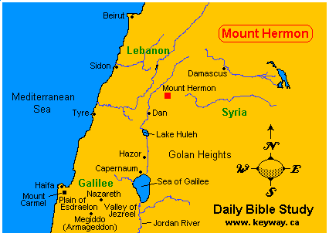
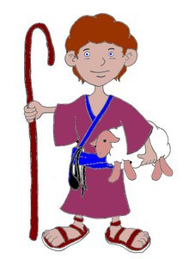
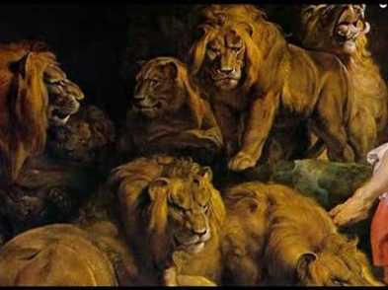
“⁸Come with me from Lebanon, my bride, may you come with me from Lebanon. Journey down from the summit of Amana, from the summit of Senir and Hermon, from the dens of lions, from the mountains of leopards.” (Song 4:8)
Shepherd’s Concern
She’s inaccessible
She’s in danger
It’s her choice
Notes:
Song 4:8 – None of the places mentioned should be taken literally, especially since we know she’s in Jerusalem, and the places mentioned are very far away, beyond Israel’s borders. (CLICK) “Lebanon” is north of Israel, and it is a word that closely resembles the word for “frankincense”. Recall that she told Solomon in 4:6 that she’d depart to the “hill of frankincense”, and since this is where the Shepherd is, metaphorically, this could be her veiled way of saying, “I just want to go somewhere alone where I can think about the Shepherd”.
The summit of Amana is northwest of Damascus, Hermon is a 9000ft mountain in Damascus and “Senir” is the Amorite name for it (Deut 3:9). Each of them are notable and foreboding mountains which, like Lebanon, are outside Israel’s borders. They are emblems, and the prophets often used “Hermon” and “Senir” to represent the carnal side of life as opposed to Jerusalem.
(CLICK) And what do the emblems “dens of lions” and “mountains of leopards” have in common? They’re dangerous situations. Remember where we left off in 4:1-7, Solomon’s carnal pickup lines that ended w/him complimenting her breast until she cut it off and asked to leave.
(CLICK) Point: – as she is alone meditating, she’s imagining a worried Shepherd (who is in the place of her “conscience”) trying to convince her to remove herself permanently from this carnal, dangerous environment of predators. And she’s going to have to be the one to do it because right now she’s as inaccessible to him as the summits of these mountains, as though she is on the far corners of the earth. That she is his bride would mean he expects to marry her.

Slide 3
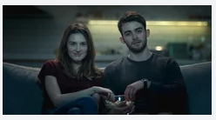
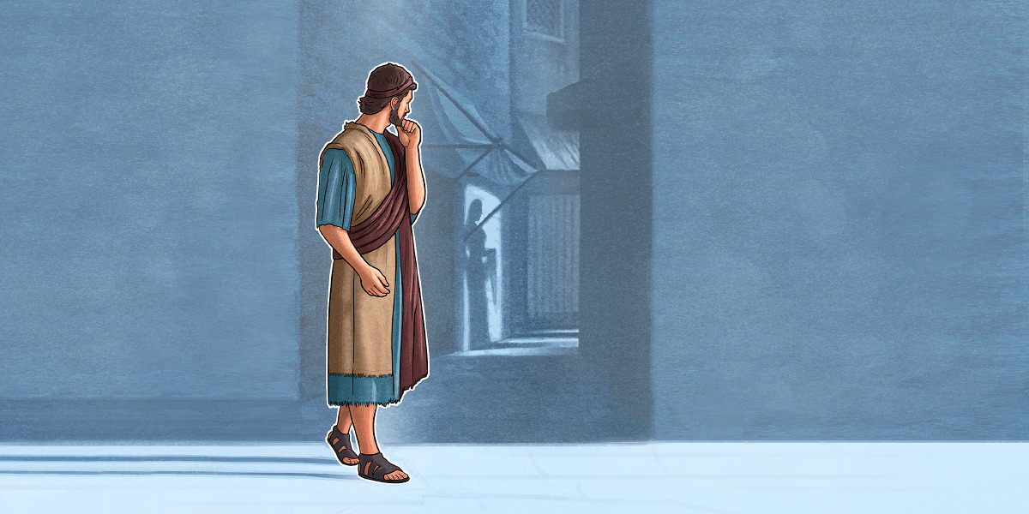
Avoiding Dangerous Situations
Notes:
PRACTICAL APPLICATION – Last week, we talked about the importance of fleeing youthful lusts. One day we may find ourselves in a situation like Joseph, that we can’t help, in which we’ll have to do this. But let’s be honest, many times we invite these situations by making unwise choices about where to spend our time w/those of the opposite sex. What are some of these situations?
Young and single? (CLICK) Alone in an apartment w/your boyfriend/girlfriend – “What’s wrong w/sitting down together and watching a movie?” Absolutely nothing in and of itself. In Prov 7, we read of a young man who was enticed by the harlot. But before she ever enticed him, what does it say about him? (CLICK) – Prov 7:7-10 – “I saw among the naive, and discerned among the youths a young man lacking sense, passing through the street near her corner; and he takes the way to her house, in the twilight, in the evening, in the middle of the night and in the darkness. And behold, a woman comes to meet him”. What was wrong w/him walking down this particular corner at night by himself? Absolutely nothing, in and of itself, same as being alone together w/your sweetheart in an apartment. But while we can talk all day long about how he should have fled when she started to seduce him, the fact is, he’s have never even opened the door for this possibility if he’d mindful of where he was. God includes this verbiage in this story for a reason because He wants to not put ourselves in situations in which the probability of something sinful happening occurs.
(CLICK)Married? Don’t be alone w/someone of the opposite sex. Safeguard your marriage, and the best way to do that is by agreeing upon boundaries w/your spouse – situations that are allowable and those that are not, and regular communication about these things.
COMMENTS

Slide 4
“⁹You have made my heart beat faster, my sister, my bride; you have made my heart beat faster with a single glance of your eyes, with a single strand of your necklace. ¹⁰How beautiful is your love, my sister, my bride! How much better is your love than wine, and the fragrance of your oils than all kinds of spices! ¹¹Your lips, my bride, drip honey; honey and milk are under your tongue, and the fragrance of your garments is like the fragrance of Lebanon.” (Song 4:9-11)
Shepherd’s Feelings
Crazy about her
Notes:
The next thing she’s going to remember about the Shepherd is just how smitten w/her he is. Keep in mind that this is fresh off of Solomon’s attempts to charm her. And so, what we’re going to notice is that though it is obvious the Shepherd is physically attracted to her, he speaks differently about her than Solomon did, lifting up her character and her love w/the utmost respect.
Song 4:9 – the term “my sister” was a conventional title in Israel, a common term of endearment in the East. Now, they’re both Israelites, but the idea is unlike Solomon, she is not a sexual object, but is like family to him. 1 Tim 5:2 – “the older women as mothers, and the younger women as sisters, in all purity.”
“you have made my heart beat faster” is one word in Hebrew = “to devastate him, stir him up”. Remember when she said about him in 2:5 that she was lovesick? (CLICK) Same kind of endearment, and it’s similar to, “you drive me crazy”. But in contrast to Solomon being affected by her body, (CLICK) the shepherd is affected by one look from her eyes, though he doesn’t describe her eyes. One single strand of her necklace makes him melt. Anything associated w/her brings him to his knees.

Slide 5
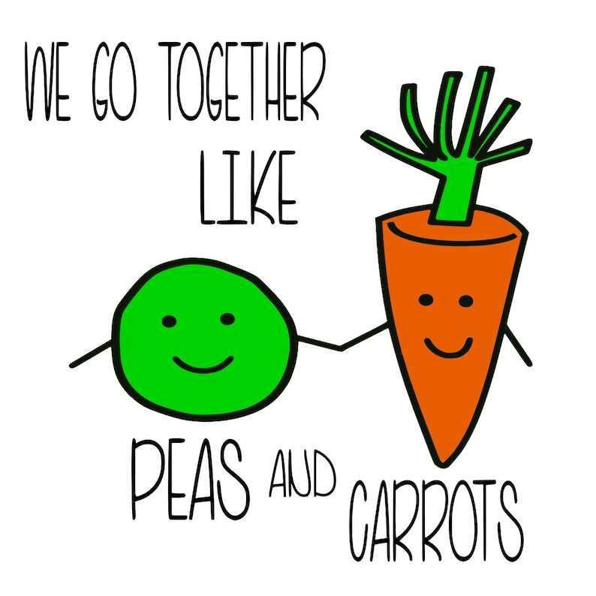
“⁹You have made my heart beat faster, my sister, my bride; you have made my heart beat faster with a single glance of your eyes, with a single strand of your necklace. ¹⁰How beautiful is your love, my sister, my bride! How much better is your love than wine, and the fragrance of your oils than all kinds of spices! ¹¹Your lips, my bride, drip honey; honey and milk are under your tongue, and the fragrance of your garments is like the fragrance of Lebanon.” (Song 4:9-11)
Shepherd’s Feelings
Crazy about her
Shared sentiments
Notes:
Song 4:10 – To him, her love was of great value, intoxicating, and enriches his life – it was unsurpassed. The smell she had picked up from being out in the flowers of the field was so much better than the expensive spices someone like Solomon could gift her. Compare this to what she said about him in 1:2-3 – same compliment. You almost see them arguing over whose love is better – “Your love is better than wine.” “No, your love is better than wine!” (agree to disagree). If you’re going to argue, you might as well argue over the other being the more awesome person.
What is interesting to see when you compare throughout this book the thoughts that they both have about one another, (CLICK) we find they have shared sentiments. The qualities she spent her life developing in herself are the things she saw in him and vice versa – shared sentiments, and that is the key to a healthy relationship, and what we’re looking for in someone we want to marry.

Slide 6
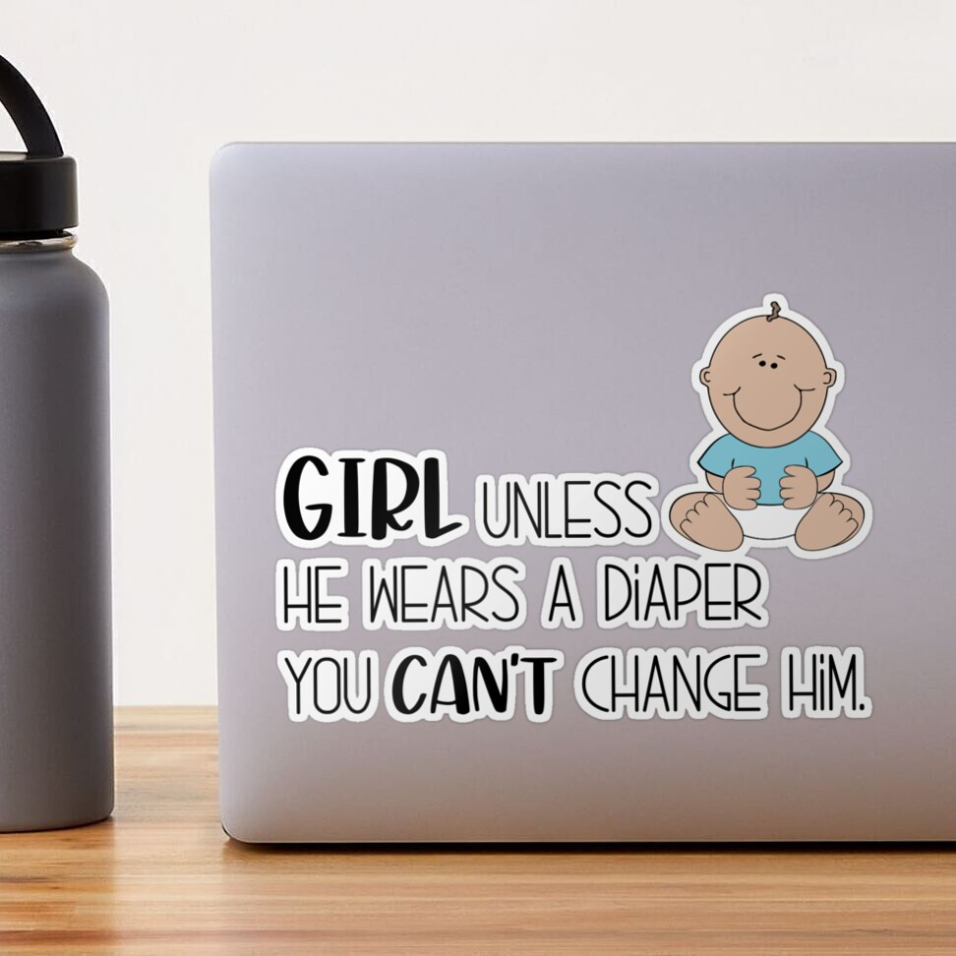
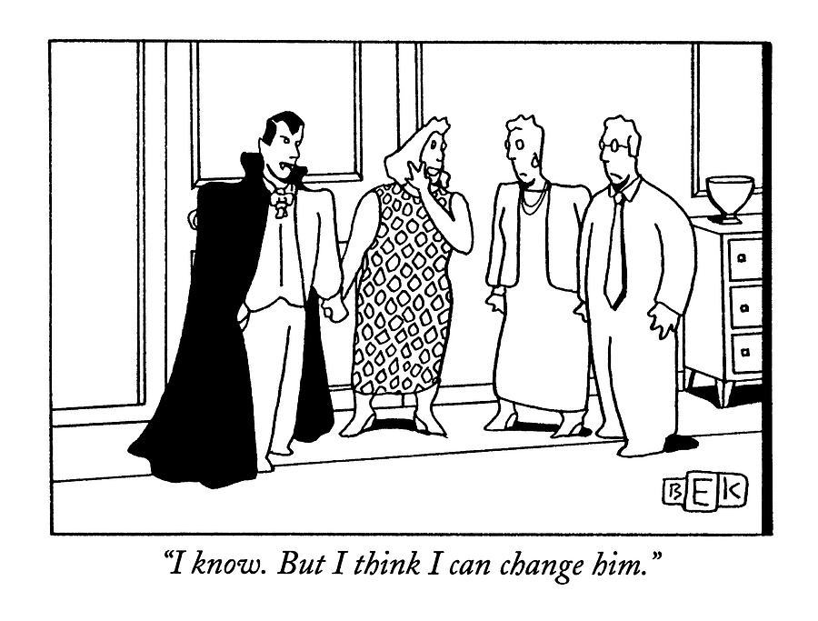
Don’t Marry Someone To Change Them
Notes:
PRACTICAL APPLICATION – Because what happens if you don’t? (CLICK) “I can change him”. Every single year, one of our college students decides they’re going to date a nonChristian. They start coming to church w/them here. Then they come up to me and say something like, “Can you help me teach him the importance of being baptized?” What are we, Catholic? No, I won’t teach him the importance of being baptized just so you can tell mom and dad he got immersed and they can feel better about you dating them. I will teach him about Jesus, the object of our faith, and once he gets to know Him, he’ll see the need to be baptized.
Also, remember that the dating relationship is when everybody is on their best behavior. When you’re married, those reins are removed and you begin to see each other as you really are. Don’t confuse the man you’re dating w/how he’ll be in marriage.
(CLICK) There’s a saying – “Unless he wears a diaper, you can’t change him.” Now, he can change himself. But the time to see if he does is before you marry him. And I’d even argue that the time to see if he’ll change is before you get romantically involved w/him so you can ensure all your objectivity is at your disposal.
COMMENTS

Slide 7
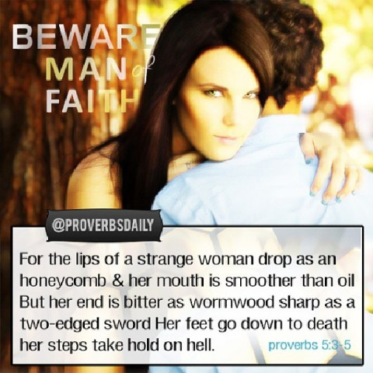
“⁹You have made my heart beat faster, my sister, my bride; you have made my heart beat faster with a single glance of your eyes, with a single strand of your necklace. ¹⁰How beautiful is your love, my sister, my bride! How much better is your love than wine, and the fragrance of your oils than all kinds of spices! ¹¹Your lips, my bride, drip honey; honey and milk are under your tongue, and the fragrance of your garments is like the fragrance of Lebanon.” (Song 4:9-11)
Shepherd’s Feelings
Crazy about her
Shared sentiments
Enjoys conversation
Notes:
Song 4:11 – I don’t think this is alluding to them kissing, (CLICK) but rather how much he enjoys listening to her, because this is a common emblem in the bible. (CLICK) Regarding the Law, David said in Psa 19:10 – “They are more desirable than gold, yes, than much fine gold; sweeter also than honey and the drippings of the honeycomb.” (CLICK) Prov 5:3 – “For the lips of an adulteress drip honey and smoother than oil is her speech”. Same emblems – to the shepherd, her words were sweet and he enjoyed listening to her talk, as it enriched his life as much as Canaan did for Israel, being the land of “milk and honey”.
Stark contrast to Solomon, isn’t it? All Solomon saw was a beautiful mouth, a beautiful smile, but he could care less about the beautiful words that proceeded from it. No, the shepherd loved conversation w/her.

Slide 8
“¹²A garden locked is my sister, my bride, a rock garden locked, a spring sealed up. ¹³Your shoots are an orchard of pomegranates with choice fruits, henna with nard plants, ¹⁴nard and saffron, calamus and cinnamon, with all the trees of frankincense, myrrh and aloes, along with all the finest spices. ¹⁵You are a garden spring, a well of fresh water, and streams flowing from Lebanon.” (Song 4:12-15)
Shepherd’s Feelings
Crazy about her
Shared sentiments
Enjoys conversation
Marriage potential
Notes:
Song 4:12-14 – Many commentaries suggest that the Shepherd is praising her virginity, knowing that should they get married, it will be something wonderful to be experienced by the man she chooses to give herself to. But I’d argue that this is too limiting of an interpretation. Let’s examine the word plays:
These spices in vs. 13-14 would have been some of the most expensive, valuable, and exotic on the earth. And until now, they’ve been locked up. But they’re ready to be let loose.
Yet these spices all came from distant lands, and for a single garden to contain all of them would either be a fantasy or transplanted for the wealthy. Even then, it would be a sensory overload.
The word “shoots” means “to send out” and can mean “tendrils” or “branches”
Pomegranates have a lot of seeds. They embody fruitfulness, and that’s her garden.
(CLICK) Point: The Shepherd sees just how awesome of a homemaker the Shulamite would make. She’d be an amazing wife, an amazing mother. She’s a person that would bear fruit, not just physically in the form of children, but what she’d bring to her family by way of her character, making that home what it ought to be. She’s got all those rare qualities and gifts that every man who sees her should say, “I’ve got to have her. I’m not going to find anybody better”.
Song 4:15 – (CLICK) The idea is that she’s “life giving”. As of now, all that potential is locked up, sealed up, and the Shepherd used “Lebanon” in reference to her inaccessibility in 4:8. But she’s got way to much to offer as a godly woman, and so her potential needs to be let loose where these fountains can flow out and make a home a gracious and beautiful home, because within her garden, she a wealth of value, richness, and abundance, like the virtuous woman of Prov 31.

Slide 9
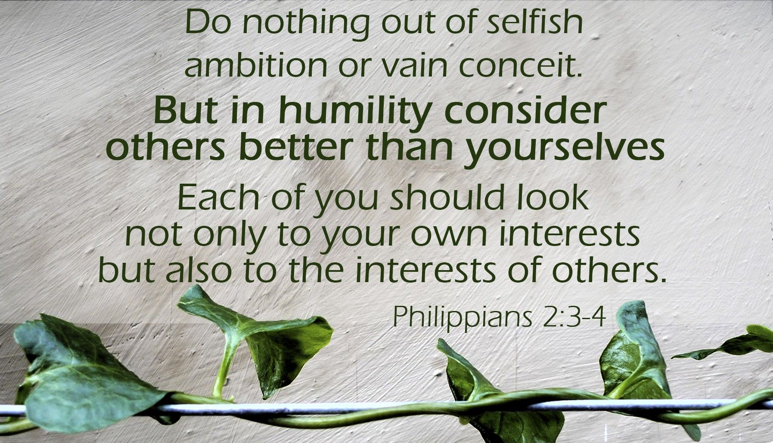
Be Someone Worth Pursuing
Notes:
PRACTICAL APPLICATION – We love to talk about what we’re looking for in a future spouse. But what we really need to be focusing on is being the person someone else cannot live without. Because marriage is not a selfish endeavor where one seeks to be spoiled and nursed by the other, but rather where we learn selflessness (CLICK) – Phil 2:3-4 – “Do nothing from selfishness or empty conceit, but with humility of mind regard one another as more important than yourselves; do not merely look out for your own personal interests, but also for the interest of others.” One must ask themselves:
“What traits, abilities, and sacrifices can I offer today to this individual to show them what kind of person I really am and want to be?”
“Will I help this person be the godly person they need to be?”
“Am I truly interested in seeing if something great can result from this relationship or am I merely passing time?”
Solomon sees an external physical beauty that infatuates him. (CLICK) The Shepherd sees an inner beauty of great light, that when released in the home would enrich that home. Big difference, isn’t it?
Boys, pay attention. That’s the difference between infatuation and true love. This garden’s water is protected so that it goes only to the rightful owner. There is abundance and beauty to be had when her garden is finally opened.
COMMENTS

Slide 10
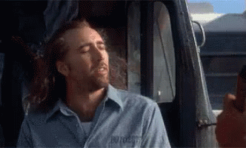
“¹⁶Awake, O north wind, and come, wind of the south; make my garden breathe out fragrance, let its spices be wafted abroad. May my beloved come into his garden and eat its choice fruits!.” (Song 4:16)
“¹I have come into my garden, my sister, my bride; I have gathered my myrrh along with my balsam. I have eaten my honeycomb and my honey; I have drunk my wine and my milk. Eat, friends; drink and imbibe deeply, O lovers.” (Song 5:1)
Shepherd’s Feelings
Crazy about her
Shared sentiments
Enjoys conversation
Marriage potential
Ready to marry
Notes:
Her reply? (in her mind) – Song 4:16a – Remember, this was her own advice to the daughters of Jerusalem to not “arouse or awaken love until it pleases”. (CLICK) Now she’s wanting the fragrance to reach the shepherd so that he’ll know she has chosen him. (CLICK) I believe this is the point where the Shulamite has finally made up her mind that she wants to be w/the Shepherd.
Song 4:16b – In other words, “I am yours. My garden has been locked up long enough, now I want to open it to you”, because notice she now refers to it as “his” garden. She wants to give the shepherd all the value and prosperity of her life that she has saved up for the man she loves. She’s ready.
And she’s imagining the Shepherd’s response being (bad chapter break) – Song 5:1a – In other words, his response is “Yes”. He accepts her invitation. When he imagines tasting life w/her, it’s the best life. What he is saying is, “I have found what I am looking for. There is nothing more to be proved. You’re exactly who I want just as you are.”
And then I think a chorus chimes in here – Song 5:1b – In other words, this is an unknown chorus encouraging this to happen, perhaps heaven itself endorsing this, as if to say, “When a couple in love reaches this moment, there is no point in putting off marriage – this is the time when marriage needs to happen, when both realize they can’t live w/o the other. To me, this is the pinnacle point of the book.
COMMENTS

Slide 11
“²I was asleep but my heart was awake. A voice! My beloved was knocking: ‘Open to me, my sister, my darling, my dove, my perfect one! For my head is drenched with dew, my locks with the damp of the night.’ ³‘I have taken off my dress, how can I put it on again? I have washed my feet, how can I dirty them again?’” (Song 5:2-3)
Shulamite’s Second Dream
The Shepherd arrives
She plays “hard to get”
Notes:
Now we get to the Shulamite’s 2nd dream. But unlike the one in chapter 3 which had a happy ending, this one turns out to be a nightmare! – Song 5:2 – (CLICK) So, this dream begins w/the shepherd coming to see her at night after she’s already gone to bed. From prior verses, this is what she wanted, right? And that his “head is drenched w/dew” probably implies he’d traveled all night to see her.
But she gives him these lame excuses – Song 5:3 – (CLICK) Sounds like she could be playing hard to get. Or is she teasing him? Playing on his emotions? Or, was it the chase/game that excited her? Does she think he’s being pushy and so therefore thinking, “Why should I run to the door as soon as he knocks? He can wait.” Odd that she’d be acting like this in her dream after we just saw at the end of chapter 4 that she decided to choose him. But maybe emotional vulnerability is getting the best of her better judgment and it’s scaring her and so she’s trying to regain control of relationship. Many ways to interpret this.
It reminds me of what Jesus says in Rev 3:20 – “Behold, I stand at the door and knock; if anyone hears My voice and opens the door, I will come in to him and will dine with him, and he with Me.” Despite her seeming to be ready to pull the trigger, maybe this dream is a reminder that she’s not as ready as she thought she was. Marriage requires sacrificial adjustments and she is thinking more about her discomforts than she is his discomforts.

Slide 12
“⁴My beloved extended his hand through the opening, and my feelings were aroused for him. ⁵I arose to open to my beloved; and my hands dripped with myrrh, and my fingers with liquid myrrh, on the handles of the bolt. ⁶I opened to my beloved, but my beloved had turned away and had gone! My heart went out to him as he spoke. I searched for him but I did not find him; I called him but he did not answer me. ⁷The watchmen who make the rounds in the city found me, they struck me and wounded me; the guardsmen of the walls took away my shawl from me..” (Song 5:4-7)
Shulamite’s Second Dream
The Shepherd arrives
She plays “hard to get”
Desire overcomes reluctance
Overplayed her hand
Subconscious guilt
Notes:
Song 5:4-5 – So, seeing his diligence, seeing his hand, it calms her and reminds her of the deep love they have for one another. (CLICK) Her desire overcomes her reluctance/excuses. She rushes to let him in. But it may be that she’s struggling to open the door because her hands were oily. In 4:16, she wants to opens her garden to him, but when he comes, she can’t even open the door to him.
But then she finally “gets a grip” – Song 5:6a – Wait a minute, I thought he was at the door? What happened to him? Apparently, her excuses put him off and he decided to leave. (CLICK) She overplayed her hand. He decided not to be pushy, not to force himself in and beg her to take him. He backs off and she realizes the big mistake she made.
Song 5:6b – And so, afraid that she’s lost him, she goes from not wanting to get out of bed to charging out into the streets in her pajamas looking for him and calling out to him. Ah, now the roles are reversed! Now she longs for him and won’t be satisfied until she finds him.
Song 5:7 – Did the watchmen strike her because they assumed she was a wanton, loose woman? (CLICK) Since it is a dream, it could be her subconscious’ response to her guilt over slowness in response.

Slide 13
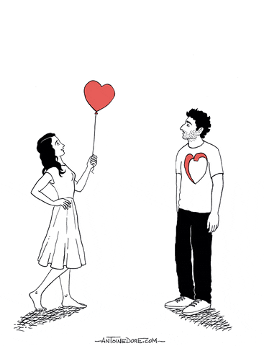
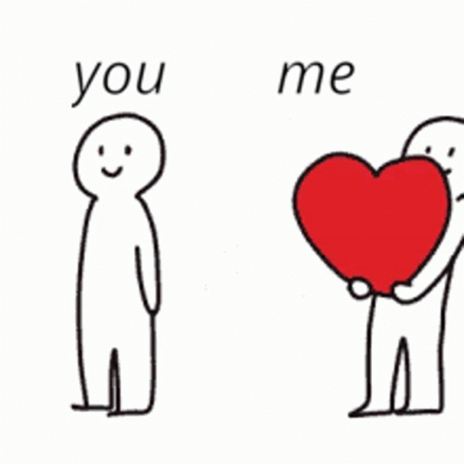
Romantic Relationships Are Serious
Notes:
PRACTICAL APPLICATION – This is a prime example of what can happen when you don’t take romantic relationships seriously. “But I don’t want anything serious”. Romantic relationships are serious things because they involve another person’s heart, soul, and future is wrapped up into this. That doesn’t mean they’re not fun and enjoyable, too. But dating is serious. If you’re not ready to be in a “serious” dating relationship, then don’t be in any dating relationship because by saying, “I don’t want anything serious”, what you’re really saying is, “I don’t want to take the other person seriously”. If you like spending time with that person, be their friend. But don’t introduce romance into the picture unless you’re ready to take them seriously as a potential future spouse. This is not a game. Don’t toy with someone else’s emotions for your own temporal gain.
As in the first dream sequence, the resolution is possible only as the protagonists in this song recognize the mutual responsibility each has to the other.
COMMENTS

Slide 14
“⁸I adjure you, O daughters of Jerusalem, if you find my beloved, as to what you will tell him: for I am lovesick.” (Song 5:8)
Notes:
Now she’s starting to express some regret for the actions that led her to Solomon’s court – Song 5:8 – In 2:5, she was overwhelmed by love. (CLICK) Here, she is aching, and can’t take it anymore. She fears the possibility of losing him, especially because the Shepherd doesn’t know that she is staying true to him because he doesn’t know what is happening in Jerusalem. So does she tell the daughters to search him out? The verse begins as if she is repeating what she’s already counseled the daughters, but it ends differently. She’s realizing she should have never entertained Solomon’s proposal.

Slide 15
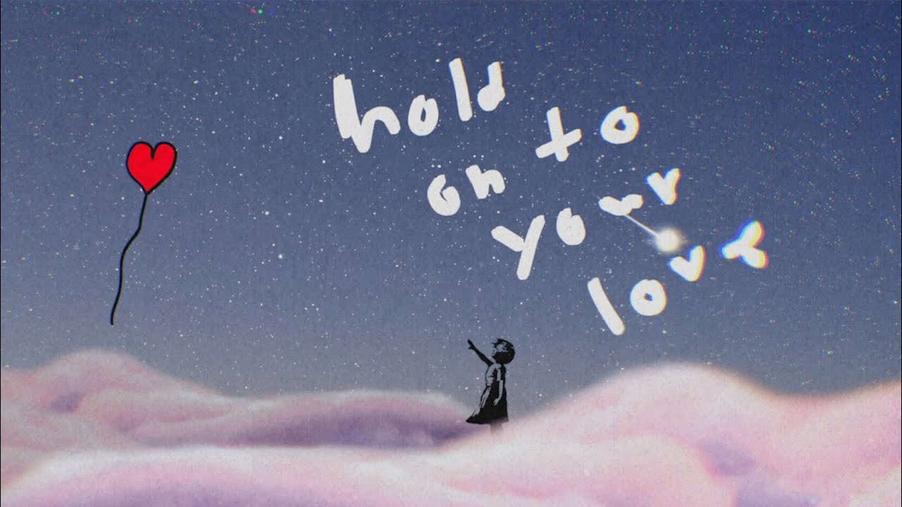
Don’t Let A Good One Get Away
Notes:
PRACTICAL APPLICATION – You come here and play games, date everybody you can, break up w/them, develop a reputation of “playing the field”, and then you do eventually meet “the one” you don’t think you can live without, will your prior reputation encourage them or repel them?
COMMENTS

