Slide 2
CURRICULUM
Sep 06: Introduction
Sep 13: Its Nature
Sep 20: Its Standard of Authority
Sep 27: False Standards (1)
Oct 04: False Standards (2)
Oct 11: Applying the Standard (1)
Oct 18: Applying the Standard (2)
Oct 25: Local Organization (1)
Nov 01: Local Organization (2)
Nov 08: Local Organization (3)
Nov 15: Nature of Worship
Nov 22: ***No Class***
Nov 29: Elements of Worship
Dec 06: Its Work of Edification
Dec 13: Its Work of Evangelism
Dec 20: Its Work of Benevolence
Dec 27: ***No Class***
Jan 03: ***No Class***
Notes:
As we studied last week, interpreting the NT is not limited to obeying direct commands. God also reveals His will through indirect methods such as “approved examples” and “necessary implications”, and we derive authority through these indirect methods.
We also looked at 2 different categories of commands – those which are specific and those which are general. A specific command limits our choices to those things God has specifically identified, but general commands give us some liberty for determining the most appropriate ways to carry out commands in which God was not specific, and we’ll inevitably use “aids” to achieve these general commands.
And yet we also saw last week that God expects His silence to be respected. We must not add anything to what He has already revealed – 2 Tim 3:17 tell us He has equipped us for every good work.
This actually presents another potential issue. As we determine the best “aids” by which to fulfill those general commands that God gives us, if we’re not careful, what may look like an “aid” could actually end up being an “addition” by which we are adding to what God has already revealed, and thereby not respecting His silence.

Slide 3
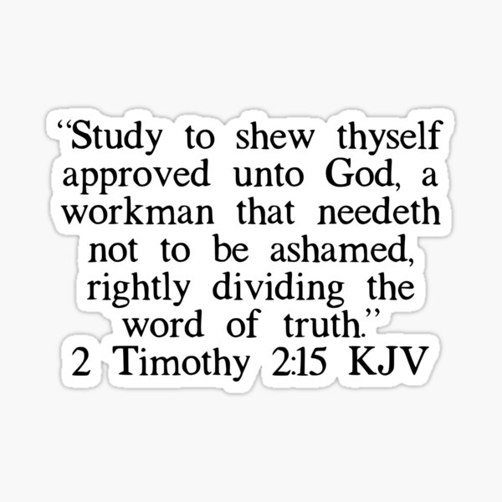
Notes:
So, how do you toe the line? One way is by what is taught in 2 Tim 2:15 – rightly dividing, or accurately handling, God’s word means we must pay attention to things like context, we must resist the urge to isolate verses by themselves at the expense of other teaching in scripture, we must look at the overall picture of scripture, and host of other considerations.
But what are we looking for? What principle do we need to understand to best help us rightly divide as it pertains to obeying general commands?

Slide 4
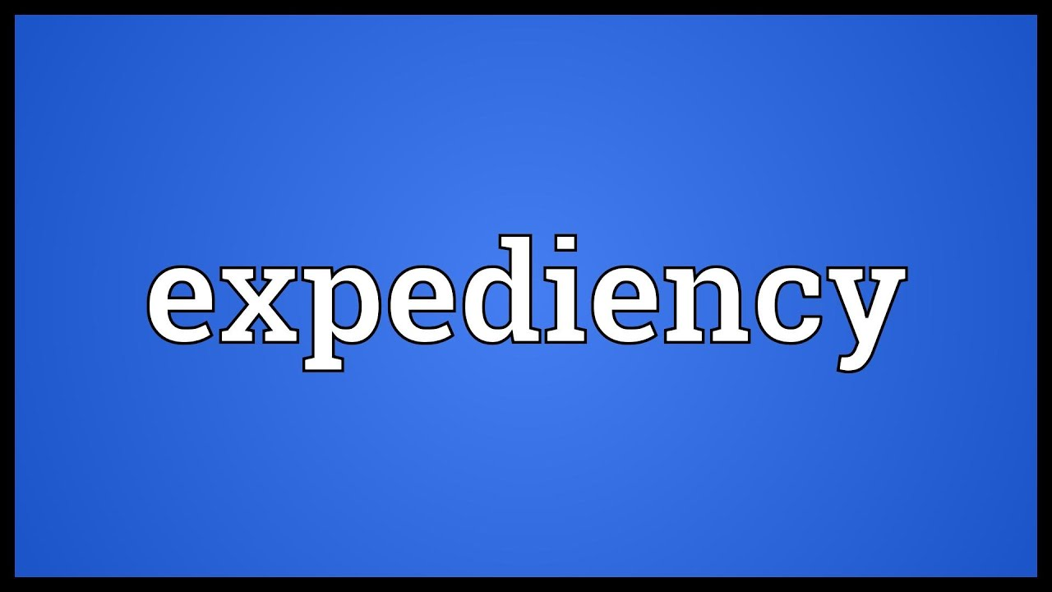
Notes:
The answer is the principle of “expediency”. By determining what is the most expedient way to carry out a general command, this will help us to distinguish between what is an “aid” and what is an “addition”. And like every other hermeneutical technique we’ve looked at so far, “expediency” is a scriptural concept – 1 Cor 10:23 – “All things are lawful for me, but all things are not expedient: all things are lawful for me, but all things edify not.”

Slide 5
Expediency
“appropriate to a purpose”
“a spiritually profitable or advantageous method for carrying out the Lord's instructions to us.”
“An advantageous means or method that one may use to accomplish a goal. It signifies that which is suitable for achieving certain ends.”
Webster defines an expedient as something “useful for effecting a desired result; suited to the circumstances or the occasion; advantageous, convenient.”
Notes:
What is expediency? There are several ways to define it – these four definitions are pretty good
.
.
.
So, when God gives us a “general command”, there is some liberty in how we obey it. But rather than just opening the floodgates to allow us to do whatever we want, thus finding ourselves in a situation where we’re adding to God’s word, by being expedient, we’re looking at the best choice among various options. And fortunately for us, the bible sets certain guidelines that will help us to obey God’s commands in the most expedient way possible. And by sticking to these very reasonable guidelines, it will help us avoid a lot of trouble.
PRAY

Slide 6
Expediency
Spiritually Profitable?
1 Cor 10:23 – “All things are lawful for me, but all things are not expedient: all things are lawful for me, but all things edify not.”
Mark 16:15-16 – “¹⁵And He said to them, ‘Go into all the world and preach the gospel to all creation. ¹⁶He who has believed and has been baptized shall be saved; but he who has disbelieved shall be condemned.’”
Notes:
#1 – “Is it spiritually profitable?” – 1 Cor 10:23 (KJV) – The context Paul is speaking in terms of are those things which are matters of liberty, and we would all agree there is liberty in obeying general commands. But in the NASB, it uses the word “profitable” in place of “expedient”, and we saw that word in one of the definitions we looked at – “a spiritually profitable or advantageous method for carrying out the Lord's instructions to us.” And so, when confronted w/a general command, one of the questions we need to be pondering is, “What is the most spiritually profitable thing to do in this particular case?”
(CLICK) Let’s use our test case we looked at last week – Mark 16:15-16 – One of the points we made last week is when it comes to “go” preach the gospel, God does not specify how we are to “go”. We could walk, run, ride a bike, take a car, take a plane, etc. But if I’m trying to be expedient, I have to look at the particular situation and, all things considered, try to determine what is the most spiritually profitable thing to do.
Example: In 2017, Bob Simpson and I went to Guatemala and did some preaching in the city of Quetzaltenango, in the spirit of “go into all the world.” Now, there are several ways to get to Guatemala – what would be the most expedient way? Would the most profitable way be to drive there? (CLICK) We’d have to get to the Mexican border, drive all the way through Mexico, a long way, and then into Guatemala. I would argue that when you consider time, money, and safety, that is not the most expedient way to get to Guatemala. On the other end, what if the church paid to rent us a private jet? That’d be nice, we’d be safe, well rested and relaxed. But think about the money, how it would look, etc. No, I think we’d all agree that all things considered, money, safety, time, taking a normal flight to Guatemala was the most expedient way to “go”.
Example: Cuba? Can’t travel by air…
So, expediency is about what is spiritually profitable. However, that doesn’t always mean it’s the most convenient thing to do. In fact, an expedient might involve a large amount of labor and effort, yet have the biggest pay off spiritually. As stewards of God’s resources, this is something we have to think about.

Slide 7
Expediency
Spiritually Profitable?
Lawful?
1 Cor 10:23 – “All things are lawful for me, but all things are not expedient: all things are lawful for me, but all things edify not.”
Mark 16:15-16 – “¹⁵And He said to them, ‘Go into all the world and preach the gospel to all creation. ¹⁶He who has believed and has been baptized shall be saved; but he who has disbelieved shall be condemned.’”
Notes:
#2 – “Is it lawful?” – 1 Cor 10:23 – While there is liberty in many matters, if an expedient causes us to violate other areas of God’s word, it cannot be a true expedient.
Example – Let’s keep using Mark 16:15-16 as our test case. Another point we made about this verse last week is that God does not specify “where” a person must get baptized. It could be a baptistry, a lake, a river, a pool, the ocean, anywhere we could fully immerse the person obeying the gospel. In fact, the most expedient way to go about this might actually come down to what we have the easiest access to, given that scripture indicates baptism is something that is to be done immediately. I once baptized someone in the ocean from a boat 5 miles off-shore – it was the most expedient way to do it at the time.
Example – However, there is an episode recorded by the early church historian Eusebius in 253AD (Church History VI. xliii. 14, 17) in which a man named Novation was sick and confined to a bed. Has had never been baptized. Because of the difficulty involved in immersing him, a local “bishop” allowed him to simply have water poured on him. This is the first known historical incident we have of baptism by any other means than immersion. Now some might argue that given the circumstance, this was just as much an expediency as whether or not you baptize someone in a lake, an ocean, or a river. But baptism is a burial (Rom 6:4-5). The very word itself means to “dip, to plunge, to immerse”. And so, by having watered poured on him, what this bishop reasoned at the time as simply a matter of convenience actually violated other clear, scriptural principles about baptism. A true expediency must lie within the scope of God’s authority. If it doesn’t, if doing it causes us to violate other scripture, it ceases being an aid and becomes an addition that violates God’s law.
COMMENTS

Slide 8
Expediency
Spiritually Profitable?
Lawful?
Edify?
1 Cor 10:23 – “All things are lawful for me, but all things are not expedient: all things are lawful for me, but all things edify not.”
1 Cor 14:26c – “Let all things be done for edification”
Rom 14:15b – “Do not destroy with your food him for whom Christ died.”
Rom 14:19 – “So then we pursue the things which make for peace and the building up of one another.”
Notes:
#3 – “Does it edify?” – 1 Cor 10:23 – This could easily be classified under, “Is it lawful?” because (CLICK) 1 Cor 14:26c. The word “edification” means to “build up”, and as we’ll study later, this is one of the primary works of a local church, and one of the primary reasons behind our worship next to praising God. And so, as we’re judging how to best go about doing certain things, if our intent tis to build up as best we can, we should be making decisions equips to give God our best. We want the best teaching at this church, the best song leading, the best bible classes, and we want to provide one another the best opportunities to grow stronger in faith and in our service to God and one another. That’s one aspect of this.
Now, what is the opposite of “build up”? It is to “break down”. And so, in determining what is the most expedient way to apply God’s word, by implication, we’d want to avoid tearing down another person (CLICK) – Rom 14:15b – The food we eat is a matter of liberty, after all.
Example – Suppose someone is glutton free, and this is due to health reasons. I’ve known brethren who get pretty severe migraines if they eat even a little bit of glutton. Could we revert to glutton free bread for the LS in order to keep from hurting our brother/sister every time they ate it? I don’t see why not, as there don’t appear to be any laws we’re violating doing so. However, what if they asked us to swap out bread completely and substitute another food? We couldn’t do that because when Jesus instituted the LS, He specifically listed bread and fruit of the vine as the elements we would partake of.
So, while a true expedient deals w/matters of wisdom, judgment, and choice, even so, we should never select a path that tears down rather than builds up (CLICK) – Rom 14:19 – We must not tear down someone by insisting upon our own way. Let all things be done for edification.

Slide 9
Expediency
Spiritually Profitable?
Lawful?
Edify?
Stumbling block?
1 Cor 8:9 – “But take care that this liberty of yours does not somehow become a stumbling block to the weak.”
Rom 14:13 – “Therefore let us not judge one another anymore, but rather determine this—not to put an obstacle or a stumbling block in a brother’s way.”
Notes:
#4 – “Is it a stumbling block?” – 1 Cor 8:9 – An expedient must not lead others to sin. Paul taught in 1 Cor 8 that eating meats sacrificed to idols was, in itself, lawful. Yet, in certain situations, it was a stumbling block to weaker brethren as it would lead them to violating their conscience.
Example – Muslims don’t eat pork. Suppose we convert someone who for their entire lives was Muslim and despite the fact that they are now a Christian, they still can’t bring themselves to eat pork? If we were having that person over to dinner shortly, would it be right to slap a big juicy porkchop on their plate and say, “Oh just eat it already, God doesn’t care.” No, we would be trying to make them violate their conscience about some matter of liberty, and would become a stumbling block to them.
(CLICK) Rom 14:13 – We should never insist on a particular expediency if it is either violating the conscience or causing a brother to sin. We would need to look into another means by which to fulfill general commands.

Slide 10
Notes:
Now, if I’m sitting here listening to this stuff for the first time, I might be tempted to think, “Expediency? This is kind of petty. Does this stuff even matter?”
Yes, because not understanding these principles has led to changes in the gospel. Not understanding these principles has led to fighting and division. And not understanding these principles has led to the greatest apostasy the church has ever seen, as I’ll attempt to show in 2 weeks. What often first looks like an “aid”, an “expedient”, can so easily become a “practice” which later can become “doctrine”. And it always happens in small steps.
See, as a local church, we have to make decisions about how to go about doing the things God would have us to do. But every now and then, we are going to make mistakes. When that happens, when we realize that what we’re doing is violating one or more of the principles of true expediency, we need to stop it, make a course correction, and we need to be transparent about that. See, making a mistake, being wrong, is not the worst thing in the world while we’re still on this earth. Because you know what one of the greatest things is about coming to the conclusion that we’ve been wrong? It gives us a chance to be right. This is one of the million reasons why we love God – in His grace, He allows us to mess up and to make the proper adjustments. We wouldn’t be here if He didn’t. The absolute worst thing we could ever do is stubbornly hang on to something just because it’s the way we’ve always done it, it’s what my family members have done for generations, or because my ego simply won’t allow me to admit error. No, when mistakes come to light, we just need to correct it, try to do a better job in the future, and show one another grace when correction is actually made.
This is important for all to understand, both as individuals and as a local church, and it will be very important to remember when we begin talking next week about the organization, the worship, and the work of the local church.
COMMENTS

Slide 11
False Standards
“On no other foundation can the parties ever meet, than on the Bible alone, without note or comment; and in no other name will they ever unite, but in that given to the disciples at Antioch - CHRISTIAN. But should all the professors of Christianity reject all their various creeds and names, and agree to receive the Bible alone, and be called by no other name than Christian, will this unite them? No, we are fully convinced that unless they all possess the spirit of that book and name they are far, very far, from Christian union.” – Barton Stone, published in ‘The Christian Messenger’ (1828)
Old Testament
Majority Rule
Family
Elders
Preachers
Creed/Tradition
Government
Conscience
Human Wisdom
Feelings
Fear
Comfort
Desire
Dream/Vision
Notes:
Barton Stone, one of the leading pioneers in the Reformation movement in the 19th century, wrote these insightful words in an article entitled "Christian Union" published in The Christian Messenger (1828): “On no other foundation can the parties ever meet, than on the Bible alone, without note or comment; and in no other name will they ever unite, but in that given to the disciples at Antioch - CHRISTIAN. But should all the professors of Christianity reject all their various creeds and names, and agree to receive the Bible alone, and be called by no other name than Christian, will this unite them? No, we are fully convinced that unless they all possess the spirit of that book and name they are far, very far, from Christian union.”
Just like most of you, I feel like I’ve sat through seemingly countless bible studies on authority – I’ve preached my fair share of sermons on it. In fact, we almost pride ourselves in being the ones who know how to apply God’s word better than everyone else out there. And yet for all the teaching we’ve done on it, I, just like you, have watched brethren who espouse these principles begin to fold when one or more of those false standards of authority start taking precedence (CLICK) – family, fear, some fleshly desire, pride. You know who else I’ve seen fold when they needed to take a stand? Me. We’ve all done it. But I’m thankful for brethren who have loved me enough to pull me aside and correct me when I’ve fallen prey to this.

Slide 12
Finding Unity
Diligence
Eph 4:1-3 – “¹Therefore I, the prisoner of the Lord, implore you to walk in a manner worthy of the calling with which you have been called, ²with all humility and gentleness, with patience, showing tolerance for one another in love, ³being diligent to preserve the unity of the Spirit in the bond of peace.”
Notes:
So, what is involved in finding unity among one another? What is this “spirit of the book and name” Barton referred to? (CLICK) – Eph 4:1-3 – I want to start w/the last thing on the list – (CLICK) diligence.
That word “diligence” means to be “eager, zealous, to make haste, fervent, to move speedily”. When there is an issue in our unity, a doctrinal dispute, an unrepented of sin, we are not doing God’s will by sweeping it under the rug. That is the most unbiblical, scripturally backwards stand that we could ever take as Christians, as a local church. We are to be diligent to preserve unity, and this of course requires some work. But it is work that will more often than not weed out those who are serious about doing God’s will from those who are not.
Example – Years ago at a previous church I preached at, we discovered that one of our families was in a MDR situation. We had just gotten an eldership and they were still finding their bearings and when they found out, the way they decided to handle the situation is to address it w/the family and give them two weeks to decide what they were going to do before the church took action. Well, I was a lot younger and more inexperienced than I am now, but I knew that wasn’t the way to go about that so I asked the elders to first allow me to study the issue w/them. I had a good relationship w/this family and I wanted to see if I could leverage that by reasoning w/them from scripture. The elders agreed. I had 3 studies w/them about the issue. The first one was very uneasy. The 2nd study was extremely tense, and they were ornery. Then by the end of the 3rd study, they were yelling and cussing at me and refused to study the issue any further, w/me or anyone else. And after they continued to refuse study, I spoke to the elders, we informed the church, and after that didn’t work, we withdrew from them.
What is a major aspect of our fellowship as Christians? – Acts 2:42ab – “They were continually devoting themselves to the apostles’ teaching and to fellowship…”. Unity demands that both sides of an issue be diligent to preserve unity. When one side is being diligent and the other is not, not only is that often a good indication of which side is in error, it often dictates the bounds of fellowship. But diligence is a spirit we must have if we’re ever going to get on common ground.

Slide 13
Finding Unity
Diligence
Humility
Eph 4:1-3 – “¹Therefore I, the prisoner of the Lord, implore you to walk in a manner worthy of the calling with which you have been called, ²with all humility and gentleness, with patience, showing tolerance for one another in love, ³being diligent to preserve the unity of the Spirit in the bond of peace.”
Notes:
“With all humility” – It took humility to obey the gospel. Because in doing so, we all admitted that we were sinners, that we were wrong. But the idea that we are wrong and continue to make mistakes in judgment, that we continue to be works in progress, that is supposed to carry over into our Christianity, too – 1 John 1:8 – “If we say that we have no sin, we are deceiving ourselves and the truth is not in us.” But there will always be this pull to want to be “right” and not have to admit wrong to other people, especially people you’re not unified with. Unity cannot be achieved w/o humility. In fact, unity w/God Himself cannot be achieved w/o humility – Jas 4:6b – “God is opposed to the proud, but gives grace to the humble.” We must have true humility if we’re to be unified w/one another as well as our God in heaven.
COMMENTS

Slide 14
Finding Unity
Diligence
Humility
Gentleness
Eph 4:1-3 – “¹Therefore I, the prisoner of the Lord, implore you to walk in a manner worthy of the calling with which you have been called, ²with all humility and gentleness, with patience, showing tolerance for one another in love, ³being diligent to preserve the unity of the Spirit in the bond of peace.”
Notes:
“gentleness” – You’d probably take it personal if someone started cussing you out on in public for seemingly no reason, unless you found out that person had Tourette Syndrome. Then you’d approach it entirely different. Brethren, sin is not personal, and so there’s no need to get worked up about it. Hurting people hurt people. And so, conflict needs to be handled w/gentleness – Gal 6:1a – “Brethren, even if anyone is caught in any trespass, you who are spiritual, restore such a one in a spirit of gentleness”. You may have to be blunt, but be gentle.

Slide 15
Finding Unity
Diligence
Humility
Gentleness
Patience
Eph 4:1-3 – “¹Therefore I, the prisoner of the Lord, implore you to walk in a manner worthy of the calling with which you have been called, ²with all humility and gentleness, with patience, showing tolerance for one another in love, ³being diligent to preserve the unity of the Spirit in the bond of peace.”
Notes:
“Patience” – unity is often not accomplished the first conversation through…nor the second…nor the third. It might not get done in a day…or a week…or a month…or even a year. Otherwise, there would be no reason to be diligent – 1 Thes 5:14 – “We urge you, brethren, admonish the unruly, encourage the fainthearted, help the weak, be patient with everyone.” It takes some people time to come to terms w/some things. Be as patient toward them as you want God to be patient w/you.
COMMENTS

Slide 16
Finding Unity
Diligence
Humility
Gentleness
Patience
Tolerance
Eph 4:1-3 – “¹Therefore I, the prisoner of the Lord, implore you to walk in a manner worthy of the calling with which you have been called, ²with all humility and gentleness, with patience, showing tolerance for one another in love, ³being diligent to preserve the unity of the Spirit in the bond of peace.”
Notes:
“Tolerance” – some of your translations say, “forbearing” or “bearing with one another”, which is a better translation IMHO. In Rev 2, Jesus was against the church in Thyatira because they tolerated the woman Jezebel. I “think” that the idea of bearing w/someone in situations like this is recognizing what is behind the actual issue at play. In the example of the guy w/Tourette Syndrome, it was a disease. I may not like that he is having a meltdown, and he still needs help, but now that I know why he is acting this way, it allows me to hone in on the root problem as opposed to being too obsessed over the symptom. Why is this brother or sister acting this way? What is their background? Was there some tragedy in their life that is behind why they are taking this position? Some scars? Knowing these things doesn’t mean there isn’t still an issue that needs addressed and correcting, but it does help illuminate how I can best help them because it may be by bearing a burden for them, that will go a long way toward solving an issue of division than simply confronting them.

Slide 17
Finding Unity
Diligence
Humility
Gentleness
Patience
Tolerance
Love
Eph 4:1-3 – “¹Therefore I, the prisoner of the Lord, implore you to walk in a manner worthy of the calling with which you have been called, ²with all humility and gentleness, with patience, showing tolerance for one another in love, ³being diligent to preserve the unity of the Spirit in the bond of peace.”
Notes:
“Love” – This should go without saying. I should not aspire to unity simply because what the other person is doing for me is aggravating. I should want unity out of a sincere love for God and His word and a love for my brethren. There must resonate within our spiritual family a love that cares so much for another brother/sister in Christ, that we cannot stand for that person to continue to be blinded by the walls they’ve built around them.
When these “spirits” exist within us, unity is achievable. When we don’t have this spirit from these verses, there will only be division and strife.

Slide 18
CURRICULUM
Sep 06: Introduction
Sep 13: Its Nature
Sep 20: Its Standard of Authority
Sep 27: False Standards (1)
Oct 04: False Standards (2)
Oct 11: Applying the Standard (1)
Oct 18: Applying the Standard (2)
Oct 25: Local Organization (1)
Nov 01: Local Organization (2)
Nov 08: Local Organization (3)
Nov 15: Nature of Worship
Nov 22: ***No Class***
Nov 29: Elements of Worship
Dec 06: Its Work of Edification
Dec 13: Its Work of Evangelism
Dec 20: Its Work of Benevolence
Dec 27: ***No Class***
Jan 03: ***No Class***

