Slide 3
Hebrew
Roman

Slide 4
Illegalities
No proceeding allowed to be held at night
No proceedings allowed on Sabbaths, feast days, or their eves
Accused cannot be compelled to testify against himself
2 or 3 witnesses required to convict
Proceedings must be held in the Chamber of Hewn Stones
A quorum of 23 required to convict
Accused must be treated humanely
Sanhedrin not allowed to originate charges or witness against accused
Prejudiced judges not allowed to proceed over a trial
No rending of garments
Balloting must be taken from most junior to most senior member
Unanimous verdict of guilty had the same effect as an acquittal

Slide 5
Sanhedrin
Deut 16:18-20 – “You shall appoint for yourself judges and officers in all your towns which the Lord your God is giving you, according to your tribes, and they shall judge the people with righteous judgment. You shall not distort justice; you shall not be partial, and you shall not take a bribe, for a bribe blinds the eyes of the wise and perverts the words of the righteous. Justice, and only justice, you shall pursue, that you may live and possess the land which the Lord your God is giving you.”
Great
Sanhedrin
Lesser Sanhedrin
Lesser Sanhedrin
Lower Tribunal
Lower Tribunal
Lower Tribunal

Slide 6
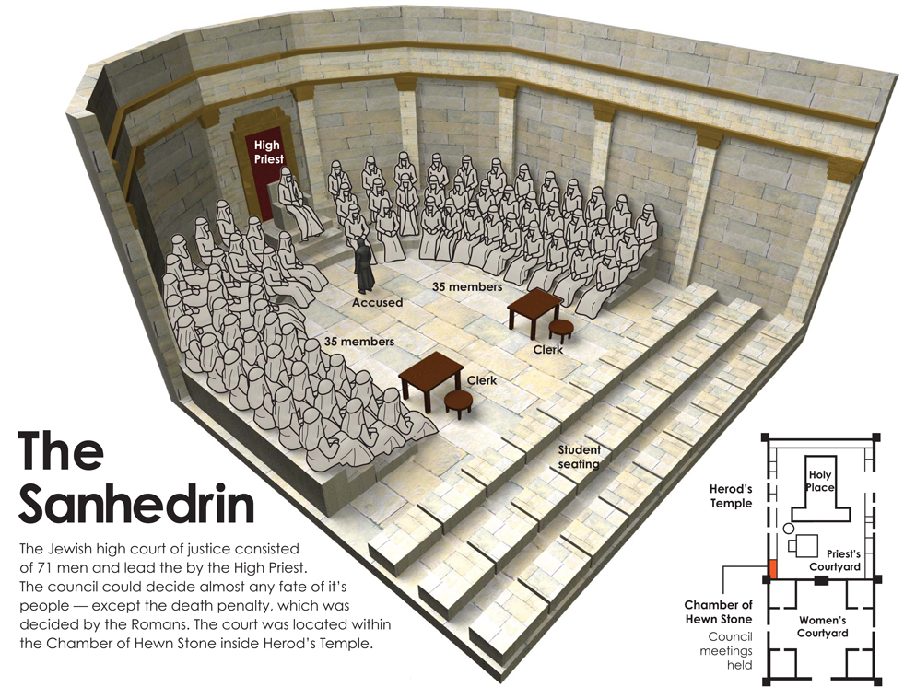
Sanhedrin

Slide 7
Sanhedrin
Guarantees
A Public Trial
The Right of Self Defense
Evidence of 2 or 3 Witnesses

Slide 8
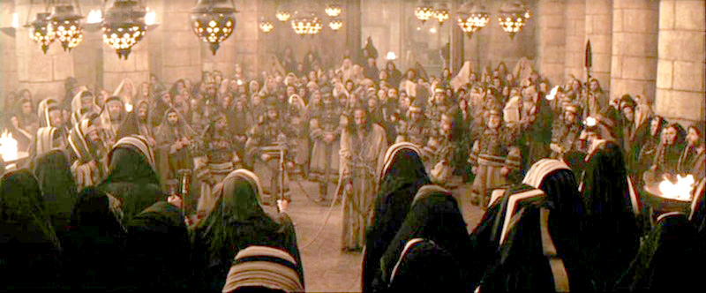
Sanhedrin
Luke 22:66 – “When it was day, the Council of elders of the people assembled, both chief priests and scribes, and they led Him away to their council chamber…”

Slide 9
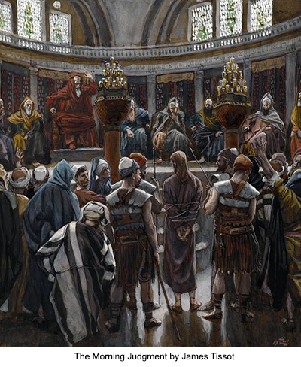
Sanhedrin
Luke 22:67a – “If You are the Christ, tell us.”
Luke 22:67b-69 – “If I tell you, you will not believe; and if I ask a question, you will not answer…
…but from now on the Son of Man will be seated at the right hand of the power of God.’”

Slide 10
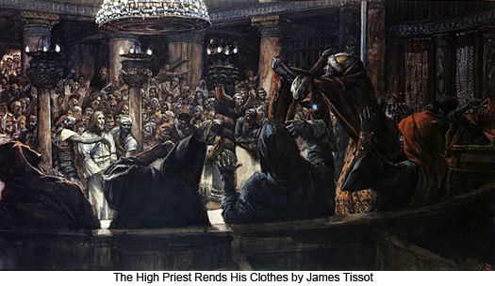
Sanhedrin
Luke 22:70a – “And they all said, ‘Are You the Son of God, then?’”
Luke 22:70b-71 – “And He said to them, ‘Yes, I am.’ Then they said, ‘What further need do we have of testimony? For we have heard it ourselves from His own mouth.’”

Slide 11
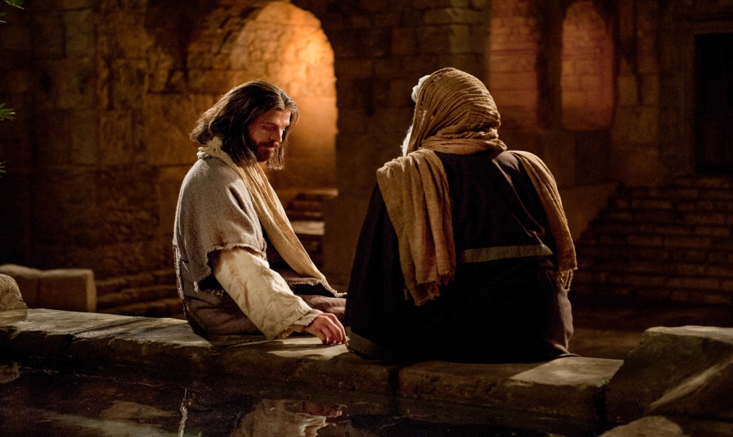
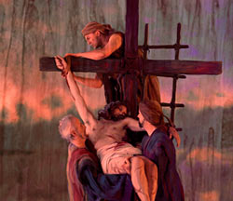
Sanhedrin
Mark 15:43 – “Joseph of Arimathea came, a prominent member of the Council, who himself was waiting for the kingdom of God; and he gathered up courage and went in before Pilate, and asked for the body of Jesus.”
John 7:50-52 – “Nicodemus (he who came to Him before, being one of them) said to them, ‘Our Law does not judge a man unless it first hears from him and knows what he is doing, does it?’ They answered him, ‘You are not also from Galilee, are you? Search, and see that no prophet arises out of Galilee.’”

Slide 12
Sanhedrin
Illegalities
No proceedings on Sabbaths, feast days, or on their eves
“Court must not be held on the Sabbath, or any holy day.” (Mishnah, Betza, ch. v, #2)
“They shall not judge on the eve of the Sabbath-day, nor on that of any festival” (Mishnah, Sanhedrin, ch. iv, #1)
Sanhedrin could not originate charges nor witness against the accused
"The Sanhedrin could not originate charges; it could only investigate those brought before it" (Edersheim in, "Life and times of Jesus the Messiah" Vol. I. p.309)
"The only prosecutors were the witnesses in the crime. The witnesses constituted the charge. There was no formal indictment until these witnesses spoke in the public assembly. When they spoke, and the evidence of two agreed together, it formed the legal charge, libel, or indictment." (Mendelsohn in "The Criminal Jurisprudence of the Ancient Hebrews," p.110)
Deut 19:16-17
Prejudiced judges not allowed to proceed over a trial
"There must not be on the judicial bench either a relation, or a particular friend, or an enemy of either the accused or the accuser" (Mendelsohn in "Criminal Jurisprudence of the Ancient Hebrews" p. 108).
"Nor under any circumstances was a man known to be at enmity with the accused person permitted to occupy a position among his judges" (Benny in "Criminal Code of the Jesus" p. 37).

Slide 13
Sanhedrin
Illegalities
The accused cannot be condemned on his own confession
“We have it as a fundamental principle of our jurisprudence that no one can bring an accusation against himself. Should a man make confession of guilt before a legally constituted tribunal, such confession is not to be used against him…our law never condemns on the simple confession of an accused party.” (Mishnah, Sanhedrin, ch. vi, #2. , Maimonides Sanhedrin)
If the death sentence is pronounced, a 2nd trial is to be held the next day
“A criminal case resulting in the acquittal of the accused may terminate the same day on which it began. But if a sentence of death is to be pronounced, it cannot be conducted before the following day.” (Mishna, Sanhedrin“, ch. iv, #1)

Slide 14
Pompey
Imperator
81–48 B.C.
Child
Marriage
Julius Caesar
Dictator
48–44 B.C.
Appointed
Adopted
Livia
Augustus Caesar
Emperor
31 B.C. – A.D 14
Adopted
Tiberius Caesar
Emperor, A.D. 14–37
(forced to divorce Vispania to marry Julia)
Julia
Claudia
(father was a Roman soldier)
Pontius Pilate
Procurator of Judea
A.D. 26–36

Slide 15
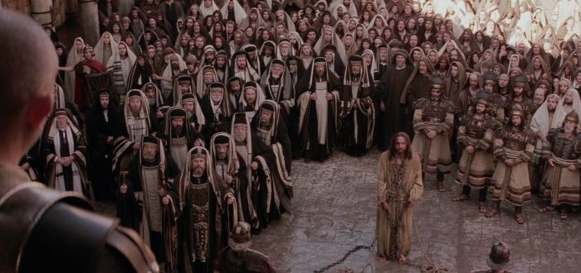
Pontius Pilate
Luke 23:1 – “Then the whole body of them got up and brought Him before Pilate.”
John 18:28 – “Then they led Jesus from Caiaphas into the Praetorium, and it was early; and they themselves did not enter into the Praetorium so that they would not be defiled, but might eat the Passover.”

Slide 16
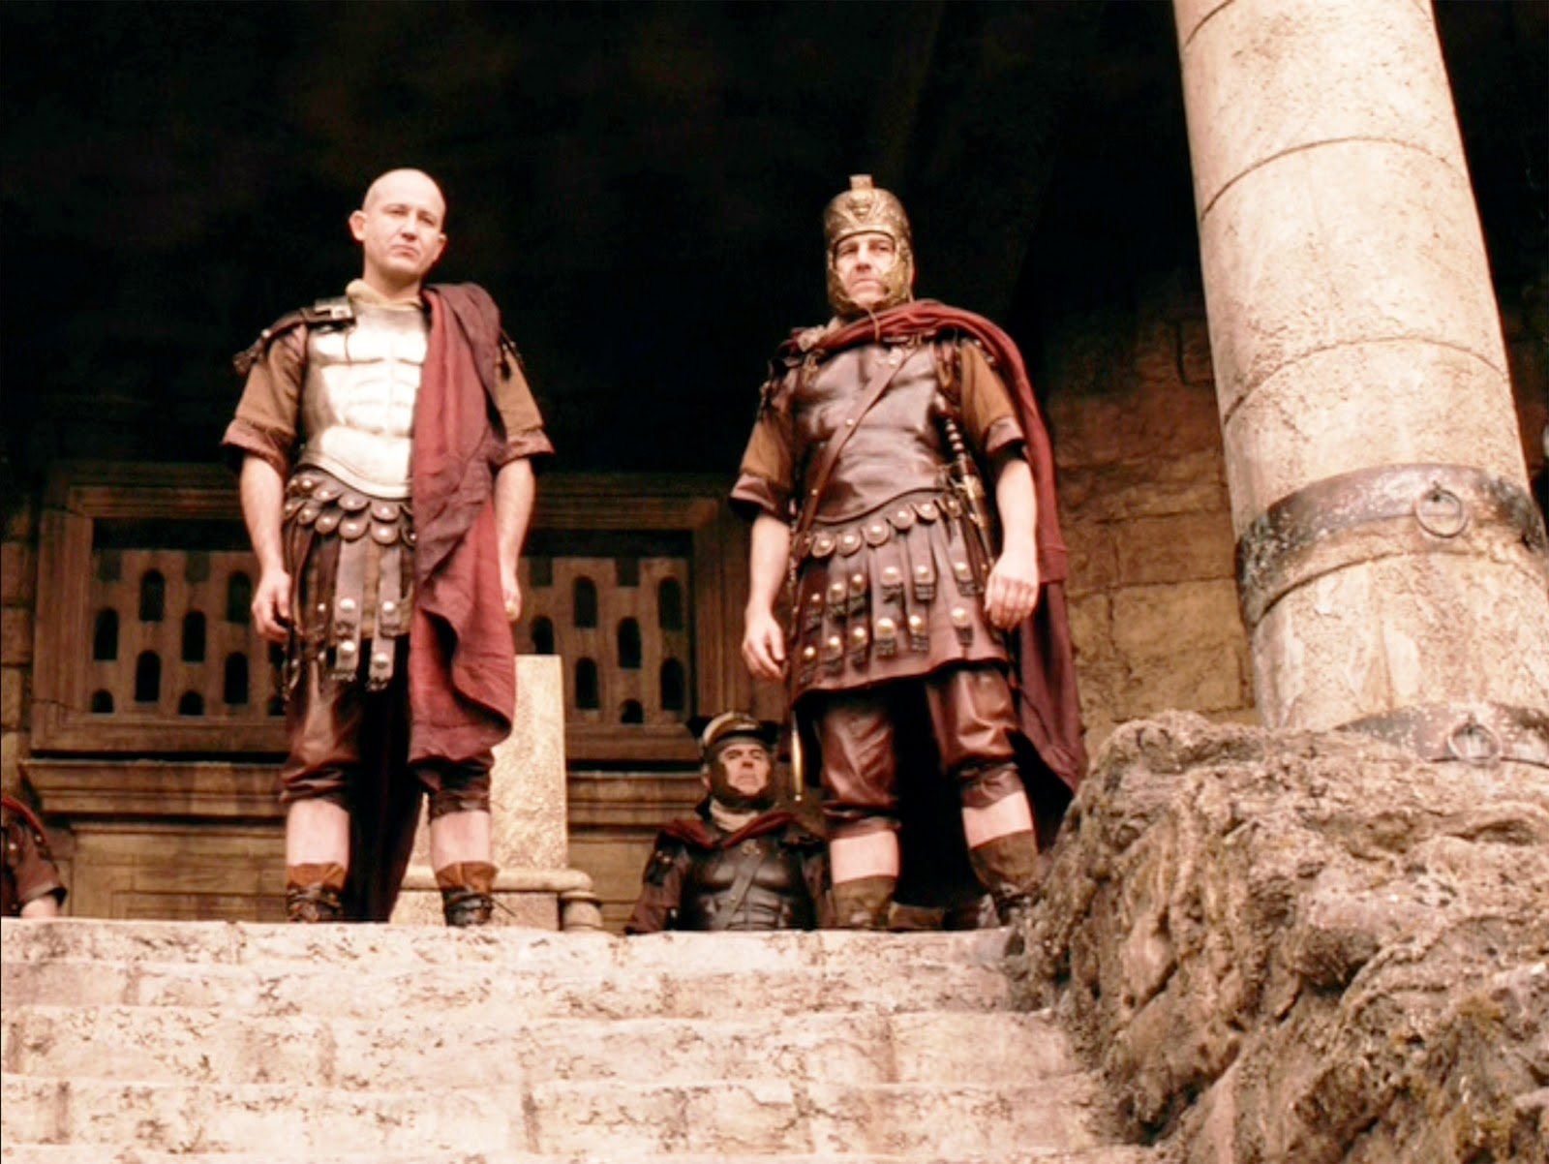
Pontius Pilate
John 18:29-30 – “Therefore Pilate went out to them and said, ‘What accusation do you bring against this Man?’ They answered and said to him, ‘If this Man were not an evildoer, we would not have delivered Him to you.’”
John 18:31 – “So Pilate said to them, ‘Take Him yourselves, and judge Him according to your law.’ The Jews said to him, ‘We are not permitted to put anyone to death.’”

Slide 17
Pontius Pilate
Stages to a Roman Trial
Accusation
Inquiry
Judgment

Slide 18
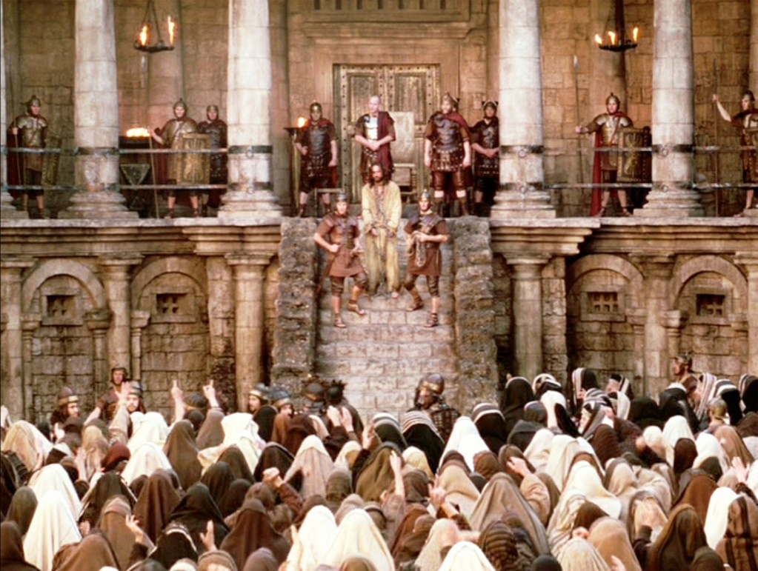
Pontius Pilate
Luke 23:2 – “And they began to accuse Him, saying, ‘We found this man misleading our nation and forbidding to pay taxes to Caesar, and saying that He Himself is Christ, a King.’”
Accusation
Inquiry
Judgment

Slide 19
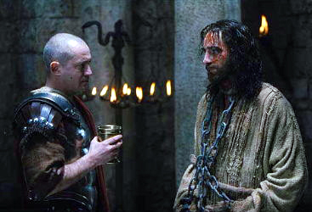
Pontius Pilate
John 18:33 – “Therefore Pilate entered again into the Praetorium, and summoned Jesus and said to Him, ‘Are You the King of the Jews?’”

Slide 20
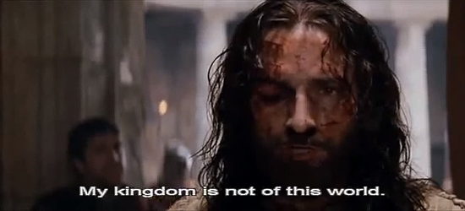
Pontius Pilate
John 18:34 – “Jesus answered, ‘Are you saying this on your own initiative, or did others tell you about Me?’”

Slide 21
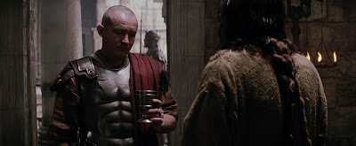
Pontius Pilate
John 18:35 – “Pilate answered, ‘I am not a Jew, am I? Your own nation and the chief priests delivered You to me; what have You done?’”

Slide 22
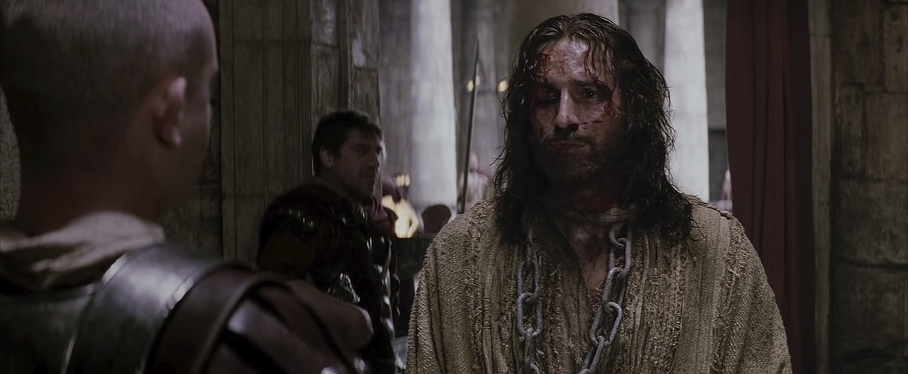
Pontius Pilate
John 18:36 – “Jesus answered, ‘My kingdom is not of this world. If My kingdom were of this world, then My servants would be fighting so that I would not be handed over to the Jews; but as it is, My kingdom is not of this realm.’”

Slide 23
Pontius Pilate
John 18:37 – “Therefore Pilate said to Him, ‘So You are a king?’ Jesus answered, ‘You say correctly that I am a king. For this I have been born, and for this I have come into the world, to testify to the truth. Everyone who is of the truth hears My voice.’”

Slide 24
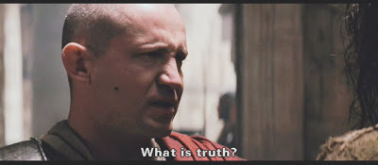
Pontius Pilate
John 18:38 – “Pilate said to Him, ‘What is truth?’”
John 14:6 – “I am the way, and the truth, and the life; no one comes to the Father but through Me.”
John 8:31-32 – “So Jesus was saying to those Jews who had believed Him, ‘If you continue in My word, then you are truly disciples of Mine; and you will know the truth, and the truth will make you free.’”

Slide 25
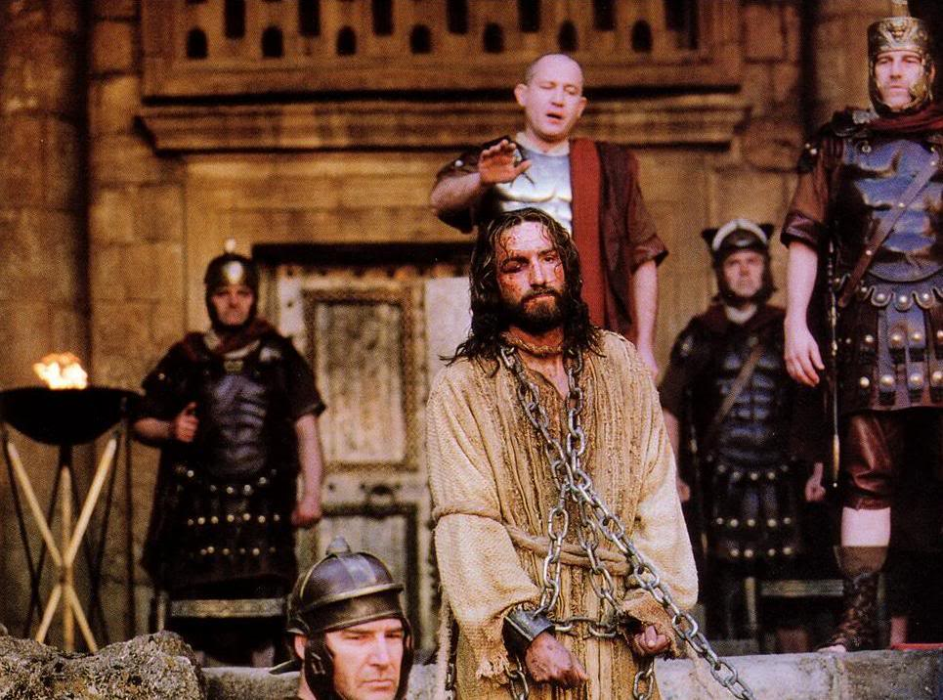
Pontius Pilate
John 18:38b – “And when he had said this, he went out again to the Jews and said to them, ‘I find no guilt in Him.’”
Accusation
Inquiry
Judgment

Slide 26
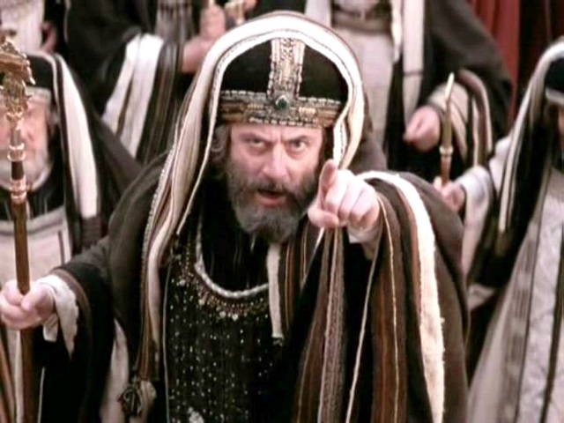
Pontius Pilate
Luke 23:5 – “But they kept on insisting, saying, ‘He stirs up the people, teaching all over Judea, starting from Galilee even as far as this place.’”

