Slide 1
Building Better Homes

Slide 2
Q?
What kind of homes do our children
need?

Slide 3
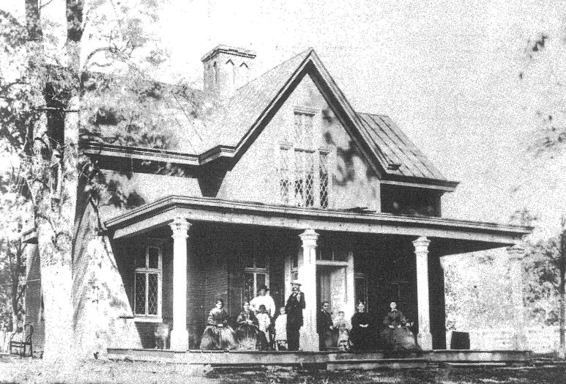
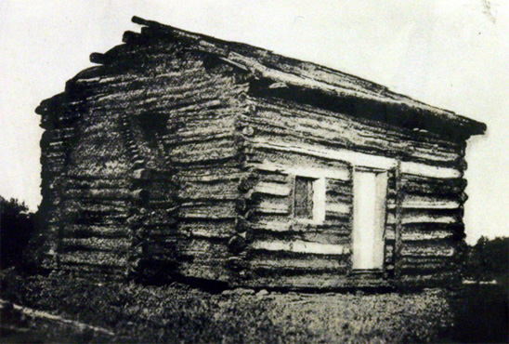

Slide 4
The crying need in our culture is not better houses… it’s better homes.

Slide 5
Proverbs
15:16-17
&
17:1

Slide 6
2 Ptr. 3 “seeing that all these things shall be dissolved…”

Slide 7
Gen.2:24
Josh. 24.15
Matt. 7.24-26
“Let marriage be had in honor among all and let the bed be undefiled, for fornicators and adulterers God will judge.” Heb.13:4

Slide 8
“disposable-marriage” in a disposable culture
“I think God wants me to be happy”
“I thought things would be different”
“I want to do what I want to do”
“It’s not good for the kids to see us unhappy”
“I’m not in love anymore”
Luke 16.18; Mark 10; Matt. 19
Malachi 2:13-16

Slide 9
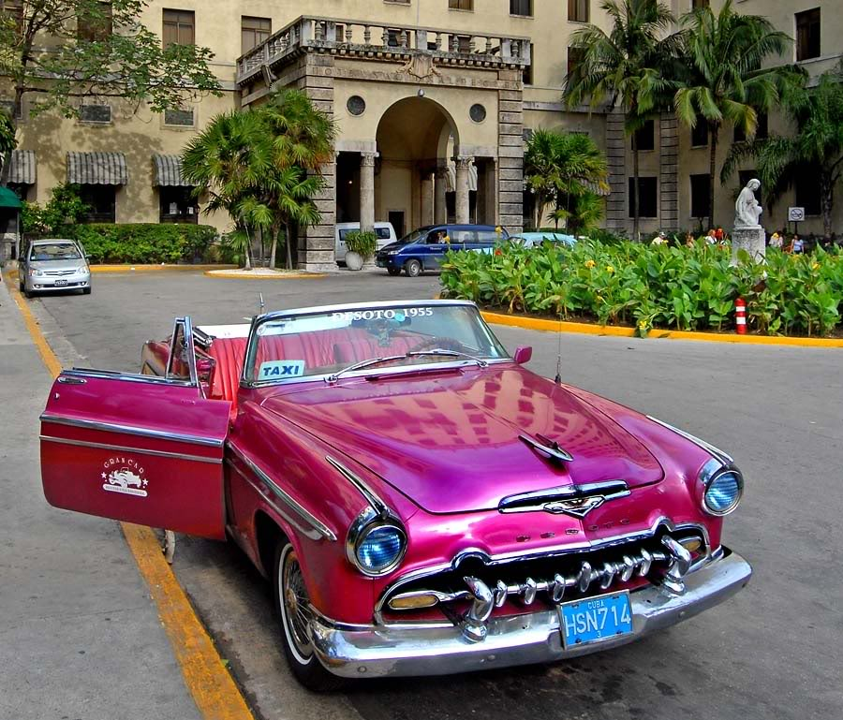
a lesson from cuban cars

Slide 10
husbands
Gen. 2.18, 24 -leave & cleave
Gen.3.13-19; 1 Tim. 5.8
provide for physical needs
Deut.6.1-9; Eph.6.4
provide spiritual leadership
Eph. 5.25, 28-29
provide leadership generally
a sacrificial & serving leader : Eph. 5.25

Slide 11
the relative importance of temporary threats & eternal threats…

Slide 12
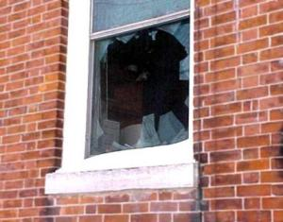
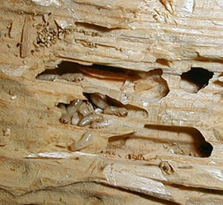
What would I do …?

Slide 13
What would I do …?
If I found your well or water line was toxic?
If you found your neighbors were feeding trash to your children?

Slide 14
on a spiritual & moral level… …am I letting toxic filth infiltrate my home?

Slide 15
Godliness does not come from taking our cues from the world Rm.12.1-2

Slide 16
an analogy: a man & a woman & a garden

Slide 17
Eph 5:25, 28-31, 33 ESV
25 Husbands, love your wives, as Christ loved the church and gave himself up for her, ...
28-31 In the same way husbands should love their wives as their own bodies. He who loves his wife loves himself. For no one ever hated his own flesh, but nourishes and cherishes it, just as Christ does the church, because we are members of his body.
31 "Therefore a man shall leave his father and mother and hold fast to his wife, and the two shall become one flesh." ... 33 However, let each one of you love his wife as himself, and let the wife see that she respects her husband.
husbands

Slide 18
REMEMBERING YOUR VOWS:
“love and cherish” Eph.5.28-29
“honor” 1Ptr.3.7
“to her and her alone” Job.31.1; Pr.5; Mt.5
husbands

Slide 19
wife
Eph. 5.22-24
Wives, submit to your own husbands, as to the Lord. For the husband is the head of the wife even as Christ is the head of the church, his body, and is himself its Savior. Now as the church submits to Christ, so also wives should submit in everything to their husbands.

Slide 20
LOVE
RESPECT

