Slide 2
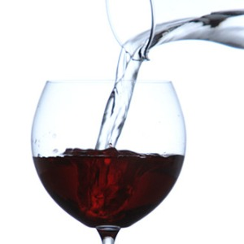
Did Jesus
Turn Water
Into Wine?

Slide 3
Why Do Many Assume Alcohol?
The word “wine” is used
No refrigerators to prevent fermentation
Vs. 10 says “drunk freely” or “well drunk”

Slide 4
“Wine” in the Bible
Fermented
Prov 20:1 – “Wine is a mocker, strong drink a brawler, and whoever is intoxicated by it is not wise.”
Isa 5:11, 22 – “Woe to those who rise early in the morning that they may pursue strong drink, who stay up late in the evening that wine may inflame them...Woe to those who are heroes in drinking wine and valiant men in mixing strong drink”.

Slide 5
“Wine” in the Bible
Unfermented
Isa 65:8 – “Thus says the LORD, ‘As the new wine is found in the cluster, and one says, “Do not destroy it, for there is benefit in it,” so I will act on behalf of My servants in order not to destroy all of them.”
Isa 16:10 – “Gladness and joy are taken away from the fruitful field; in the vineyards also there will be no cries of joy or jubilant shouting, no treader treads out wine in the presses, for I have made the shouting to cease.”
Lam 2:11-12 – “My eyes fail from weeping, I am in torment within; my heart is poured out on the ground because people are destroyed, because children and infants faint in the streets of the city. They say to their mothers, ‘Where is bread and wine?’ as they faint like the wounded in the streets of the city, as their lives ebb away in their mothers’ arms.”

Slide 6
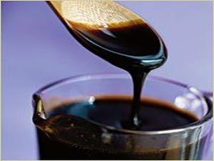
Preservation of Wine
Boiling
Prov 9:1-5 – “Wisdom has built her house, she has hewn out her seven pillars; she has prepared her food, she has mixed her wine; she has also set her table; she has sent out her maidens, she calls from the tops of the heights of the city: ‘Whoever is naive, let him turn in here!’ To him who lacks understanding she says, ‘Come, eat of my food and drink of the wine I have mixed.’”
Aristotle – “The wine of Arcadia was so thick that it was necessary to scrape it from the skin bottles in which it was contained and to dissolve the scrapings in water.” (quoted in Nott’s Lectures on Biblical Temperance, p. 80).
Horace – “There is no wine sweeter to drink than that of Lesbos; it was like nectar . . . and would not produce intoxication.”

Slide 7
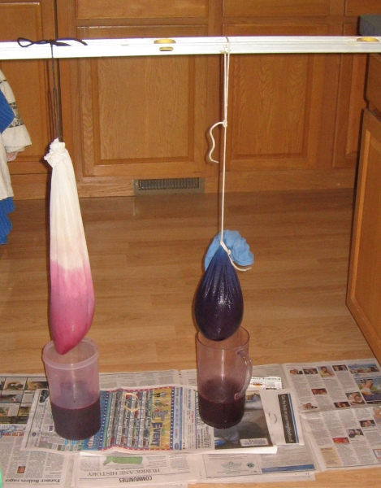
Preservation of Wine
Filtering
Isa 25:6 – “The Lord of hosts will prepare a lavish banquet for all peoples on this mountain; a banquet of aged wine, choice pieces with marrow, and refined, aged wine.”
Pliny The Younger – “The most useful wine has all its force or strength broken by the filter.” (Natural History, 23.24).
Plutarch – “Wine is rendered feeble in strength when it is frequently filtered. The strength or spirit thus being excluded, the wine neither inflames the brain nor infests the mind and passions, and is much more pleasant to drink.” (Symposiacs, 693b 3-5).

Slide 8
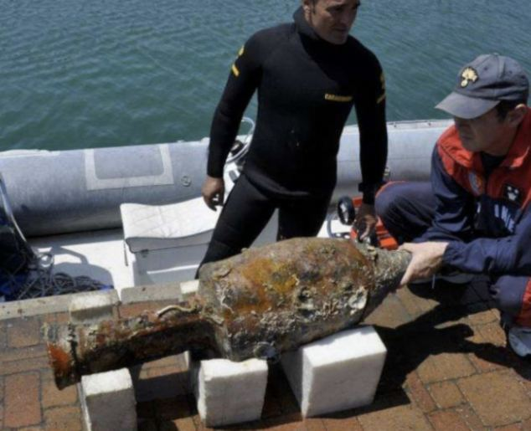
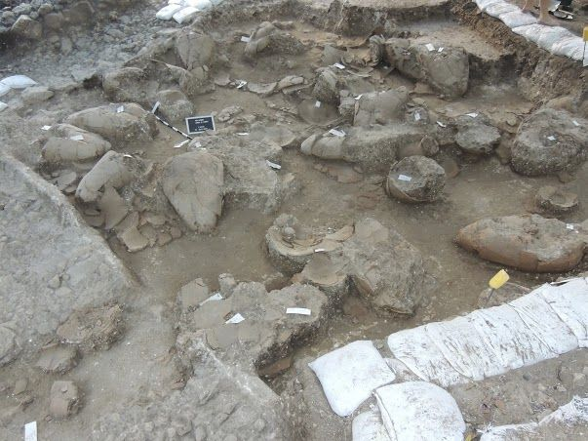
Preservation of Wine
Stored & Sealed

Slide 9
Problems Assuming Alcoholic
Did Jesus provide a substance that:
Mocks (Prov 20:1)
Destroys (Nah 1:10)
Leads To Poverty (Prov 23:21)
Woes (Hab 2:15; Isa 5:11,22)
Sorrow (Prov 23:29)
Contention (Prov 23:29)
Complaining (Prov 23:29)
Perversion (Prov 23:33b)
Worries without cause (Prov 23:29)
Impairs judgment (Prov 31:4-5; Isa 28:7)
Inflames passions (Isa 5:11)
Enslaves (Tit 2:3)

Slide 10
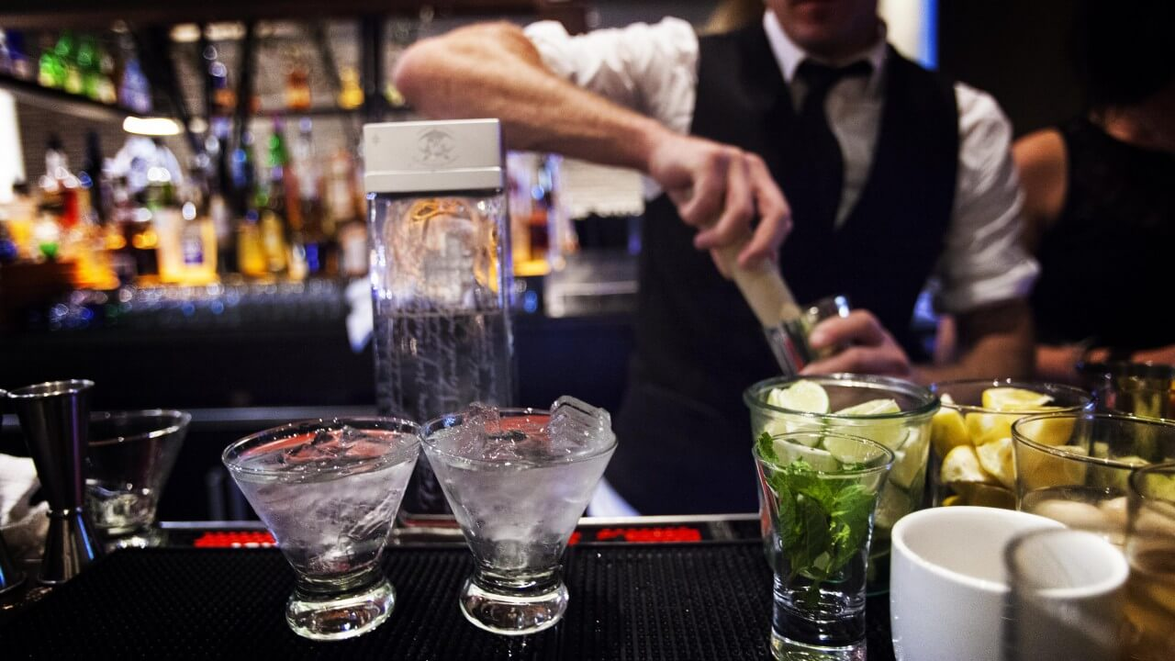
Problems Assuming Alcoholic
Justifies More Than Social Drinking
Luke 17:1-2 – “He said to His disciples, ‘It is inevitable that stumbling blocks come, but woe to him through whom they come! It would be better for him if a millstone were hung around his neck and he were thrown into the sea, than that he would cause one of these little ones to stumble.’”

Slide 11
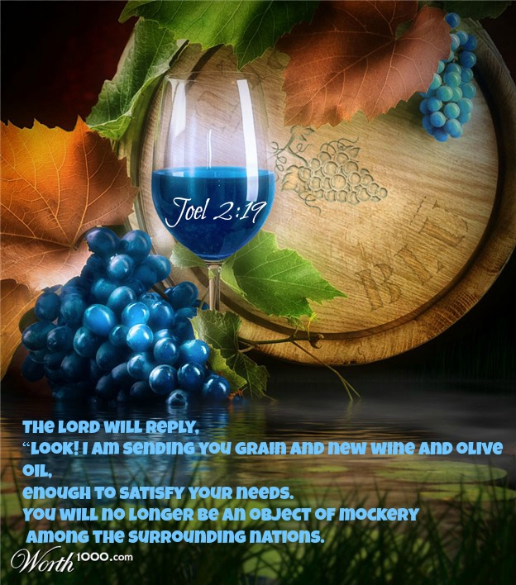
Problems Assuming Alcoholic
Diminishes Power of Miracle
Sign of the New Covenant
Hos 2:21-22 – “It will come about in that day that I will respond,” declares the Lord. “I will respond to the heavens, and they will respond to the earth, and the earth will respond to the grain, to the new wine and to the oil, and they will respond to Jezreel.”
Jer 31:12 – “They will come and shout for joy on the height of Zion, and they will be radiant over the bounty of the Lord—over the grain and the new wine and the oil, and over the young of the flock and the herd; and their life will be like a watered garden, and they will never languish again.”

Slide 12
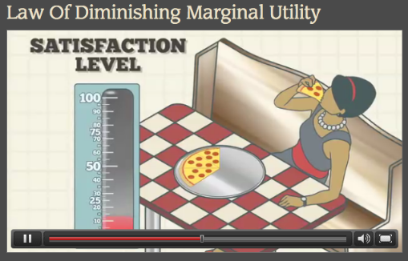
Proper Interpretation
“Drunk Freely”, “Well Drunk”
Law of Diminishing Marginal Utility

Slide 13
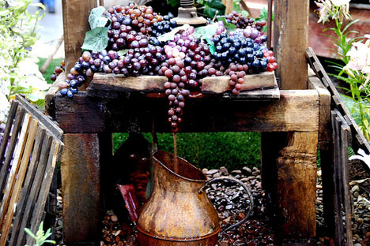
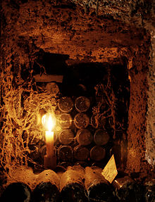
Proper Interpretation
What is “Good Wine”?
Either:
Fresh Juice Directly From Grape
Isa 65:8a – “Thus says the LORD, ‘As the new wine is found in the cluster, and one says, “Do not destroy it, for there is benefit in it,”’….
Aged Juice
Isa 25:6 – “The Lord of hosts will prepare a lavish banquet for all peoples on this mountain; a banquet of aged wine, choice pieces with marrow, and refined, aged wine.”

