Slide 2
Before You Get Married…

Slide 3
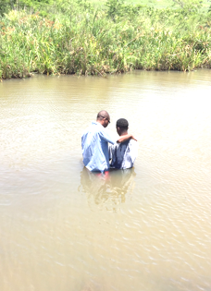
The Power Behind The Vow
Rom 10:9-10 – “that if you confess with your mouth Jesus as Lord, and believe in your heart that God raised Him from the dead, you will be saved; for with the heart a person believes, resulting in righteousness, and with the mouth he confesses, resulting in salvation.”

Slide 4
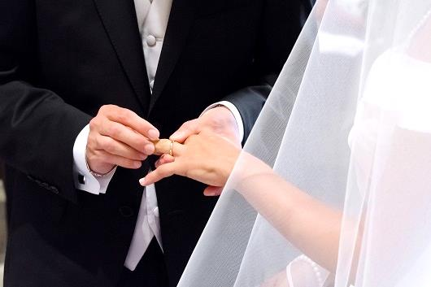
The Power Behind The Vow
Gen 2:23-24 – “The man said, ‘This is now bone of my bones, and flesh of my flesh; she shall be called woman because she was taken out of Man. For this reason a man shall leave his father and his mother, and be joined to his wife; and they shall become one flesh.”

Slide 5
The Power Behind The Vow
Matt 19:4-6 – “Have you not read that He who created them from the beginning made them male and female, and said, ‘For this reason a man shall leave his father and mother and be joined to his wife, and the two shall become one flesh’? So they are no longer two, but one flesh. What therefore God has joined together, let no man separate.”

Slide 6
QUESTIONS FOR THE MARRIED AND & UNMARRIED
Do you have the integrity for this kind of commitment?
Deut 7:6-9a; 9:4-6
Do they have the integrity for this kind of commitment?
Jer 17:9
Why do you want to marry this person?
Prov 31:28-29
If an illness occurs, why would you want to care for them?
Eccl 9:11
Are we working to make marriage easy for our spouse?
1 Pet 3:7a

