Slide 2
Matt 16:18 – “I also say to you that you are Peter, and upon this rock I will build My church; and the gates of Hades will not overpower it.”
Acts 20:28 – “Be on guard for yourselves and for all the flock, among which the Holy Spirit has made you overseers, to shepherd the church of God which He purchased with His own blood.”
Eph 1:22-23 – “And He put all things in subjection under His feet, and gave Him as head over all things to the church, which is His body, the fullness of Him who fills all in all.”
Eph 3:10 – “so that the manifold wisdom of God might now be made known through the church to the rulers and the authorities in the heavenly places.”

Slide 3
The
Work
of
the
Church

Slide 4
1 Pet 2:9 – “But you are a chosen race, a royal priesthood, a holy nation, a people for God’s own possession, so that you may proclaim the excellencies of Him who has called you out of darkness into His marvelous light;”
1 Pet 2:10 – “for you once were not a people, but now you are the people of God; you had not received mercy, but now you have received mercy.”
Col 1:13 – “For He rescued us from the domain of darkness, and transferred us to the kingdom of His beloved Son”

Slide 5
Ek
klesia
“Ekklesia”
called
= “called”
= “out of”
out of
“…who has
you
darkness
into His marvelous light” (1 Pet 2:9c )

Slide 6
2 Thes 2:14 – “ It was for this He called you through our gospel, that you may gain the glory of our Lord Jesus Christ.”

Slide 7
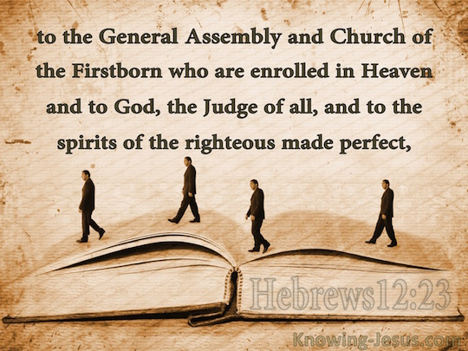

Slide 9
1) Government
1 Pet 2:13-14 – “Submit yourselves for the Lord’s sake to every human institution, whether to a king as the one in authority, or to governors as sent by him for the punishment of evildoers and the praise of those who do right.”
2) Family
Col 3:18-21 – “Wives, be subject to your husbands, as is fitting in the Lord. Husbands, love your wives and do not be embittered against them. Children, be obedient to your parents in all things, for this is well-pleasing to the Lord. Fathers, do not exasperate your children, so that they will not lose heart.”

Slide 10
3) Neighbors
1 Pet 2:11-12 – “Beloved, I urge you as aliens and strangers to abstain from fleshly lusts which wage war against the soul. Keep your behavior excellent among the Gentiles, so that in the thing in which they slander you as evildoers, they may because of your good deeds, as they observe them, glorify God in the day of visitation.”
4) Enemies
Matt 5:44 – “But I say to you, love your enemies and pray for those who persecute you”
Rom 12:20a – “But if your enemy is hungry, feed him, and if he is thirsty, give him a drink”.

Slide 11
5) Brethren
John 13:34-35 – “A new commandment I give to you, that you love one another, even as I have loved you, that you also love one another. By this all men will know that you are My disciples, if you have love for one another.”
1 John 3:18 – “Little children, let us not love with word or with tongue, but in deed and truth”
6) Job
Eph 4:28 – “He who steals must steal no longer; but rather he must labor, performing with his own hands what is good, so that he will have something to share with one who has need.”

Slide 12
7) Devotion
1 Thes 5:16-18 – “Rejoice always; pray without ceasing; in everything give thanks; for this is God’s will for you in Christ Jesus.”
8) Study
Heb 5:12a – “ For though by this time you ought to be teachers, you have need again for someone to teach you the elementary principles”
2 Tim 2:2 – “The things which you have heard from me in the presence of many witnesses, entrust these to faithful men who will be able to teach others also.”

Slide 13
9) Prayer
Jas 5:13a – “Is anyone among you suffering? Then he must pray.”
10) Singing
Jas 5:13b – “Is anyone cheerful? He is to sing praises.”

Slide 14
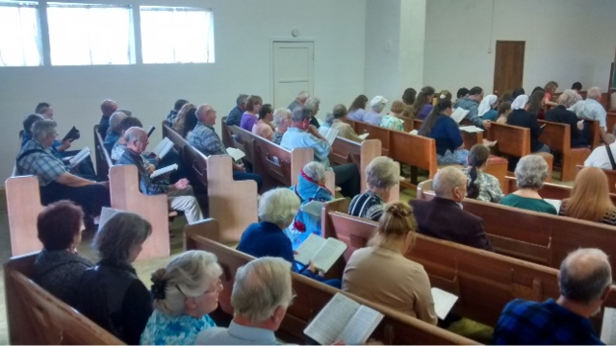
1 Cor 1:2a – “To the church of God which is at Corinth.”
2 Cor 1:1b – “To the church of God which is at Corinth.”
1 Cor 11:16 – “But if one is inclined to be contentious, we have no other practice, nor have the churches of God.”
Rom 16:16 – “Greet one another with a holy kiss. All the churches of Christ greet you.”
Acts 15:22a – “Then it seemed good to the apostles and the elders, with the whole church, to choose men from among them to send to Antioch with Paul and Barnabas…”
Rom 16:1 – “I commend to you our sister Phoebe, who is a servant of the church which is at Cenchrea.”
1 Pet 5:1-2a – “Therefore, I exhort the elders among you, as your fellow elder and witness of the sufferings of Christ, and a partaker also of the glory that is to be revealed, shepherd the flock of God among you, exercising oversight”

Slide 15
Individual Christian vs. Local Church
Matt 18:15-17 – “If your brother sins, go and show him his fault in private; if he listens to you, you have won your brother. But if he does not listen to you, take one or two more with you, so that by the mouth of two or three witnesses every fact may be confirmed. If he refuses to listen to them, tell it to the church; and if he refuses to listen even to the church, let him be to you as a Gentile and a tax collector.”
Individual
Church

Slide 16
Individual Christian vs. Local Church
1 Tim 5:3-4 – “Honor widows who are widows indeed; but if any widow has children or grandchildren, they must first learn to practice piety in regard to their own family and to make some return to their parents; for this is acceptable in the sight of God.”
1 Tim 5:16 – “If any woman who is a believer has dependent widows, she must assist them and the church must not be burdened, so that it may assist those who are widows indeed.”
Individual
Church

Slide 17
2 Tim 3:16-17

