Slide 1
Welcome to auburn!
Fall 2017
Orientation Night
University church of Christ

Slide 2
Orientation night
Welcome to Auburn!
Introduction
Walker Davis
Forms / Opportunities to Serve / Website
Stacy Norman/Ashley Miller
Spiritual Work Groups & Adopt-A-Student
Jeff Jerkins
Extracurricular Spiritual Growth
Jared Johnson
Becoming a Member & Conclusion
Larry Rouse

Slide 3
Orientation night
Welcome to Auburn!
Introduction
Walker Davis
Forms / Opportunities to Serve / Website
Stacy Norman / Ashley Miller
Spiritual Work Groups & Adopt-A-Student
Jeff Jerkins
Extracurricular Spiritual Growth
Jared Johnson
Becoming a Member & Conclusion
Larry Rouse

Slide 4
MEETING TIMES
SUNDAY
9:30 am Bible Classes for All Ages
10:20 am Worship
6:00 pm Worship
WEDNESDAY
7:00 pm Bible Classes for All Ages
Please don’t skip Bible Class!

Slide 5
ELDERS
Larry Rouse
Walker Davis
DEACONS
Jeff Jerkins – Benevolence, Spiritual Work Groups
Jared Johnson – Teaching Program
Ashley Miller – A/V, IT, Equipment
Stacy Norman – Worship, Duty Roster
Jimmy Roberts – Buildings/Grounds
EVANGELISTS
Larry Rouse
Ryan Hasty
Gustavo Marino

Slide 6
Several requests:
Parking
Park in grass area
Leave some spaces near building for visitors
Auditorium Seating
Move in/closer, make room for visitors
Leave last 3 middle pews open – Sunday AM service

Slide 7
Orientation night
Welcome to Auburn!
Introduction
Walker Davis
Forms / Opportunities to Serve / Website
Stacy Norman / Ashley Miller
Spiritual Work Groups & Adopt-A-Student
Jeff Jerkins
Extracurricular Spiritual Growth
Jared Johnson
Becoming a Member & Conclusion
Larry Rouse

Slide 8
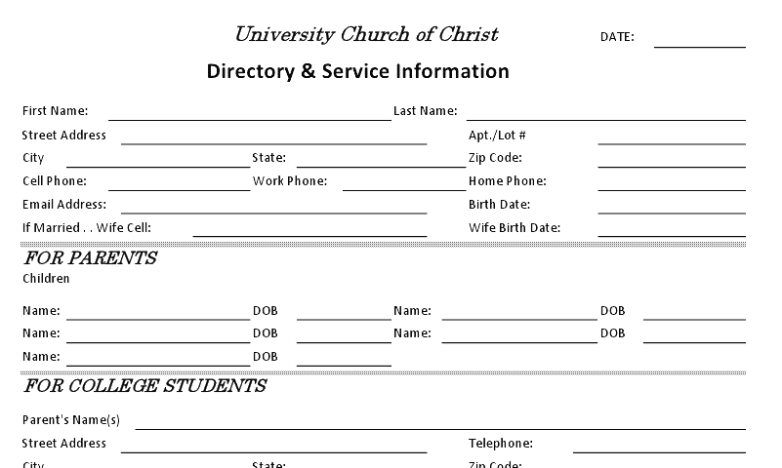
Forms and opportunities to serve
Contact Information
Teaching Classes
Sunday 9:30am
Wednesday 7:00pm
Participation in Assemblies
Opportunities to Serve
Guys, Check the Duty Roster MONTHLY
Please complete this form tonight!

Slide 9
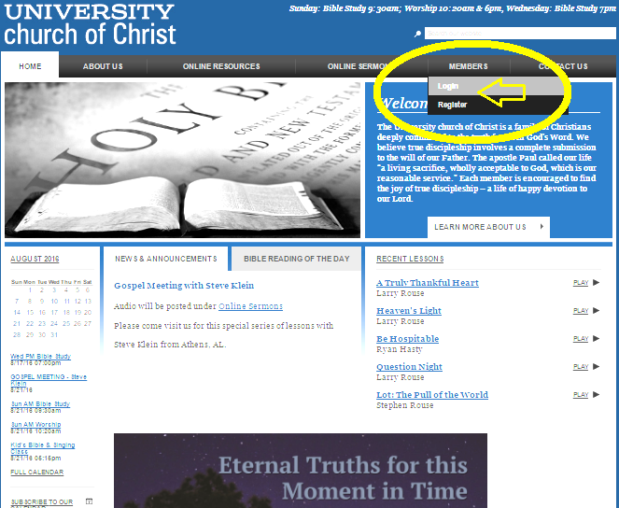
www.auchurch.com

Slide 10
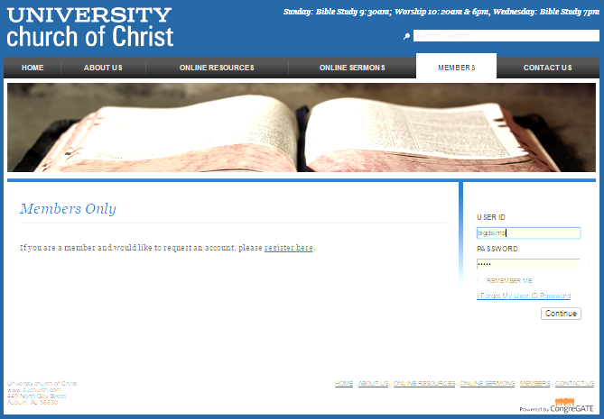
www.auchurch.com

Slide 11
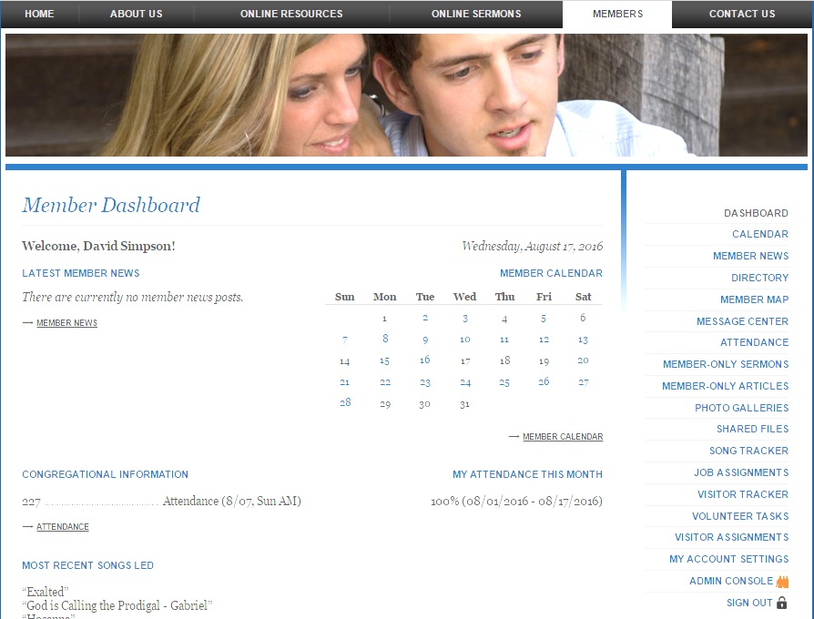
www.auchurch.com

Slide 12
Orientation night
Welcome to Auburn!
Introduction
Walker Davis
Forms / Opportunities to Serve / Website
Stacy Norman
Spiritual Work Groups & Adopt -A-Student
Jeff Jerkins
Extracurricular Spiritual Growth
Jared Johnson
Becoming a Member & Conclusion
Larry Rouse

Slide 13
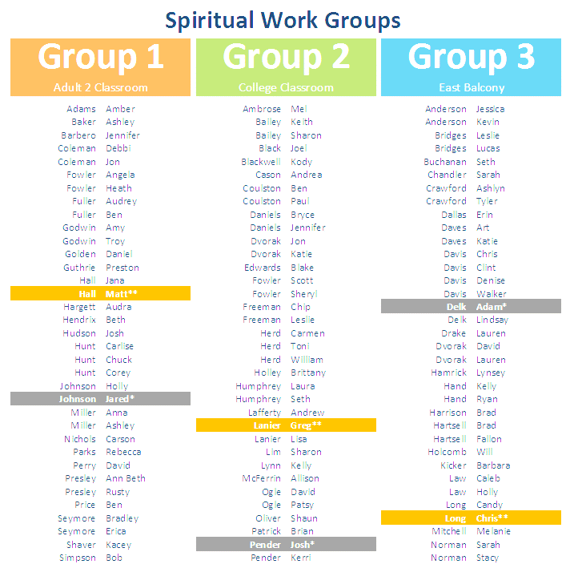
Spiritual Work Groups (Opportunities to Serve)
Greet and Follow Up with Visitors
Write Cards
Provide Transportation
Clean Building
Yard Maintenance

Slide 14
Adopt-A-Student
Several students assigned (adopted) by resident member.
For current school year
Opportunities for encouragement, assistance, spiritual & social interaction.
In turn encourage, get to know resident member and fellow students.

Slide 15
Orientation night
Welcome to Auburn!
Introduction
Walker Davis
Forms / Opportunities to Serve / Website
Stacy Norman / Ashley Miller
Spiritual Work Groups & Adopt-A-Student
Jeff Jerkins
Extracurricular Spiritual Growth
Jared Johnson
Becoming a Member & Conclusion
Larry Rouse

Slide 16
Extracurricular Spiritual growth
Bible Classes (In-Home)
College devotional (every other Sunday Night)
Men’s and women’s classes
1st-5th grade/6th-12th grade devotionals
Other studies/Bible readings
Truth Seekers – On Campus Opportunities
Student Weekend Study
Other Opportunities to Associate with Christians
Stay Connected by E-mail : auchurch.com Message Center
(for spiritual and non-spiritual events and notifications)
Find Friends who will help you grow spiritually!
“He who walks with wise men will be wise” Proverbs 13:20
LISTEN for Times and Locations to be Announced

Slide 17
Orientation night
Welcome to Auburn!
Introduction
Walker Davis
Forms / Opportunities to Serve / Website
Stacy Norman / Ashley Miller
Spiritual Work Groups & Adopt-A-Student
Jeff Jerkins
Extracurricular Spiritual Growth
Jared Johnson
Becoming a Member & Conclusion
Larry Rouse

Slide 18
Orientation night
Welcome to Auburn!
Thank you for coming to Auburn!
Let’s make this a great year!
Don’t forget to complete
your contact information
tonight!
Get your PICTURE made in
the next couple of weeks!
It really does help us get to know each other!

