Slide 2
In Defense of

Slide 3
? Verses Mentioning Faith ?
John 3:16 – “For God so loved the world, that He gave His only begotten Son, that whoever believes in Him shall not perish, but have eternal life.”
Acts 10:43 – “Of Him all the prophets bear witness that through His name everyone who believes in Him receives forgiveness of sins.”
Eph 2:8a – “For by grace you have been saved through faith…”
None of these verses say “faith alone”
Matt 4:4 – “Man shall not live on bread alone, but on every word that proceeds out of the mouth of God.”
Psa 119:160a – “The sum of Your word is truth…”
2 Tim 3:16a says, “All scripture is God-breathed”…

Slide 4
? Verses Mentioning Faith ?
Verses That Don’t Mention “Faith”
1 Pet 3:21 – “Corresponding to that, baptism now saves you—not the removal of dirt from the flesh, but an appeal to God for a good conscience—through the resurrection of Jesus Christ”
Luke 13:3 – “I tell you, no, but unless you repent, you will all likewise perish.”
1 Cor 13:2 – “If I have the gift of prophecy, and know all mysteries and all knowledge; and if I have all faith, so as to remove mountains, but do not have love, I am nothing”
Opposition: “Repentance and love are implied!”
Answer: “Why can’t baptism also be implied?”
Only One Verse Says “Faith Alone”
Jas 2:24 – “You see that a man is justified by works and not by faith alone”

Slide 5
? John’s Gospel Never Mentions Baptism ?
John 20:30-31 – “Therefore many other signs Jesus also performed in the presence of the disciples, which are not written in this book; but these have been written so that you may believe that Jesus is the Christ, the Son of God; and that believing you may have life in His name.”
Other Things Not Mentioned in John:
Repentance
Forgiveness
Parables
Demons
Jesus’ Birth
Jesus’ Ascension

Slide 6
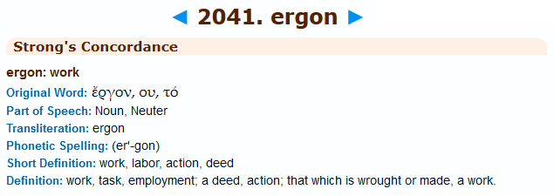
? Works Don’t Save…Baptism Is A Work ?
Rom 3:27 – “For we maintain that a man is justified by faith apart from works of the Law.”
Eph 2:8-9 – “For by grace you have been saved through faith; and that not of yourselves, it is the gift of God; not as a result of works, so that no one may boast.”
Jas 2:24 says, “You see that a man is justified by works and not by faith alone”

Slide 7
? Works Don’t Save…Baptism Is A Work ?
Faith is a Work
John 6:28-29 – Therefore they said to Him, “What shall we do, so that we may work the works of God?” Jesus answered and said to them, “This is the work of God, that you believe in Him whom He has sent.”
Opposition: “Faith is a work of God so that’s ok!”
Col 2:11-13 – “and in Him you were also circumcised with a circumcision made without hands, in the removal of the body of the flesh by the circumcision of Christ; having been buried with Him in baptism, in which you were also raised up with Him through faith in the working of God, who raised Him from the dead. When you were dead in your transgressions and the uncircumcision of your flesh, He made you alive together with Him, having forgiven us all our transgressions”
Answer: “Baptism is also a work of God.”

Slide 8
? Works Don’t Save…Baptism Is A Work ?
Confession is Something We “Do”
Rom 10:9-10 – “that if you confess with your mouth Jesus as Lord, and believe in your heart that God raised Him from the dead, you will be saved; for with the heart a person believes, resulting in righteousness, and with the mouth he confesses, resulting in salvation.”
Opposition: “But we cannot earn our salvation!”
Answer: “Nothing earned when obedience driven by love.”
Gal 5:6 – “For in Christ Jesus neither circumcision nor uncircumcision means anything, but faith working through love.”
1 Cor 13:2b – “…if I have all faith, so as to remove mountains, but do not have love, I am nothing”

Slide 9
? Works Don’t Save…Baptism Is A Work ?
True Faith Is An “Obedient” Faith
Heb 11:7 – “By faith Noah, being warned of God of things not seen as yet, moved with fear, prepared an ark to the saving of his house; by the which he condemned the world, and became heir of the righteousness which is by faith” How did Noah demonstrate his faith? He obeyed.”
Heb 11:17 – “By faith Abraham, when he was tried, offered up Isaac: and he that had received the promises offered up his only begotten son”
Rom 1:5 – “through whom we have received grace and apostleship to bring about the obedience of faith among all the Gentiles for His name’s sake”
Rom 16:26 – “but now is manifested, and by the Scriptures of the prophets, according to the commandment of the eternal God, has been made known to all the nations, leading to obedience of faith”
Water Baptism is an Expression of Our Faith
Matt 28:19 – “Go therefore and make disciples of all the nations, baptizing them in the name of the Father and the Son and the Holy Spirit”

Slide 10
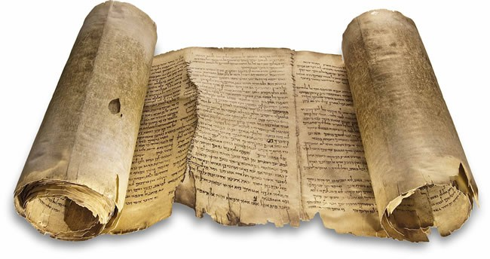
? The Mediator Argument ?
1 Tim 2:5 – “For there is one God, and one mediator also between God and men, the man Christ Jesus.”
Do The Following Verses Make Men Mediators?
1 Cor 1:21 – “For since in the wisdom of God the world through its wisdom did not come to know God, God was well-pleased through the foolishness of the message preached to save those who believe.”
Rom 10:13-14 – “For ‘Whoever will call on the name of the Lord will be saved.’ How then will they call on Him in whom they have not believed? How will they believe in Him whom they have not heard? And how will they hear without a preacher?”

Slide 11
? The Mark 16:16 Argument ?
Mark 16:16 – “He who has believed and has been baptized shall be saved; but he who has disbelieved shall be condemned.”
Baptism Without Belief Is Moot
Acts 8:36-37a – “As they went along the road they came to some water; and the eunuch said, ‘Look! Water! What prevents me from being baptized?’ And Philip said, ‘If you believe with all your heart, you may.’”
John 3:18 – “He who believes in Him is not judged; he who does not believe has been judged already, because he has not believed in the name of the only begotten Son of God.”
This Coming Sunday…
He Who Believes And Is Baptized
Will Receive $1 Million.
He Who Does Not Believe
Will Receive Nothing.

