Slide 2
1 Cor 13:4d – Love
1) does not brag (outward)
2) is not arrogant (inward)

Slide 3
C. S. Lewis – “There is one vice of which no man in the world is free; which everyone in the world loathes when he sees it in someone else; and of which hardly any people, except Christians, ever imagine that they are guilty themselves. I have heard people admit that they are bad-tempered, or that they cannot keep their heads about girls or drink, or even that they are cowards. I do not think I have ever heard anyone who was not a Christian accuse himself of this vice. And at the same time I have very seldom met anyone, who was not a Christian, who showed the slightest mercy to it in others. There is no fault which makes a man more unpopular, and no fault which we are more unconscious of in ourselves. And the more we have it ourselves, the more we dislike it in others.” (Mere Christianity)

Slide 4
Prov 6:16-19 – “¹⁶There are six things which the Lord hates, yes, seven which are an abomination to Him: ¹⁷Haughty eyes, a lying tongue, and hands that shed innocent blood, ¹⁸A heart that devises wicked plans, feet that run rapidly to evil, ¹⁹A false witness who utters lies, and one who spreads strife among brothers.”
Mark 7:21-22 – “²¹For from within, out of the heart of men, proceed the evil thoughts, fornications, thefts, murders, ²²adulteries, deeds of coveting and wickedness, as well as deceit, sensuality, envy, slander, pride and foolishness.”
Rom 1:29-30 – “²⁹being filled with all unrighteousness, wickedness, greed, evil; full of envy, murder, strife, deceit, malice; they are gossips, ³⁰slanderers, haters of God, insolent, arrogant, boastful, inventors of evil, disobedient to parents

Slide 5
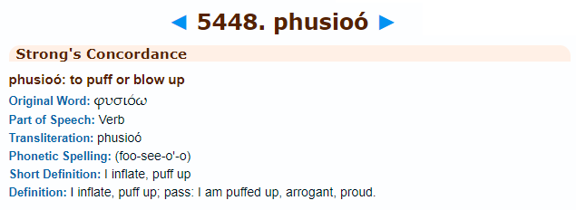
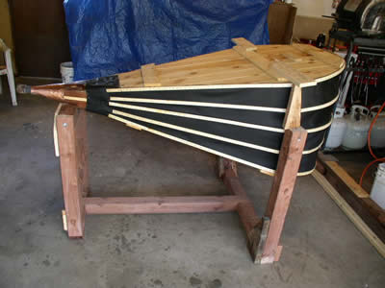
1 Cor 5:1-2 – “¹It is actually reported that there is immorality among you, and immorality of such a kind as does not exist even among the Gentiles, that someone has his father’s wife. ²You have become arrogant and have not mourned instead, so that the one who had done this deed would be removed from your midst.”
1 Cor 8:1 – “Now concerning things sacrificed to idols, we know that we all have knowledge. Knowledge makes arrogant, but love edifies.”
Col 2:18 – “Let no one keep defrauding you of your prize by delighting in self-abasement and the worship of the angels, taking his stand on visions he has seen, inflated without cause by his fleshly mind.”

Slide 6
Assault On God’s Sovereignty
Question #1
1 Cor 4:7a – “For who regards you as superior?”
Question #2
1 Cor 4:7b – “What do you have that you did not receive?”
Question #3
1 Cor 4:7b – “And if you did receive it, why do you boast as if you had not received it?”

Slide 7
Invites God’s Judgment
Prov 8:13 – “The fear of the Lord is to hate evil; pride and arrogance and the evil way and the perverted mouth, I hate.”
Prov 11:2 – “When pride comes, then comes dishonor, but with the humble is wisdom.”
Prov 16:5 – “Everyone who is proud in heart is an abomination to the Lord; assuredly, he will not be unpunished.”
Prov 16:18 – “Pride goes before destruction, and a haughty spirit before stumbling.”
Prov 29:23 – “A man’s pride will bring him low, but a humble spirit will obtain honor.”
Jas 4:6 – “But He gives a greater grace. Therefore it says, ‘God is opposed to the proud, but gives grace to the humble.’”

Slide 8
Interrupts Peace & Love
2 Cor 13:5a – “Test yourselves to see if you are in the faith; examine yourselves!”
How do I react when someone refuses to take notice of me?
How do I react when someone snubs me?
How do I react when someone shows off around me?
How do I react when someone patronizes me?
How do I react when someone dismisses my ideas?
How do I react when someone has something I don’t have?

Slide 9
Application
We need to humble ourselves before God
Dan 2:47 – “The king answered Daniel and said, ‘Surely your God is a God of gods and a Lord of kings and a revealer of mysteries, since you have been able to reveal this mystery.’”
Dan 3:28-29 – “²⁸Nebuchadnezzar responded and said, “Blessed be the God of Shadrach, Meshach and Abed-nego, who has sent His angel and delivered His servants who put their trust in Him, violating the king’s command, and yielded up their bodies so as not to serve or worship any god except their own God. ²⁹Therefore I make a decree that any people, nation or tongue that speaks anything offensive against the God of Shadrach, Meshach and Abed-nego shall be torn limb from limb and their houses reduced to a rubbish heap, inasmuch as there is no other god who is able to deliver in this way.’”

Slide 10
Application
We need to humble ourselves before God
Humility is what allows us to truly know God
John 5:44 – “How can you believe, when you receive glory from one another and you do not seek the glory that is from the one and only God?”

Slide 11
Application
We need to humble ourselves before God
Humility is what allows us to truly know God
Humility is what allows us to love one another
Phil 2:3-4 – “³Do nothing from selfishness or empty conceit, but with humility of mind regard one another as more important than yourselves; ⁴do not merely look out for your own personal interests, but also for the interests of others.”

Slide 12
