Slide 5
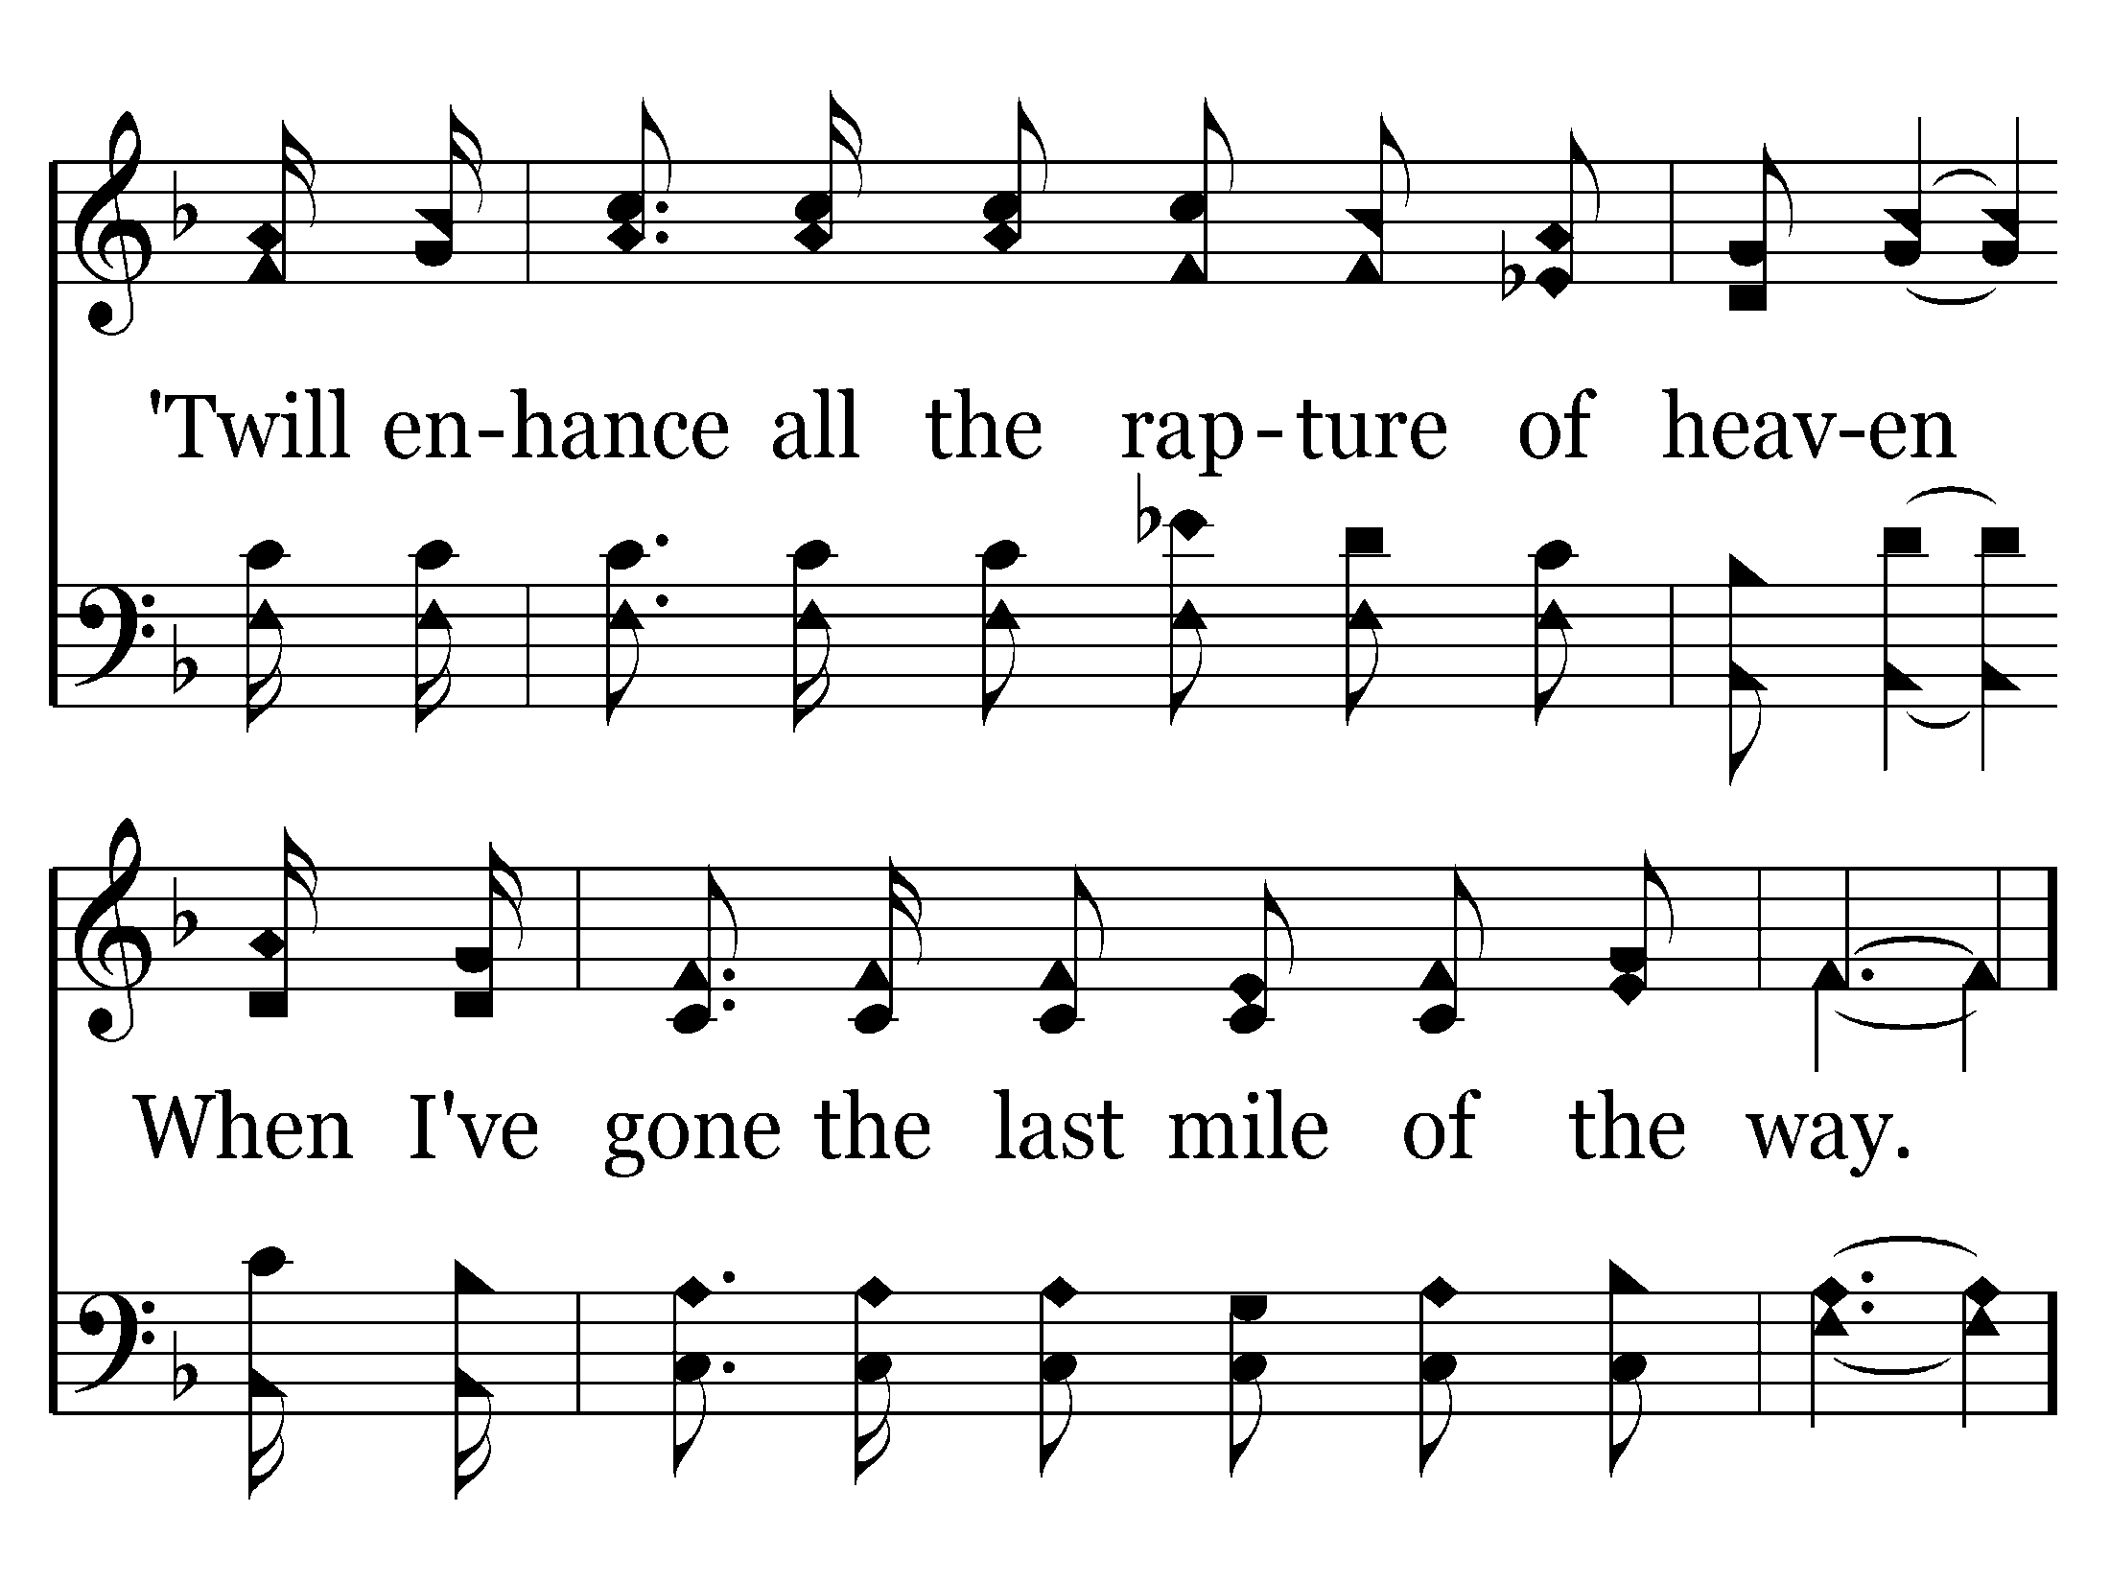

Slide 6
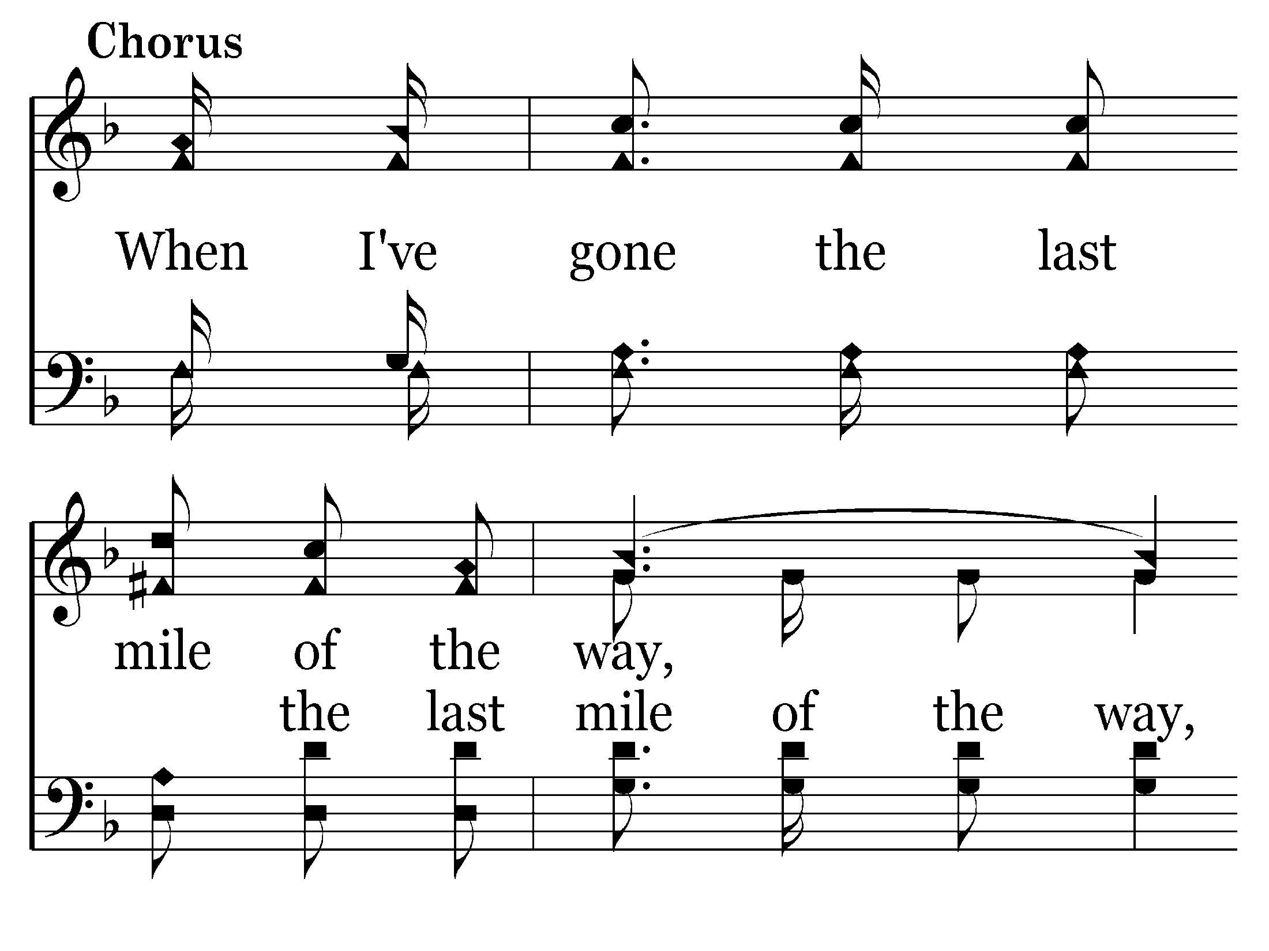

Slide 7
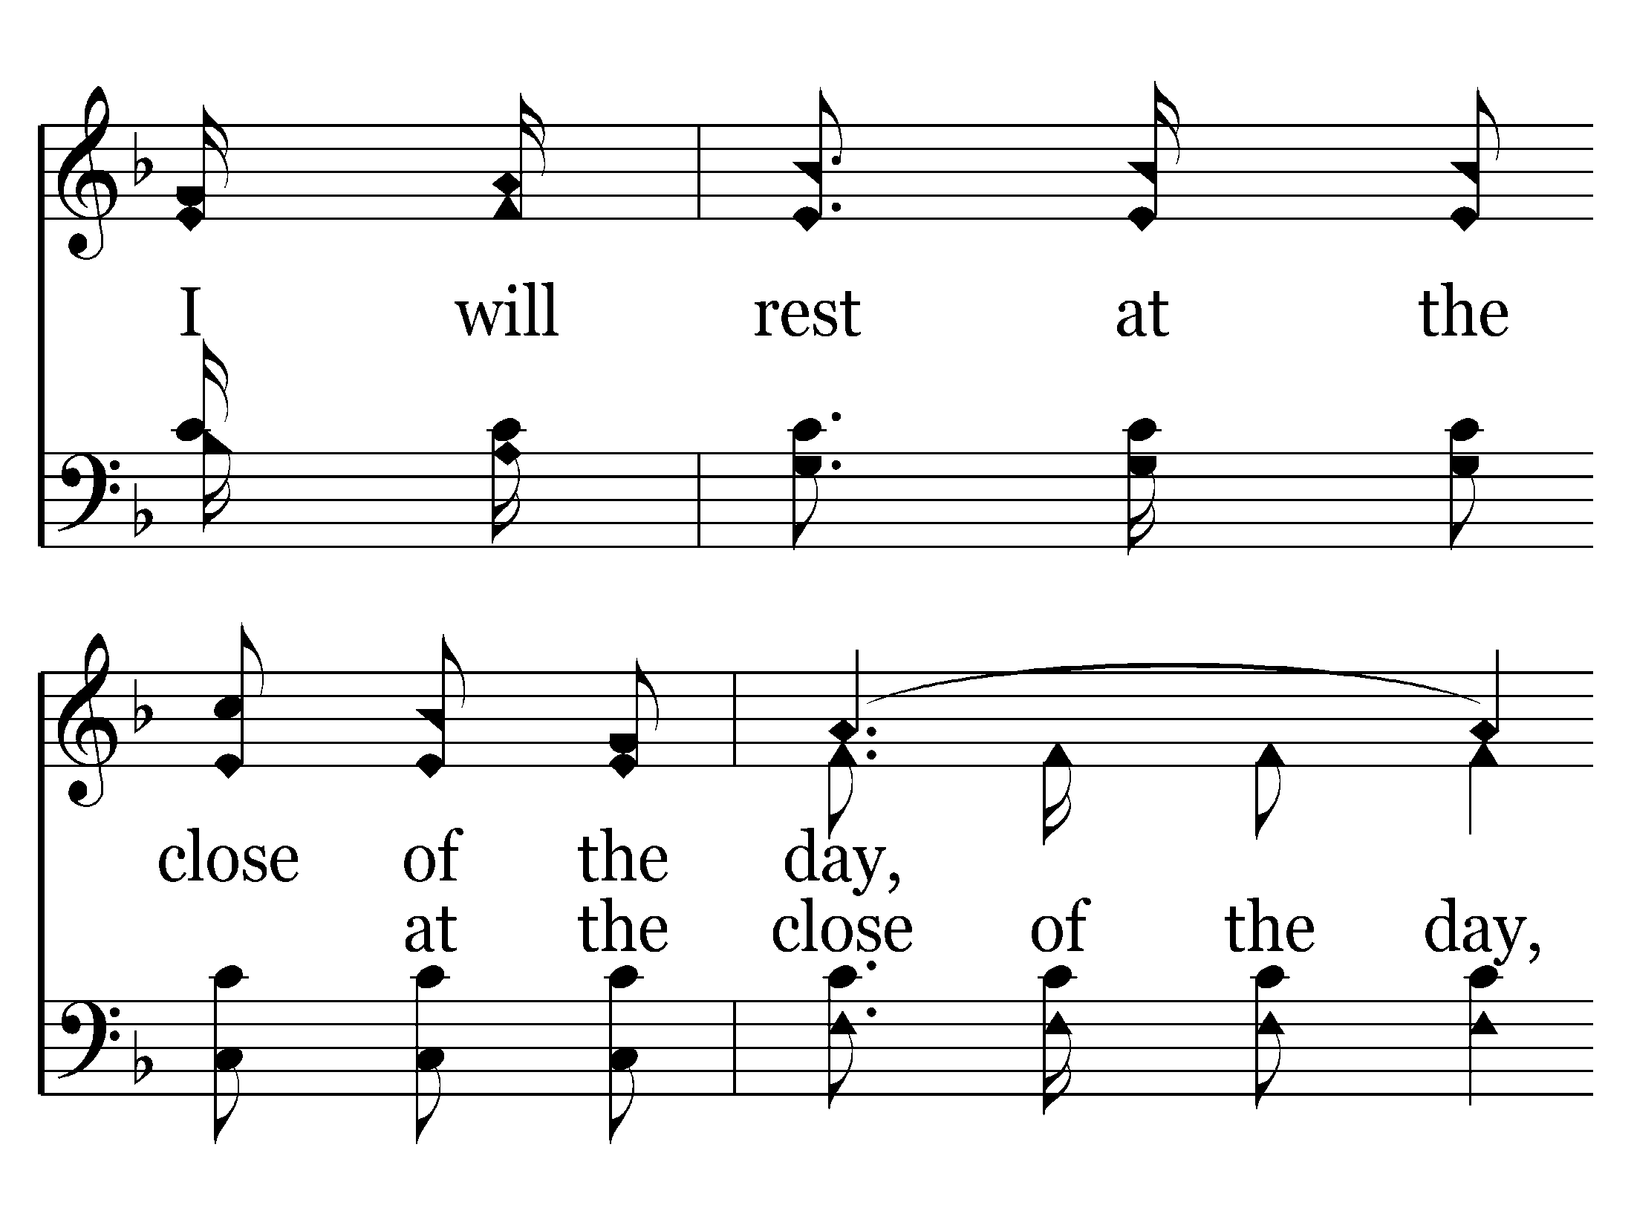

Slide 8
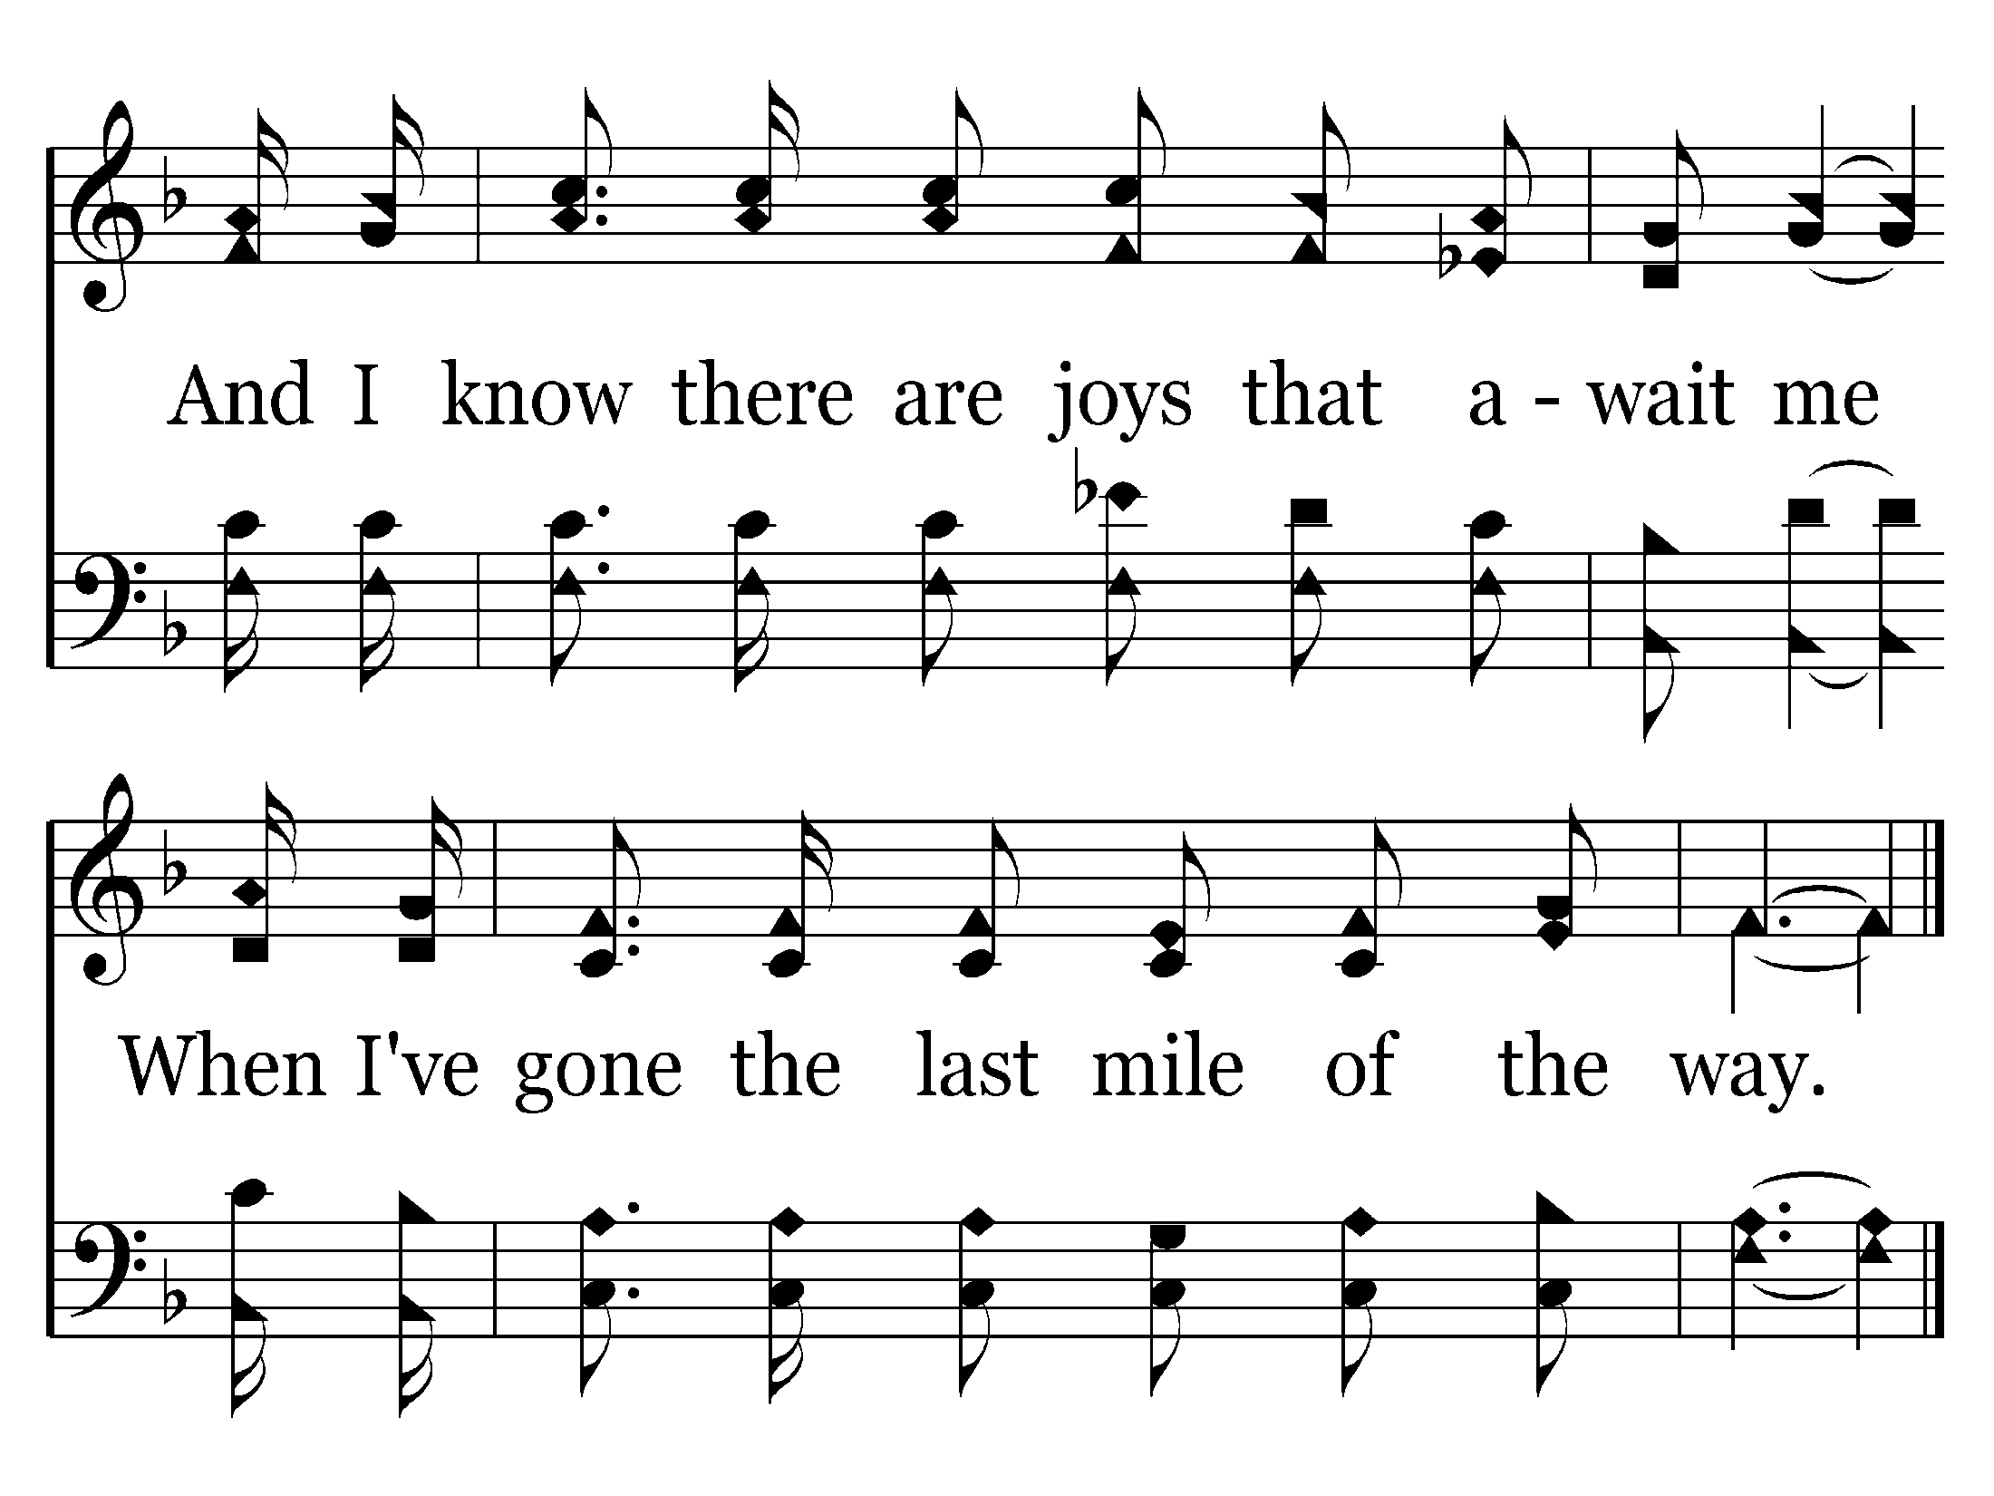
457 - The Last Mile Of The Way - C.3
End of Song

Slide 10
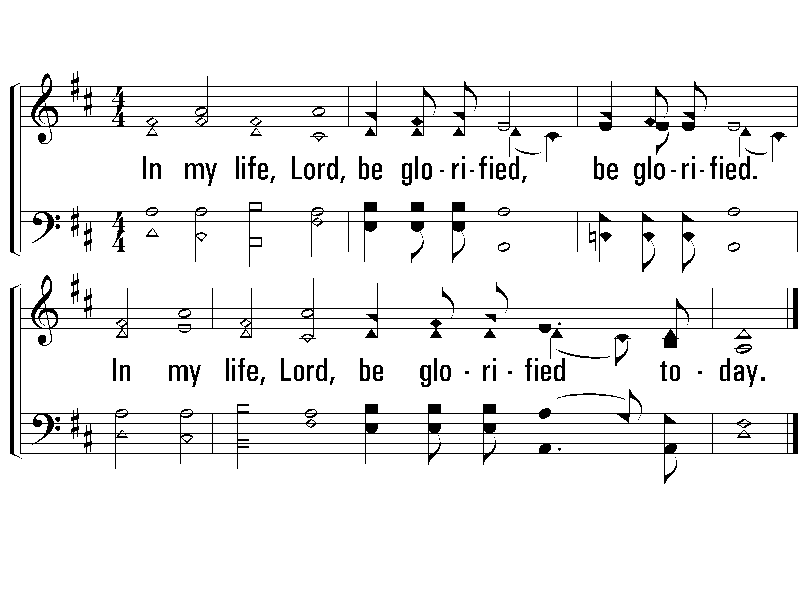
1 - In My Life, Lord, Be Glorified
1.
In my life, Lord, be glorified, be glorified.
In my life, Lord, be glorified today.
Words and Music by: Bob Kilpatrick
Copyright © 1978 by Bob Kilpatrick Music. Assigned 1998 to The Lorenz Corporation.
All Rights Reserved. International copyright secured
© 2001 The Paperless Hymnal™

Slide 11
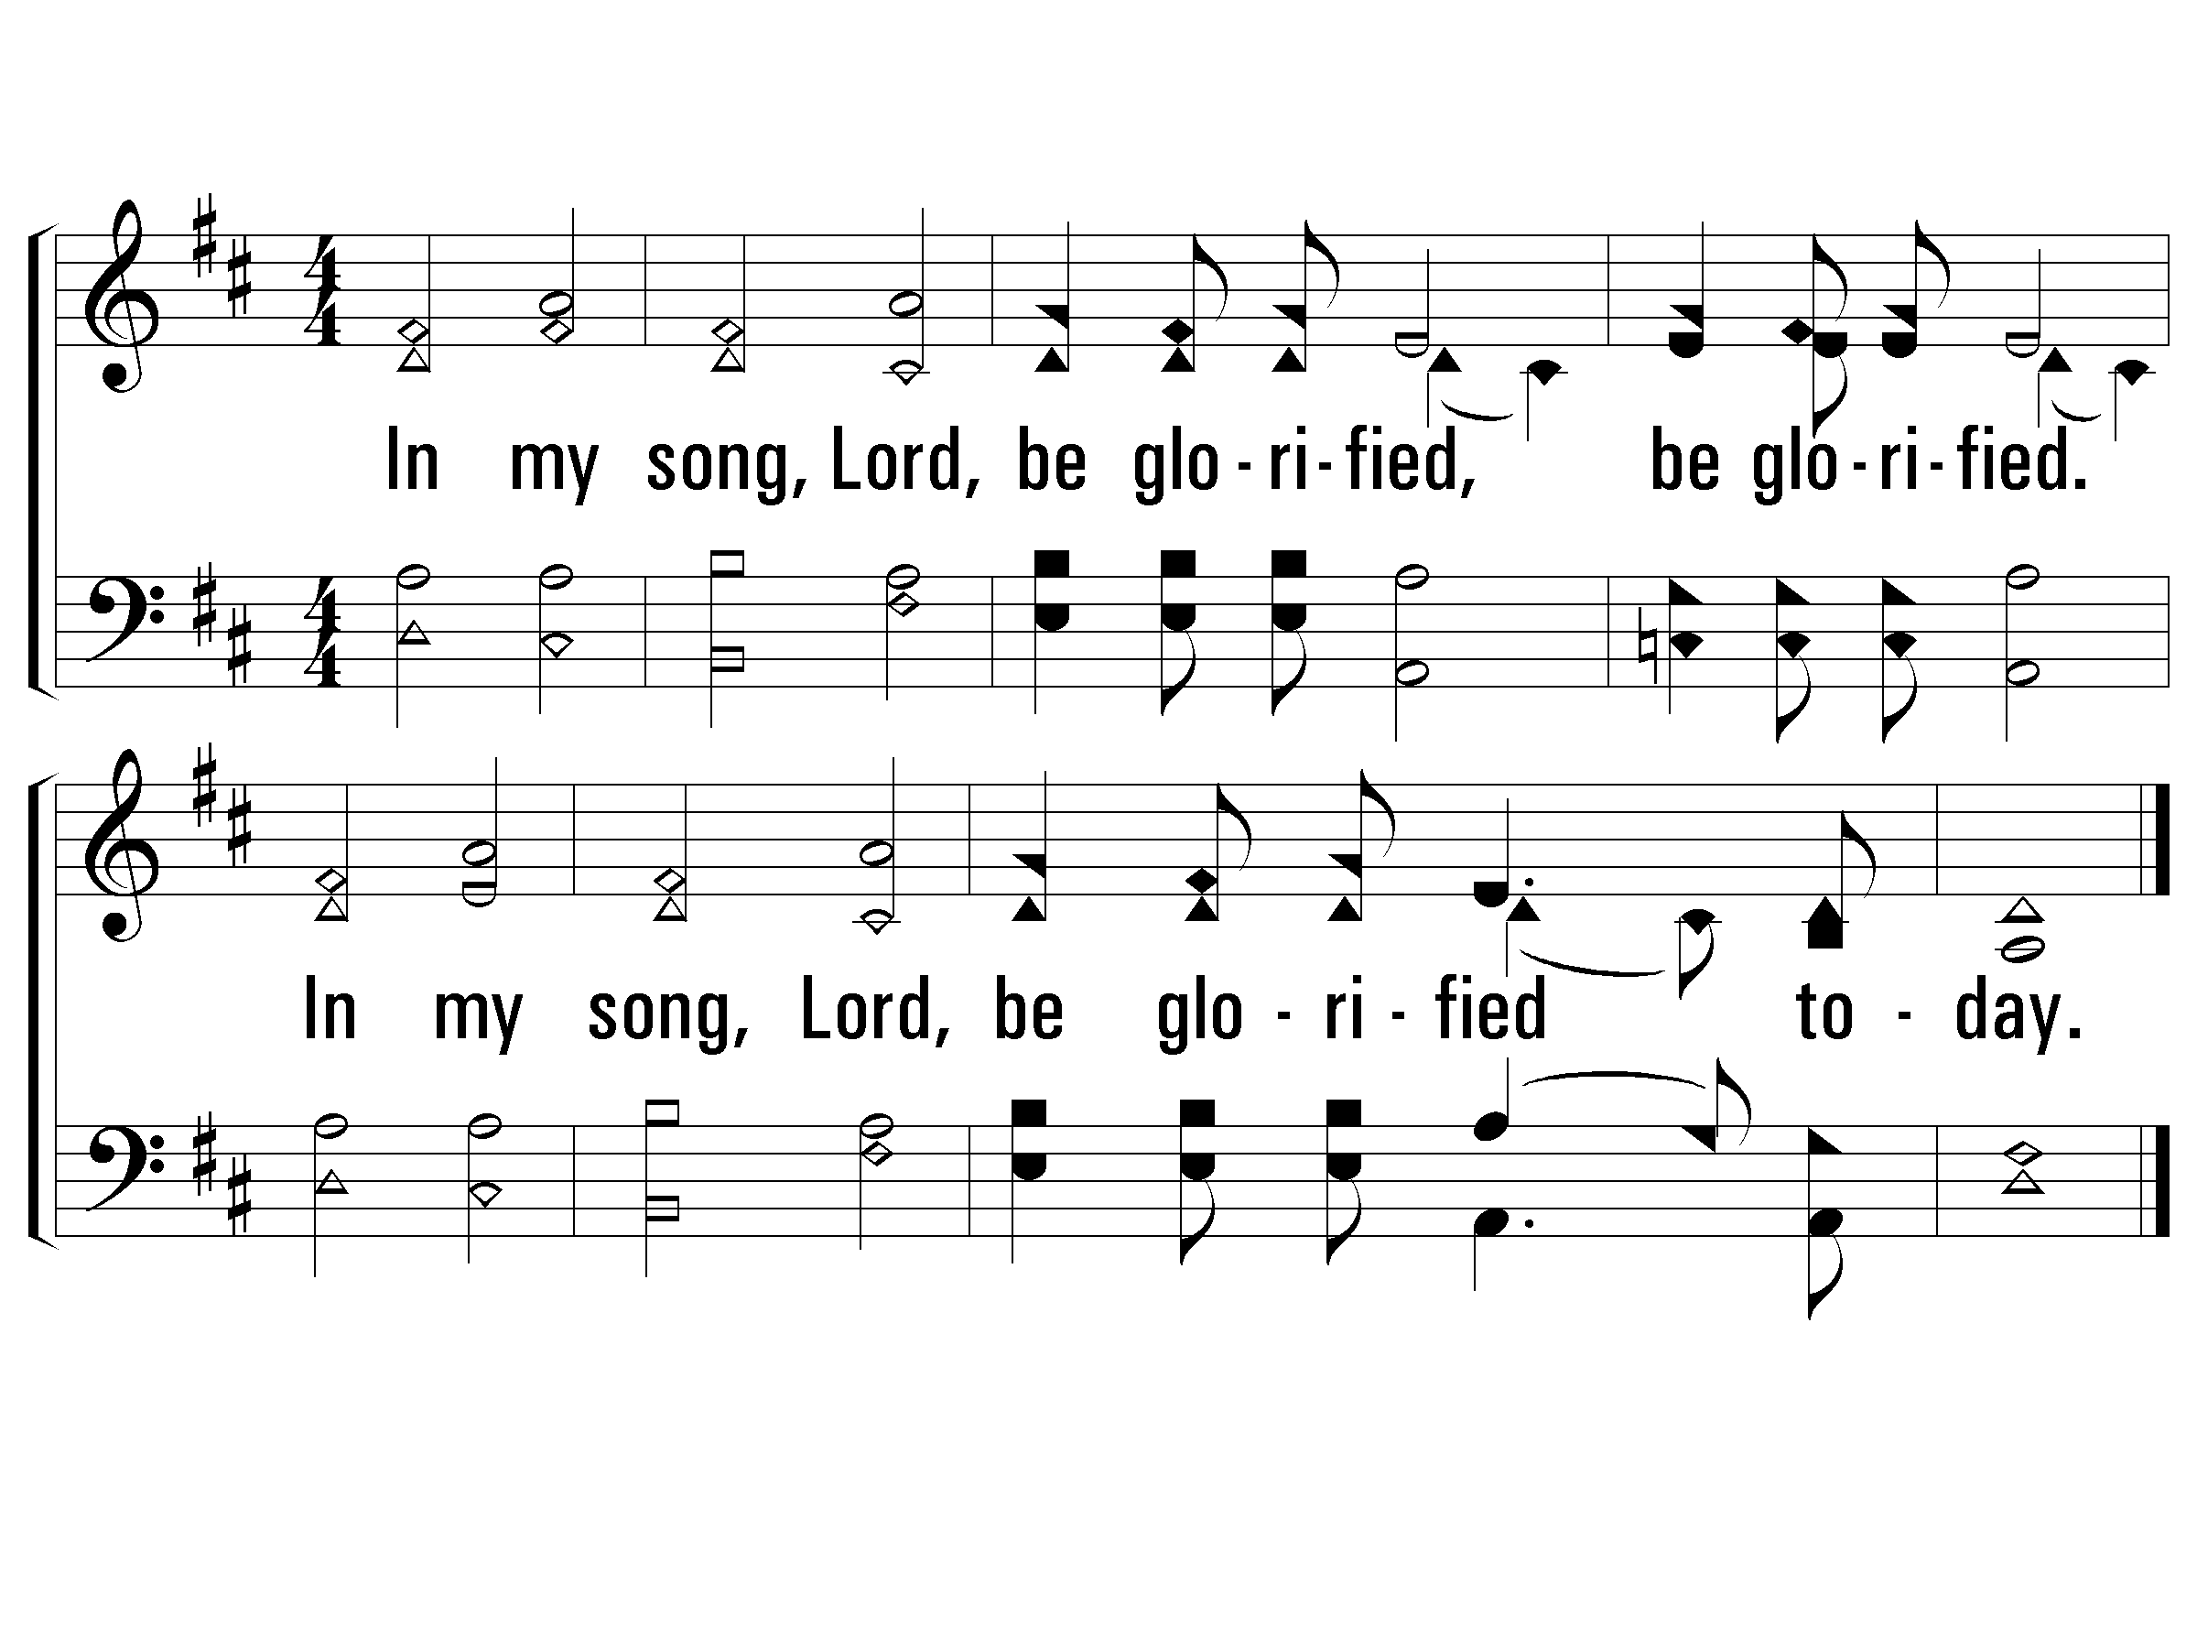
2 - In My Life, Lord, Be Glorified
2.
In my song, Lord, be glorified, be glorified.
In my song, Lord, be glorified today.
Words and Music by: Bob Kilpatrick
Copyright © 1978 by Bob Kilpatrick Music. Assigned 1998 to The Lorenz Corporation.
All Rights Reserved. International copyright secured
© 2001 The Paperless Hymnal™

Slide 12
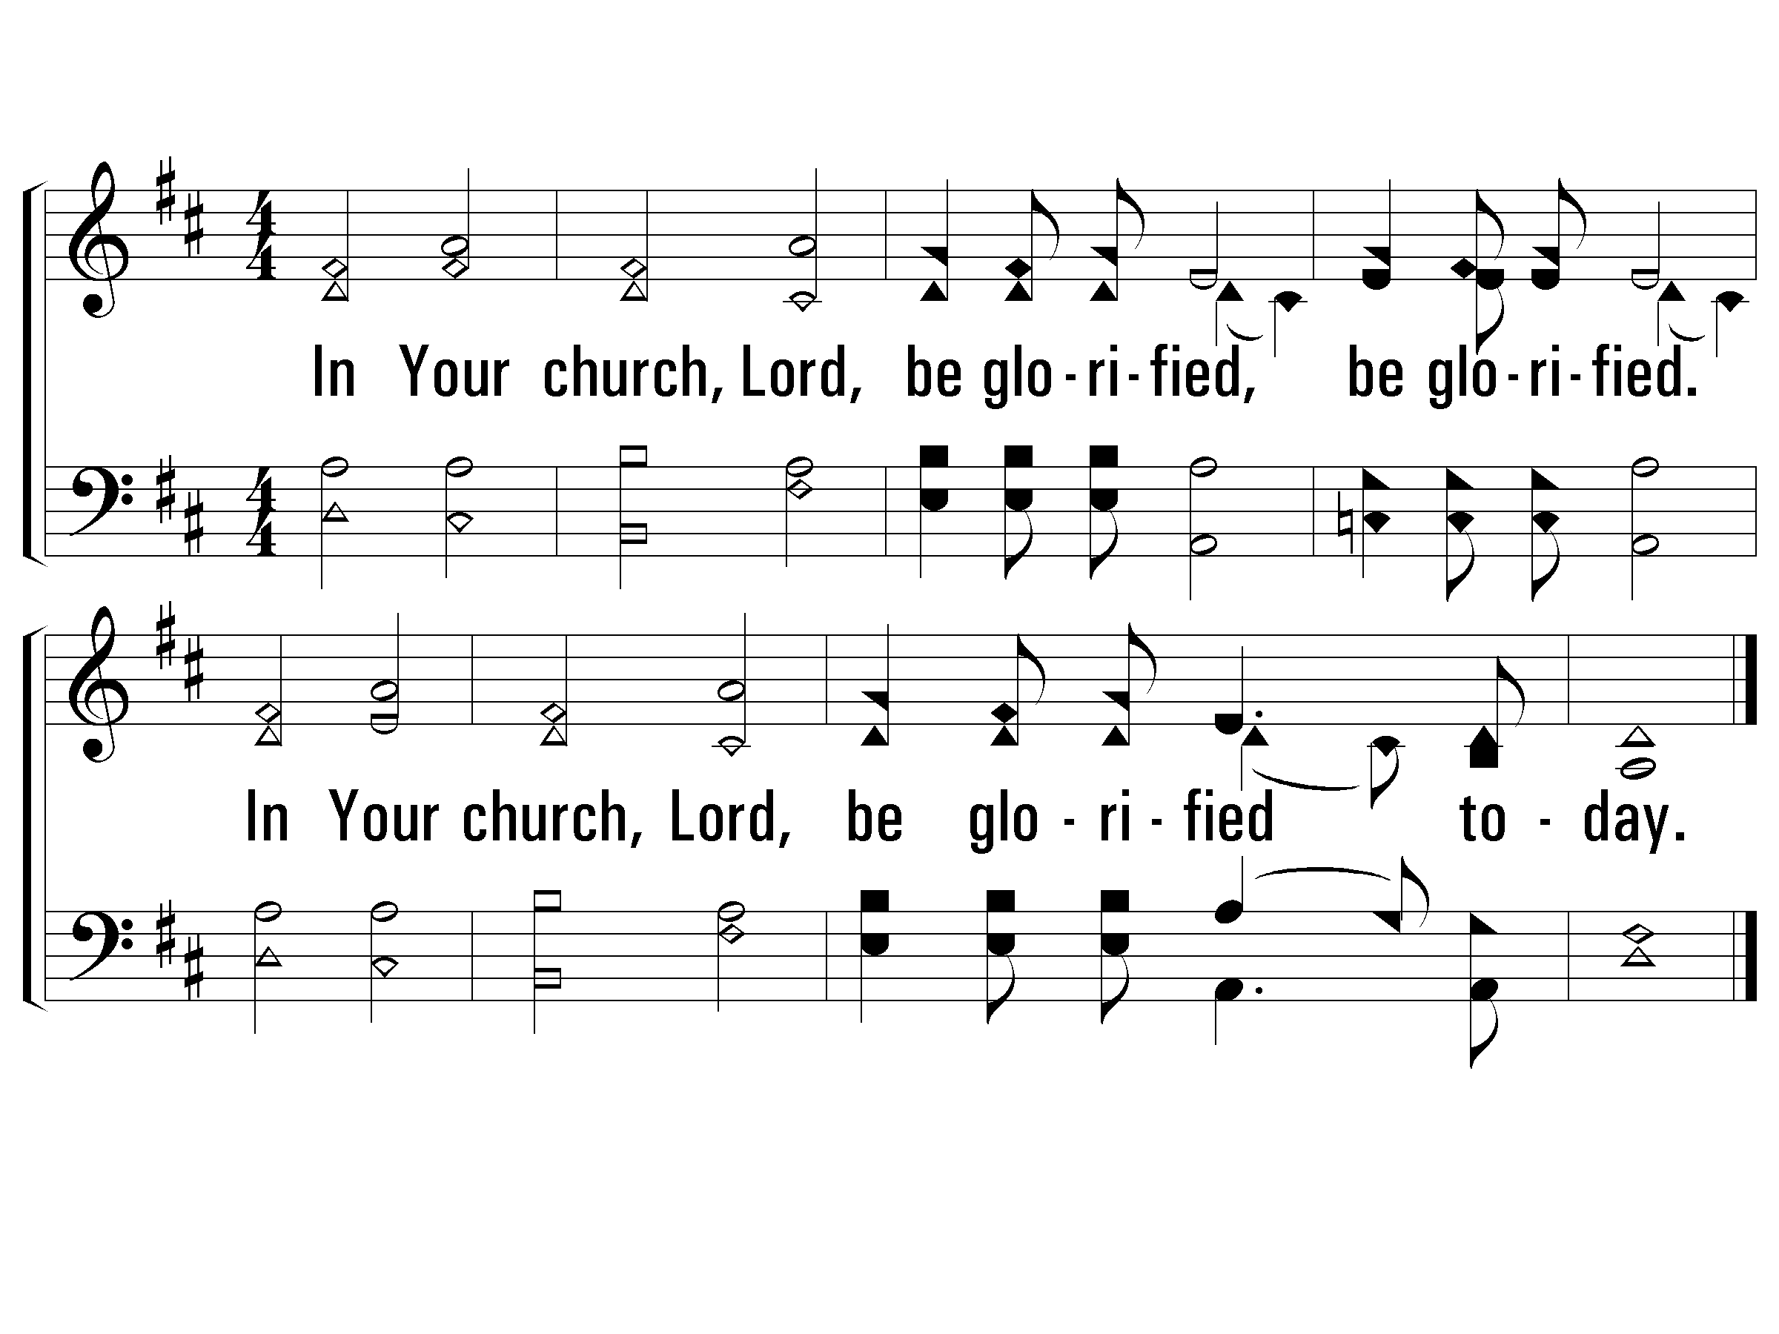
3 - In My Life, Lord, Be Glorified
3.
In Your church, Lord, be glorified, be glorified.
In Your church, Lord, be glorified today.
Words and Music by: Bob Kilpatrick
Copyright © 1978 by Bob Kilpatrick Music. Assigned 1998 to The Lorenz Corporation.
All Rights Reserved. International copyright secured
© 2001 The Paperless Hymnal™

Slide 14
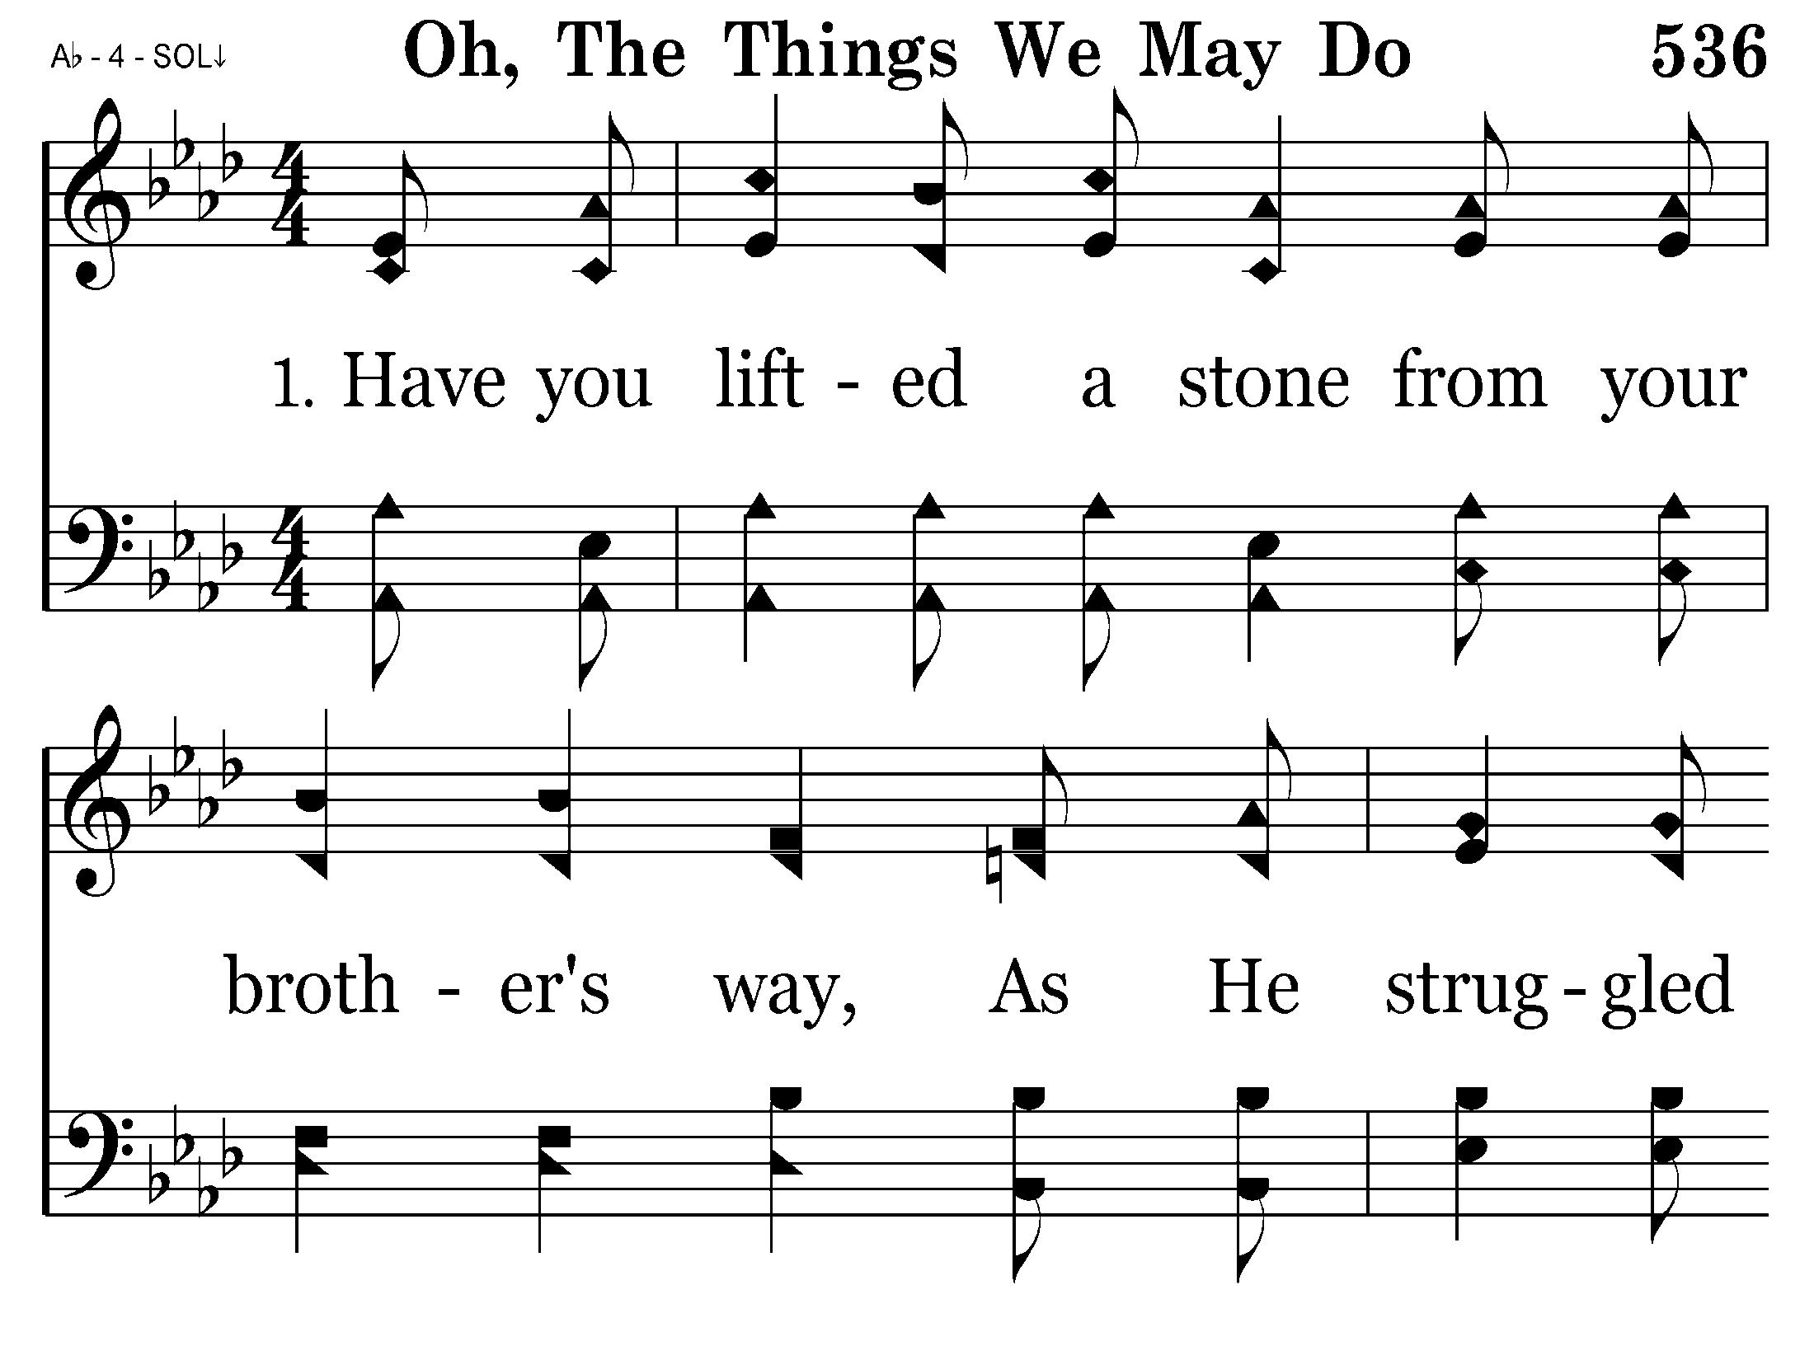
536 - Oh, The Things We May Do - 1.1

Slide 15
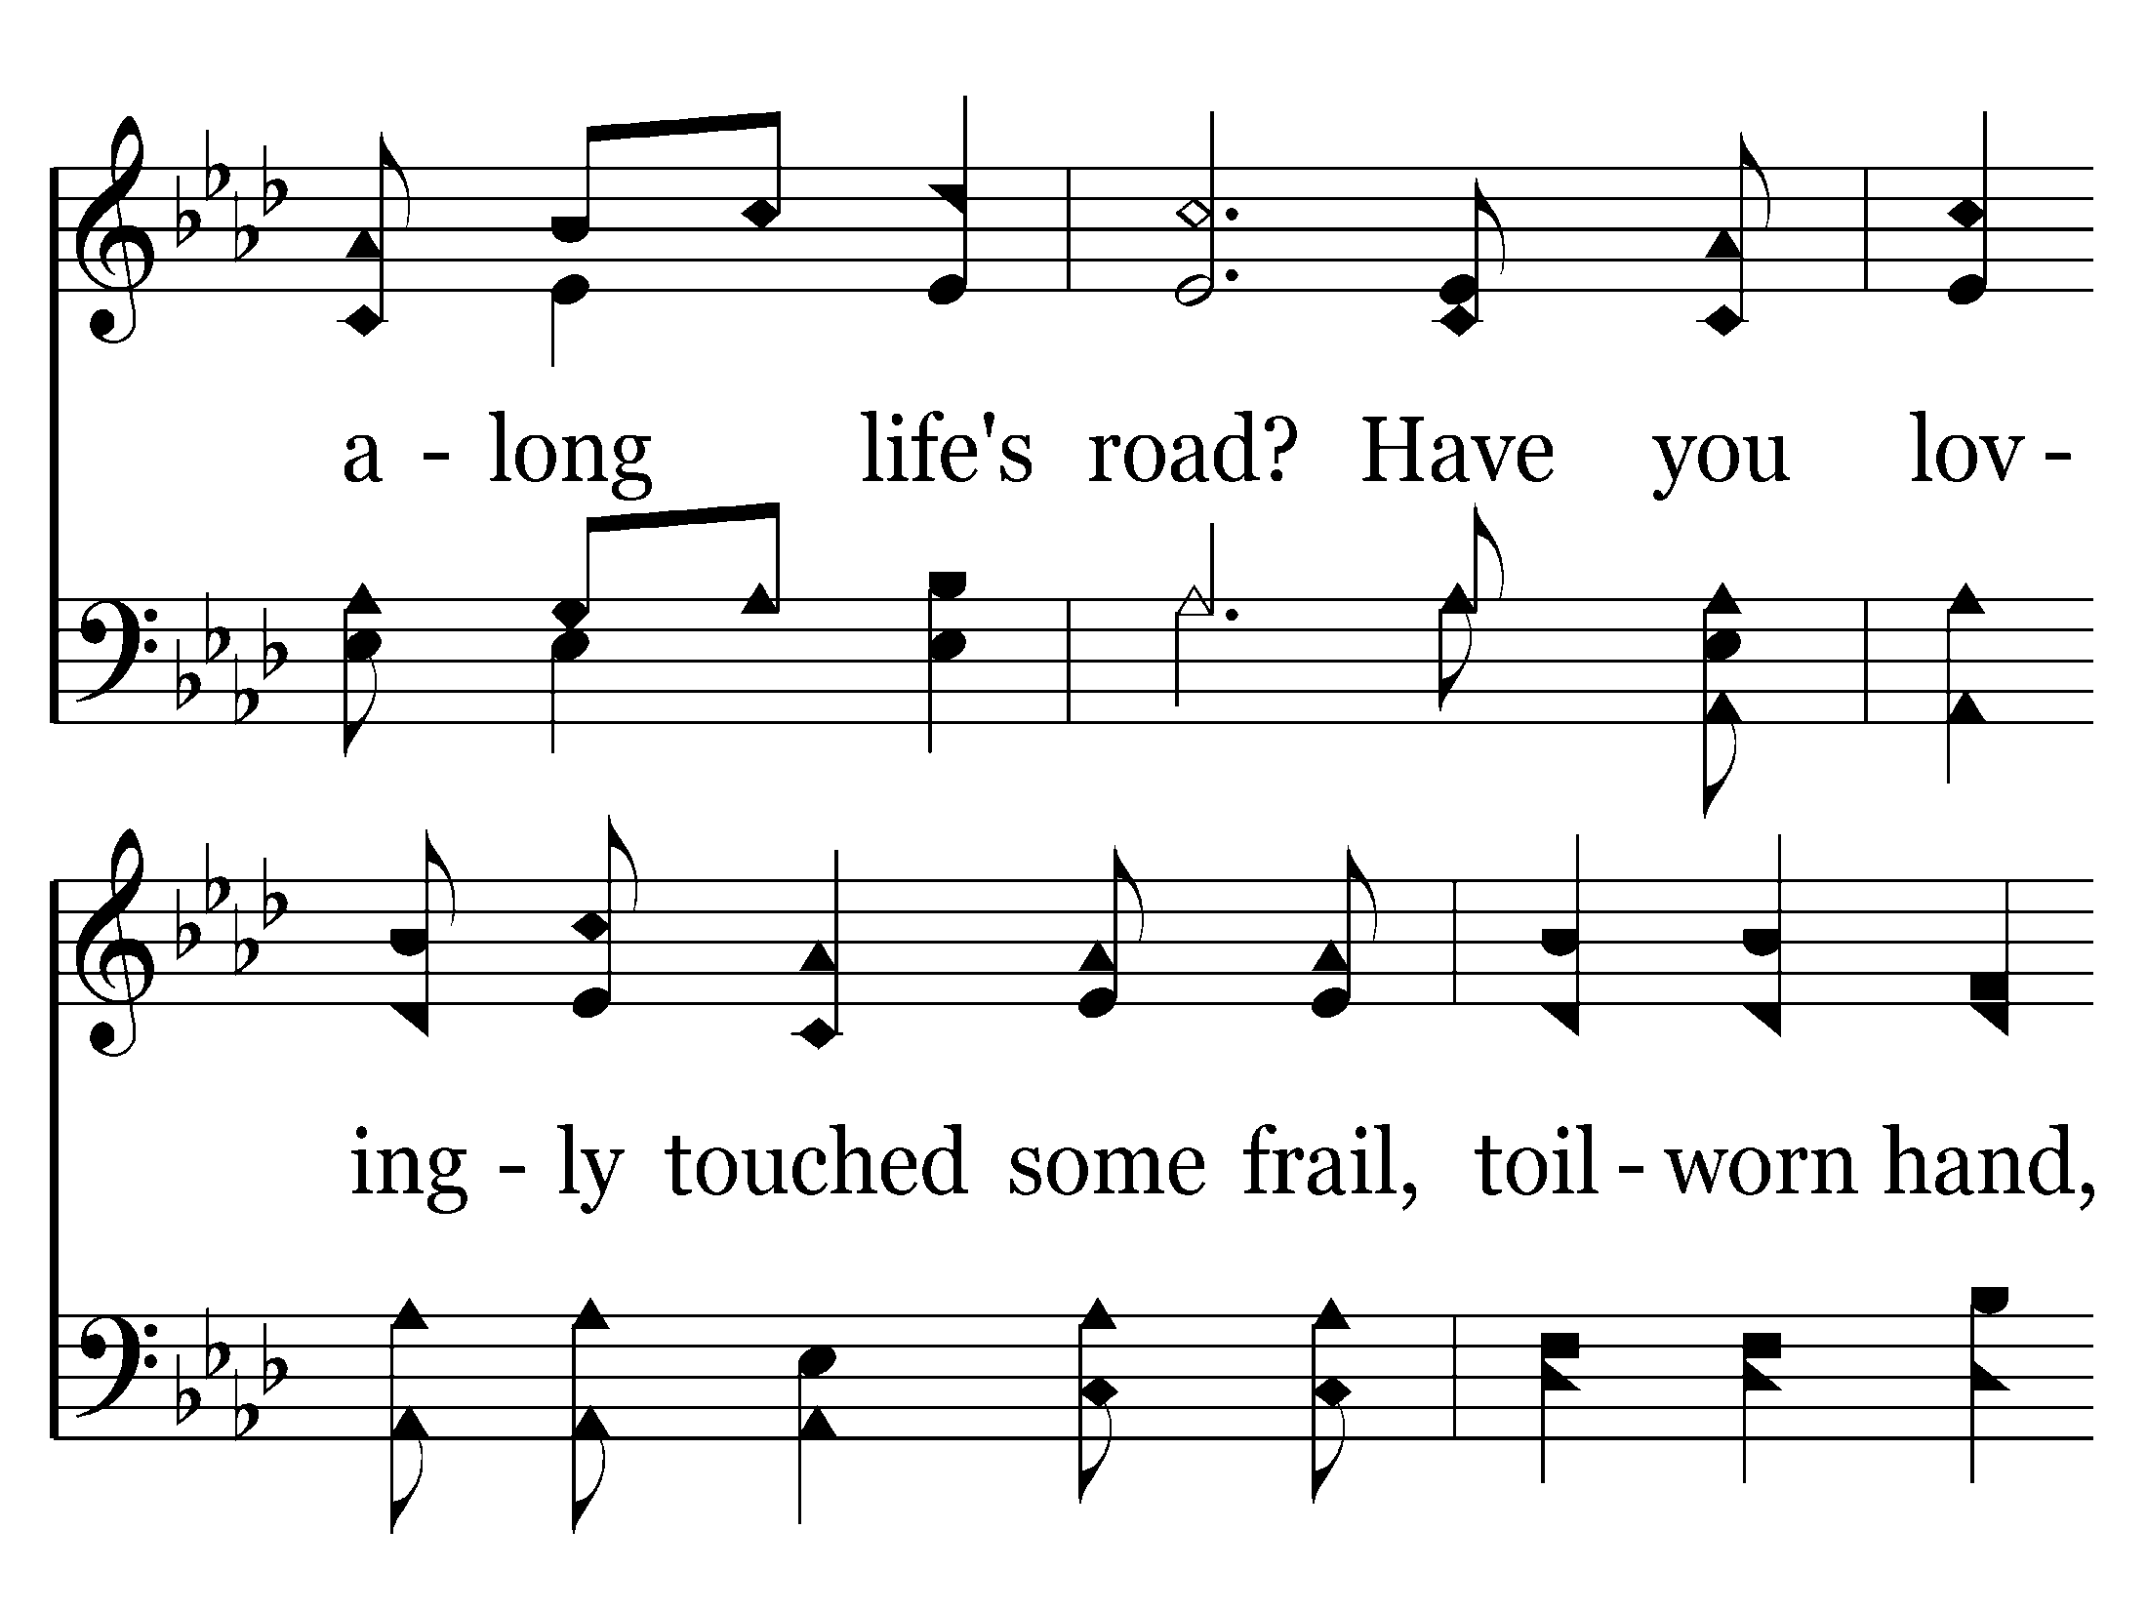
536 - Oh, The Things We May Do - 1.2

Slide 16
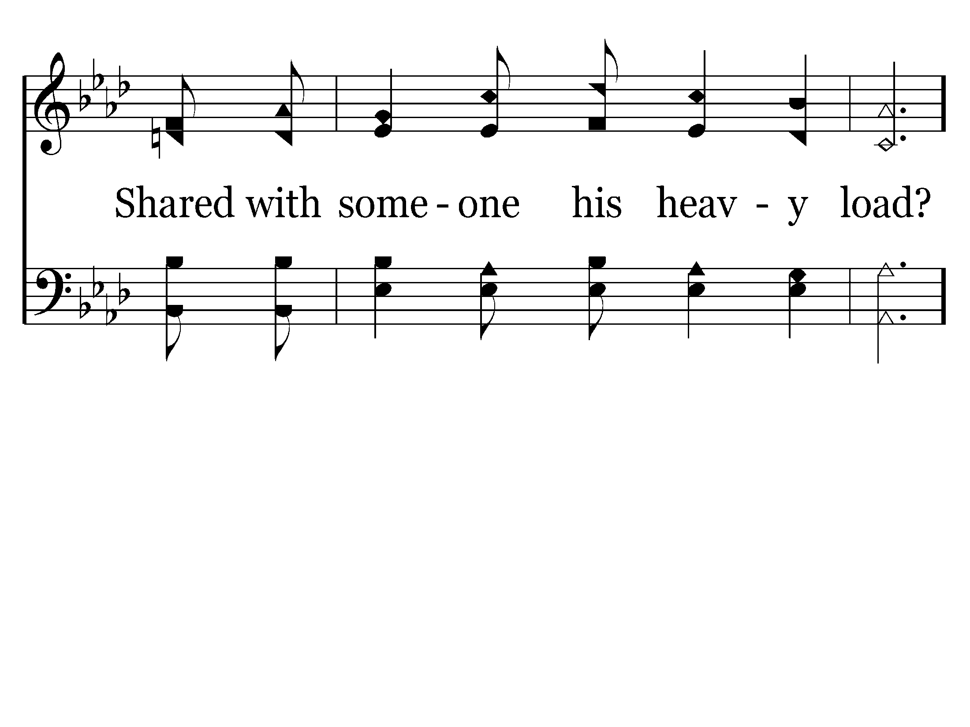
536 - Oh, The Things We May Do - 1.3

Slide 17
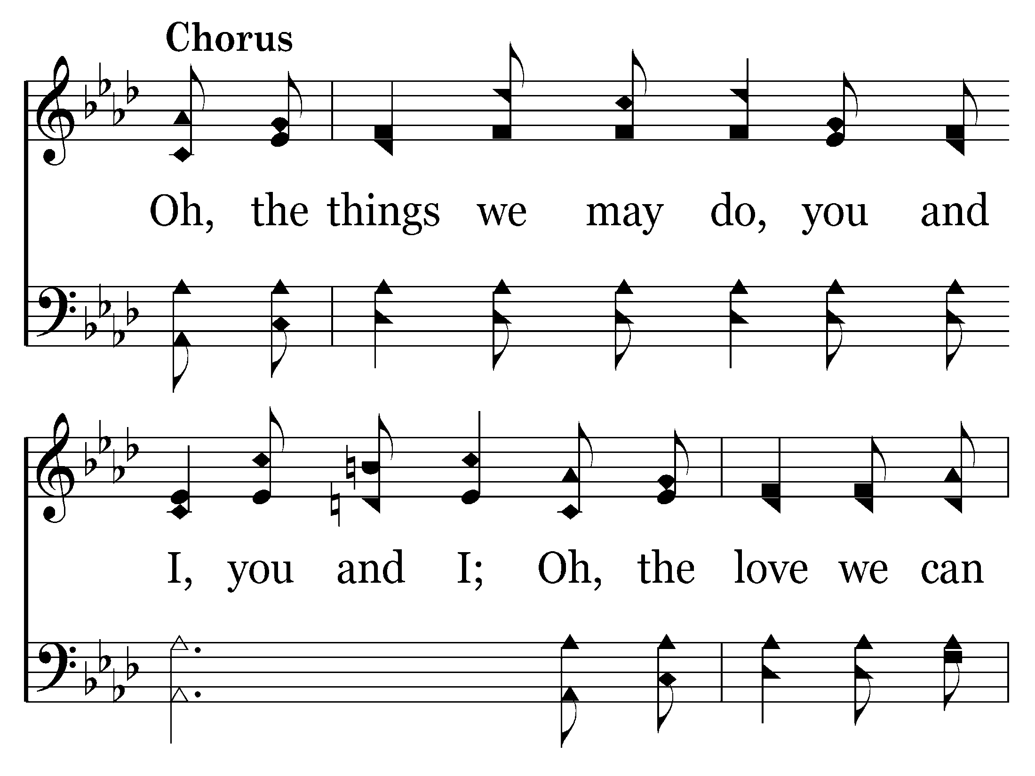
536 - Oh, The Things We May Do - C.1

Slide 18
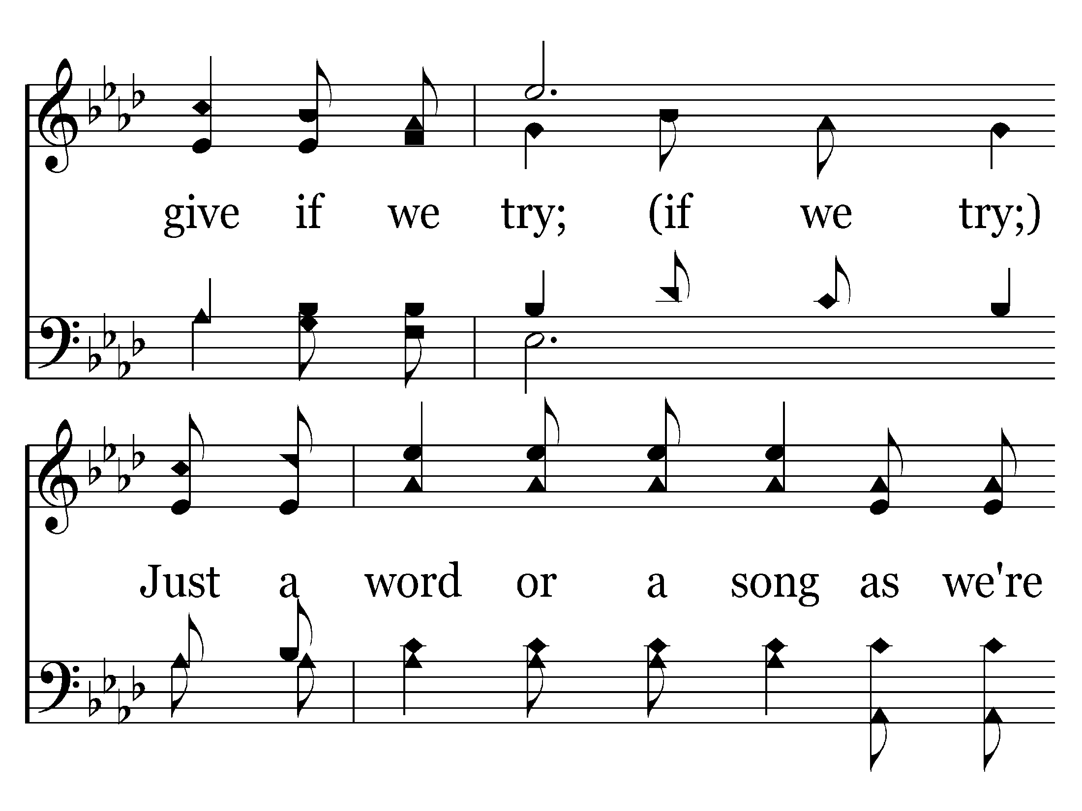
536 - Oh, The Things We May Do - C.2

Slide 19
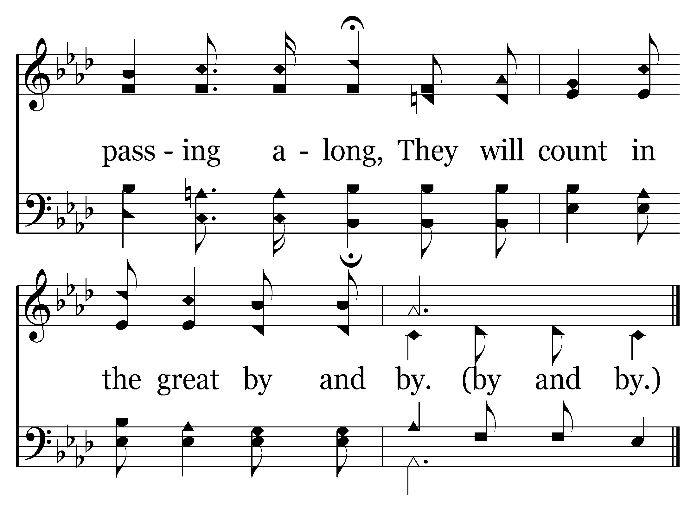
536 - Oh, The Things We May Do - C.3
End of Verse 1

Slide 20
536 - Oh, The Things We May Do - 2.1

Slide 21
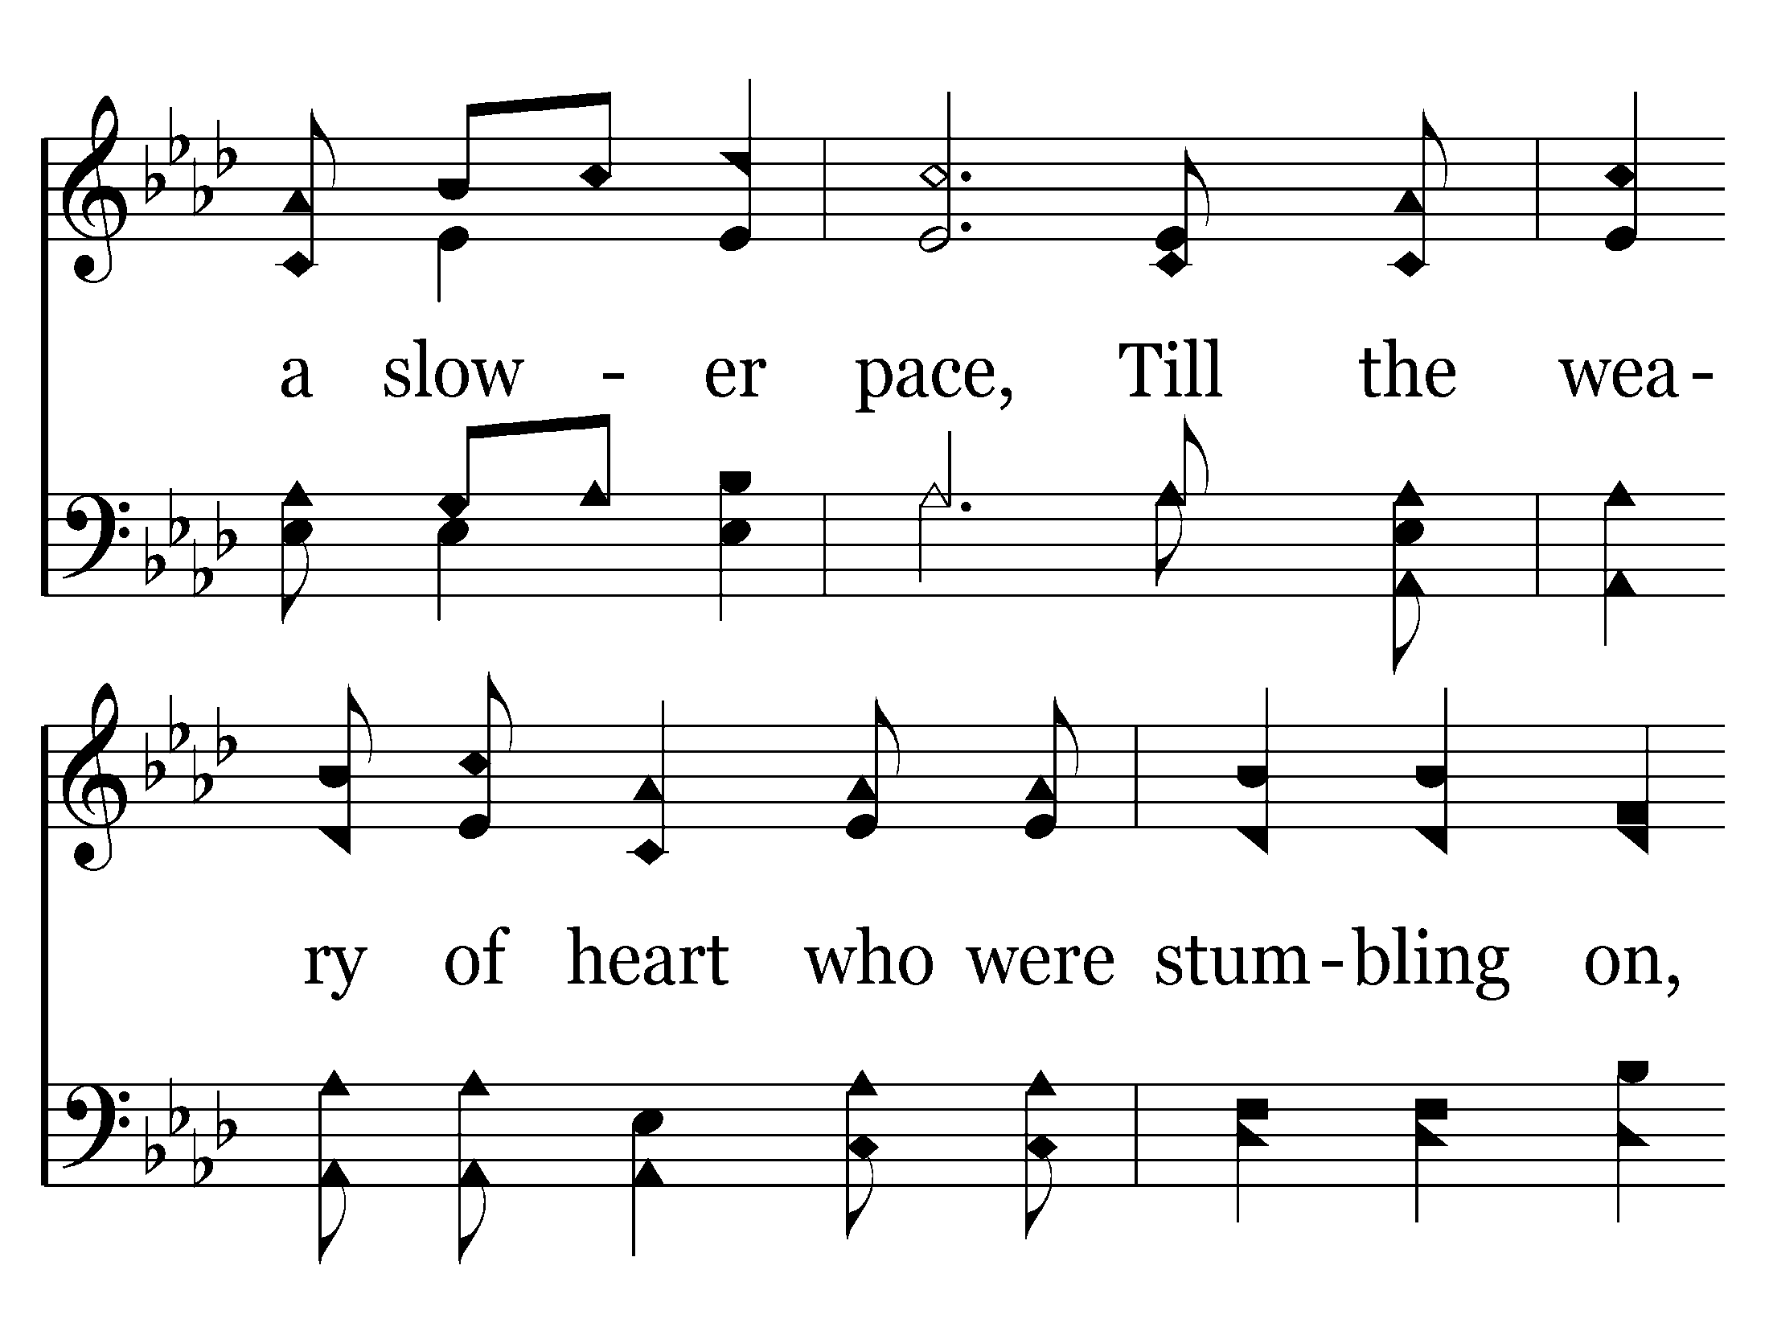
536 - Oh, The Things We May Do - 2.2

Slide 22
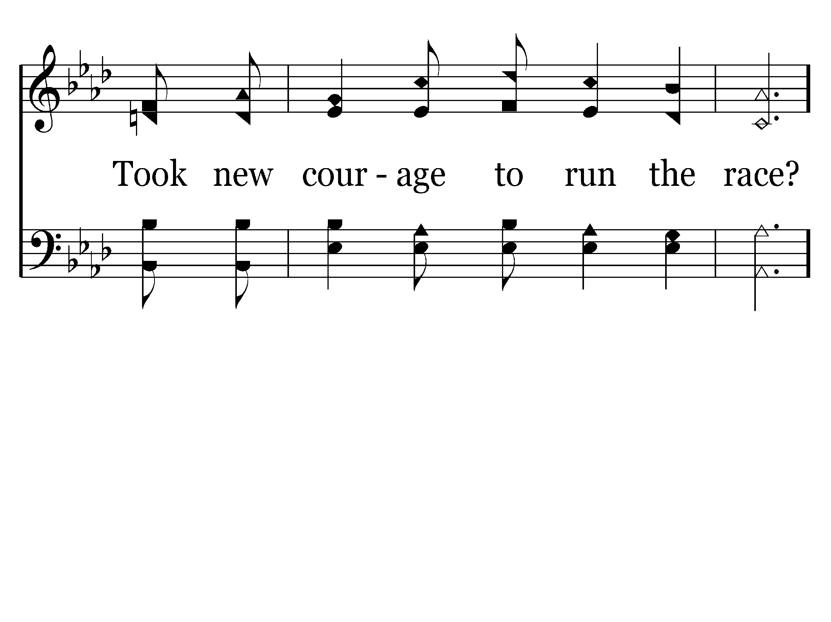
536 - Oh, The Things We May Do - 2.3

Slide 23
536 - Oh, The Things We May Do - C.1

Slide 24
536 - Oh, The Things We May Do - C.2

Slide 25
536 - Oh, The Things We May Do - C.3
End of Verse 2

Slide 27
576 - Faith Is The Victory - 1.1

Slide 28
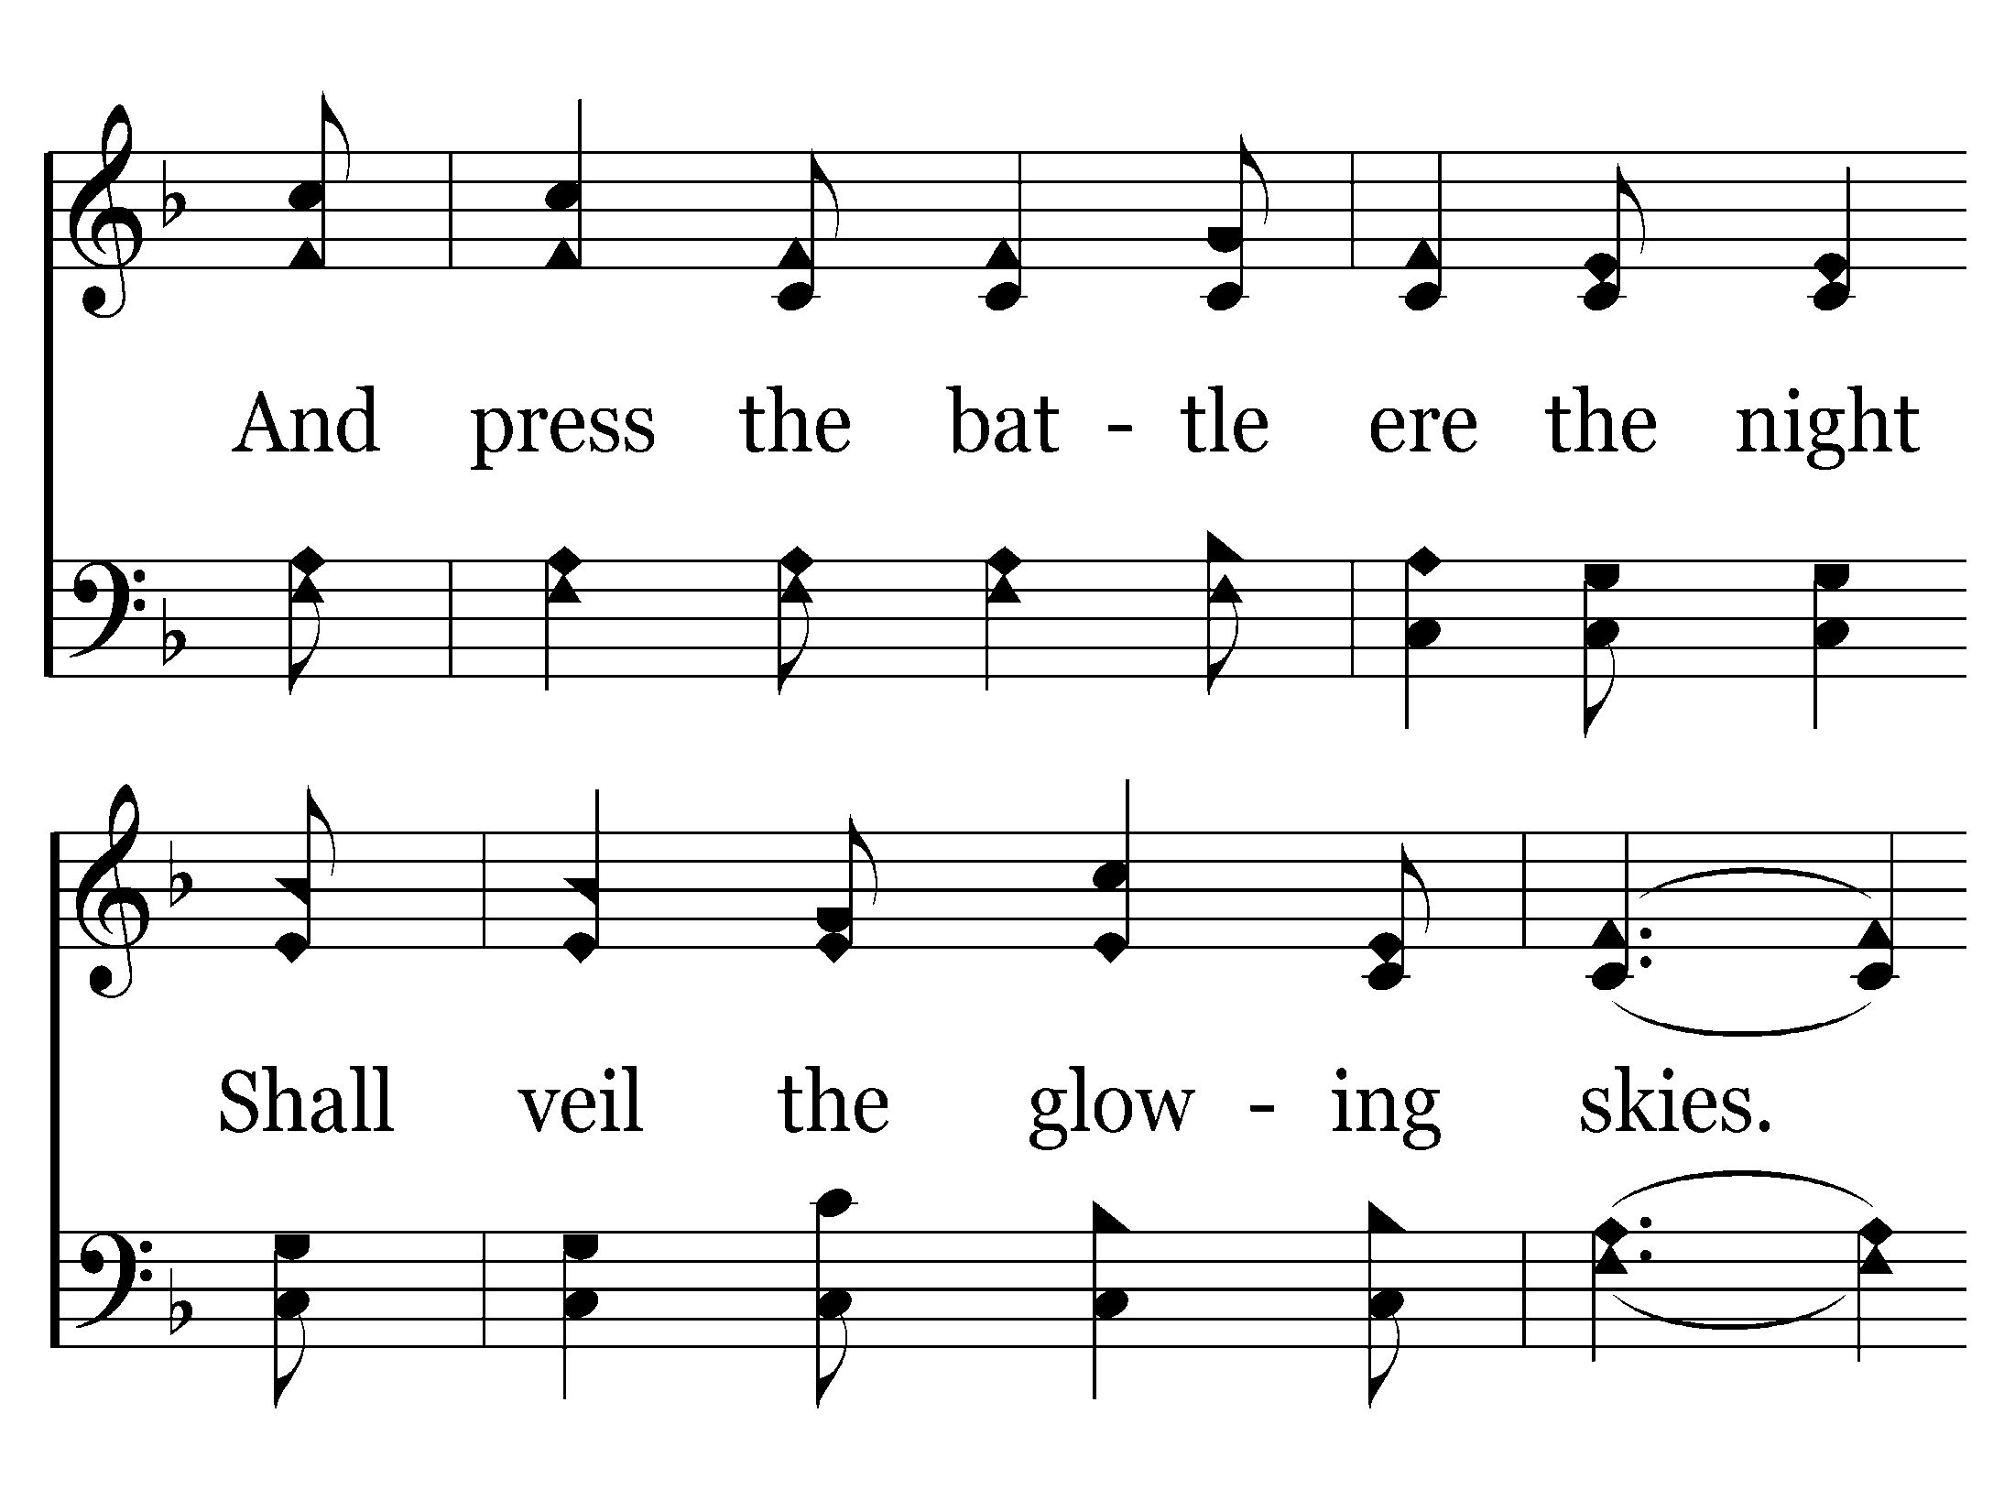
576 - Faith Is The Victory - 1.2

Slide 29
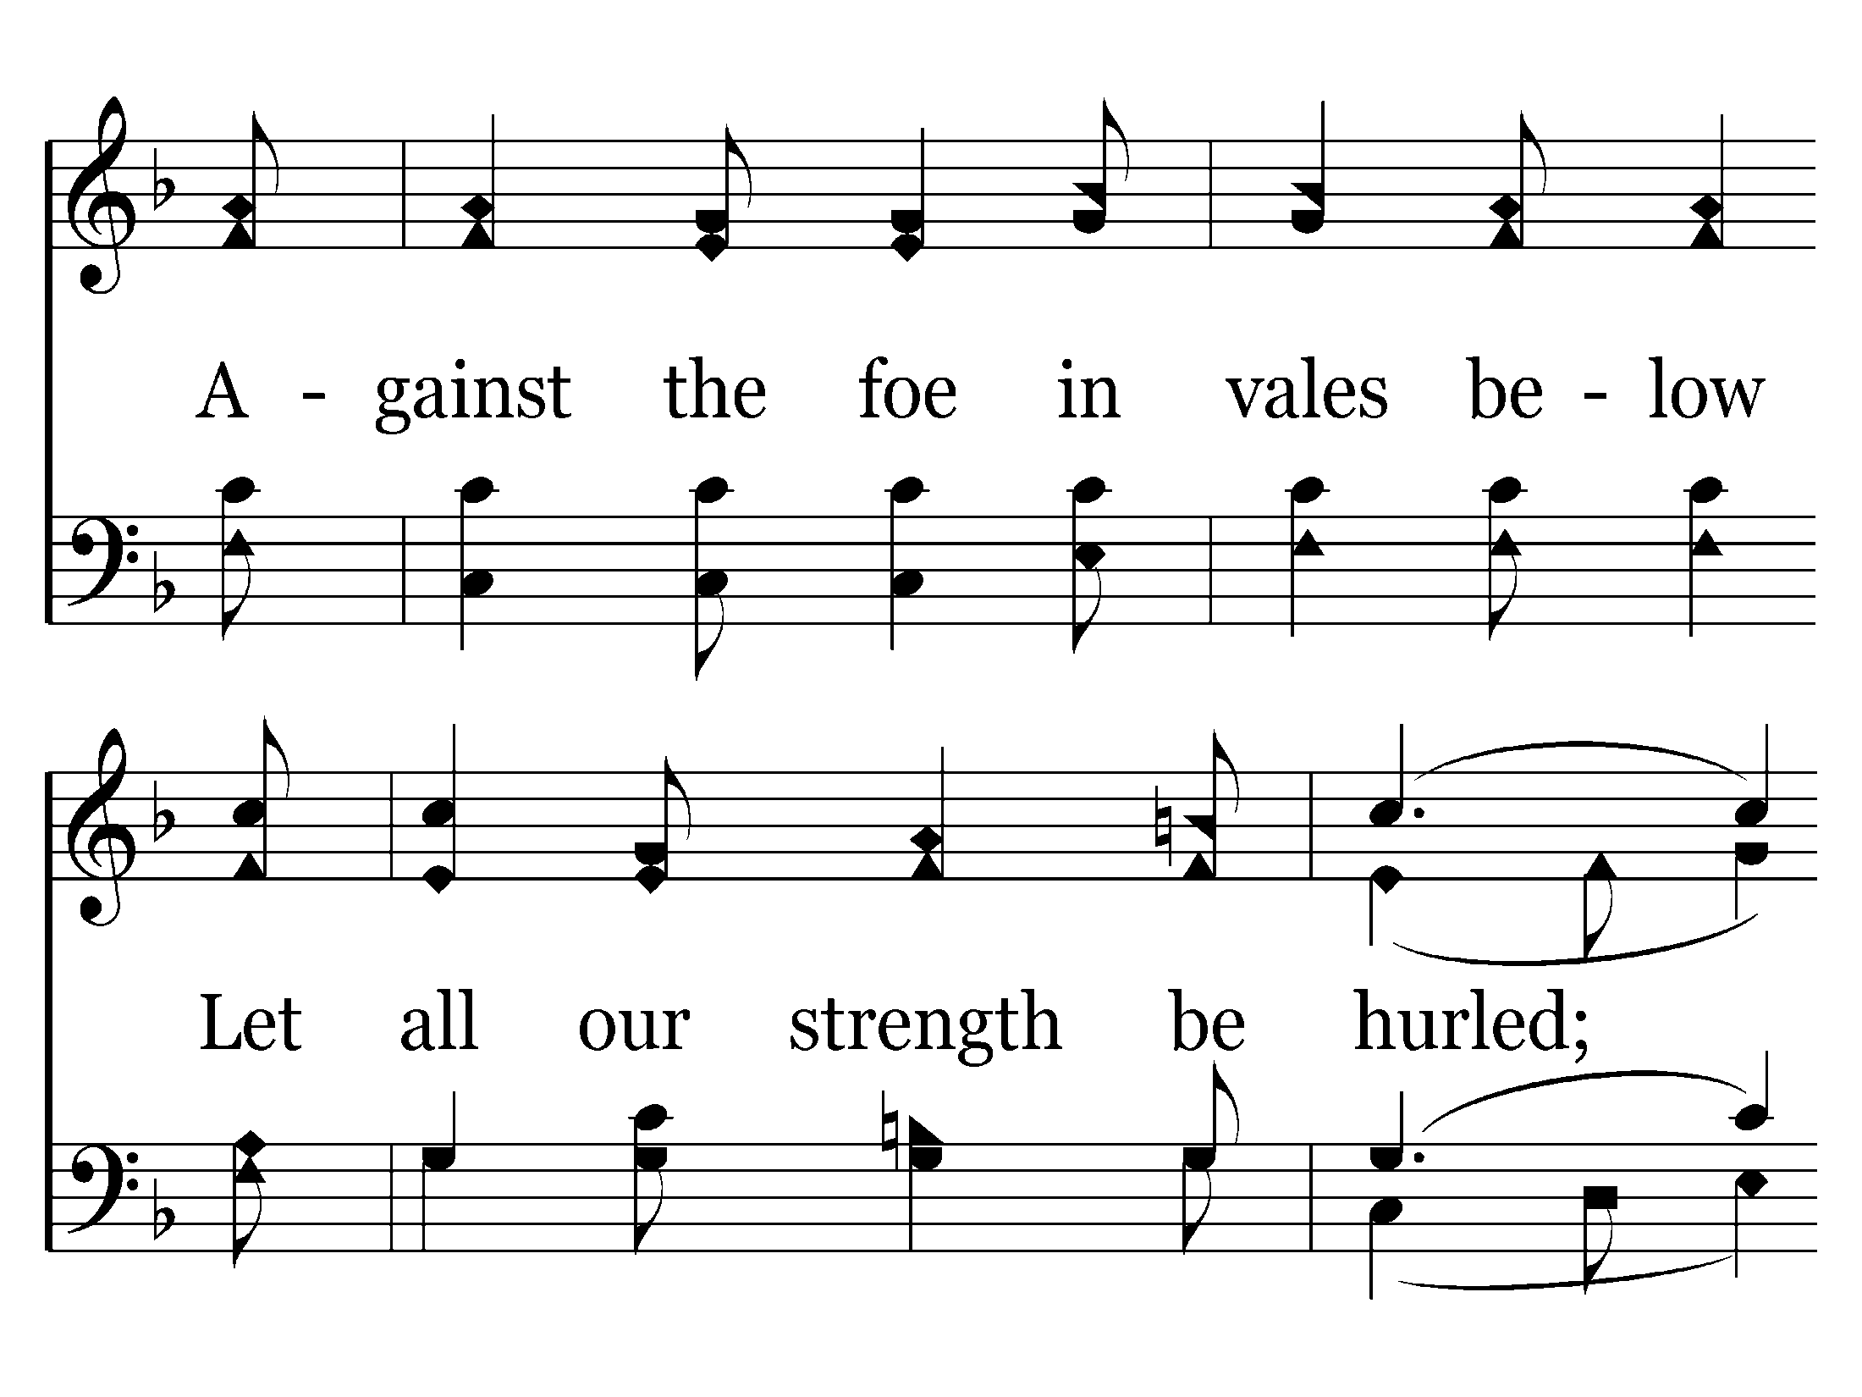
576 - Faith Is The Victory - 1.3

Slide 30
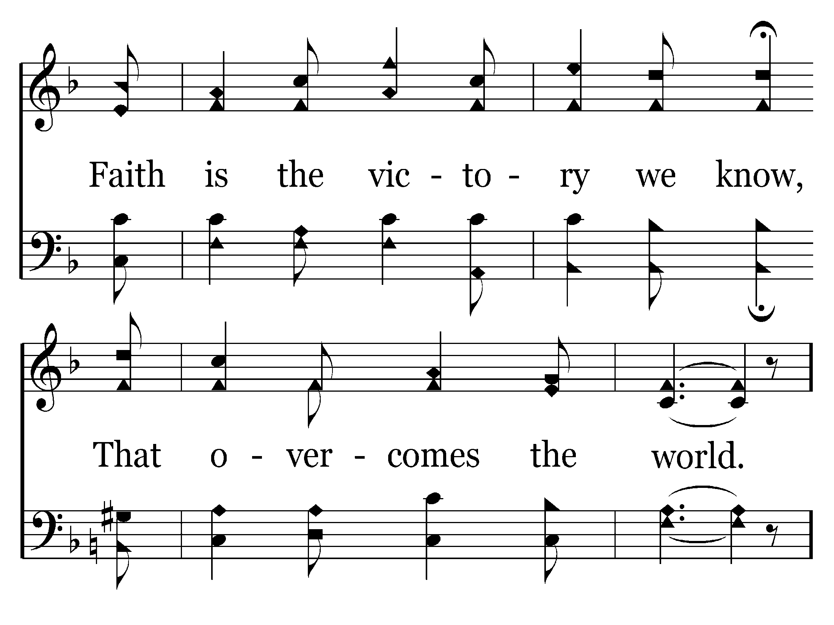
576 - Faith Is The Victory - 1.4

Slide 31
576 - Faith Is The Victory - 2.1

Slide 32
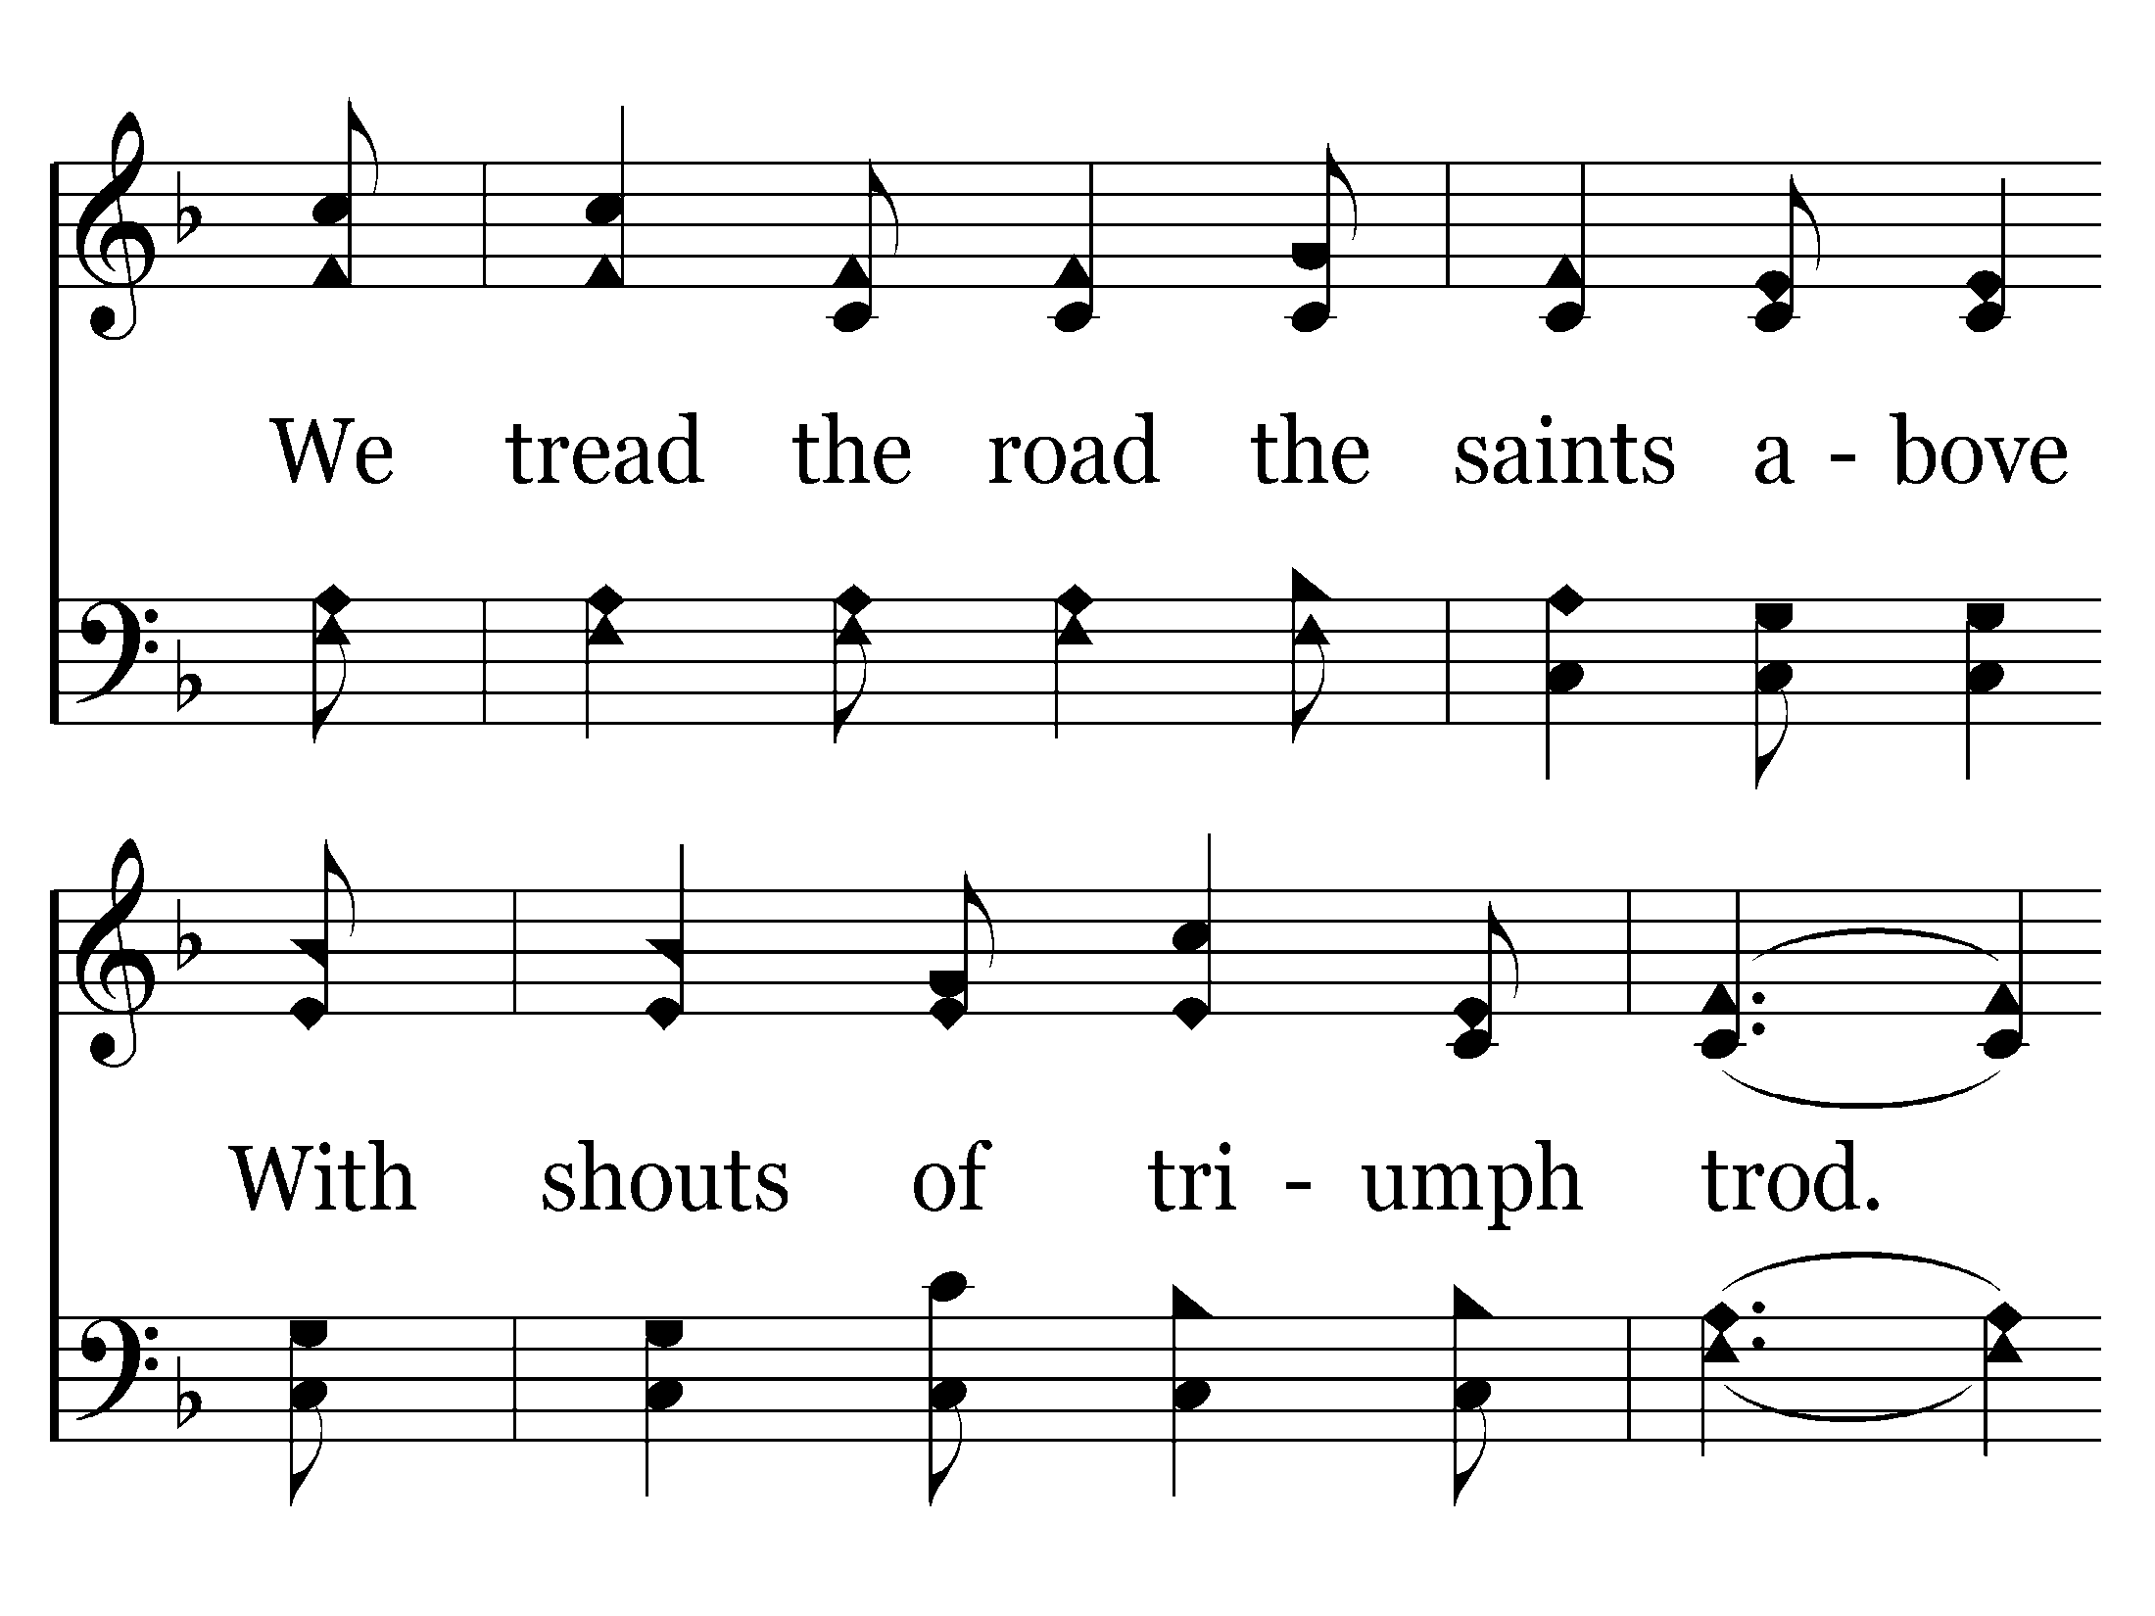
576 - Faith Is The Victory - 2.2

Slide 33
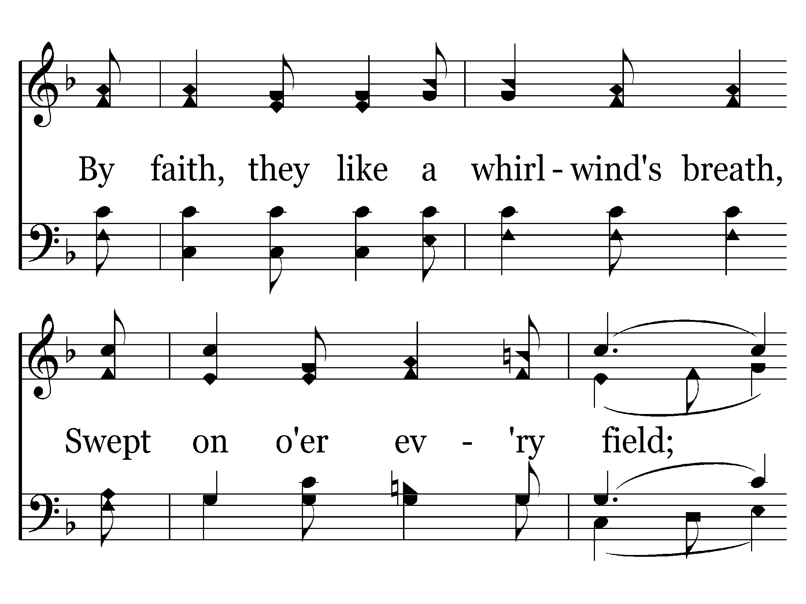
576 - Faith Is The Victory - 2.3

Slide 34
576 - Faith Is The Victory - 2.4

Slide 35
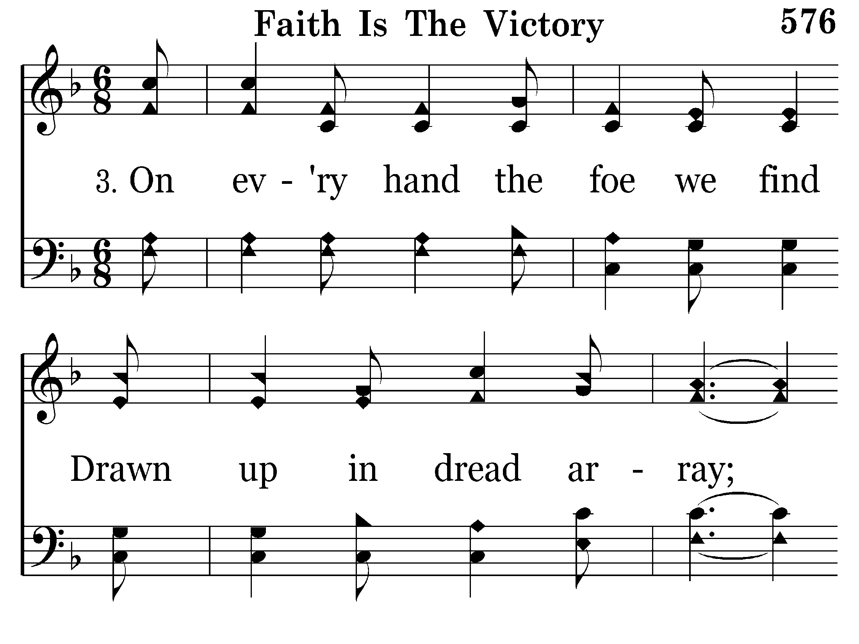
576 - Faith Is The Victory - 3.1

Slide 36
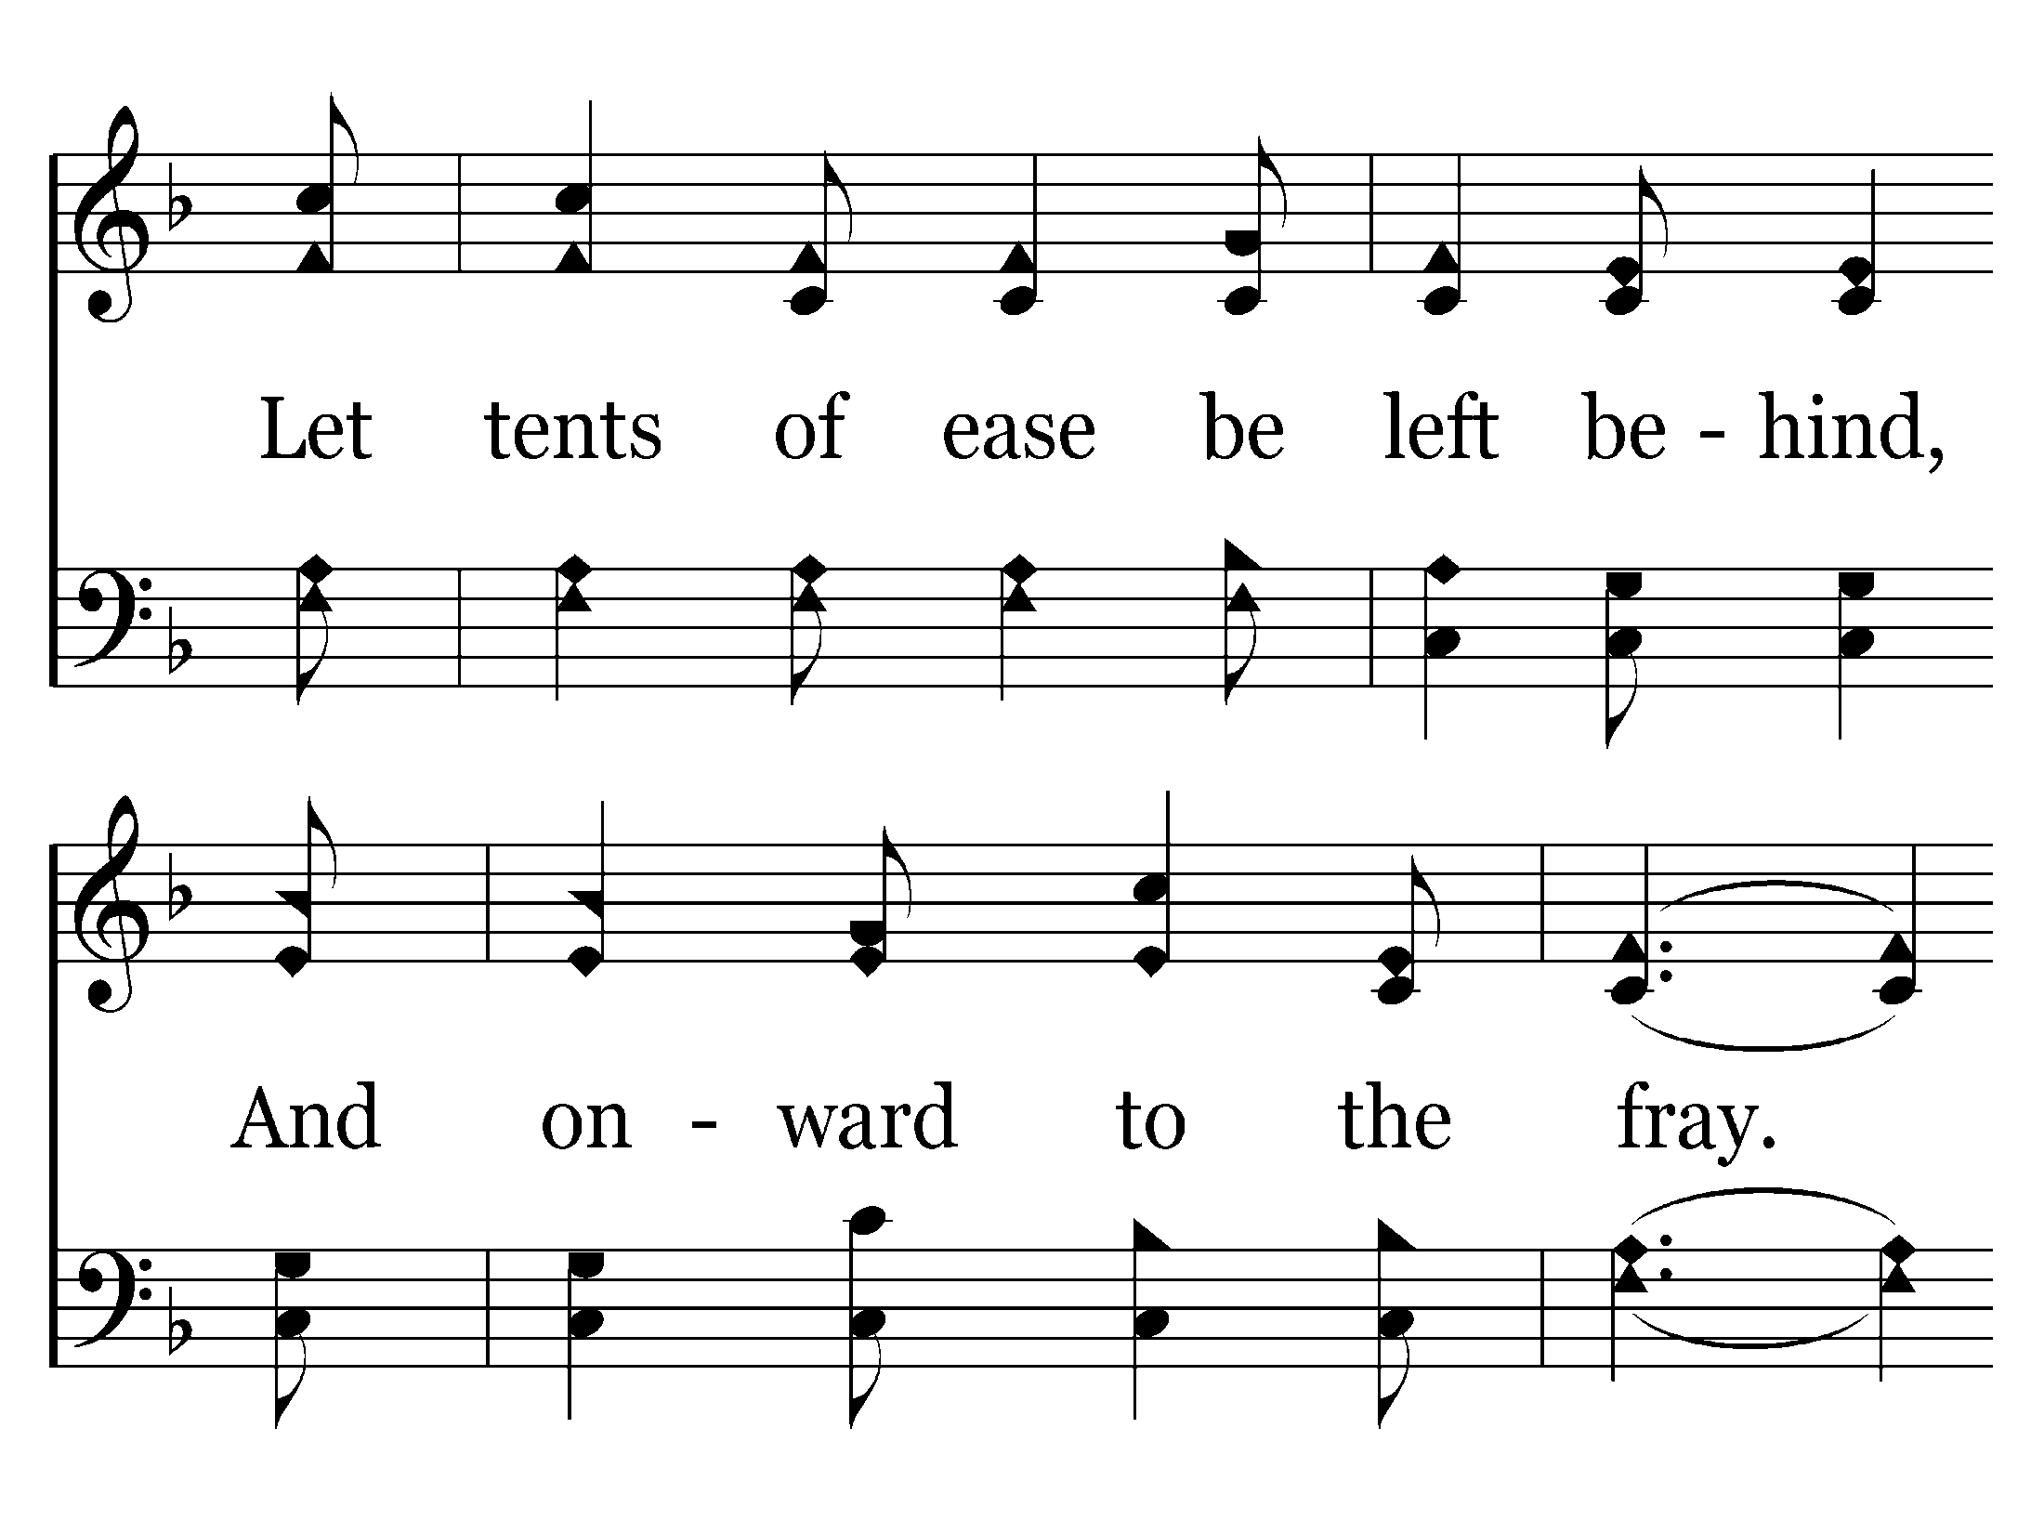
576 - Faith Is The Victory - 3.2

Slide 37
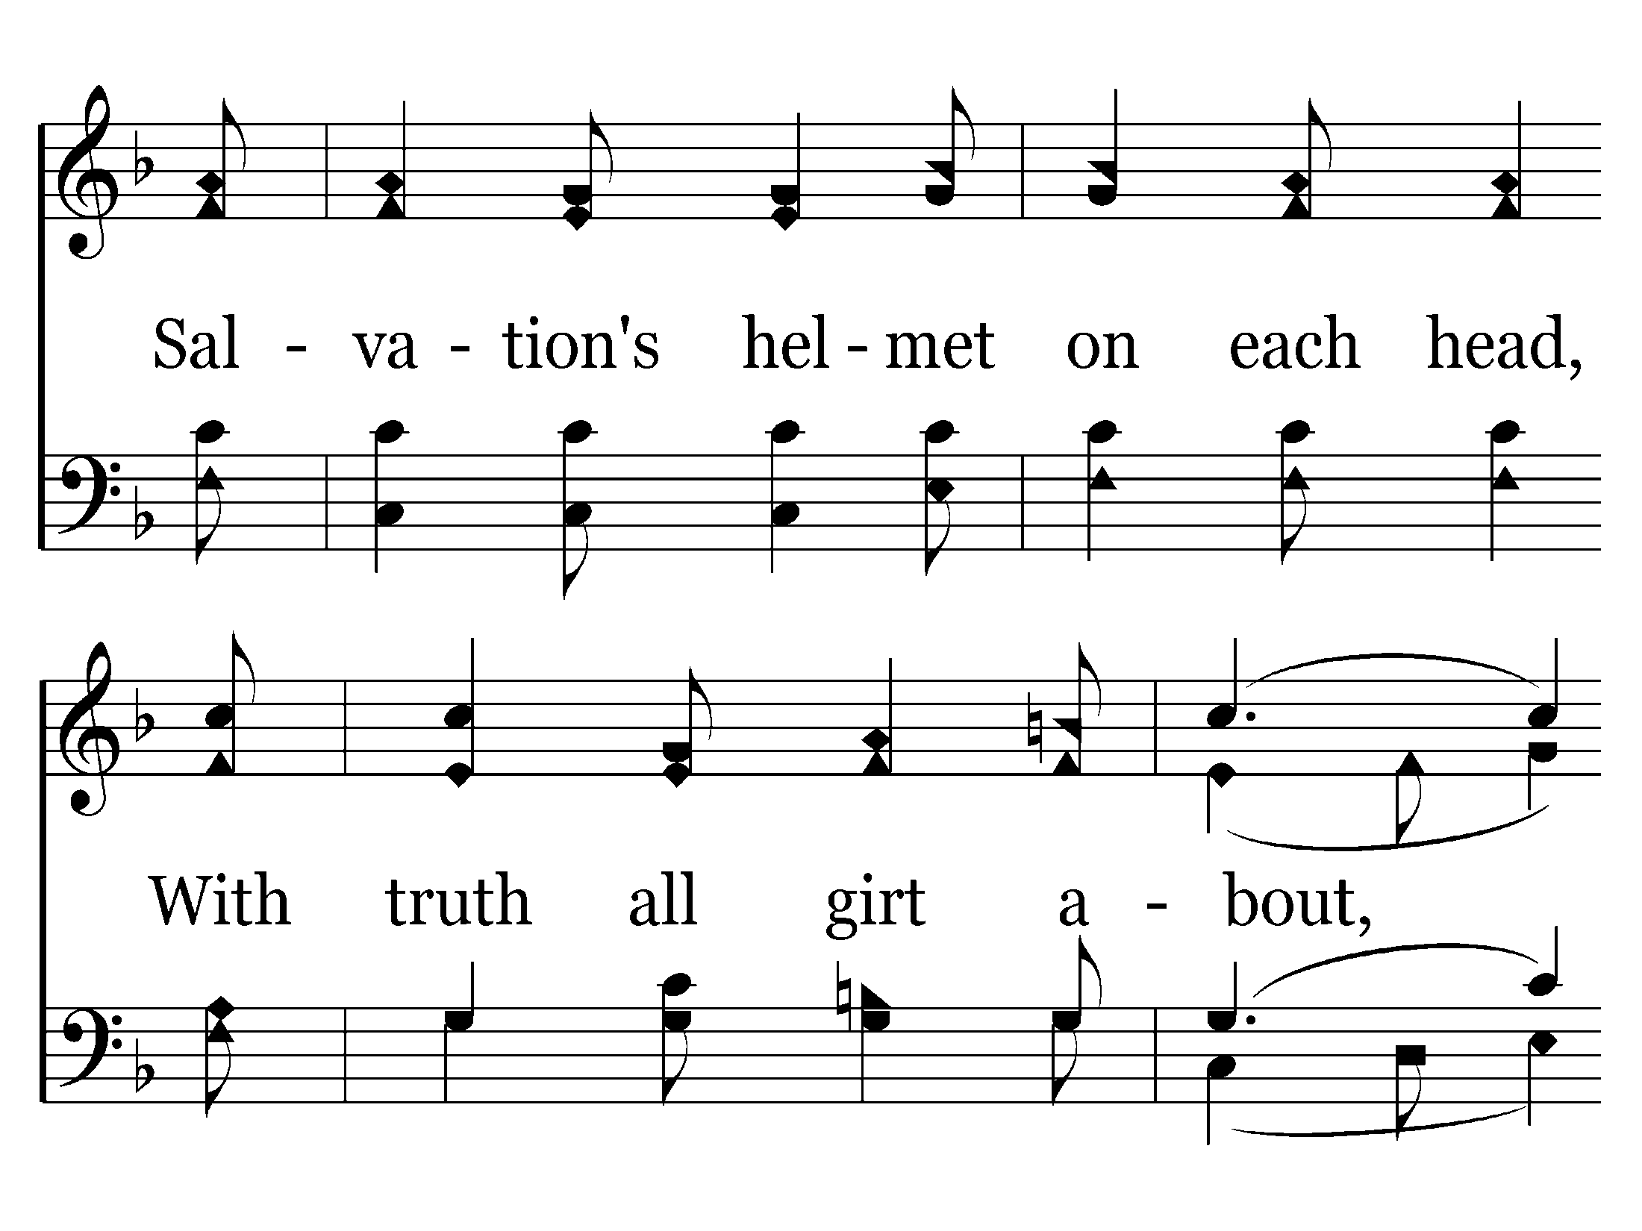
576 - Faith Is The Victory - 3.3

Slide 38
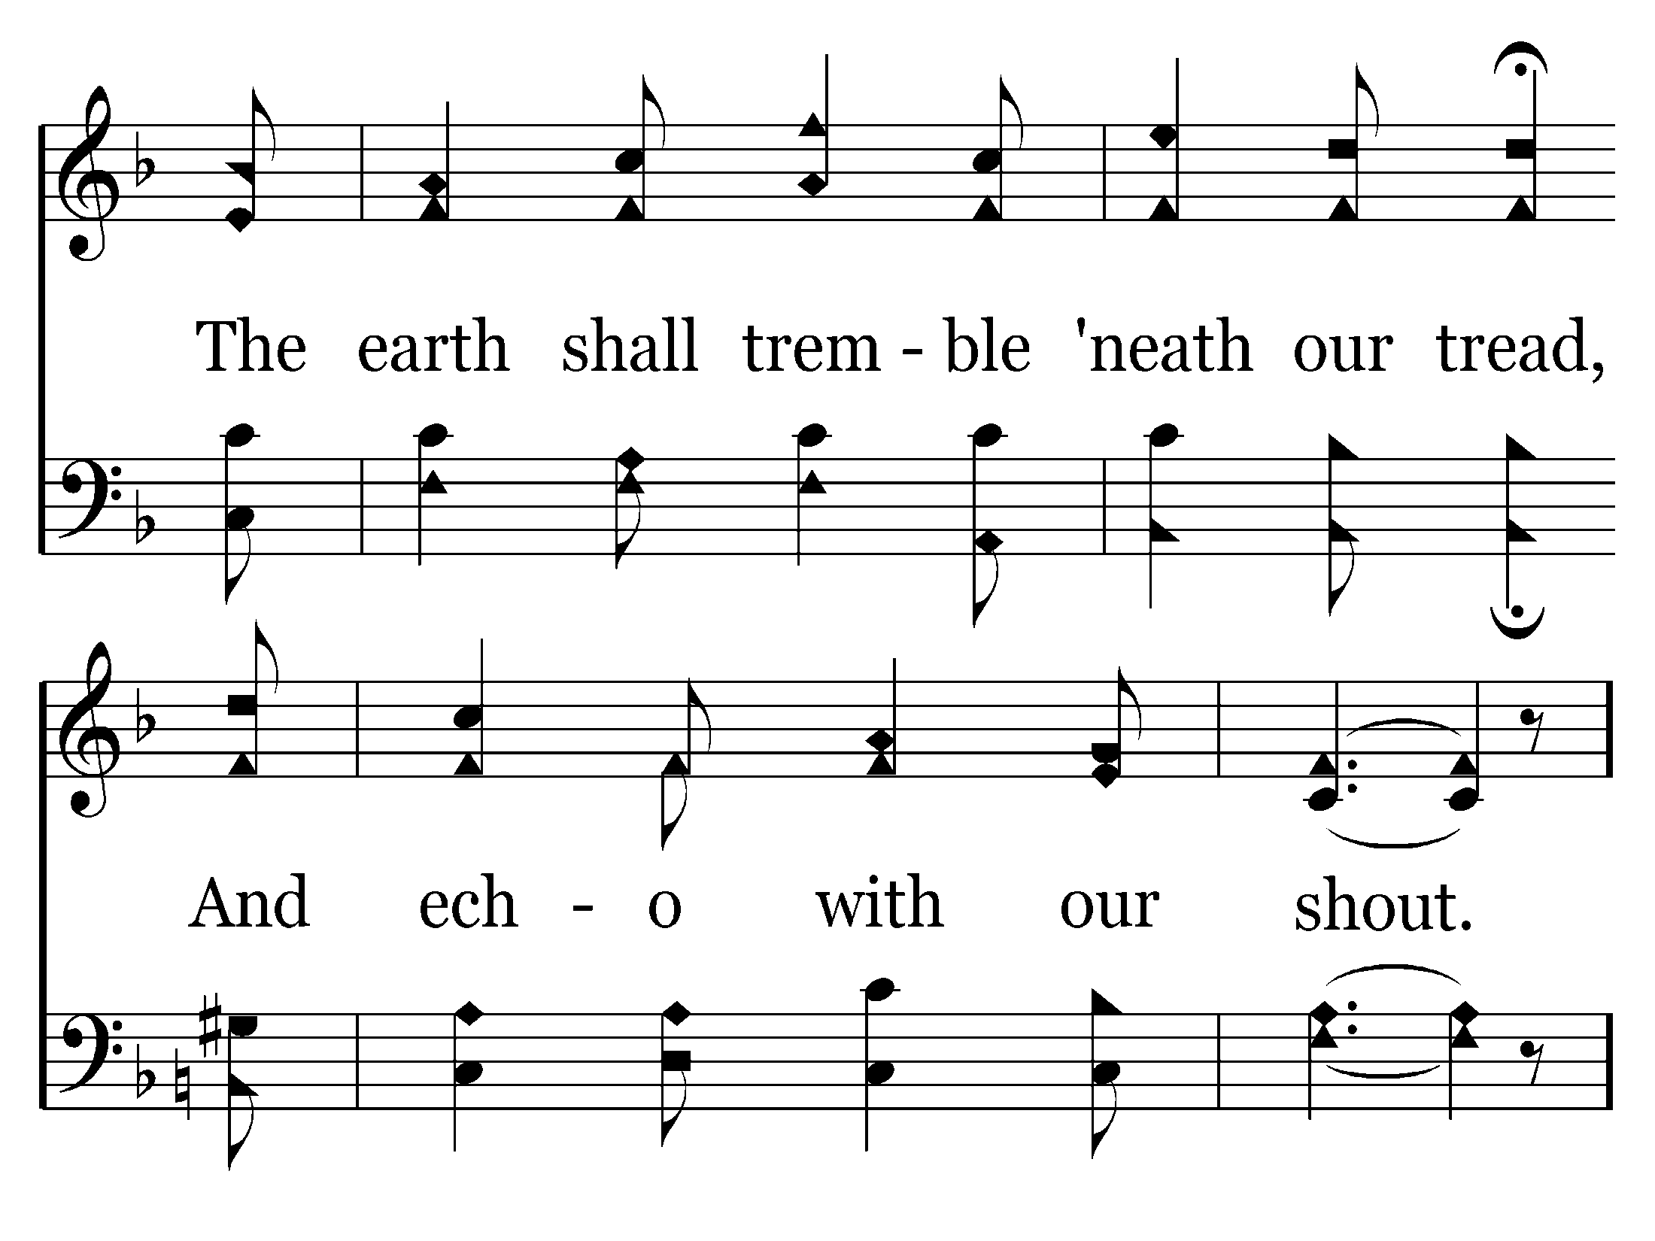
576 - Faith Is The Victory - 3.4

Slide 39
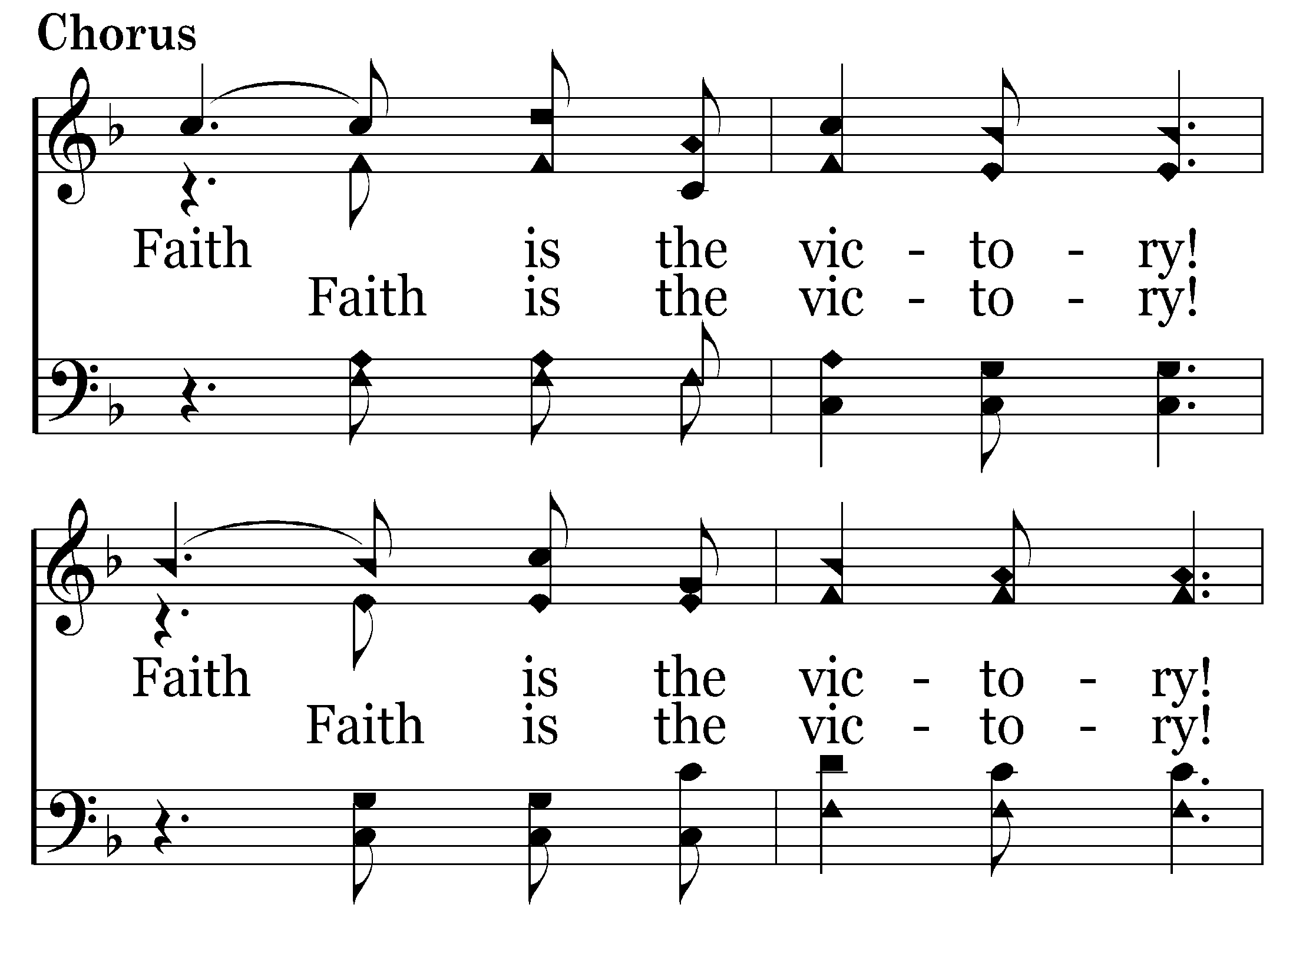
576 - Faith Is The Victory - C.1

Slide 40
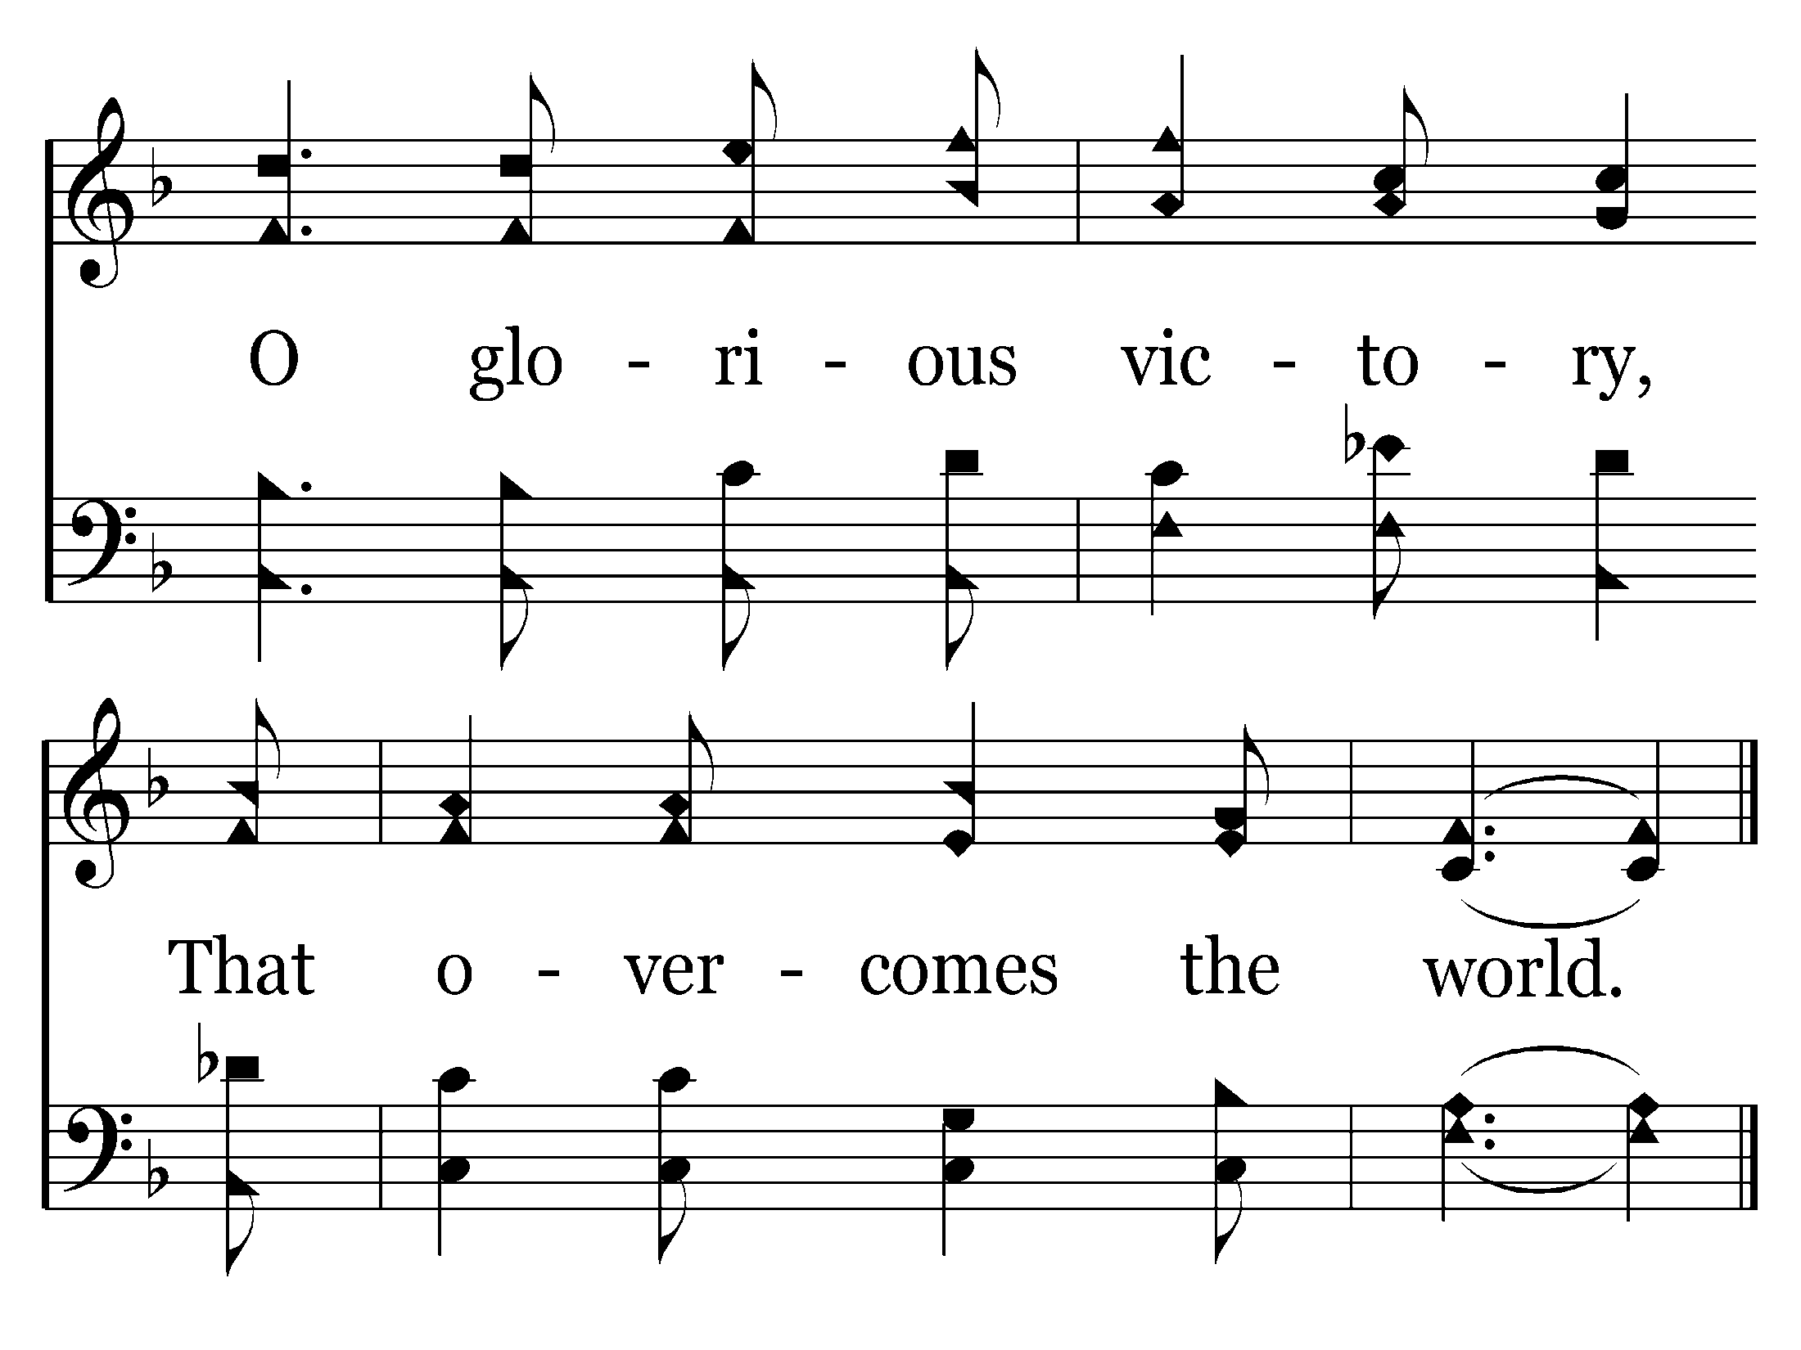
576 - Faith Is The Victory - C.2
End of Song

Slide 42
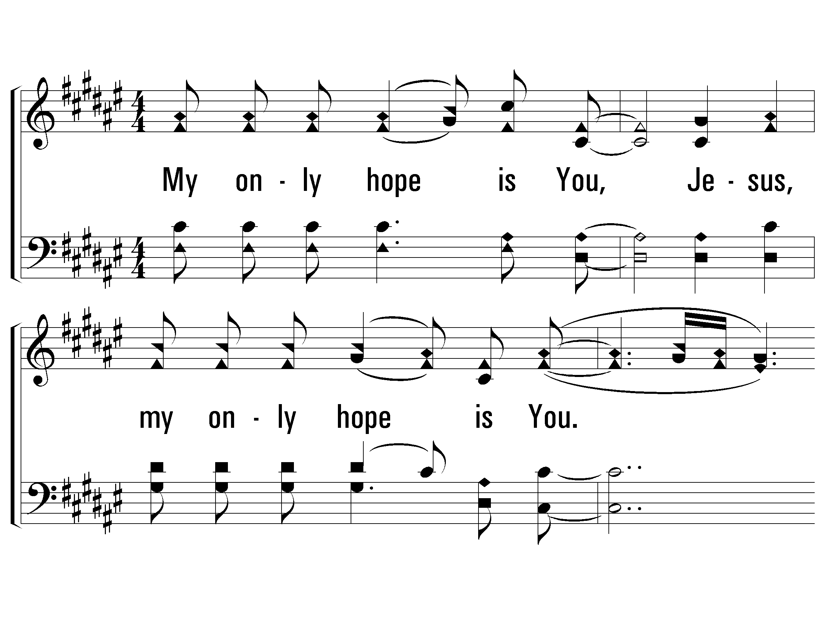
1 - My Only Hope is You
1.
My only hope is You, Jesus,
my only hope is You.
From early in the morning till late at night,
my only hope is You.
Words & Music: John Paul Timble
© 2006 The Paperless Hymnal®

Slide 43
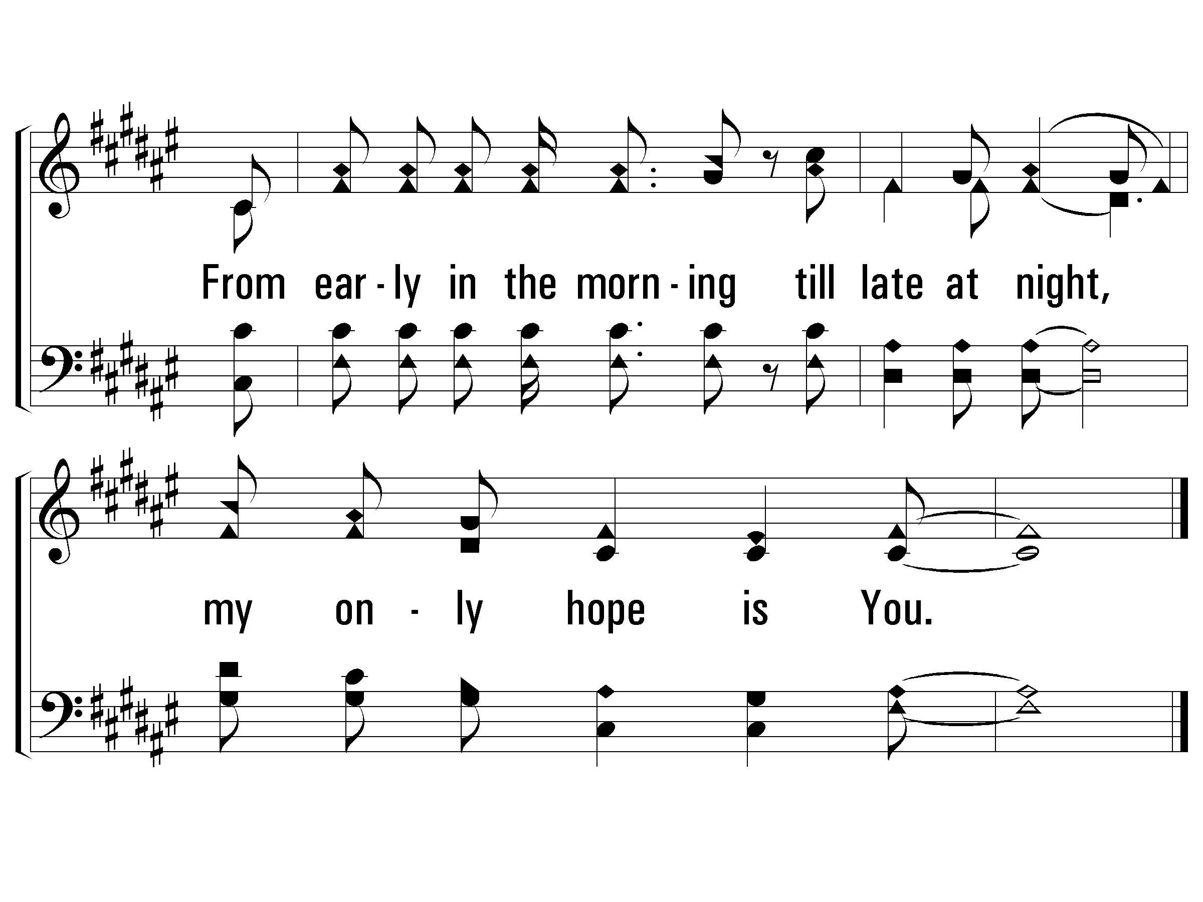
1 - My Only Hope is You
© 2006 The Paperless Hymnal®

Slide 44
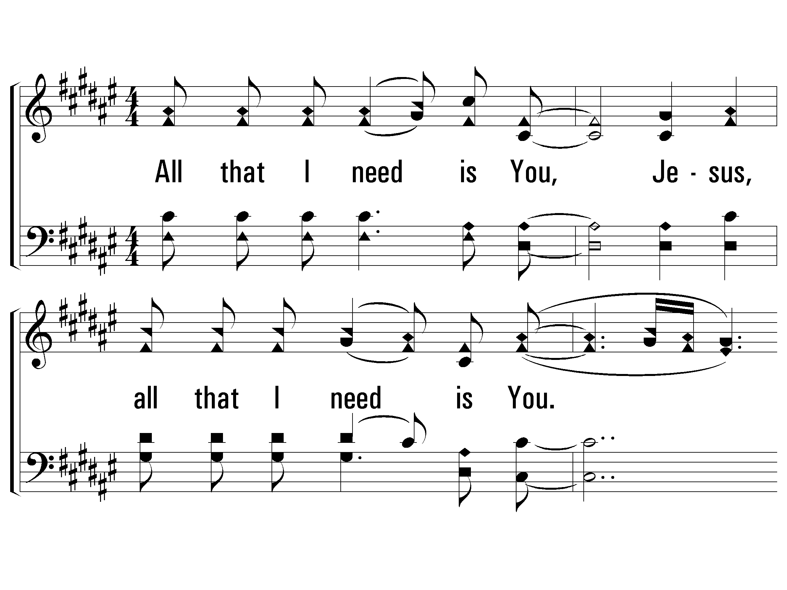
4 - My Only Hope is You
4.
All that I need is You, Jesus,
all that I need is You.
From early in the morning till late at night,
all that I need is You.
Words & Music: John Paul Timble
© 2006 The Paperless Hymnal®

Slide 45
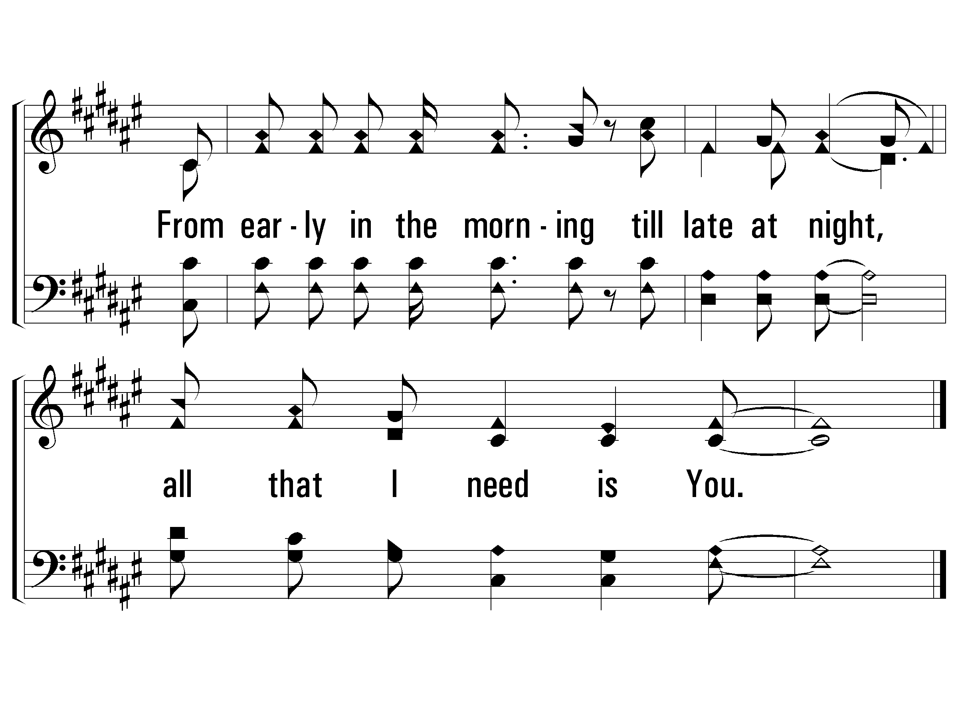
4 - My Only Hope is You
© 2006 The Paperless Hymnal®

Slide 47
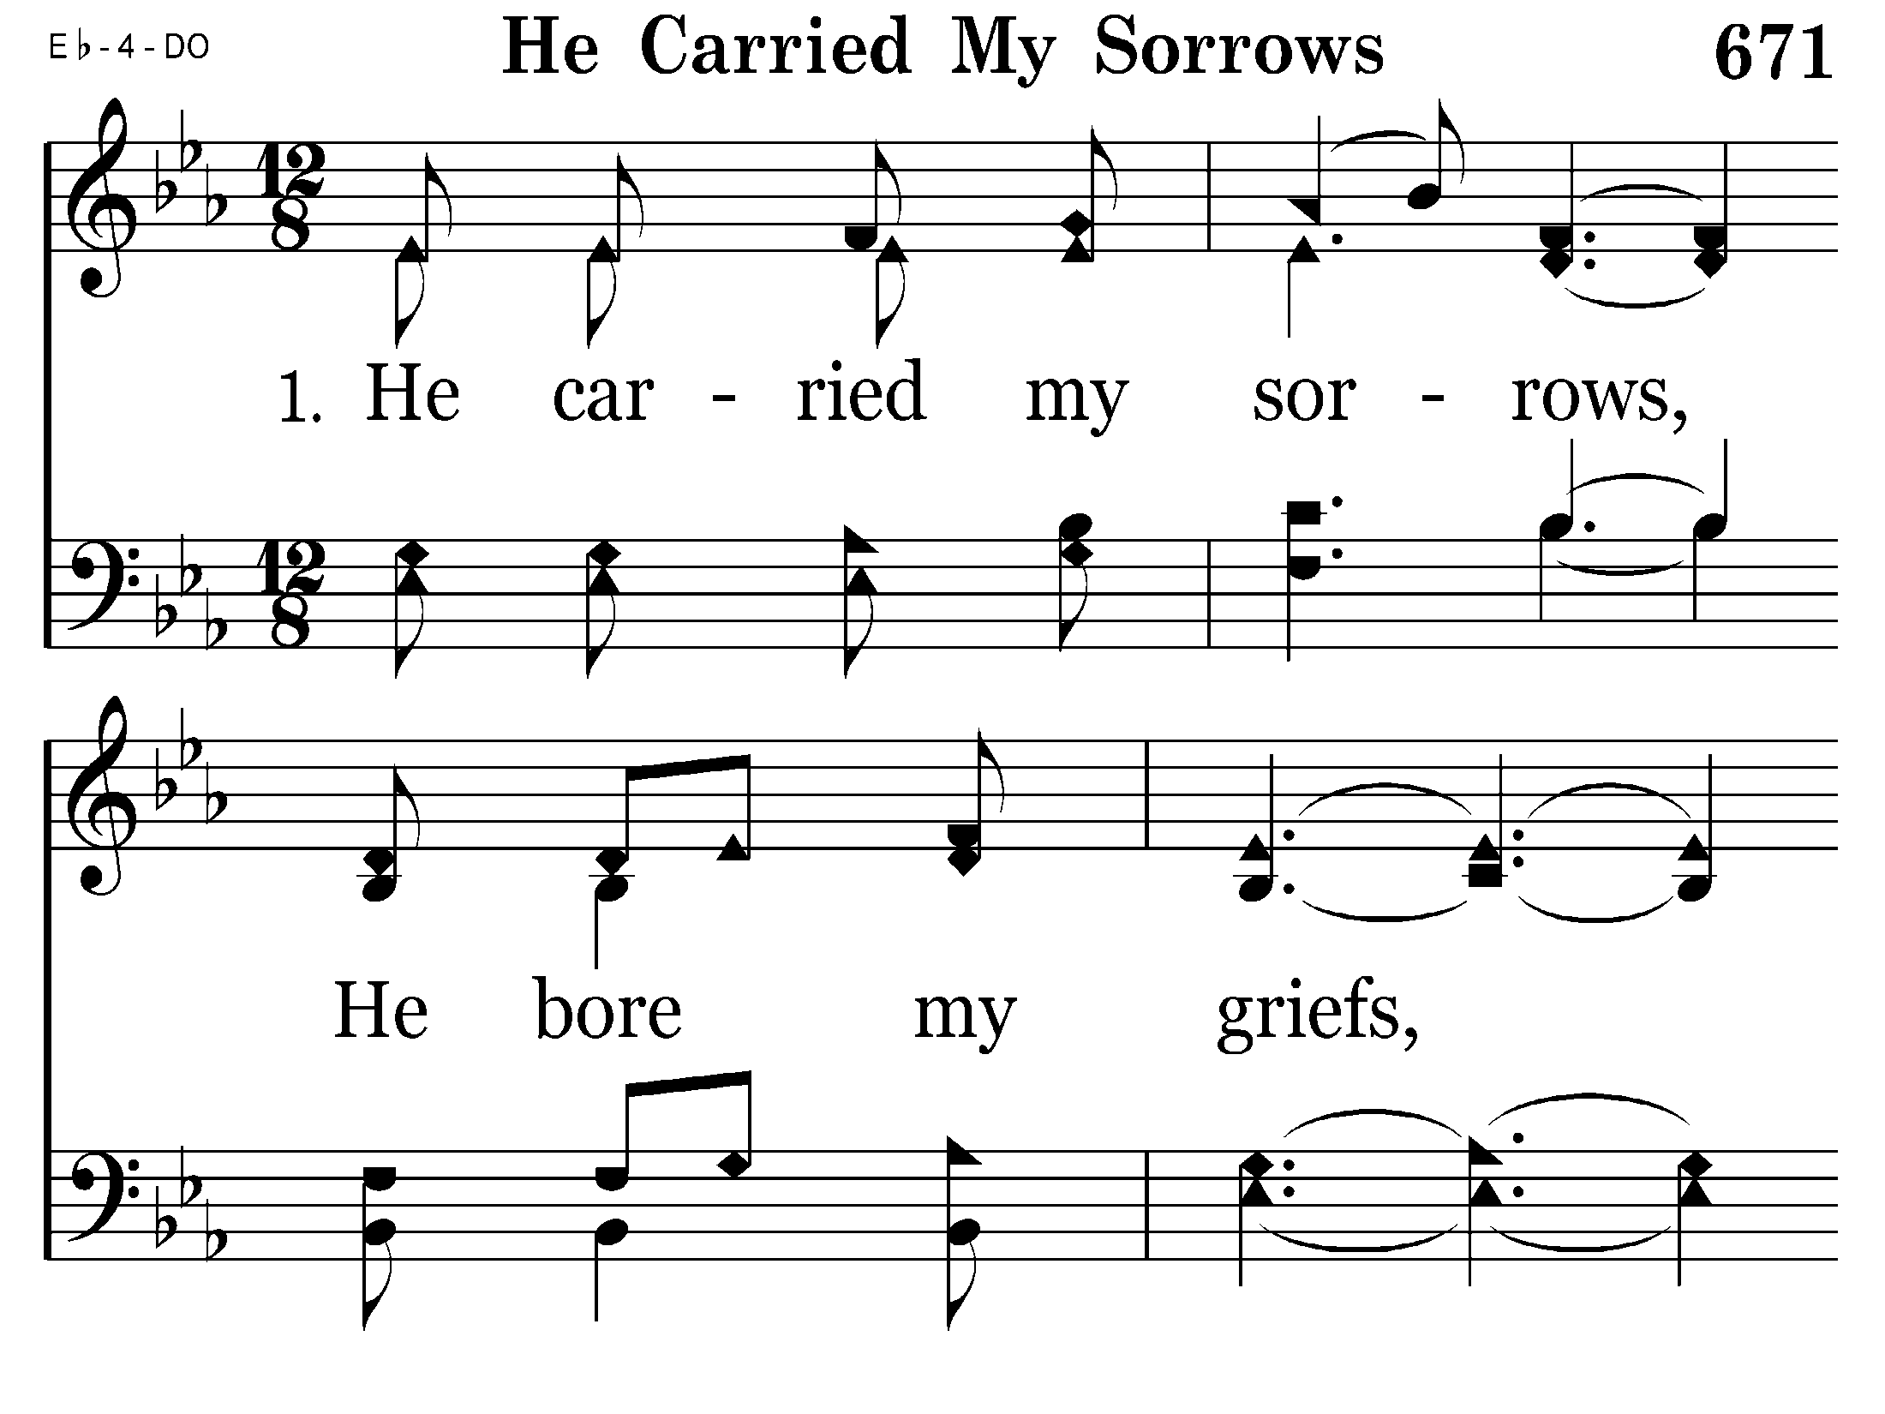
671 - He Carried My Sorrows - 1.1

Slide 48
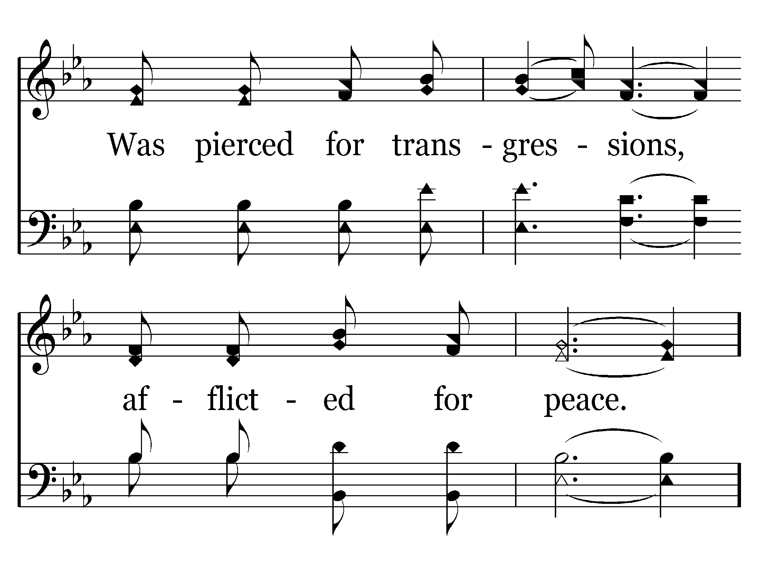
671 - He Carried My Sorrows - 1.2

Slide 49
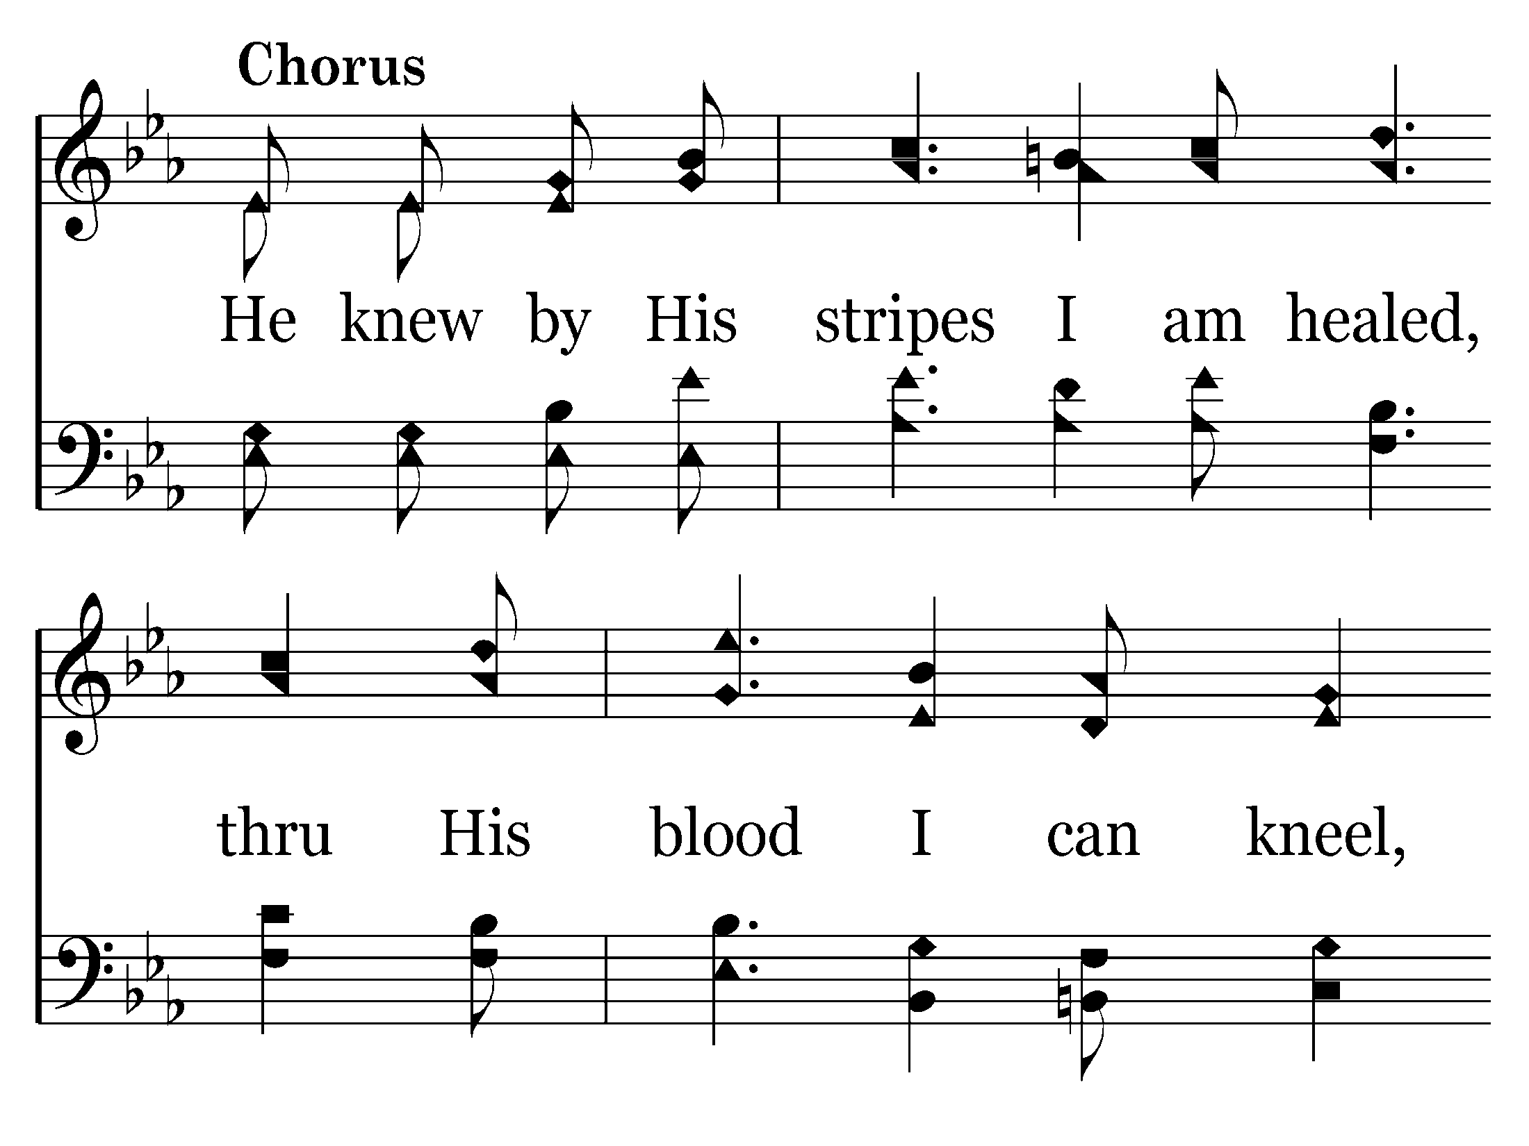
671 - He Carried My Sorrows - C.1

Slide 50
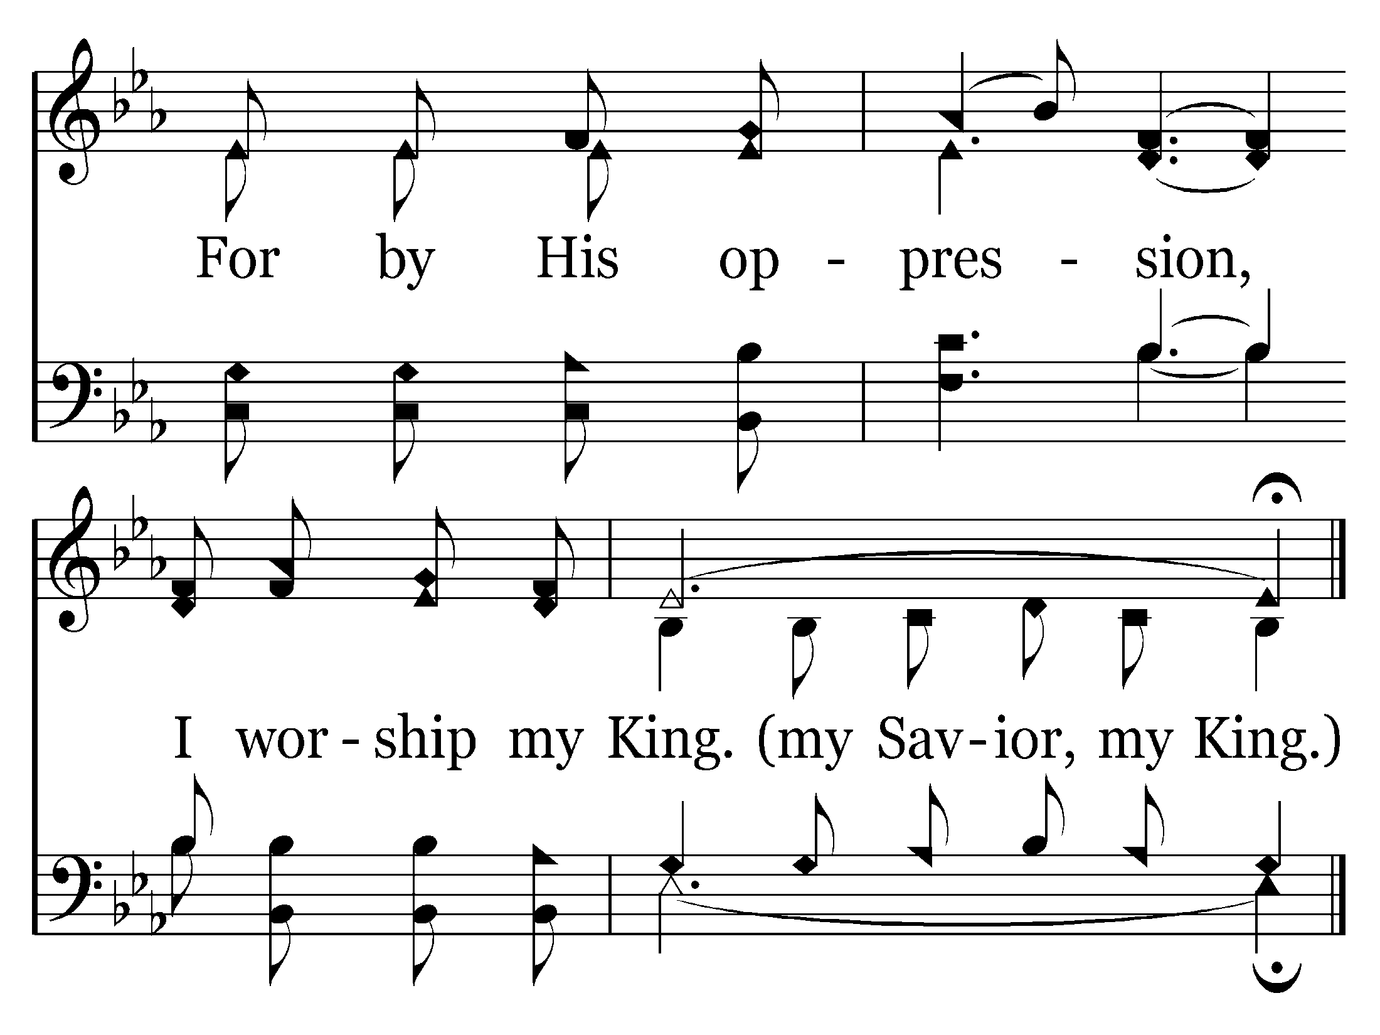
671 - He Carried My Sorrows - C.2
End of Verse 1

Slide 51
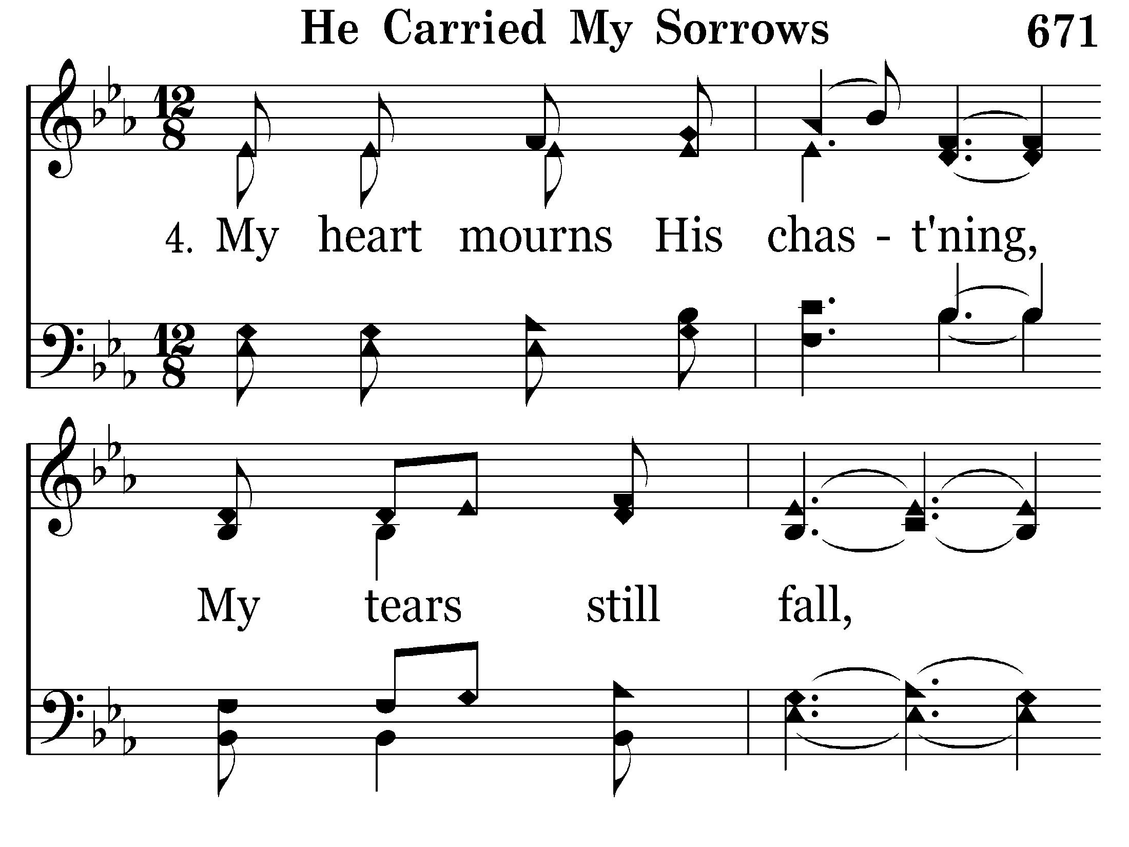
671 - He Carried My Sorrows - 4.1

Slide 52
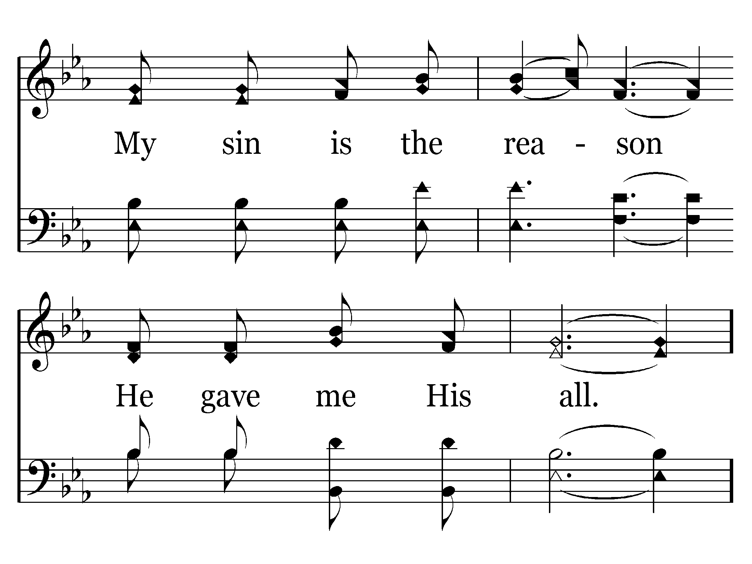
671 - He Carried My Sorrows - 4.2

Slide 53
671 - He Carried My Sorrows - C.1

Slide 54
671 - He Carried My Sorrows - C.2
End of Song

Slide 56
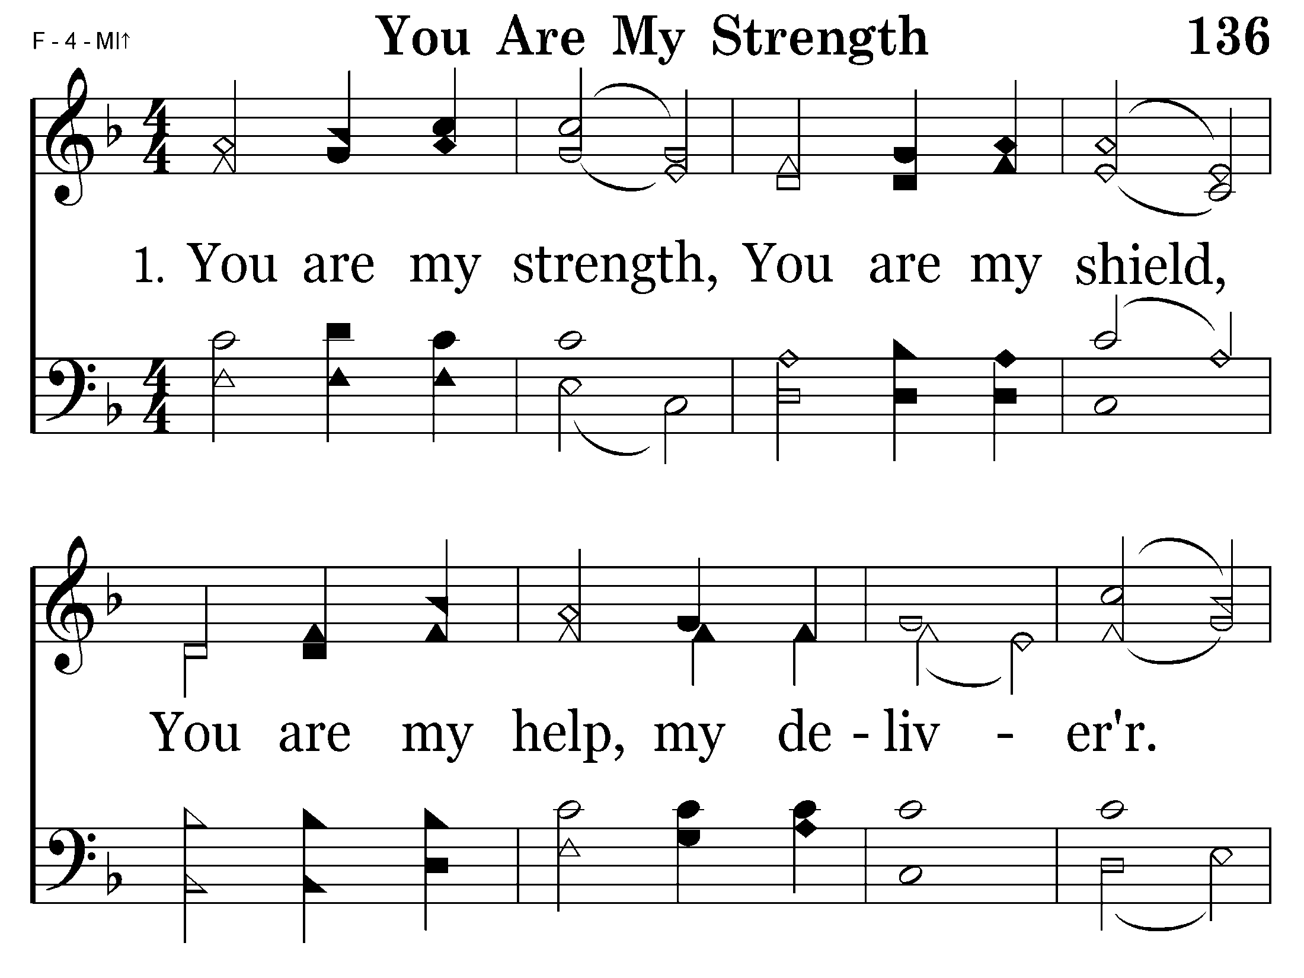
136 - You Are My Strength - 1.1

Slide 57
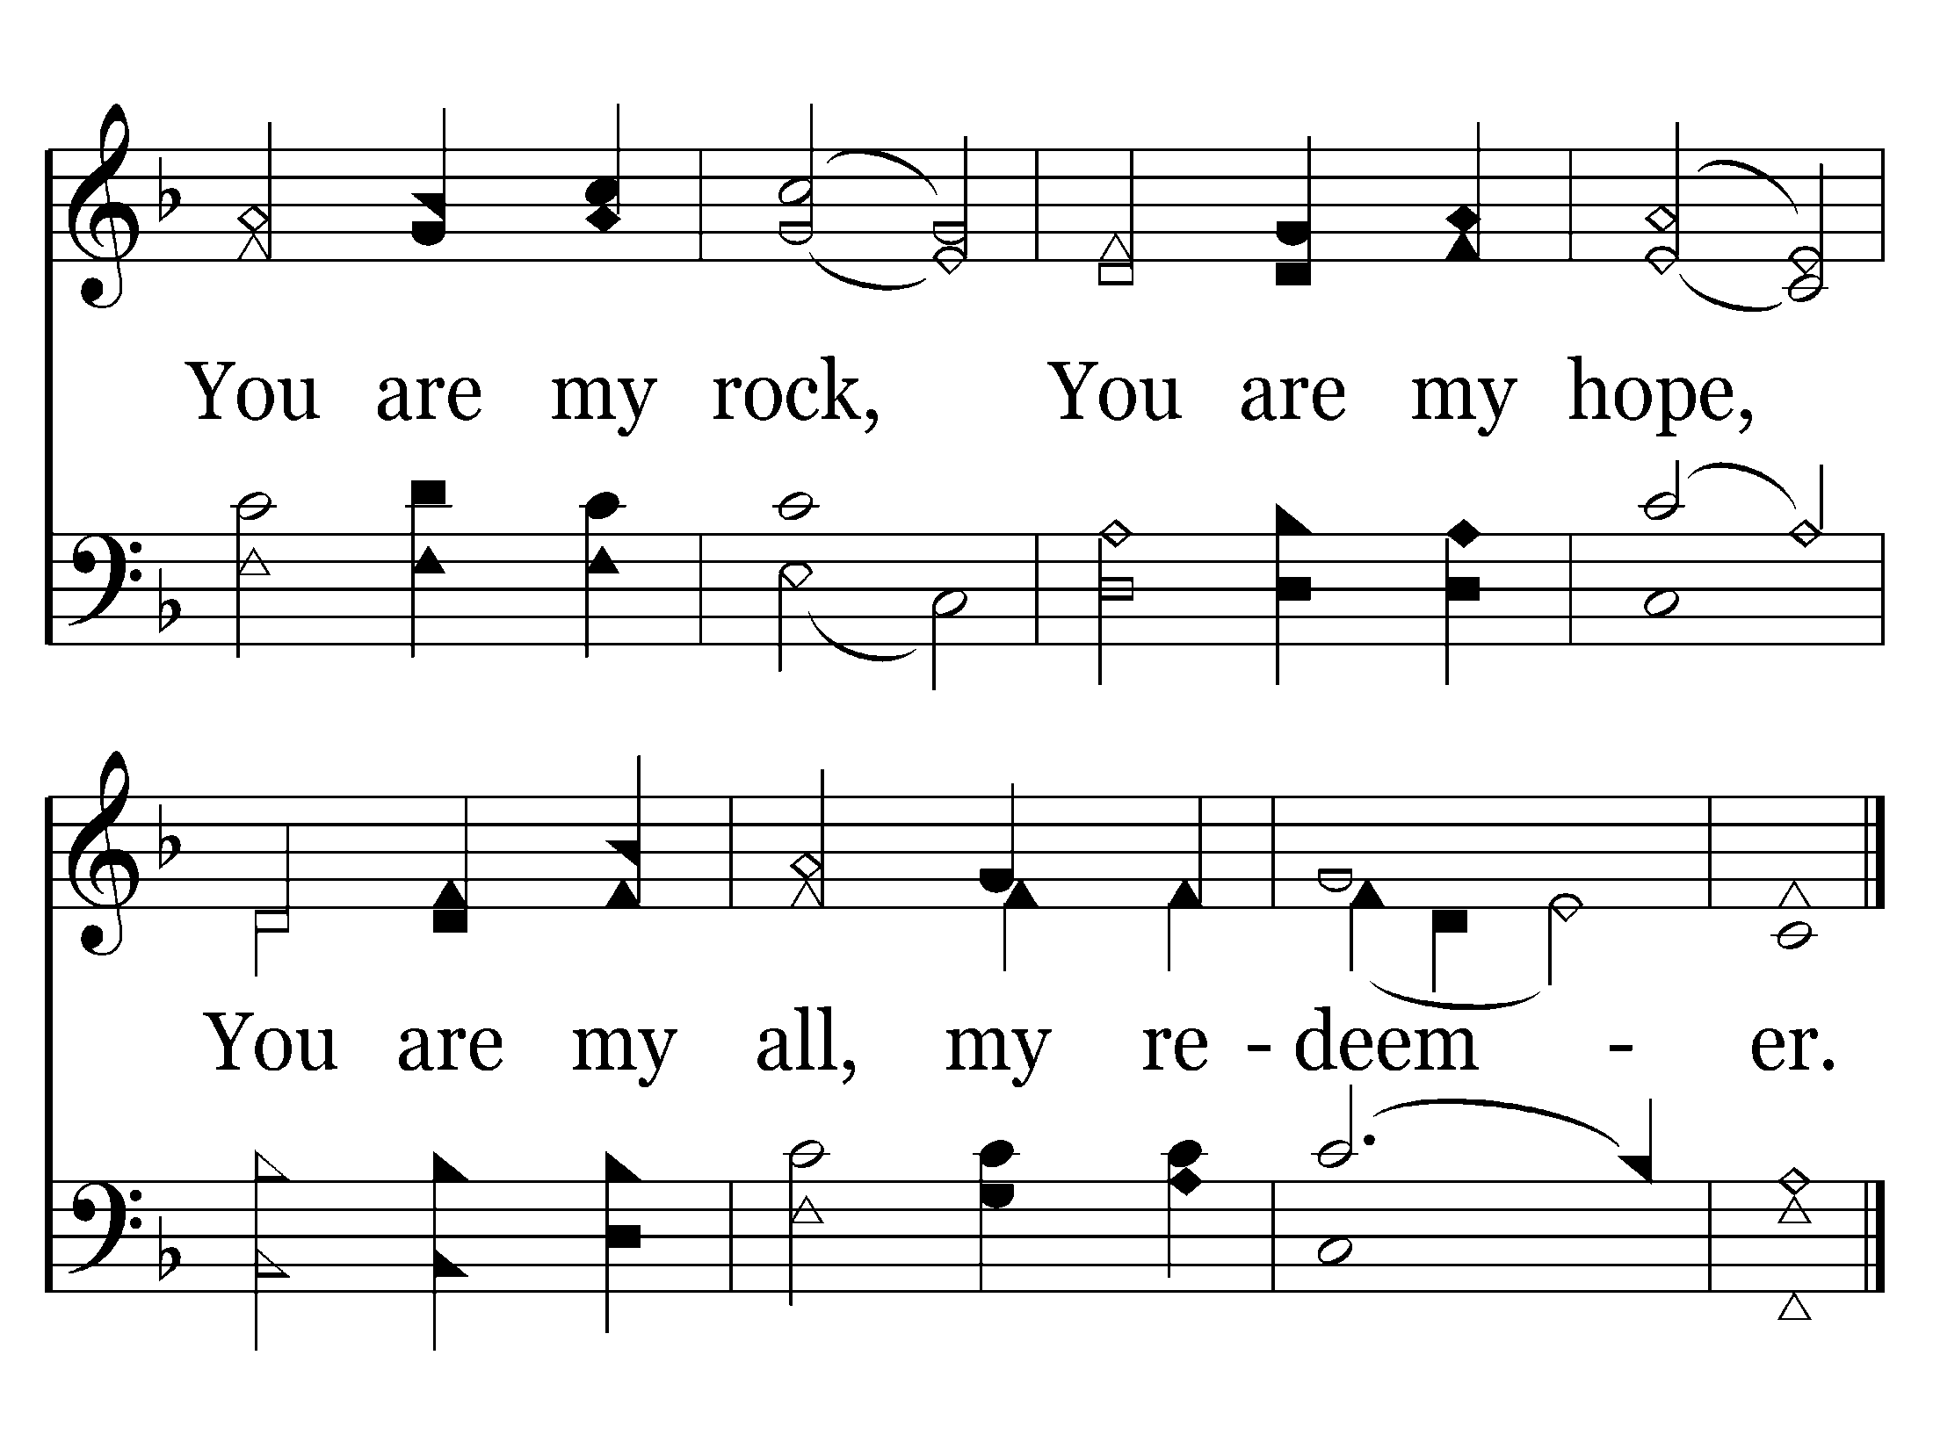
136 - You Are My Strength - 1.2
End of Verse 1

Slide 58
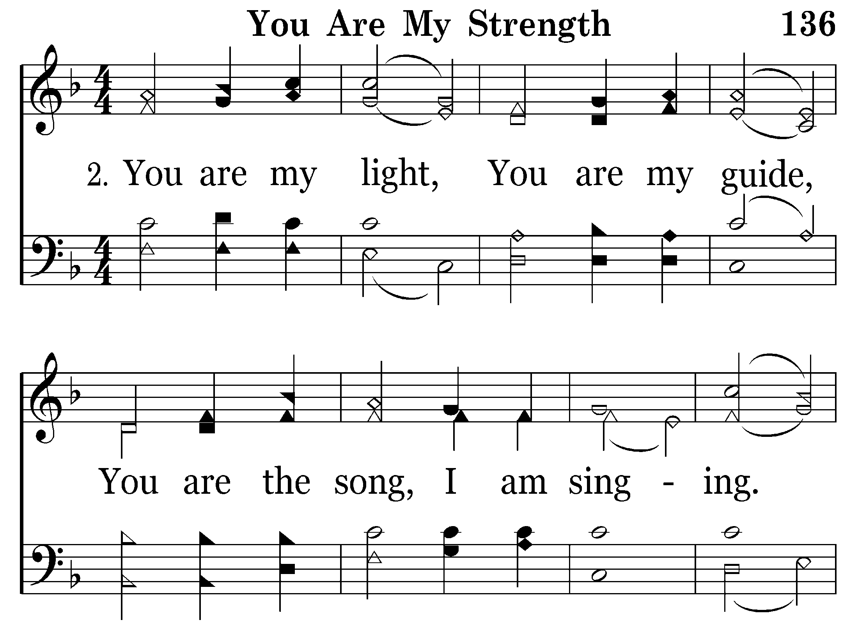
136 - You Are My Strength - 2.1

Slide 59
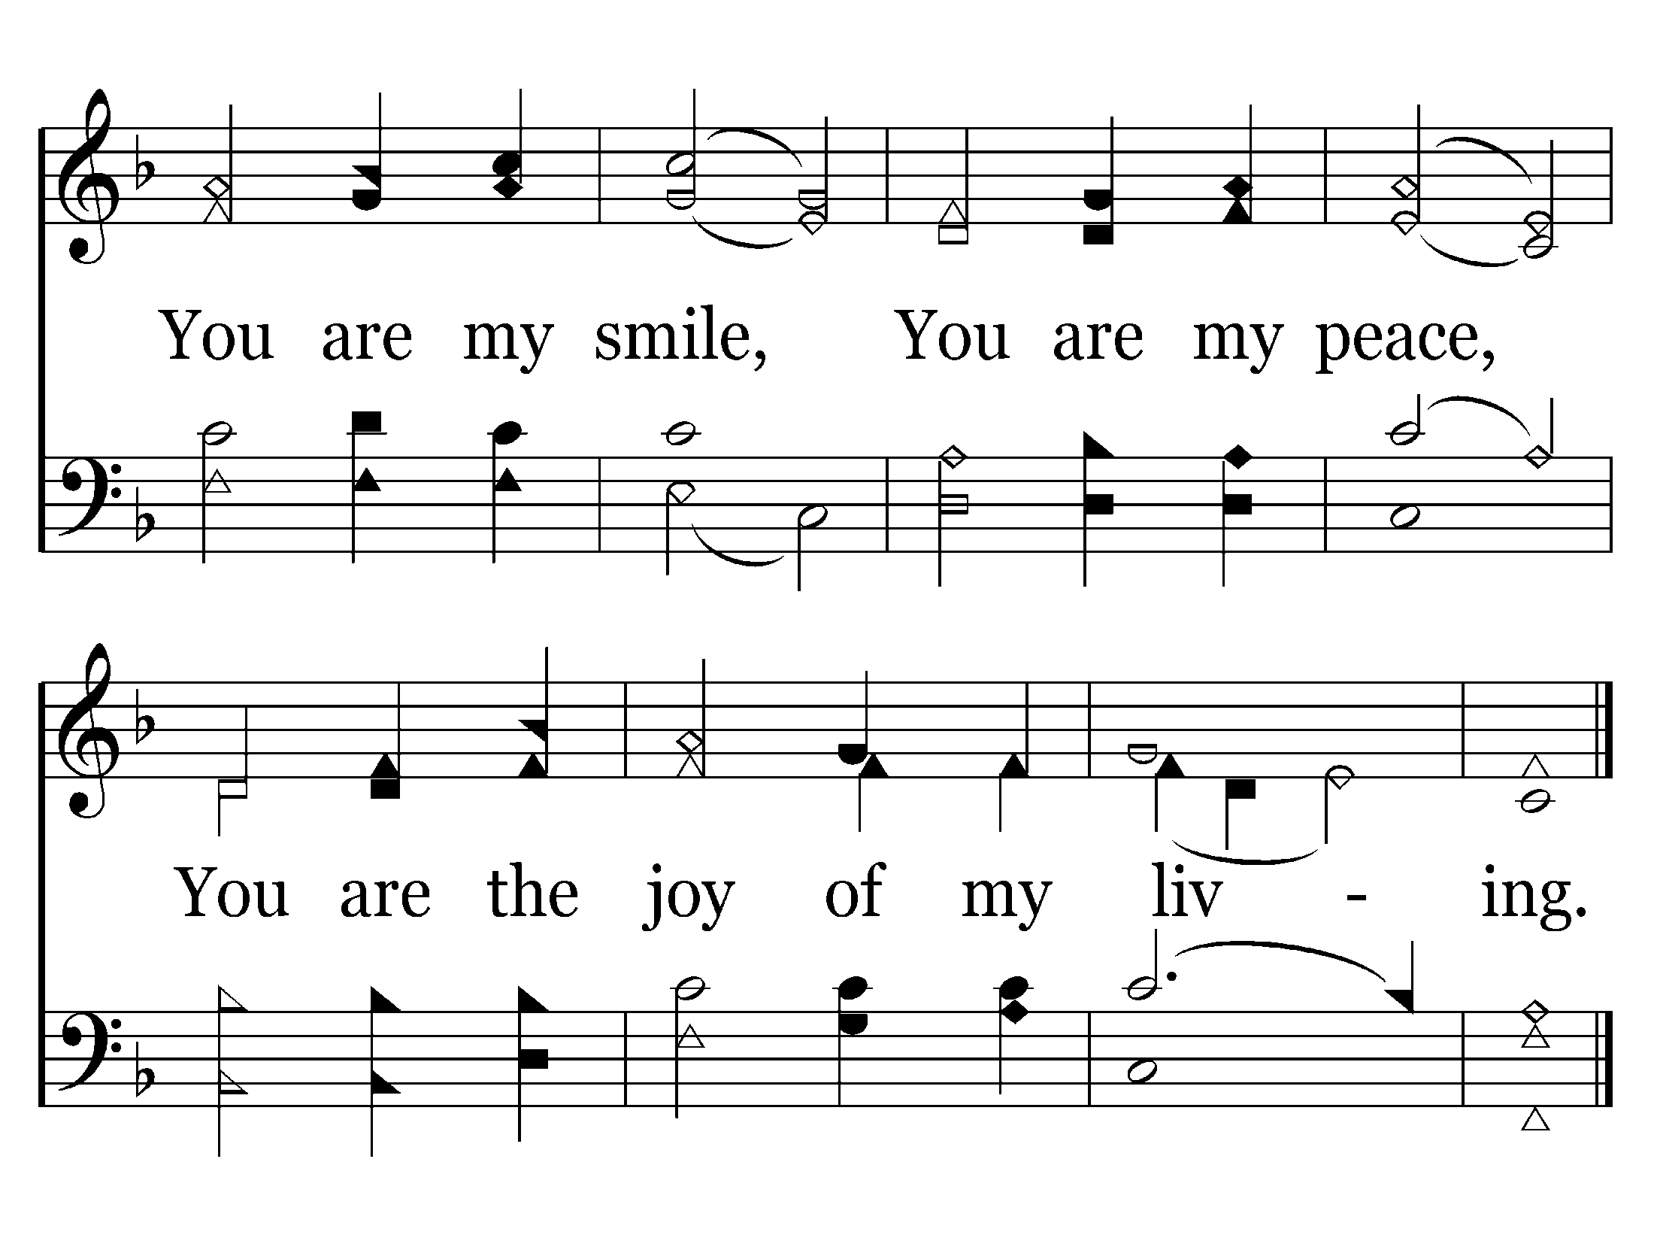
136 - You Are My Strength - 2.2
End of Song

Slide 61
185 - Jesus Is Lord Of All - 1.1

Slide 62
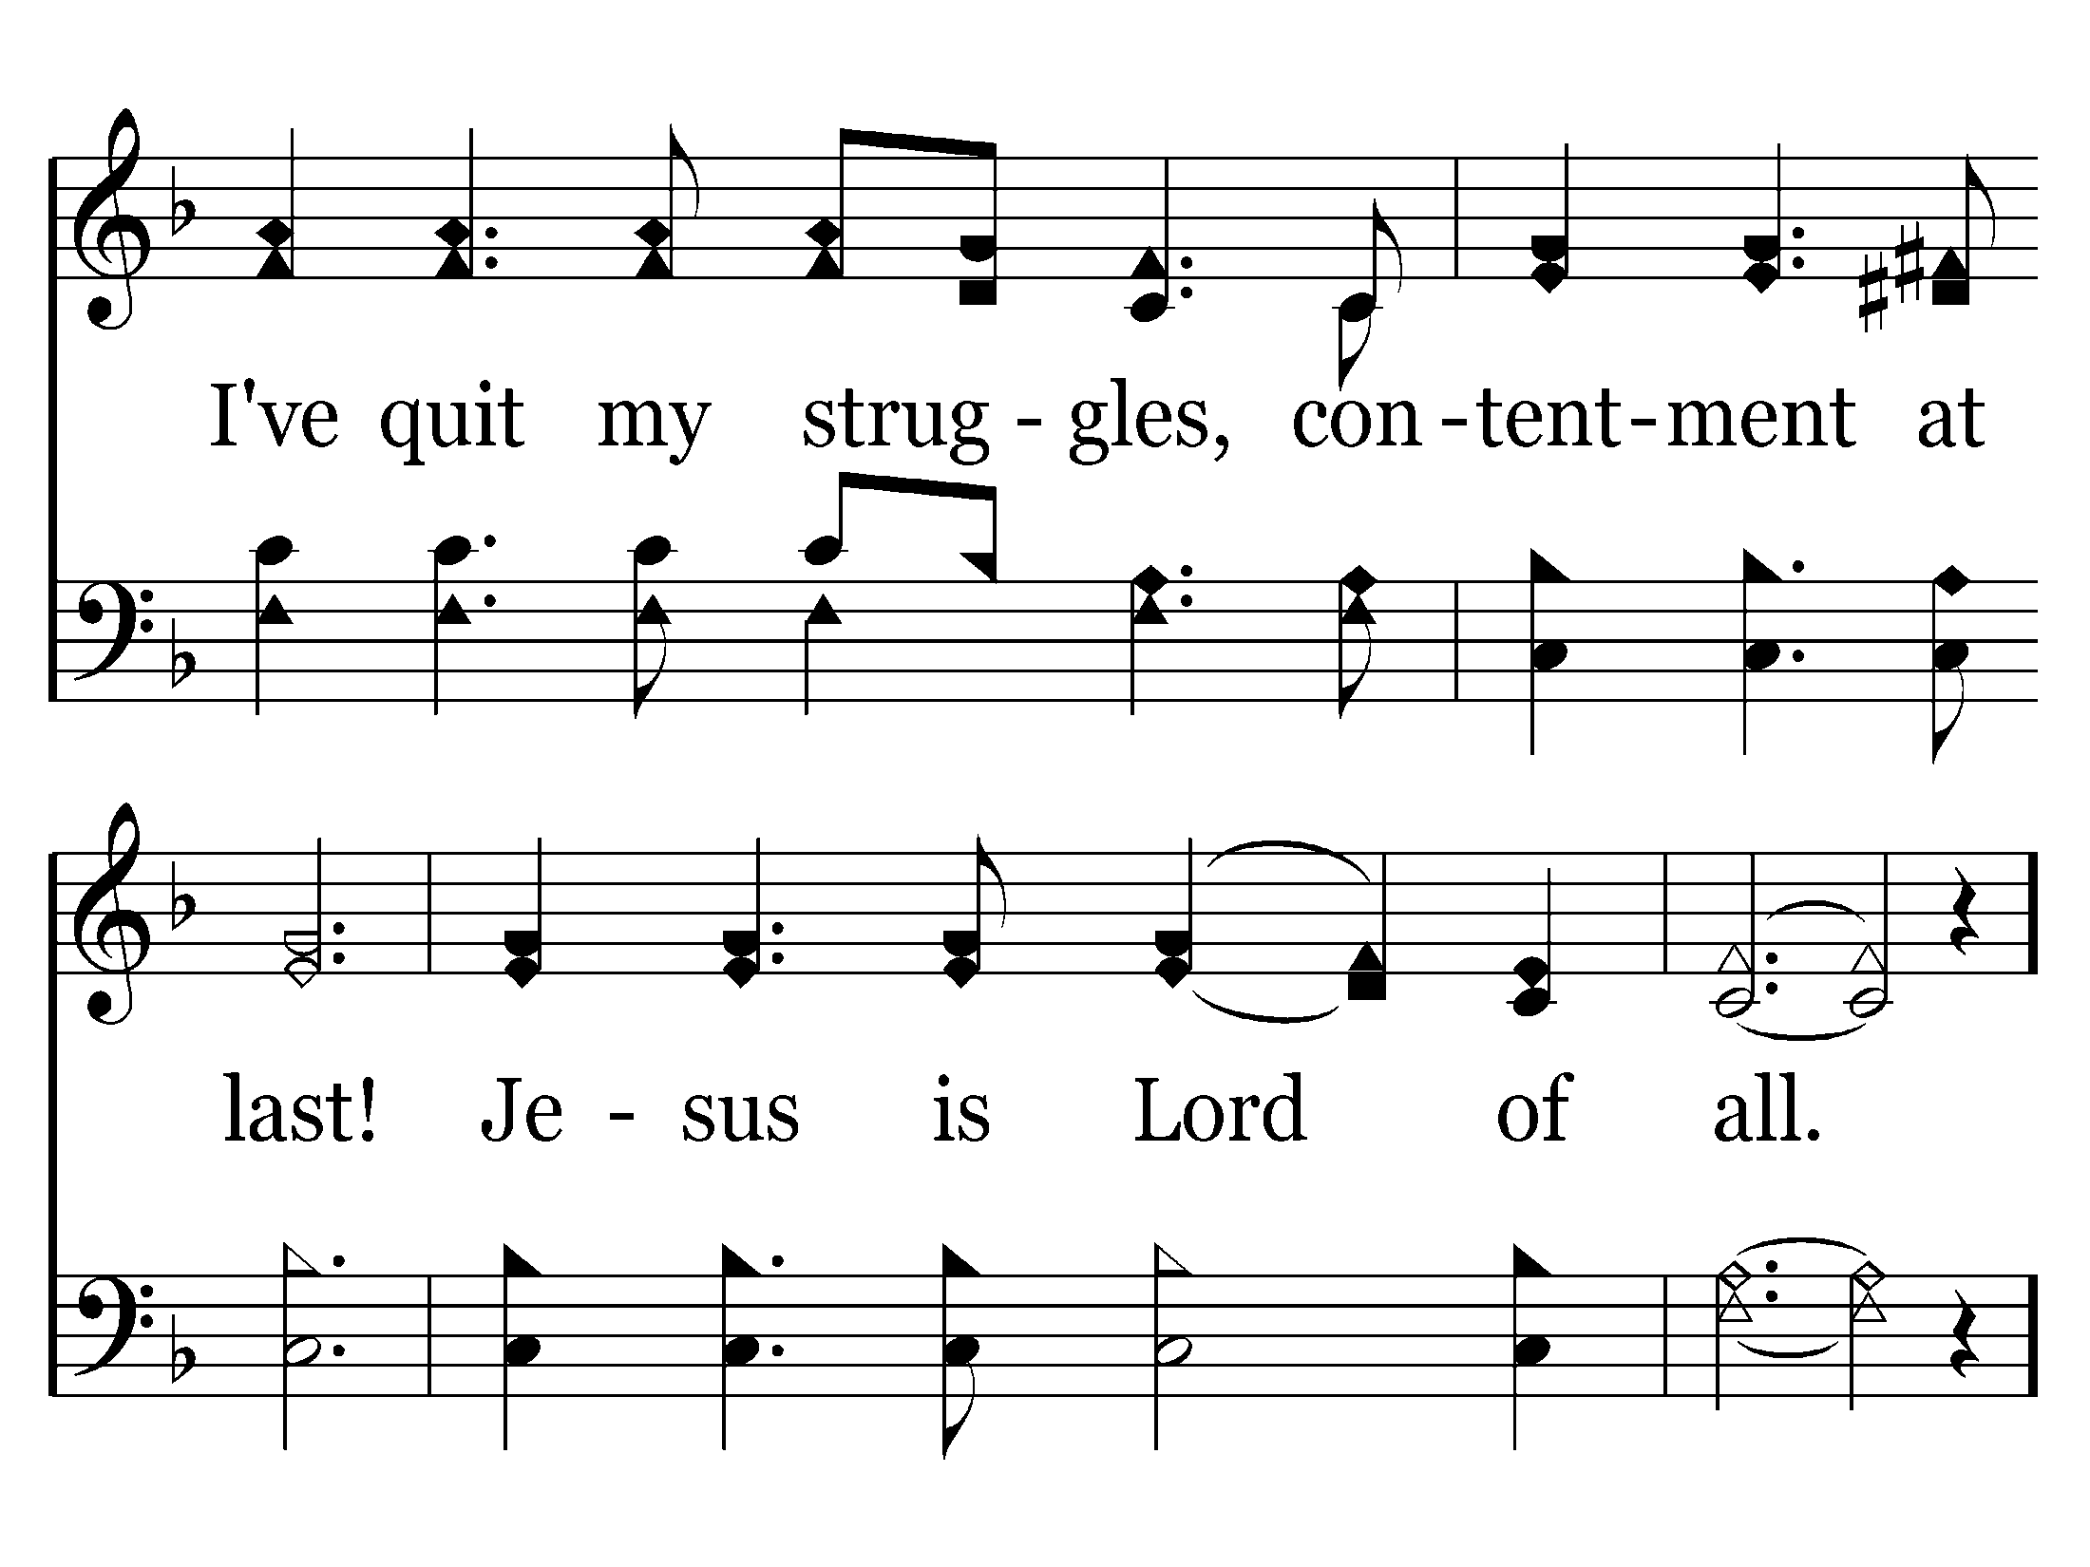
185 - Jesus Is Lord Of All - 1.2

Slide 63
185 - Jesus Is Lord Of All - 2.1

Slide 64
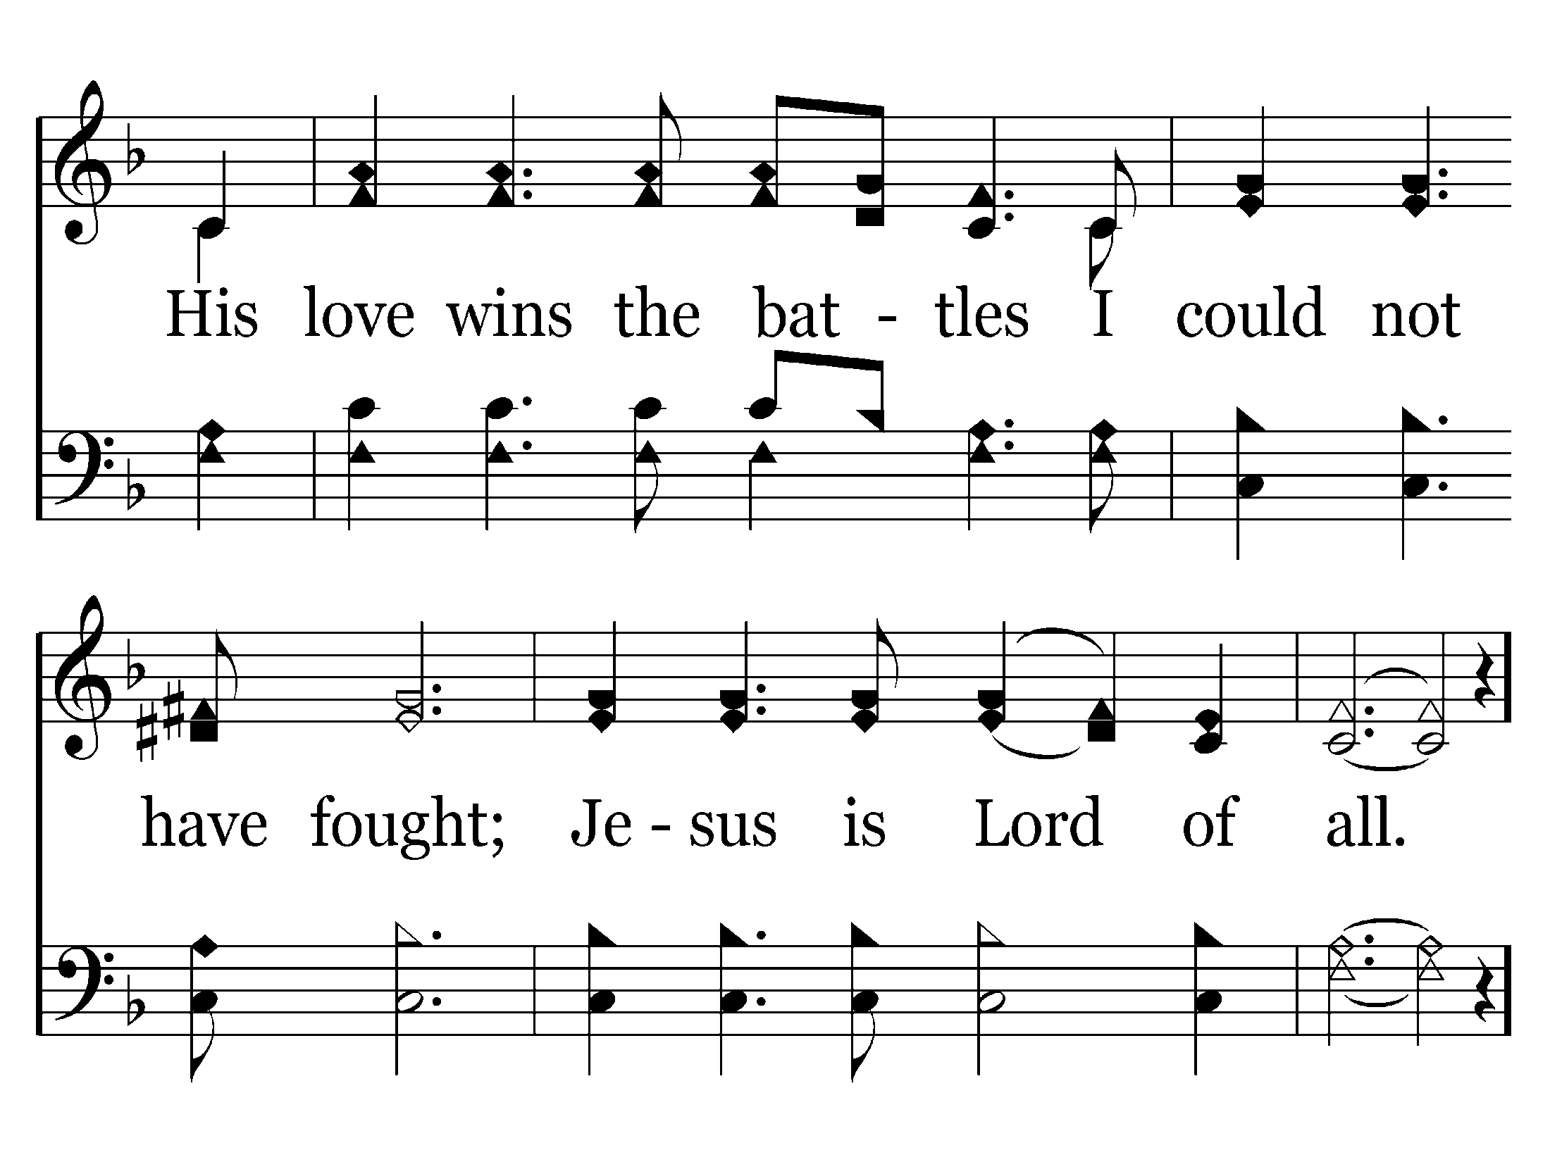
185 - Jesus Is Lord Of All - 2.2

Slide 65
185 - Jesus Is Lord Of All - 3.1

Slide 66
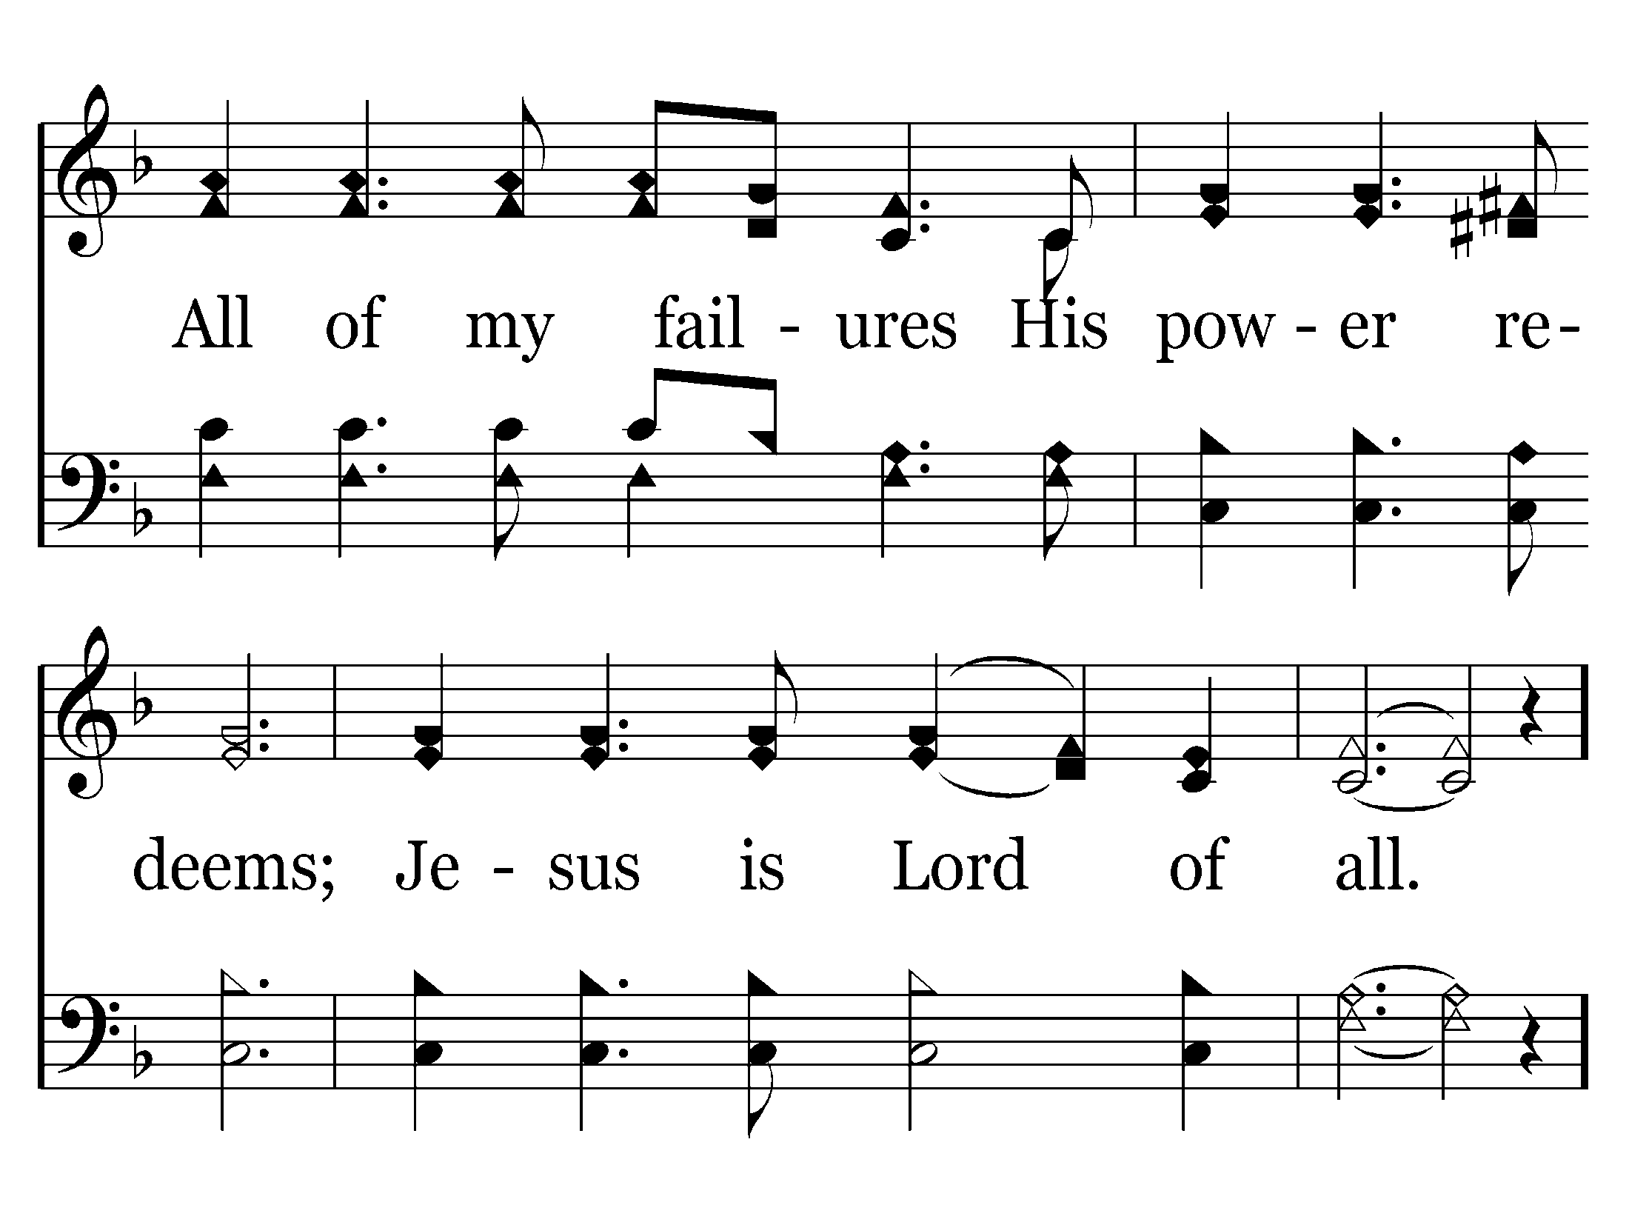
185 - Jesus Is Lord Of All - 3.2

Slide 67
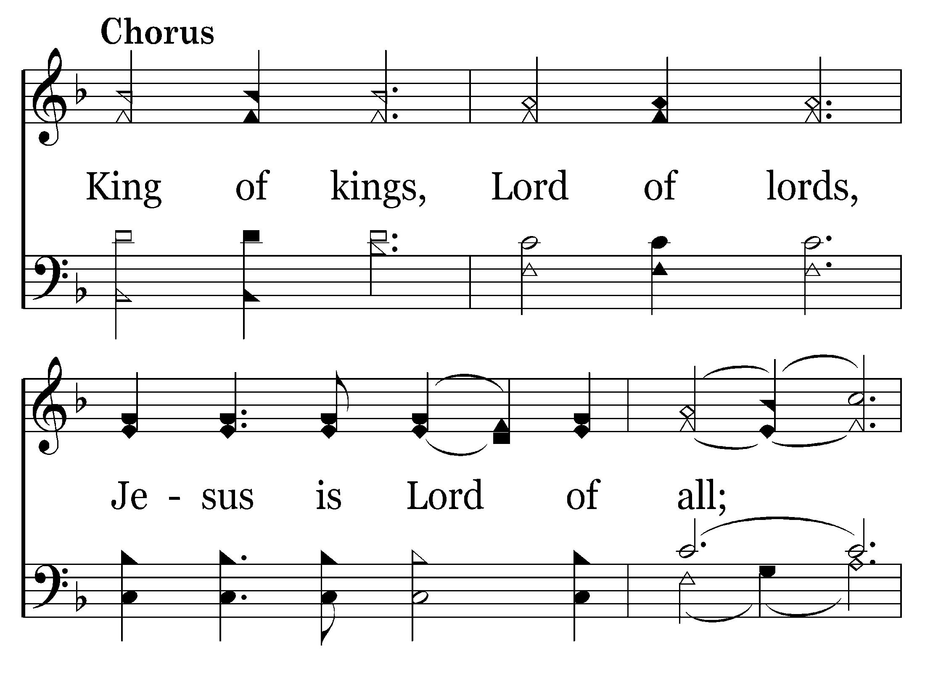
185 - Jesus Is Lord Of All - C.1

Slide 68
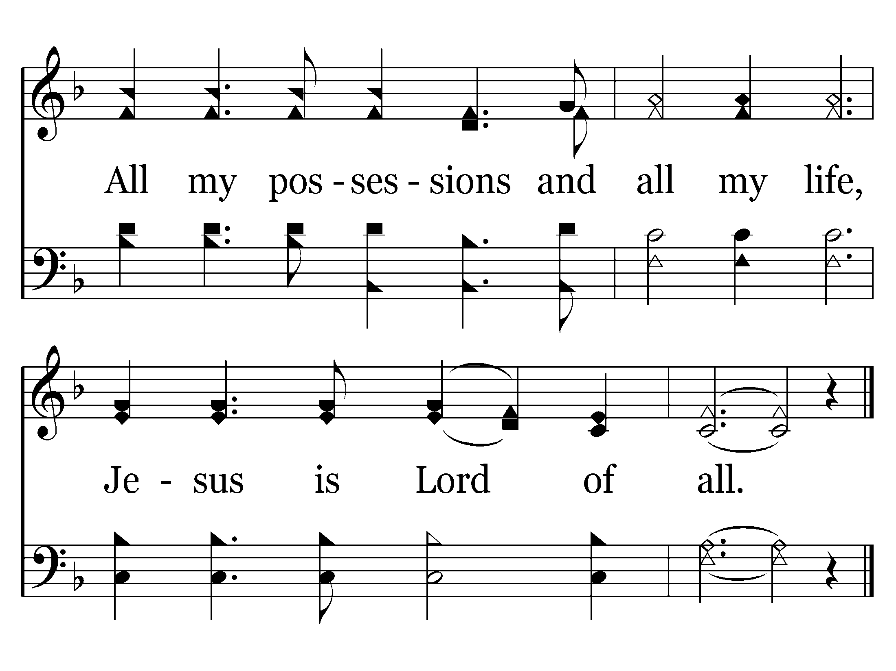
185 - Jesus Is Lord Of All - C.2
End of Song

Slide 70
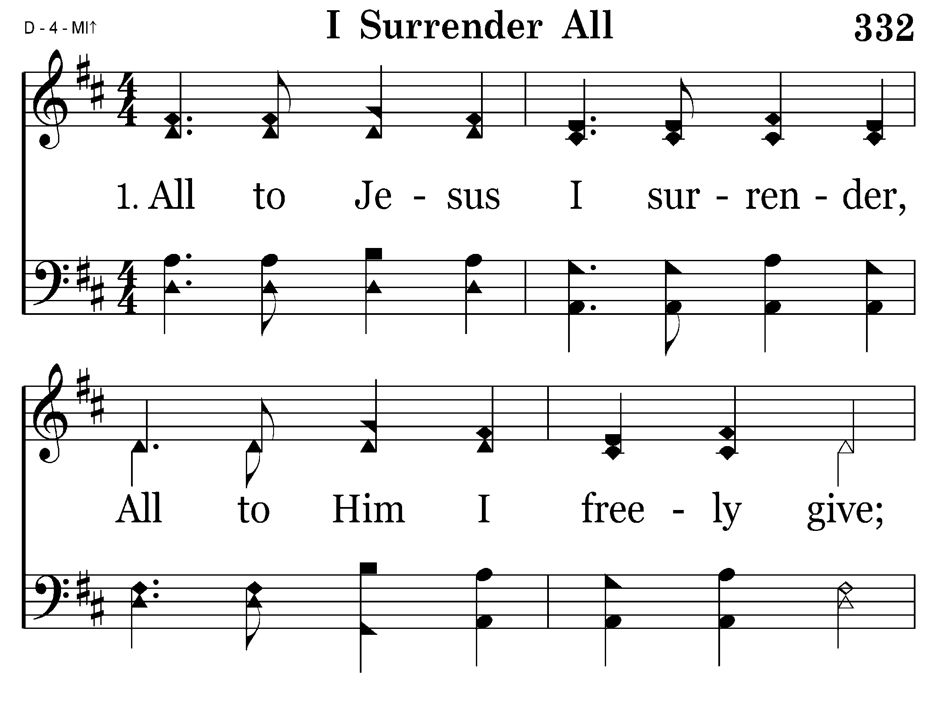
332 - I Surrender All - 1.1

Slide 71
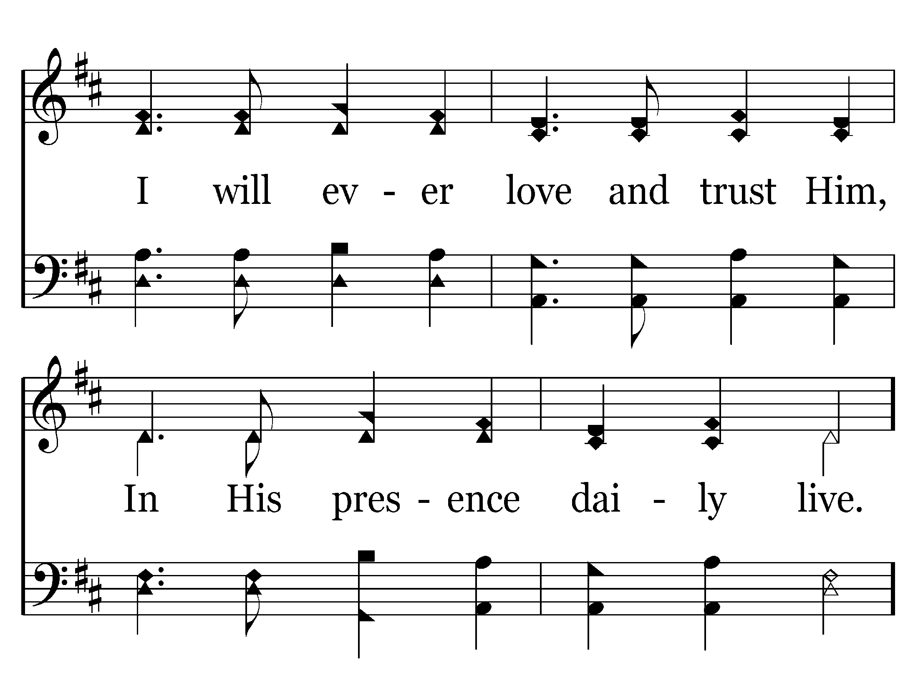
332 - I Surrender All - 1.2

Slide 72
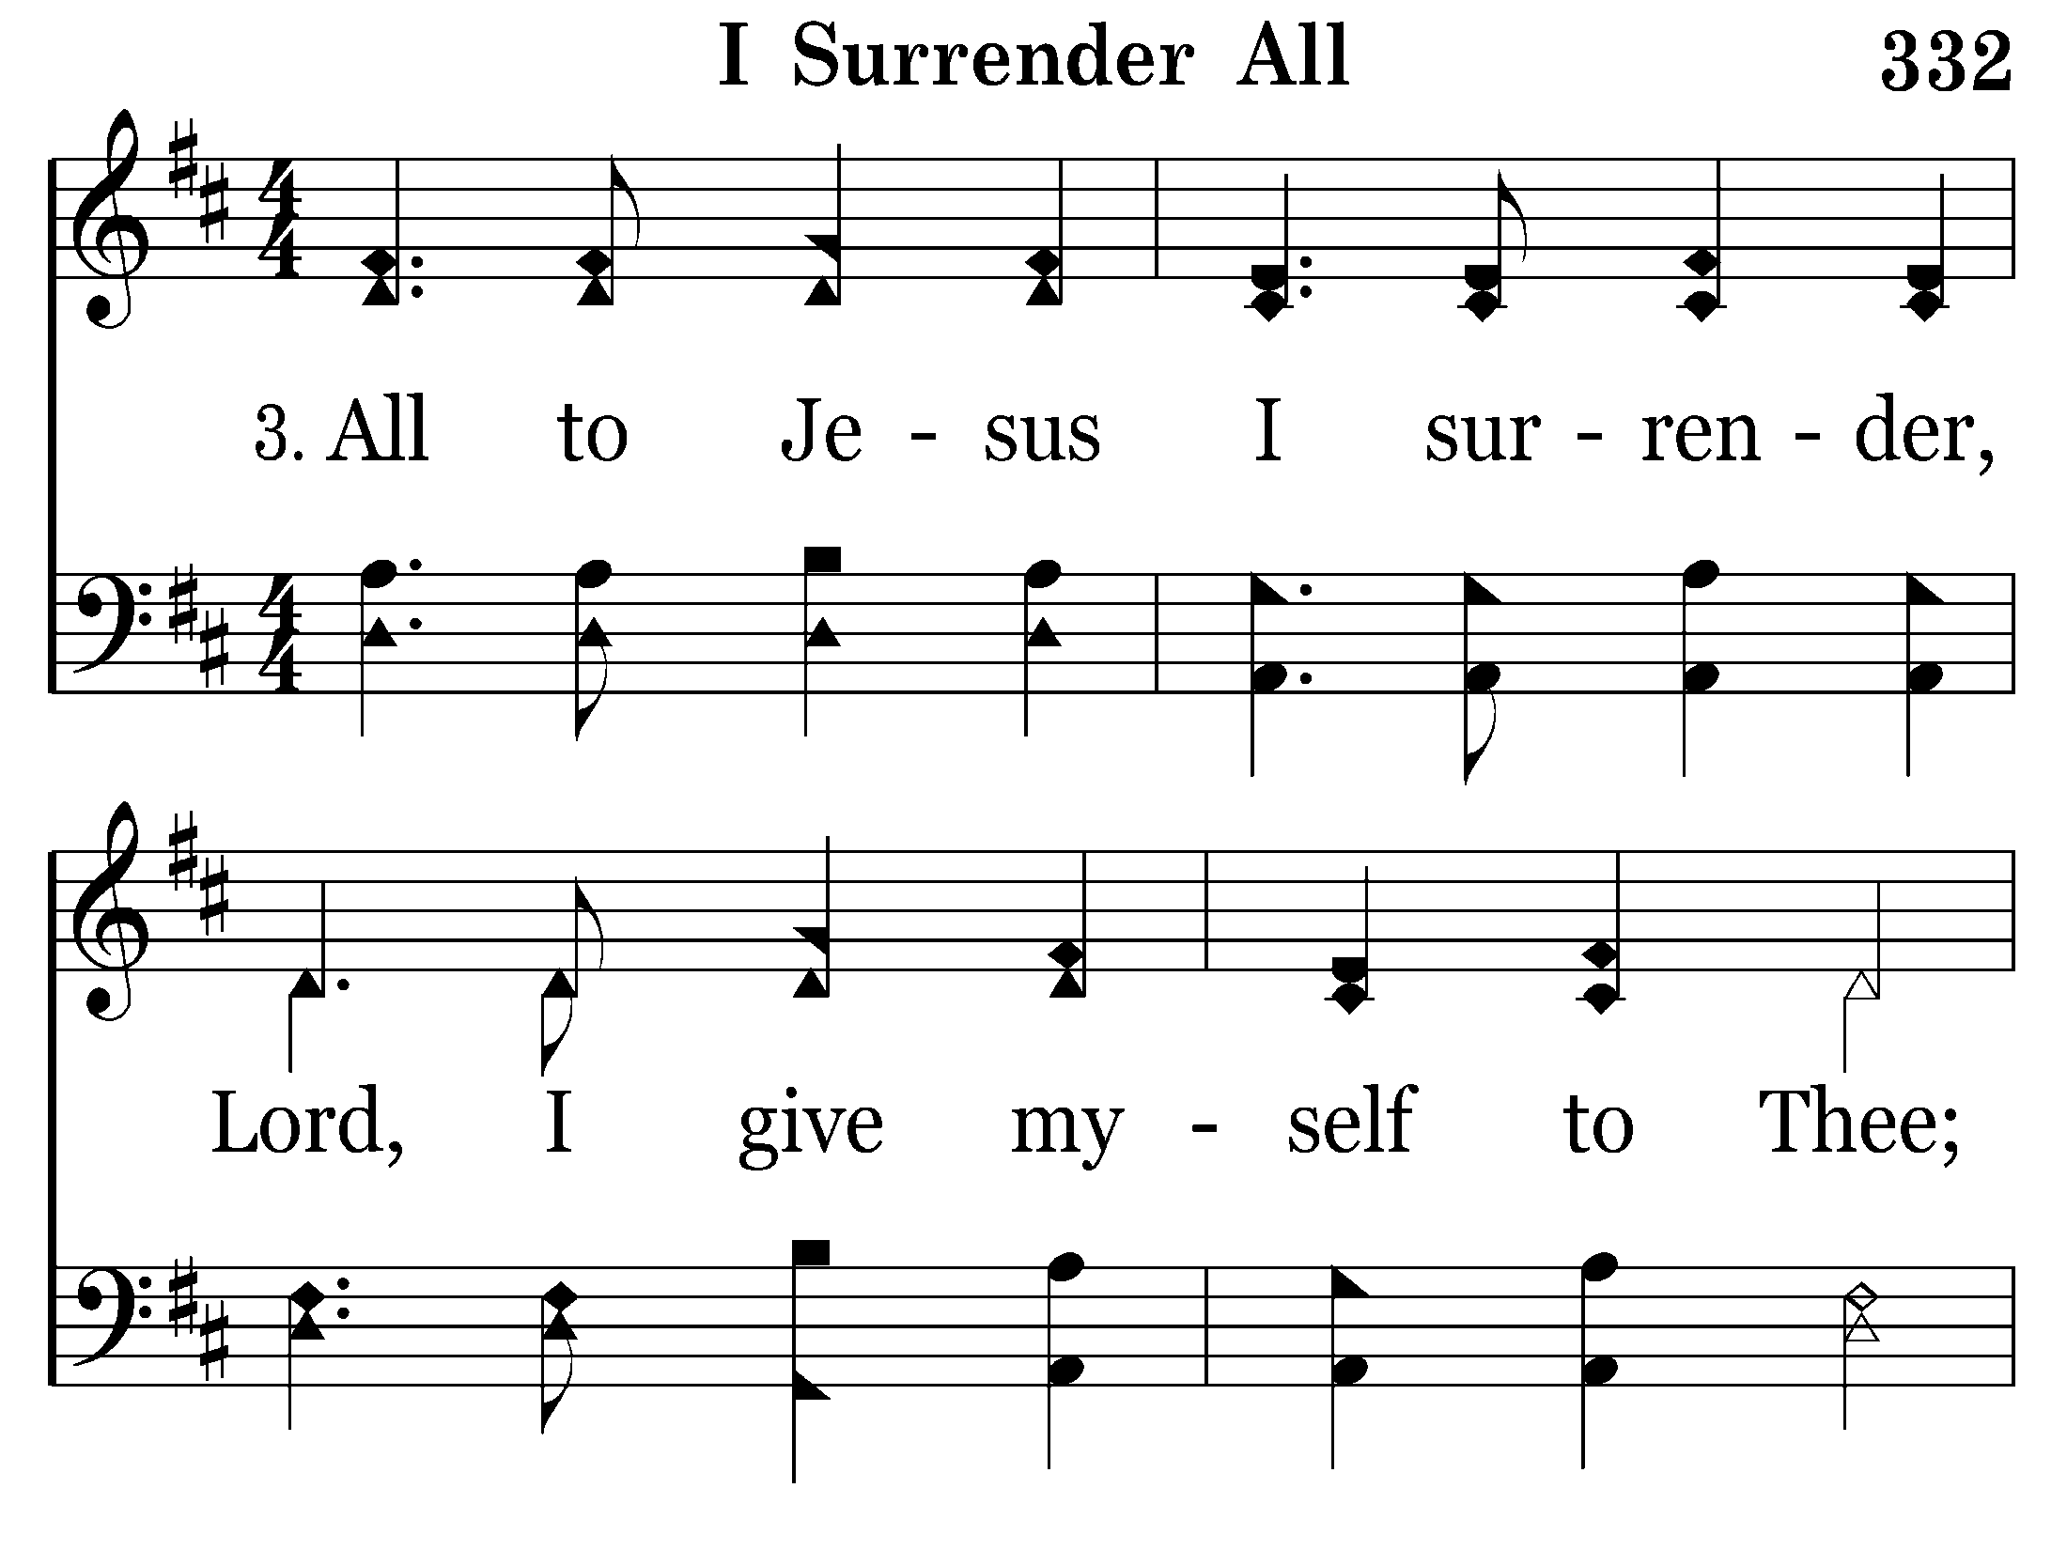
332 - I Surrender All - 3.1

Slide 73
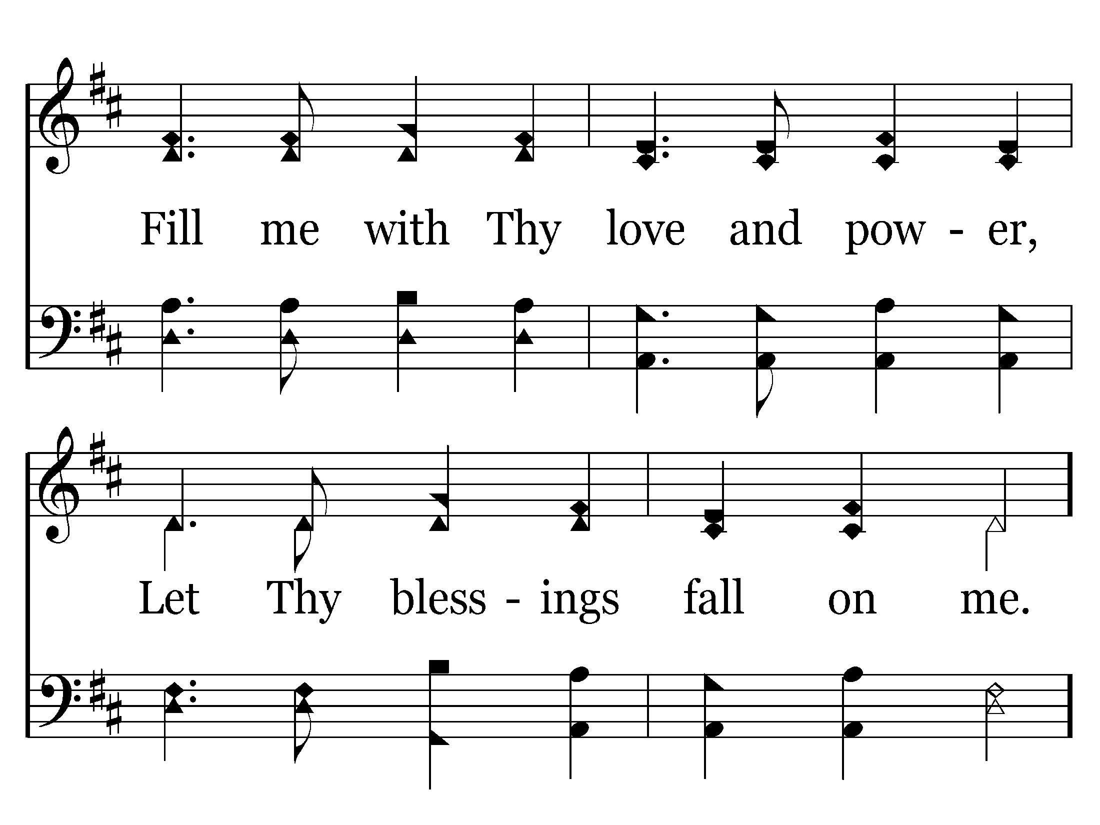
332 - I Surrender All - 3.2

Slide 74
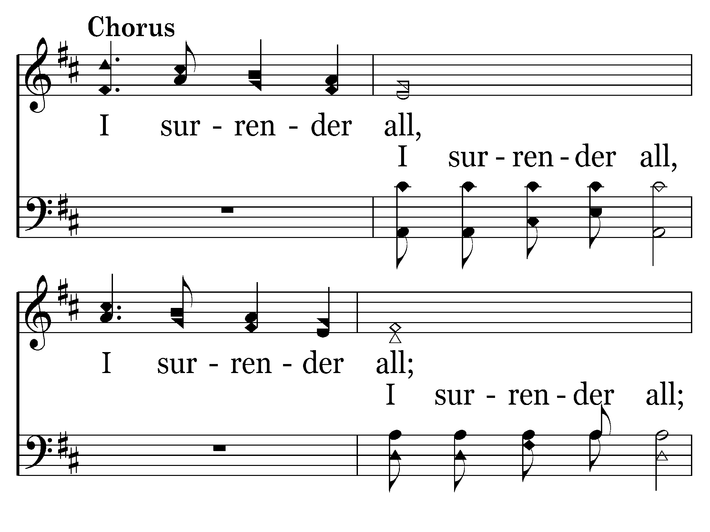
332 - I Surrender All - C.1

Slide 75
332 - I Surrender All - C.2
End of Song

Slide 77
366 - Rescue The Perishing - 1.1

Slide 78
366 - Rescue The Perishing - 1.2

Slide 79
366 - Rescue The Perishing - 1.3

Slide 80
366 - Rescue The Perishing - C.1
End of Verse 1

Slide 81
366 - Rescue The Perishing - 3.1

Slide 82
366 - Rescue The Perishing - 3.2

Slide 83
366 - Rescue The Perishing - 3.3

Slide 84
366 - Rescue The Perishing - C.1
End of Song

Slide 86
420 - O Thou Fount Of Every Blessing - 1.1

Slide 87
420 - O Thou Fount Of Every Blessing - 1.2

Slide 88
420 - O Thou Fount Of Every Blessing - 1.3

Slide 89
420 - O Thou Fount Of Every Blessing - 1.4
End of Verse 1

Slide 90
420 - O Thou Fount Of Every Blessing - 2.1

Slide 91
420 - O Thou Fount Of Every Blessing - 2.2

Slide 92
420 - O Thou Fount Of Every Blessing - 2.3

Slide 93
420 - O Thou Fount Of Every Blessing - 2.4
End of Verse 2

Slide 94
420 - O Thou Fount Of Every Blessing - 3.1

Slide 95
420 - O Thou Fount Of Every Blessing - 3.2

Slide 96
420 - O Thou Fount Of Every Blessing - 3.3

Slide 97
420 - O Thou Fount Of Every Blessing - 3.4
End of Song

