Slide 3
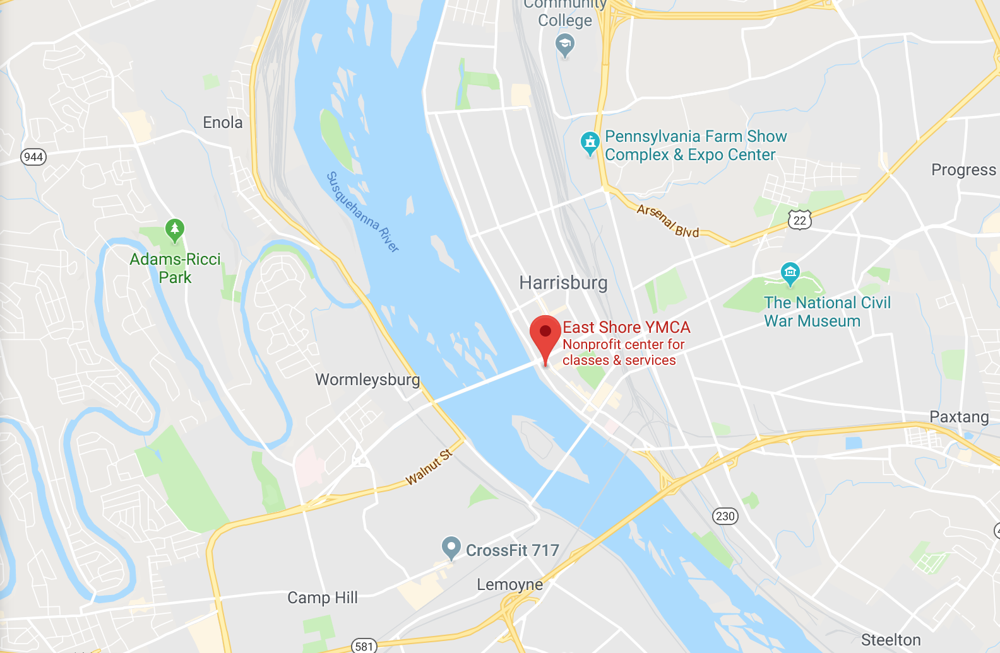

Slide 4
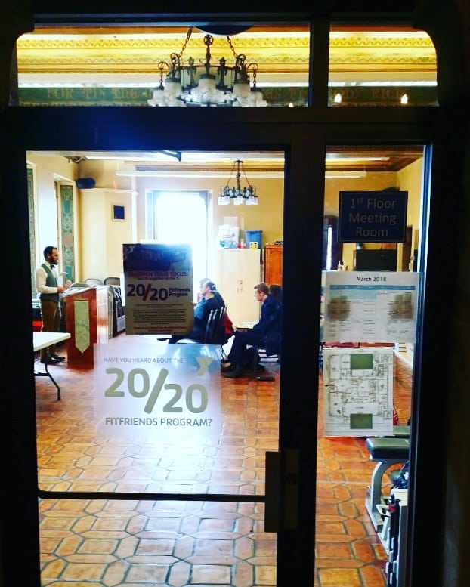

Slide 5
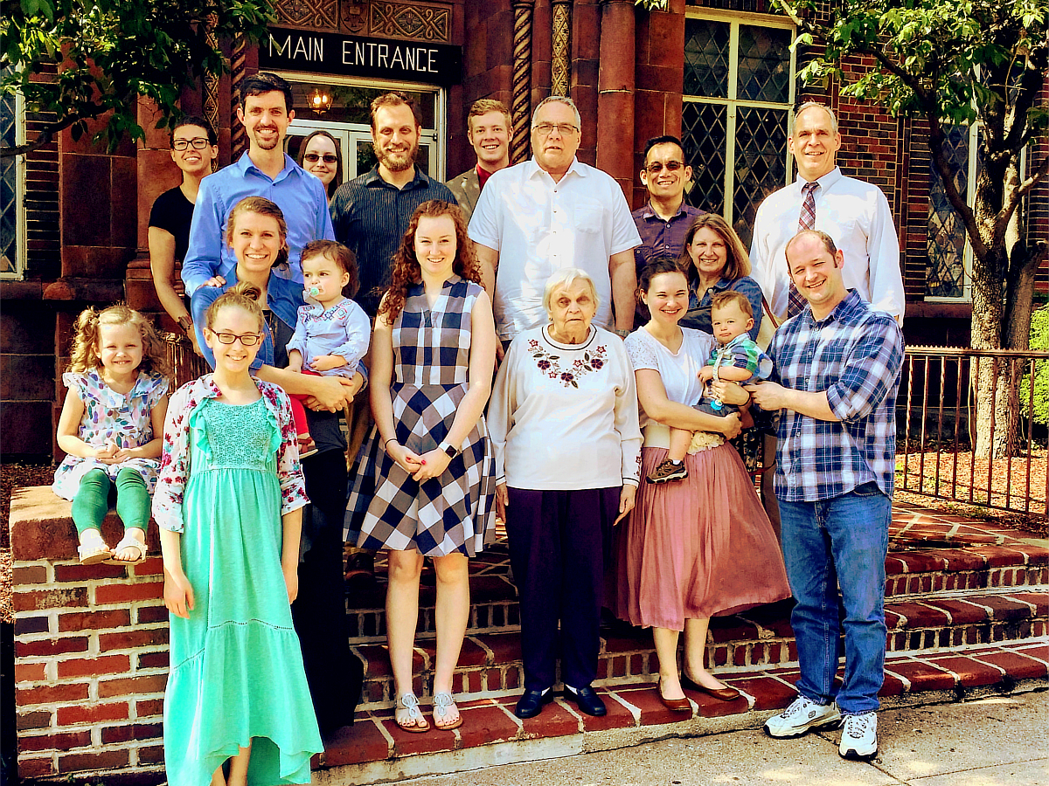

Slide 6
SONG WORSHIP
WORKSHOP
Sun 10:20 am - Worship Within the Veil
Sun 6:00 pm - The Sacrifice of Praise
Mon 7 pm - Asaph, Heman, & Jeduthun
Tue 7 pm - Teaching through Hymns, Part 1
Wed 7 pm - Teaching through Hymns, Part 2
University church of Christ
Sept 16-19, 2018

Slide 7
WORSHIP
WITHIN THE VEIL
HEB 10:19
Unless otherwise indicated, all Scripture quotations are from The ESV® Bible (The Holy Bible, English Standard Version®), copyright © 2001 by Crossway, a publishing ministry of Good News Publishers. Used by permission. All rights reserved.

Slide 8
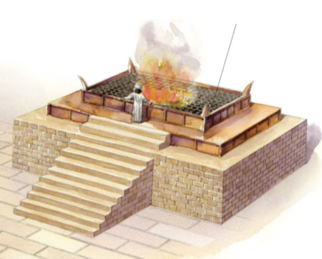
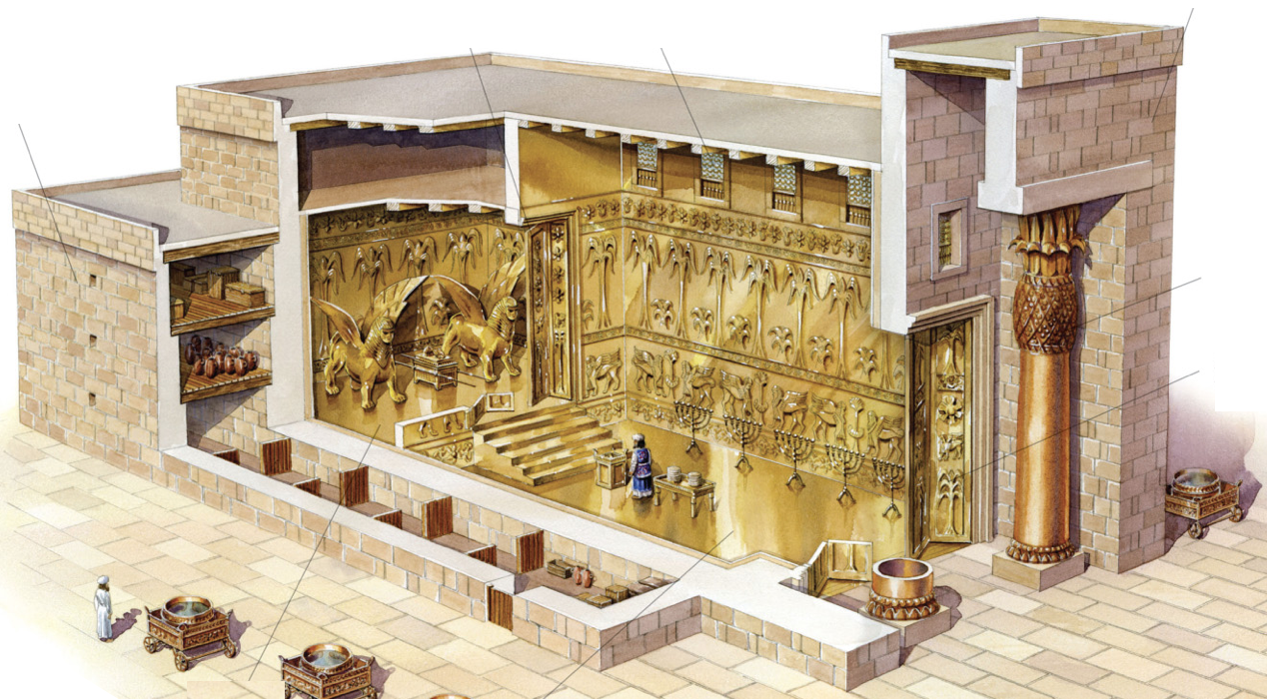
A NATION OF PRIESTS
If you are a Christian,
you are a priest of God Almighty!
The priesthood: showing what holiness looks like
Ex 19:6 - Israel: “a kingdom of priests and a holy nation”
1 Pt 2:5,9 - Christians: “a holy priesthood… a royal priesthood”

Slide 9
A NATION OF PRIESTS
The role of priest had 2 dimensions:
Represent the people to God (draw near, offer sacrifices, intercede, etc.)
Represent God to the people (holy clothing, conduct, teaching about holiness [Lv 10:8ff; Dt 17:8ff])
God

Slide 10
APPROACHING GOD
God
Ex 25:8 - Lessons from the tabernacle:
I must have clean hands & a pure heart
A death occurred to allow me to come near
I still cannot see God Himself
The tabernacle/temple said:
- God is with you
- …But keep your distance!

Slide 11
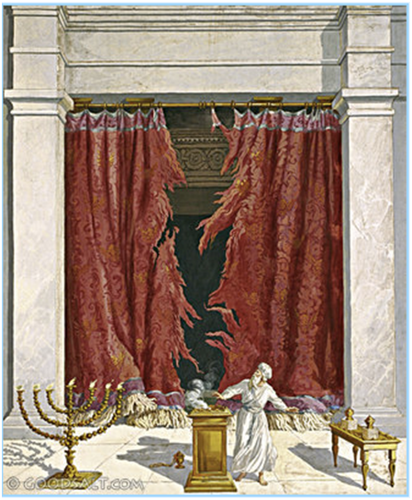
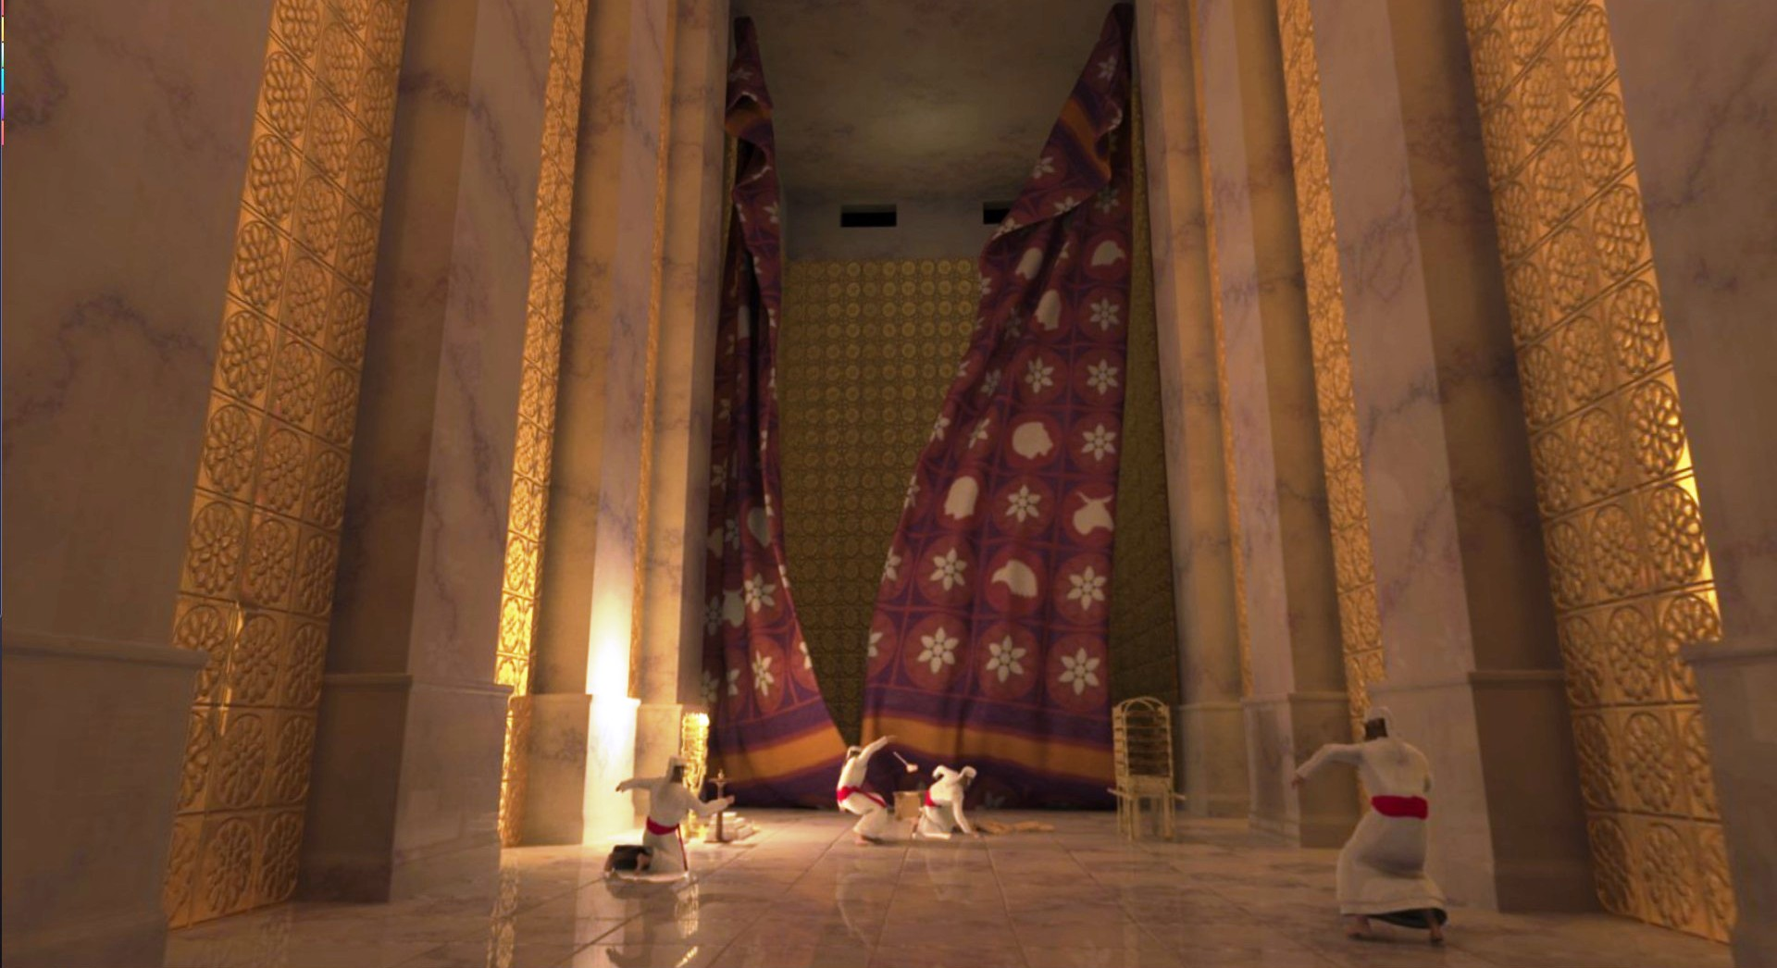
APPROACHING GOD

Slide 12
WORSHIP WITHIN THE VEIL
God
Mk 15:38 - When Jesus died, the veil was torn open.
Heb 10:19-20 - We now have an unbelievable privilege:
By the blood of Jesus, we can enter the most holy place!

Slide 13
WORSHIP WITHIN THE VEIL
God
Heb 4:16 - Because we have this unspeakable privilege, how should we react?
Heb 10:19-25 - Draw near, hold fast, consider each other
Heb 12:28-29 - Worship with reverence and awe
Heb 13:15 - Offer the sacrifice of praise

Slide 16
SONG WORSHIP
WORKSHOP
Sun 10:20 am - Worship Within the Veil
Sun 6:00 pm - The Sacrifice of Praise
Mon 7 pm - Asaph, Heman, & Jeduthun
Tue 7 pm - Teaching through Hymns, Part 1
Wed 7 pm - Teaching through Hymns, Part 2
University church of Christ
Sept 16-19, 2018

Slide 17
THE
SACRIFICE
OF PRAISE
HEB 13:15
Unless otherwise indicated, all Scripture quotations are from The ESV® Bible (The Holy Bible, English Standard Version®), copyright © 2001 by Crossway, a publishing ministry of Good News Publishers. Used by permission. All rights reserved.

Slide 18
WORSHIP WITHIN THE VEIL

Slide 19
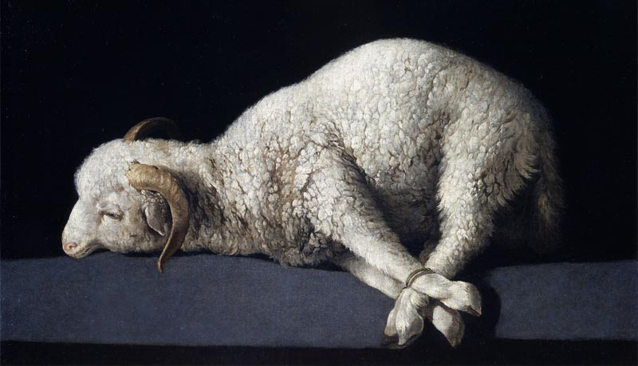
THE SACRIFICE OF PRAISE
Do you offer sacrifices?
Hb 13:15-16 - Sacrifices:
Praise - fruit of lips
Do good
Share what you have
Not every sacrifice is pleasing to God:
Gen 4:3-5 - “the firstborn… fat portions…”
Ex 12:5, etc. - “without blemish…” (36x Ex-Num)
Mal 1:6-8 - God knows when we’re lazy
God deserves better than our best.

Slide 20
THE SACRIFICE OF PRAISE
Internal:
Low sleep
Hunger
Worry
Chronic pain
External:
Other worshippers
Kids
Clothing
Songs themselves
What obstacles hinder our sacrifices?
Amos 5:21-24; 1 Pt 3:7 - A life of sin, hypocrisy
Mal 1:8 - Laziness: lack of preparation, thought
Distraction: internal, external

Slide 21
THE SACRIFICE OF PRAISE
Selection:
New song
Hard / old words
Not favorite style
Difficult music
What obstacles hinder our sacrifices?
Amos 5:21-24; 1 Pt 3:7 - A life of sin, hypocrisy
Mal 1:8 - Laziness: lack of preparation, thought
Distraction: internal, external
Selection: words & music for all to offer to God

Slide 22
THE SACRIFICE OF PRAISE
Leadership:
Too fast / slow
Can’t see
Slide operation
Lack of energy
What obstacles hinder our sacrifices?
Amos 5:21-24; 1 Pt 3:7 - A life of sin, hypocrisy
Mal 1:8 - Laziness: lack of preparation, thought
Distraction: internal, external
Selection: words & music for all to offer to God
Poor leadership, poor following

Slide 23
THE SACRIFICE OF PRAISE
Attitude / Self-focus:
Not favorite song
Oversung
Not entertaining
Not encouraging
What obstacles hinder our sacrifices?
Amos 5:21-24; 1 Pt 3:7 - A life of sin, hypocrisy
Mal 1:8 - Laziness: lack of preparation, thought
Distraction: internal, external
Selection: words & music for all to offer to God
Poor leadership, poor following
Poor attitude, self-focus (Heb 10:24)
My sacrifice is my responsibility.

Slide 24
THE SACRIFICE OF PRAISE
Heb 13:15 - How can I offer a better sacrifice?
Preparation: Get your heart ready
Perspective: God’s holy presence
Participation: The more you put in, the more you and others benefit
Practice: Make hymns a habit, work at it
God deserves better than my best.
My sacrifice is my responsibility.

Slide 26
ASAPH, HEMAN,
& JEDUTHUN
Unless otherwise indicated, all Scripture quotations are from The ESV® Bible (The Holy Bible, English Standard Version®), copyright © 2001 by Crossway, a publishing ministry of Good News Publishers. Used by permission. All rights reserved.

Slide 27
LEADERS OF TEMPLE WORSHIP
1 Ch 15:16-17 - Heman (6:33,37), Asaph, & Ethan
15:12-13 - Correction after Uzzah’s death
v22 - Chenaniah led because he understood
1 Ch 16:7-36 - First organized psalm service
v8-22 = Ps 105:1-15
v23-33 = Ps 96:1-13a (v34 used frequently)
v35-36 = Ps 106:47-48
16:37,41 - Ethan renamed Jeduthun
1 Ch 25:1,7 - Prophesied (teaching), trained, skillful
Worship must not be random, but thoughtful.

Slide 28
THOUGHTFUL WORSHIP
1 Ch 16:7 - Thoughtful preparation:
Theme / part of service
Not just “my favorite songs” (preaching?)
Does this song fit what we are thinking on?

Slide 29
THOUGHTFUL WORSHIP
1 Ch 16:7 - Thoughtful preparation:
Theme / part of service
Song selection
Does it teach truth? Col 3:16
Can we understand it?
Do we know the song well?
Is too difficult for the congregation?

Slide 30
THOUGHTFUL WORSHIP
1 Ch 16:7 - Thoughtful preparation:
Theme / part of service
Song selection
Order
Start with a strong, well-known song
Build your theme logically

Slide 31
THOUGHTFUL WORSHIP
1 Ch 16:7 - Thoughtful preparation:
Theme / part of service
Song selection
Order
1 Ch 25:7 - Thoughtful leadership
Appropriate comments / explanation
Correct pitch
Start & stop together

Slide 32
1 – Faith is the Victory
1.
Encamped along the hills of light,
Ye Christian soldiers, rise,
And press the battle ere the night
Shall veil the glowing skies.
Against the foe in vales below
Let all our strength be hurled;
Faith is the victory, we know,
That overcomes the world.
Words by: John H. Yates
Music by: Ira D. Sankey
© 2001 The Paperless Hymnal™

Slide 33
1 – Faith is the Victory
© 2001 The Paperless Hymnal™

Slide 34
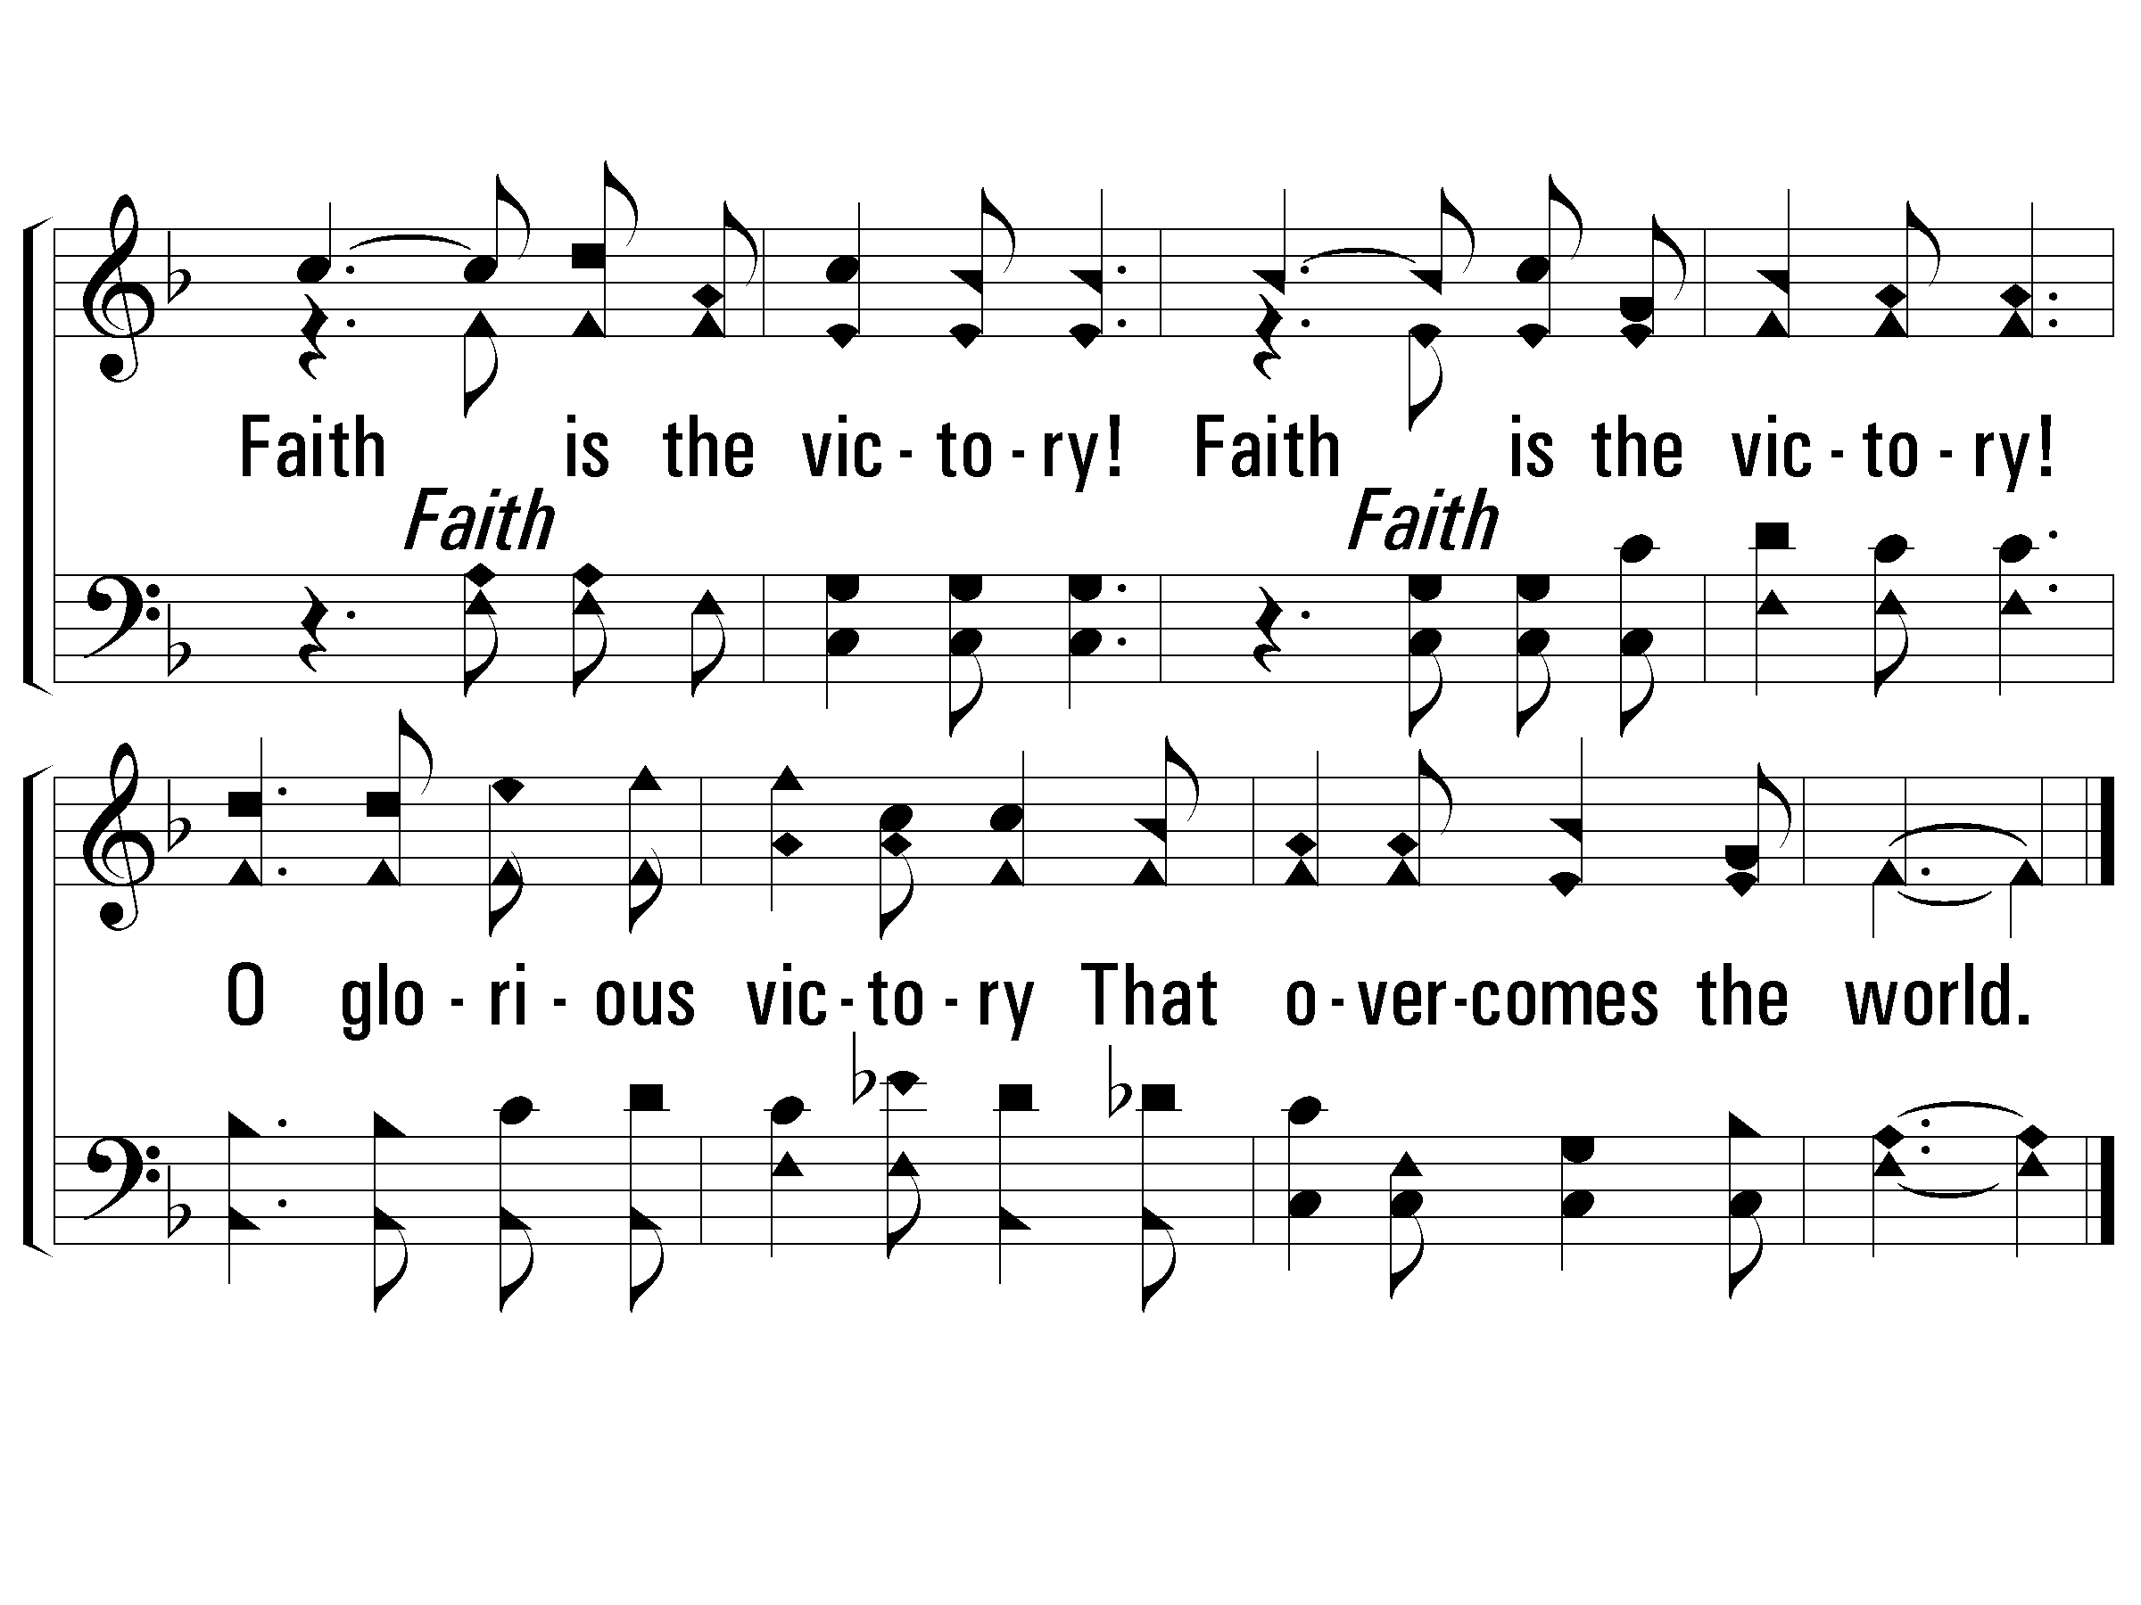
c – Faith is the Victory
Faith is the victory!
Faith is the victory!
O glorious victory
That o-ver-comes the world.
© 2001 The Paperless Hymnal™

Slide 35
THOUGHTFUL WORSHIP
1 Ch 16:7 - Thoughtful preparation:
Theme / part of service
Song selection
Order
1 Ch 25:7 - Thoughtful leadership
Appropriate comments / explanation
Correct pitch
Start & stop together
Appropriate pace

Slide 36
1 – Faith is the Victory
1.
Encamped along the hills of light,
Ye Christian soldiers, rise,
And press the battle ere the night
Shall veil the glowing skies.
Against the foe in vales below
Let all our strength be hurled;
Faith is the victory, we know,
That overcomes the world.
Words by: John H. Yates
Music by: Ira D. Sankey
© 2001 The Paperless Hymnal™

Slide 37
1 – Faith is the Victory
© 2001 The Paperless Hymnal™

Slide 38
c – Faith is the Victory
Faith is the victory!
Faith is the victory!
O glorious victory
That o-ver-comes the world.
© 2001 The Paperless Hymnal™

Slide 39
THOUGHTFUL WORSHIP
1 Ch 16:7 - Thoughtful preparation:
Theme / part of service
Song selection
Order
1 Ch 25:7 - Thoughtful leadership
Appropriate comments / explanation
Correct pitch
Start & stop together
Appropriate pace
Energy & engagement

Slide 40
1 – Faith is the Victory
1.
Encamped along the hills of light,
Ye Christian soldiers, rise,
And press the battle ere the night
Shall veil the glowing skies.
Against the foe in vales below
Let all our strength be hurled;
Faith is the victory, we know,
That overcomes the world.
Words by: John H. Yates
Music by: Ira D. Sankey
© 2001 The Paperless Hymnal™

Slide 41
1 – Faith is the Victory
© 2001 The Paperless Hymnal™

Slide 42
c – Faith is the Victory
Faith is the victory!
Faith is the victory!
O glorious victory
That o-ver-comes the world.
© 2001 The Paperless Hymnal™

Slide 43
THOUGHTFUL WORSHIP
1 Ch 16:7 - Thoughtful preparation:
Theme / part of service
Song selection
Order
1 Ch 25:7 - Thoughtful leadership
Appropriate comments / explanation
Correct pitch
Start & stop together
Appropriate pace
Energy & engagement
Prepare & practice:
To glorify God, not to glorify self/song
To edify others, not to put on a show
To teach, to admonish, to let the Word dwell richly within us

Slide 45
THROUGH
TEACHING
HYMNS
PART 1
Unless otherwise indicated, all Scripture quotations are from The ESV® Bible (The Holy Bible, English Standard Version®), copyright © 2001 by Crossway, a publishing ministry of Good News Publishers. Used by permission. All rights reserved.

Slide 46
fdnsjk
fdsnjk

Slide 48
THROUGH
TEACHING
HYMNS
PART 2
Unless otherwise indicated, all Scripture quotations are from The ESV® Bible (The Holy Bible, English Standard Version®), copyright © 2001 by Crossway, a publishing ministry of Good News Publishers. Used by permission. All rights reserved.

Slide 49
fdnsjk
fdsnjk

