Slide 1
THE
SACRIFICE
OF PRAISE
HEB 13:15
Unless otherwise indicated, all Scripture quotations are from The ESV® Bible (The Holy Bible, English Standard Version®), copyright © 2001 by Crossway, a publishing ministry of Good News Publishers. Used by permission. All rights reserved.

Slide 2
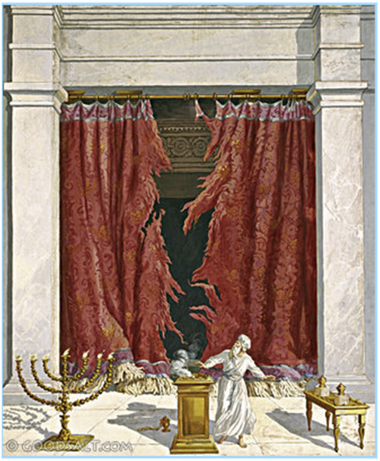
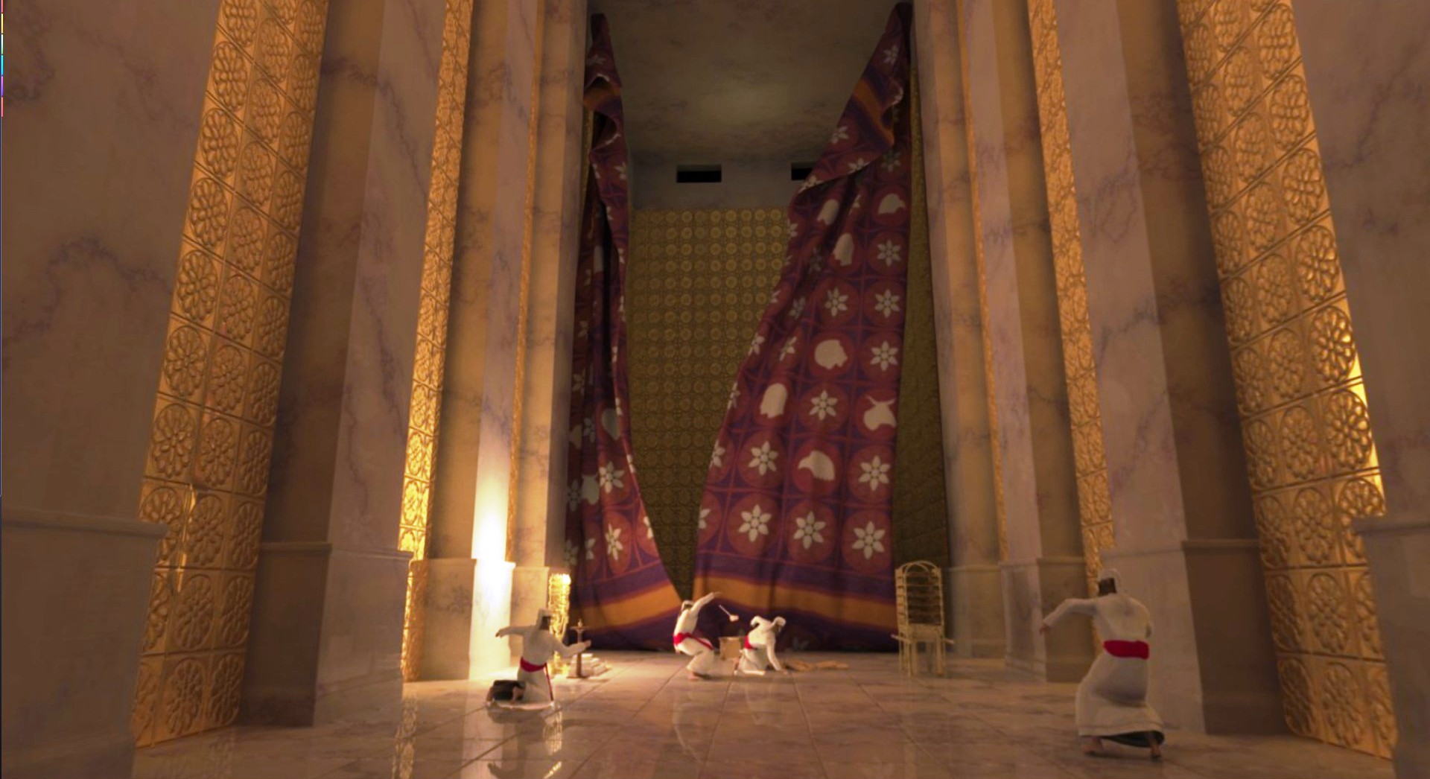
APPROACHING GOD

Slide 3
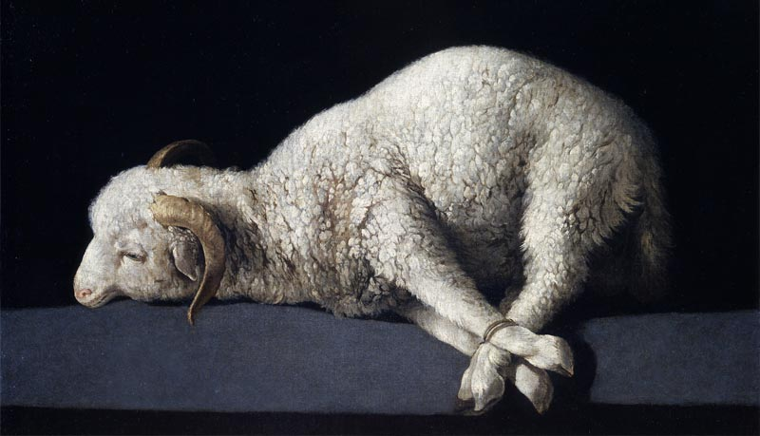
THE SACRIFICE OF PRAISE
Do you offer sacrifices?
Hb 13:15-16 - Sacrifices:
Praise - fruit of lips
Do good
Share what you have
Not every sacrifice is pleasing to God:
Gen 4:3-5 - “the firstborn… fat portions…”
Ex 12:5, etc. - “without blemish…” (36x Ex-Num)
Mal 1:6-8 - God knows when we’re lazy
God deserves better than our best.

Slide 4
THE SACRIFICE OF PRAISE
What obstacles hinder our sacrifices?
Amos 5:21-24; 1 Pt 3:7 - A life of sin, hypocrisy
Mal 1:8 - Laziness: lack of preparation, thought
Distraction: internal, external
Selection: words & music for all to offer to God
Poor leadership, poor following
Poor attitude, self-focus (Heb 10:24)
My sacrifice is my responsibility.

Slide 5
THE SACRIFICE OF PRAISE
Heb 13:15 - How can I offer a better sacrifice?
Preparation: Get your heart ready
Perspective: God’s holy presence
Participation: The more you put in, the more you and others benefit
Practice: Make hymns a habit, work at it
God deserves better than my best.
My sacrifice is my responsibility.

