Slide 1
Purpose

Slide 2
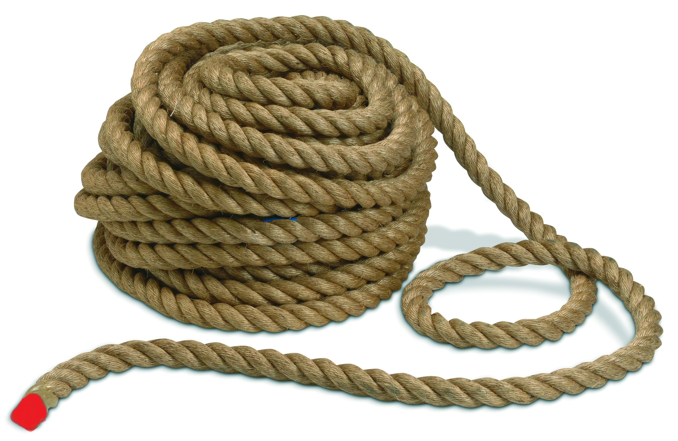

Slide 3
Two goals
If we spend our time in the RED part and not think of their eternal life.
If we spend our time in the RED part but focus on our purpose.

Slide 4
Today people are concerned with;
Cars
Money
Houses
Jobs
Etc.

Slide 5
Luke 16:19-23
19"There was a rich man who was dressed in purple and fine linen and lived in luxury every day. 20At his gate was laid a beggar named Lazarus, covered with sores 21and longing to eat what fell from the rich man's table. Even the dogs came and licked his sores. 22"The time came when the beggar died and the angels carried him to Abraham's side. The rich man also died and was buried. 23In Hades, where he was in torment, he looked up and saw Abraham far away, with Lazarus by his side.

Slide 6
Mark 10:17-22
17As Jesus started on his way, a man ran up to him and fell on his knees before him. "Good teacher," he asked, "what must I do to inherit eternal life?" 18"Why do you call me good?" Jesus answered. "No one is good-except God alone. 19You know the commandments: 'You shall not murder, you shall not commit adultery, you shall not steal, you shall not give false testimony, you shall not defraud, honor your father and mother.'" 20"Teacher," he declared, "all these I have kept since I was a boy." 21Jesus looked at him and loved him. "One thing you lack," he said. "Go, sell everything you have and give to the poor, and you will have treasure in heaven. Then come, follow me." 22At this the man's face fell. He went away sad, because he had great wealth.

Slide 7
You spend your life worried about what’s in your wallet, but for what? That money won’t show up in your coffin

Slide 8
Matthew 6:21
For where your treasure is, there your heart will be also.

Slide 9
Galatians 2:11-21
11When Cephas came to Antioch, I opposed him to his face, because he stood condemned. 12For before certain men came from James, he used to eat with the Gentiles. But when they arrived, he began to draw back and separate himself from the Gentiles because he was afraid of those who belonged to the circumcision group. 13The other Jews joined him in his hypocrisy, so that by their hypocrisy even Barnabas was led astray.

Slide 10
Galatians 2:11-21
14When I saw that they were not acting in line with the truth of the gospel, I said to Cephas in front of them all, "You are a Jew, yet you live like a Gentile and not like a Jew. How is it, then, that you force Gentiles to follow Jewish customs?

Slide 11
Galatians 2:11-22 continued
15"We who are Jews by birth and not sinful Gentiles 16know that a person is not justified by the works of the law, but by faith in Jesus Christ. So we, too, have put our faith in Christ Jesus that we may be justified by faith in Christ and not by the works of the law, because by the works of the law no one will be justified. 17"But if, in seeking to be justified in Christ, we Jews find ourselves also among the sinners, doesn't that mean that Christ promotes sin? Absolutely not!

Slide 12
Galatians 2:11-21
18If I rebuild what I destroyed, then I really would be a lawbreaker. 19"For through the law I died to the law so that I might live for God. 20I have been crucified with Christ and I no longer live, but Christ lives in me. The life I now live in the body, I live by faith in the Son of God, who loved me and gave himself for me. 21I do not set aside the grace of God, for if righteousness could be gained through the law, Christ died for nothing!"

Slide 13
2nd Samuel 11:4-26
4Then David sent messengers to get her. She came to him, and he slept with her. (Now she was purifying herself from her monthly uncleanness.) Then she went back home. 5The woman conceived and sent word to David, saying, "I am pregnant." 6So David sent this word to Joab: "Send me Uriah the Hittite." And Joab sent him to David. 7When Uriah came to him, David asked him how Joab was, how the soldiers were and how the war was going. 8Then David said to Uriah, "Go down to your house and wash your feet." So Uriah left the palace, and a gift from the king was sent after him.

Slide 14
2nd Samuel 11:4-26
9But Uriah slept at the entrance to the palace with all his master's servants and did not go down to his house. 10David was told, "Uriah did not go home." So he asked Uriah, "Haven't you just come from a military campaign? Why didn't you go home?" 11Uriah said to David, "The ark and Israel and Judah are staying in tents, and my commander Joab and my LORD's men are camped in the open country. How could I go to my house to eat and drink and make love to my wife? As surely as you live, I will not do such a thing!" 12Then David said to him, "Stay here one more day, and tomorrow I will send you back." So Uriah remained in Jerusalem that day and the next.

Slide 15
2nd Samuel 11:4-26 continued
13At David's invitation, he ate and drank with him, and David made him drunk. But in the evening Uriah went out to sleep on his mat among his master's servants; he did not go home. 14In the morning David wrote a letter to Joab and sent it with Uriah. 15In it he wrote, "Put Uriah out in front where the fighting is fiercest. Then withdraw from him so he will be struck down and die." 16So while Joab had the city under siege, he put Uriah at a place where he knew the strongest defenders were. 17When the men of the city came out and fought against Joab, some of the men in David's army fell; moreover, Uriah the Hittite died.

Slide 16
2nd Samuel 11:4-26
18Joab sent David a full account of the battle. 19He instructed the messenger: "When you have finished giving the king this account of the battle, 20the king's anger may flare up, and he may ask you, 'Why did you get so close to the city to fight? Didn't you know they would shoot arrows from the wall?

Slide 17
2nd Samuel 11:4-26
21Who killed Abimelek son of Jerub-Besheth? Didn't a woman drop an upper millstone on him from the wall, so that he died in Thebez? Why did you get so close to the wall?' If he asks you this, then say to him, 'Moreover, your servant Uriah the Hittite is dead.'" 22The messenger set out, and when he arrived he told David everything Joab had sent him to say. 23The messenger said to David, "The men overpowered us and came out against us in the open, but we drove them back to the entrance of the city gate.

Slide 18
2nd Samuel 11:4-26
24Then the archers shot arrows at your servants from the wall, and some of the king's men died. Moreover, your servant Uriah the Hittite is dead." 25David told the messenger, "Say this to Joab: 'Don't let this upset you; the sword devours one as well as another. Press the attack against the city and destroy it.' Say this to encourage Joab." 26When Uriah's wife heard that her husband was dead, she mourned for him.

Slide 19
Many ways we can focus on our purpose
Being a light
Using our gifts
Encouraging others to be part of Christ
Baptizing – Following the steps of Baptism
Remaining Faithful

Slide 20
Matthew 5:13-16
13"You are the salt of the earth. But if the salt loses its saltiness, how can it be made salty again? It is no longer good for anything, except to be thrown out and trampled underfoot. 14"You are the light of the world. A town built on a hill cannot be hidden. 15Neither do people light a lamp and put it under a bowl. Instead they put it on its stand, and it gives light to everyone in the house. 16In the same way, let your light shine before others, that they may see your good deeds and glorify your Father in heaven.

Slide 21
Woodlawn quote
You have a gift, something that can’t be taught, but YOU have to decide what you are going to do with it.

Slide 22
Romans 12:6
We have different gifts, according to the grace given to each of us. If your gift is prophesying, then prophesy in accordance with your faith;

Slide 23
1st Peter 4:10
Each of you should use whatever gift you have received to serve others, as faithful stewards of God's grace in its various forms.

Slide 24
Hebrews 10:23-25
23Let us hold unswervingly to the hope we profess, for he who promised is faithful. 24And let us consider how we may spur one another on toward love and good deeds, 25not giving up meeting together, as some are in the habit of doing, but encouraging one another-and all the more as you see the Day approaching.

Slide 25
Matthew 11:15
Whoever has ears, let them hear.

Slide 26
Mark 5:36
Overhearing what they said, Jesus told him, "Don't be afraid; just believe."

Slide 27
2nd Chronicles 7:14
14if my people, who are called by my name, will humble themselves and pray and seek my face and turn from their wicked ways, then I will hear from heaven, and I will forgive their sin and will heal their land.

Slide 28
Romans 10:9
If you declare with your mouth, "Jesus is LORD," and believe in your heart that God raised him from the dead, you will be saved.

Slide 29
Colossians 2:12-13
12having been buried with him in baptism, in which you were also raised with him through your faith in the working of God, who raised him from the dead. 13When you were dead in your sins and in the uncircumcision of your flesh, God made you alive with Christ. He forgave us all our sins,

Slide 30
Isaiah 53:1-10
1Who has believed our message and to whom has the arm of the LORD been revealed? 2He grew up before him like a tender shoot, and like a root out of dry ground. He had no beauty or majesty to attract us to him, nothing in his appearance that we should desire him. 3He was despised and rejected by mankind, a man of suffering, and familiar with pain. Like one from whom people hide their faces he was despised, and we held him in low esteem. 4Surely he took up our pain and bore our suffering, yet we considered him punished by God, stricken by him, and afflicted.

Slide 31
Isaiah 53:1-10
5But he was pierced for our transgressions, he was crushed for our iniquities; the punishment that brought us peace was on him, and by his wounds we are healed. 6We all, like sheep, have gone astray, each of us has turned to our own way; and the LORD has laid on him the iniquity of us all. 7He was oppressed and afflicted, yet he did not open his mouth; he was led like a lamb to the slaughter, and as a sheep before its shearers is silent, so he did not open his mouth. 8By oppression and judgment he was taken away. Yet who of his generation protested? For he was cut off from the land of the living; for the transgression of my people he was punished.

Slide 32
Isaiah 53:1-10 continued
9He was assigned a grave with the wicked, and with the rich in his death, though he had done no violence, nor was any deceit in his mouth. 10Yet it was the LORD's will to crush him and cause him to suffer, and though the LORD makes his life an offering for sin, he will see his offspring and prolong his days, and the will of the LORD will prosper in his hand.

Slide 33
Revelation 2:10
Do not be afraid of what you are about to suffer. I tell you, the devil will put some of you in prison to test you, and you will suffer persecution for ten days. Be faithful, even to the point of death, and I will give you life as your victor's crown.

Slide 34
Matthew 7:21
"Not everyone who says to me, 'LORD, LORD,' will enter the kingdom of heaven, but only the one who does the will of my Father who is in heaven.

