Slide 2
Matthew 27:15-26

Slide 3
Barabbas Deserved to Die!
(Matthew 27:16) And they had then a notorious prisoner called Barabbas.
(Mark 15:7) And among the rebels in prison, who had committed murder in the insurrection, there was a man called Barabbas.
(John 18:40) They cried out again, “Not this man, but Barabbas!” Now Barabbas was a robber.
Pilate Knew Jesus was Innocent!
Pilate’s “Either/Or” Choice!

Slide 4
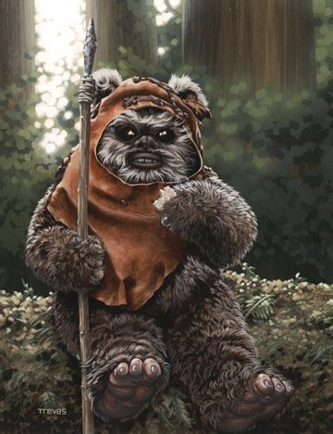
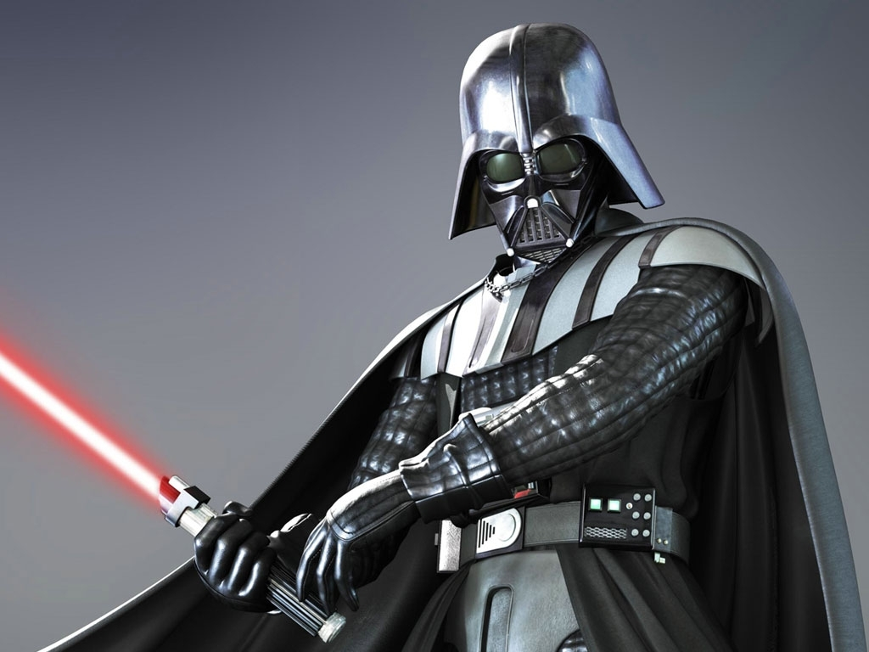
Choose Whom to Release?
Evil Darth Vader
Sweet Ewok

Slide 5
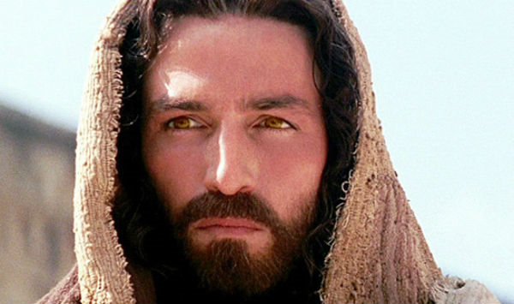
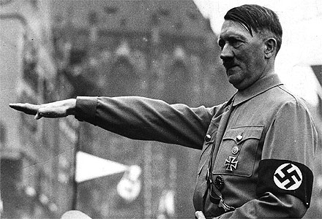
Choose Whom to Release?
Jesus Christ as played by James Caviezel in “The Passion of the Christ”
Adolf Hitler

Slide 6
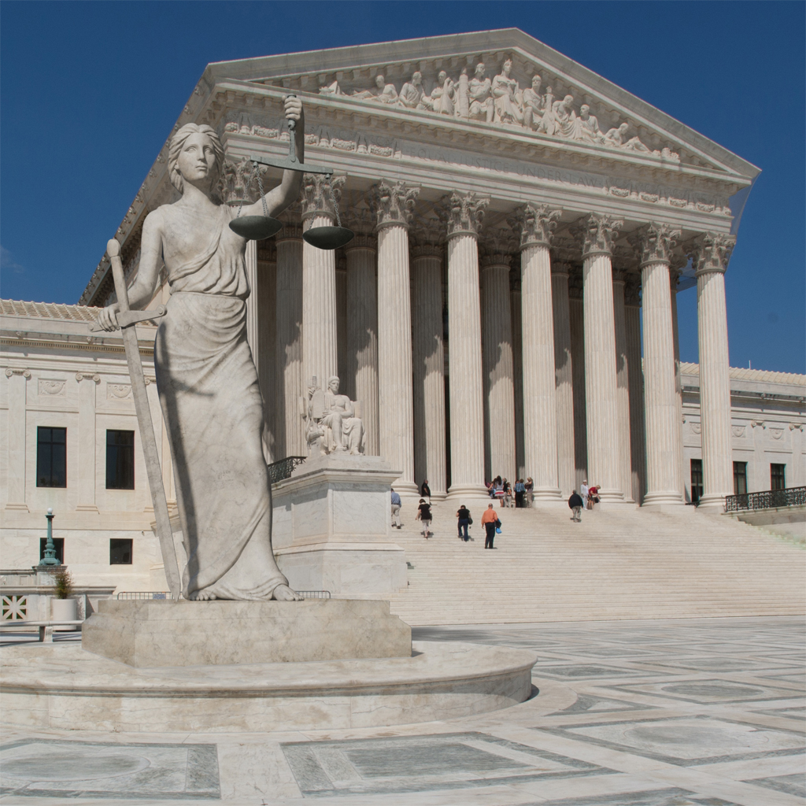
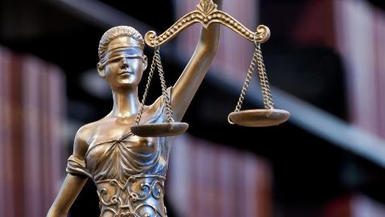
Barabbas, Set Free by Mercy, Not Justice
Justice Looks at:
Only the Facts
No Kindness
No Extenuating Circumstances
Barabbas Lives Only B/c Jesus Dies!
Mercy operates Contrary to Justice!
Mercy can Forgive & Set Free
Lady Justice @ U.S. Supreme Court Bldg.

Slide 7
Barabbas Gets to Live Again!
Barabbas Receives an Unconditional Pardon!
What Becomes of Barabbas After This?
Possibility #1
He’s Convicted
He Repents
He Follows Jesus!
Possibility #2
Goes into Denial
Becomes a Recluse
Refuses to Face his Past & Demons
Possibility #3
Doesn’t Learn a Thing
Goes Back to a Life of Crime
Rearrested & Crucified

Slide 8
Application to Us Today
“I am Barabbas!” – “You are Barabbas!”
What Do We Do With Jesus?
Possibility #1
Live a Neutral Life re. Jesus
Live for My Wants & Pleasures
Don’t Honor Jesus at All
Possibility #2
Go Back to Living the Same Life as Before
Sinning Willfully!
Eat, Drink, be Merry, for Tomorrow We Die
Possibility #3
(Galatians 2:20) I have been crucified with Christ. It is no longer I who live, but Christ who lives in me. And the life I now live in the flesh I live by faith in the Son of God, who loved me and gave himself for me.

Slide 9
Matthew 27:15-26

