Slide 1
Notes:
Matthew 13:34 “All these things Jesus spoke to the crowds in parables, and He did not speak to them without a parable.”
*It has been estimated that 1/3 of the teachings of Jesus that are recorded are Parables.
*This is why it is an important study, because Jesus, the great teacher and story teller, used them so often.
Matthew 13:35 “This was to fulfill what was spoken through the prophet: "I WILL OPEN MY MOUTH IN PARABLES; I WILL UTTER THINGS HIDDEN SINCE THE FOUNDATION OF THE WORLD.“
This prophecy of Jesus from Psalm 78:2 written by Asaph (a wisdom Psalm, discussing the history of the Israelite people) is fulfilled in the ministry of Jesus.
78:1 sounds a great like something else Jesus would say. It reads, “Listen, O my people, to my instruction; Incline your ears to the words of my mouth.”
How would Jesus say this? “He who has ears, let him hear….”

Slide 2
Notes:
Jesus ended many of his parables with this saying. What is the point?
It’s not that we don’t have ears…it’s that we don’t use them! Scripture has always place a premium on hearing God’s voice. The great command from God through Moses began with the words, “Hear O Israel: The LORD our God is one LORD” (Deuteronomy 6:4 KJV). Proverbs 8:34 says, “Happy are those who listen to me.”
Jesus urges us to listen like sheep. “The sheep recognize his voice. . .they follow because they’re familiar with the shepherd’s voice” (John 10:3-5).
What would Jesus say to the University church of Christ if he was here tonight? I have no doubt that His message would include this statement. Each and every one of the seven churches in Revelation is addressed in the same manner: “He who has an ear, let him hear what the Spirit says to the churches” (Revelation 2:7; 2:11; 2:17; 2:29; 3:6; 3:13; 3:22).
Our ears, unlike our eyes, do not have lids. They are intended to remain open! How long has it been since you had your hearing checked? When God sows seed your way, what is the result?
**“Faith comes from hearing…” (Romans 10:17).**

Slide 3
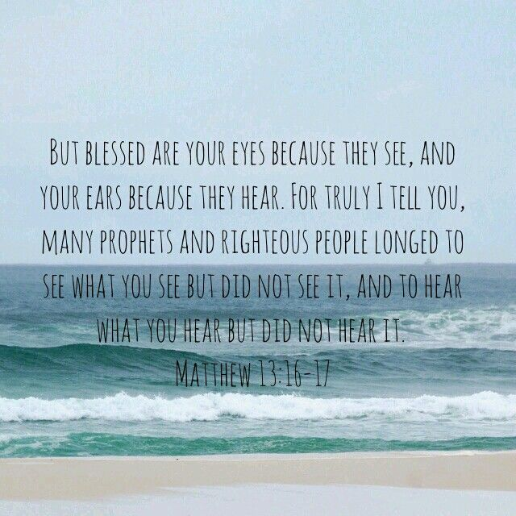
Notes:
Conclusion – Matthew 13:16-17
-We are blessed to be able to freely study the word of God and specifically the parables of Jesus.
-What we are to study are things that Abraham, Moses, David, Isaiah, Jeremiah, Daniel and many others looked and desired to hear but didn’t fully understand what we do through Jesus Christ and full revealed will of God.
-The mysteries of the kingdom, the secrets from the foundations of the world are now being revealed through Jesus Christ.
Romans 16:25-26 ²⁵ Now to Him who is able to establish you according to my gospel and the preaching of Jesus Christ, according to the revelation of the mystery which has been kept secret for long ages past, ²⁶ but now is manifested, and by the Scriptures of the prophets, according to the commandment of the eternal God, has been made known to all the nations, leading to obedience of faith;

Slide 4
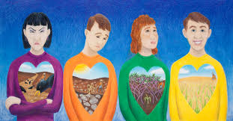
Notes:
1- Responsibility of the hearer – How is your heart? We want to be like the man in yellow, a good and honest heart able to bear fruit, 30, 60, 90 fold!
2-Tares and Dragnet – The existence of good and bad together and the ultimate separation of the two in judgement. SEE Matthew 13:43 – The righteous will shine forth as the SUN
3-True Value – The Treasure hidden in the field – the Pearl of Great Price. We pointed out the key being the JOY! The JOY – Matthew 13:44 ‘and from JOY over it he goes and sells all that he has…’ IT IS A CHOICE! In the parable the man in the field and the merchant were willing to sell ALL, in order to have the BEST. And they did it with JOY!
4-Kingdom parables about growth – the Mustard Seed and Leaven – This was taught by Jesus to show that the Kingdom would grow, start small but grow. We talked in this class about the history of the University church of Christ. How in 1965 this church started with 8 in a small room to what we see today….!!! Do not despise the small start…Zechariah 4:10 ¹⁰ For who has despised the day of small things? Jesus says just a cup of cold water….Matthew 10:42
5- The Parable of the Good Samaritan –(Love and neighborliness) We learned to love our neighbor and help those in need! Matthew 23:23-24 Jesus says that Mercy is a weightier matter! It is important. Ex: story of motorcycle by 280. OPEN OUR EYES to opportunity. “GO AND DO LIKEWISE!”
6-The Unmerciful Servant – (Love and forgive) As the parable of the Good Samaritan teaches us to show mercy to all we see in need. We learned that the mercy shown to us by God MUST cause us to be merciful to others. What are you holding onto and unwilling to forgive? Forgiveness takes faith! We can not afford to not forgive others or seek to be right with one another.
Matthew 6:12 “And forgive us our debts, as we also have forgiven our debtors!” This parable teaches us that God expects, no demands of us to be forgiving to others. It is the natural outcome of someone that has been forgiven.
Matthew 6:12, 14-15, ¹⁴ For if you forgive others for their transgressions, your heavenly Father will also forgive you. ¹⁵ But if you do not forgive others, then your Father will not forgive your transgressions.
7-The persistent widow and Friend at Midnight – We learned to be persistent in our prayers. God, like our earthly fathers, wants to give us good things. Even more so! ASK, SEEK, KNOCK – We talked about the progression of the effort. Many times we ask and that is maybe it….
8-The Rich Fool – Big Barn – BIGGER FOOL – We learned that one’s life DOES NOT consist of the abundance of possessions! This man had a great year, that was not a sin and it appears his wealth was from good and honest work. The sin and problem was not giving place to God and being thankful. Luke 12:34 “Where your treasure is there your heart will be also.” We must treasure the right things. We must ask when is enough?
9- The lost things – sheep, coin, son. Luke 15 is referred to as the Gospel within the gospel. We learned how heaven rejoices at one that was lost is found. The key to this was the repentance (lost son). The message to the sinners (and to us) is that God is searching, waiting, wanting our return and when we do He is ready to rejoice! We made the point that worst than being lost is being lost and NO ONE looking for you. The tax collectors and sinners needed to hear that message. It is one that truly resonated with them and should with you and me. God is looking for us to return and if we are dwelling in ‘His house’ to be joyful and welcoming when others return as well!!! 15:24 “²⁴ for this son of mine was dead and has come to life again; he was lost and has been found.’ And they began to celebrate.” - Resurrection, salvation, and JOY!!!
10- Responsibility – talents/minas. We must be productive as we wait on the Lord’s return. Do you remember the 5 talent and 2 talent man on who quick they went to work? Matt 25:16 “Immediately”!!! We have been blessed with abilities, opportunities, we need to be about the Lord’s work. We can’t be like the one talent man, frozen with fear (Lord says wicked and lazy) and do nothing!
11- The Wedding Feast – Judgement – For many are called but few are chosen! We must respond in readiness to God’s invitation and cloth ourselves properly for He is coming to judge.

Slide 5
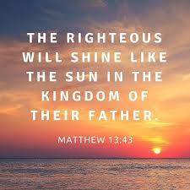

Slide 7
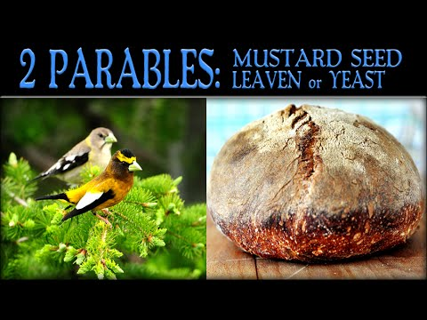

Slide 10
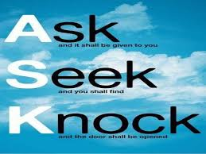

Slide 13
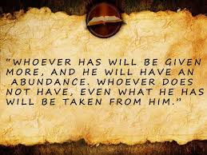

Slide 15
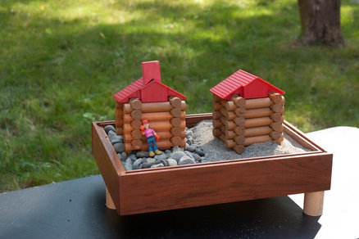
Notes:
Possible on of the first parables recorded by Jesus is found in Matthew 7:24-27 at the end of the sermon on the mount. It is retold by Luke in Luke 6:46-49 when he records for us the same sermon. The parable starts Therefore in Matthew. Jesus has just taught about bearing fruit and being known this way. 7:20 says “so then, you will know them by their fruit.” Then He says this difficult statement about the Day of Judgement. Matthew 7:21-23 What’s the problem? Jesus says He never knew them! WHY? The answer lies in this parable…
We will read both but focus mainly on Matthew’s account.
Matthew 7:24-27
7:24 – Therefore….Jesus says that those that HEAR His words and DOES them will be compared (like) a wise man who built his house on the rock. This is what set Jesus apart from other teachers. Ryan, Larry…any teacher can not make this claim! Only Jesus. 1 Cor 11:1 Paul says to imitate him….as he imitates Christ. Jesus and His words are the ONLY guide for man’s soul. We must hear and do His words or our lives will crumble.
Many here know about building homes. The most important part of the process is the foundation? WHY? Is it cheap or expensive to fix a foundation after the house is built? Ex: It's Better to Build Boys Than Mend Men: Truett Cathy
7:25 – Rain, flood, winds slammed the house YET it DID NOT FALL! For it was founded on the rock.
7:26 – Everyone who HEARS my words but DOES NOT do them is like a foolish man who built his house on the sand.
7:27 - – Rain, flood, winds slammed the house….and it fell and GREAT was its fall.
In Matthew it is noted after this great sermon that Jesus was unlike the scribes as one who taught with authority!
*READ Luke 6:46-49

Slide 16
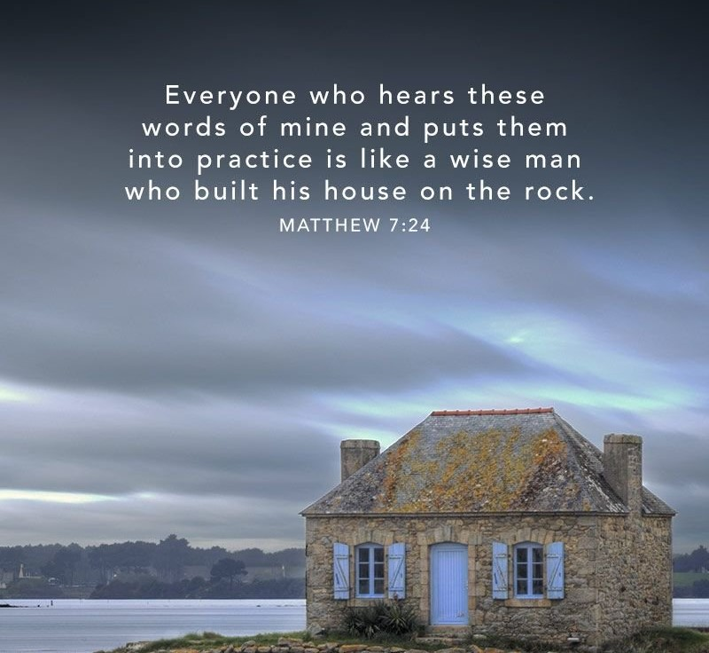
Lessons!
Foundation?
HEAR!
DO = OBEY
Storms WILL come!
Stand the test of Time!
Notes:
Jesus is not teaching us about building our physical homes…but our spiritual homes! It starts with building the RIGHT foundation.
-Hearing the words of Jesus - Romans 10:17 - Faith comes by hearing and hearing by the word of God.
-DOING the words – Go back to Matt 7:22 and the question asked. What is the obvious answer to this question? NO!! It is NOT what someone professes that counts, yet rather what he does.
Other places that Jesus says this:
^{Luke 6:46} “Why do you call Me, ‘Lord, Lord,’ and do not do what I say?
Luke 8:21 ²¹ But He answered and said to them, “My mother and My brothers are these who hear the word of God and do it.”
John 13:17 - ¹⁷ If you know these things, you are blessed if you do them.
John 15:14 ¹⁴ You are My friends if you do what I command you.
*We see a great emphasis by Jesus on doing. But what is the balance? The doing MUST come from Hearing His words. Doing HIS will!
What keeps us from DOING?
-We need to do immediately – Remember the parable of the talents, Parable of the Sower. These actions COULD NOT wait!
-We do not do bc we don’t want to be inconvenienced. We are too busy!
-We do not look ahead! The man that built his house on the sand didn’t look ahead to the rainy season that would cause a flood to come right through that ‘good looking’ spot to built. We have no vision for the future. Why does someone train? What are you preparing for? We must read our Bibles, pray, help others to get us through…We must prepare for those days we studied about Sunday night. When things suddenly change….That is NOT the time to start preparing your foundation.
James 2: 14-26 –
2 – Storms WILL come - It is not “IF” it is “WHEN”. The storms come to BOTH the wise and the foolish.
1 Peter 4:12 “Beloved do not be surprised a the fiery order among you…which comes upon you for your testing, as though some strange things were happening to you.
James 1:2-3 ² Consider it all joy, my brethren, when you encounter various ^{[a]}trials, ³ knowing that the testing of your faith produces ^{[b]}endurance.
Romans 5:3-5 - ³ And not only this, but we also exult in our tribulations, knowing that tribulation brings about perseverance; ⁴ and perseverance, proven character; and proven character, hope; ⁵ and hope does not disappoint, because the love of God has been poured out within our hearts through the Holy Spirit who was given to us.
Romans 8:18 - ¹⁸ For I consider that the sufferings of this present time are not worthy to be compared with the glory that is to be revealed to us.
Job 23:10 - "But He knows the way I take; When He has tried me, I shall come forth as gold.
3-Faith is NOT a one time decision! A faithful life is lives ONE DAY AT DAY, making the decision every morning to live that day for God and not yourself. How do you build endurance? You work out: spiritually: PRAY, Read your bible, worship, attend services, DO for others.
Heb. 10:36-39
³⁶ For you have need of endurance, so that when you have done the will of God, you may receive ^{[a]}what was promised.
³⁷ For yet in a very little while, He who is coming will come, and will not delay. ³⁸ But My righteous one shall live by faith; And if he shrinks back, My soul has no pleasure in him.
³⁹ But ^{[b]}we are not of those who shrink back to destruction, but of those who have faith to the ^{[c]}preserving of the soul.

Slide 17
Notes:
Build your house on the rock!!! HOW?
Psalm 37:3 - Trust in the Lord and do good;

