Slide 2
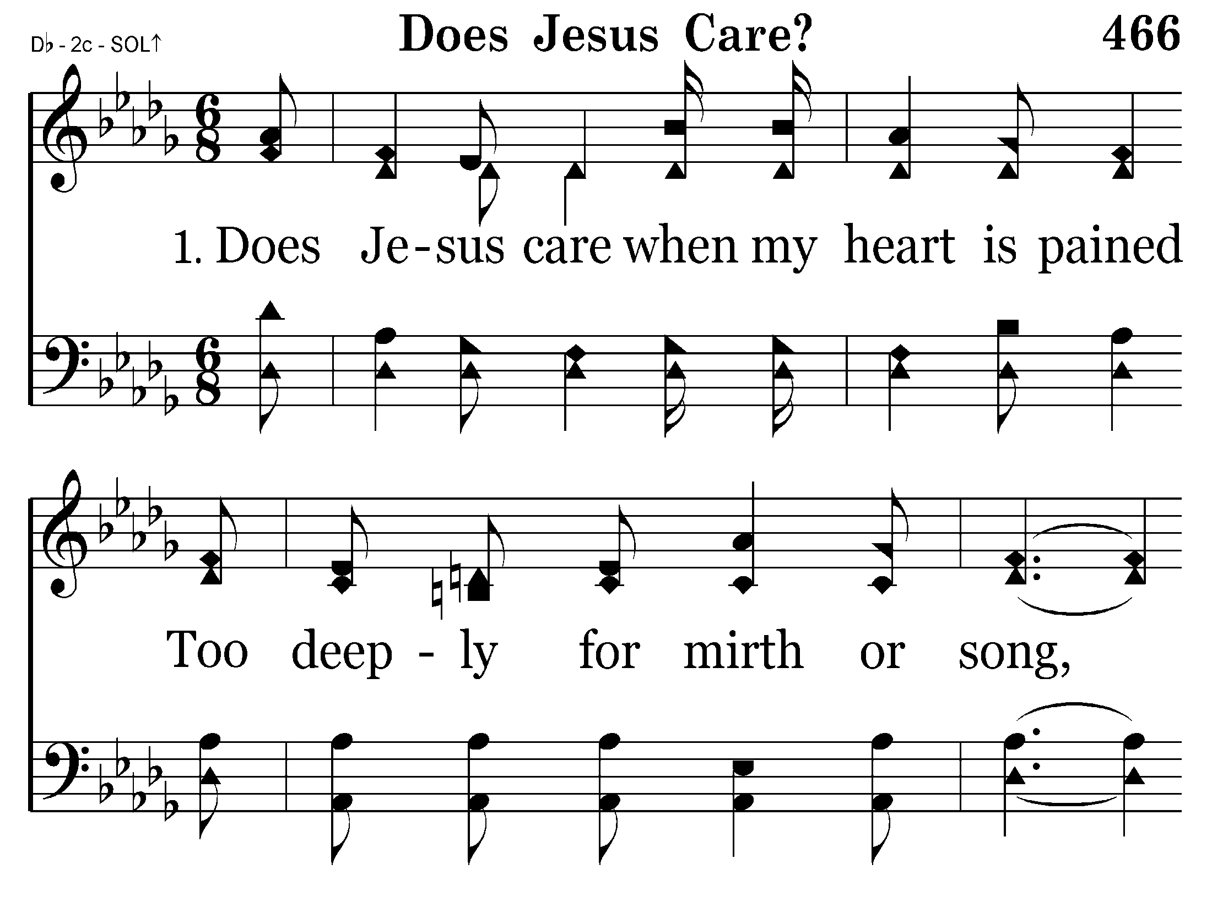
466 - Does Jesus Care - 1.1

Slide 3
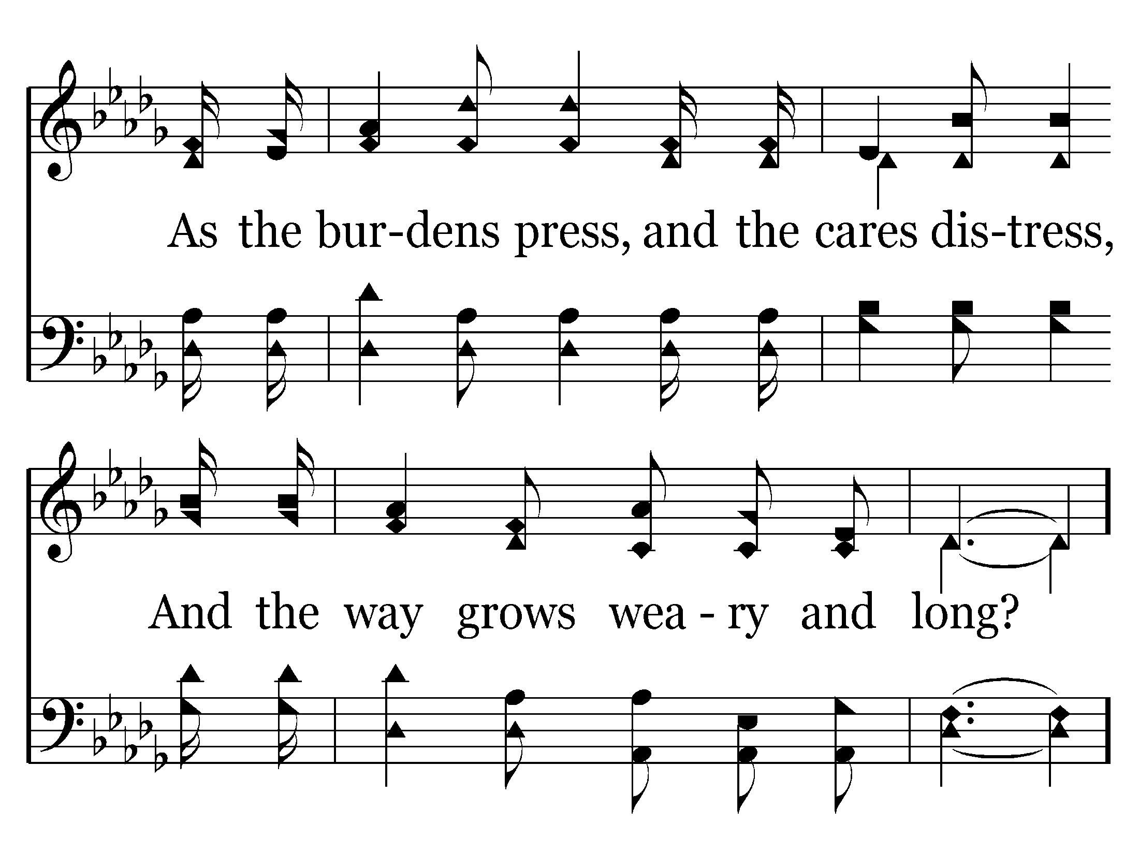
466 - Does Jesus Care - 1.2

Slide 4
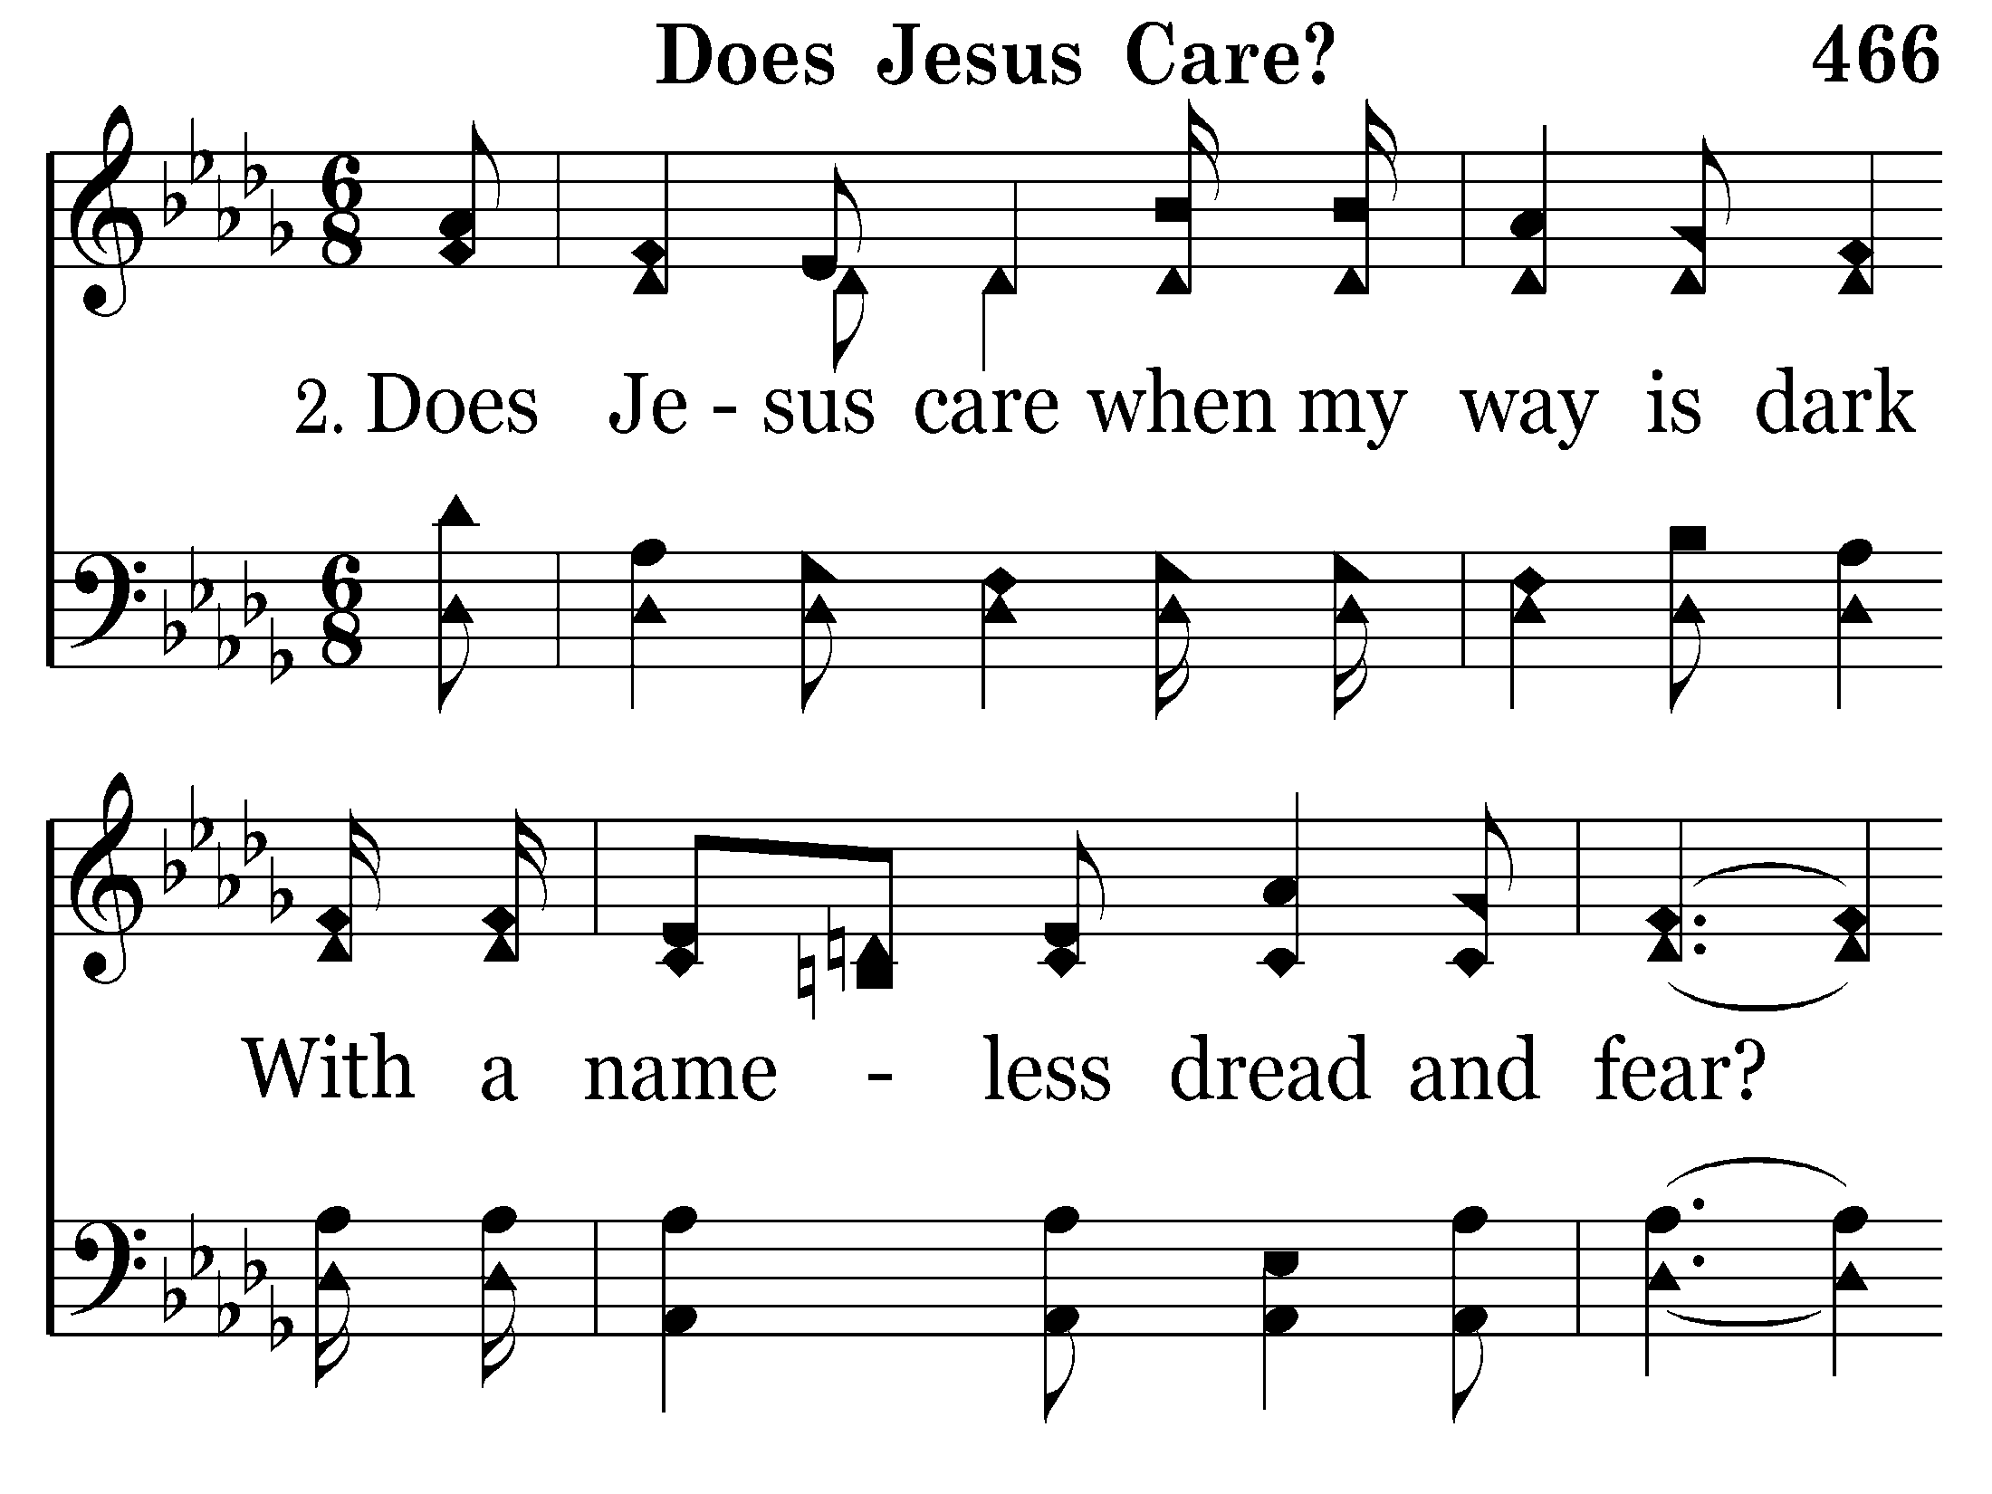
466 - Does Jesus Care - 2.1

Slide 5
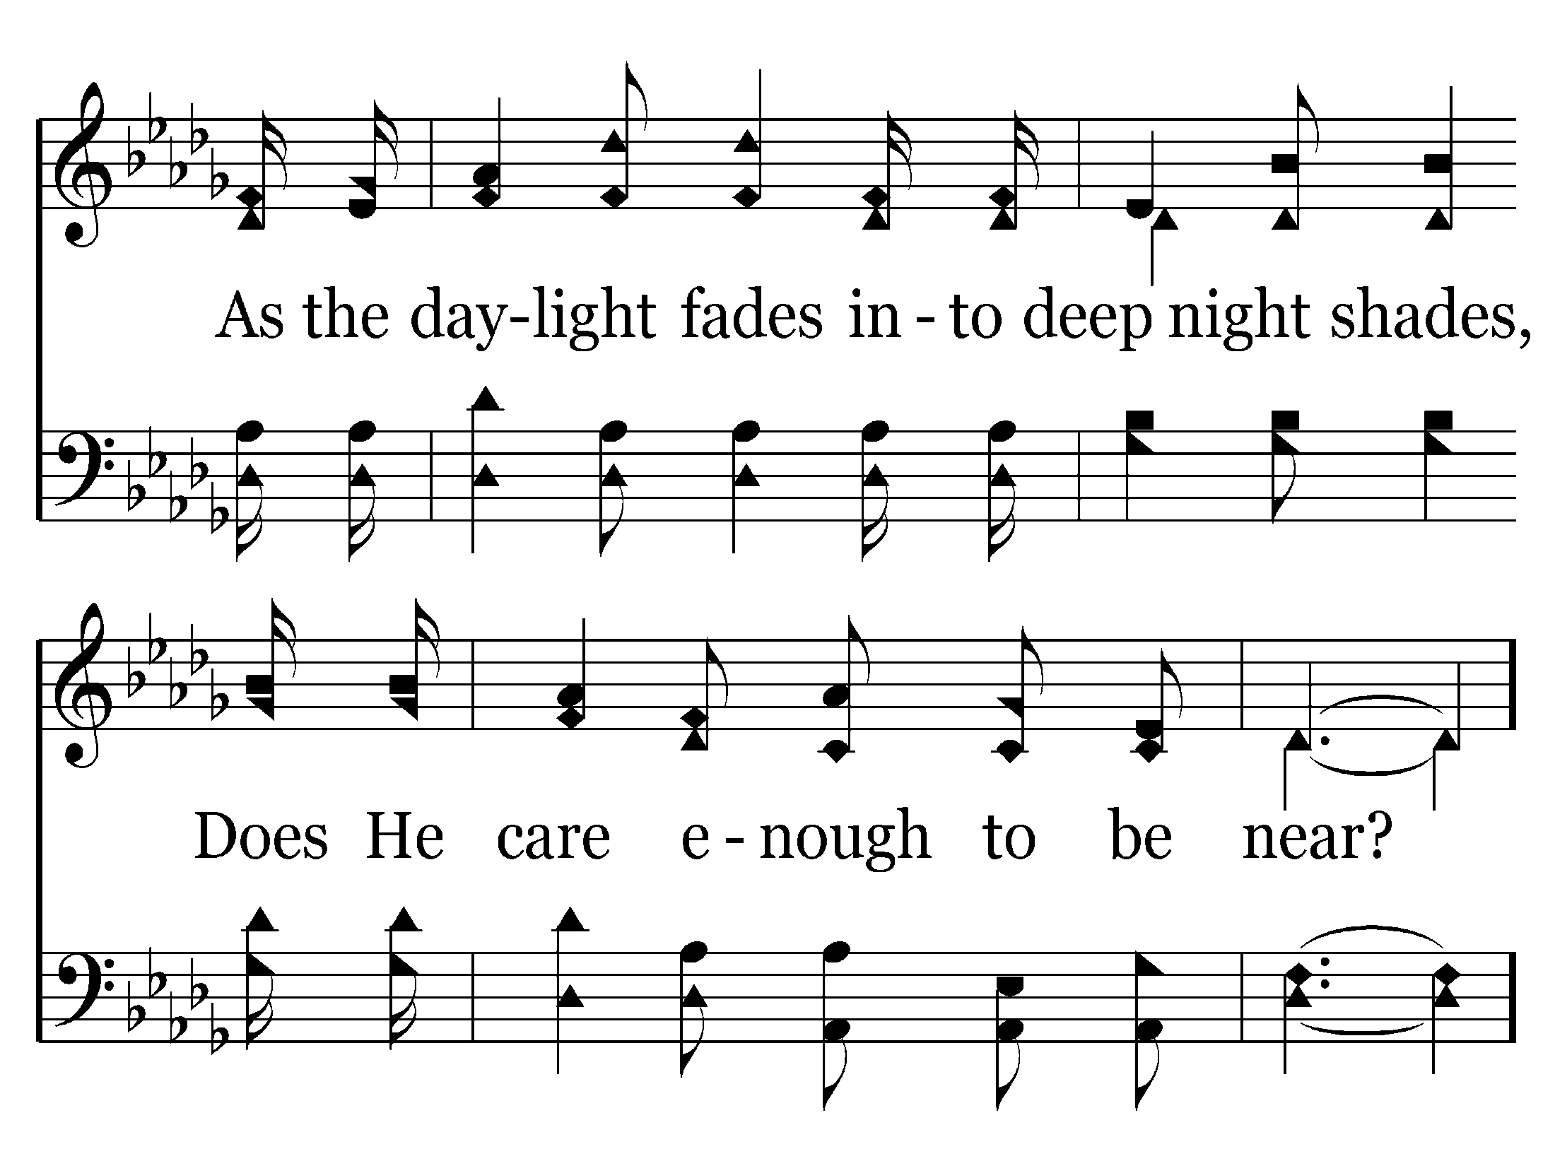
466 - Does Jesus Care - 2.2

Slide 6
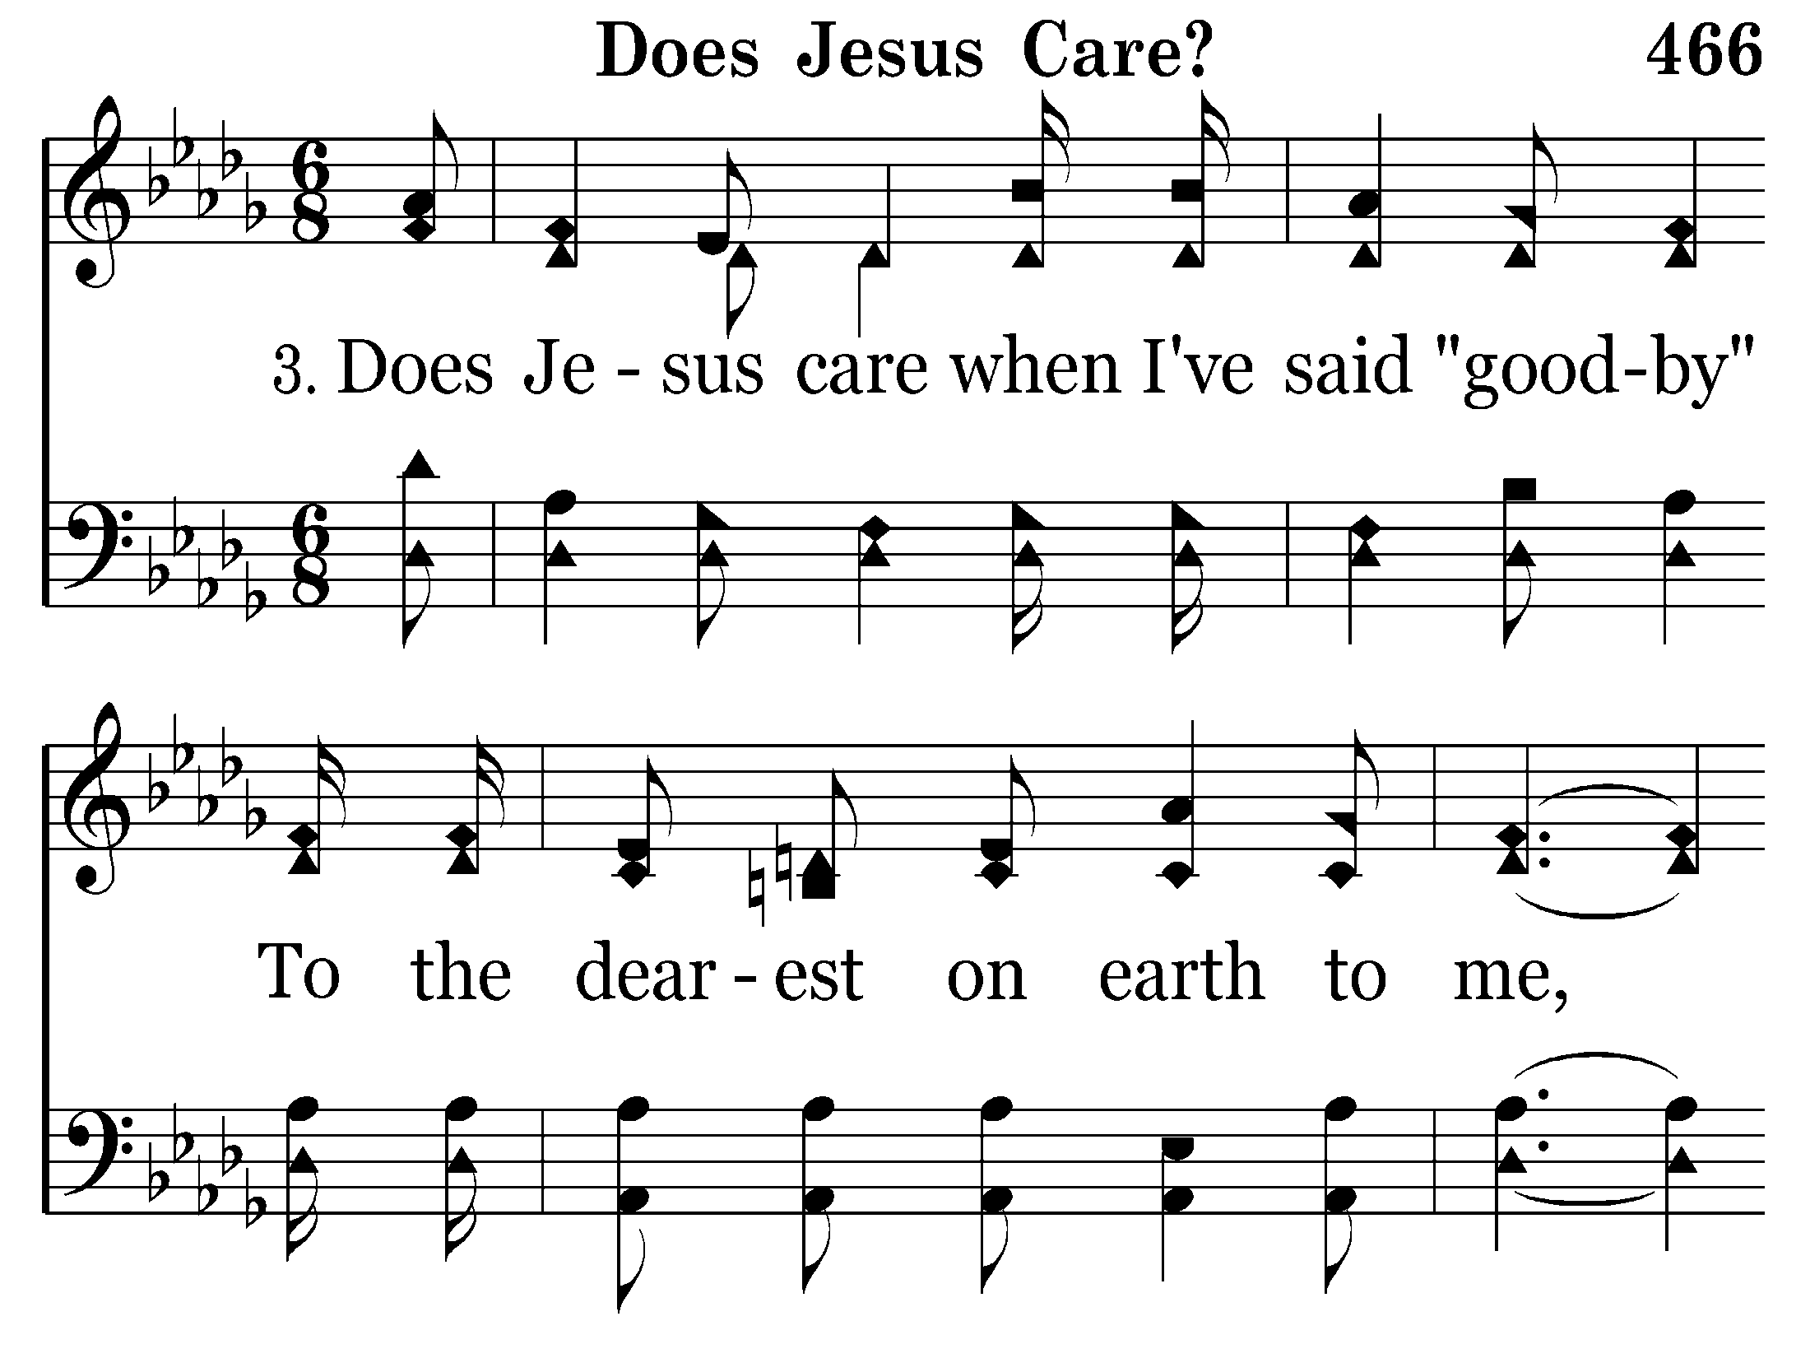
466 - Does Jesus Care - 3.1

Slide 7
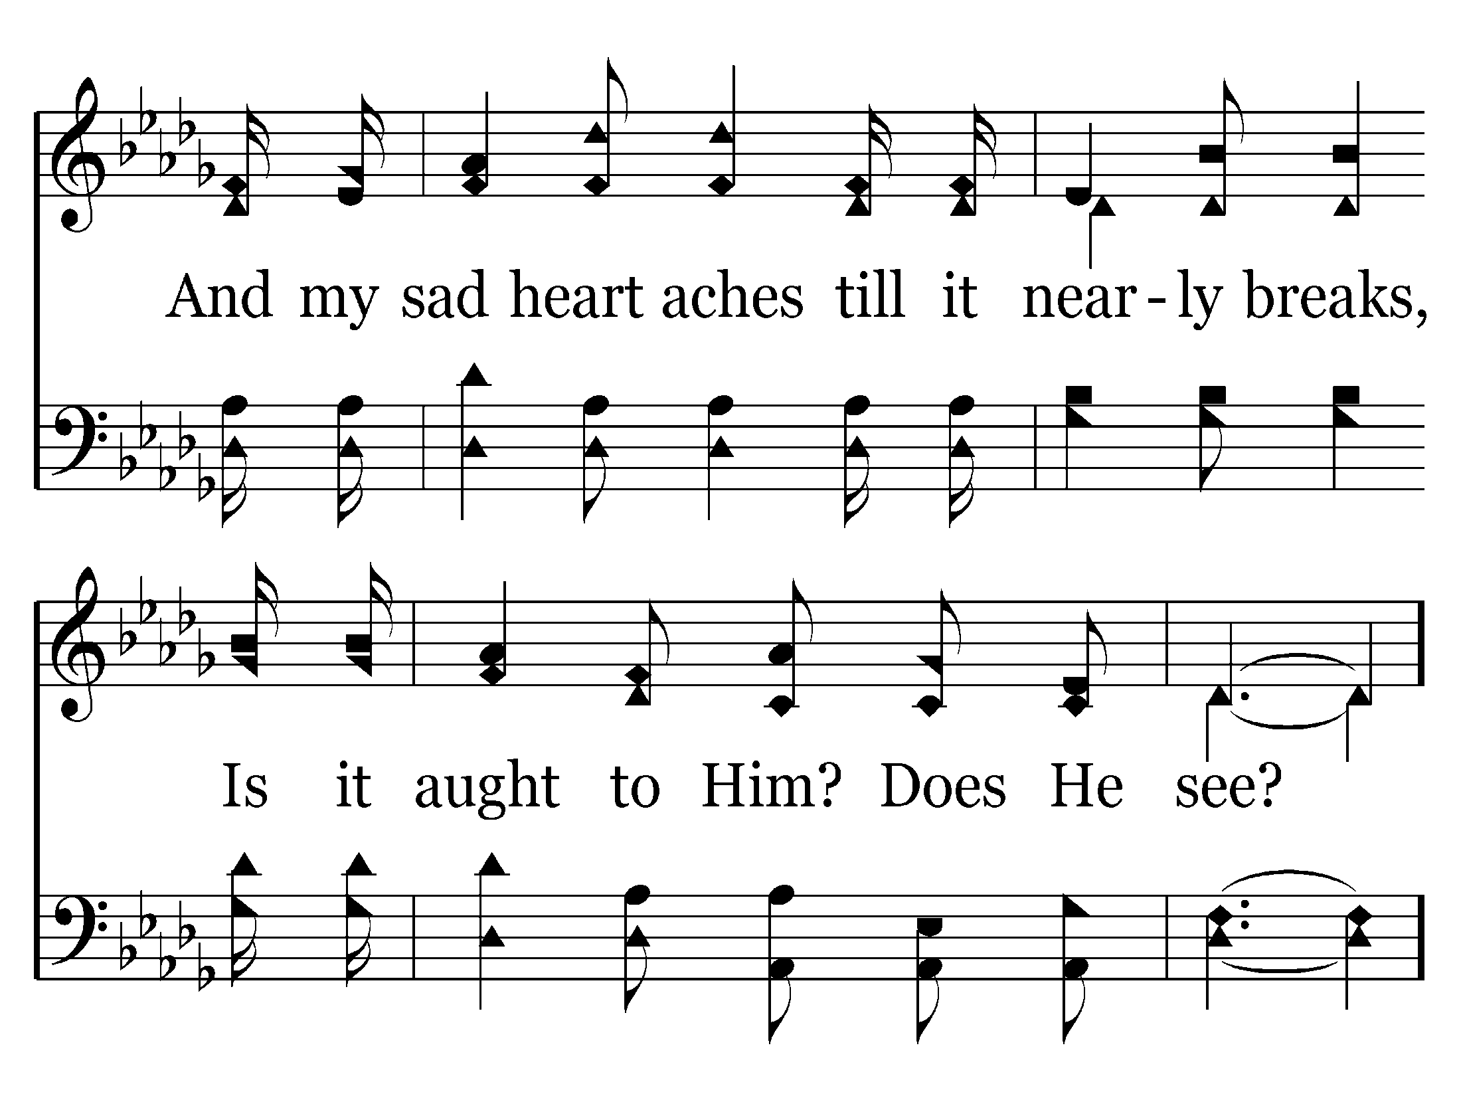
466 - Does Jesus Care - 3.2

Slide 8
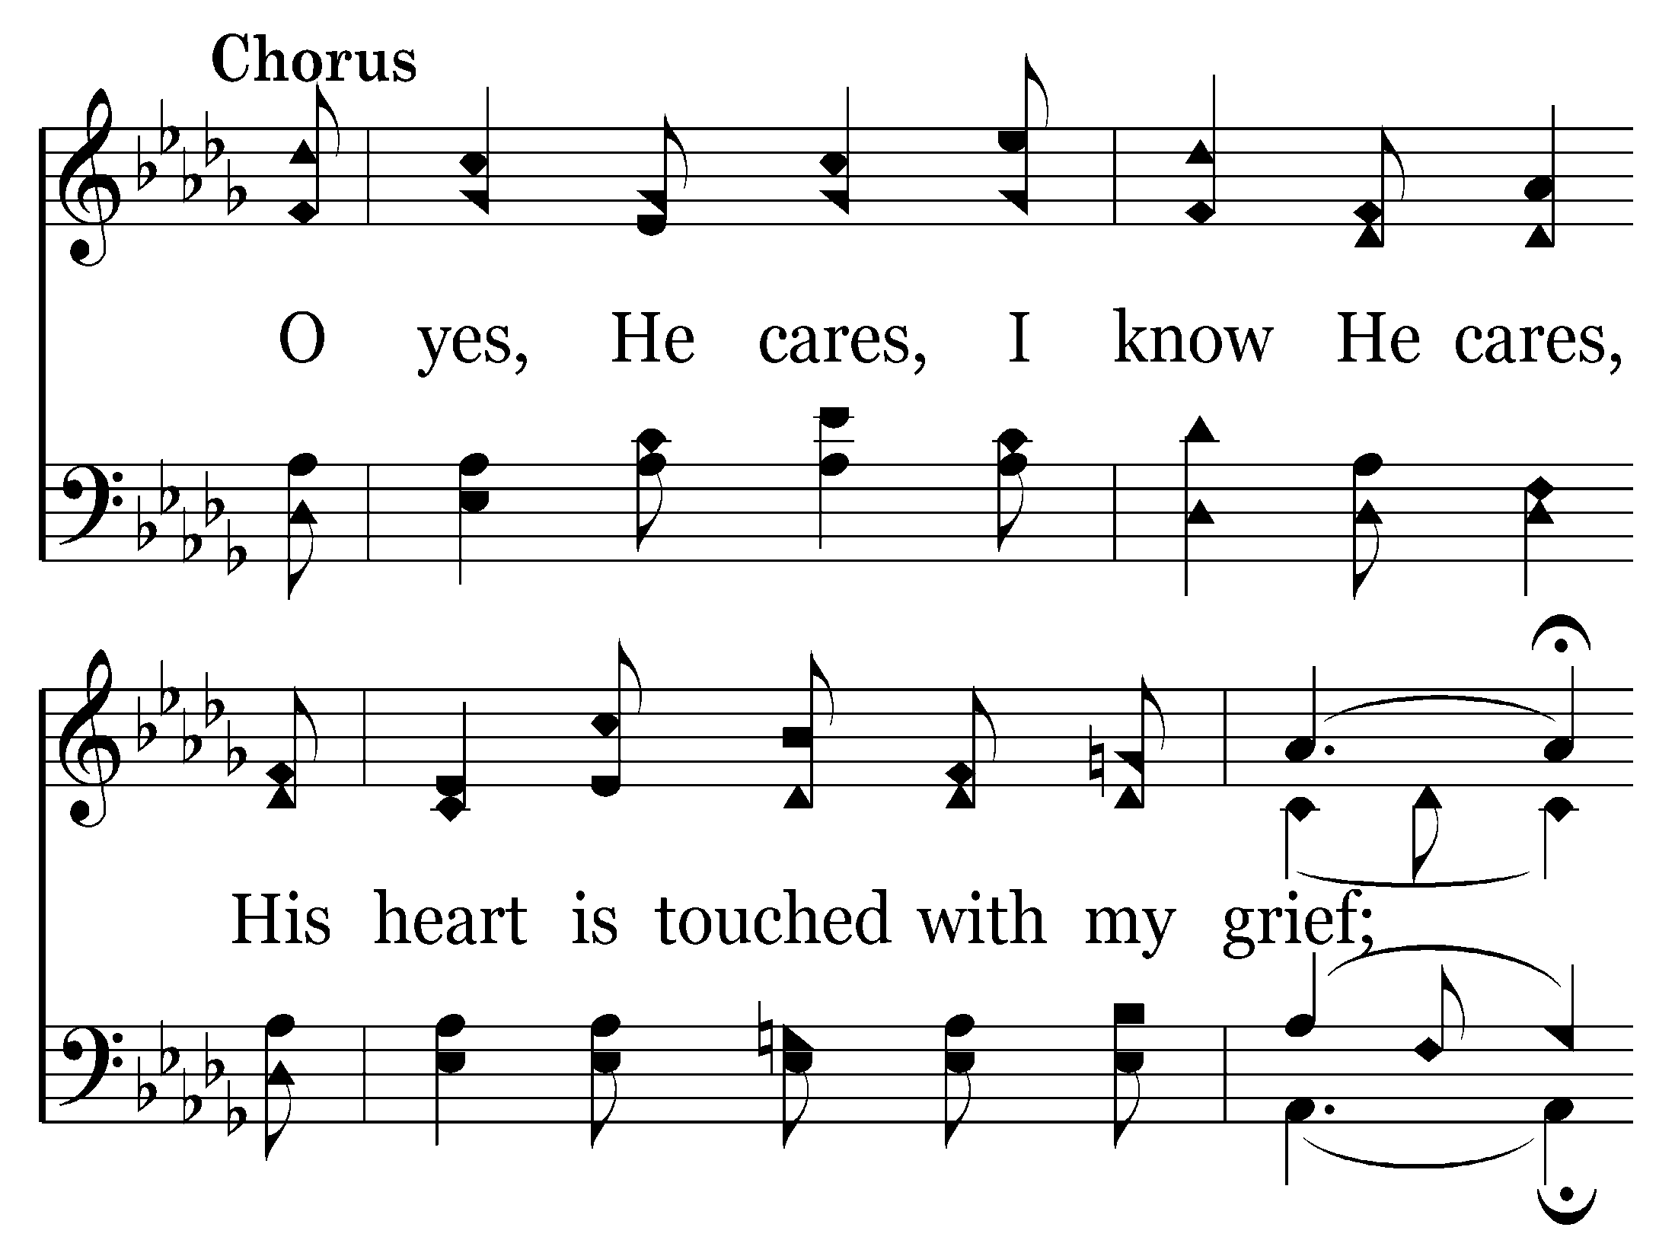
466 - Does Jesus Care - C.1

Slide 9
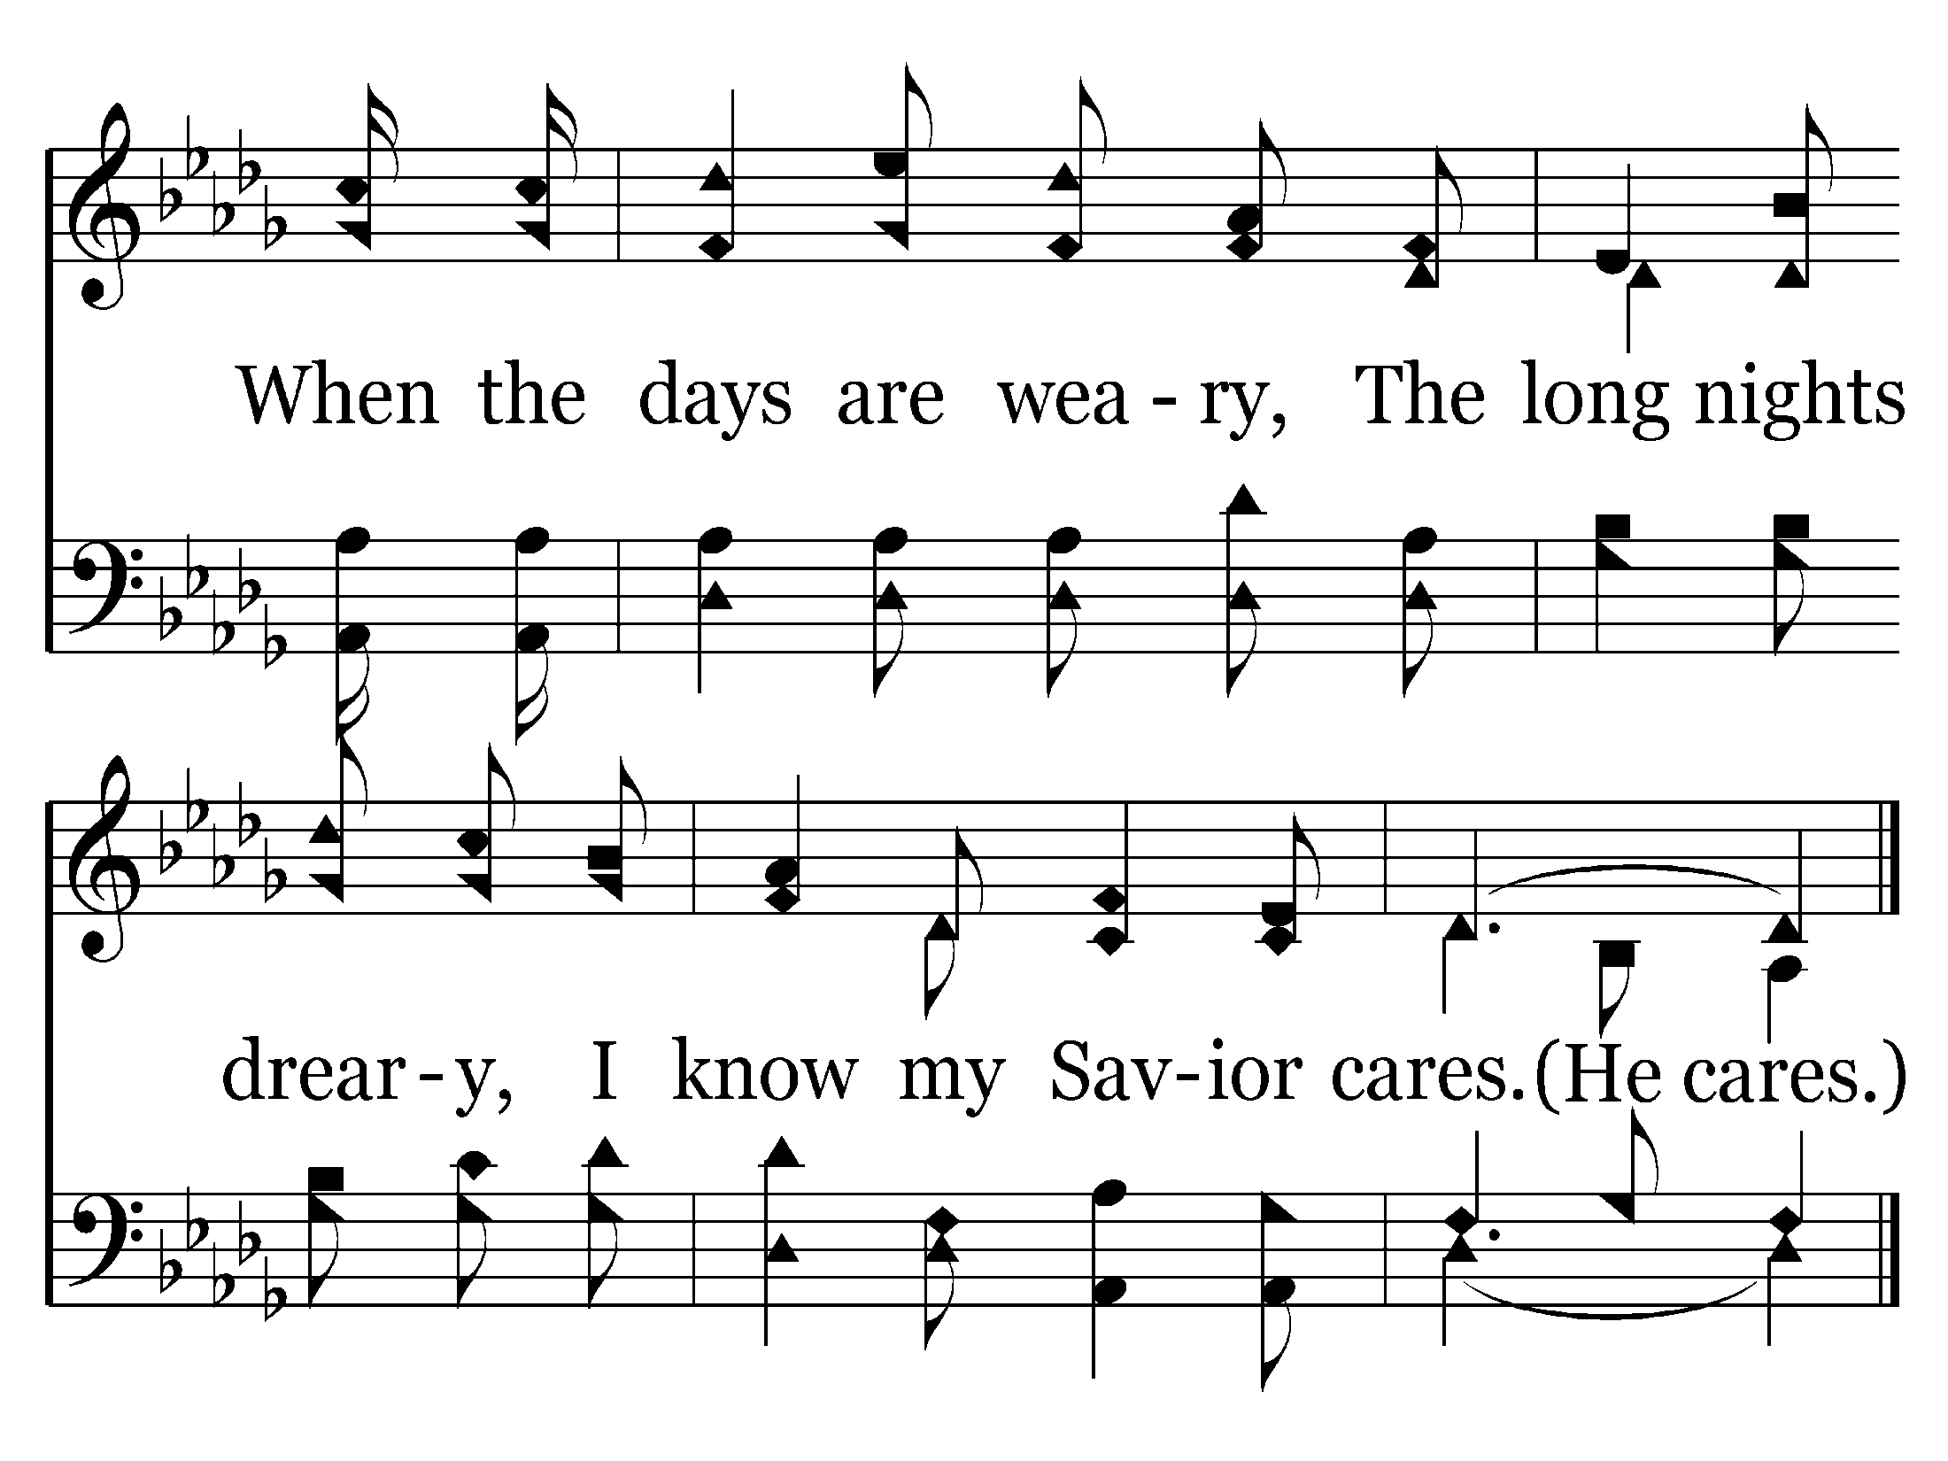
466 - Does Jesus Care - C.2
End of Song

Slide 11
V1a – You Are God Alone
© 2014 The Acappella Company

Slide 12
V1b – You Are God Alone
© 2014 The Acappella Company
Notes:
“de-pend-ent” (Question – the pdf of the sheet music has it as de-pen-dent; do I have an out-of-date pdf of the sheet music? I made the change to de-pend-ent, though.)
“an-y” (Same here as above. The pdf of the sheet music has it as a-ny. I made the change to an-y, though.)

Slide 13
V1c – You Are God Alone
© 2014 The Acappella Company
Notes:
“an-y-thing.” (Same thing in the PDF of the music. It says “a-ny-thing.” I made the change to an-y-thing.)
Is there any way to create more space for the tenor sixteenth note G# below “of”? We need to scoot it to the right a bit.
The soprano sixteenth note D# above “we” also needs to be scooted a bit to the right.

Slide 14
V1d – You Are God Alone
© 2014 The Acappella Company

Slide 15
C1a – You Are God Alone
© 2014 The Acappella Company

Slide 16
C1b – You Are God Alone
© 2014 The Acappella Company

Slide 17
C1c – You Are God Alone
© 2014 The Acappella Company

Slide 18
C1d – You Are God Alone
© 2014 The Acappella Company
Notes:
The alto note above “are” on the bottom system is out of line with the soprano note. Also on slide C2d, C3d, Coda2 & Coda3 (Just a note – on the PDF sheet music, it has that note out of line with the soprano. Don’t know if it needs to be changed there as well.)

Slide 19
V2a – You Are God Alone
© 2014 The Acappella Company

Slide 20
V2b – You Are God Alone
© 2014 The Acappella Company

Slide 21
V2c – You Are God Alone
© 2014 The Acappella Company
Notes:
top system: very last note in the system—can the “column” be moved to the right to create more space for the tenor G#? Or scoot the syllable to the right underneath/over the notes, then drag the column with the C# in soprano back to the left so it creates some space for the last sixteenth. It’s just a bit crowded there.
bottom system: treble clef, alto stems need to be a bit longer above “we can give.” bass clef: flip the stems below “everything”

Slide 22
V2d – You Are God Alone
© 2014 The Acappella Company
Notes:
alto stems above “way it is” need to be longer. Move all lyrics downward if necessary to accomplish this. I don’t remember if I recommended this be put on one system. If it would be easy to change it back to two systems we might need to do that. If it’s a great hassle, we at least need to find a way to give a little more space to that poor soprano B sixteenth note above “is.”

Slide 23
C2a – You Are God Alone
© 2014 The Acappella Company

Slide 24
C2b – You Are God Alone
© 2014 The Acappella Company

Slide 25
C2c – You Are God Alone
© 2014 The Acappella Company

Slide 26
C2d – You Are God Alone
© 2014 The Acappella Company

Slide 27
B1a – You Are God Alone
© 2014 The Acappella Company
Notes:
bottom system: move all lyrics down, extend the length of the alto stem on the downbeat (C#), decrease the length of the alto stem on the quarter note F#, decrease the length of the bass stem on the quarter note A#--it should extend only as far as the previous beamed A# notes went.

Slide 28
B1b – You Are God Alone
© 2014 The Acappella Company

Slide 29
B1c – You Are God Alone
© 2014 The Acappella Company
Notes:
bottom system: bass A# quarter note—shorten the stem. Soprano beamed eighth note on C# above “ble” – shorten the stem a bit if possible.

Slide 30
B1d – You Are God Alone
© 2014 The Acappella Company

Slide 31
C3a – You Are God Alone
© 2014 The Acappella Company

Slide 32
C3b – You Are God Alone
© 2014 The Acappella Company

Slide 33
C3c – You Are God Alone
© 2014 The Acappella Company

Slide 34
C3d – You Are God Alone
© 2014 The Acappella Company

Slide 35
CODA1 – You Are God Alone
© 2014 The Acappella Company
Notes:
comma after Yes? Made the change, but the PDF of the sheet music does not have the comma after “yes.”

Slide 36
CODA2 – You Are God Alone
© 2014 The Acappella Company

Slide 37
CODA3 – You Are God Alone
© 2014 The Acappella Company

Slide 39
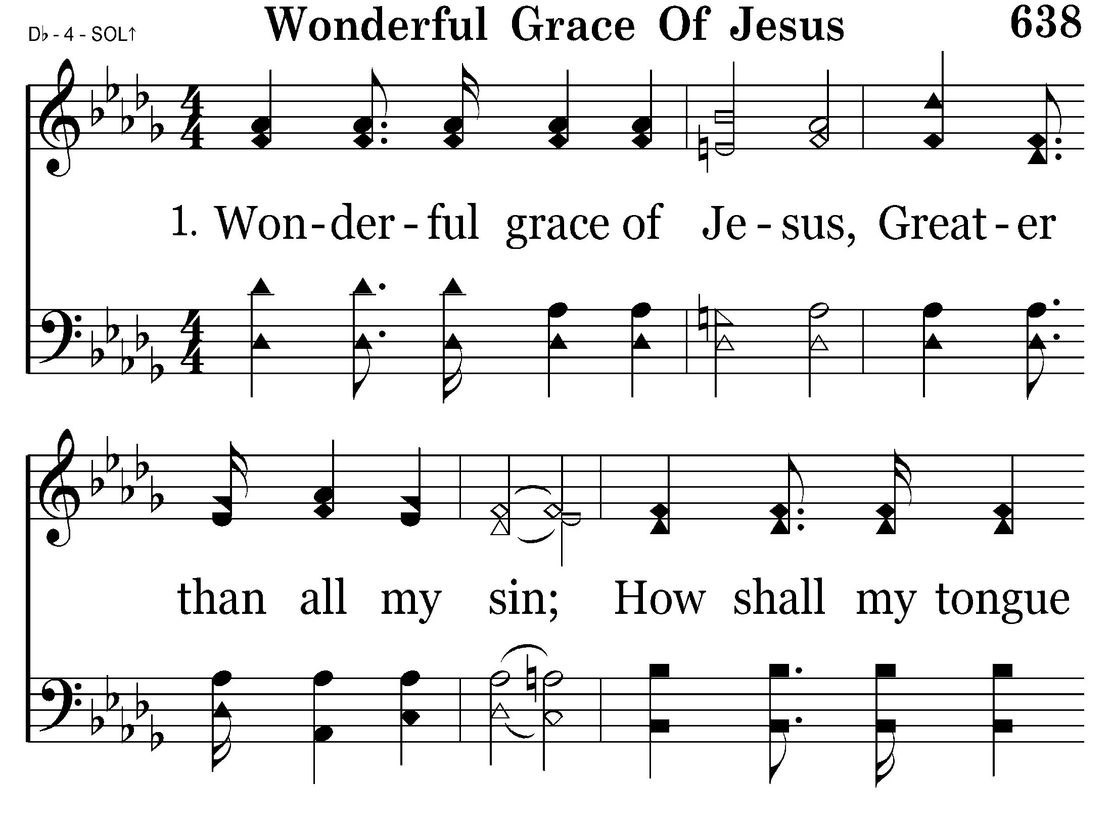
638 - Wonderful Grace - 1.1

Slide 40
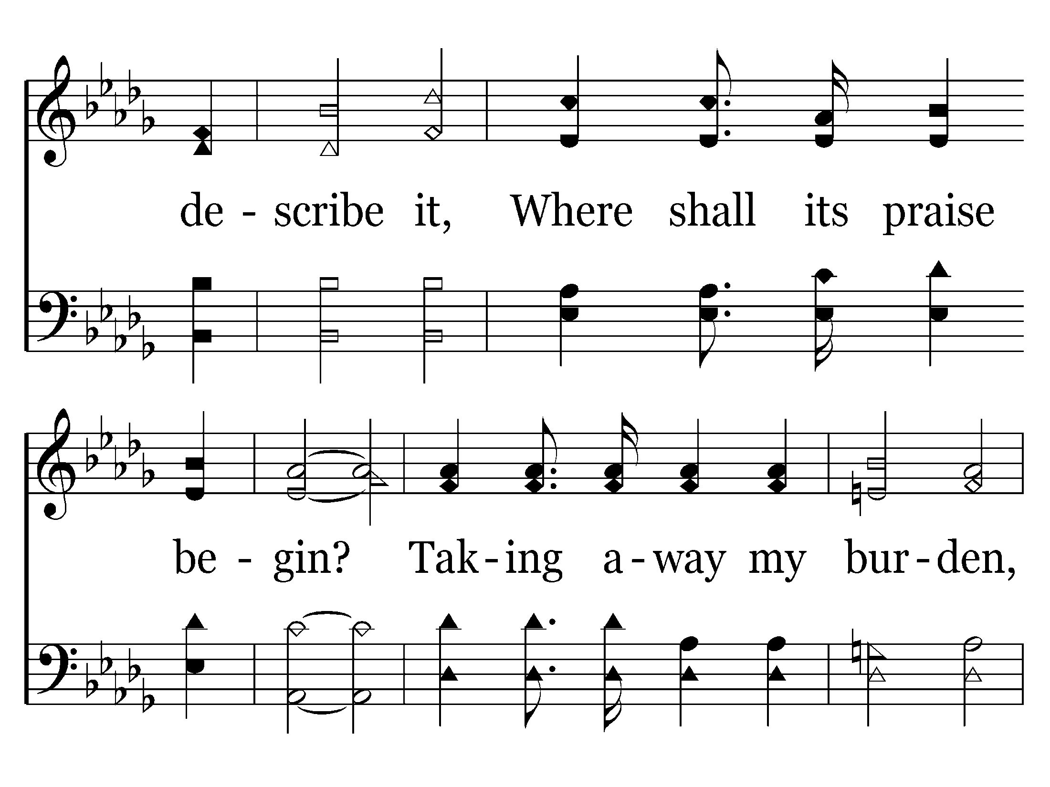
638 - Wonderful Grace - 1.2

Slide 41
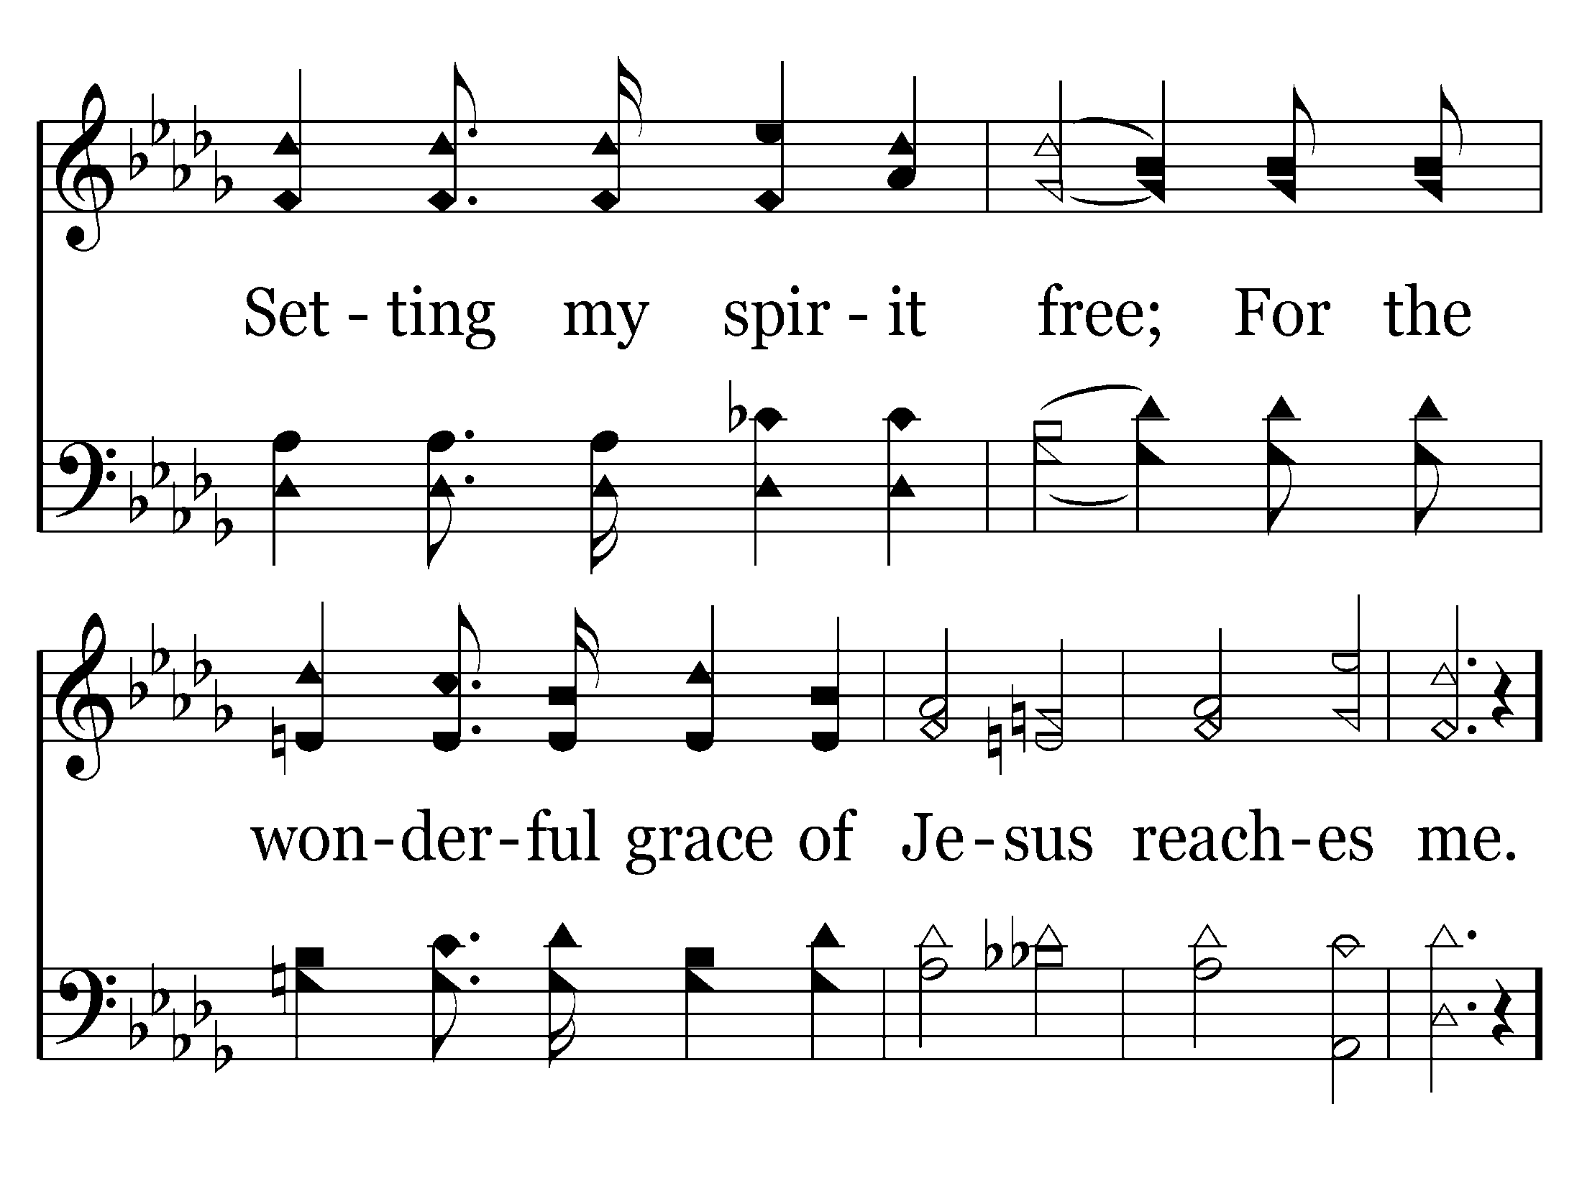
638 - Wonderful Grace - 1.3

Slide 42
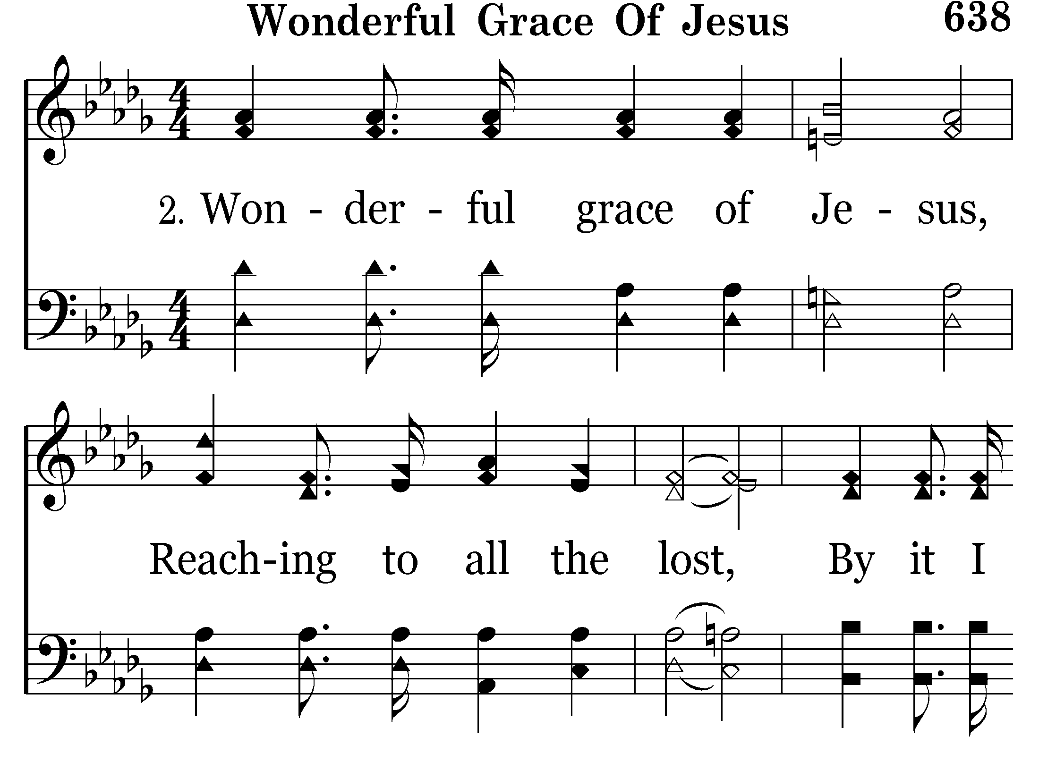
638 - Wonderful Grace - 2.1

Slide 43
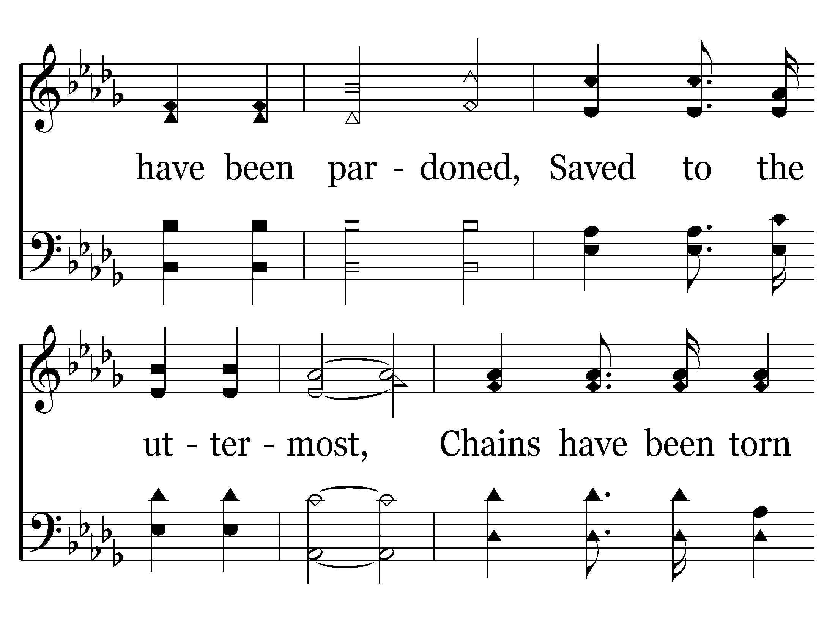
638 - Wonderful Grace - 2.2

Slide 44
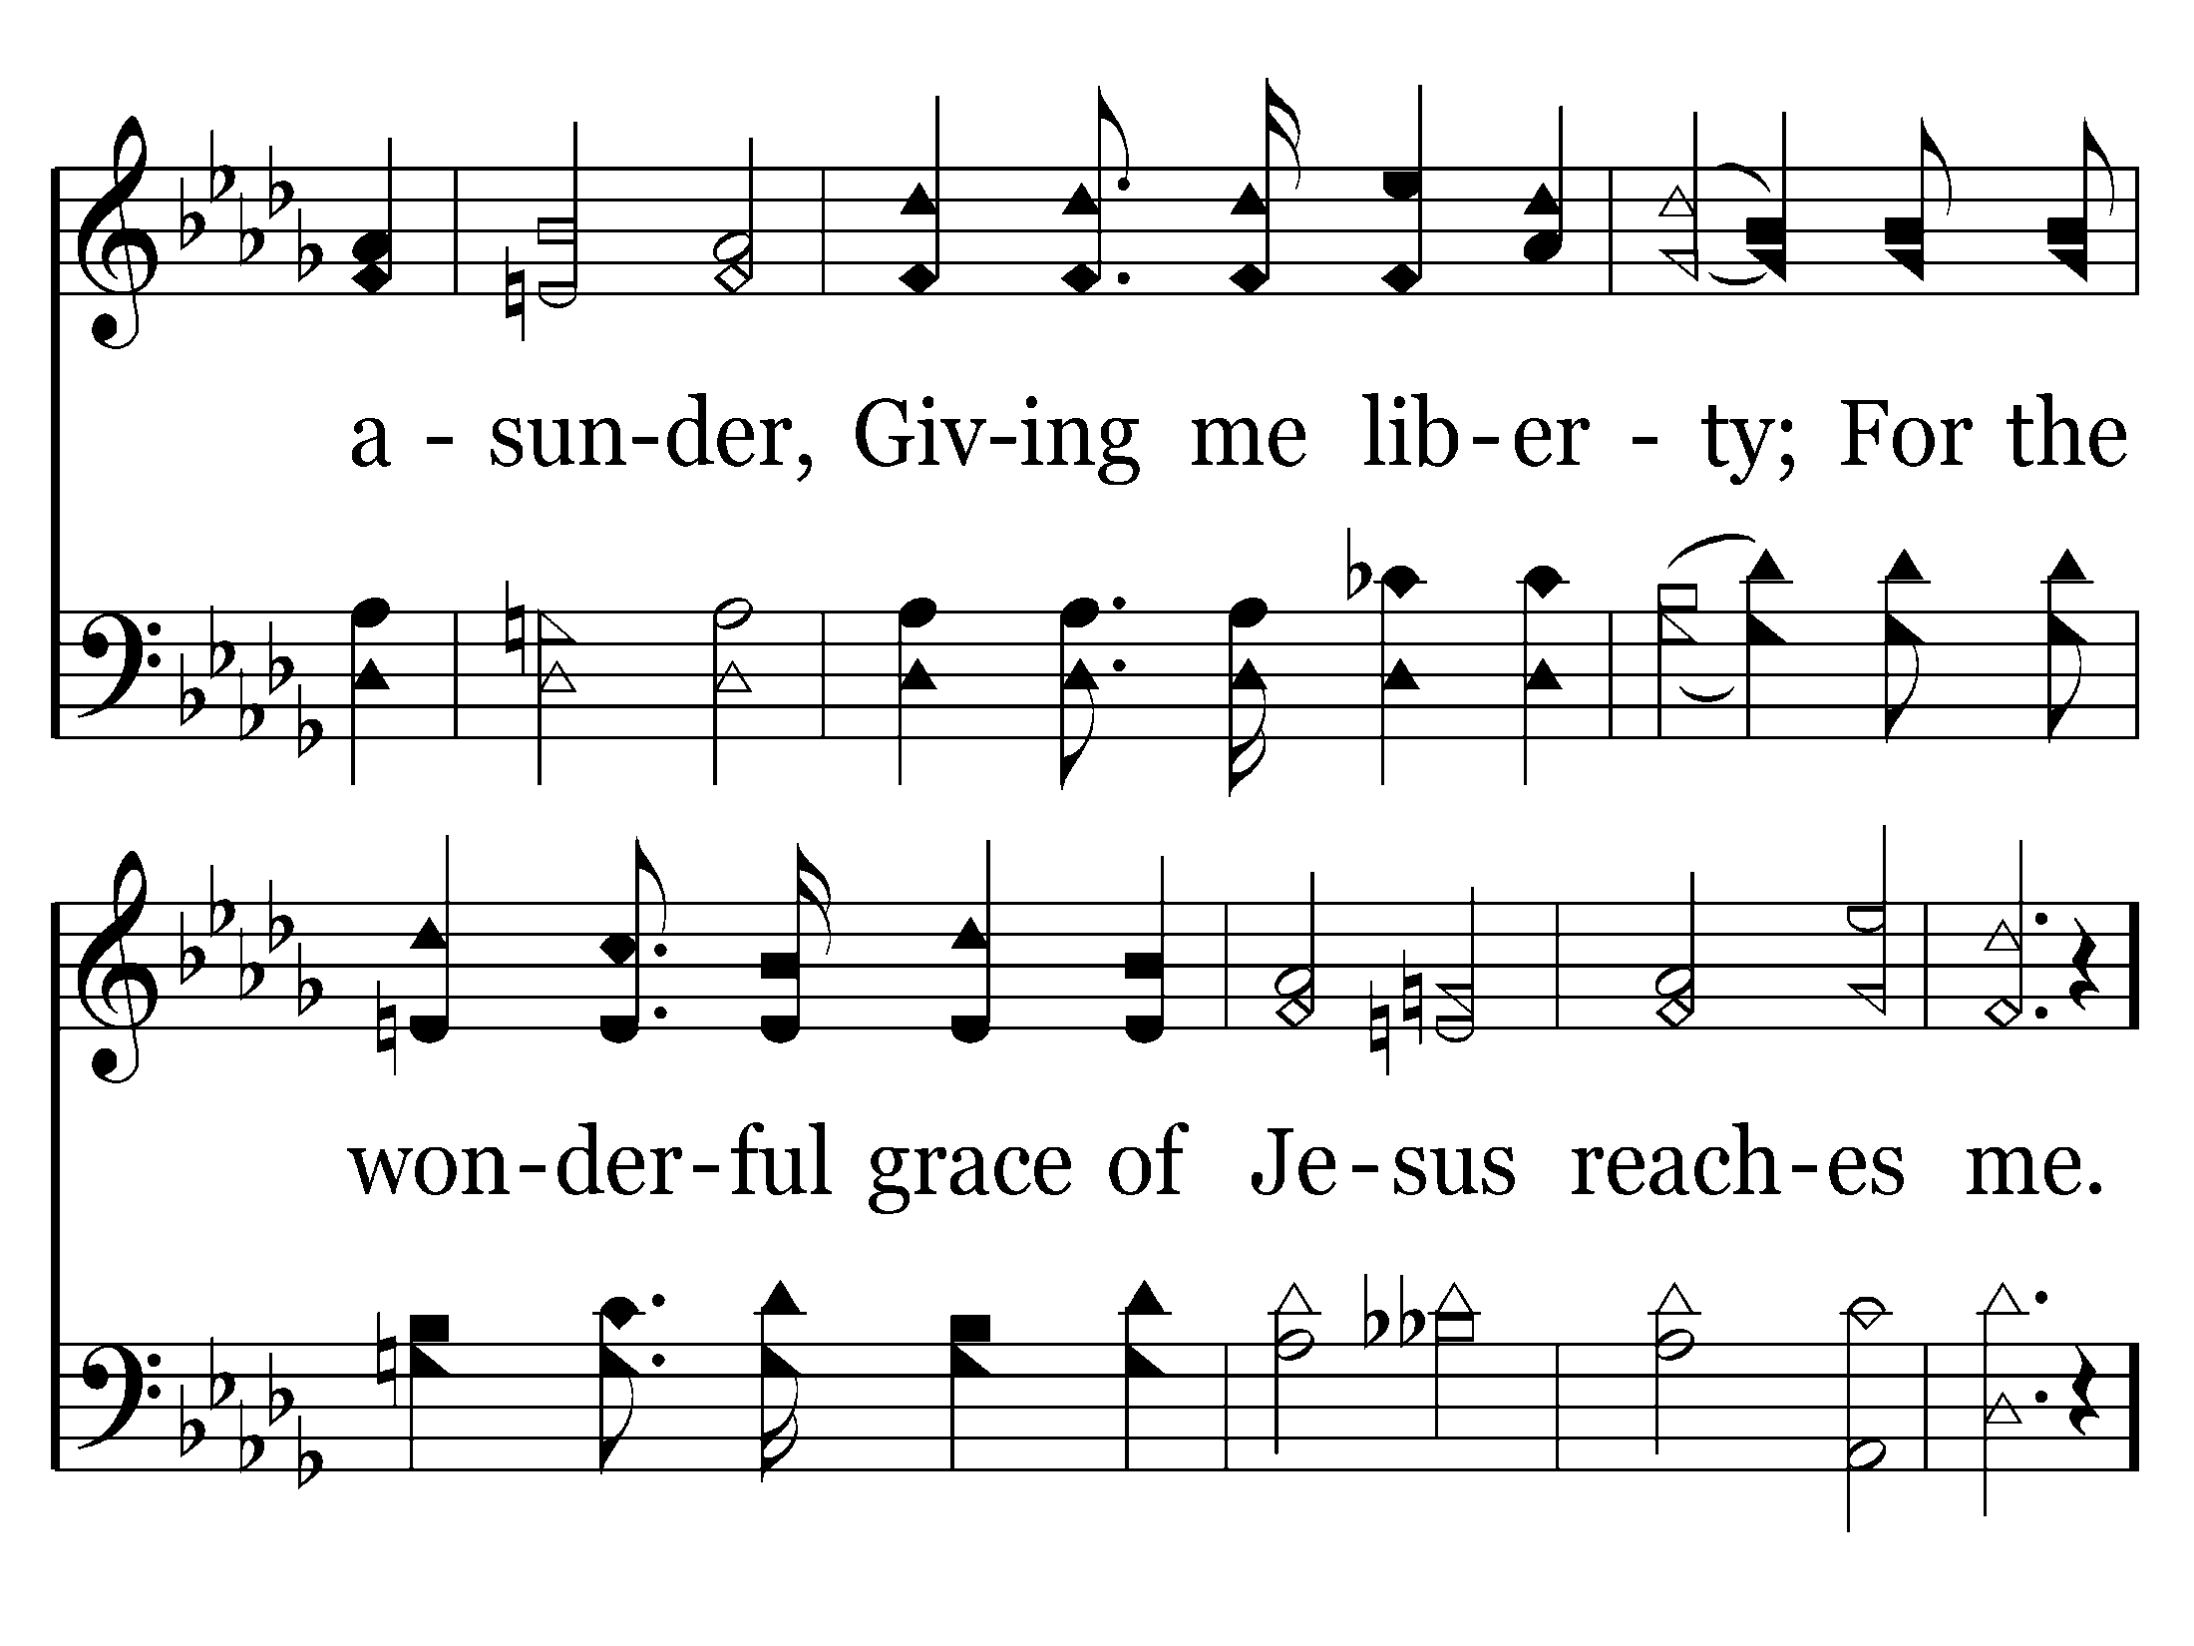
638 - Wonderful Grace - 2.3

Slide 45
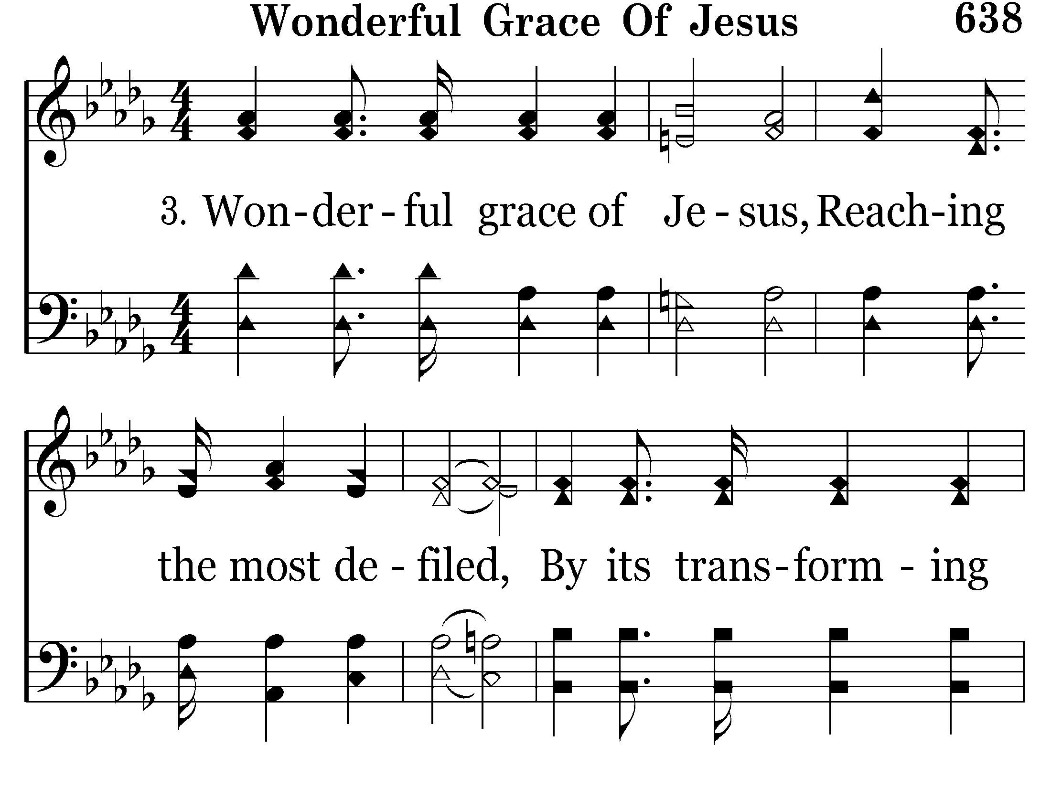
638 - Wonderful Grace - 3.1

Slide 46
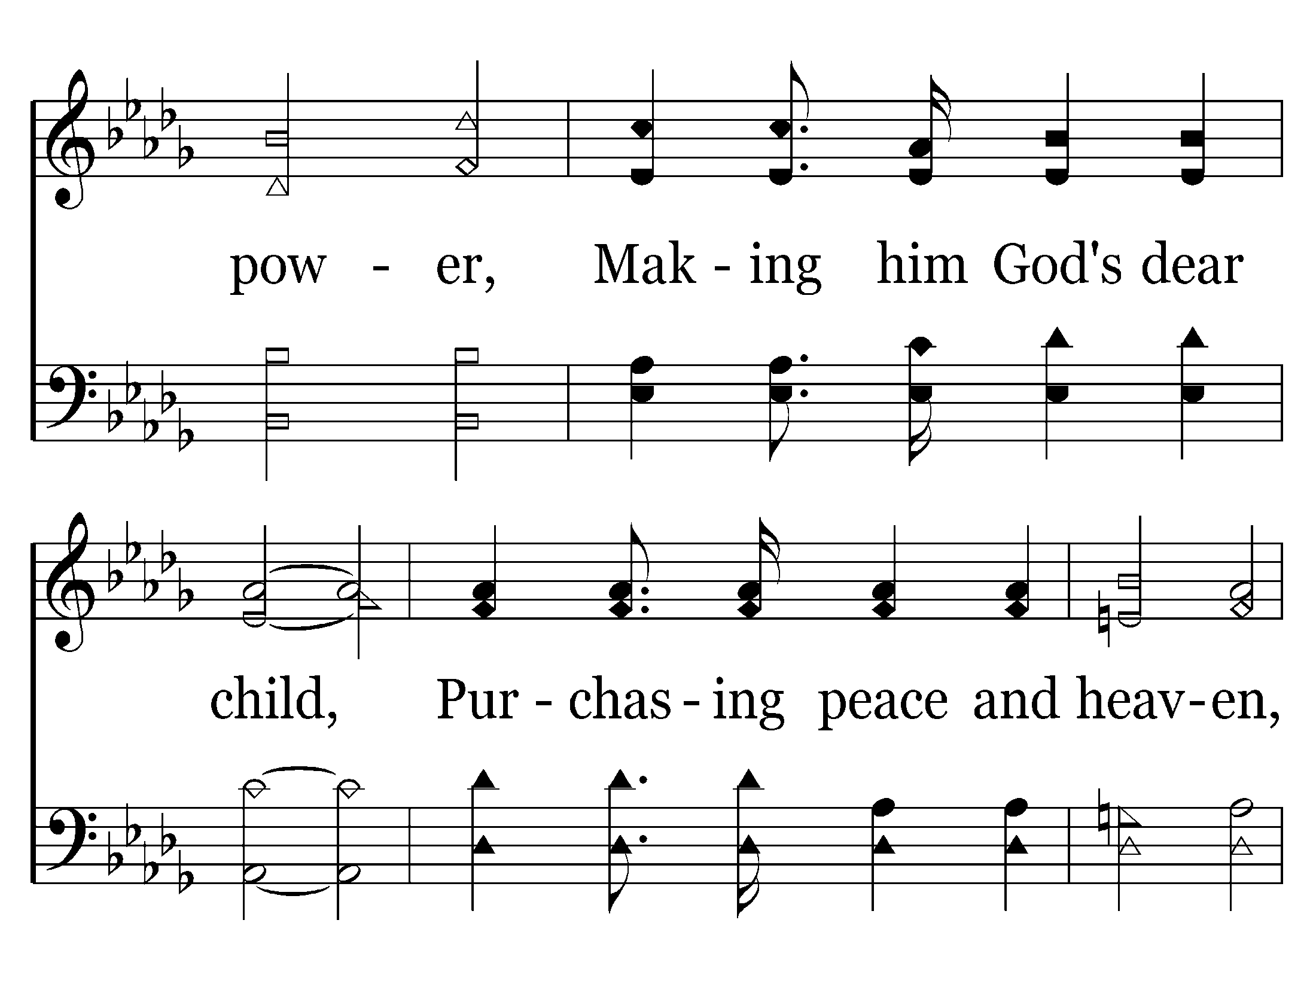
638 - Wonderful Grace - 3.2

Slide 47
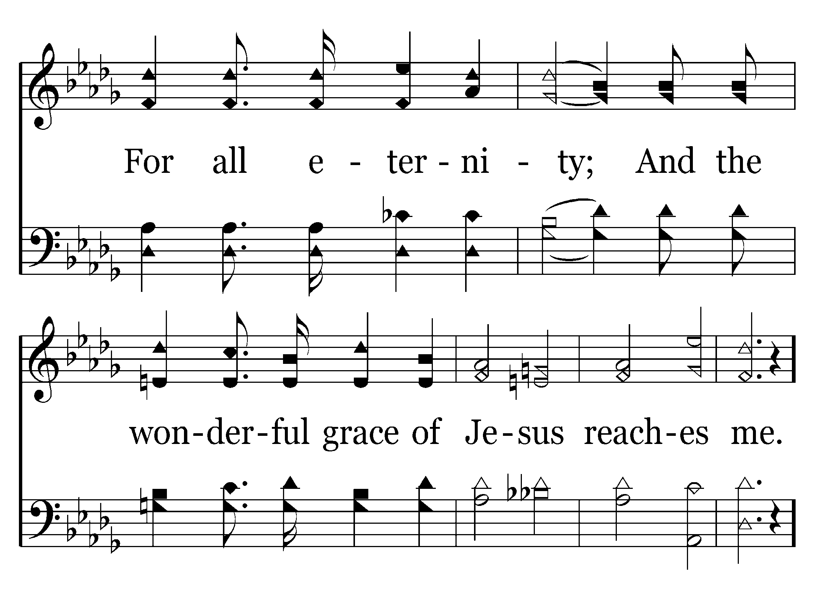
638 - Wonderful Grace - 3.3

Slide 48
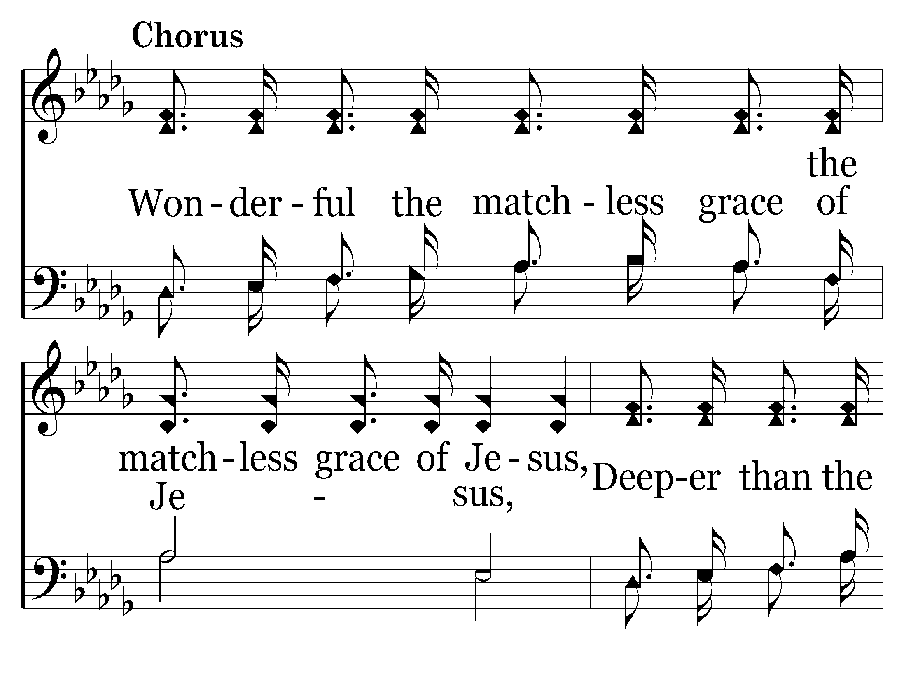
638 - Wonderful Grace - C.1

Slide 49
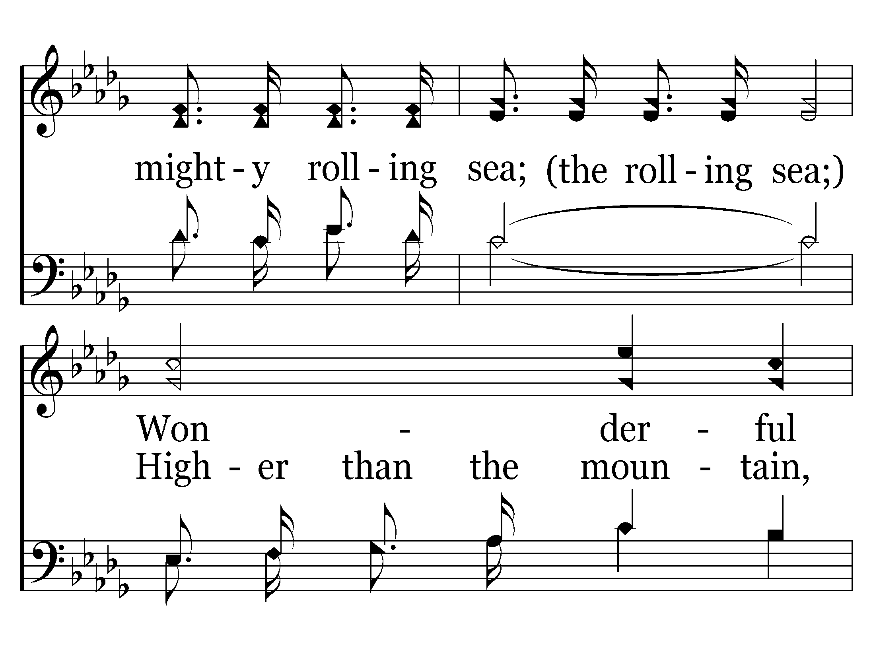
638 - Wonderful Grace - C.2

Slide 50
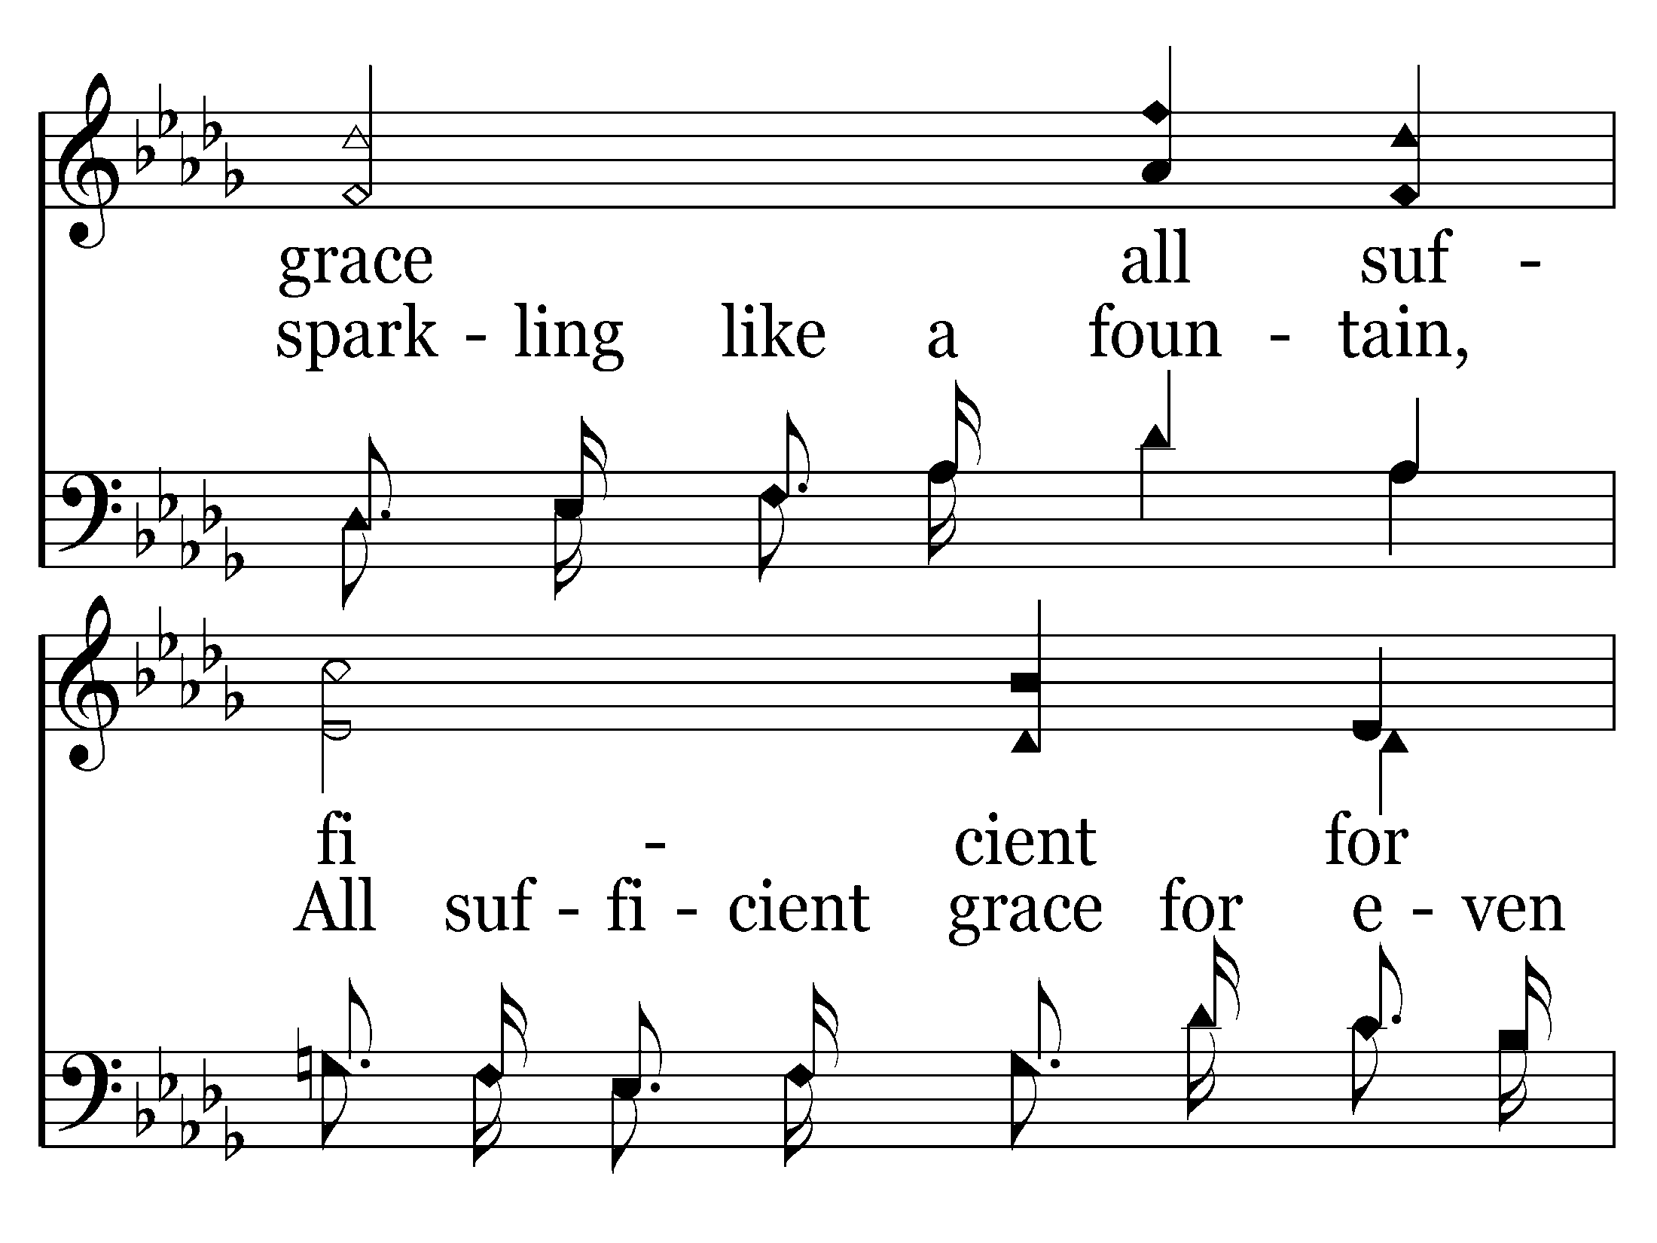
638 - Wonderful Grace - C.3

Slide 51
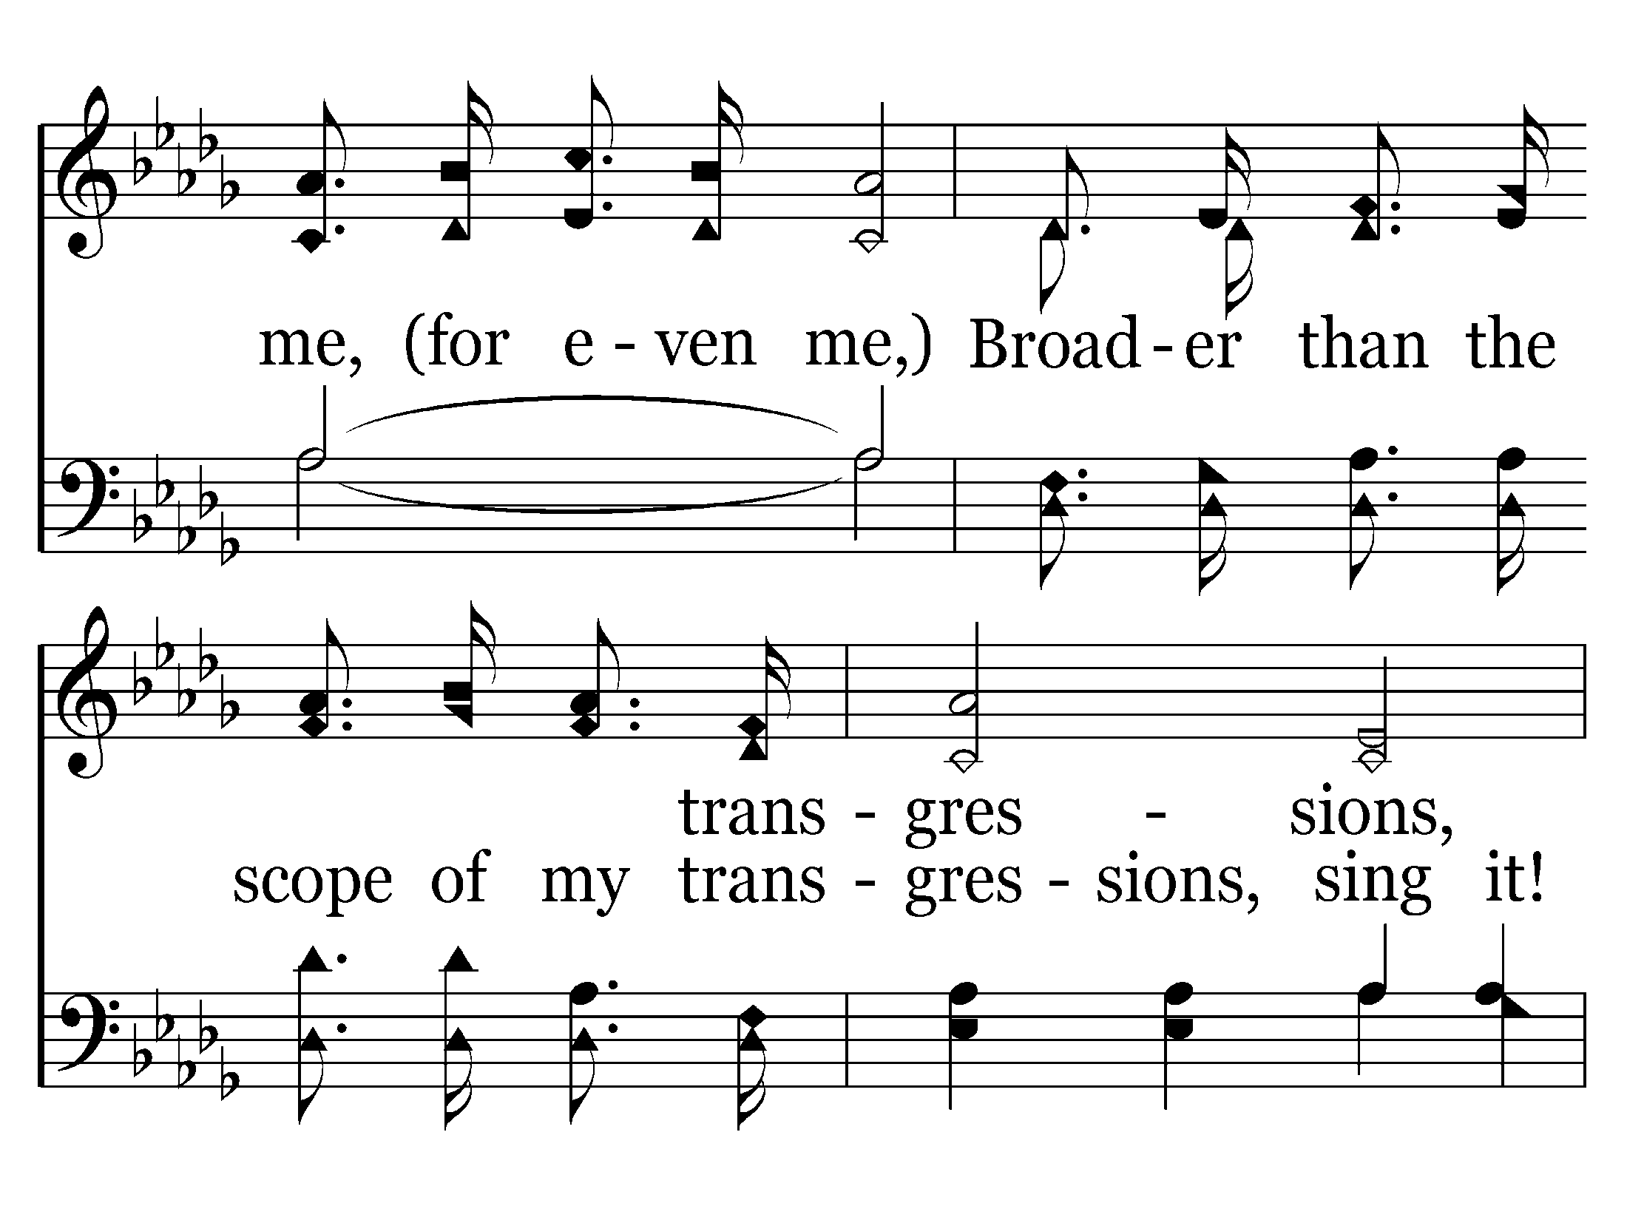
638 - Wonderful Grace - C.4

Slide 52
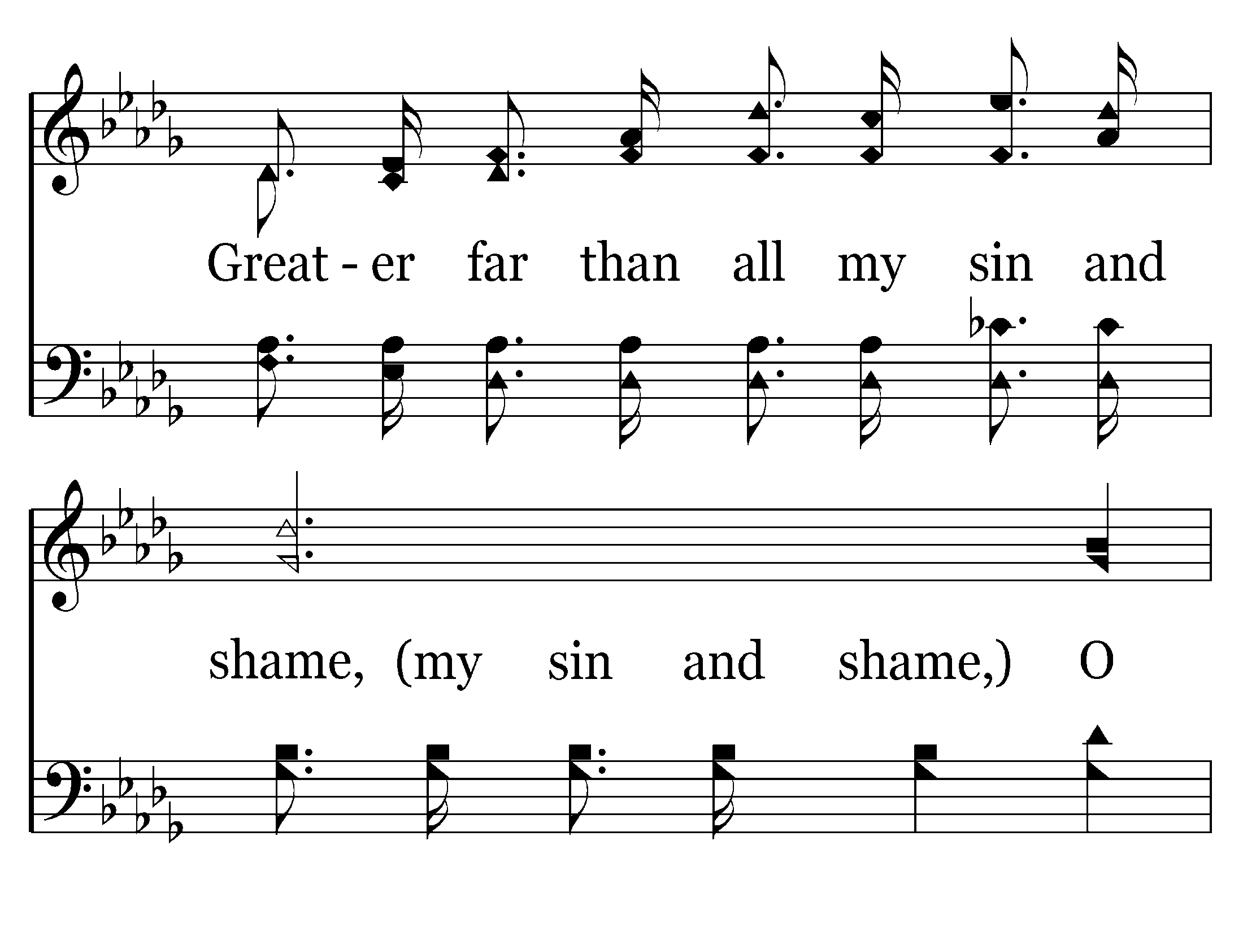
638 - Wonderful Grace - C.5

Slide 53
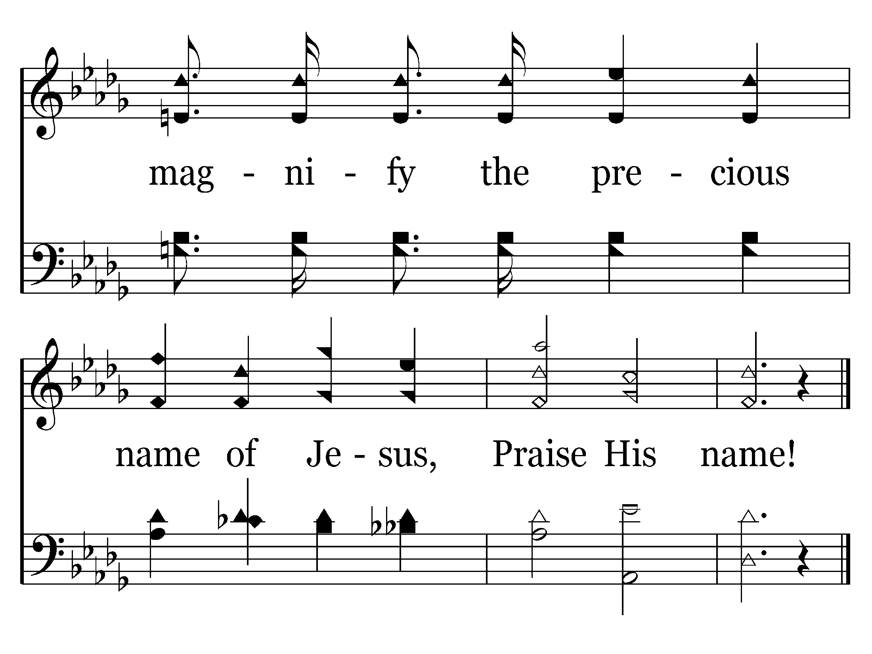
638 - Wonderful Grace - C.6
End of Song

Slide 55
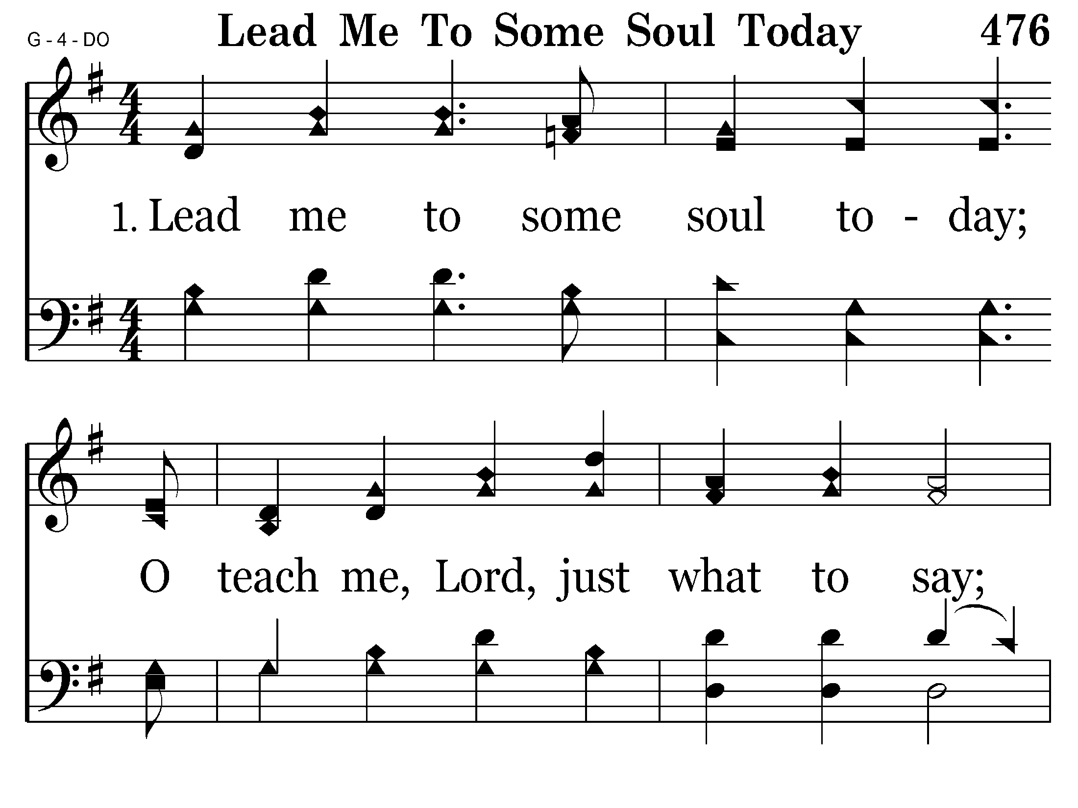
476 - Lead Me To Some Soul Today - 1.1

Slide 56
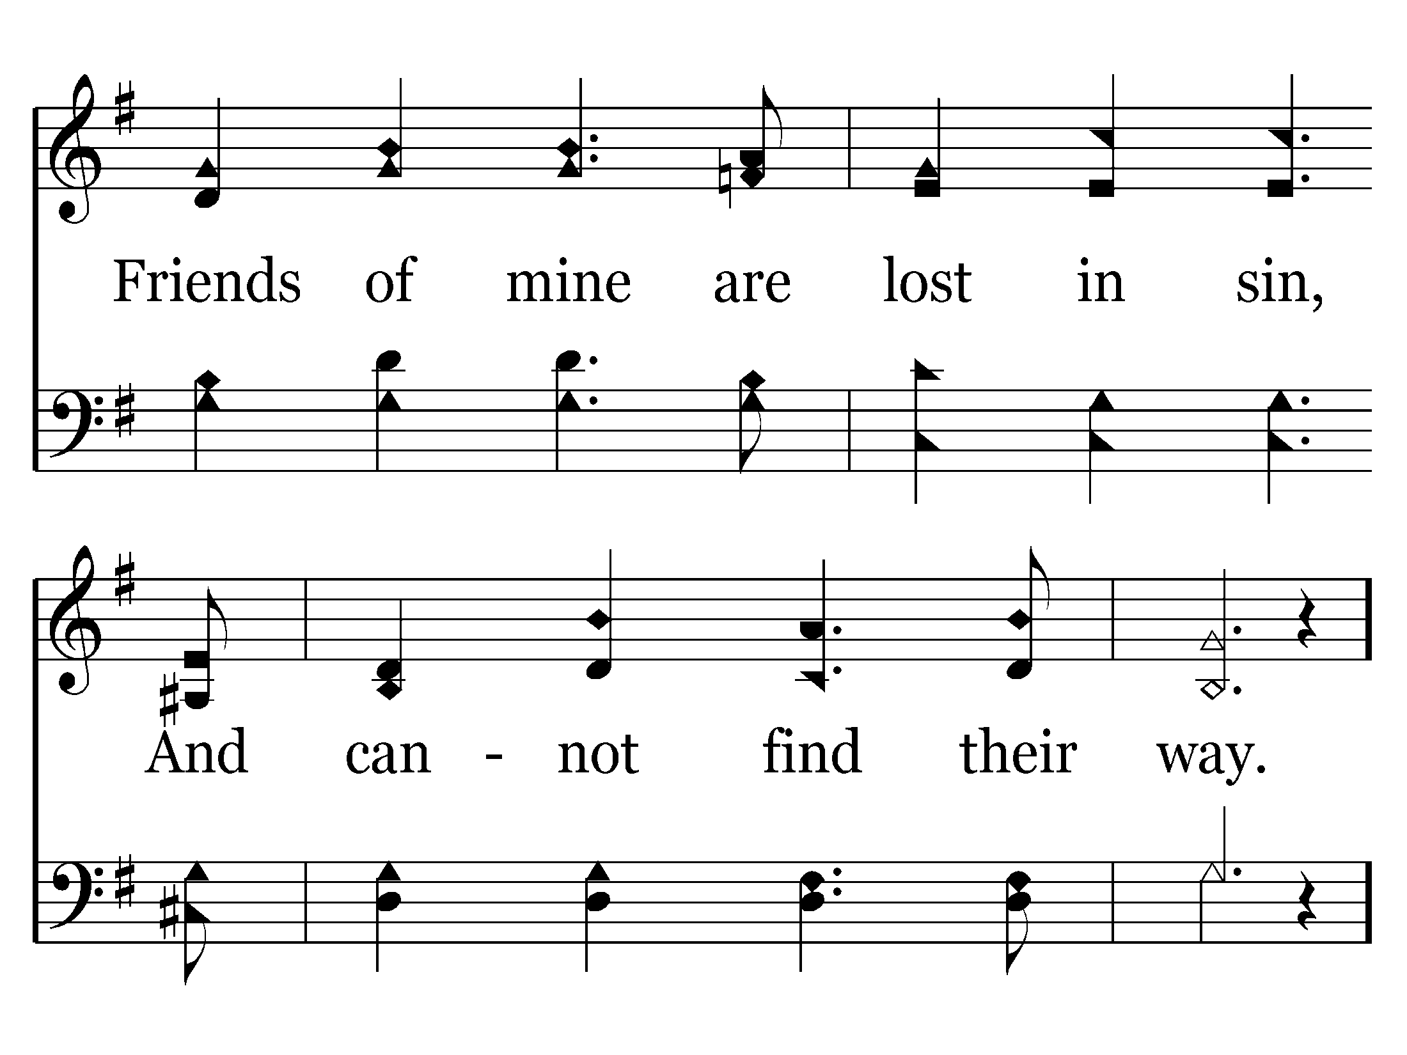
476 - Lead Me To Some Soul Today - 1.2

Slide 57
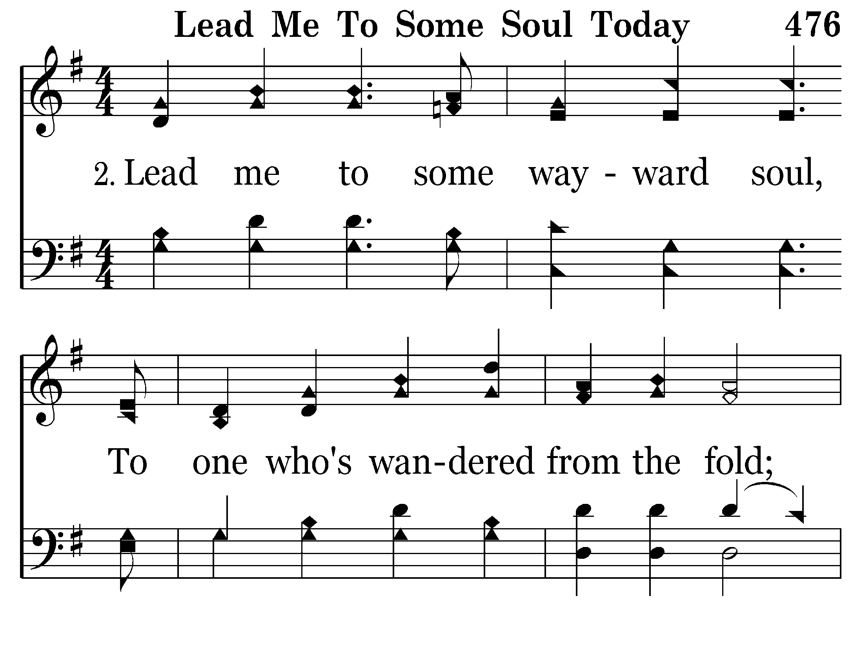
476 - Lead Me To Some Soul Today - 2.1

Slide 58
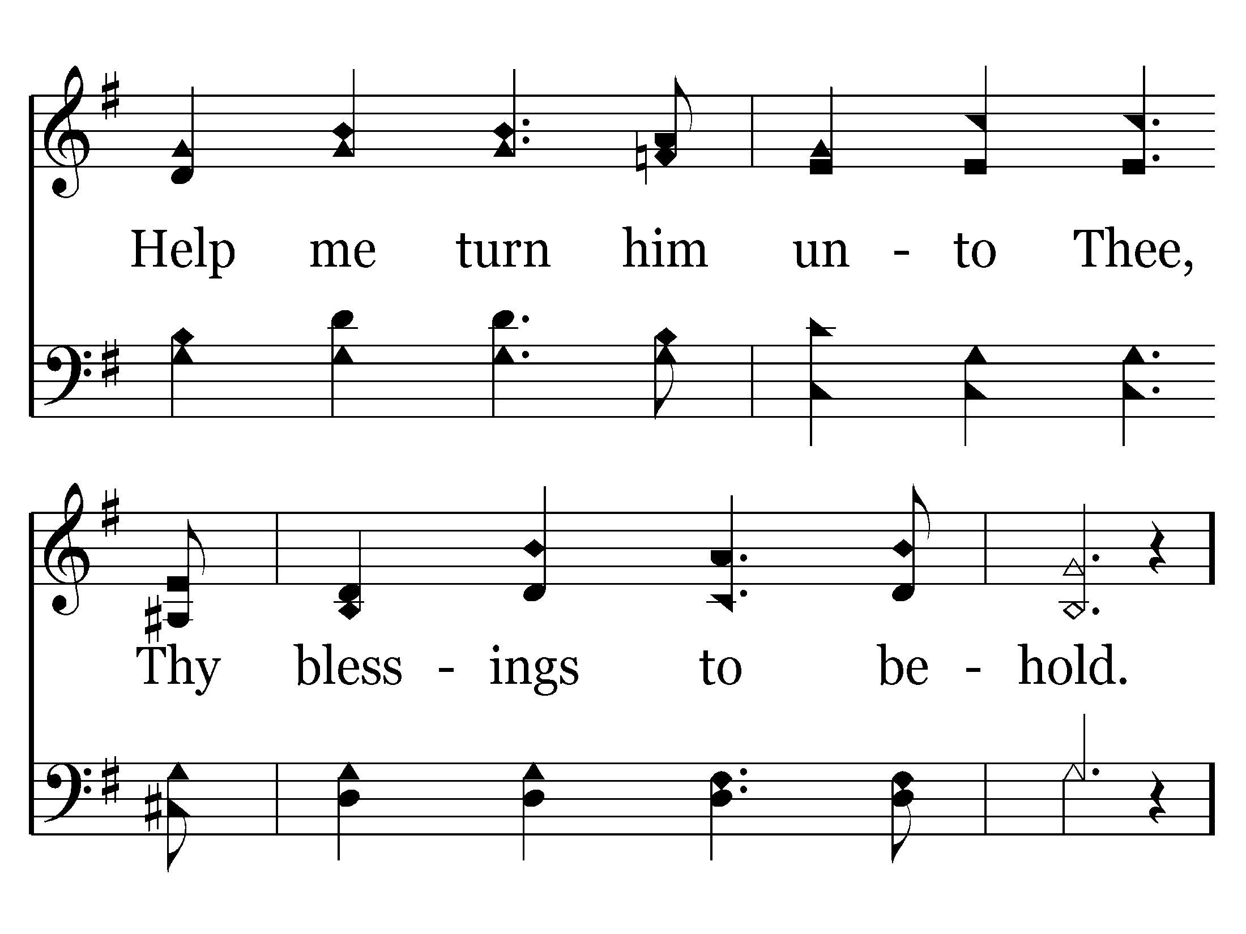
476 - Lead Me To Some Soul Today - 2.2

Slide 59
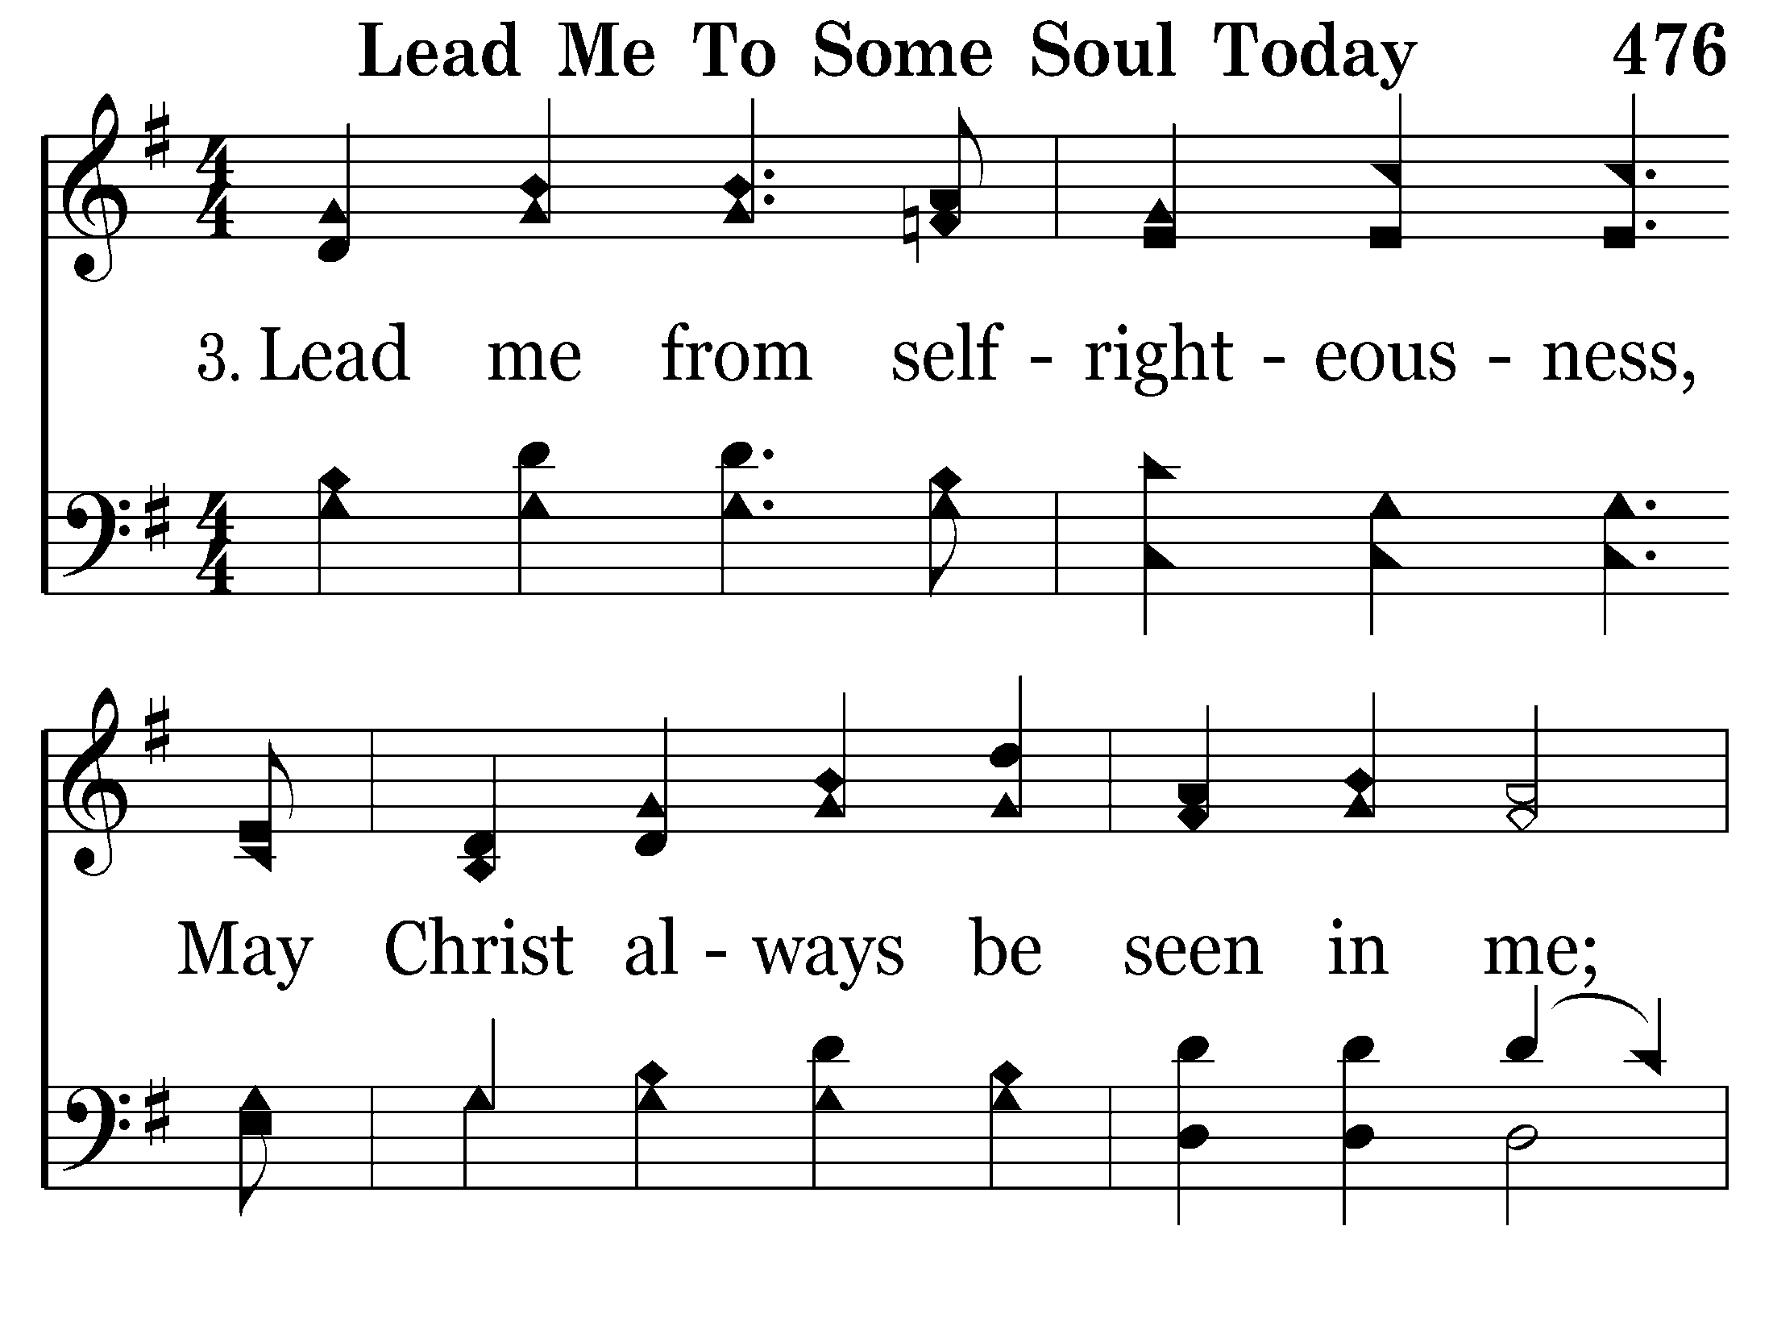
476 - Lead Me To Some Soul Today - 3.1

Slide 60
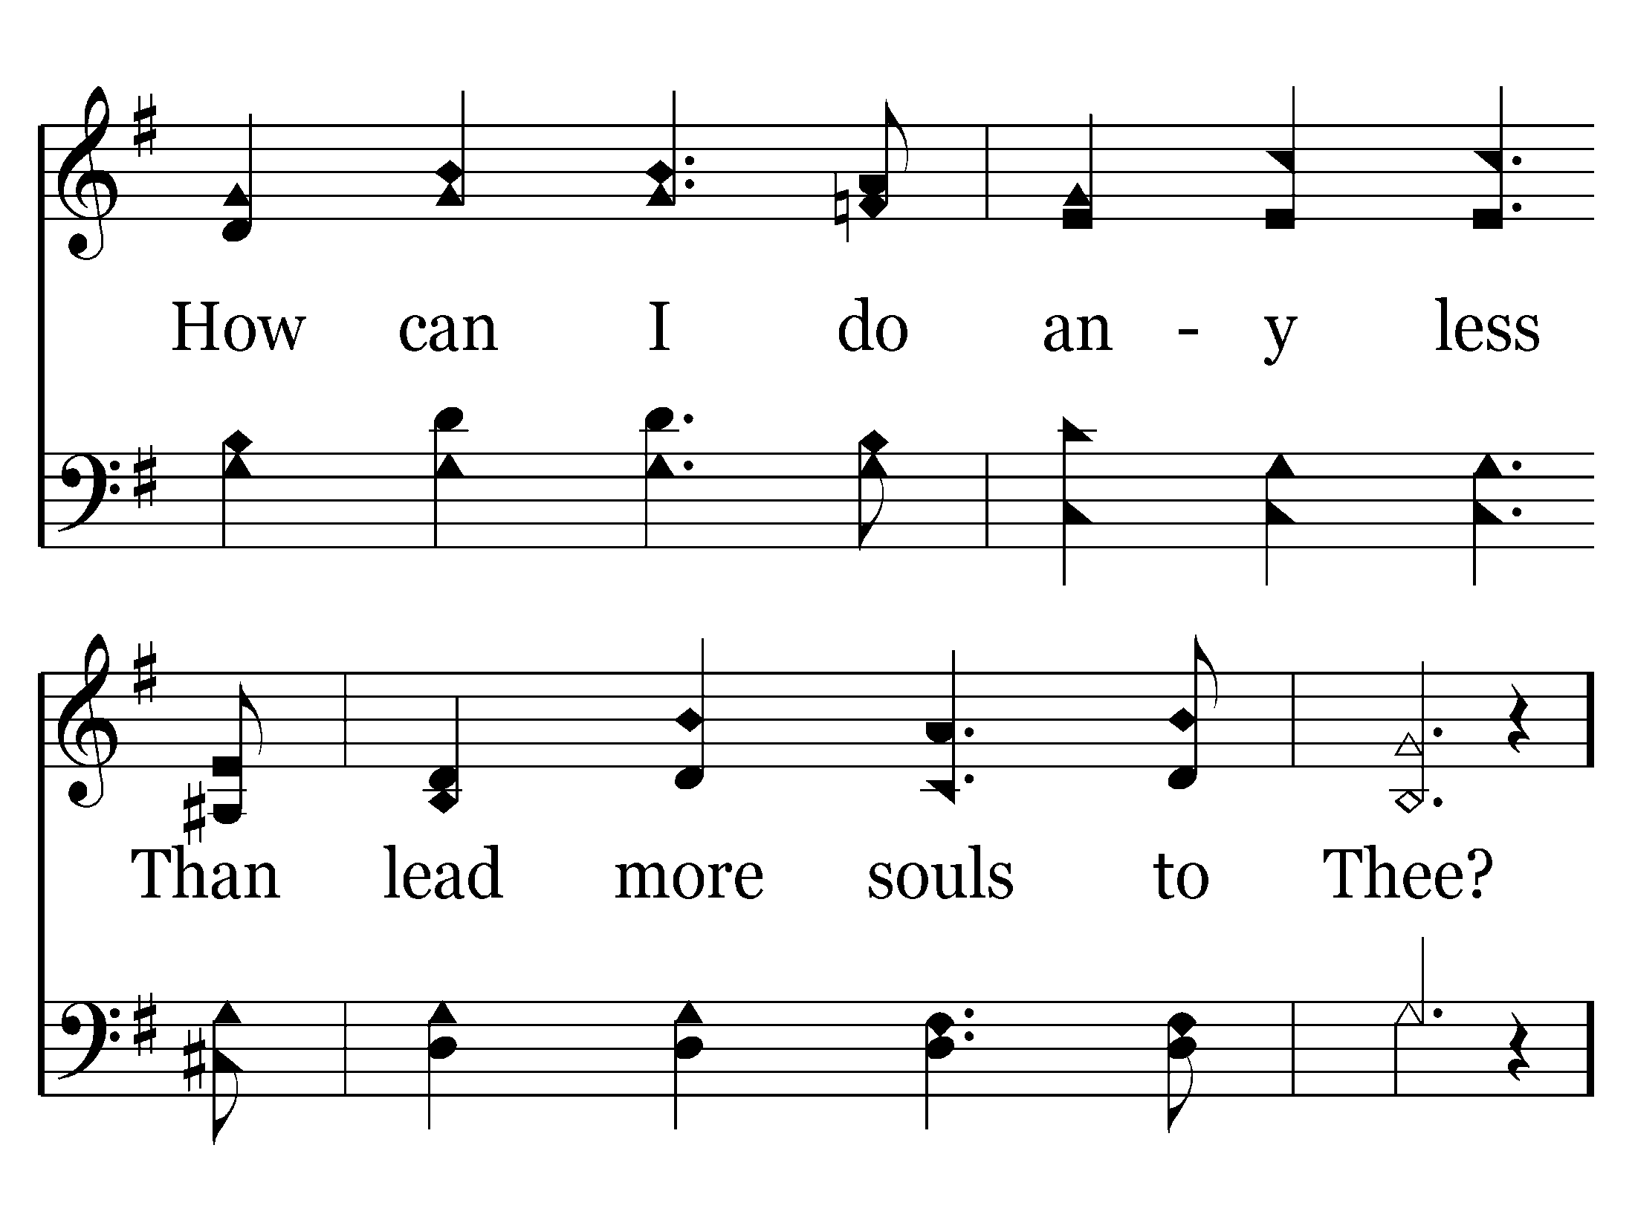
476 - Lead Me To Some Soul Today - 3.2

Slide 61
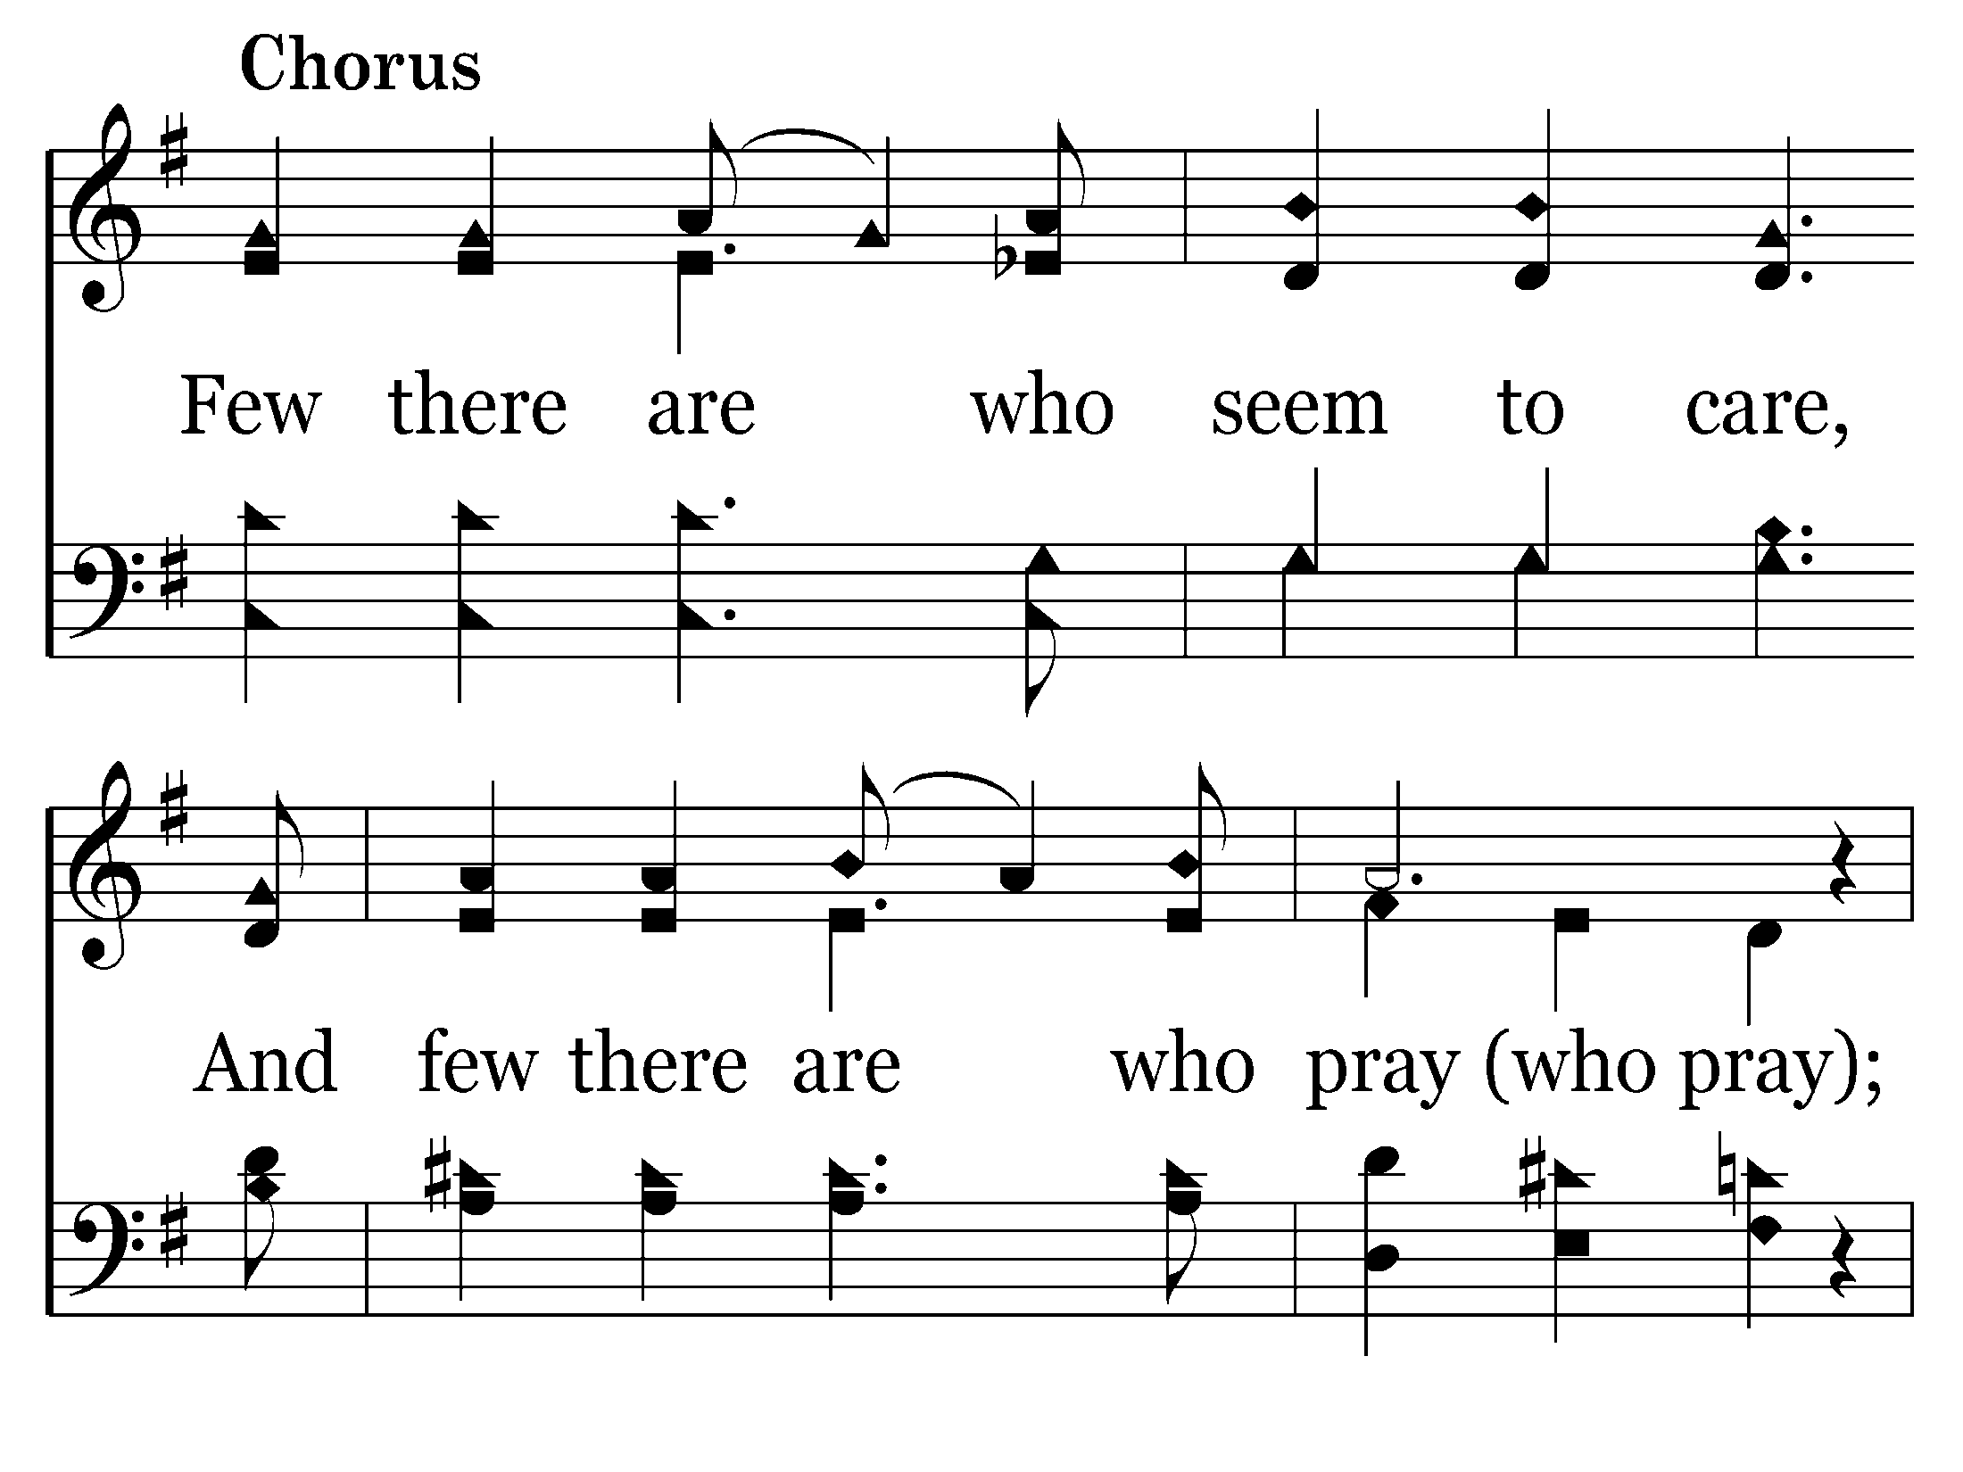
476 - Lead Me To Some Soul Today - C.1

Slide 62
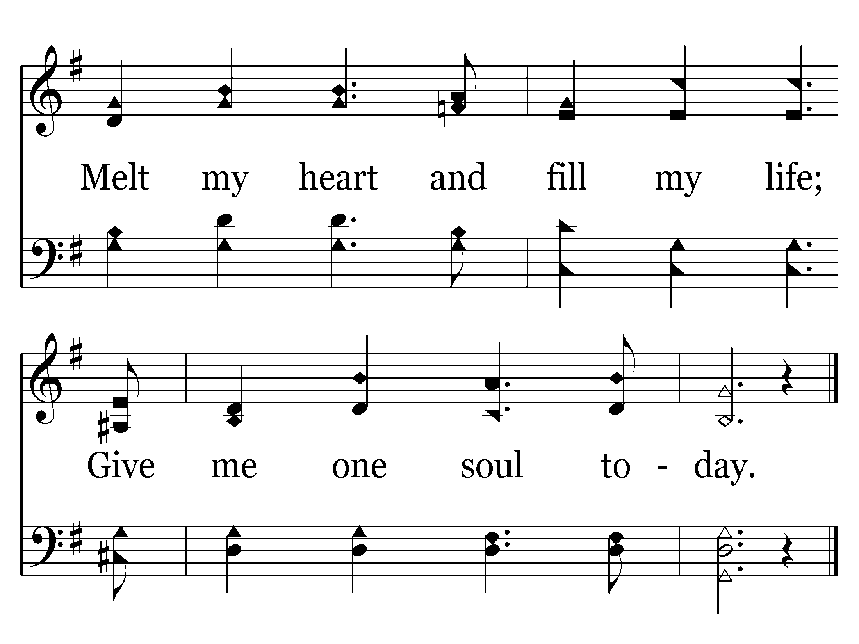
476 - Lead Me To Some Soul Today - C.2
End of Song

Slide 64
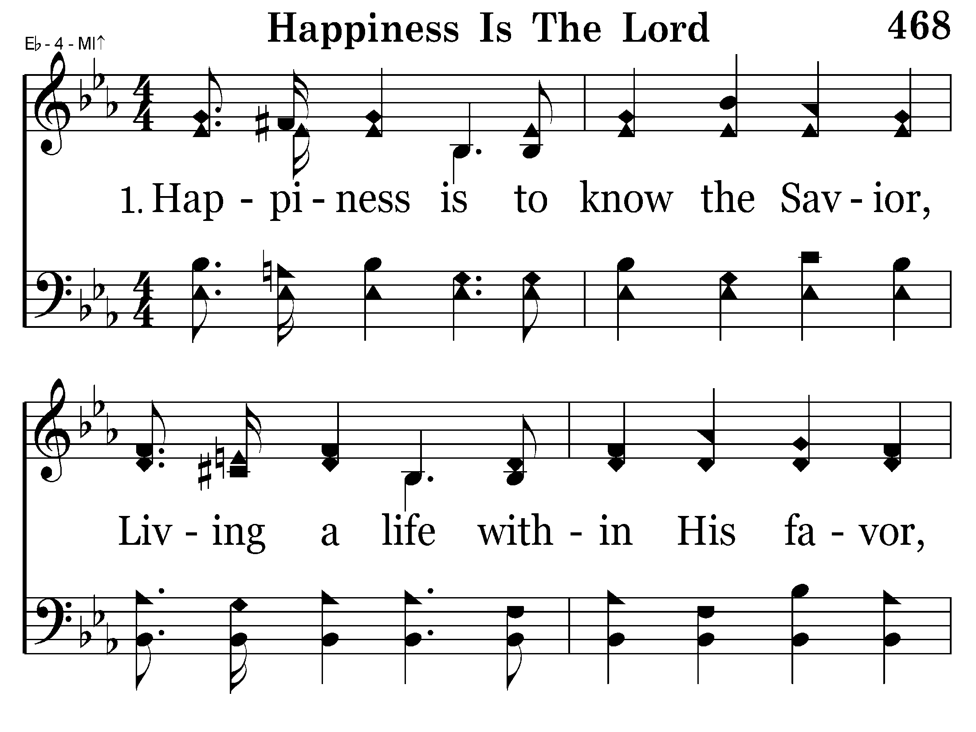
468 - Happiness Is The Lord - 1.1

Slide 65
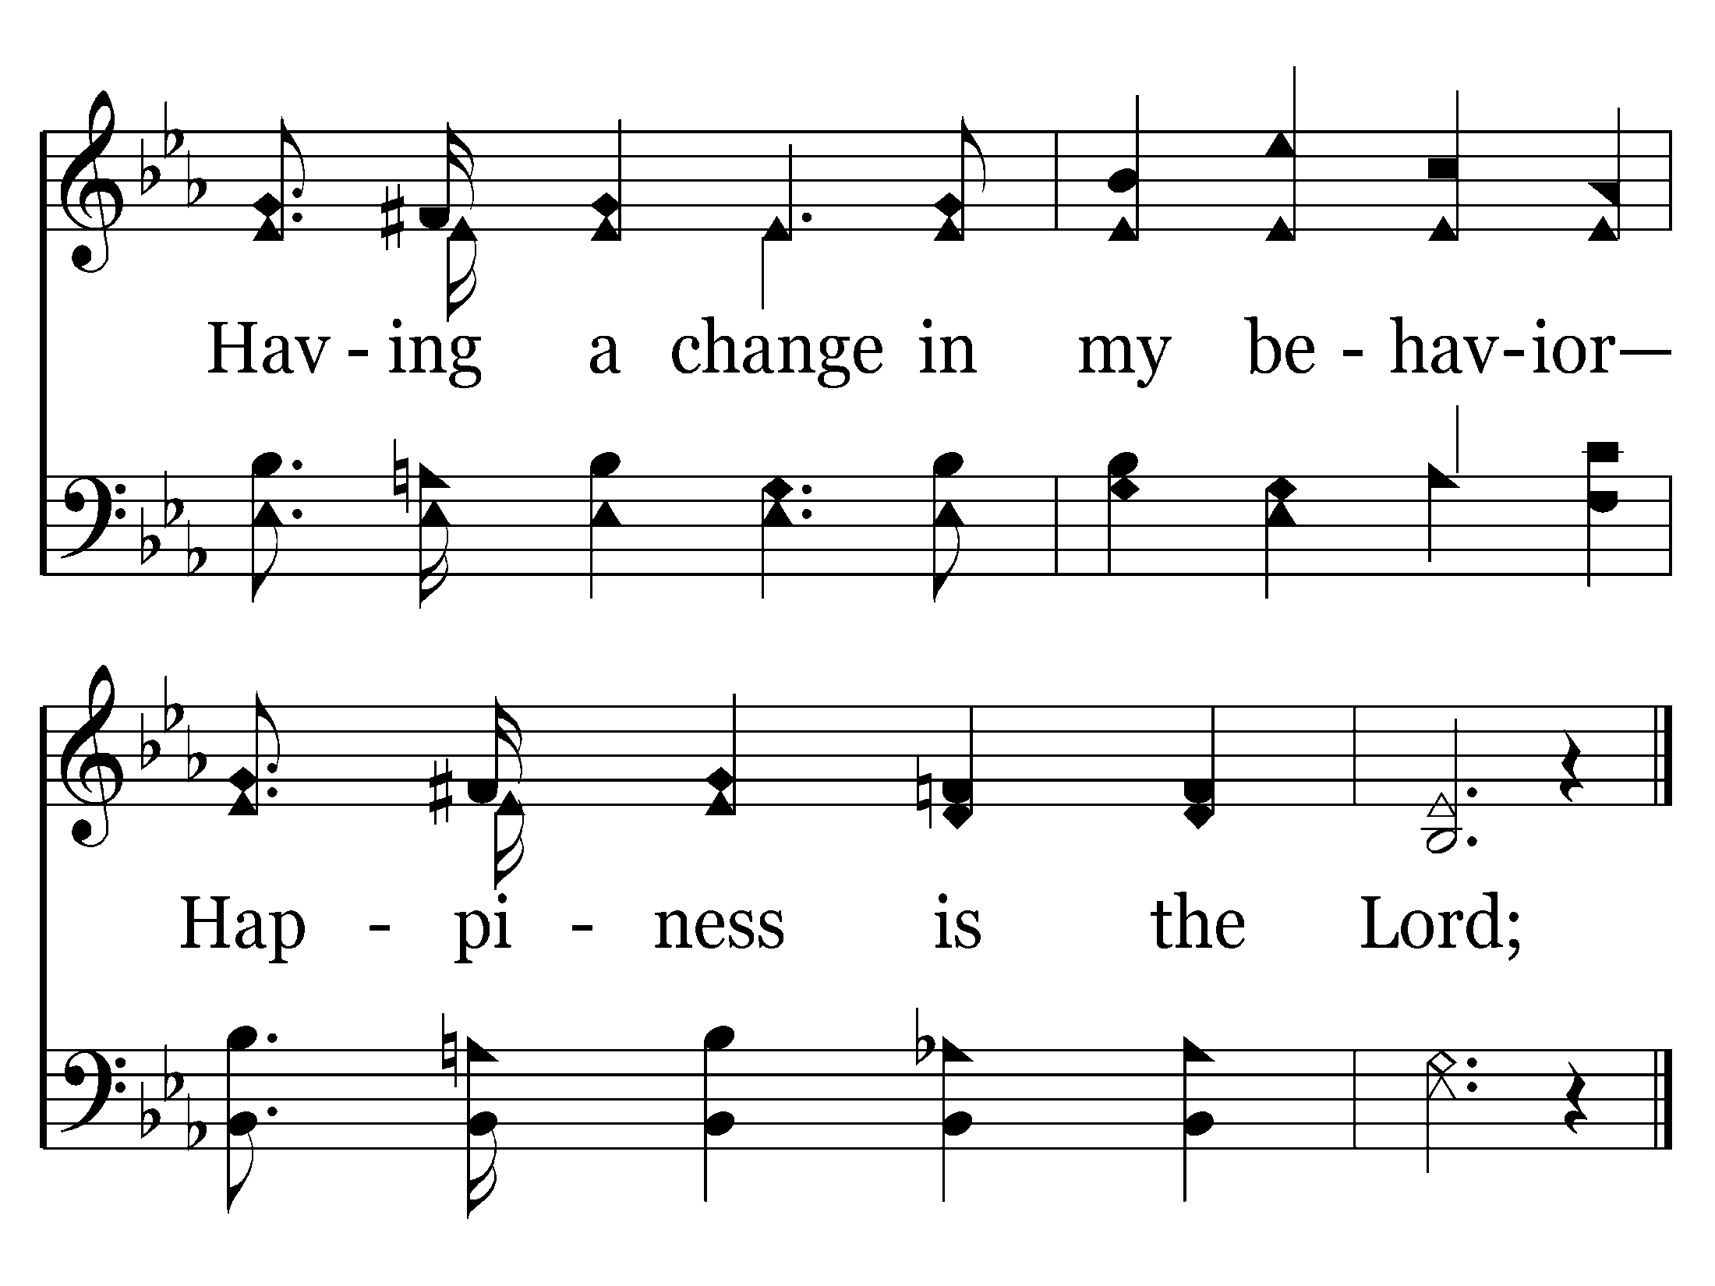
468 - Happiness Is The Lord - 1.2
End of Verse 1

Slide 66
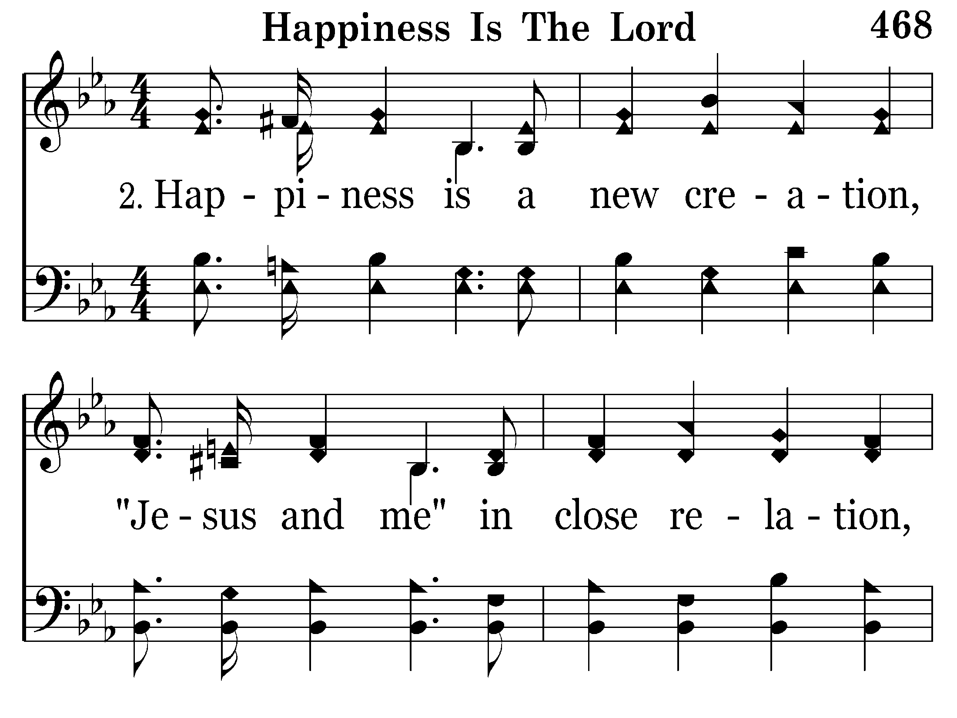
468 - Happiness Is The Lord - 2.1

Slide 67
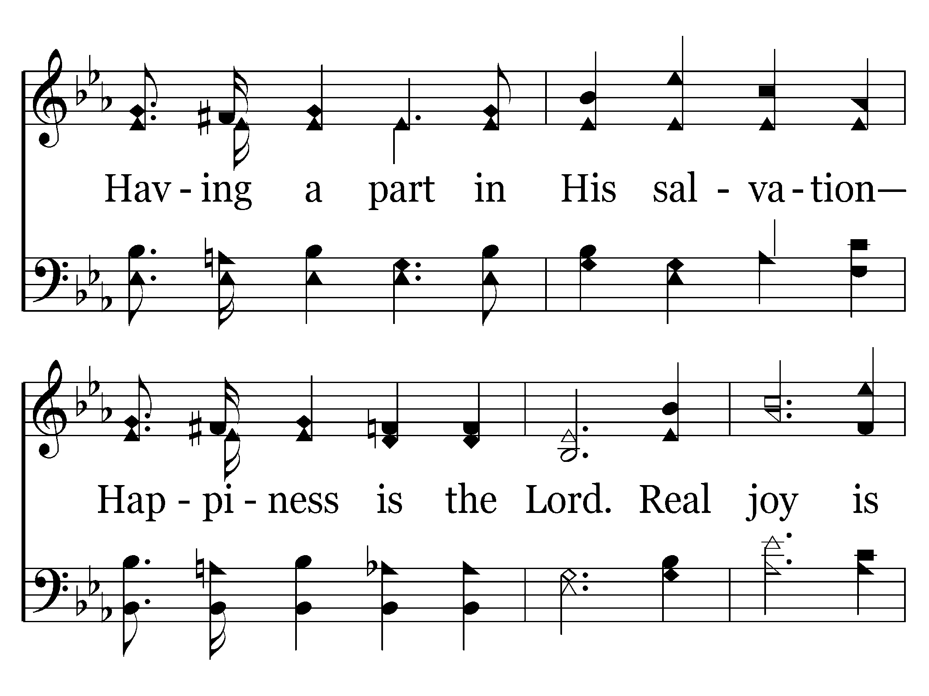
468 - Happiness Is The Lord - 2.2

Slide 68
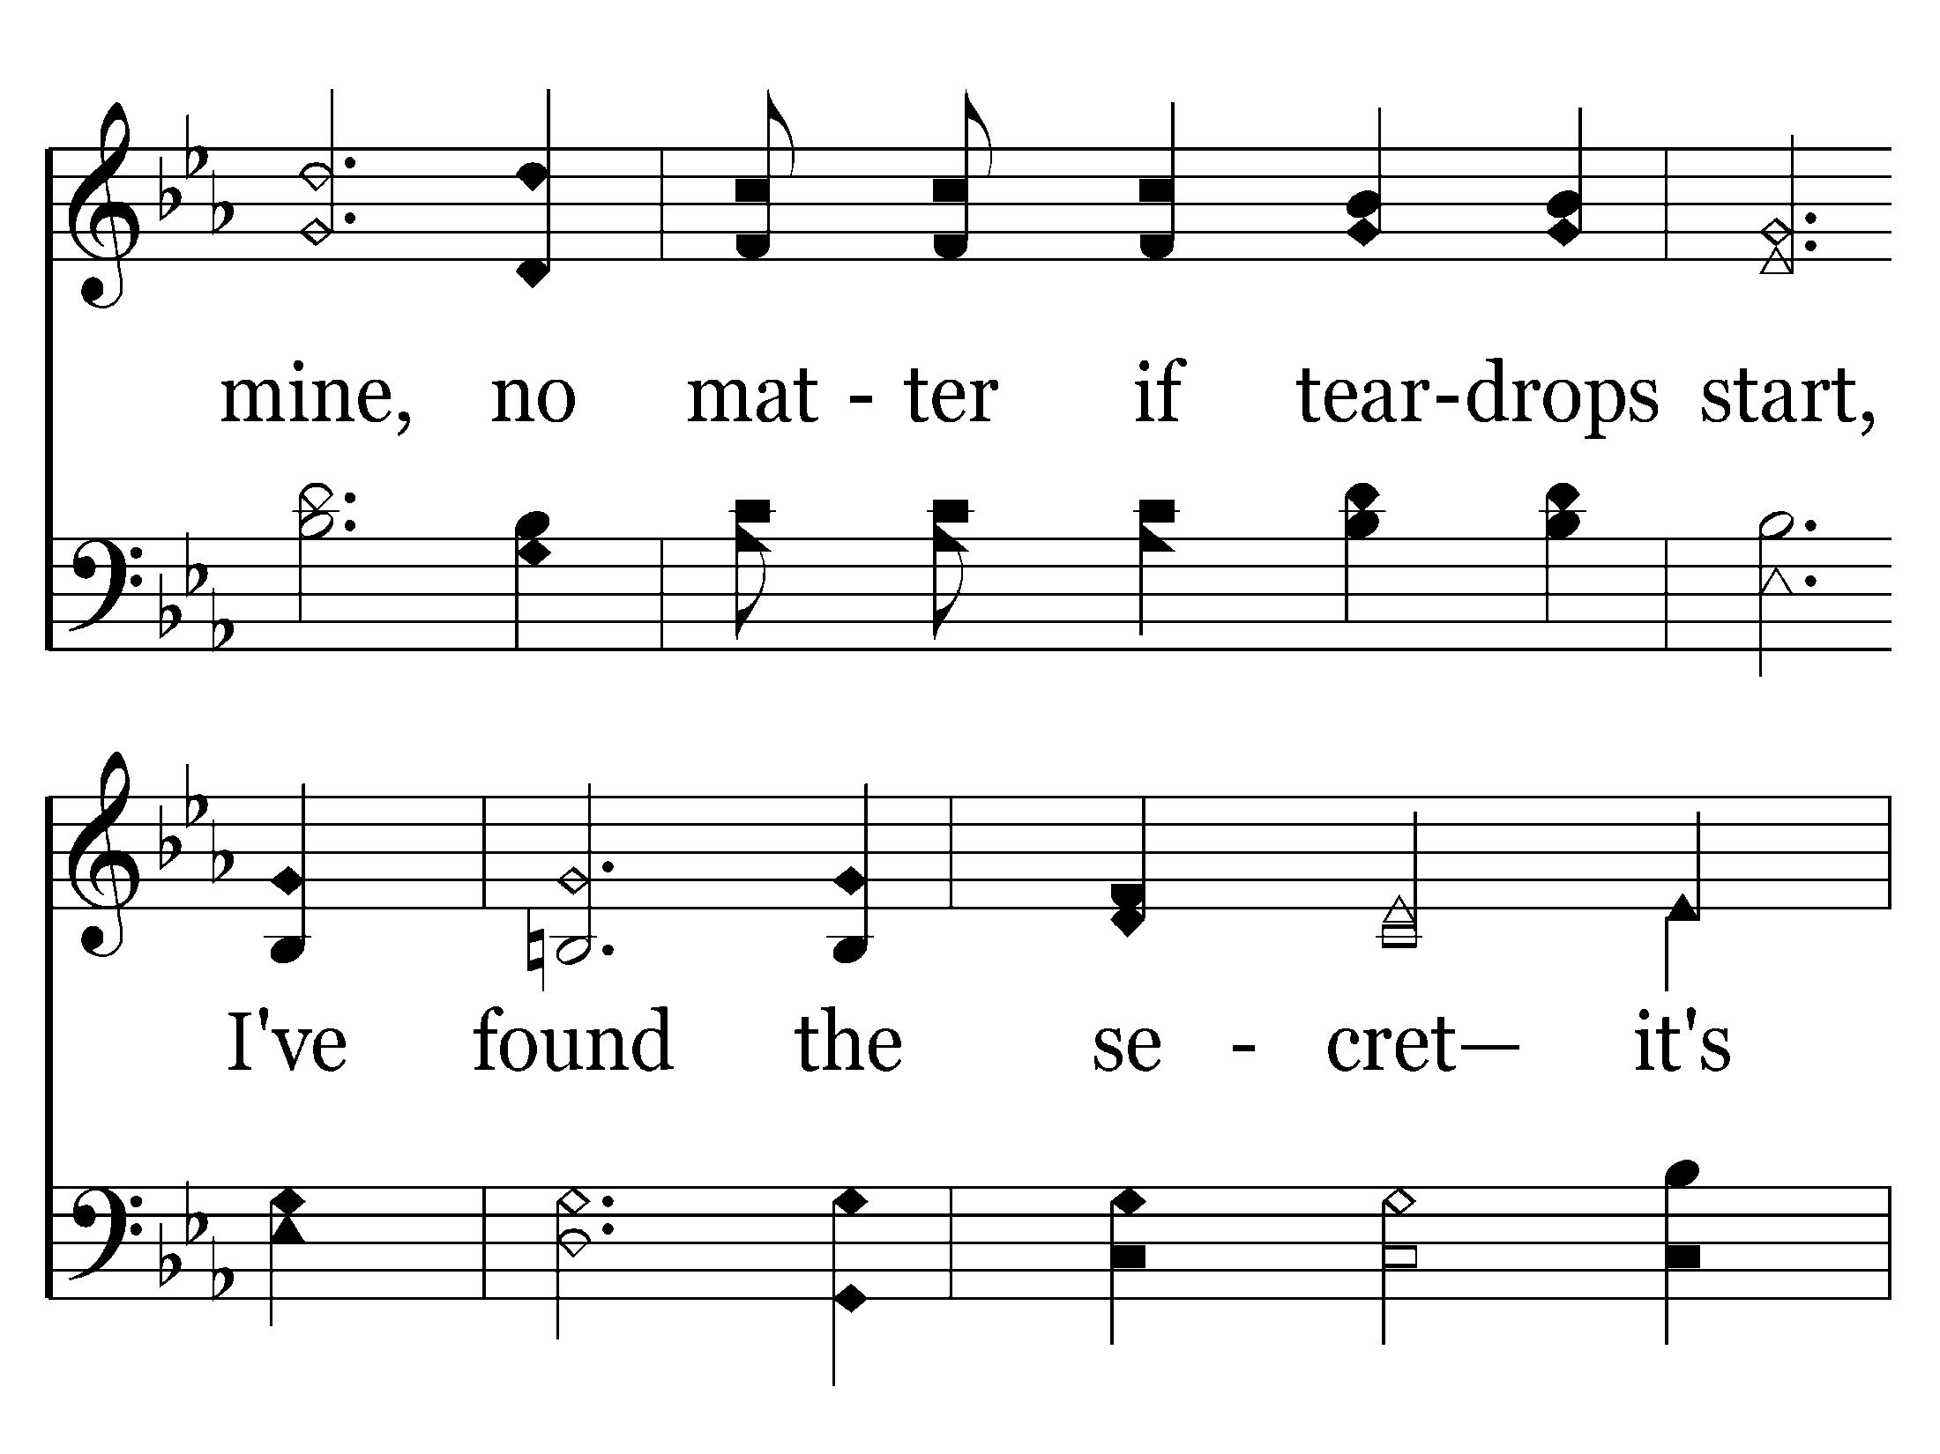
468 - Happiness Is The Lord - 2.3

Slide 69
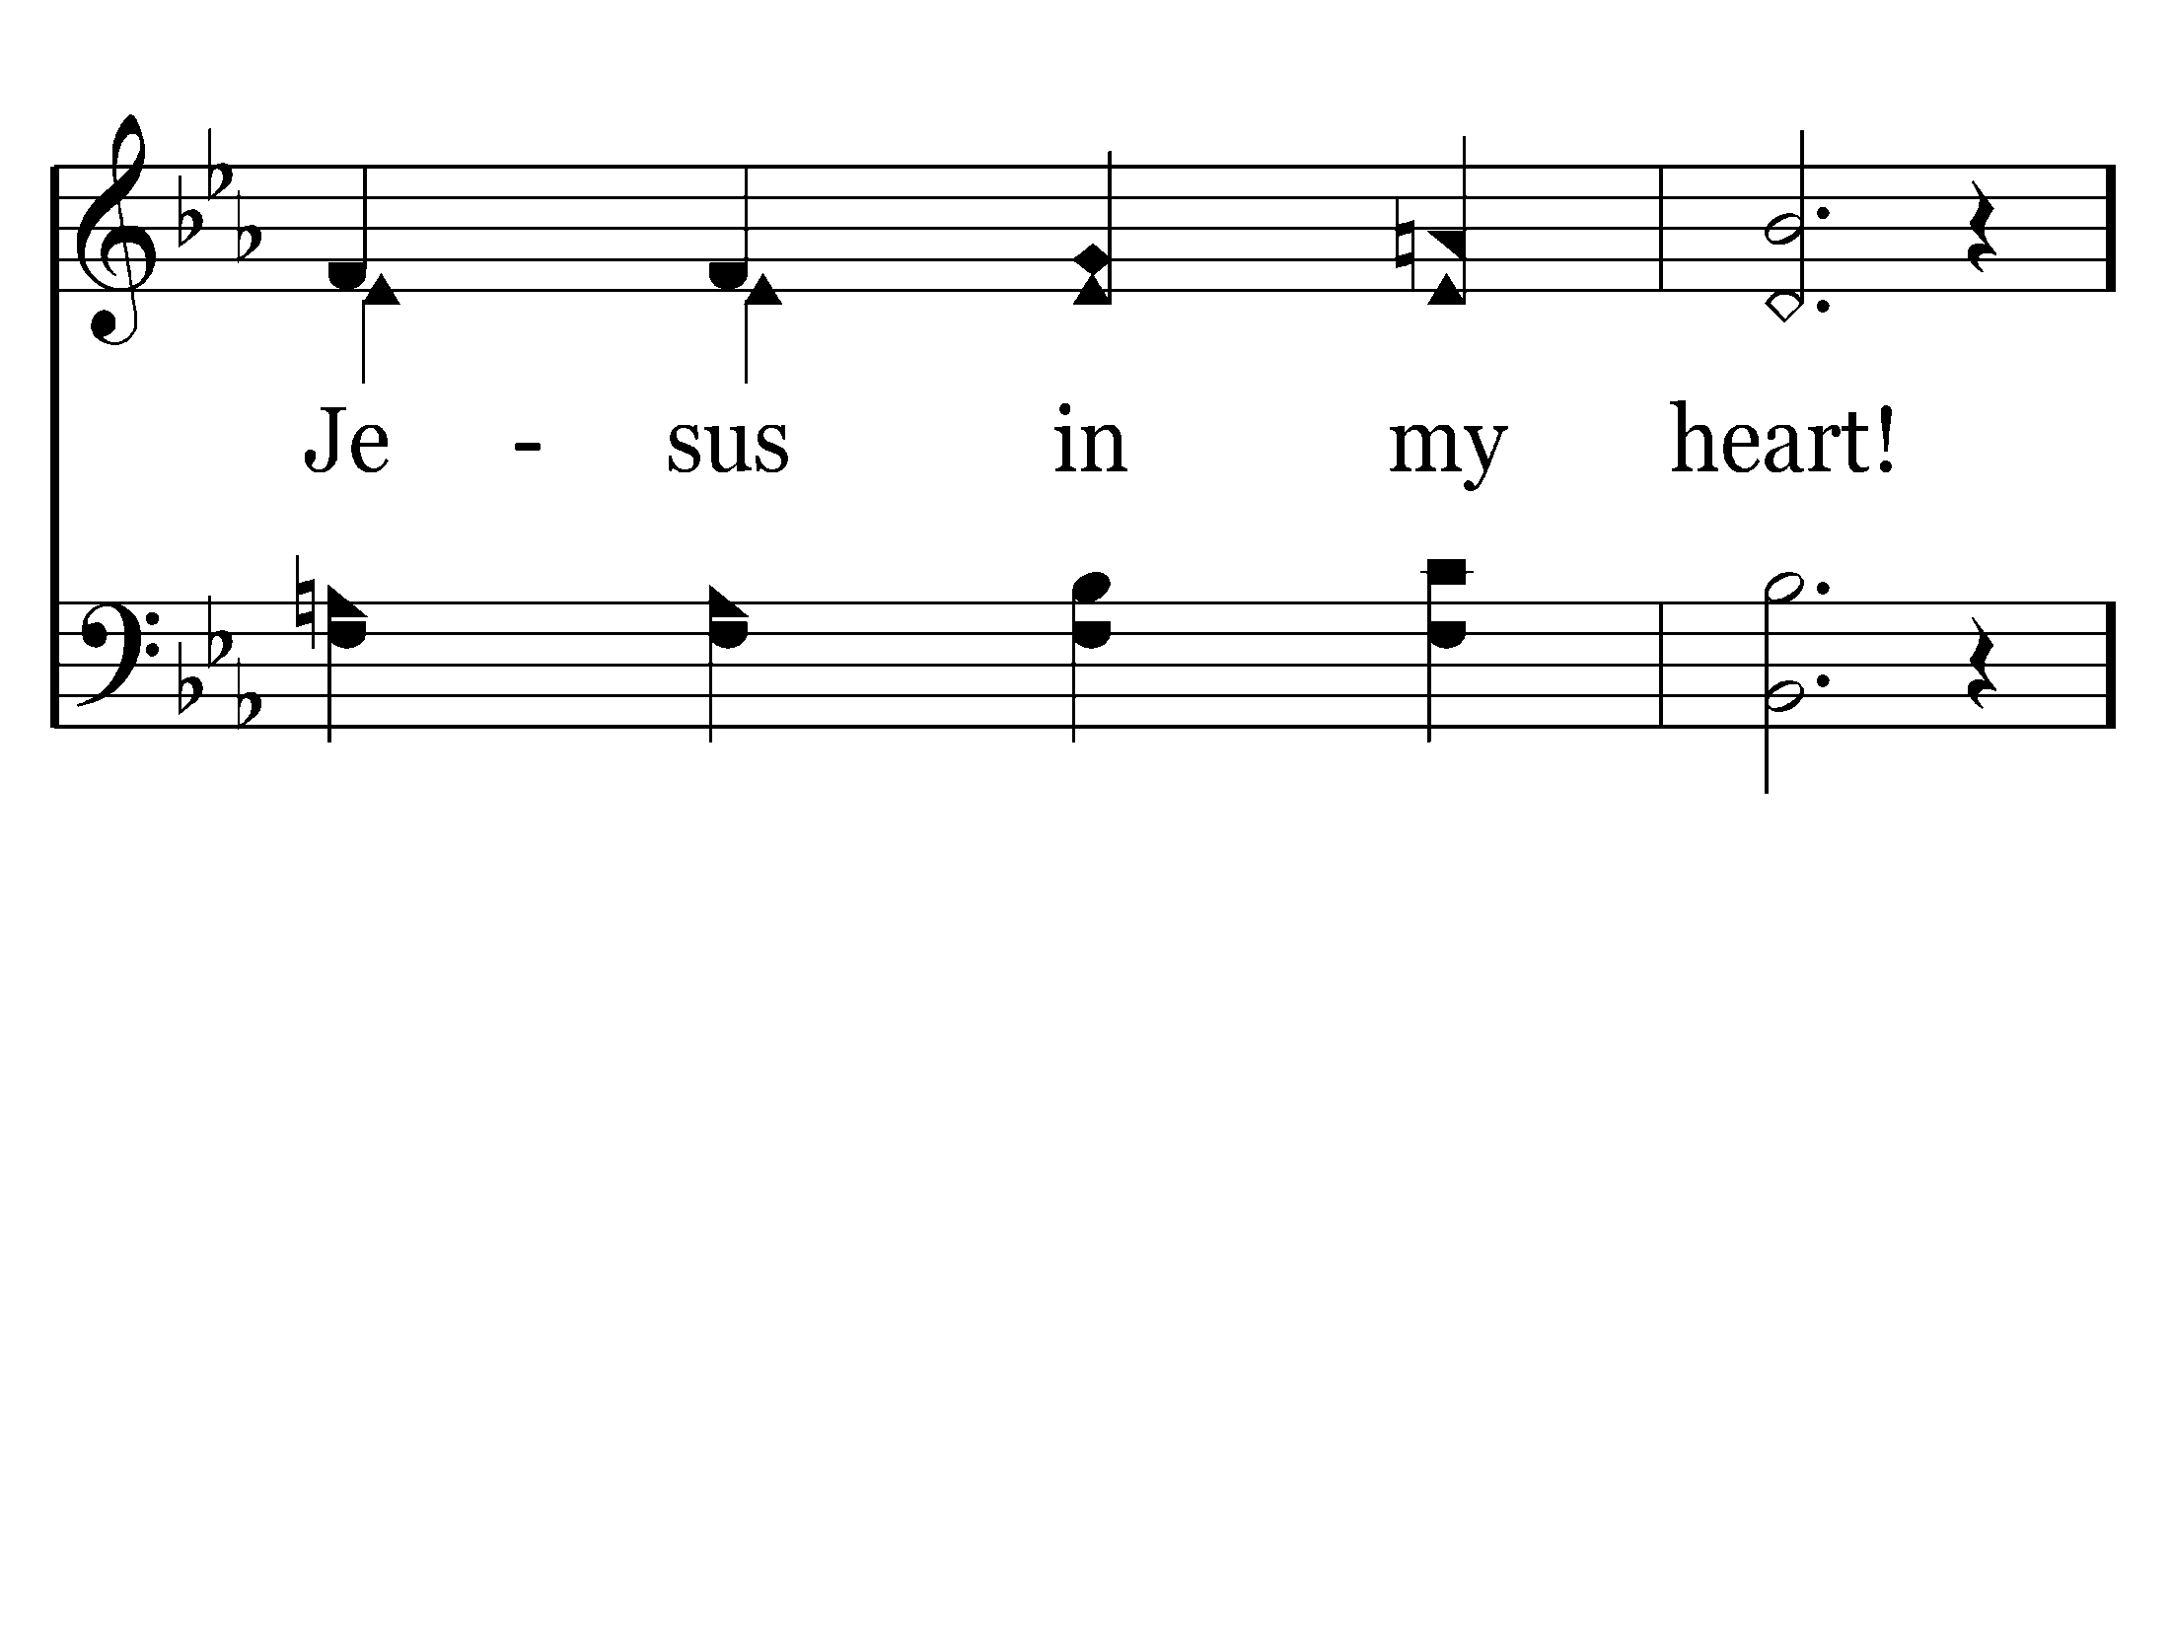
468 - Happiness Is The Lord - 2.4
End of Verse 2

Slide 70
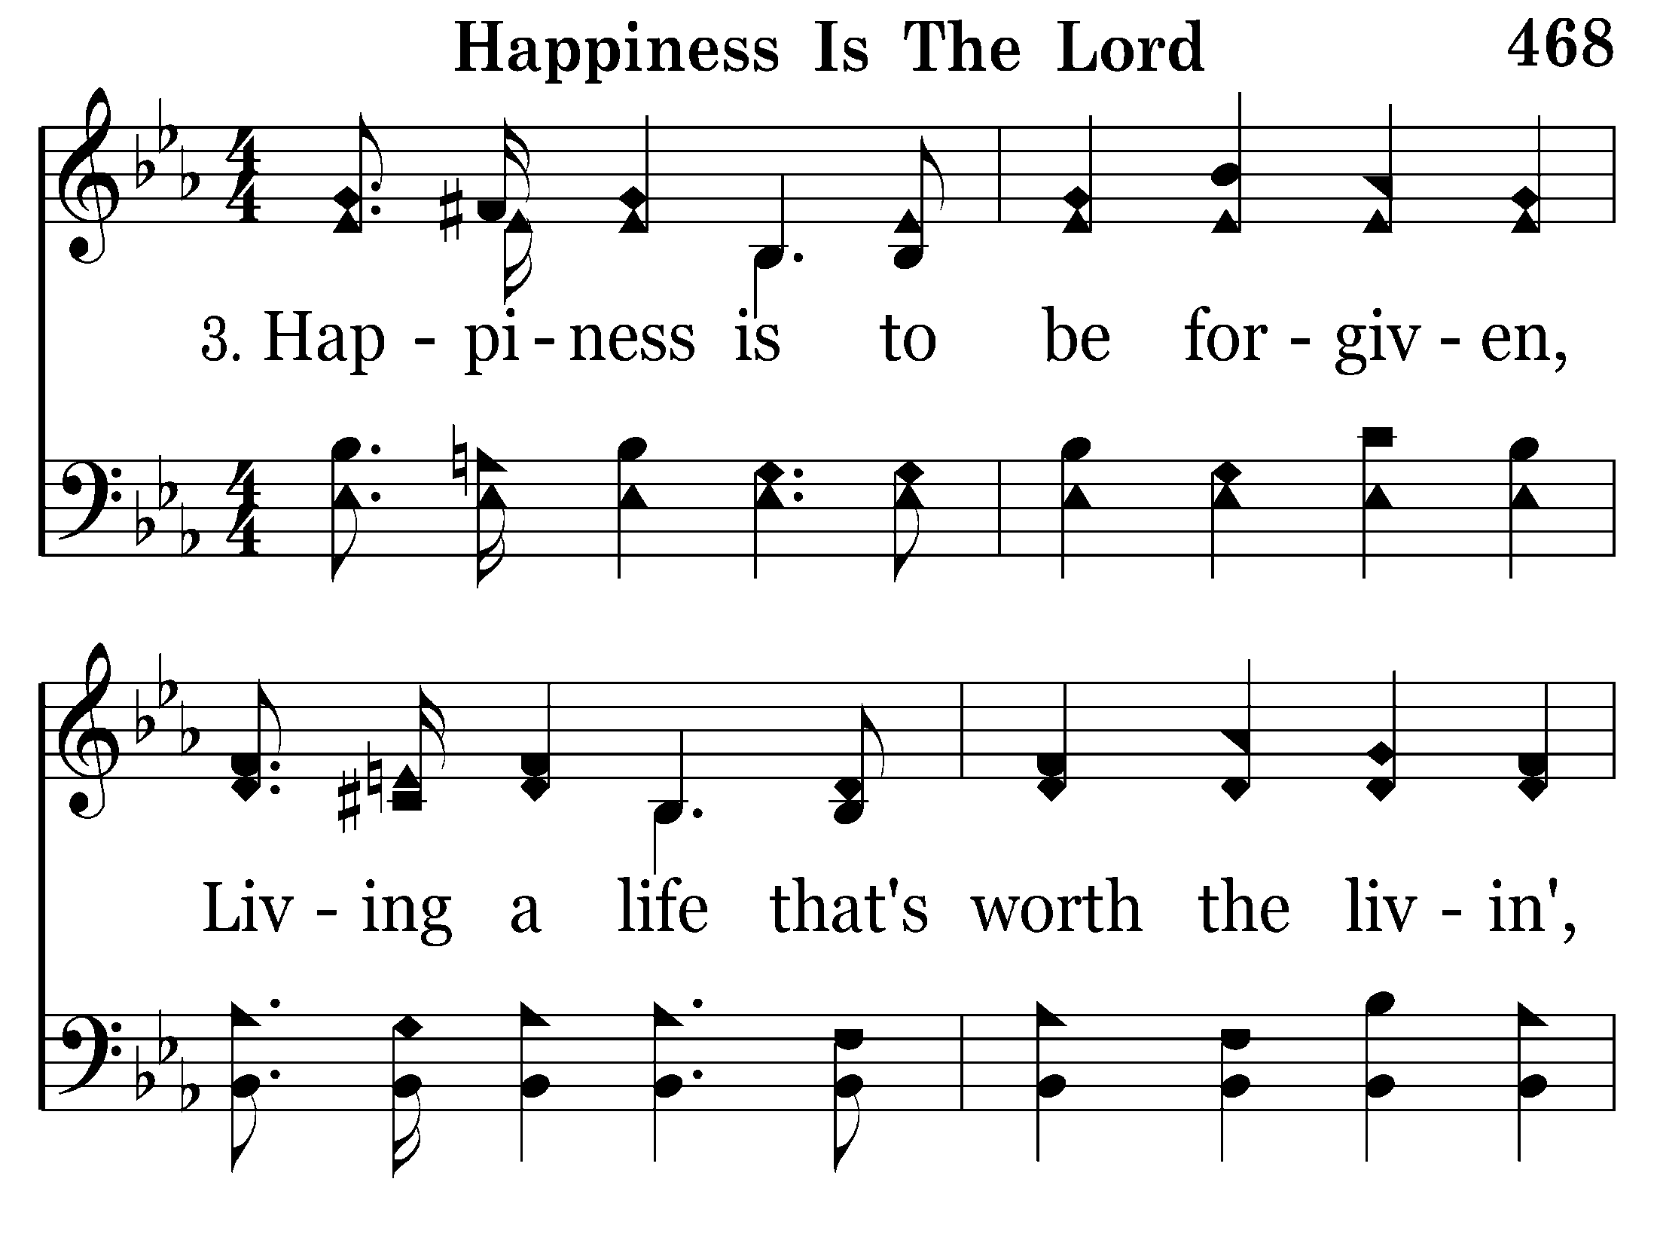
468 - Happiness Is The Lord - 3.1

Slide 71
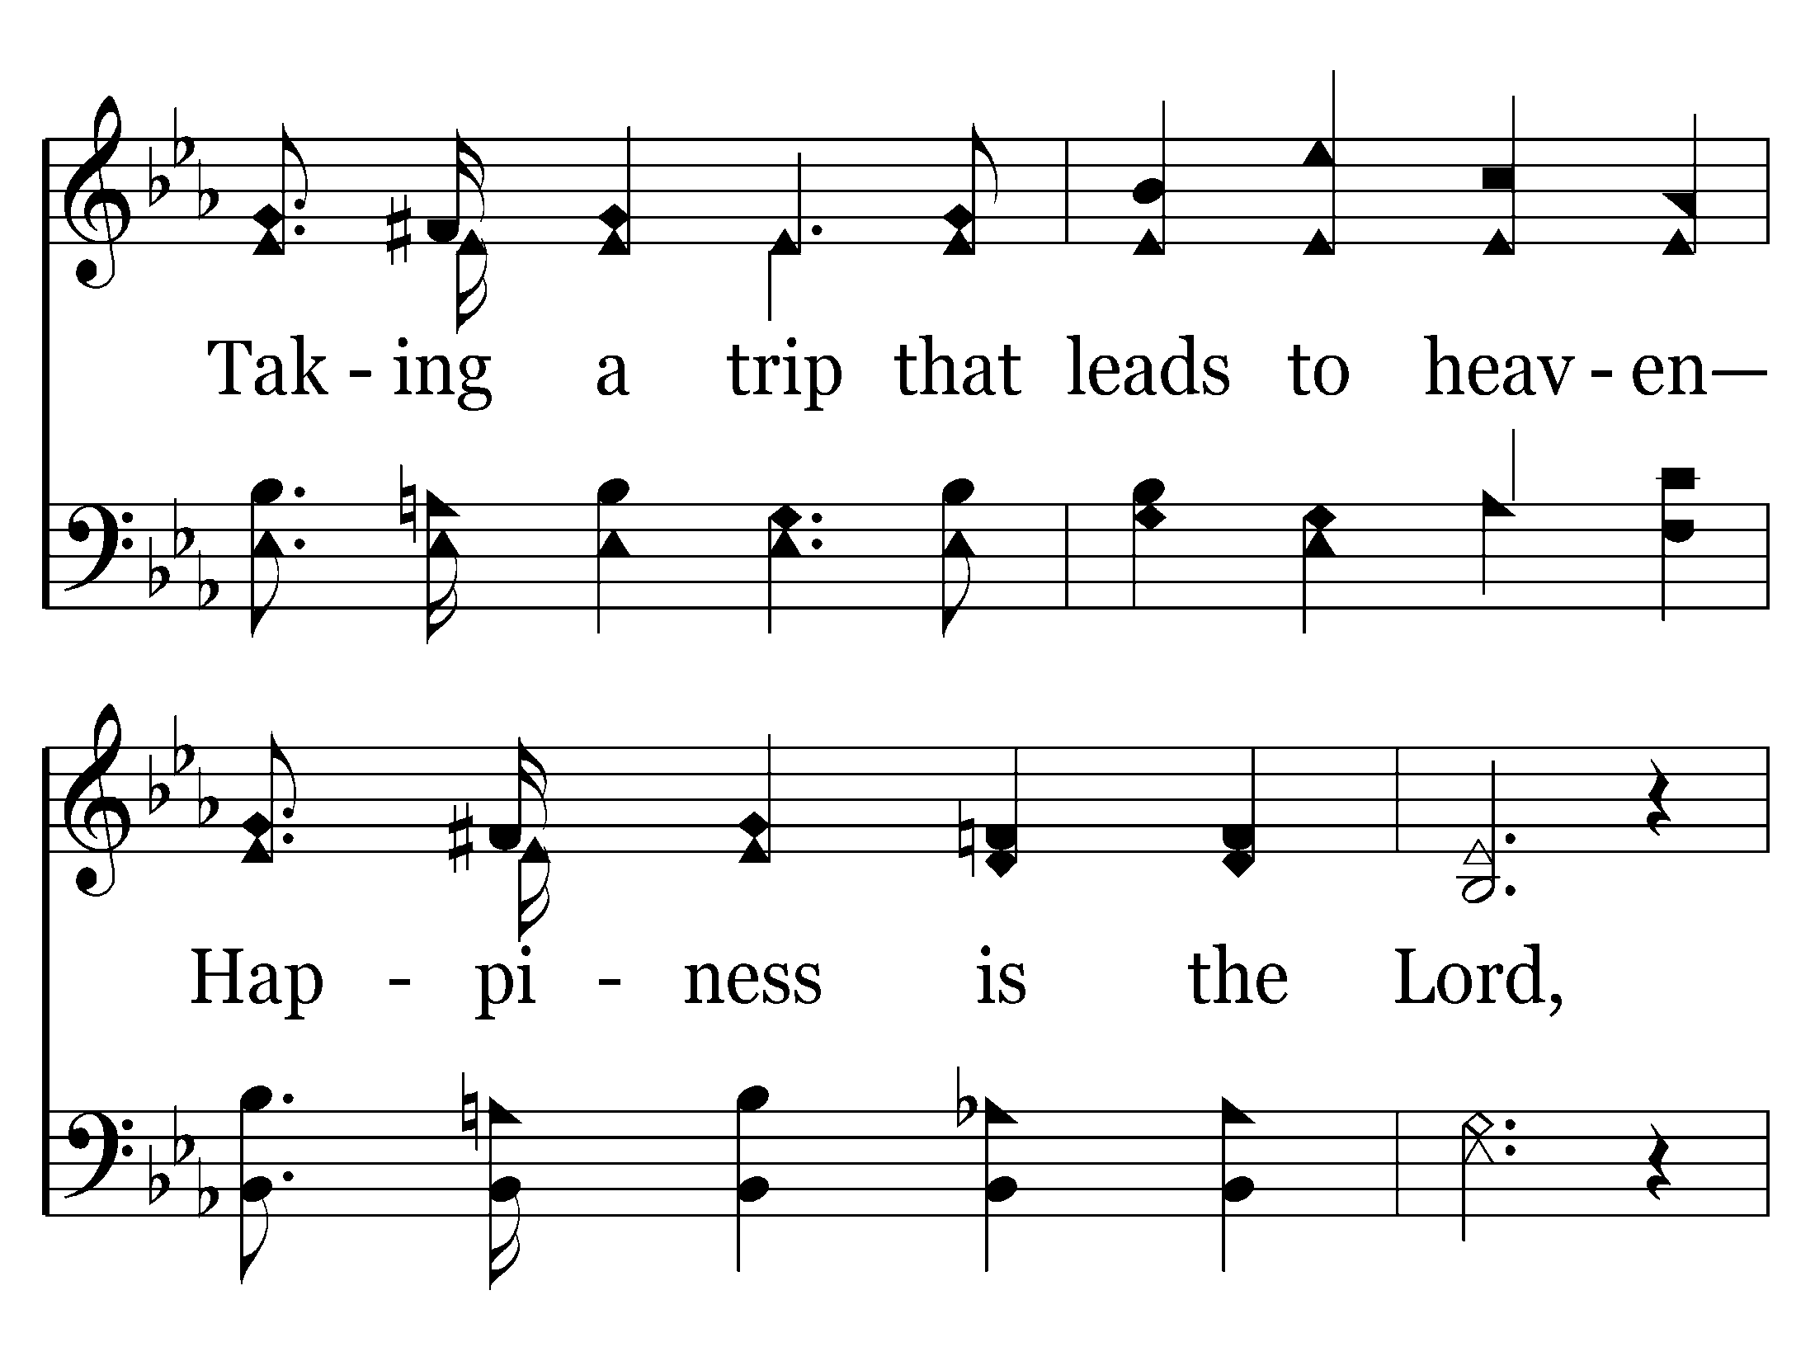
468 - Happiness Is The Lord - 3.2

Slide 72
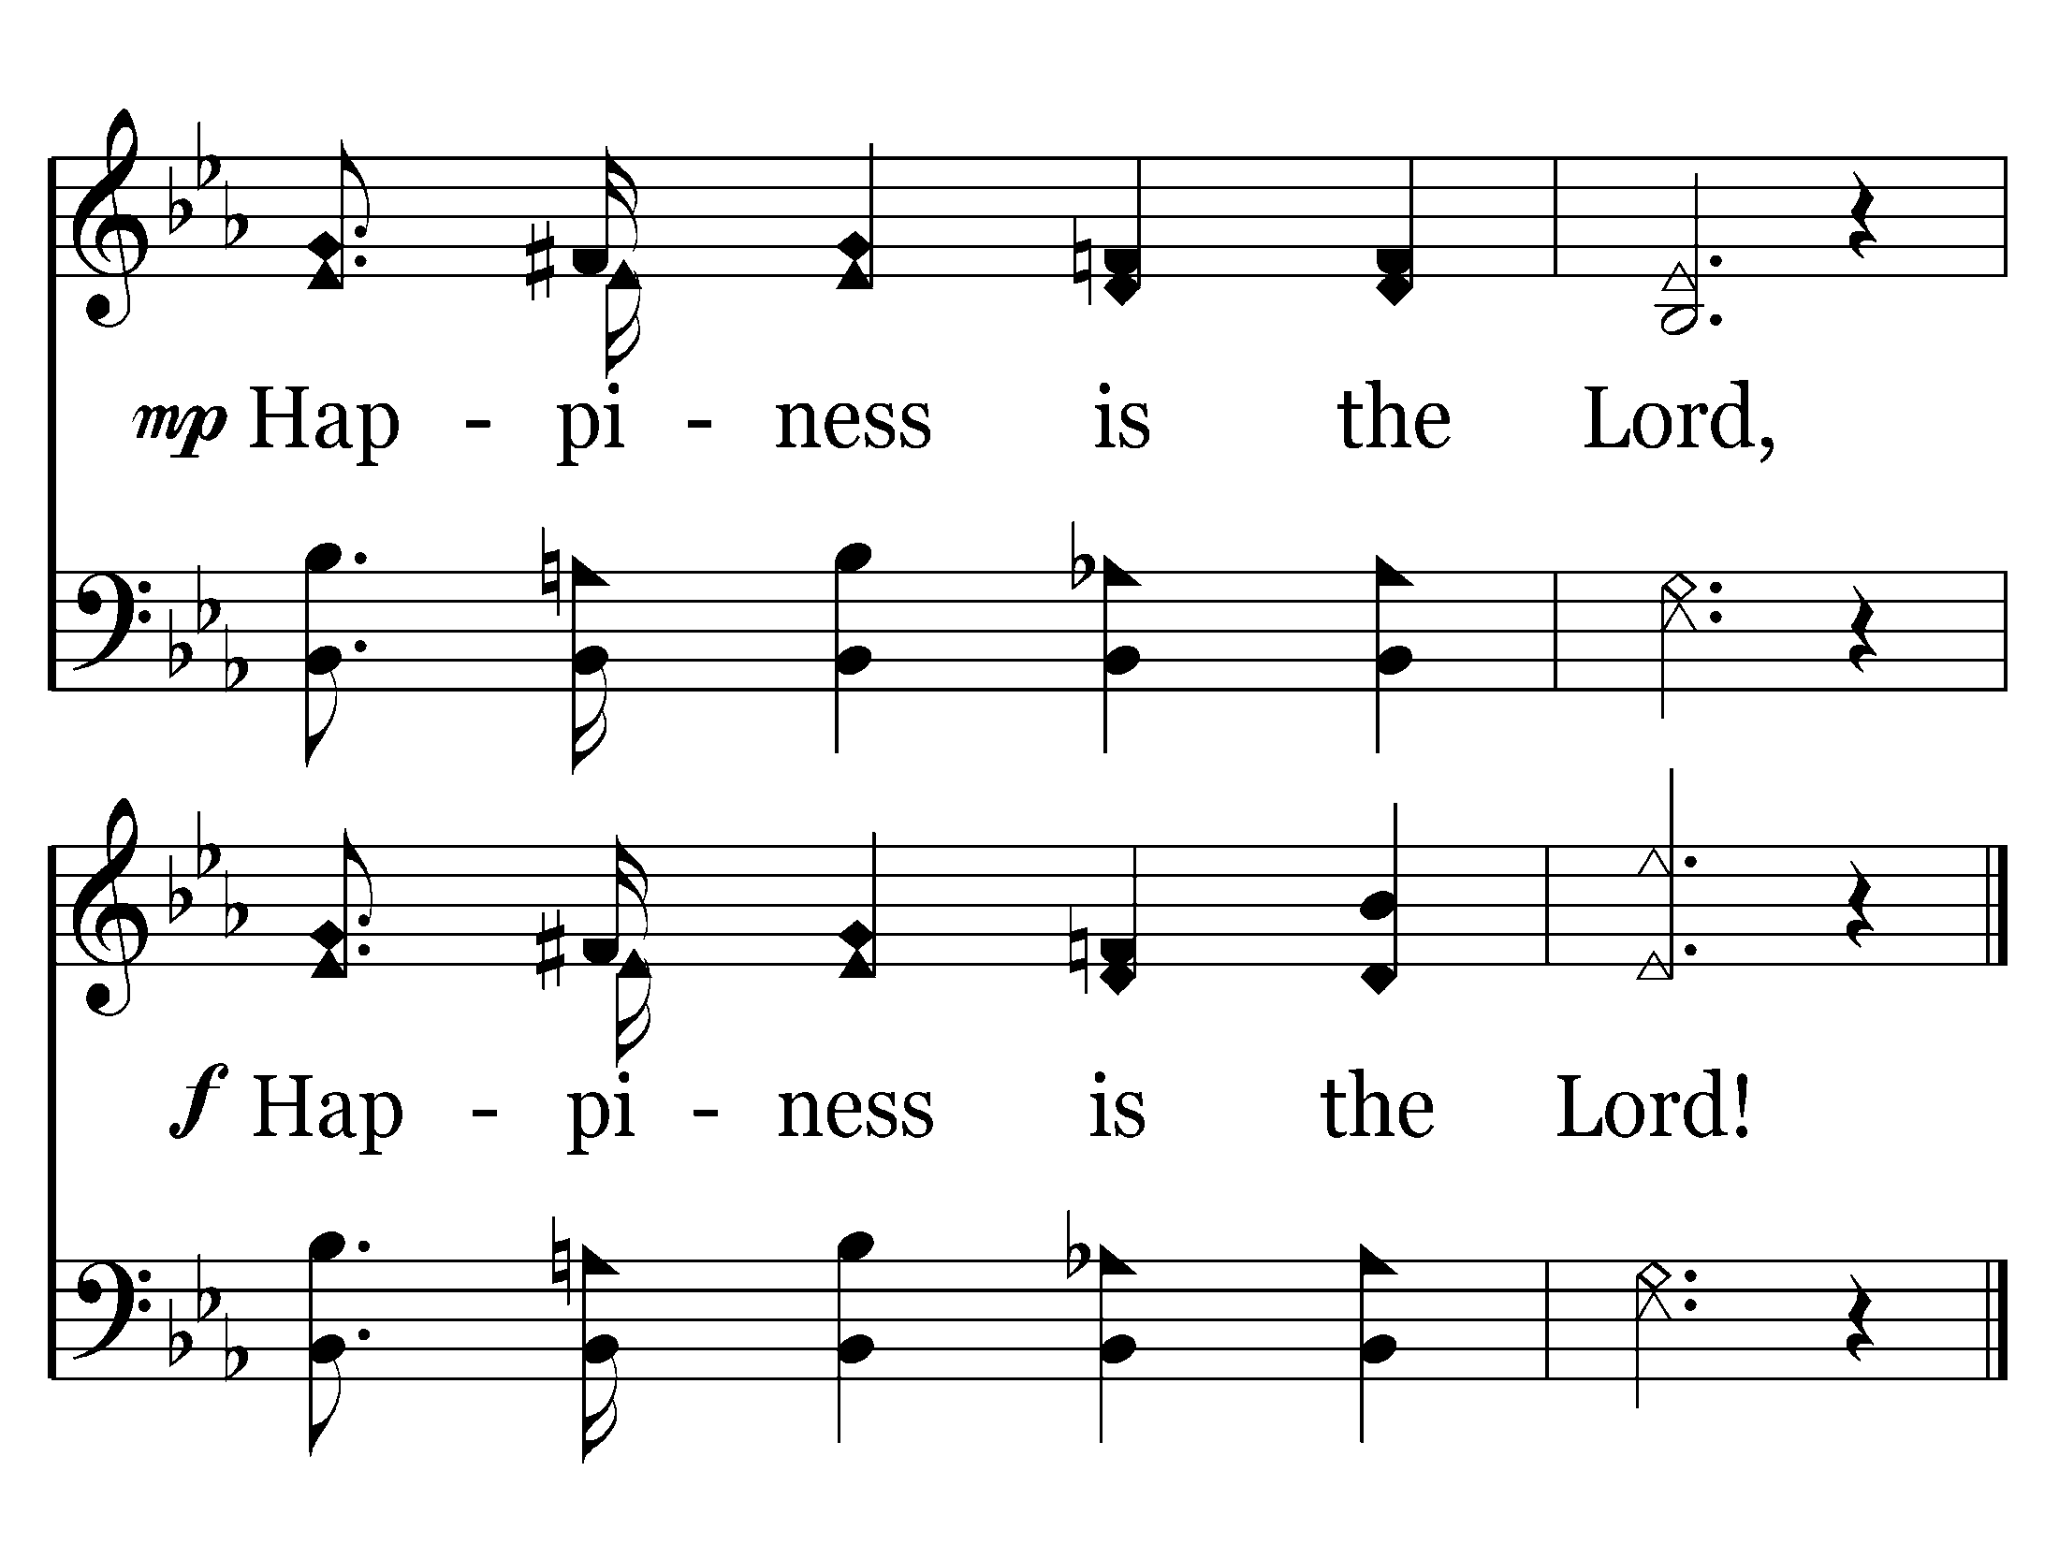
468 - Happiness Is The Lord - 3.3
End of Song

Slide 74
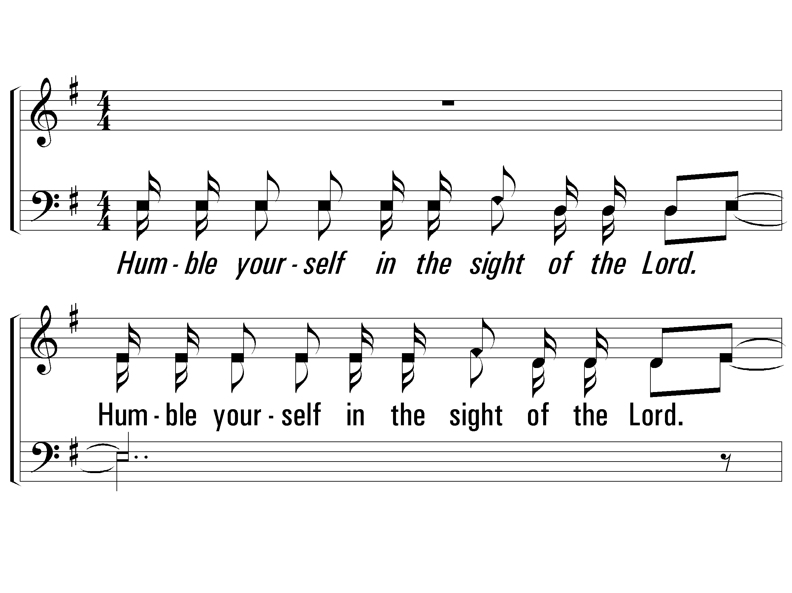
1 – Humble Yourself
1.
Humble yourself in the sight of the Lord.
Humble yourself in the sight of the Lord.
And He will lift you up.
And He will lift you up.
Words & Music: Bob Hudson
Copyright © 1978 CCCM Music (Admin. by Maranatha! Music c/o The Copyright Company, Nashville, TN) /
Maranatha! Music (Admin. by The Copyright Company, Nashville, TN)
All rights reserved. International copyright secured. Useb by permission.
© 2004 The Paperless Hymnal™

Slide 75
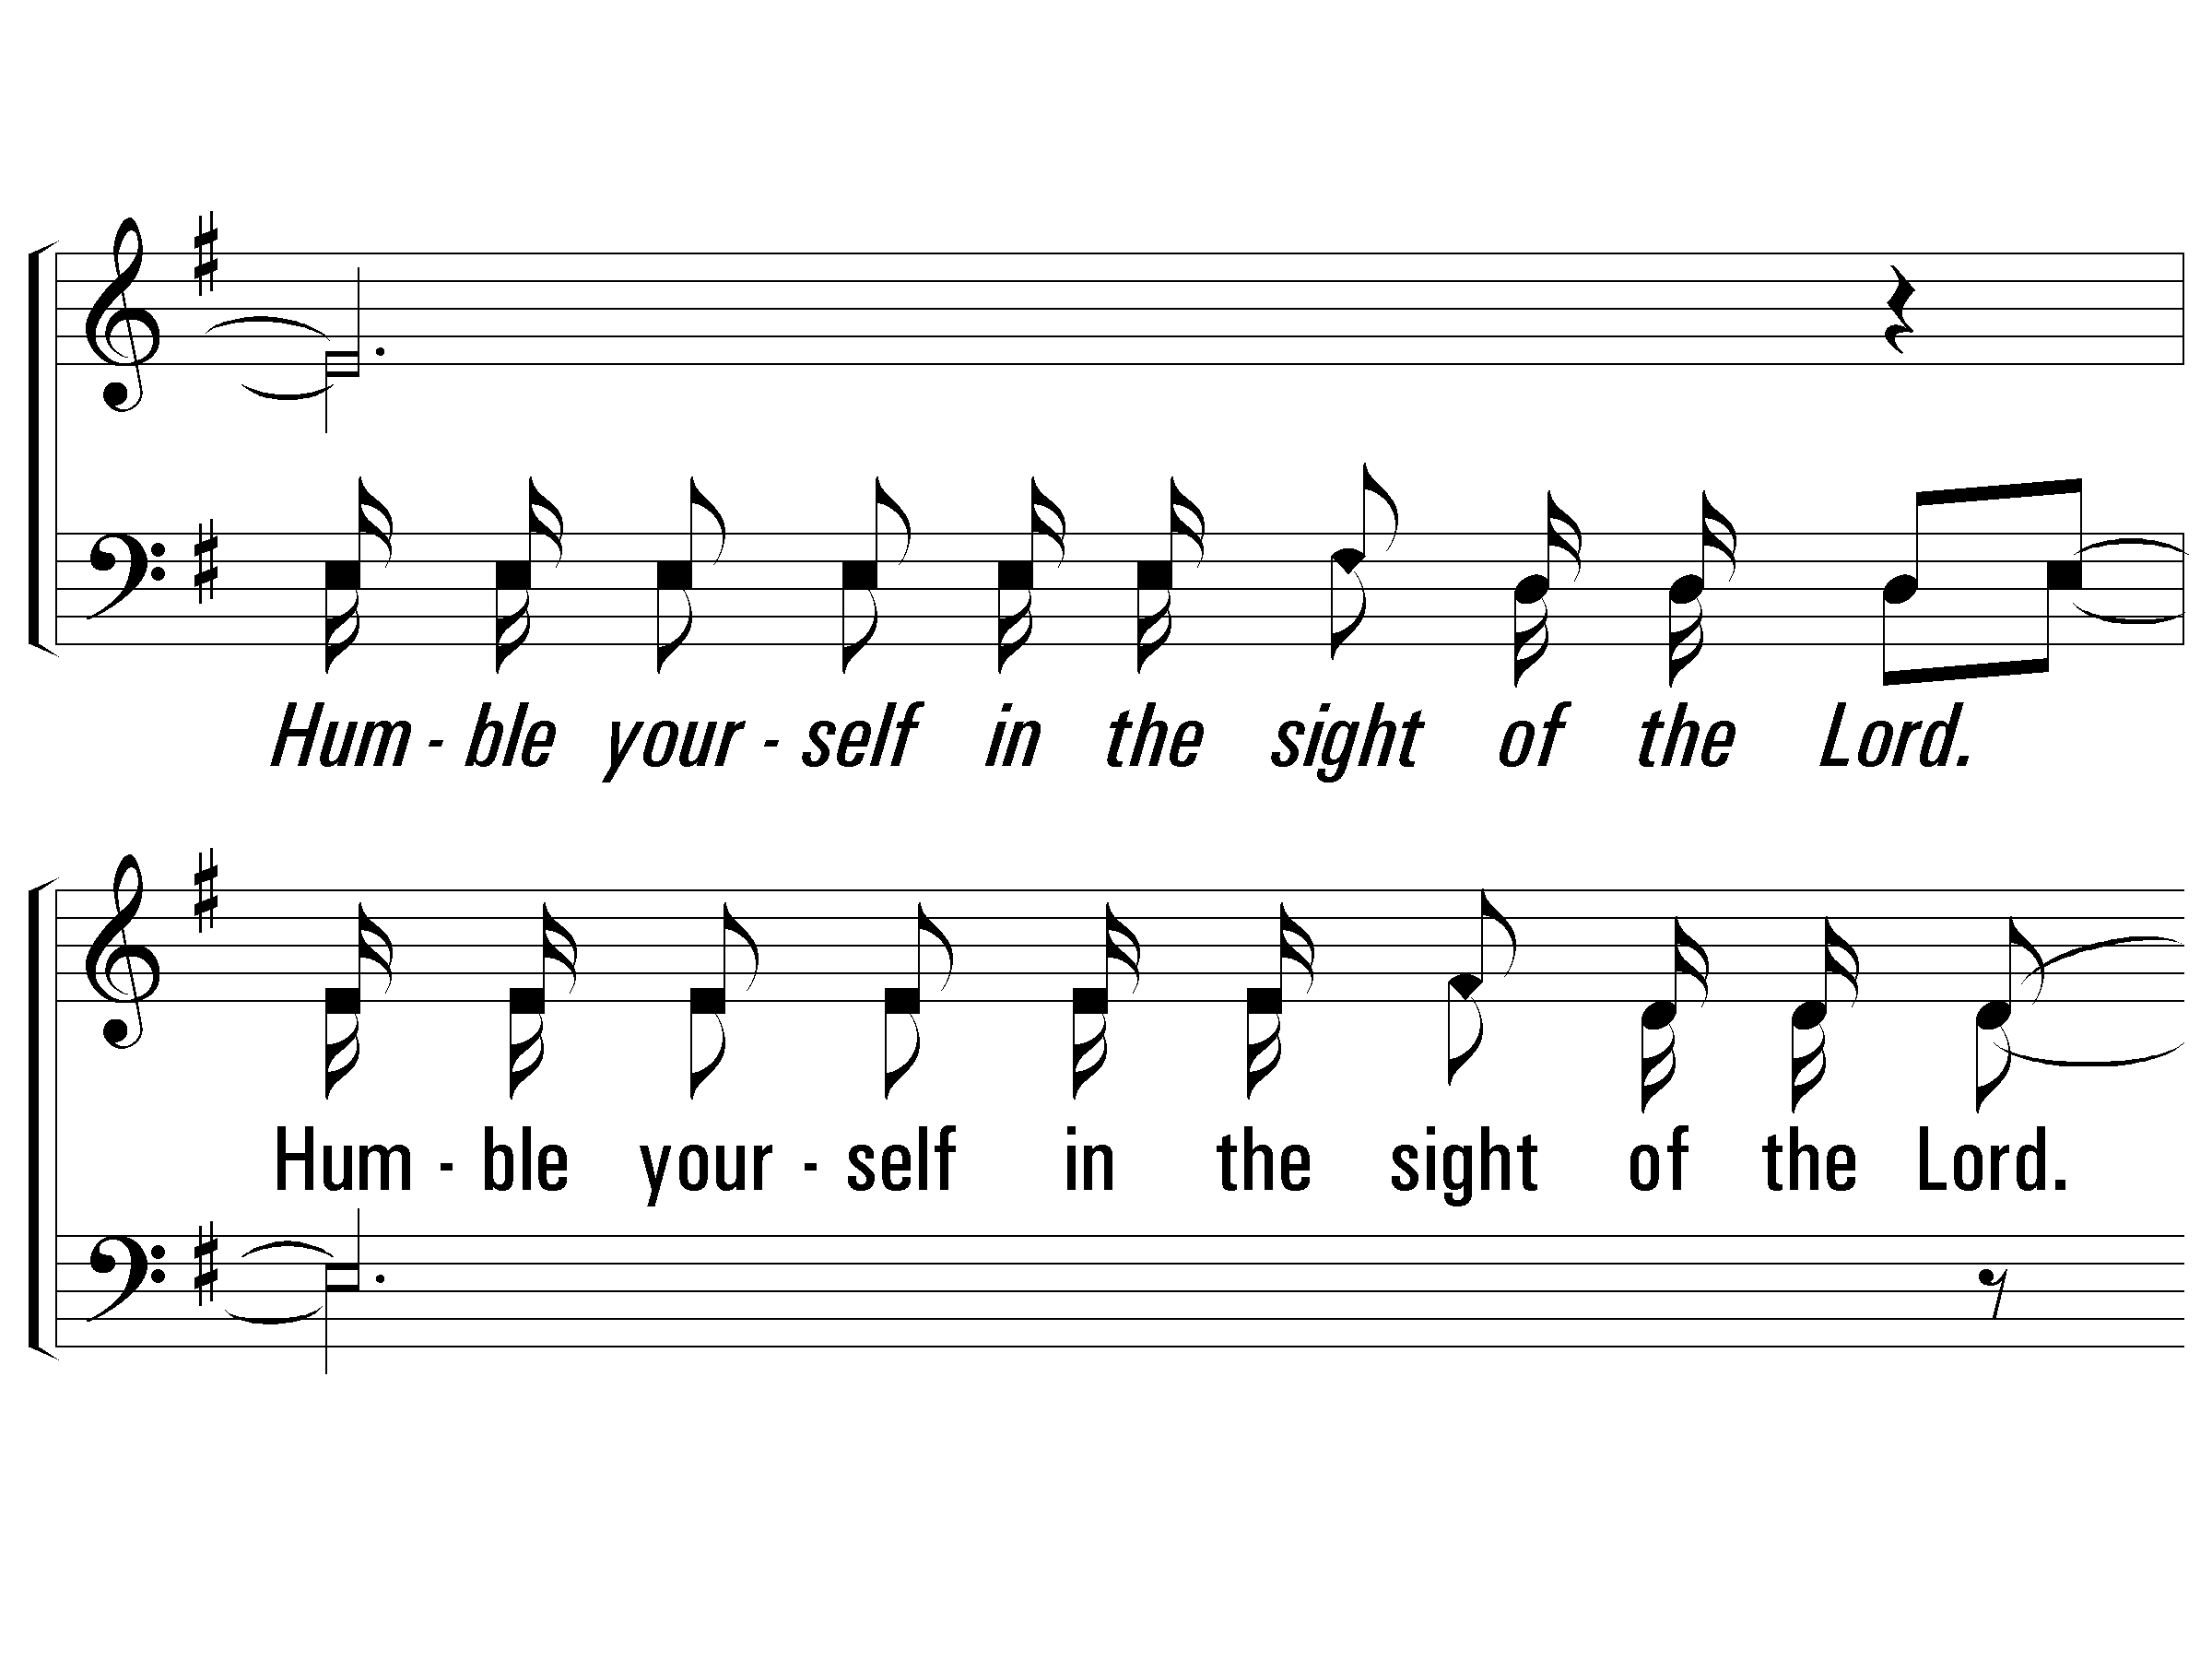
1 – Humble Yourself
© 2004 The Paperless Hymnal™

Slide 76
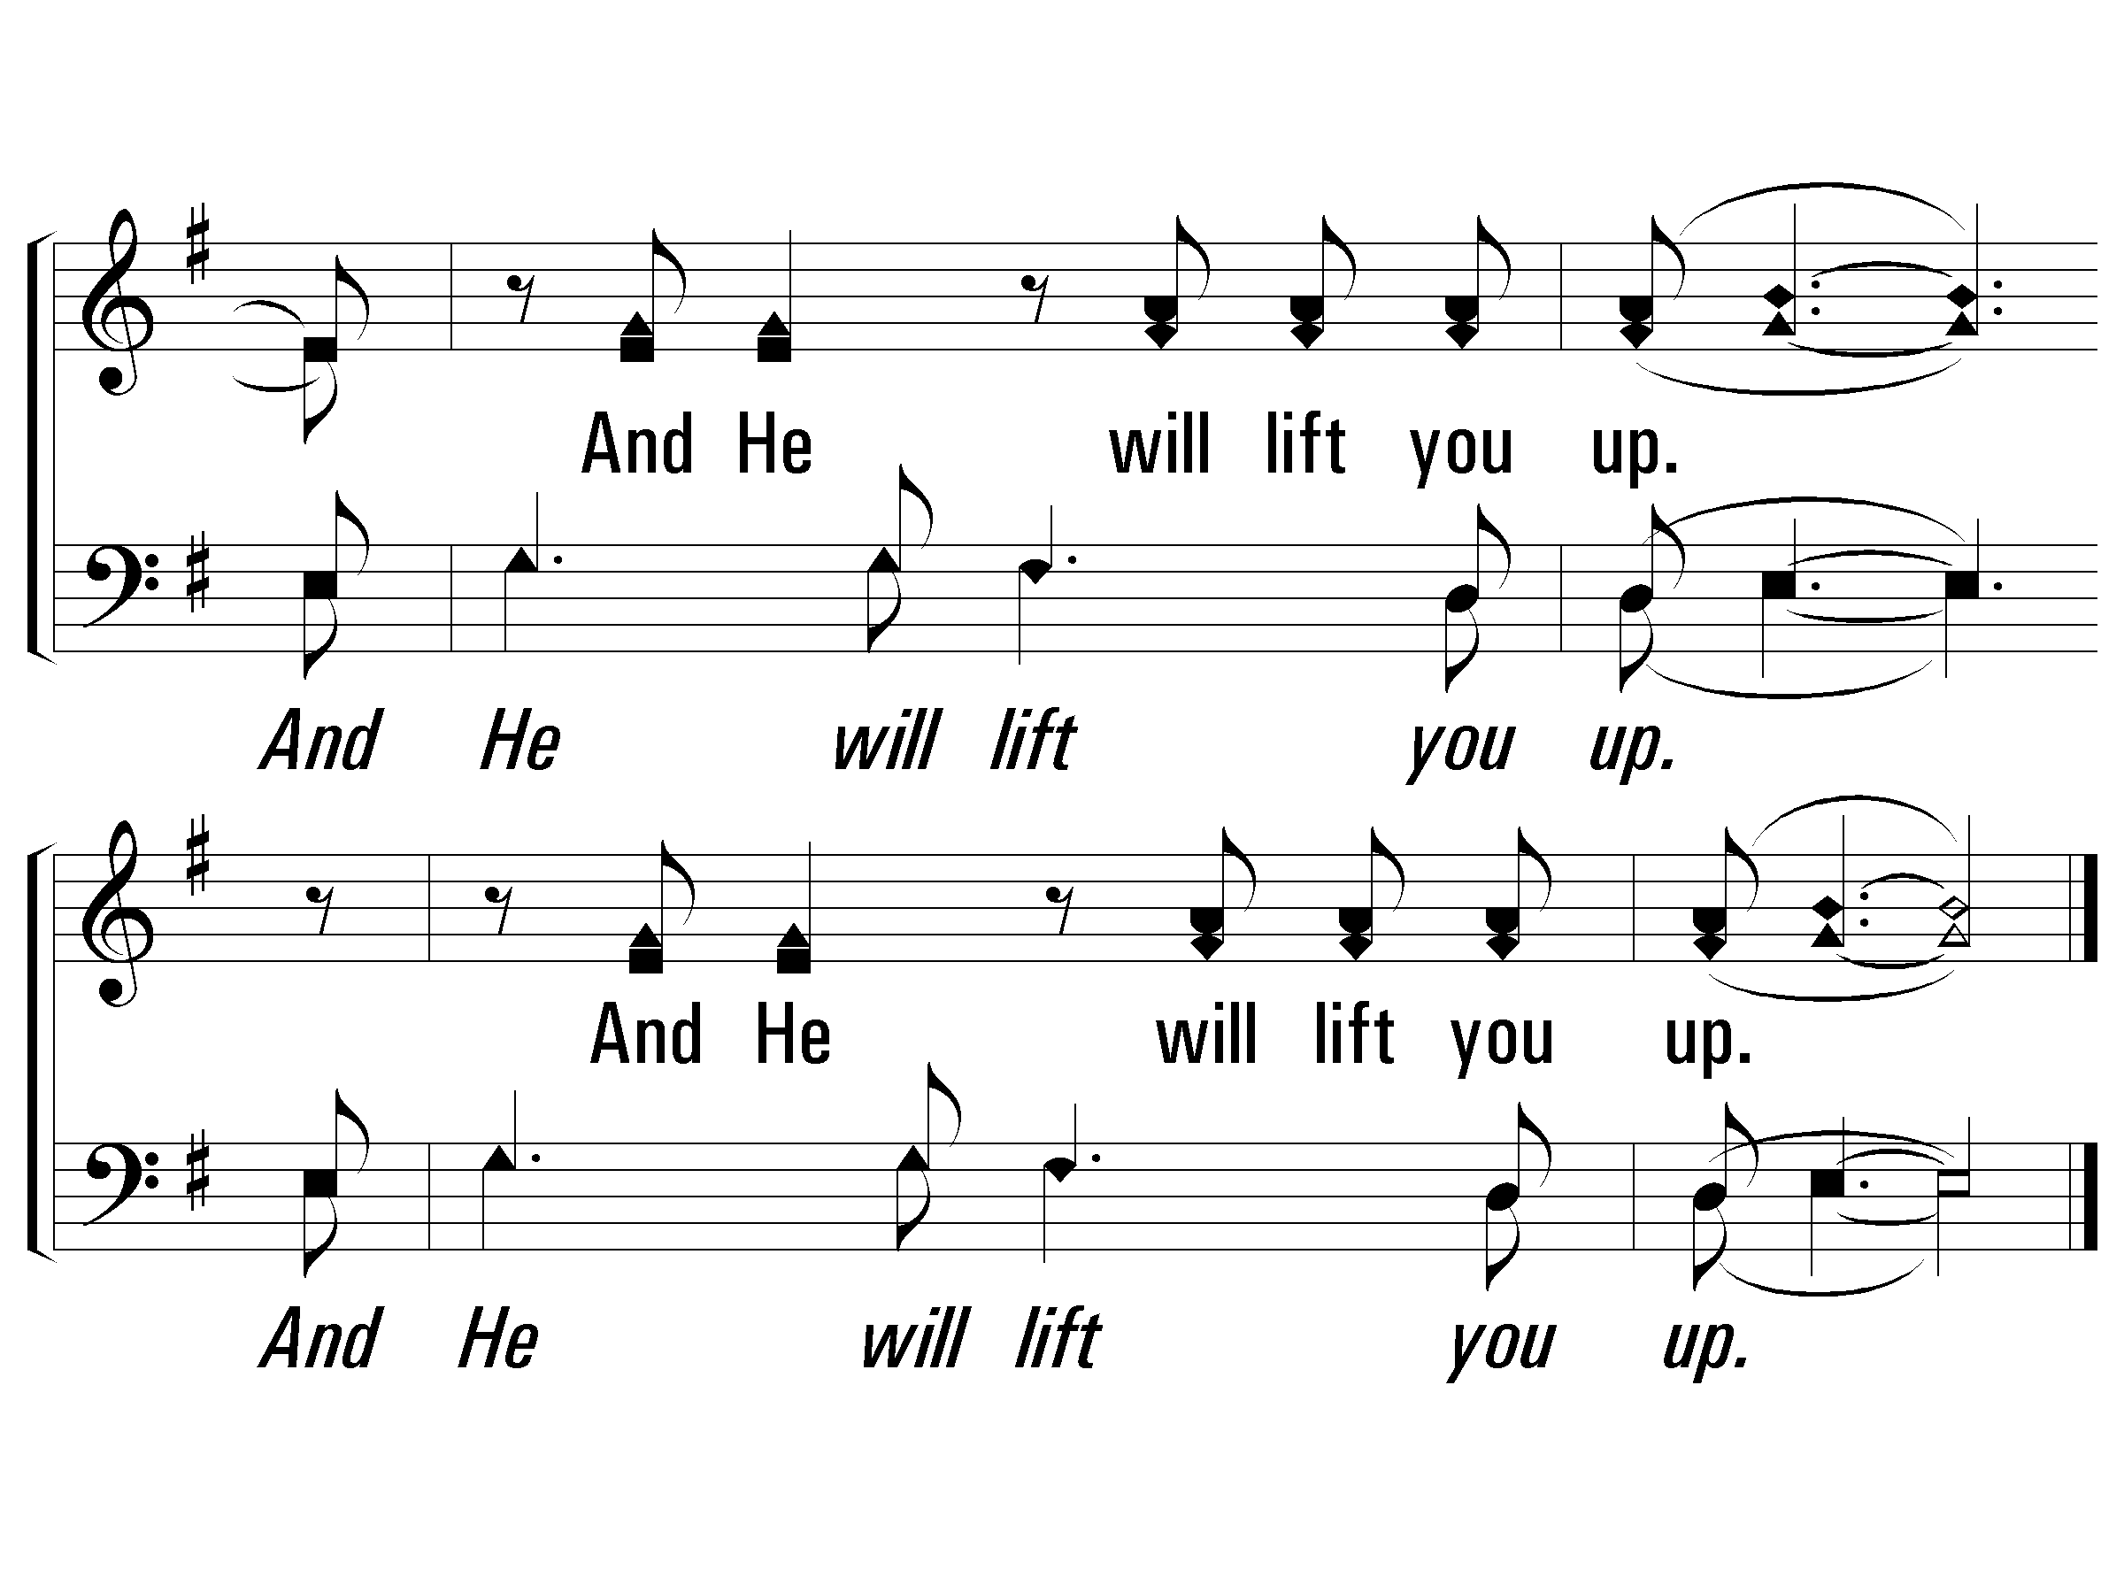
1 – Humble Yourself
© 2004 The Paperless Hymnal™

Slide 77
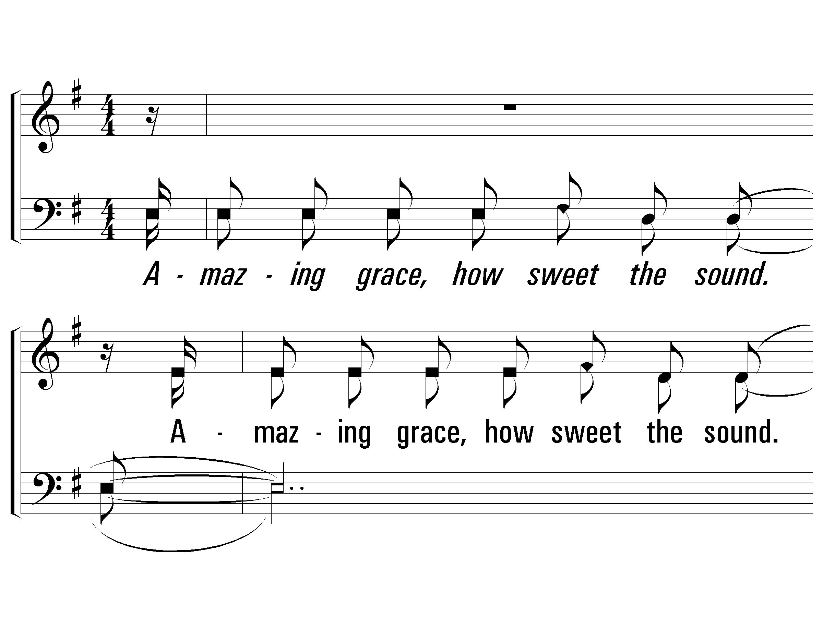
3 – Humble Yourself
3.
Amazing grace, how sweet the sound.
Amazing grace, how sweet the sound.
That saved a wretch like me.
That saved a wretch like me.
Words & Music: Bob Hudson
Copyright © 1978 CCCM Music (Admin. by Maranatha! Music c/o The Copyright Company, Nashville, TN) /
Maranatha! Music (Admin. by The Copyright Company, Nashville, TN)
All rights reserved. International copyright secured. Useb by permission.
© 2004 The Paperless Hymnal™

Slide 78
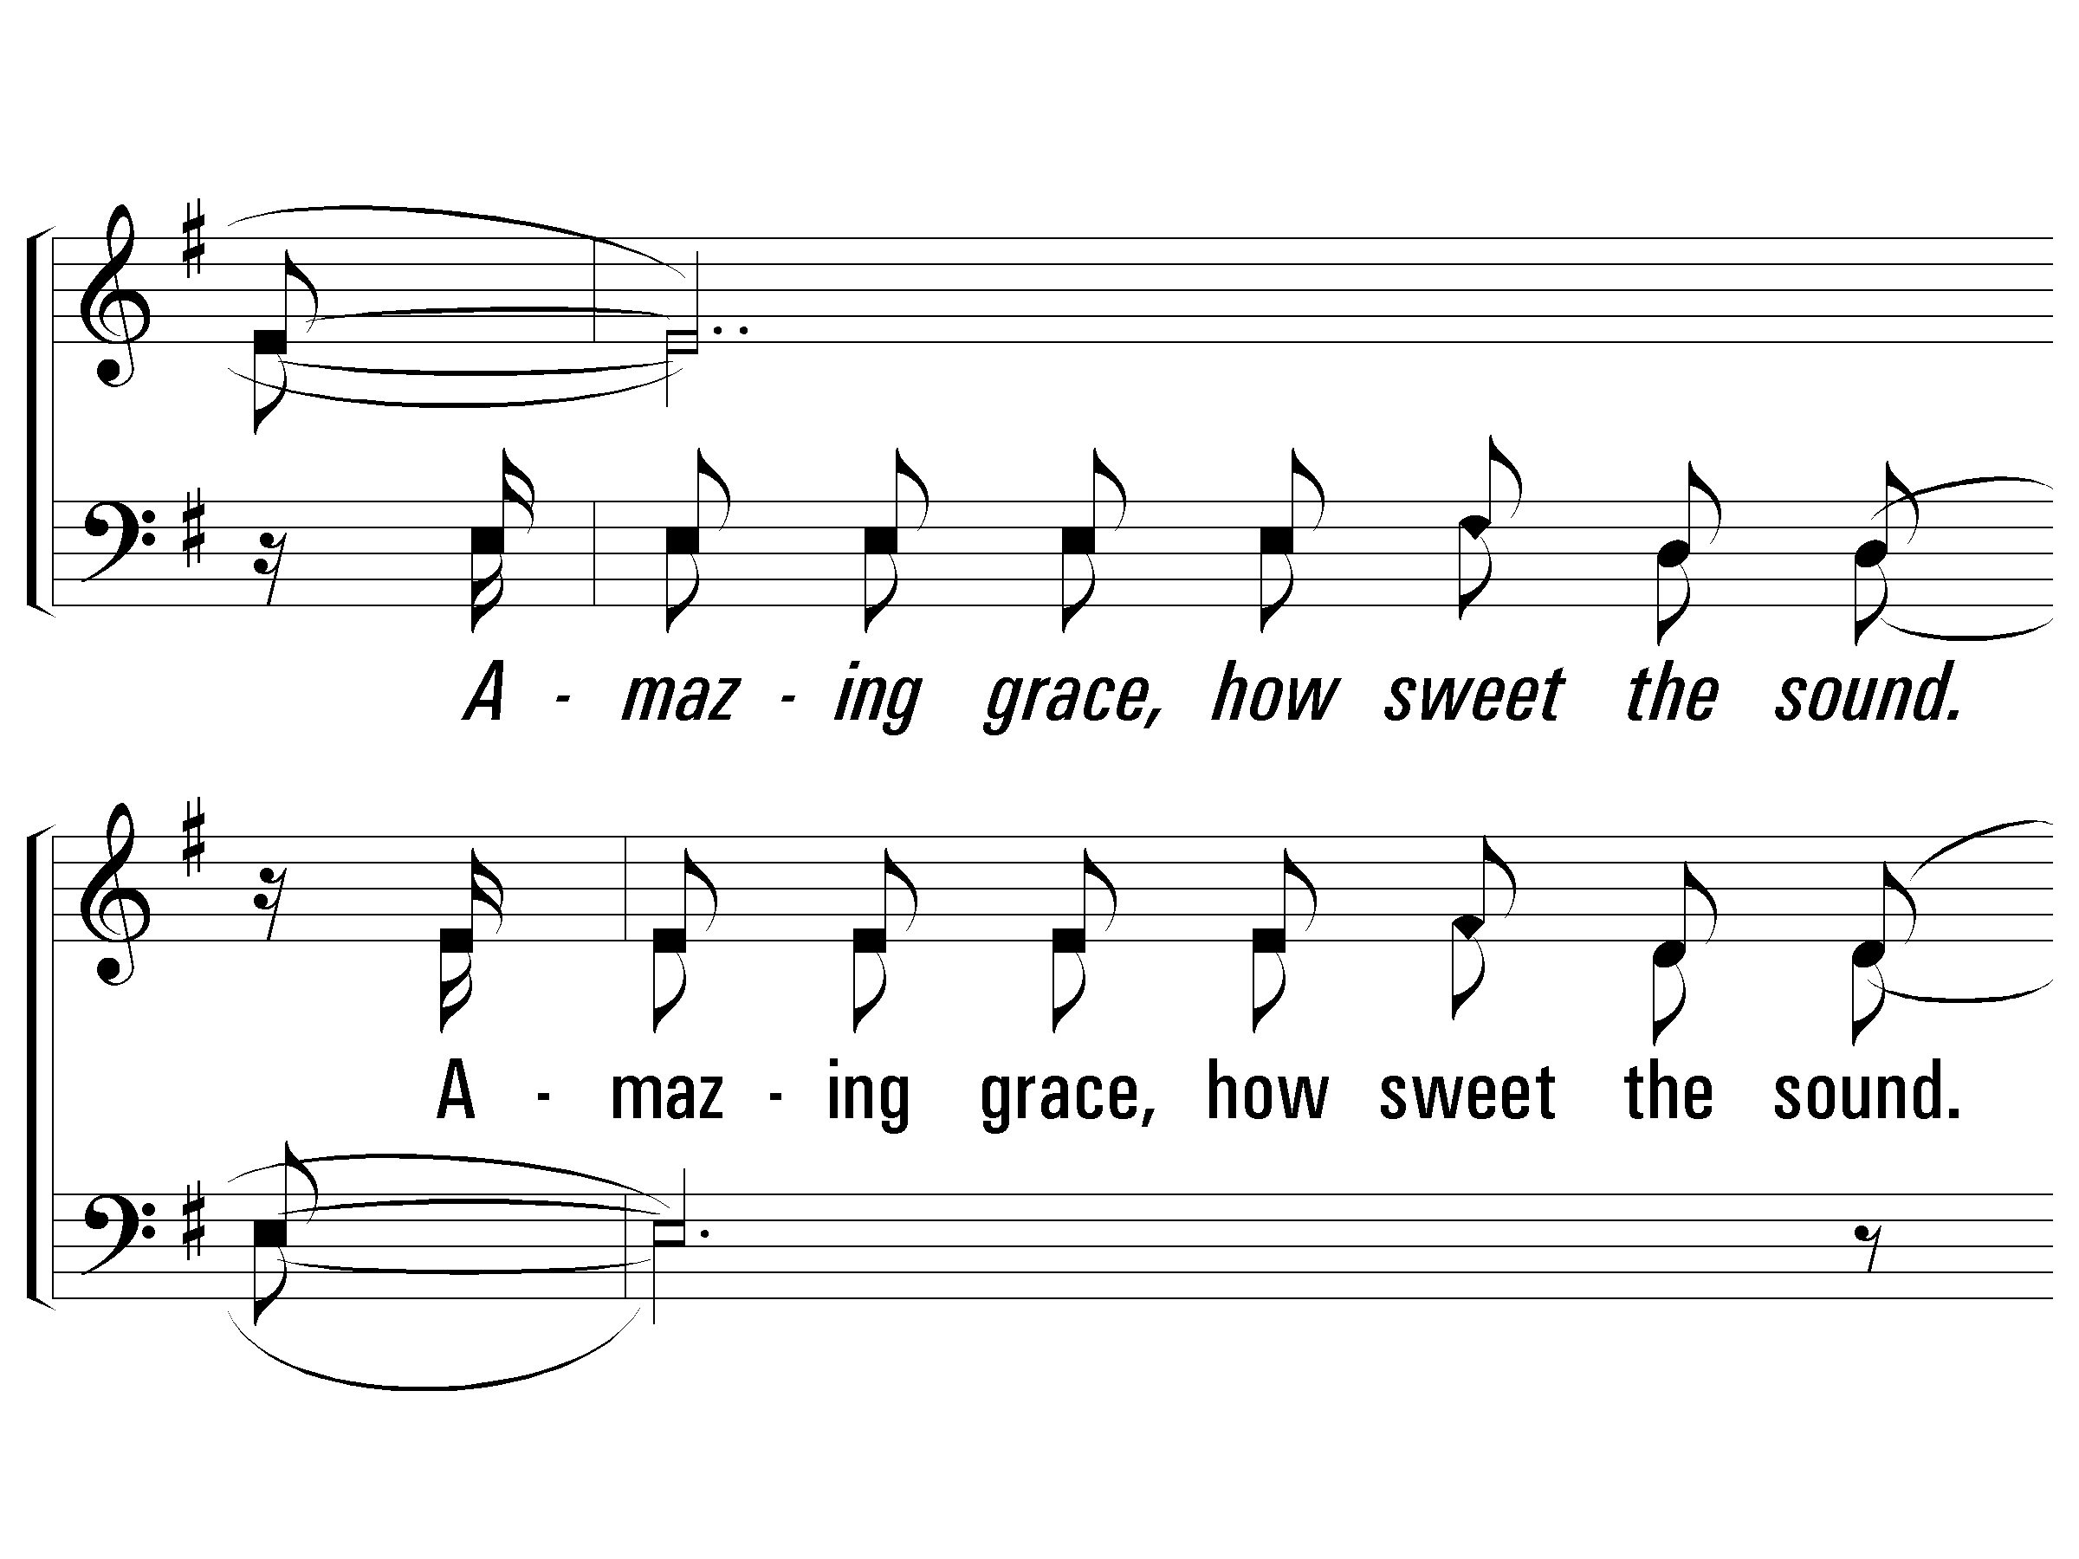
3 – Humble Yourself
© 2004 The Paperless Hymnal™

Slide 79
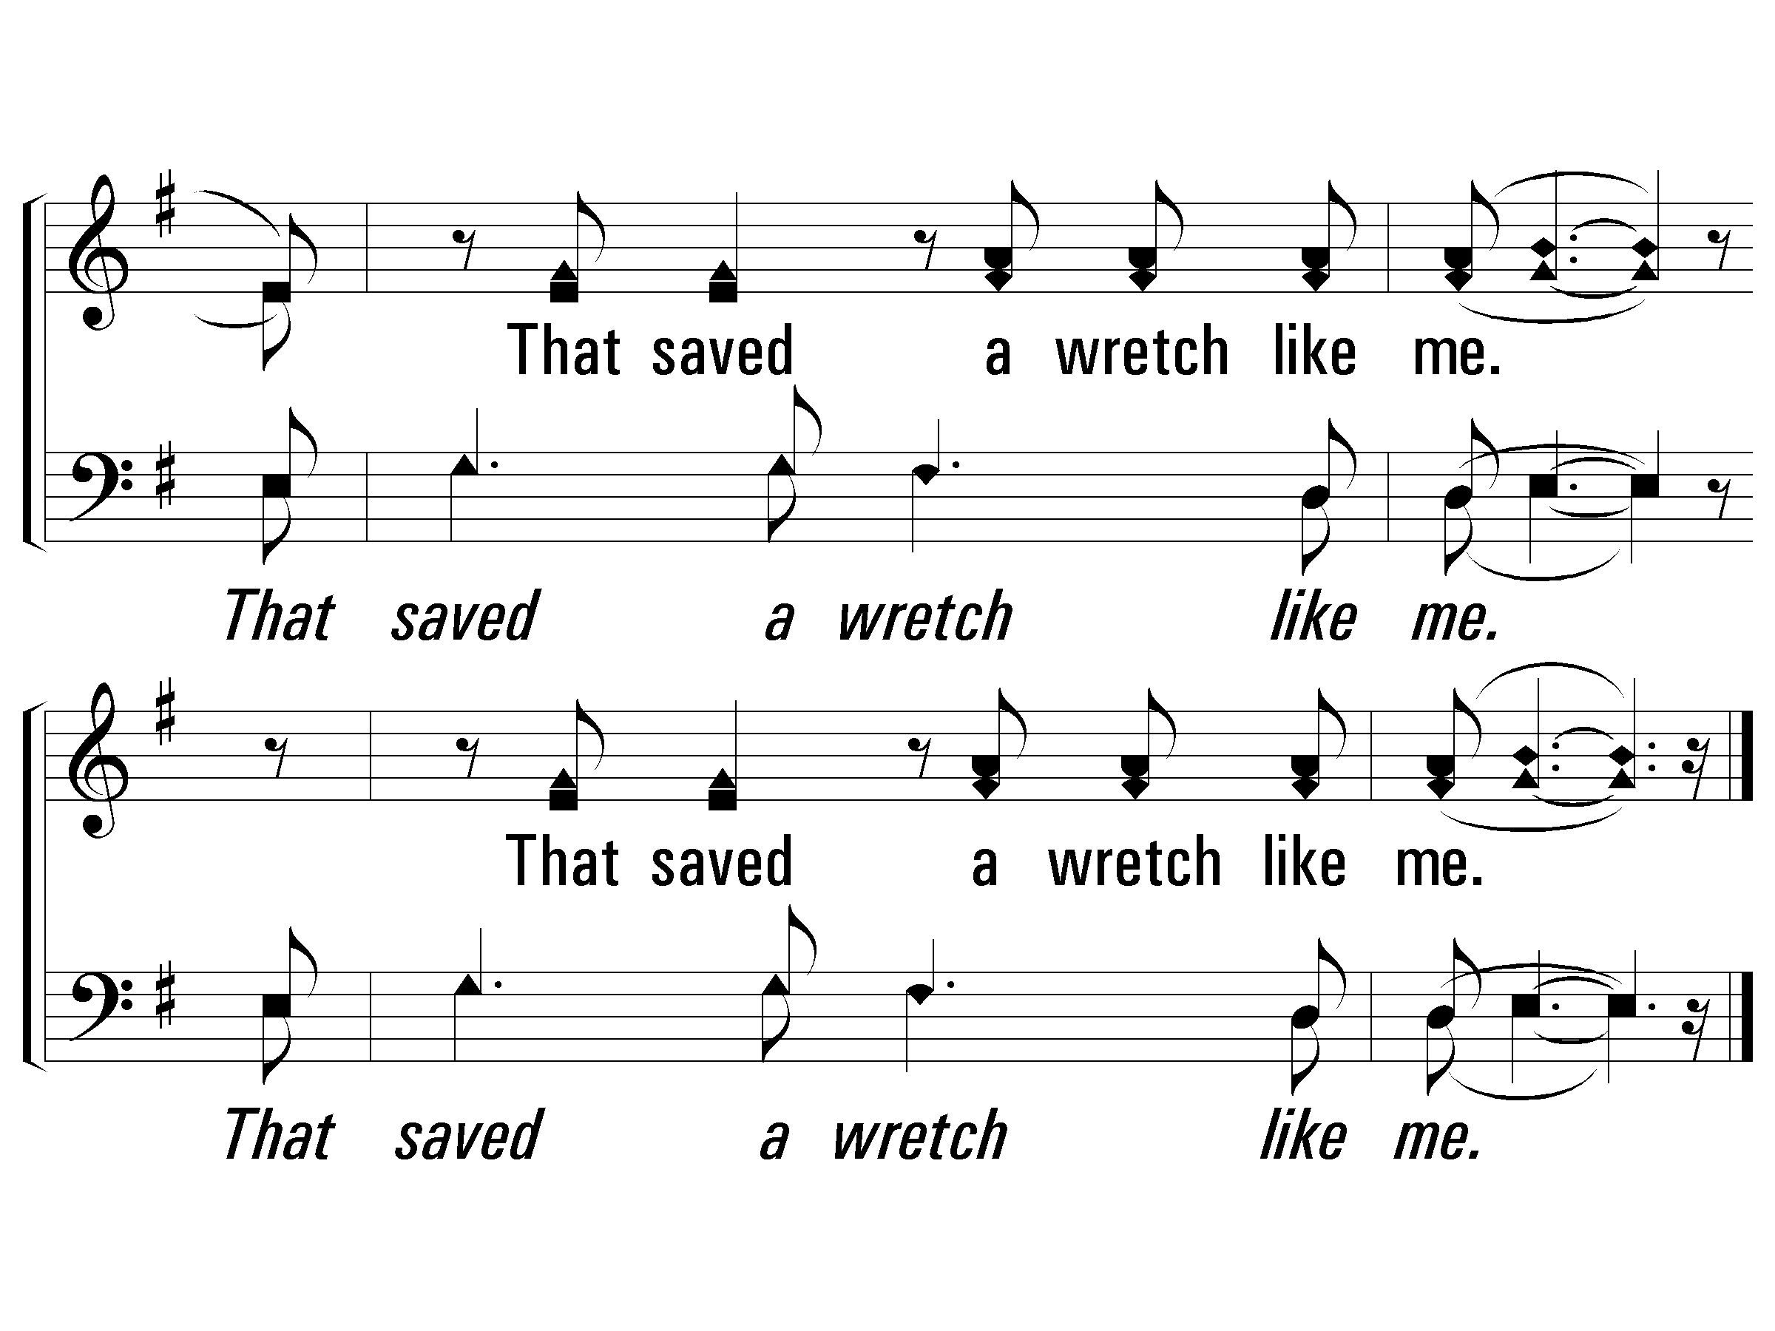
3 – Humble Yourself
© 2004 The Paperless Hymnal™

Slide 80
5 – Humble Yourself
5.
Humble yourself in the sight of the Lord.
Humble yourself in the sight of the Lord.
And He will lift you up.
And He will lift you up.
Words & Music: Bob Hudson
Copyright © 1978 CCCM Music (Admin. by Maranatha! Music c/o The Copyright Company, Nashville, TN) /
Maranatha! Music (Admin. by The Copyright Company, Nashville, TN)
All rights reserved. International copyright secured. Useb by permission.
© 2004 The Paperless Hymnal™

Slide 81
5 – Humble Yourself
© 2004 The Paperless Hymnal™

Slide 82
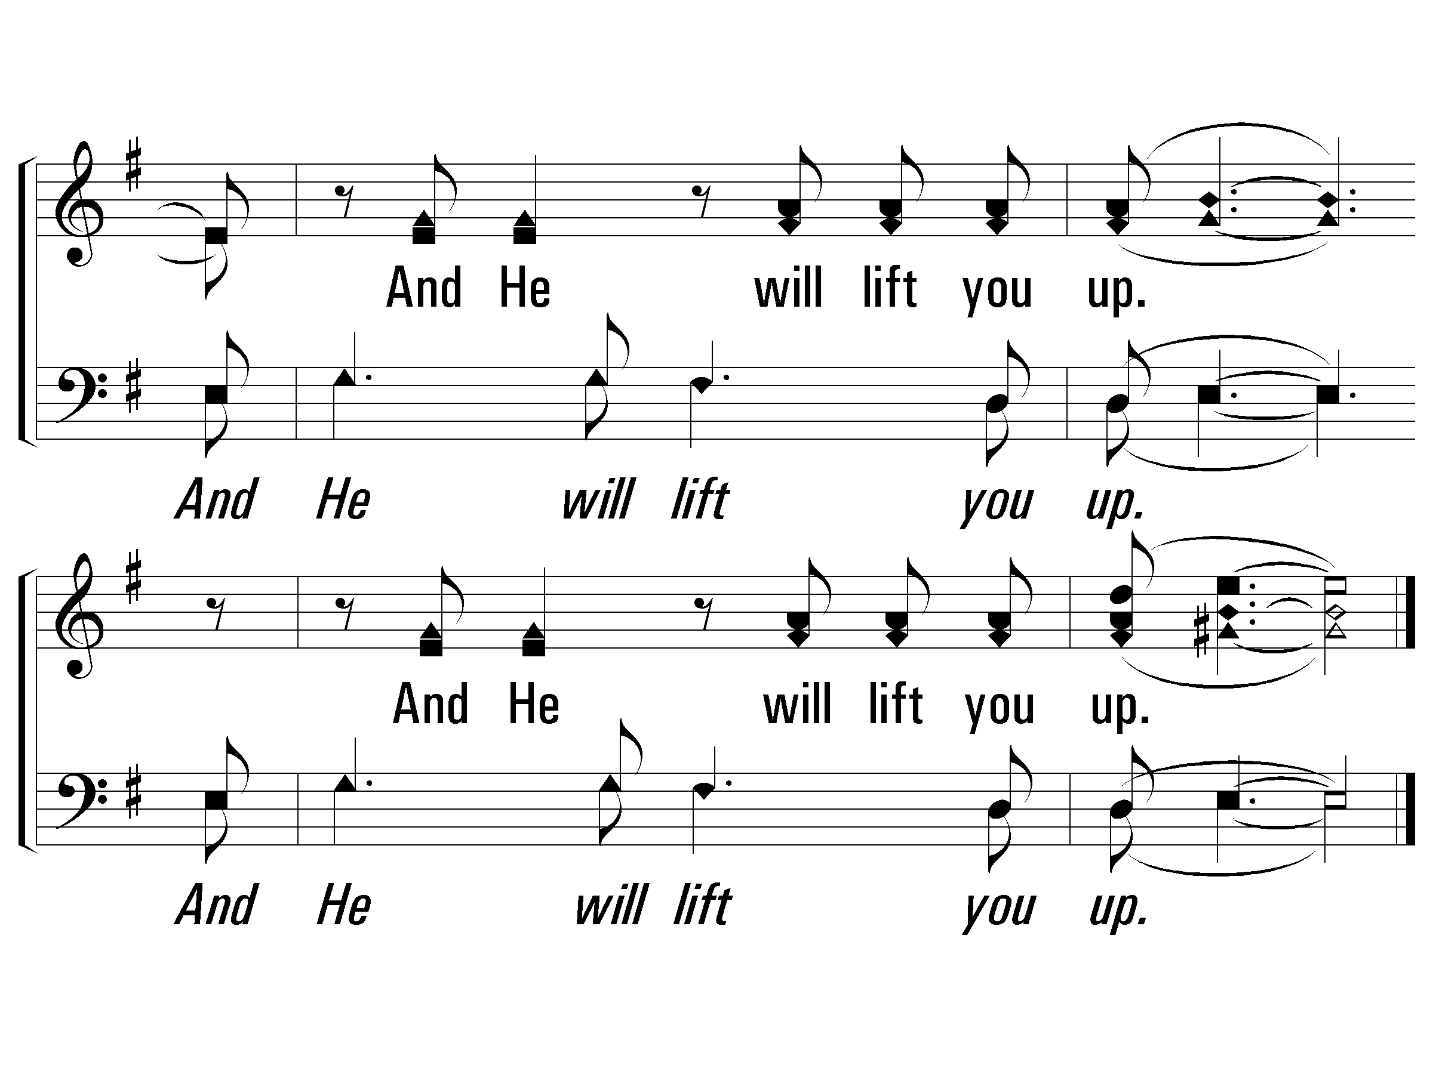
5 – Humble Yourself
© 2004 The Paperless Hymnal™

Slide 84
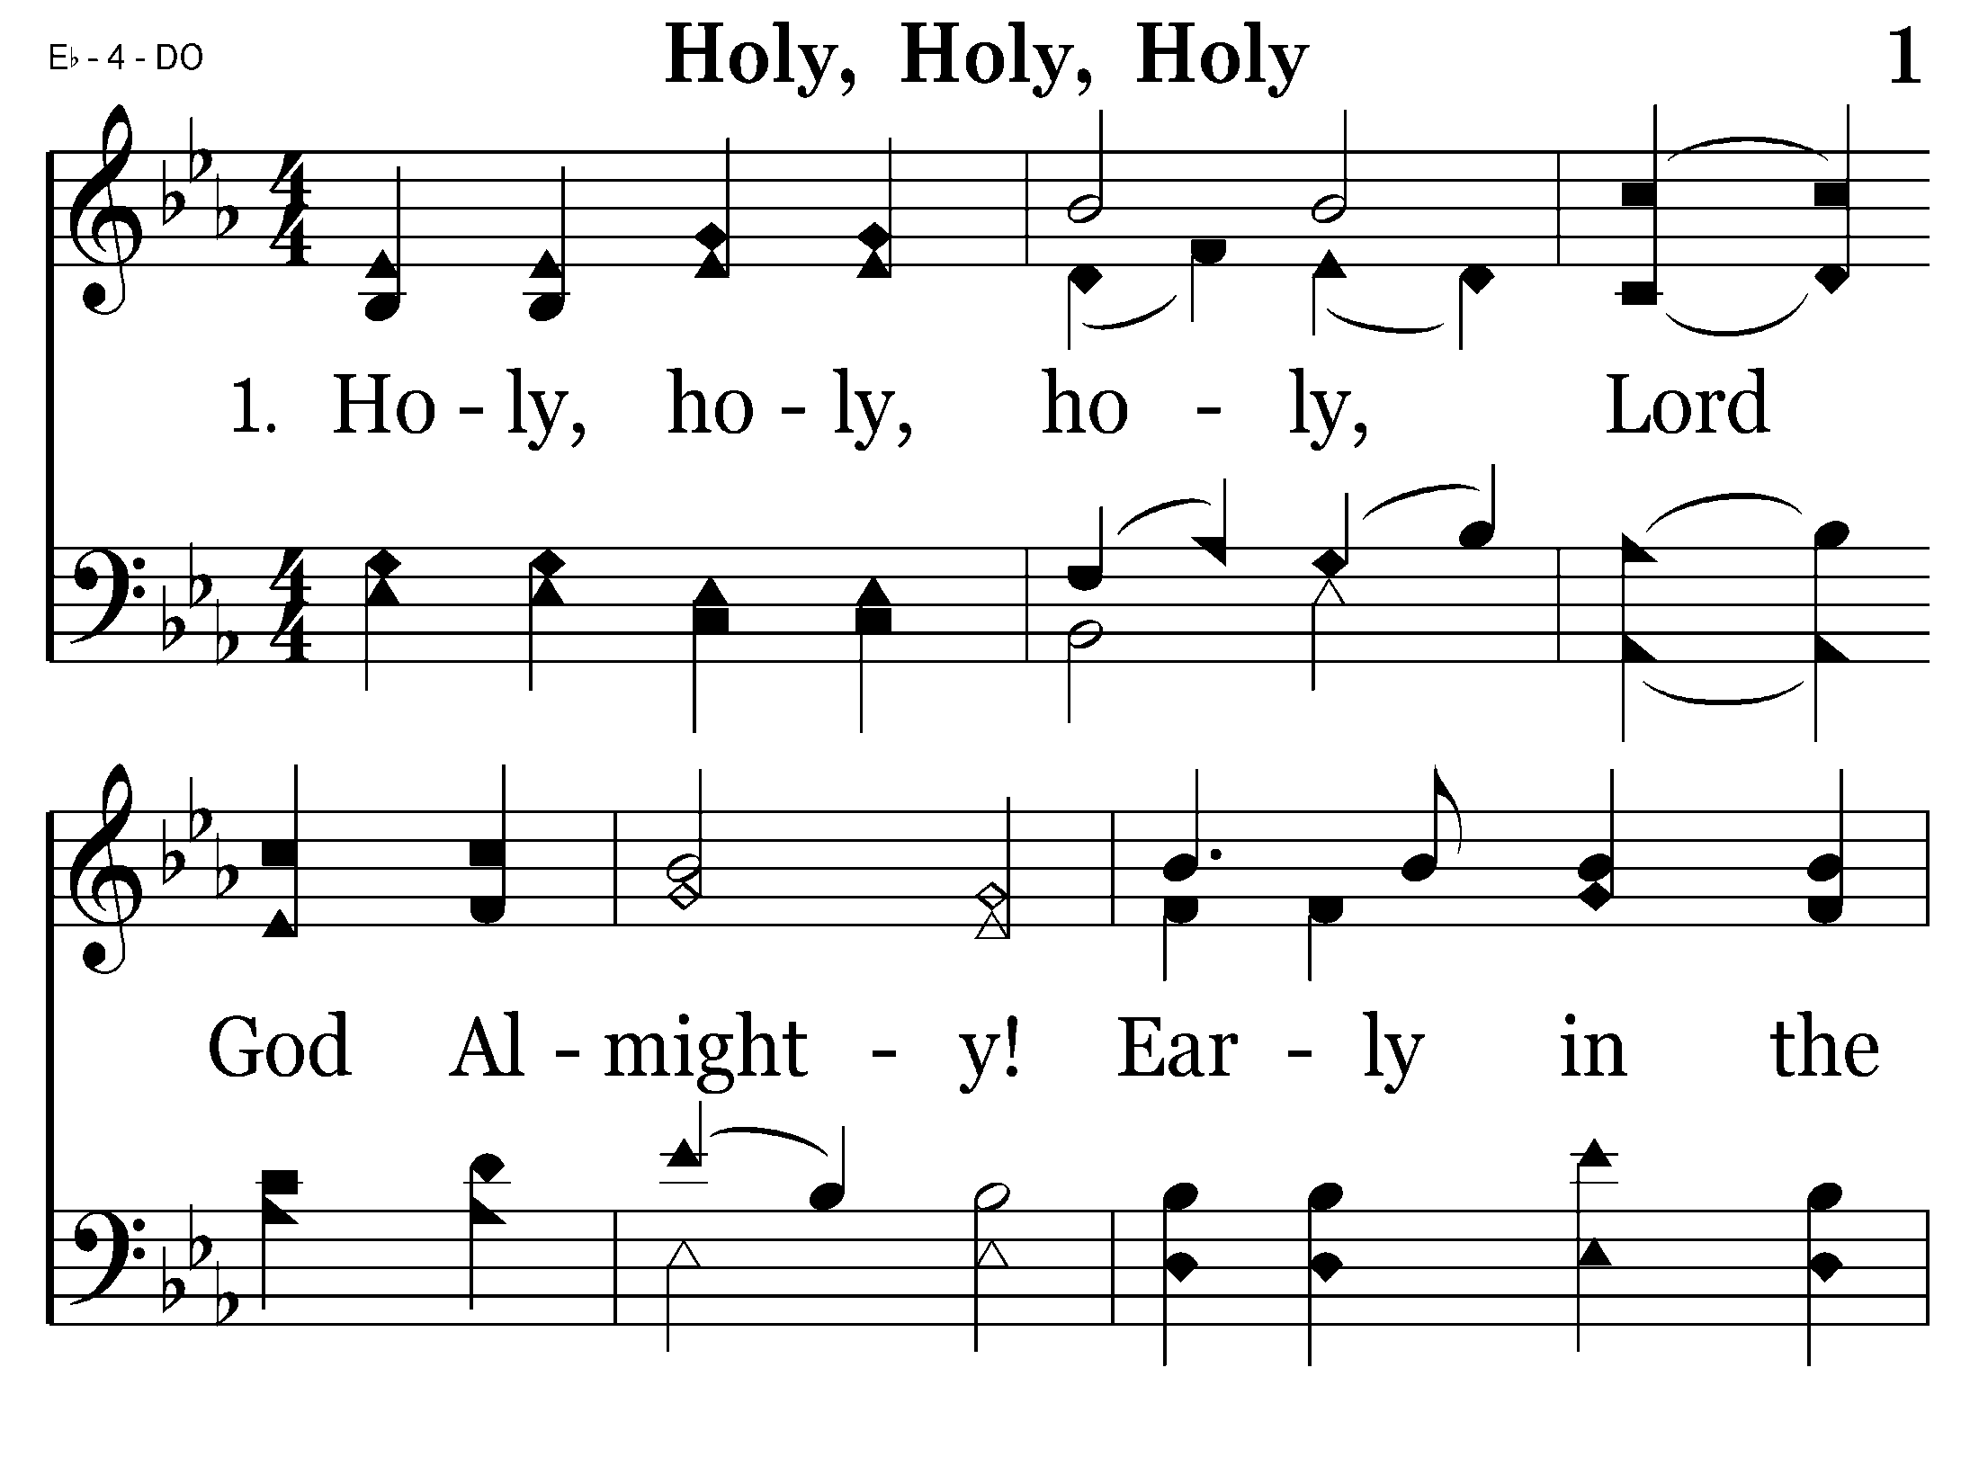
001 - Holy, Holy, Holy - 1.1

Slide 85
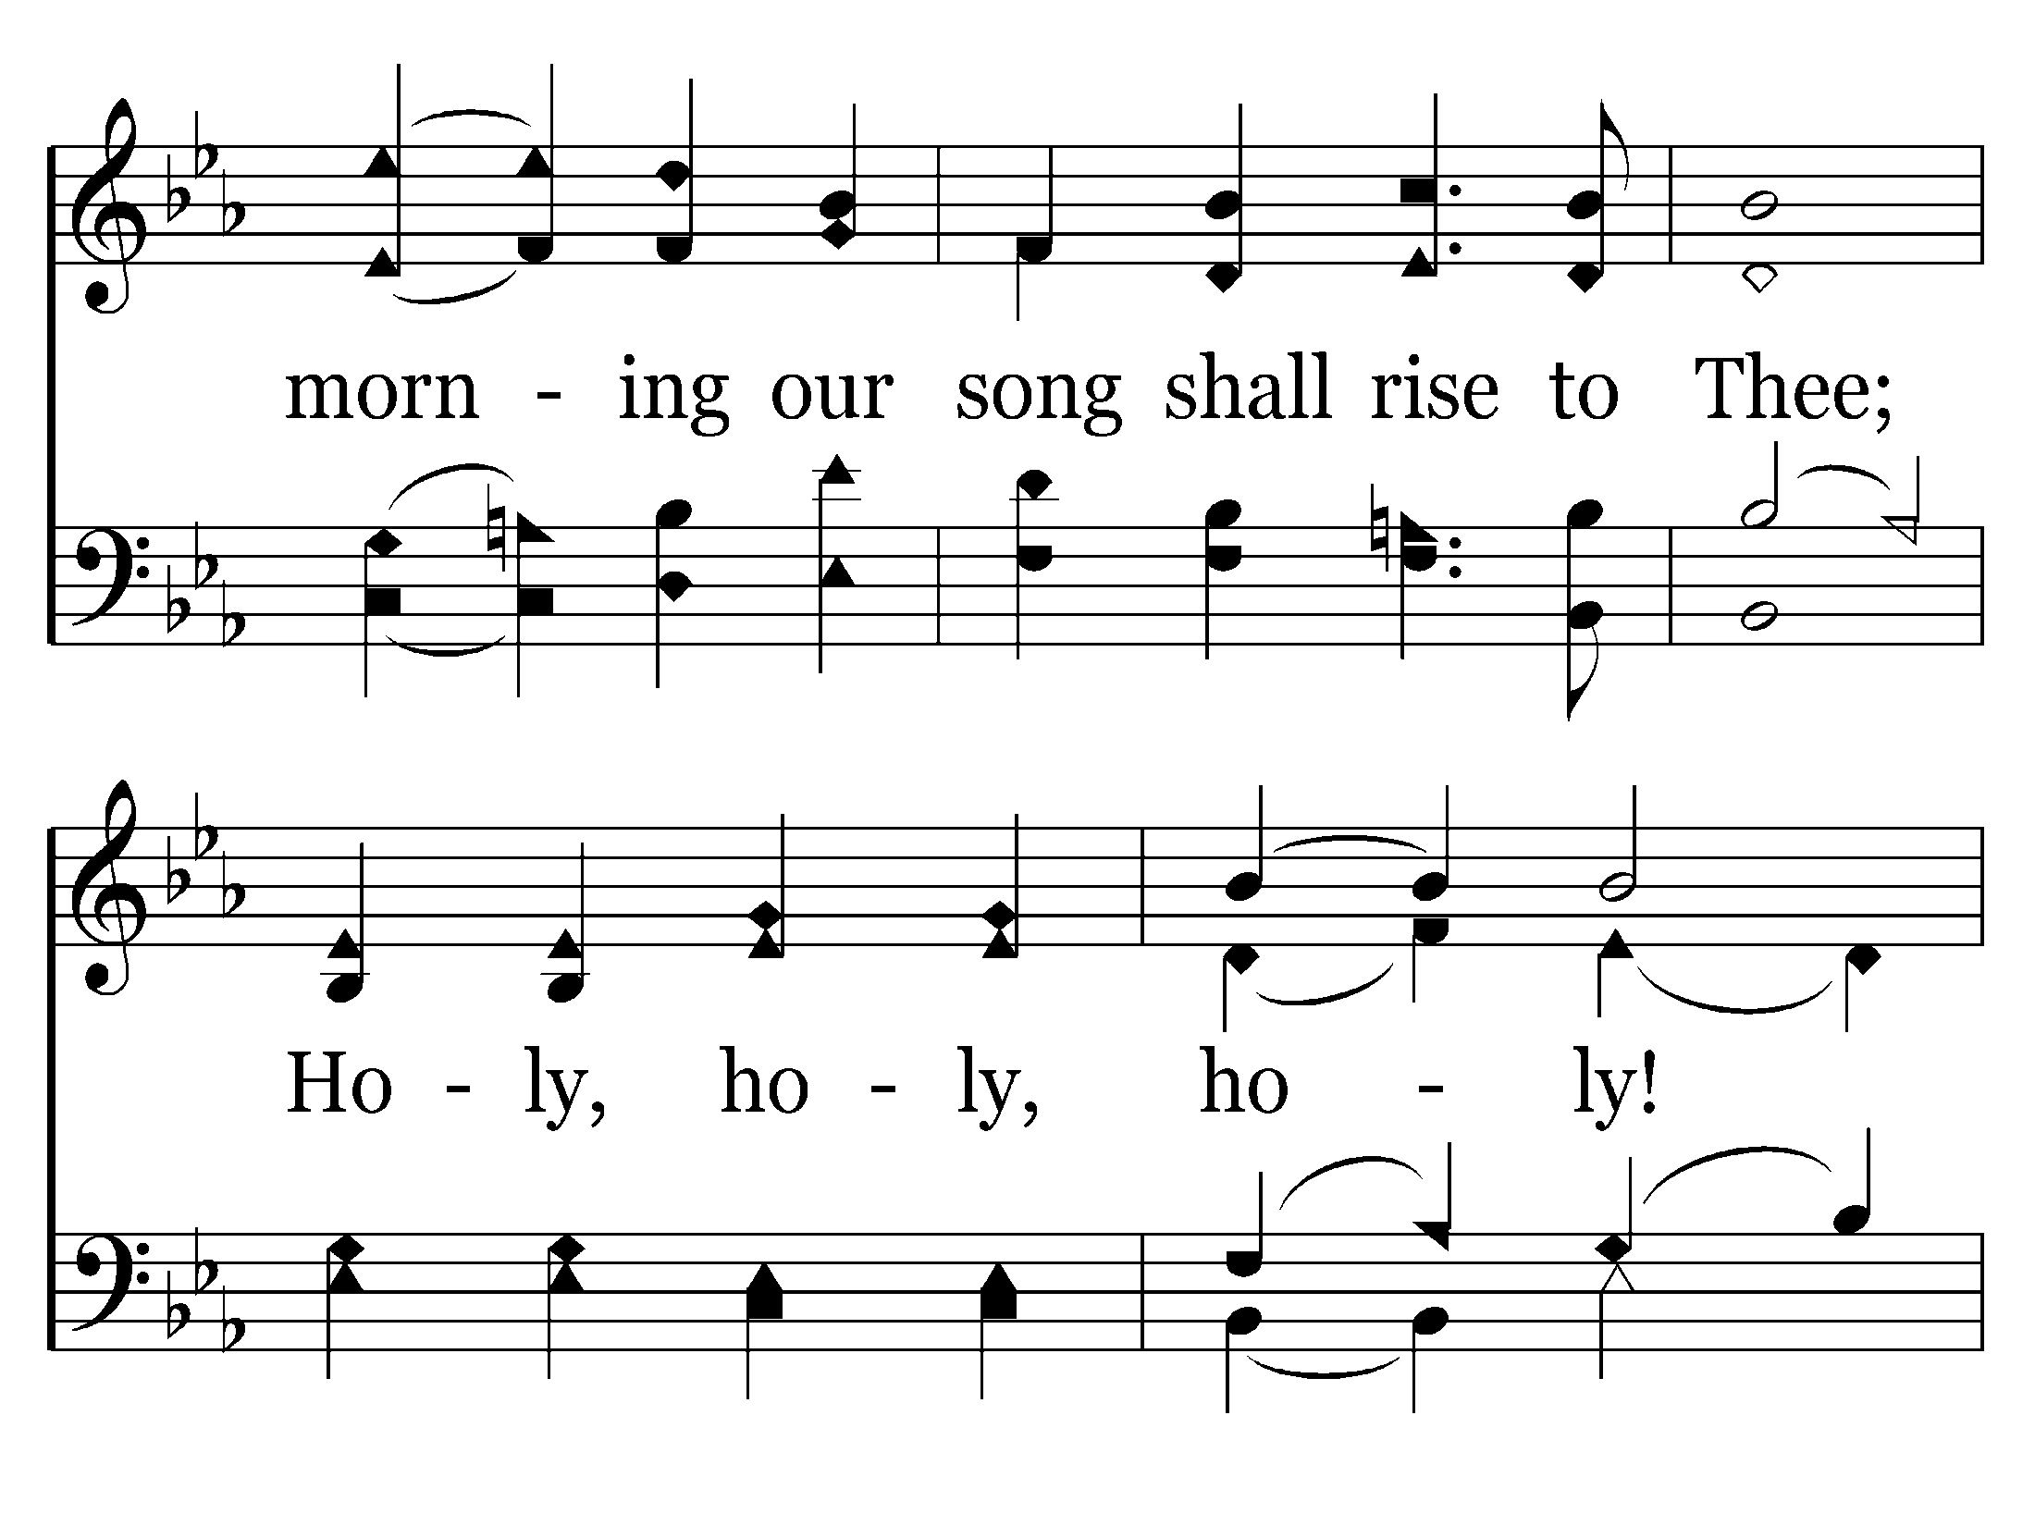
001 - Holy, Holy, Holy - 1.2

Slide 86
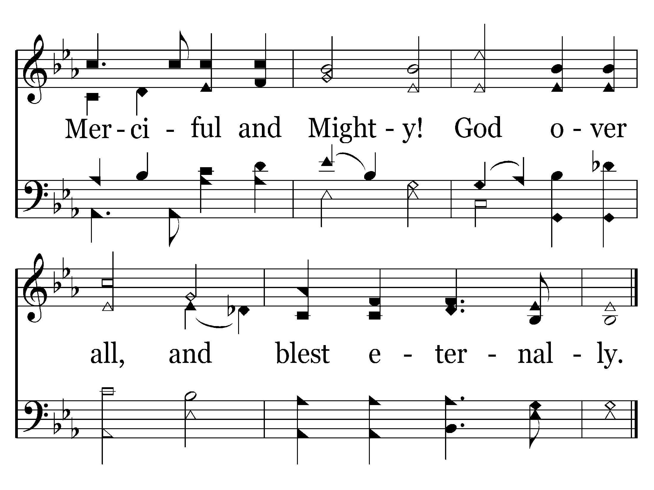
001 - Holy, Holy, Holy - 1.3
End of Verse 1

Slide 87

001 - Holy, Holy, Holy - 4.1

Slide 88

001 - Holy, Holy, Holy - 4.2

Slide 89

001 - Holy, Holy, Holy - 4.3
End of Song

Slide 91

285 - Zion's Call - 1.1

Slide 92

285 - Zion's Call - 1.2

Slide 93

285 - Zion's Call - 2.1

Slide 94

285 - Zion's Call - 2.2

Slide 95

285 - Zion's Call - 3.1

Slide 96

285 - Zion's Call - 3.2

Slide 97

285 - Zion's Call - C.1

Slide 98

285 - Zion's Call - C.2

Slide 99

285 - Zion's Call - C.3
End of Song

Slide 101


Slide 102


Slide 103


Slide 104


Slide 105


Slide 106


Slide 107


Slide 108


Slide 109


Slide 111

563 - Jesus, Name Above All Names - 1.1

Slide 112

563 - Jesus, Name Above All Names - 1.2

Slide 113

563 - Jesus, Name Above All Names - 1.3
End of Verse 1

Slide 114

563 - Jesus, Name Above All Names - 2.1

Slide 115

563 - Jesus, Name Above All Names - 2.2

Slide 116

563 - Jesus, Name Above All Names - 2.3
End of Song

Slide 118

297 - Prepare To Meet Thy God - 1.1

Slide 119

297 - Prepare To Meet Thy God - 1.2

Slide 120

297 - Prepare To Meet Thy God - C.1

Slide 121

297 - Prepare To Meet Thy God - C.2

Slide 122

297 - Prepare To Meet Thy God - C.3

Slide 123

297 - Prepare To Meet Thy God - C.4
End of Verse 1

Slide 124

297 - Prepare To Meet Thy God - 2.1

Slide 125

297 - Prepare To Meet Thy God - 2.2

Slide 126
297 - Prepare To Meet Thy God - C.1

Slide 127
297 - Prepare To Meet Thy God - C.2

Slide 128
297 - Prepare To Meet Thy God - C.3

Slide 129
297 - Prepare To Meet Thy God - C.4
End of Verse 2

Slide 130

297 - Prepare To Meet Thy God - 3.1

Slide 131

297 - Prepare To Meet Thy God - 3.2

Slide 132
297 - Prepare To Meet Thy God - C.1

Slide 133
297 - Prepare To Meet Thy God - C.2

Slide 134
297 - Prepare To Meet Thy God - C.3

Slide 135
297 - Prepare To Meet Thy God - C.4
End of Song

