Slide 2
Better Worship:
Treating the symptoms
- vs -
addressing the core issue

Slide 4
The Foundation
Jehovah God.
God deserves our worship.

Slide 5
God is HOLY.
Lev. 10:1-3
“I dwell in the high and holy place, and also with him who is of a contrite and lowly spirit.”
Isaiah 57:15
God’s holiness matters.
What’s that mean?
God is unique.

Slide 6
God is HOLY.
Lev. 10:1-3
God’s holiness matters.
“Who is like the Lord our God, who is seated on high...?”
Psalm 113:4-5
What’s that mean?
God is “set apart.”

Slide 7
God is HOLY.
Perfectly…
Powerful.
Knowledgeable.
Present.
Full of life.
Right.

Slide 8
“Holy, holy, holy, is the Lord of hosts; the whole earth is full of his glory!”
Isaiah 6:3

Slide 9
God is GLORIOUS.
Glory = importance.
Glory = weight/gravity
God’s glory = Jesus of Nazareth
Heb. 1:3

Slide 10
Worship
Our response to God’s presence.
Moses, Gideon, Isaiah, John

Slide 11
Worship:
Our attempt to accurately understand, praise, thank, magnify, and even imitate the Lord of lords and King of kings.

Slide 12
Worship:
Our attempt to accurately understand, praise, thank, magnify, and even imitate the Lord of lords and King of kings.

Slide 14
Worship:
Our attempt to accurately understand, praise, thank, magnify, and even imitate the Lord of lords and King of kings.

Slide 15
Worship:
Our attempt to accurately understand, praise, thank, magnify, and even imitate the Lord of lords and King of kings.
Even at our best, God is always better.

Slide 16
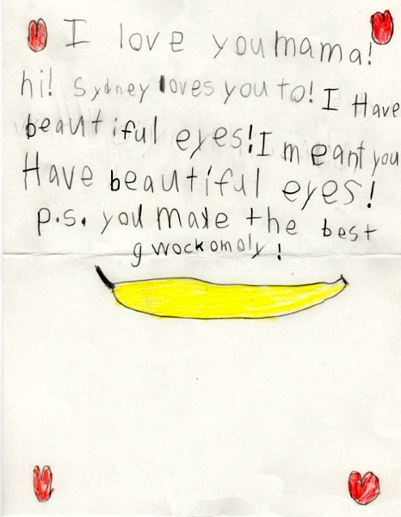

Slide 17
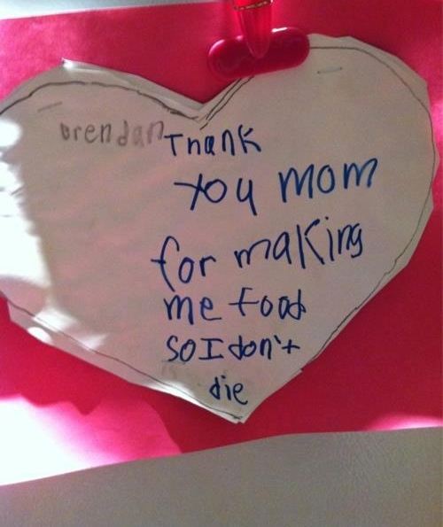

Slide 18
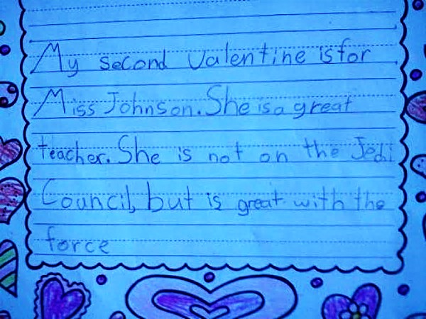

Slide 19
God is pleased with sincere worship.

Slide 20
“Ascribe to the Lord the glory due his name; worship the Lord in the splendor of holiness.”
Psa. 29:2

