Slide 1
Notes:
Last week, we discussed the concept that love is not rude or unbecomingly. I mentioned that I believe it to be one of the most difficult of these love characteristics to define, which translators also seem to think given how many different words are used when you compare different bible versions. But while the characteristic we’re going to discuss this morning is not difficult to define, it is, to me, the most difficult to apply, at least when I come face to face with it personally. Whenever conflict arises in my own personal life as a result of some bad choice I have made, whether in my marriage, my job, the church, or a personal choice, once the dust settles and I step back and perform an autopsy on the situation, it always seems to come back to this idea expressed in the second part of 1 Cor 13:5 - “[love] does not seek its own”.
Think about all the things we do, all the activities we engage in, where we’re seeking out our own without even thinking about it. Where you go, how you go, who you talk with, how you talk with that person, how you use your credit card, your computer, your phone, what job you choose, where you vacation, what you read, how you dress, what time you get up in the mornings, what time you go to bed at night, what you eat, how or if you exercise, what time you get to church, what car you drive, how you train your children, how you respond to your parents, the seat you choose on an airplane, the parking spot you pick, how you pray, what you pray for, and on and on it goes. Every area of life, every activity, every thought is effected by this. These decisions and a thousand more generally tend to revolve around some personal preference wherein it becomes about me, even if not to a hole degree, at least to some degree. So let’s talk this morning about this idea of love not seeking its own. I hope I can do a better job of teaching on it than I do of applying it.

Slide 2
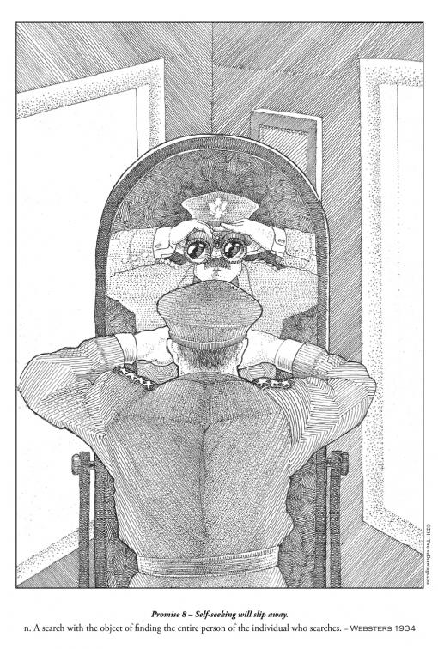
Love Does Not Seek Its Own
“seek” = “zéteó”
“intense searching and investigating”
The Corinthians Problem
Divisiveness – 1 Cor 1 - 3
Attitude Toward Paul – 1 Cor 4
Suing Christians – 1 Cor 6
The Lord’s Supper – 1 Cor 11
Spiritual Gifts – 1 Cor 12
Notes:
There is a relationship between love not behaving rudely and love not seeking its own. If love does not behave rudely, that means it will always consider others before it acts; and because love does not seek its own, it is not looking to solely meet its own needs. So not only does love consider others before it acts, it is also not motivated by selfish desires. These first two charactestics in vs. 5 truly are two sides of the same coin.
The Greek word for “seek” is the word “zéteó”. And if you study how this word is used in other verses, it is often used to depict the “seeking” of a person who is so put out by not getting what he wants, that he turns to the court system to sue or to demand the thing he is striving so hard to obtain. So this describing a person who can’t take “no” for an answer. He’s so intent on getting his own way that he will search, investigate, and never give up his pursuit to get what he wants. This person is so bent on getting his way, he’ll twist the facts, look for loopholes, put words in people’s mouths, try to hold others responsable for promises they never made, leap on mistakes to twists someone’s arm to their will, and various other manipulative methods. That’s the idea behind this word. And any person who demands his own way, who tramples on the rights of others for the sake of upholding his own, or who insists on having his due over another, that person is not showing love. Because agape love is not about us; its about what we can do for others.
And this was a behavior that was plaguing the Corinthians of that day, their divisiveness in regards to leadership, their attitude toward Paul, their attitude toward legal issues with Christians, their attitude towards the Lord’s Supper, and their attitude towards spiritual gifts. In each and every single one of those issues, you see that the root problem was they were focusing too much on their own needs and preferences rather than serving one another. And lest we say, “Yeah, those foolish Corinthians”, brethren, we know this is one of our biggest problems; not necessarily here in this church, but throughout society. We live in a culture of entitlements, where people are more interested in protecting their own interests than in working together to solve difficult issues. It’s paralyzing our government, polarizing our relationships, and destroying families. And if my part of the convseration in a relationship is focused on what I can get out of it, or if I’m interested in protecting my personal rights, it is not a relationship that I can say that I’m practicing agape love. So this was not a Corithian problem only. It truly is a problem of the human race.

Slide 3
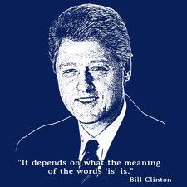
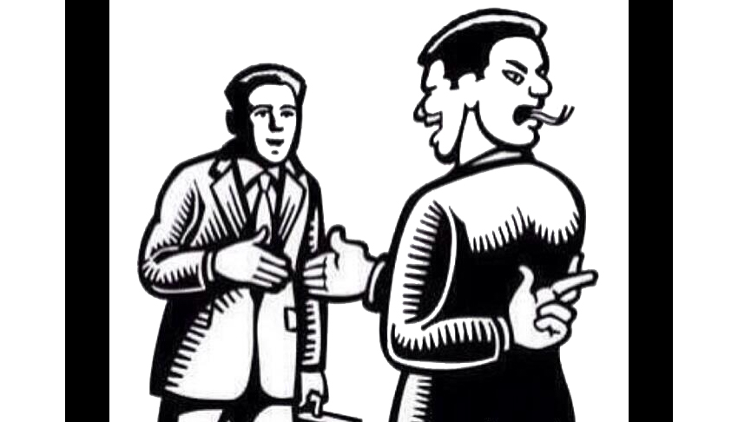
Selfishness Is A Master Of Disguise
Wordsmith
Matt 22:15-16 – “Then the Pharisees went and plotted together how they might trap Him in what He said. And they sent their disciples to Him, along with the Herodians, saying, “Teacher, we know that You are truthful and teach the way of God in truth, and defer to no one; for You are not partial to any.”
Notes:
Here’s a question, when we want to promote an evil practice, what is a very common method that we use to remove the stigma of that practice? Don’t we give it a respectable label? That’s why abortion is called “termination of pregnancy”, fornication is called “premarital sex, adultery is called “extra-marital affair”, and covetousness is called ambition. Society assigns these alternative names to sin just to destigmatize it and to sugar coat it for their own self-gratification because calling sin “sin” for some people is too hard. Some would rather lie to themselves about what they’re doing than to admit.
Selfishness works the same way. Rare is the man that wants to admit when he is merely seeking his own, that he is being selfish. And so the way we deceive ourselves regarding this sin is by wearing a thousand different masks to cover up our motive. Self-seeking is a master chameleon. Selishness is a master of disguise.
One mask that our selfishness wears is the mask of a wordsmith. Do you want to get your way? Do you want to manipulate someone into taking your self-indulgent position on a matter or giving into your wants and whims? We can do this when in out push for something, we bend and shape our words, palter, or twist our rationales for why our personal preferences are reasonable, right and even best. Many of us remember a president who was an excellent wordsmith – Bill Clinton. "It depends upon what the meaning of the word 'is' is. We also see it in the use of flattery, which is an attempt to get someone to believe or do something they never wanted to do or believe in the first place. We’re appealing to a person’s sense of self-doubt so that they’ll be more obliged to give into my point of view because I make them feel good about themselves. If I can pick just the right words to compliment someone with, I can get them on my self-seeking side of things.
Remember when the Pharisees attempted this with Jesus? - Matt 22:15-16 – “Then the Pharisees went and plotted together how they might trap Him in what He said. And they sent their disciples to Him, along with the Herodians, saying, “Teacher, we know that You are truthful and teach the way of God in truth, and defer to no one; for You are not partial to any.” They were not interested in Jesus. They were self-seeking, plotting to trap Him, hoping they may find a weakness in His character in perhaps a sense of self doubt, by which to flatter Him into incriminating Him and thereby get what they wanted.
So a self-seeking person often wears the mask of a wordsmith. But this is nothing more than psychological manipulation at its core, that rather than confront my selfish nature head on, I must insist on having my way, resorting to tactics of verbal manipulation in order to fulfill my desires and cravings. We need to be on guard against this mask and if we find ourselves guilty it needs to be removed and flung into perdition where it belongs.

Slide 4
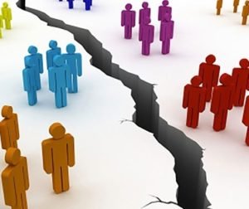
Selfishness Is A Master Of Disguise
Wordsmith
Attorney
Tit 3:10-11 – “Reject a factious man after a first and second warning, knowing that such a man is perverted and is sinning, being self-condemned.”
Notes:
Our selfishness can wear the mask of an attorney, an expert litigator trained in both defense and prosecution, bent on persuading judge and jury on behalf of itself. This mask does two things: First, it knows how to accuse in order to get its way through nit-picking or blame-gaming. Secondly, it knows how to mount a sturdy defense by playing the guilt card, exaggerating the issue, or dwelling on unfairness. Selfishness is so easily disguised as a master litigator bent solely on achieving self-indulgent victory rather than expressing the kind of love that gives and serves another.
Brethren, I could tell you horror stories of a factious man that is a part of a church I once preached at in which I had regular clashes with. He was a power-hungry, self-seeking individual who so desired to have his way that if he didn’t get it, he would go behind the scenes with every person at that church that he thought he could manipulate, either giving his defense if he was on the hot bed, or making his case as a prosecutor if he had a personal agenda to achieve. Tit 3:10-11 – “Reject a factious man after a first and second warning, knowing that such a man is perverted and is sinning, being self-condemned.” It’s not simply the wordsmith that is dangerous, but also the one who prides himself in his ability to debate a matter in which there is no logical defense.
This can happen in a marriage when one partner is arguing a case simply on the basis that it will make he/she feel good rather than whether it is mutually beneficial for both parties. And it may work for a time, if the victim of this manipulation is someone who is prone to think the best of their mate, ignorant of their scheme. But over time, this will wear the other party thin, and only bitterness and resentment will remain, destroying whatever foundation you once had. In marriage, it is not the one who can win the argument who is right. It’s what is right, what is virtuous, what is selfless, what is mutually beneficial to the family as opposed to the individual.
Be careful of this mask. Our intense desire to argue and defend our cane may be nothing more than an attempt to disguise our self-seeking.

Slide 5
Selfishness Is A Master Of Disguise
Wordsmith
Attorney
“Eros” Love
2 Sam 13:15 – “Then Amnon hated her with a very great hatred; for the hatred with which he hated her was greater than the love with which he had loved her.”
Notes:
“Eros” love can be a disguse for selfishness. As we discussed a few weeks ago in our introduction to the characteristics of love, “eros” is that love between the sexes where there is passion, chemistry, and infatuation. And though the word “eros” is never found in scripture, the concept is certainly there whenever we see someone inflamed with sexual desire. How many of us, at some moment of our life, thought we truly loved someone only to realize later that we only loved them because they made me happy? How many of us thought we were truly in love, and nothing could ever take us away from that feeling, only to realize over time that the characteristic he/she had that once made such an impression on us no longer does? Many married couples who never truly understood agape love soon realize how selfish that “love” can truly be and that it is no real love at all. Hence, why in a failing marriage, someone says, “I don’t love you anymore”. “Eros” is selfish in nature, only looking for what it can receive. If it does give, it only gives in order to receive. If it fails to get what it wants or expects, bitterness or resentment develops. The Greeks actually viewed this “love” as a dangerous, fiery, and irrational form of love that could take hold of you and possess you—an attitude shared by many later spiritual thinkers.
(2 Sam 13) When Amnon gave into his lusts concerning his half-sister Tamar, notice what occurred – 2 Sam 13:15 – “Then Amnon hated her with a very great hatred; for the hatred with which he hated her was greater than the love with which he had loved her.” Why the sudden change? Because no matter how much pleasure he derived from what he did, it could not cover the guilty conscious it brought him. He hated Tamar because he hated himself. This type of love is no true love because it’s a love with strings attached. “I love you so long as it’s good for me. I love you for what I gain from love you.” Like Tamar, people are emotionally damaged from this kind of love every day because that love is self-seeking.
This particular mask will eventually fade into obscurity and if no spiritual foundation has bene laid from which true love has developed, it leads to nothing but broken relationships.

Slide 6
God Does Not Seek His Own
Immutable
Self-Sufficient
Notes:
Now God is the perfect example of one who does not seek His own, isn’t He? Since God is love, that means He does not seek His own. God is not looking to advance His position or better His situation at our expense. It’s impossible for God to do that because of two of His qualities: His immutability and His self-sufficiency. That He is immutable means He does not change, He does not grow, He does not improve – God remains the same. If He were to seek personal benefit, that would mean He went from not having a benefit to having one. And to do that requires change; but change is not something God can do.
Num 23:19 – “God is not a man, that He should lie, nor a son of man, that He should repent; has He said, and will He not do it? Or has He spoken, and will He not make it good?”
Anf then because He is self-sufficient, He is not in need of nor dependant on anything outside of Himself – He is lacking nothing. If God were to seek His own, that would imply He is deficient in some way and needs to add something to who He is. God does not seek His own because He already has everything.
Psa 50:10-12 – “For every beast of the forest is Mine, the cattle on a thousand hills. I know every bird of the mountains, and everything that moves in the field is Mine. If I were hungry I would not tell you, for the world is Mine, and all it contains.” Why wouldn’t He tell us? Because anything we would use to meet that need is not ours to begin with; its already His.
Now, in practical terms, this means God gains nothing from us in that we cannot add to the quality of His existence by giving Him anything. In His relationship with us, God is not self-seeking. So the opposite of self-seeking is seeking others’ benefit, which is what God does for us. We serve a servant God. This means we are the only ones who truly profit from our relationship with Him. God gains nothing from us, yet He gives everything to us. We take and take and take, but He gives and He gives and He gives.

Slide 7
Jesus Does Not Seek His Own
In His attitude toward the Father
John 12:49 – “ For I did not speak on My own initiative, but the Father Himself who sent Me has given Me a commandment as to what to say and what to speak.”
John 5:30 – “I can do nothing on My own initiative. As I hear, I judge; and My judgment is just, because I do not seek My own will, but the will of Him who sent Me.”
In His attitude toward people
Matt 20:28 – “just as the Son of Man did not come to be served, but to serve, and to give His life a ransom for many.”
Phil 2:6-8 – “⁶although He existed in the form of God, did not regard equality with God a thing to be grasped, ⁷but emptied Himself, taking the form of a bond-servant, and being made in the likeness of men. ⁸Being found in appearance as a man, He humbled Himself by becoming obedient to the point of death, even death on a cross.”
Notes:
Likewise, Jesus perfectly embodied this spirit as He dwelled among men on the Earth. He loved the Father so much, we find Him frequently stating that He did not come to do His will, but the will of His Father in heaven.
John 12:49 – “ For I did not speak on My own initiative, but the Father Himself who sent Me has given Me a commandment as to what to say and what to speak.”
John 5:30 – “I can do nothing on My own initiative. As I hear, I judge; and My judgment is just, because I do not seek My own will, but the will of Him who sent Me.”
Jesus did not come to this planet to gratify His own will, whether distinct or in opposition from that of His Father’s. He had no secret agenda, no separate interest and no personal advantage to pursue. And in no scenario was this attitude more present than when He went to the cross. To Jesus, it was all about the Father and what he wanted because He knew the Father’s will was the best will. He trusted in that will so much that ever if the temptation arose wherein His will was in conflict with the Father’s will, He defauted to the Father’s will.
Further, this attitude displayed itself in His dealings with other people.
Matt 20:28 – “just as the Son of Man did not come to be served, but to serve, and to give His life a ransom for many”
Jesus came to give, not to get. He came to help, not to be helped. He came as a servant, not a ruler or dictator who just wanted others to meet His needs or desires. His whole life was an example of being other-oriented.
Phil 2:6-8 – “although He existed in the form of God, did not regard equality with God a thing to be grasped, but emptied Himself, taking the form of a bond-servant, and being made in the likeness of men. Being found in appearance as a man, He humbled Himself by becoming obedient to the point of death, even death on a cross”
Think about what is being said here. The incarnation was the journey of all journeys. Here He is in heaven, scores of angels surrounding Him and heaping upon Him all the glory that is due. And then here we are down here, in a rotten and deplorable mess. We see how sinful this world is. We made that bed all by ourselves. And Jesus owes us nothing because what we really deserve is justice; and if justice were done, we’d have already been wiped off the face of the Earth and sent straight to hell because we’ve asked for it. That is what is owed us. That is what justice demands, and I don’t want to be treated with justice by Jesus because that would be it for me. But He emptied Himself. This does not mean He was any less God, it simply means He gave up the privileges associated with being God. He gave up the privileges of deity and the glory that was His in heaven, and He came down here to this cesspit and allowed people to slap Him in the face and gloat at the spectacle of his suffering. He came down here so people could spit on Him and beat Him with their fists. How could He do such a thing? How could He allow it? Because He emptied Himself. When the word became flesh, it started out as a tiny little dot the size of a period on a peasant girl’s womb. And I don’t know how that tiny microcosm of an existence controlled the universe. That’s way past my pay grade. But I absolutely believe it because the bible says so. But an act of selflessness. He didn’t owe us anything. He came here because we needed Him. You know what we would have said if asked to do that “Why should I go down there? I didn’t cause this, these people got themselves in that mess, let them get themselves out of it”. But that wasn’t the attitude of Christ. Nor did He come because people begged for Him to come. No, Paul said in Romans 5 that we were enemies basking in our self-destructive tendencies without a care in the world for what sin was doing to us. Jesus came not because called for him or wanted Him, but because we needed Him. And so He emptied Himself. And we’ll never be able to understand what it was like for Him to come down to a place so diseased with selfishness and wickedness. Oh how it must have made His skin crawl to be here. It must have looked like someone had beaten this planet with the ugly stick. Yet He came. And that’s the heart of the gospel, folks, that you and I take this example we find in Christ and develop this kind of attitude.

Slide 8
Application
Redefines what completes us
Col 2:10a – “and in Him you have been made complete”
Redefines every relationship we are in
Phil 2:3-4 – “Do nothing from selfishness or empty conceit, but with humility of mind regard one another as more important than yourselves; do not merely look out for your own personal interests, but also for the interests of others.”
Redefines “rights” and “liberties”
1 Cor 10:23 – “All things are lawful, but not all things are profitable. All things are lawful, but not all things edify.”
Notes:
Putting on a selfless attitude that loves others at the expense of oneself will cause me to completely redefine my life for the better, and in three ways.
1. Redefines what completes us – Col 2:10a – “and in Him you have been made complete”. Understand the implication of this. Whatever significance we’re searching for in life, whatever gain, whatever high standing, everything we could ever hope to be or achieve that is actually going to matter for all eternity is being in Christ. That’s it. That’s the highest that we could ever achieve, and its higher in standing than we could ever possibly imagine. Being a Christian is the highest we could ever achieve. “But I want to be something great in the church!” Be fully and complete in Christ, and you will be. But the world will hate you. “But I want the world to like me too.” No, you can’t have that unless you sacrifice your Christian morals which will lose the respect of the faithful. Remember, when Paul crucified himself to the world, the world crucified itself to Paul. And so we need to quit worrying about what others think and worry about what Jesus thinks. Because when we’re totally consumed with being in Him, we’ll stop seeking those things that benefit us. And that will help us start loving the way that He loved, which will radically change every relationship I have.
2. Redefines every relationship we are in. When we are struggling to love another person, typically what is happening is that that person is doing something that we experience negatively or is failing to do something that we would experience positively. “I can’t love my spouse because he/she keeps doing A, B, and C and he/she never does X, Y, and Z.” Whenever we find ourselves thinking in this way, the problem is not that we are struggling to love them. The problem is that we have forgotten what love is. Love does not look to its own things. Love, in no way, shape, or form, depends on the actions of others for it to exists or even thrive. While it may be easier to love someone who treats us exactly how we would like to be treated, this is not a better form of love than the secular humanist or the atheist can muster up. Jesus, though, taught us to love our enemies and we can only do this if we embrace the radical idea that love does not seek its own. And that will redefine every single one of our relationships. Phil 2:3-4 – “Do nothing from selfishness or empty conceit, but with humility of mind regard one another as more important than yourselves; do not merely look out for your own personal interests, but also for the interests of others.” “Do nothing”. What that means is that we are never, never, without exception, to do anything from selfish motives…ever. I don’t know about you, but as I seriously meditate on this part of the passage, my mind starts spinning almost out of control, thinking, “Why did I do this, why do I do that, who am I thinking mostly about when I act this way, or respond that way? I mean, never, ever, ever do anything with selfish motives? Okay starting today, no more doing anything with a selfish motive. How will tomorrow look different than every other day I have lived on this earth? Would you even know me, would my wife recognize me?”
3. Redefines “rights” and “liberties”. Remember when we were very little, kindergarten age? What was the first lesson lesson our parents and our kindergarten teachers tried to teach us when it came down to our relationship with other kids? The importance of sharing. Herein was the idea that something may technically be mine, but that the right thing to do is to share those good things with others who don’t have what I have, whether it’s a toy, a cookie, etc. And children eventually pick that up, some sooner than others. So how did we as an adult generation get to be less mature than children as we constantly banter about our “rights” at the expense of others?1 Cor 10:23 – “All things are lawful, but not all things are profitable. All things are lawful, but not all things edify.”

