Slide 1
Notes:
The story of David & Abigail is one of my favorite stories in the OT, at the very least one of my top 300 stories. David and his men have been on the run from Saul for several years and while they were hiding out in the wilderness in Carmel, they had been protecting some of the shepherds who worked for a wealthy man of the area named Nabal.
1 Sam 25:5-13 – “David sent ten young men; and David said to the young men, “Go up to Carmel, visit Nabal and greet him in my name; and thus you shall say, ‘Have a long life, peace be to you, and peace be to your house, and peace be to all that you have. Now I have heard that you have shearers; now your shepherds have been with us and we have not insulted them, nor have they missed anything all the days they were in Carmel. Ask your young men and they will tell you. Therefore let my young men find favor in your eyes, for we have come on a festive day. Please give whatever you find at hand to your servants and to your son David.’ When David’s young men came, they spoke to Nabal according to all these words in David’s name; then they waited. But Nabal answered David’s servants and said, ‘Who is David? And who is the son of Jesse? There are many servants today who are each breaking away from his master. Shall I then take my bread and my water and my meat that I have slaughtered for my shearers, and give it to men whose origin I do not know?’ So David’s young men retraced their way and went back; and they came and told him according to all these words. David said to his men, ‘Each of you gird on his sword.’ So each man girded on his sword. And David also girded on his sword, and about four hundred men went up behind David while two hundred stayed with the baggage.”
What’s interesting about this text is that it is sandwiched between two chapters where David showed abundant mercy to King Saul by sparing his life, even at the expense of the advice of his own men. But David was in some kind of place here in chapter 25 where when Nabal insulted him, it greatly provoked David to want to go teach Nabal a lesson Nabal likely would not have lived through. And if it hadn’t been for Abigail, David certainly would have done something he would have later regretted.
Have you ever had one of those “gird on your sword” moments, where everything seems to be going smoothly and then someone says something insulting or inconsiderate to you? Something you heard on the news just set you off, and by the way, that’s what most news outlets are trying to do now, instill anger and wrath in its listeners and turn fellow Americans against one another. Maybe you are at the DMV on your lunch break trying to renew your license and what should be an “in and out” job is taking forever because a couple of knuckleheads in front of you can’t seem to get their act together. I don’t see how you public school teachers do it – the arguments, the back talk, the theft, the harassment, the fears over safety. Or you’re driving your car and you’re with your family and some other driver just goes and does the idiot thing that puts you and your family’s life in jeopardy. Boy, telemarketers just burn my biscuits.
Brethren, we just live in a world that encourages us to get angry, to act by our instincts which sure can be emotionally satisfying at the time. But what we’re going to study this morning, is that despite whatever emotions we may feel when things like this happen where it is tempting to be impulsive and to give into our emotions, God is calling us to a higher state of morality than this. He would have us to supplant those negative emotions through principle, saying this in 1 Cor 13:5c – “[Love] is not provoked”

Slide 2
What Is “Provoked”?
“provoked” = “paroxunó”
“to sharpen, stimulate, arouse anger, irritate”
Permissive
Prohibitive
Acts 17:16 – “Now while Paul was waiting for them at Athens, his spirit was being provoked within him as he was observing the city full of idols.”
Heb 10:24 – “and let us consider how to stimulate one another to love and good deeds”
1 Cor 13:5 – “does not act unbecomingly; it does not seek its own, is not provoked, does not take into account a wrong suffered”
Acts 15:39 – “And there occurred such a sharp disagreement that they separated from one another, and Barnabas took Mark with him and sailed away to Cyprus.”
Notes:
The word “provoked” is translated from the Greek word “paroxunó”, which means “to sharpen, stimulate, arouse anger, irritate”. It’s another one of those compound words and if you trace the two words “para” and “oxus” back and interpret them literally, as they would make sense together, it means “to cut close alongside.” It’s the idea of someone taking a knife and cutting you into the nerves and then working that knife back and forth. That is a visual that might help us to see why such an idea might mean to be provoked or irritated.
This word is used positively and negatively in scripture It is used positively in Acts 17 while Paul is walking through Athens and noticing all the idols that have been placed about. You’ll remember he even saw one that was to an unknown idol, the idea being that the Greeks assumed there were so many gods that it was likely that, in their finite knowledge, that they had missed one. So to that god(s), this one would be dedicated. So as Paul observes this…Acts 17:16 – “…his spirit was being provoked within him as he was observing the city full of idols.” The idea is he’s disturbed, upset, and righteously indignant that these people, whom he loved, could be so darkened in their understanding. And being a passionate evangelist and wanting people to be saved, it was greatly upsetting to him. And so Paul could not remain silent, and you sense how “provoked” by their lack of understanding that he really is when he preaches to them. This is a good feeling to have. It’s what drives evangelists and teachers of the gospel in that we’re “provoked” into action.
Heb 10:24 – “and let us consider how to stimulate one another to love and good deeds”. Again, a permissive use of the word in that we are to provoke love and good deeds in one another. Meaning, we’re thinking of things to say and do towards one another that might drive one another to a greater faith and devotion both toward God and toward one another.
1 Cor 13:5 is obviously talking about something else, though, because Paul is forbidding the same emotion he himself possessed in Acts 17 in another sense.
Acts 15:39 – “And there occurred such a sharp disagreement that they separated from one another, and Barnabas took Mark with him and sailed away to Cyprus.” It’s debatable whether this verse belongs in the “prohibitive” section because we suspect this was a disagreement that arose over a matter of judgment over John Mark’s reliability. Paul felt as if he couldn’t be trusted. Barnabas, being John Mark’s relative, believed that he could. Opinion or not, the word used seems to suggest that things got a little too ugly for them to continue together at that time and for the sake of the gospel, they needed to split up.

Slide 3
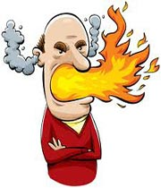
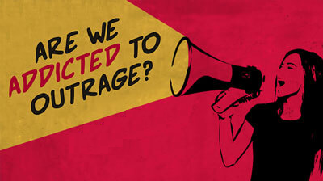
What Is “Provoked”?
Easily offended
Thin-skinned
Touchy
Short-fused
Flies Off The Handle
1 Cor 13:5 KJV – “Doth not behave itself unseemly, seeketh not her own, is not easily provoked, thinketh no evil”
Notes:
So the idea in 1 Cor 13:5 seems to suggest that a person who loves is not easily roused to anger or exasperated by another person or situation. This is a person who is easily offended. He is thin-skinned, touchy, short-fused, and easily flies off the handle. In other words, this is a person in whom it doesn’t take much to irritate or spur to anger…
The KJV does something interesting with this idea – 1 Cor 13:5 (KJV) – “Doth not behave itself unseemly, seeketh not her own, is not easily provoked, thinketh no evil”. That word “easily” is not in the original text. It was added by the translator which has led many to wonder if the translator was indeed someone who could be easily provoked to anger. The word actually means not provoked “at all”, at least in the negative sense of the word.
Love guards against being irritated; it guards against getting upset or angered by things that are said or done against it. And not justv the trite things. Those examples I listed earlier like standing in line at the DMV is minor. There are some serious things that provoke us to wrath. We live in a world plagued by terrorism, there are people taking children hostage, suicide bombings, vandalism, thieves who don’t care one bit that you’ve worked so hard for what you have and just think its free for them to take. Marriage and family circumstances in our country are terrible. And all this stress and strain that people have at home where they get no peace, joy, happiness, fulfillment, and then they have to go into the public arena and face people like me when all I want I’m trying to do is buy some milk. What circumstances do they come from at home? What do they go through in their everyday personal lives? And now the abortion, or shall I say infanticide, that is just becoming common place. And I could keep going couldn’t I? We live in a society polluted by Satan’s gimmicks where we’re practically encouraged to not only be provoked to anger, but to stay that way.

Slide 4
Why Are We Provoked?
John MacArthur – “The problem isn’t your circumstances. [The problem] is the preoccupation of your mind that you’re important, that your rights matter, that your territory is invincible. When somebody steps into your territory or violates yours rights, they trigger that anger because you’ve already predetermined that you have those rights.”
Eccl 7:9 – “Do not be eager in your heart to be angry, for anger resides in the bosom of fools.”
Notes:
Now much of the provocation from the world is certainly due to just how wicked things can truly be. And there is a degree to which we are afforded some righteous indignation due to the state of things, which we will discuss in a bit. But do you ever find, as I do, that so many times the things that anger us and provoke us are not so much “wicked” things that anger God? Rather, they are things that disturb my peace, things that don’t go my way, things that annoy me and upset my personal agenda and upset my personal plans. When that happens, the issue isn’t really over a matter of sin, necessarily, as much as it a matter of me being provoked and angered because of “rights”. I have my rights, my time, my property, my way, my schedule, and I don’t want anyone interfering with those things. Someone has violated some “right” that I feel as though I have, and it just perturbs me, it angers me, and I’m just seething inside.
John MacArthur – “The problem isn’t your circumstances. [The problem] is the preoccupation of your mind that you’re important, that your rights matter, that your territory is invincible. When somebody steps into your territory or violates yours rights, they trigger that anger because you’ve already predetermined that you have those rights.”
That is absolutely correct. It is an unfortunate consequence of not adhering to that prior quality of love of “not seeking your own”. The person who is intent on having his own way is going to be more easily provoked, easily angered. This not only keeps us from loving, but robs us of having any spiritual influence whatsoever – Eccl 7:9 – “Do not be eager in your heart to be angry, for anger resides in the bosom of fools.” But when we’re filled with the love of Christ, we will not get angry at others when they say or do something that displeases us or when they keep us from getting our own way because its not about us. Its about them, how I can bless them, how I can help them, how I can love them.

Slide 5
God Is…
Not Provoked
Provoked
Psa 103:8 – “The Lord is compassionate and gracious, slow to anger and abounding in lovingkindness.”
Num 14:18 – “The Lord is slow to anger and abundant in lovingkindness, forgiving iniquity and transgression; but He will by no means clear the guilty, visiting the iniquity of the fathers on the children to the third and the fourth generations.”
Deut 9:7 – “Remember, do not forget how you provoked the Lord your God to wrath in the wilderness; from the day that you left the land of Egypt until you arrived at this place, you have been rebellious against the Lord.”
Judg 2:12-13 – “they forsook the Lord, the God of their fathers, who had brought them out of the land of Egypt, and followed other gods from among the gods of the peoples who were around them, and bowed themselves down to them; thus they provoked the Lord to anger. So they forsook the Lord and served Baal and the Ashtaroth.”
Notes:
The ultimate example of this is God of course. 1 John 4:8 reminds us that God is love and we should therefore see in God someone who is not “provoked” in the sense that 1 Cor 13:5 is talking about. But there are also times when He is provoked. The difference is key here.
Not provoked – Psa 103:8 – “The Lord is compassionate and gracious, slow to anger and abounding in lovingkindness.” This oft stated description of God is a great summation of his character. He is good to man and when man treats God poorly, He is very slow to become angry. God is not someone who would stand in the line at the DMV stamping his foot with his arms folded wondering why those guys behind the counter can’t process people any faster. I don’t believe he would be as ill towards telemarketers as we’re inclined to be. Those trite things could not anger someone who loves with the depths that our God does. But the fact that he is “slow” to anger suggests something doesn’t it? It means, God does get angry.
Num 14:18 – “The Lord is slow to anger and abundant in lovingkindness, forgiving iniquity and transgression; but He will by no means clear the guilty, visiting the iniquity of the fathers on the children to the third and the fourth generations.” In other words, while he is slow to anger, there is a point when a person’s sins cannot be tolerated anymore and God acts. This is not God being provoked to rain down fire on us out of emotional frustration and impulsive anger. It’s an act of His justice. And even in that, He is still moved to only do what is necessary to bring us back to Him, out of His love for us.
But not notice how God is provoked:
Deut 9:7 – “Remember, do not forget how you provoked the Lord your God to wrath in the wilderness; from the day that you left the land of Egypt until you arrived at this place, you have been rebellious against the Lord.” The generation of Israelites God rescued from Egypt is a perfect example of how God’s patience and anger works. He bore the burden of their sin over and over and over again. You cannot read the OT and miss how much God loved these people, how patient He was with them, just how far and how consistent in their sin they had to go until He would punish them. But it did reach a breaking point didn’t it?
Judg 2:12-13 – “they forsook the Lord, the God of their fathers, who had brought them out of the land of Egypt, and followed other gods from among the gods of the peoples who were around them, and bowed themselves down to them; thus they provoked the Lord to anger. So they forsook the Lord and served Baal and the Ashtaroth.”
Here’s the point. If we take this idea of “love is not provoked” to mean that even righteous indignation is disqualified, we’re missing the point. If sin no longer angers us, we’ve become indifferent and that is the opposite of love. We should be righteously angered over sin and when its not unbridled passion but operates from principle, it can drive us to act as the salt of the earth and the light of the world that God would strive us to be. The point is that God was never provoked by trite things and even His people’s sinfulness took Him a long time before He would act in judgment or wrath toward them.

Slide 6
Jesus Is…
Not Provoked
Provoked
Luke 9:51-56 – “When the days were approaching for His ascension, He was determined to go to Jerusalem; and He sent messengers on ahead of Him, and they went and entered a village of the Samaritans to make arrangements for Him. But they did not receive Him, because He was traveling toward Jerusalem. When His disciples James and John saw this, they said, “Lord, do You want us to command fire to come down from heaven and consume them?” But He turned and rebuked them, and said, “You do not know what kind of spirit you are of; for the Son of Man did not come to destroy men’s lives, but to save them.” And they went on to another village.”
John 2:14-16 – “And He found in the temple those who were selling oxen and sheep and doves, and the money changers seated at their tables. And He made a scourge of cords, and drove them all out of the temple, with the sheep and the oxen; and He poured out the coins of the money changers and overturned their tables; and to those who were selling the doves He said, ‘Take these things away; stop making My Father’s house a place of business.’”
Mark 3:4-5 – “And He said to them, ‘Is it lawful to do good or to do harm on the Sabbath, to save a life or to kill?’ But they kept silent. After looking around at them with anger, grieved at their hardness of heart, He said to the man, ’Stretch out your hand.’ And he stretched it out, and his hand was restored.”
Notes:
How was Jesus not provoked? Luke 9:51-56 – “When the days were approaching for His ascension, He was determined to go to Jerusalem; and He sent messengers on ahead of Him, and they went and entered a village of the Samaritans to make arrangements for Him. But they did not receive Him, because He was traveling toward Jerusalem. When His disciples James and John saw this, they said, “Lord, do You want us to command fire to come down from heaven and consume them?” But He turned and rebuked them, and said, “You do not know what kind of spirit you are of; for the Son of Man did not come to destroy men’s lives, but to save them.” And they went on to another village.”
This kind of stuff didn’t provoke Jesus. Maybe He knew how faithful the Samaritans would become in time. Remember the many conversions that took place there in the first half of Acts 8 through the work of Phillip. We would not have that account to encourage us had Jesus gave in to those two sons of thunder. Have you ever felt like calling down fire on someone who annoys you? Have you ever stood in line at Chipotle on Magnolia? There’s this long line and they have one guy making sandwiches and there will be about 3 or 4 others just kind of hanging back looking like they’re doing nothing. And I’m on my lunch break and just trying to get a burrito and can’t seem to do even that. Jesus wasn’t provoked by things such as that. It wasn’t about Him and His rights, His time, His convenience. That’s what I make it about when I stand in line impatiently at Chipotle. To my shame, I’m thinking, “My time is more valuable than this. Where’s the manager? Why can’t he make those tacos any faster?”
But here are things that did provoke Jesus to anger. When He came to the temple on the Passover and saw what was occurring there - John 2:14-16 – “And He found in the temple those who were selling oxen and sheep and doves, and the money changers seated at their tables. And He made a scourge of cords, and drove them all out of the temple, with the sheep and the oxen; and He poured out the coins of the money changers and overturned their tables; and to those who were selling the doves He said, ‘Take these things away; stop making My Father’s house a place of business.’” Things like this did make Jesus angry.
In Mark 3, when he was in the synagogue on the Sabbath, there was a man with a withered hand and the Pharisees were watching Him to see if He dare heal a man on the Sabbath and therefore violate their precious traditions. Mark 3:4-5 – “And He said to them, ‘Is it lawful to do good or to do harm on the Sabbath, to save a life or to kill?’ But they kept silent. After looking around at them with anger, grieved at their hardness of heart, He said to the man, ’Stretch out your hand.’ And he stretched it out, and his hand was restored.” Hearts that were so hard that they would have rather Jesus leave a disfigured man disfigured when He had the power to heal him…those kinds of things made Jesus mad.
If we’re merely indifferent to the things that are wrong/unjust that we see happening in our world, we’re not necessarily behaving the right way either because all that will lead to is inaction. In our apathy, we’ll do absolutely nothing about the evil that is around us. So there are times when our anger is justified and our negative feelings are directed properly because of circumstances. But that does not give us permission to go around being people who are provoked over petty, personal slights because it can so easily get out of hand making us bold enough to say to ourselves, “Well God gives me the right to be mad”. Eccl 3:7-8 – “A time to tear apart and a time to sew together; a time to be silent and a time to speak. A time to love and a time to hate; a time for war and a time for peace.” We have to learn when it is appropriate to be provoked and when it is not. And studying the character of God and the life of Jesus will help us come closer to that balance.

Slide 7
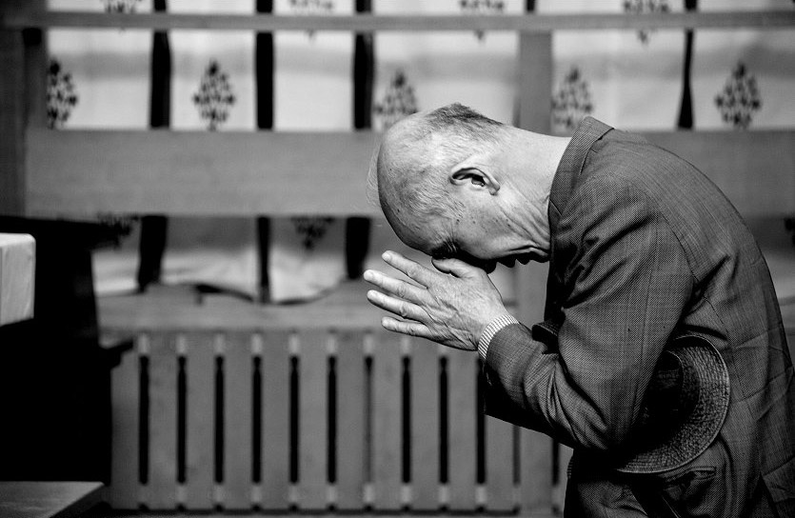
The Cure
Pray
Psa 64 – “¹Hear my voice, O God, in my complaint; preserve my life from dread of the enemy. ²Hide me from the secret counsel of evildoers, from the tumult of those who do iniquity, ³who have sharpened their tongue like a sword. They aimed bitter speech as their arrow, ⁴to shoot from concealment at the blameless; suddenly they shoot at him, and do not fear. ⁵They hold fast to themselves an evil purpose; they talk of laying snares secretly; they say, ‘Who can see them?’ ⁶They devise injustices, saying, ‘We are ready with a well-conceived plot’; for the inward thought and the heart of a man are deep. ⁷But God will shoot at them with an arrow; suddenly they will be wounded. ⁸So they will make him stumble; their own tongue is against them; all who see them will shake the head. ⁹Then all men will fear, and they will declare the work of God, and will consider what He has done. ¹⁰The righteous man will be glad in the Lord and will take refuge in Him; and all the upright in heart will glory.”
Notes:
There are a lot of prayers you can pray, but Psa 64 is a good one because you really get the idea that David is just exasperated with his circumstances.
Psa 64 – “¹Hear my voice, O God, in my complaint; preserve my life from dread of the enemy. ²Hide me from the secret counsel of evildoers, from the tumult of those who do iniquity, ³who have sharpened their tongue like a sword. They aimed bitter speech as their arrow, ⁴to shoot from concealment at the blameless; suddenly they shoot at him, and do not fear. ⁵They hold fast to themselves an evil purpose; they talk of laying snares secretly; they say, ‘Who can see them?’ ⁶They devise injustices, saying, ‘We are ready with a well-conceived plot’; for the inward thought and the heart of a man are deep. ⁷But God will shoot at them with an arrow; suddenly they will be wounded. ⁸So they will make him stumble; their own tongue is against them; all who see them will shake the head. ⁹Then all men will fear, and they will declare the work of God, and will consider what He has done. ¹⁰The righteous man will be glad in the Lord and will take refuge in Him; and all the upright in heart will glory.”
The idea behind praying when we’re feeling provoked is that we’re relying on God to give us the clarity we really need in a moment where it seems like our emotions are overruling our sense of godly principle. Again, God wants us to cast our burdens on Him, not try to take them on by ourselves. And who hasn’t done this and been successful? Who hasn’t felt like a ticking time bomb only to go to God in prayer, humbly, penitently, and in faith, only to come out of that prayer feeling better than when we began? We must develop the self-control to first remember to pray to God before giving in to provocation.

Slide 8
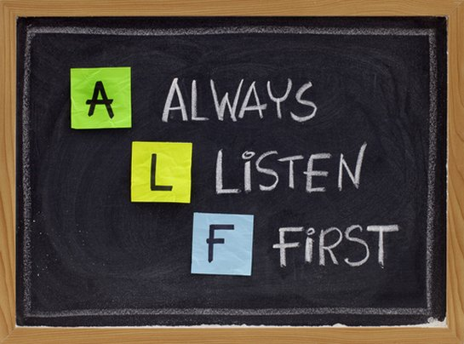
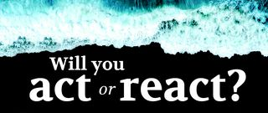
The Cure
Pray
Listen
Jas 1:19 – “This you know, my beloved brethren. But everyone must be quick to hear, slow to speak and slow to anger”
Prov 10:19 – “When there are many words, transgression is unavoidable, but he who restrains his lips is wise.”
Notes:
Jas 1:19 – “This you know, my beloved brethren. But everyone must be quick to hear, slow to speak and slow to anger”.
Love puts on the brakes. Being hot tempered usually involves making snap judgments, seeking instant vindication, and refusing to grant second chances. True love does not jump to conclusions. True love refuses to take revenge or hastily judge another. Rather, love seeks to understand. It’s empathetic. And sympathetic. You have passed the test of true love when in the midst of conflict you keep a cool head. Love does not go about with the safety off and the hammer cocked. Loving another means its difficult to get angry towards them.
Prov 10:19 – “When there are many words, transgression is unavoidable, but he who restrains his lips is wise.”
The worst thing we can do when feeling provoked is to give our heart a voice. That’s when things start funneling out that we’ll never be able to take back. And we can cause hurt and wounds in others that can never be repaired. Listen and thereby gain understanding.

Slide 9
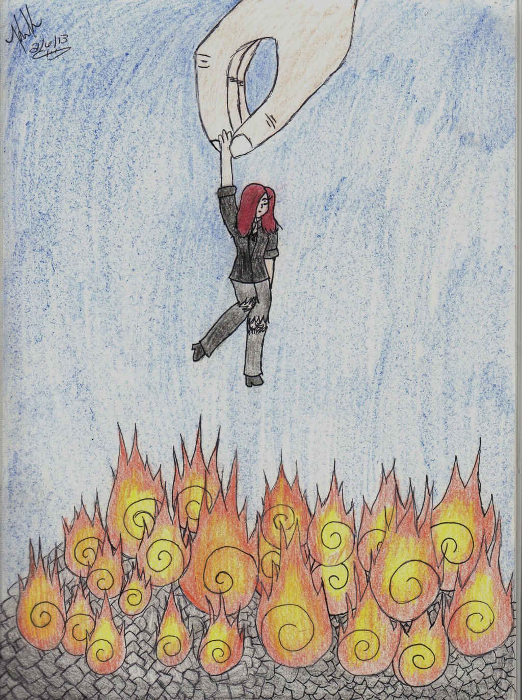
The Cure
Pray
Listen
Remember
Eph 4:32 – “Be kind to one another, tender-hearted, forgiving each other, just as God in Christ also has forgiven you.”
Eph 6:12 – “For our struggle is not against flesh and blood, but against the rulers, against the powers, against the world forces of this darkness, against the spiritual forces of wickedness in the heavenly places.”
Matt 18:33 – “Should you not also have had mercy on your fellow slave, in the same way that I had mercy on you?’”
Notes:
Finally, remember who you are. You are a Christian. And that means that in our love for Jesus, we allow Him to have more control over us than another. We live of principle, not impulse. Eph 4:32 – “Be kind to one another, tender-hearted, forgiving each other, just as God in Christ also has forgiven you.”
Also, remember who the real enemy is using this person to provoke you. Likely this is a person in whom Satan has exploited. Satan is pulling their strings like a puppet hoping in their sin that they will take down others with them. Eph 6:12 – “For our struggle is not against flesh and blood, but against the rulers, against the powers, against the world forces of this darkness, against the spiritual forces of wickedness in the heavenly places.” Our job is not to destroy others putting them in their place. Our job is to save others and expose Satan and his evil schemes.
And remember where you would be if God were one to be provoked by your sin. Matt 18:33 – “Should you not also have had mercy on your fellow slave, in the same way that I had mercy on you?’” Remember where you were before you obeyed the gospel, an enemy of God. Remember how we still struggle with sin. Should we not offer the same allowances to those who provoke us as God has allowed us, seeing as how in time we have become better for His patience toward us?

