Slide 3
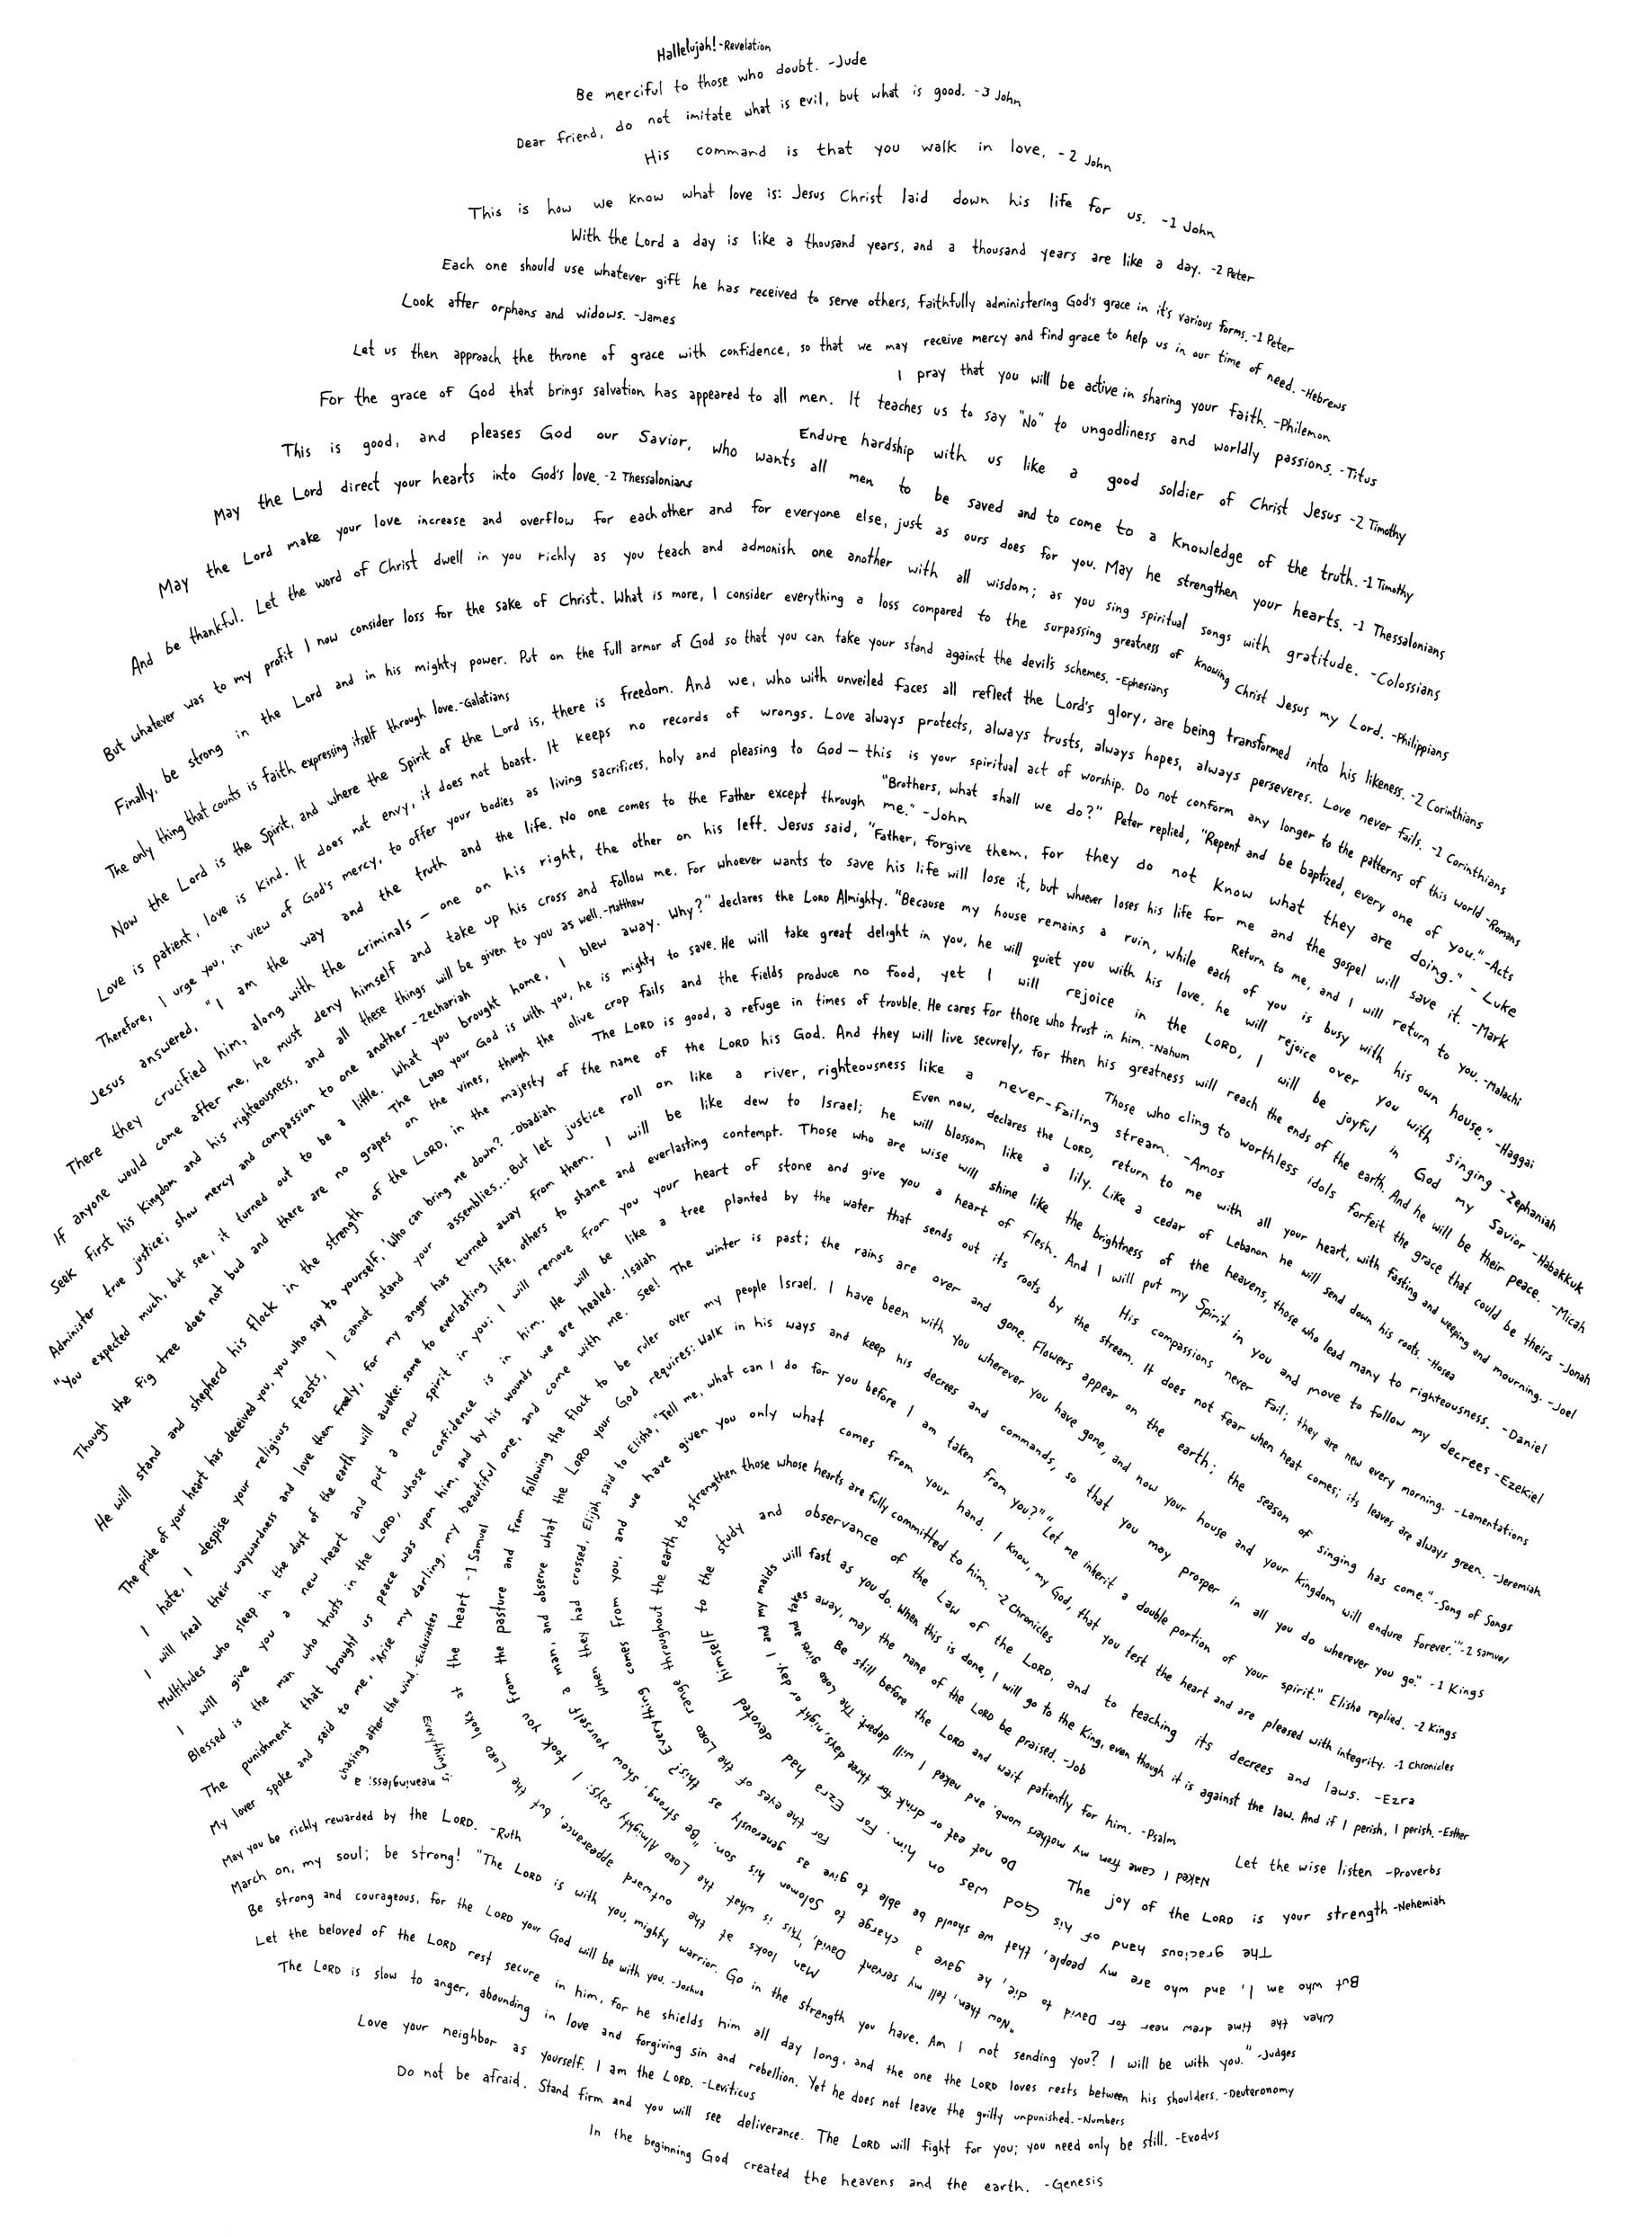
Genesis
Vs.
The
Chinese
Language

Slide 4
The Chinese Language
mouth/man
human
ruler

Slide 5
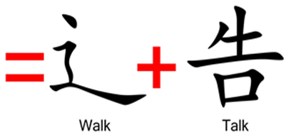
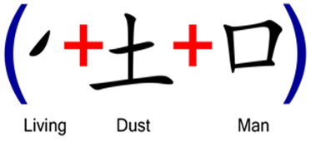
Gen 2:7 – “Then the Lord God formed man of dust from the ground, and breathed into his nostrils the breath of life; and man became a living being.”
Gen 2:8 – “Lord God planted a garden toward the east, in Eden; and there He placed the man whom He had formed.”

Slide 6
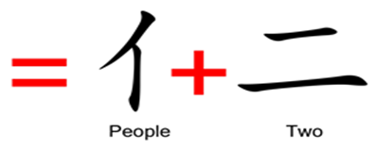
Gen 2:18 – “Then the Lord God said, ‘It is not good for the man to be alone; I will make him a helper suitable for him.’”
Gen 2:24-25 – “²⁴For this reason a man shall leave his father and his mother, and be joined to his wife; and they shall become one flesh. ²⁵And the man and his wife were both naked and were not ashamed.”

Slide 7
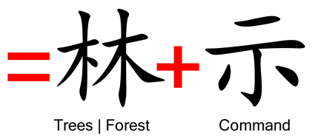
Gen 2:9 – “Out of the ground the Lord God caused to grow every tree that is pleasing to the sight and good for food; the tree of life also in the midst of the garden, and the tree of the knowledge of good and evil.”
Gen 2:16-17 – “¹⁶The Lord God commanded the man, saying, ‘From any tree of the garden you may eat freely; ¹⁷but from the tree of the knowledge of good and evil you shall not eat, for in the day that you eat from it you will surely die.’”

Slide 8
Gen 3:1 – “Now the serpent was more crafty than any beast of the field which the Lord God had made. And he said to the woman, ‘Indeed, has God said, “You shall not eat from any tree of the garden”?’”

Slide 9
Gen 3:6 – “When the woman saw that the tree was good for food, and that it was a delight to the eyes, and that the tree was desirable to make one wise, she took from its fruit and ate; and she gave also to her husband with her, and he ate.”
1 Tim 2:14 – “And it was not Adam who was deceived, but the woman being deceived, fell into transgression.”

Slide 10
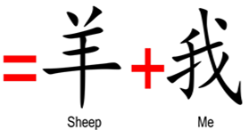
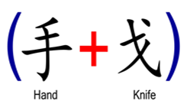
Gen 3:16 – “To the woman He said, ‘I will greatly multiply your pain in childbirth, in pain you will bring forth children; yet your desire will be for your husband, and he will rule over you.’”
Heb 9:22 – “And according to the Law, one may almost say, all things are cleansed with blood, and without shedding of blood there is no forgiveness.

Slide 11
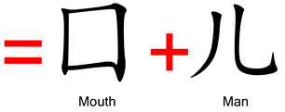
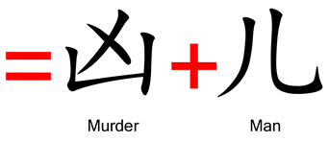
Gen 4:1-2a – “¹Now the man had relations with his wife Eve, and she conceived and gave birth to Cain, and she said, ‘I have gotten a man child with the help of the Lord.’ ²Again, she gave birth to his brother Abel.”
Gen 4:8 – “Cain told Abel his brother. And it came about when they were in the field, that Cain rose up against Abel his brother and killed him.”
Gen 4:13-15 – “¹³Cain said to the Lord, ‘My punishment is too great to bear! ¹⁴Behold, You have driven me this day from the face of the ground; and from Your face I will be hidden, and I will be a vagrant and a wanderer on the earth, and whoever finds me will kill me.’¹⁵So the Lord said to him, ‘Therefore whoever kills Cain, vengeance will be taken on him sevenfold.’ And the Lord appointed a sign for Cain, so that no one finding him would slay him.”

Slide 12
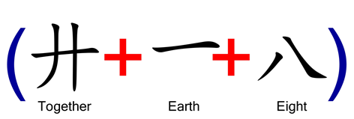
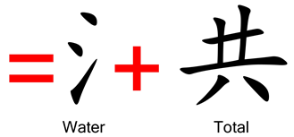
1 Pet 3:20 – “who once were disobedient, when the patience of God kept waiting in the days of Noah, during the construction of the ark, in which a few, that is, eight persons, were brought safely through the water.”

Slide 13
Gen 11:1-4 – “¹Now the whole earth used the same language and the same words. ²It came about as they journeyed east, that they found a plain in the land of Shinar and settled there. ³They said to one another, ‘Come, let us make bricks and burn them thoroughly.’ And they used brick for stone, and they used tar for mortar. ⁴They said, ‘Come, let us build for ourselves a city, and a tower whose top will reach into heaven, and let us make for ourselves a name, otherwise we will be scattered abroad over the face of the whole earth.’”

Slide 14
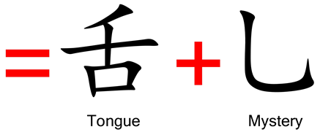
Gen 11:5-9 – “⁵The Lord came down to see the city and the tower which the sons of men had built. ⁶The Lord said, ‘Behold, they are one people, and they all have the same language. And this is what they began to do, and now nothing which they purpose to do will be impossible for them. ⁷Come, let Us go down and there confuse their language, so that they will not understand one another’s speech.’ ⁸So the Lord scattered them abroad from there over the face of the whole earth; and they stopped building the city. ⁹Therefore its name was called Babel, because there the Lord confused the language of the whole earth; and from there the Lord scattered them abroad over the face of the whole earth.”

Slide 15
1 Pet 3:20 – “who once were disobedient, when the patience of God kept waiting in the days of Noah, during the construction of the ark, in which a few, that is, eight persons, were brought safely through the water.”

