Slide 1
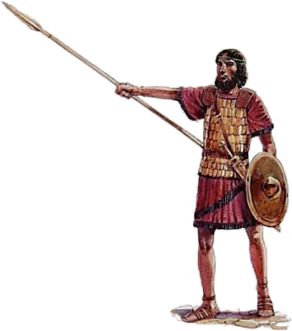
Judges
Israel Fails to Complete
Conquest of Canaan Judges 2

Slide 2
Judges: Chapter 2
Angel of the Lord said, “I will never break My covenant with you. And you shall make no covenant with the inhabitants of this land; you shall tear down their altars.” (2:1-2)
“. . . you have not obeyed My voice. Why have you done this?” (2:2)
“Therefore, I will not drive them out before you; but they shall be thorns in your side, and their gods shall be a snare to you.” (2:3)

Slide 3
Judges: Chapter 2
When the Angel of the Lord spoke this to the children of Israel, the people lifted up their voices and wept (2:4)
They sacrificed there to the Lord (2:5)
Children of Israel went each to his own inheritance to possess it (2:6)
People served the Lord all the days of Joshua and all the days of the elders who outlived Joshua (2:7)
Joshus, son of Nun, servant of the Lord, died when he was 110 years old (2:8)

Slide 4
Judges: Chapter 2
When all Joshua’s generation were gathered to their fathers, another generation arose who did not know the Lord nor the work which He had done for Israel (2:10)
Then Israel did evil in the sight of the Lord and served the Baals (2:11)
They forsook the Lord and followed other gods of the people around them; they bowed down to them and provoked the Lord to anger (2:12)

Slide 5
Judges: Chapter 2
Anger of the Lord was hot against Israel; He delivered them into hands of plunderers and sold them into hands of their enemies, so they could no longer stand against their enemies (2:14)
Hand of the Lord was against them as Lord had sworn to them; they were greatly distressed (2:15)
Nevertheless, the Lord raised up judges who delivered them out of the hand of those who plundered them (2:16)

Slide 6
Judges: Chapter 2
They would not listen to their judges and did not obey the commandments of the Lord (2:17)
When the Lord raised up a judge for them, the Lord was with the judge and delivered them from their enemy all the days of that judge (2:18)
When the judge was dead, they reverted and behaved more corruptly than their fathers; they did not cease from their own doings nor from their stubborn ways (2:19)

Slide 7
Judges: Chapter 2
The anger of the Lord was hot against Israel, and He vowed no longer to drive out before them any of the nations Joshua left when he died (2:20-21)
Therefore the Lord left those nations without driving them out (2:23)

Slide 8
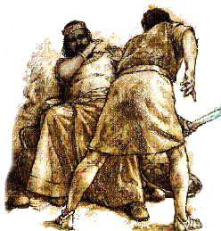
Judges
Othniel, Ehud, Shamgar Judges 3

Slide 9
Judges: Chapter 3
Nations which the Lord left (3:3):
Five lords of the Philistines
All the Canaanites
The Sidonians
The Hivites dwelling in Mount Lebanon
That He might test Israel by them (3:4)
Israel dwelt among the Canaanites, the Hittites, the Amorites, the Perizzites, the Hivites, and the Jebusites (3:5)
Israel allowed her sons and daughters to intermarry with these nations; they served their gods (3:6)

Slide 10
Judges: Chapter 3
Israel forgot the Lord and served the Baals and the Asherahs (3:7)
Lord sold them into hand of Cushan-Rishathaim, king of Mesopotamia (3:8)
They served him 8 years and they cried out to the Lord (3:9)
Lord raised up deliverer for them: Othniel son of Kenaz, Caleb’s younger brother (3:9)
Lord delivered Cushan-Rishathaim into Othniel’s hand (3:10)
Land had rest 40 years and Othniel died (3:11)

Slide 11
Judges: Chapter 3
Israel again did evil in the sight of the Lord, so He strengthened Eglon king of Moab against Israel (3:12)
Israel served Eglon for 18 years (3:14)
Lord raised up Ehud to deliver Israel, and by him Israel sent tribute to Eglon king of Moab (3:15)
Ehud made a dagger and fastened it under his clothes on his right thigh (3:16)
He brought the tribute to Eglon, a very fat man (3:17)

Slide 12
Judges: Chapter 3
Pretending to have a secret message from God for Eglon, Ehud held a private meeting with him (3:18-20)
Ehud thrust the dagger into Eglon’s belly with the hilt going in after the blade; the fat closed over the blade (3:21-22)
After Ehud escaped, Eglon’s servants found him dead on the floor (3:25)
Israel killed about 10,000 men of Moab, and Moab was subdued (3:29)
Land had rest for 80 years (3:30)
Judge after Ehud was Shamgar; he killed 600 Philistines with and ox goad (3:31)

