Slide 2
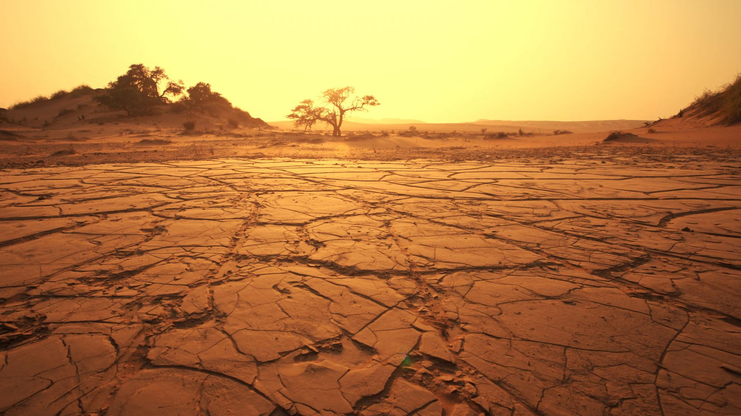
The Christian’s
Wilderness
Journey

Slide 3
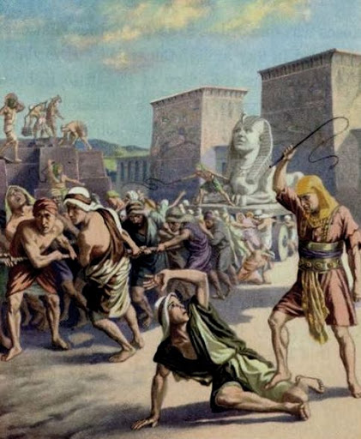
Slavery
Ex 2:23b – “the sons of Israel sighed because of the bondage, and they cried out; and their cry for help because of their bondage rose up to God.”
John 8:34 – “Truly, truly, I say to you, everyone who commits sin is the slave of sin.”
John 8:36 – “So if the Son makes you free, you will be free indeed.”

Slide 4
Slavery
Rom 6:6-7 – “knowing this, that our old self was crucified with Him, in order that our body of sin might be done away with, so that we would no longer be slaves to sin; for he who has died is freed from sin.”
Gal 5:1 – “It was for freedom that Christ set us free; therefore keep standing firm and do not be subject again to a yoke of slavery.”

Slide 5
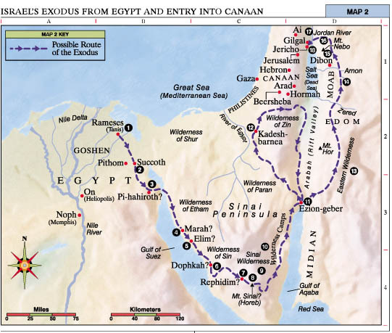

Slide 6
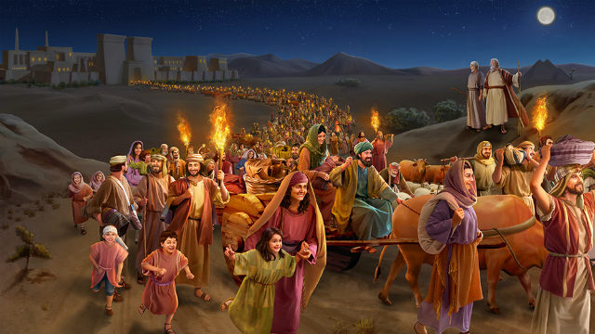
WITHOUT DELAY
Ex 12:39a-b – “They baked the dough which they had brought out of Egypt into cakes of unleavened bread. For it had not become leavened, since they were driven out of Egypt and could not delay…”
Acts 22:16: – “Now why do you delay? Get up and be baptized, and wash away your sins, calling on His name.”

Slide 7
No Provisions
Ex 12:39c – “…nor had they prepared any provisions for themselves.”
Luke 5:11 – “When “When they had brought their boats to land, they left everything and followed Him.”

Slide 8
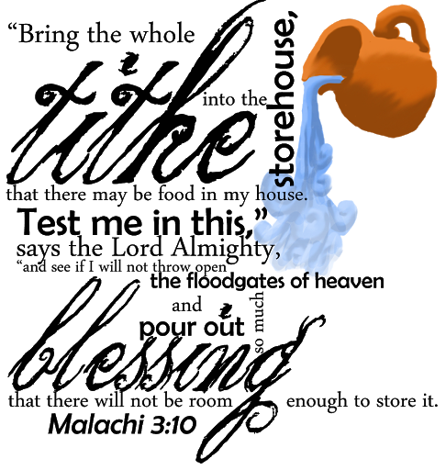
No Provisions
Deut 29:5 – “I have led you forty years in the wilderness; your clothes have not worn out on you, and your sandal has not worn out on your foot.”
Matt 6:31 – “Do not worry then, saying, ‘What will we eat?’ or ‘What will we drink?’ or ‘What will we wear for clothing?’”
Matt 6:33 – “But seek first His kingdom and His righteousness, and all these things will be added to you.”

Slide 10
The Long Way
Ex 13:17-18a – “Now when Pharaoh had let the people go, God did not lead them by the way of the land of the Philistines, even though it was near; for God said, ‘The people might change their minds when they see war, and return to Egypt.’ Hence God led the people around by the way of the wilderness to the Red Sea”

Slide 11
The Long Way
Ex 5:21 – “May the Lord look upon you and judge you, for you have made us odious in Pharaoh’s sight and in the sight of his servants, to put a sword in their hand to kill us.”
Ex 6:9 – “So Moses spoke thus to the sons of Israel, but they did not listen to Moses on account of their despondency and cruel bondage.”

Slide 12
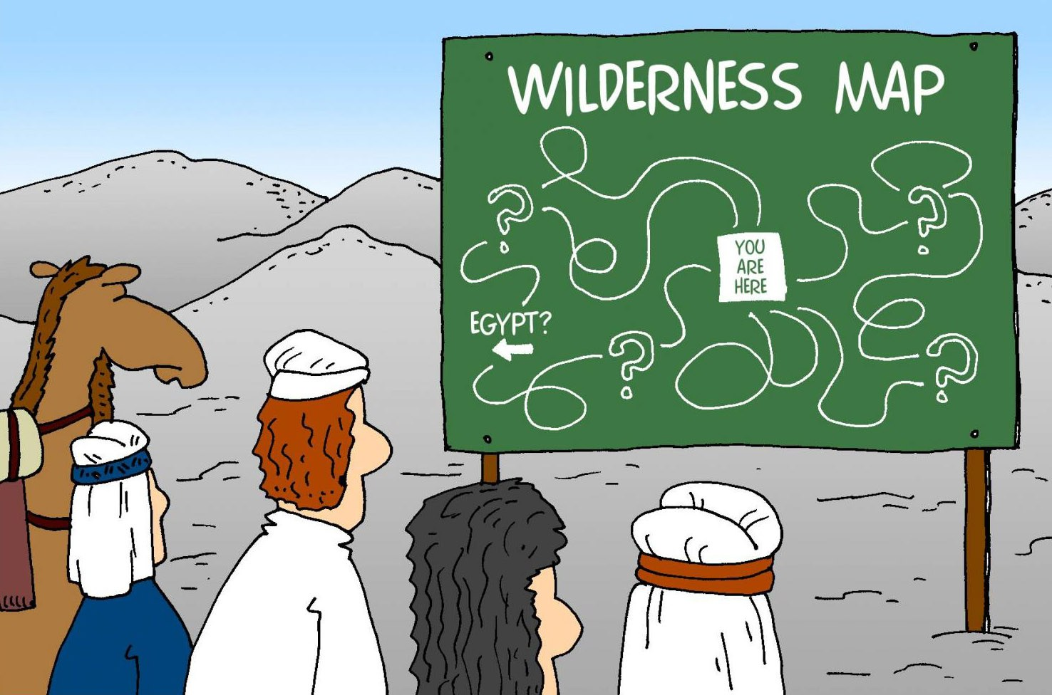
SETBACKS
Ex 14:1-4 – “Now the Lord spoke to Moses, saying, ‘Tell the sons of Israel to turn back and camp before Pi-hahiroth, between Migdol and the sea; you shall camp in front of Baal-zephon, opposite it, by the sea. For Pharaoh will say of the sons of Israel, “They are wandering aimlessly in the land; the wilderness has shut them in.” Thus I will harden Pharaoh’s heart, and he will chase after them; and I will be honored through Pharaoh and all his army, and the Egyptians will know that I am the Lord.’ And they did so.”

Slide 13
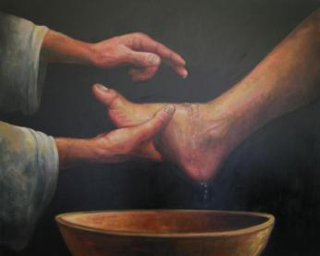
SETBACKS
Phil 2:6-8 – “although He existed in the form of God, did not regard equality with God a thing to be grasped, but emptied Himself, taking the form of a bond-servant, and being made in the likeness of men. Being found in appearance as a man, He humbled Himself by becoming obedient to the point of death, even death on a cross.”

Slide 15
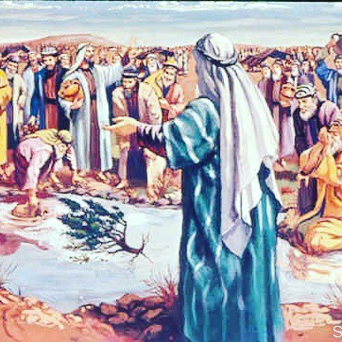
Testing
Ex 15:23-26 – “When they came to Marah, they could not drink the waters of Marah, for they were bitter; therefore it was named Marah. So the people grumbled at Moses, saying, ‘What shall we drink?’ Then he cried out to the Lord, and the Lord showed him a tree; and he threw it into the waters, and the waters became sweet. There He made for them a statute and regulation, and there He tested them. And He said, ‘If you will give earnest heed to the voice of the Lord your God, and do what is right in His sight, and give ear to His commandments, and keep all His statutes, I will put none of the diseases on you which I have put on the Egyptians; for I, the Lord, am your healer.’”

Slide 16
Testing
Ex 16:4 – “Then the Lord said to Moses, ‘Behold, I will rain bread from heaven for you; and the people shall go out and gather a day’s portion every day, that I may test them, whether or not they will walk in My instruction.”
Ex 20:20 – “Moses said to the people, ‘Do not be afraid; for God has come in order to test you, and in order that the fear of Him may remain with you, so that you may not sin.’”

Slide 17
Testing
1 Pet 1:6-7 – “In this you greatly rejoice, even though now for a little while, if necessary, you have been distressed by various trials, so that the proof of your faith, being more precious than gold which is perishable, even though tested by fire, may be found to result in praise and glory and honor at the revelation of Jesus Christ”
Jas 1:3 – “knowing that the testing of your faith produces endurance.”
Rev 3:10 – “Because you have kept the word of My perseverance, I also will keep you from the hour of testing, that hour which is about to come upon the whole world, to test those who dwell on the earth.”

Slide 19
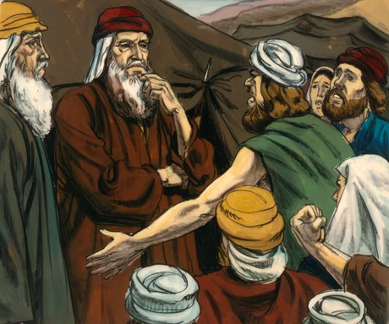
Leadership
Ex 17:1-5 – “Then all the congregation of the sons of Israel journeyed by stages from the wilderness of Sin, according to the command of the Lord, and camped at Rephidim, and there was no water for the people to drink. Therefore the people quarreled with Moses and said, ‘Give us water that we may drink.’ And Moses said to them, ‘Why do you quarrel with me? Why do you test the Lord?’ But the people thirsted there for water; and they grumbled against Moses and said, ‘Why, now, have you brought us up from Egypt, to kill us and our children and our livestock with thirst?’ So Moses cried out to the Lord, saying, ‘What shall I do to this people? A little more and they will stone me.’”

Slide 20
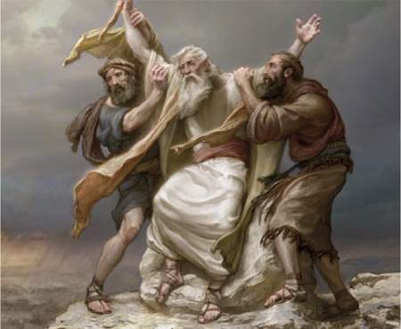
Leadership
Ex 17:11-13 – “So it came about when Moses held his hand up, that Israel prevailed, and when he let his hand down, Amalek prevailed. But Moses’ hands were heavy. Then they took a stone and put it under him, and he sat on it; and Aaron and Hur supported his hands, one on one side and one on the other. Thus his hands were steady until the sun set. So Joshua overwhelmed Amalek and his people with the edge of the sword.”

Slide 21
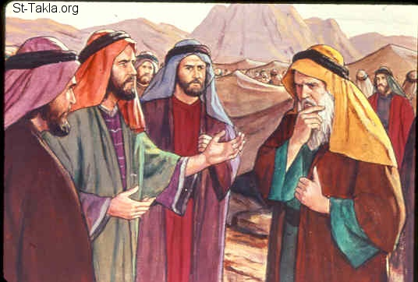
Leadership
Ex 18:17-18 – “The thing that you are doing is not good. You will surely wear out, both yourself and these people who are with you, for the task is too heavy for you; you cannot do it alone.”
Ex 18:22b-23 – “So it will be easier for you, and they will bear the burden with you. If you do this thing and God so commands you, then you will be able to endure, and all these people also will go to their place in peace.”
Acts 7:52a – “Which one of the prophets did your fathers not persecute?”

Slide 23
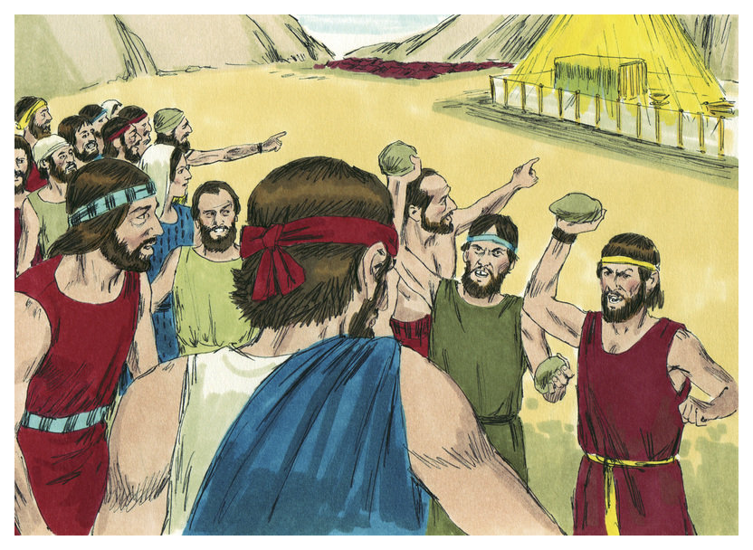
Falling
Num 14:11 – “How long will this people spurn Me? And how long will they not believe in Me, despite all the signs which I have performed in their midst?”
Num 14:22-23 – “Surely all the men who have seen My glory and My signs which I performed in Egypt and in the wilderness, yet have put Me to the test these ten times and have not listened to My voice, shall by no means see the land which I swore to their fathers, nor shall any of those who spurned Me see it.”
Num 14:35 – “I, the Lord, have spoken, surely this I will do to all this evil congregation who are gathered together against Me. In this wilderness they shall be destroyed, and there they will die.”

Slide 24
Loving
Deut 6:5 – “You shall love the Lord your God with all your heart and with all your soul and with all your might.”
Loving The Lord
Deut 5:10;
Deut 7:9
Deut 10:12
Deut 11:1
Deut 11:13
Deut 11:22
Deut 13:3
Deut 19:9
Deut 30:6
Deut 30:16

