Slide 1
Of First Importance
“For I delivered to you as of first importance what I also received, that Christ died for our sins according to the Scriptures, and that He was buried, and that He was raised on the third day according to the Scriptures, and that He appeared…”
1 Corinthians 15:3-5; NASBU

Slide 2
At the Core
What is at the center of your life?
What’s really the main thing in your life?
What’s at the top of your list?
What are you most passionate about?
What do you love to talk about?
What do you think about most when your mind is free?

Slide 3
What defines you?
Relationship
Family
A Cause, Movement, or Political Affiliation
Hobby
A Team
Talent
House, Car, or Possessions
A Constantly Shifting Gaze

Slide 4
Of First Importance
“For I delivered to you as of first importance what I also received, that Christ died for our sins according to the Scriptures…” (1 Corinthians 15:3; NASBU)
“of first importance” – protos – foremost (in time, place, order or importance) (Strong’s).

Slide 5
The Gospel of Christ
The Worst News
The Divine Dilemma
  The One we have sinned against is Holy and Just
  Every one is guilty
  Ours is an inescapable penalty
The Best News
The Divine Rescue
  The One we have sinned against is going to save us
  Unique man, unique work.
  Like us, unlike us

Slide 6
Romans 3:21-26
Holiness – Maintained
Justice – Upheld
Penalty – Paid
Wrath – Appeased
Sin – Forgiven

Slide 7
Of First Importance
Jesus is the main man and the crucifixion is the main event – 1 Timothy 2:5-6
The Resurrection declares His person and work to be true – Romans 1:4
This Man and this event is to define me!

Slide 8
Of Second Importance
If the death, burial, and resurrection of Jesus is “of first importance,” then what is of second importance?
“Of second importance” is how we respond to the death, burial, and resurrection of Jesus.
Consider Romans 6:3-11

Slide 9







"Do you not know that as many of us as were baptized into Christ Jesus were baptized into His death?"
Romans 6:3
INTO CHRIST
It was in His death on the cross that His blood was shed for our sins.

Slide 10


"We were buried with Him through baptism into death, that just as Christ was raised from the dead by the glory of the Father, even so we also should walk in newness of life."
Romans 6:4
NEW LIFE
INTO CHRIST
It was in His death on the cross that His blood was shed for our sins.

Slide 11
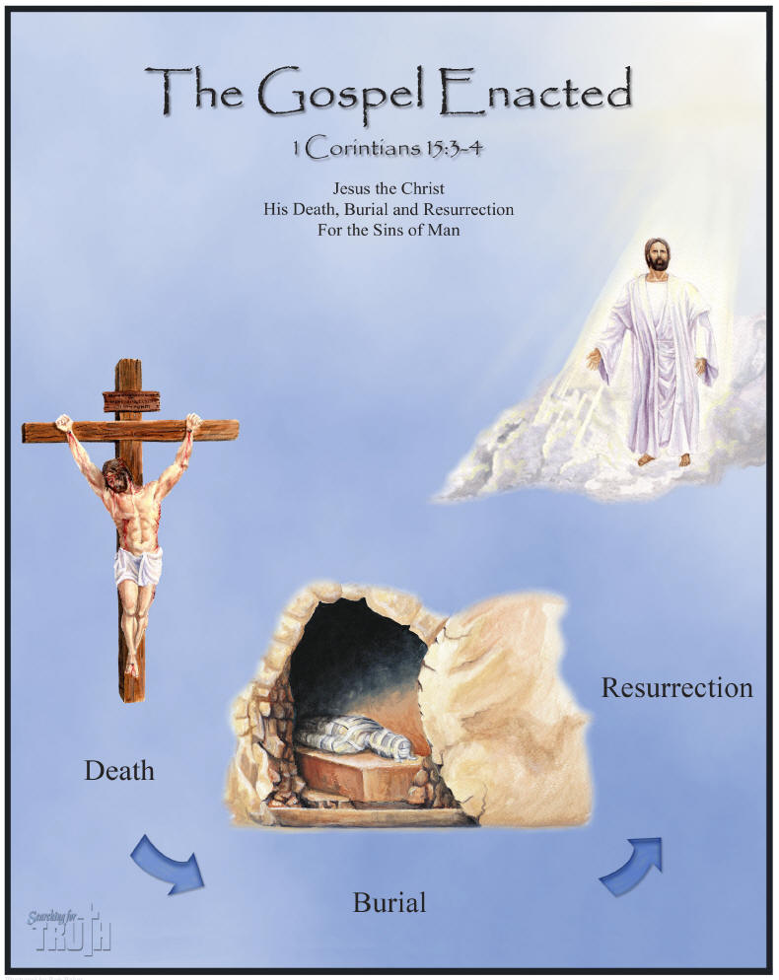
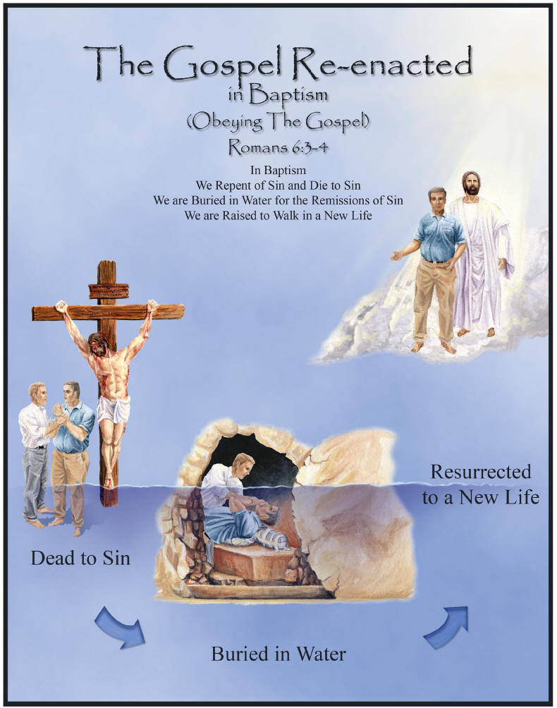
“I have been crucified with Christ...”
Galatians 2:20

