Slide 3
Why We Need It
Sin is a dreadful disease
Sin doesn’t get better w/time
Sin is a deceptive disease
Sin is contagious
It is battle-tested against sin
Sin is 100% fatal

Slide 4
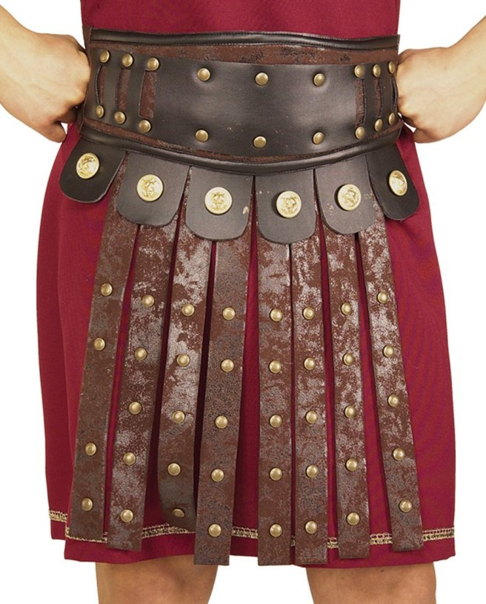
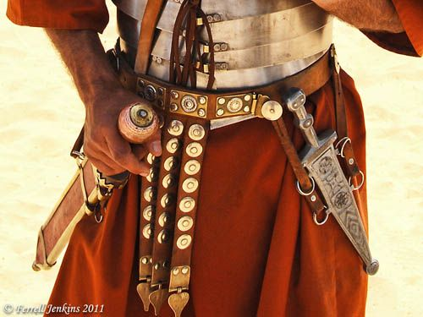
Belt of Truth
A call to be prepared
Luke 12:35; 1 Pet 1:13a; Ex 12:11
Frees from entanglements
John 8:31-32; Heb 12:1; 2 Tim 2:4
Sword of the Spirit
Take up the word of God
Heb 4:12
Offense & Defense
Psa 119:21; Rev 19:5a
Training
Heb 5:12-14
Of The Spirit
1 Thes 5:1

Slide 5
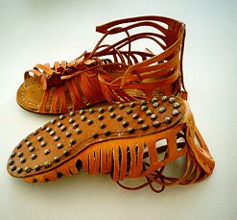
Shoes Of The Gospel Of Peace
Firm Footing
Psa 121:2-3a
Peace
Phil 4:7; Isa 2:4
Advance His Cause
Rom 10:15
Shield of Faith
Must Be Taken Up
1 Pet 1:5a; 1 John 5:4
Extinguishes Satan’s Arrows
Rom 8:1
We Push Back
1 Pet 3:15

Slide 6
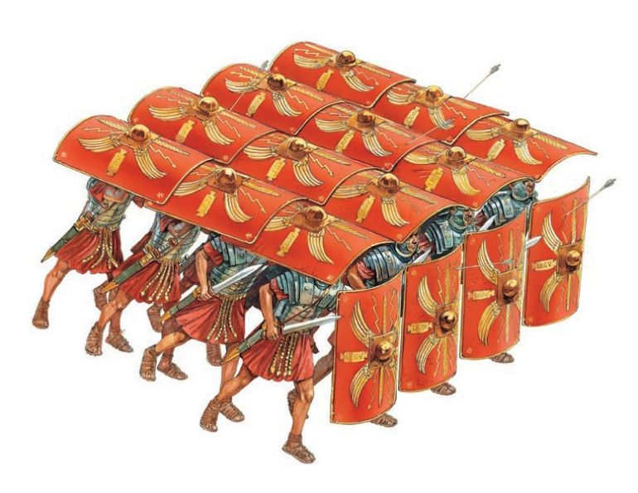
Shoes Of The Gospel Of Peace
Firm Footing
Psa 121:2-3a
Peace
Phil 4:7; Isa 2:4
Advance His Cause
Rom 10:15
Shield of Faith
Must Be Taken Up
1 Pet 1:5a; 1 John 5:4
Extinguishes Satan’s Arrows
Rom 8:1
We Push Back
1 Pet 3:15
Strength In Numbers
Eph 4:16

Slide 7
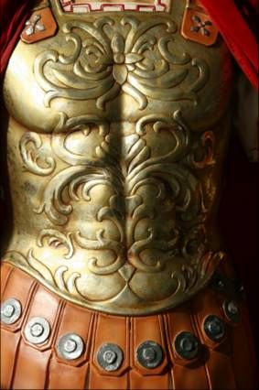
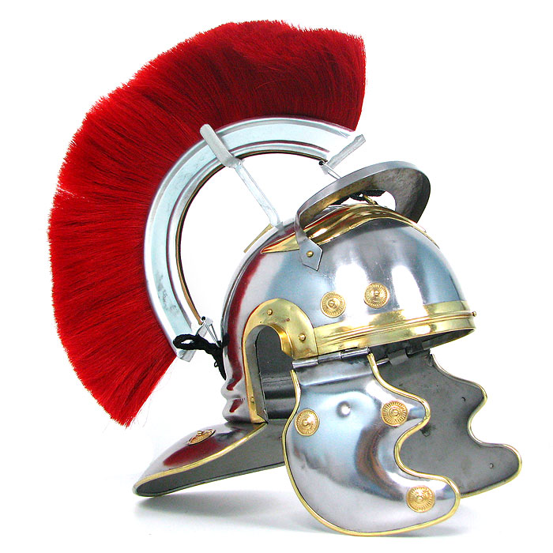
Breastplate of Righteousness
Protects the heart
Prov 4:23; 1 John 3:21
Protects From Unexpected Attacks
Luke 24:34
Covered w/Righteousness
Prov 11:4; 2 Cor 5:21; Phil 3:8-9
Helmet of Salvation
Assurance of Salvation
1 John 5:13
Hope of Salvation
1 Thes 5:8; Heb 6:19; 2 Tim 1:12

