Slide 1
Psalms
Book 4

Slide 2
Arrangement of the Psalms
The Psalms were originally collected into 5 “books” according to the material found in them
Book I (Psalm 1 & 2, 3 – 41)
Book II (Psalm 42 – 72)
Book III (Psalm 73 – 89)
Book IV (Psalm 90 – 106) - tonight
Book V (Psalm 107 – 150)

Slide 3
Psalms Book 1 Summary
Psalm 100:1 “Make a joyful noise to the Lord, all the earth!”
Psalm 101:5b “Whoever has a haughty look and
an arrogant heart I will not endure.”
Psalm 102:1 “Hear my prayer, O Lord; let my cry come to You!”
Psalm 103:11 “For as high as the heavens are above the earth,
so great is His steadfast love toward those who fear Him””
Psalm 104:28 “When you give it to them, they gather it up;
when You open Your hand, they are filled with good things.”
Psalm 105:5 “Remember the wondrous works that He has done,
His miracles, and the judgements He uttered”
Psalm 106:13 “But they soon forgot His works;
they did not wait for His counsel.”

Slide 4
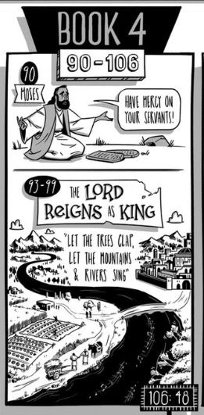
Book IV is made up primarily of anonymous poems with only three naming their author: two by David and one by Moses. It responds to Book II by reminding us that God is still in control. Psalm 93, 97 and 99 all begin by reminding us that "the Lord Reigns".

Slide 5
Psalm 105\106
Two sides of the same coin
Psalm 105 highlights God’s faithfulness
Psalm 106 shows the sins of the people
Historical view of Israel over time
Psalm 105 |  | Psalm 106
8-25 | Patriarchs – Providence
26-38 | Departure from Egypt | 7-12
39-42 | Wilderness | 13-33
43-45 | Promised Land | 34-43
 | God’s Love & Mercy | 44-48

Slide 6
The Enthronement Psalms
Psalms 93, 95-99 (94 included in some lists and not others)
Focus on God’s eternal Kingship
The previous grouping of Psalms (Book III) dealt with the crisis of Babylonian captivity, doubts about Israel’s core
These remind an with doubts that God is in control
Psalm 95:3 “For the Lord is a great God, and a great King above all gods”

Slide 7
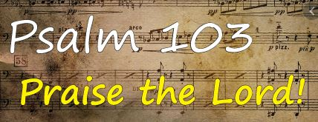
Psalm 103
Beautiful Psalm of nothing but praise
Call to Praise God (1-2)
Benefits of God’s favor (3-5)
God’s nature toward His people (6-18)
The Lord Rules (19)
Seeking all Bless God (20-22)

