Slide 1
Psalms
135 - 150

Slide 2
Arrangement of the Psalms
The Psalms were originally collected into 5 “books” according to the material found in them
Book I (Psalm 1 & 2, 3 – 41)
Book II (Psalm 42 – 72)
Book III (Psalm 73 – 89)
Book IV (Psalm 90 – 106)
Book V (Psalm 107 – 145, 146-150)

Slide 3
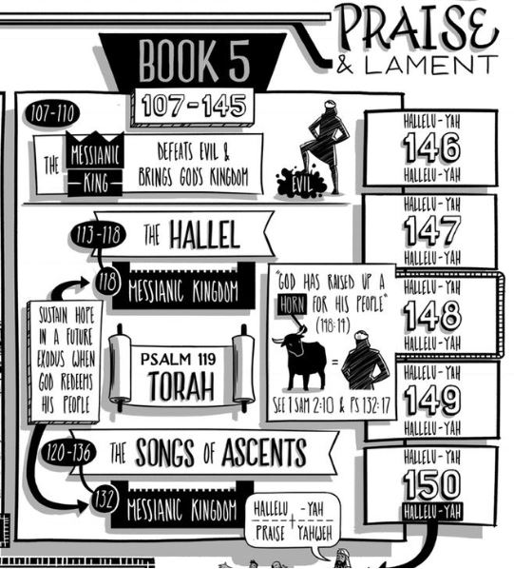
The last book continues to have many anonymous poems but it also includes a significant number by David and one by Solomon. The songs are much more positive than many of the previous books and include the Songs of Assent for pilgrims traveling to Jerusalem and the concluding Five Hallelujahs - the final grand Doxology of the Psalms.

Slide 4
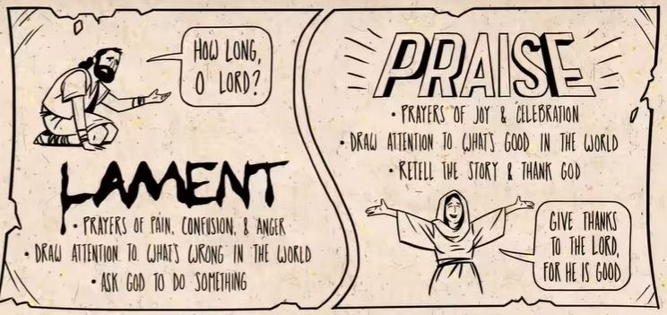
Psalm
Longest

Slide 5
Psalms Book 5 Summary
Psalm 135:13a “Your name, O Lord, endures forever”
Psalm 136:1 “Give thanks to the Lord, for He is good,
for His steadfast love endures forever.”
Psalm 137:4 “How shall we sing the Lord’s song in a foreign land?”
Psalm 138:1a “I give You thanks, O Lord, with my whole heart;”
Psalm 139:14a “I praise You, for I am fearfully and wonderfully made
Psalm 140:13 “Surely the righteous shall give thanks to Your name;
the upright shall dwell in Your presence.”
Psalm 141:3 “Set a guard, O Lord, over my mouth;
keep watch over the door of my lips!”
Psalm 142:3a “When my spirit faints within me, You know my way!”
Psalm 143:6 I stretch out my hand to You; my soul thirsts for You like parched land.”
Psalm 144:15b “Blessed are the people whose God is the Lord!”
Psalm 145:2 “Every day I will bless You and praise Your name forever and ever.”

Slide 7
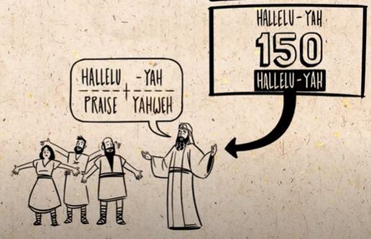
Psalm
Longest

Slide 8
Psalm 148
Psalm 148:1-4 – Heavens praise Him
Psalm 148:5-6 – Why do they praise Him?
Psalm 148:7-12 – The Earth praises Him
Psalm 148:13-14 – God alone worthy
His people are near

Slide 9
Psalm 1 – The Truly Happy Man
1 Blessed is the man who walks not in the counsel of the wicked, nor stands in the way of sinners, nor sits in the seat of scoffers
2 but his delight is in the law of the Lord, and on his law he meditates day and night.
3 He is like a tree planted by streams of water that yields its fruit in its season, and its leaf does not wither. In all that he does, he prospers.
Woven through it all “happiness can only be found in God”

Slide 10
Psalm 1 – The Way of the Wicked
4 The wicked are not so, but are like chaff that the wind drives away.
5 Therefore the wicked will not stand in the judgment, nor sinners in the congregation of the righteous;
By contrast to the righteous we see the wicked are NOT blessed. The are like chaff driven by the wind. In the judgement they will not stand and they aren’t blessed to be in the congregation of the righteous.
6 for the Lord knows the way of the righteous, but the way of the wicked will perish.
The Psalm ends with a contrast between the “two ways”. This Psalm in many ways sets the tone and mindset for much of what is to come in the entire collection.

Slide 11
Psalm 2 – Victory of the Messiah
Scene 1: The Nations Rebel (vs 1- 3)
Humanity has always sought to set itself above God or in a place without any guidance from Him.
Scene 2: God Laughs (vs 4 – 6)
God laughs at mankind's plans against him
Scene 3: The Anointed Ruler (vs 7 – 9)
God has chosen His Son King over the nations. When we look at the world today we understand that Jesus will return and justice will come with Him.
Scene 4: The Warning (vs 10 – 12)
God gives the Ruler’s of this world hope. Serve the Lord and take refuge in Him.

Slide 12
Psalm 3 – Confronting Our Fears\Anxieties
A Psalm of David, when he fled from Absalom his son.
The first Psalm attributed to David
Deals with real life struggle of fear\anxiety many of us deal with
In no way does David deny his emotions
In no way does David allow his emotions to control him
David lays the emotions before God and takes refuge in God
Instead of taking confidence in himself, he takes confidence in God
Heb 9:12-14 (our confidence is so much greater)
David’s faith made him whole

Slide 13
Why Studied the book of Psalms
As Christians it is not just wise or helpful to study the Psalms, it is commanded
Ephesians 5:19 “addressing one another in psalms and hymns and spiritual songs, singing and making melody to the Lord with your heart”
Colossians 3:16 “Let the word of Christ richly dwell within you as you teach and admonish one another with all wisdom, and as you sing psalms, hymns, and spiritual songs with gratitude in your hearts to God.”
James 5:13 “Is anyone among you suffering? Let him pray. Is anyone cheerful? Let him sing psalms.”
To avoid misinterpreting the Psalms

Slide 14
Value in studying the Old Testament
Romans 15:4 “For whatever was written in former days was written for our instruction, that through endurance and through the encouragement of the Scriptures we might have hope.”
II Timothy 3:14-17 “But as for you, continue in what you have learned and have firmly believed, knowing from whom you learned it and how from childhood you have been acquainted with the sacred writings, which are able to make you wise for salvation through faith in Christ Jesus. All Scripture is breathed out by God and profitable for teaching, for reproof, for correction, and for training in righteousness, that the man of God may be complete, equipped for every good work.”
Luke 18:31 “And taking the twelve, he said to them, “See, we are going up to Jerusalem, and everything that is written about the Son of Man by the prophets will be accomplished.””

