Slide 1
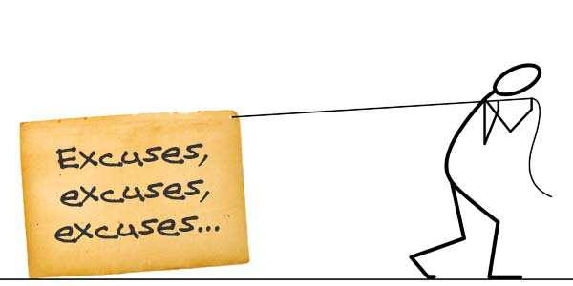
Pray Without Ceasing
Identifying and overcoming six excuses for prayerlessness in our lives

Slide 2
Too Busy!
Excuse #1:

Slide 3
Too Dry Spiritually!
Excuse #2:

Slide 4
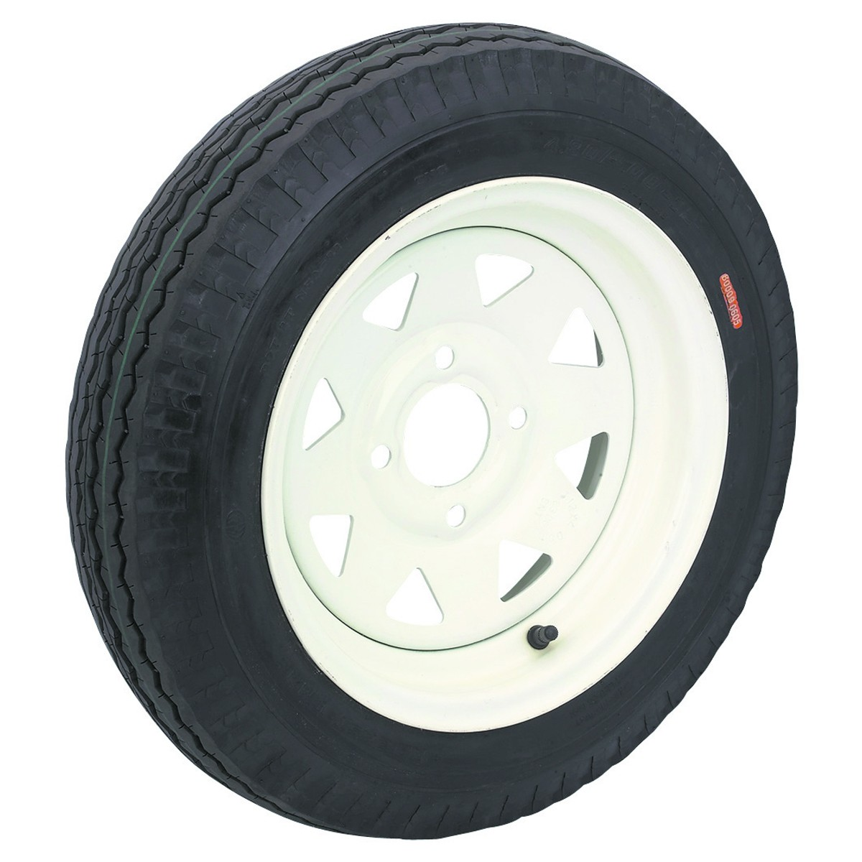
Feel No Need!
Excuse #3:

Slide 5
Too Bitter!
Excuse #4:

Slide 6
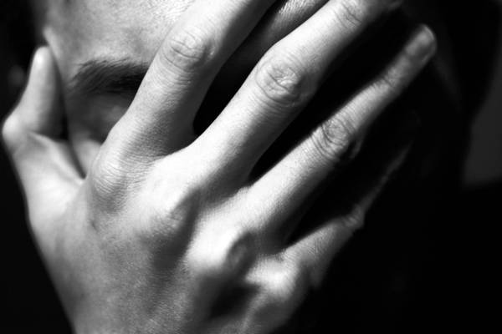
Too Ashamed!
Excuse #5:

Slide 7
Content with Mediocrity!
Excuse #6:

Slide 8
Suggestions
Choose a time and a place
Give God the first and the best
Eliminate distraction
Think about God as you pray
Pray out loud
Find a praying partner
Consider fasting
Plan a retreat

