Slide 2
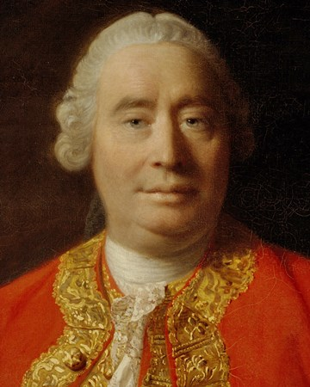
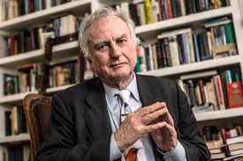
Atheists On Miracles
David Hume: 1711 – 1776
“It is a miracle that a dead man should come to life because that has never been observed in any age and country. There must therefore be a uniform experience against every miraculous event.” (An Enquiry Concerning Human Understanding, L. A. Selby Bigge, ed. (Oxford: Clarendon Press, 1902), pp. 114-16.)
Richard Dawkins: 1941 – ???
“The Virgin Birth, the Resurrection, the raising of Lazarus, even the Old Testament miracles, all are freely used for religious propaganda, and they are very effective with an audience of unsophisticates and children.” (A Devil's Chaplain (ed. Houghton Mifflin Harcourt, 2004))

Slide 3
Atheists Believe
In Miracles Too
_______________________
Miracle – “an effect or extraordinary event in the physical world that surpasses all known human or natural powers and is ascribed to a supernatural cause.”
4 Miracles of Atheism

Slide 4
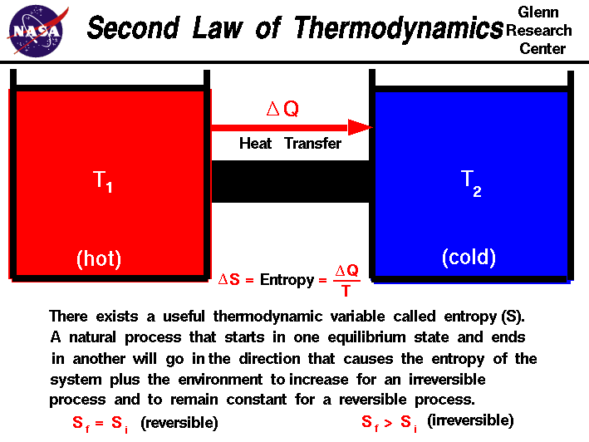
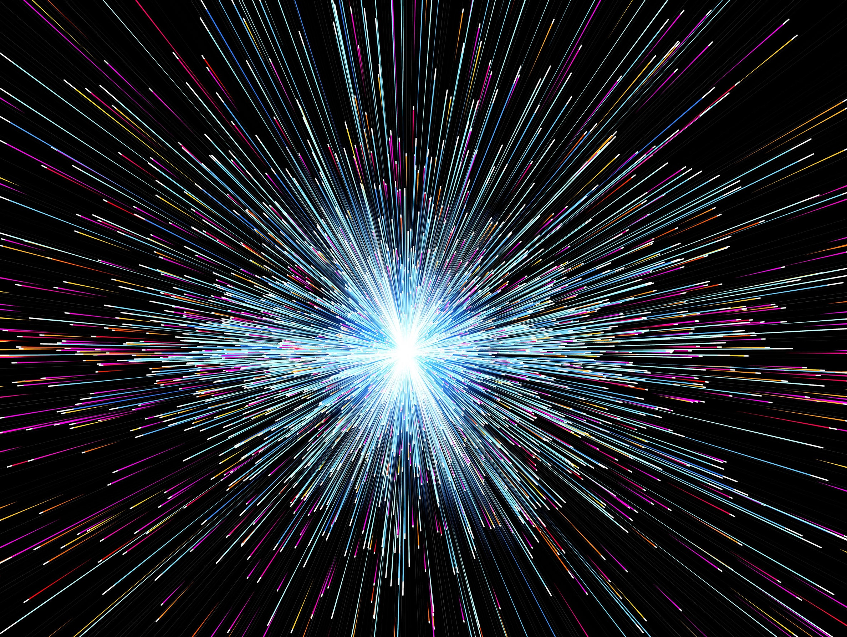
#1: Something Came From Nothing
Psa 102:25-26 – “²⁵Of old You founded the earth, and the heavens are the work of Your hands. ²⁶Even they will perish, but You endure; and all of them will wear out like a garment; like clothing You will change them and they will be changed.”

Slide 5
#1: Something Came From Nothing
Stephen Hawking – “Because there is a law like gravity, the universe can and will create itself from nothing.” (Page 180)
Notes:
This is the late Stephen Hawking, who suffered from Lou Gehrig's disease. He was considered by many to be one of the smartest men alive. His research in theoretical physics and cosmology is certainly unparalleled. He’s written tons of books, published papers, and won mounds of awards for his research. He was also an atheist. In 2010, he wrote a book called “The Grand Design”. To his credit, he believed what we have already established, that within the confines of our laws, the universe cannot be infinitely old. He believed something had to have created it. So in this book, he attempted to describe how our universe came into existence.
“Because there is a law like gravity, the universe can and will create itself from nothing.” – Now, read that again and see if you can find the inconsistencies, there are at least 2. The first is that Hawking believes the universe brought itself into existence from nothing, but he calls that “nothing” “gravity”.

Slide 6
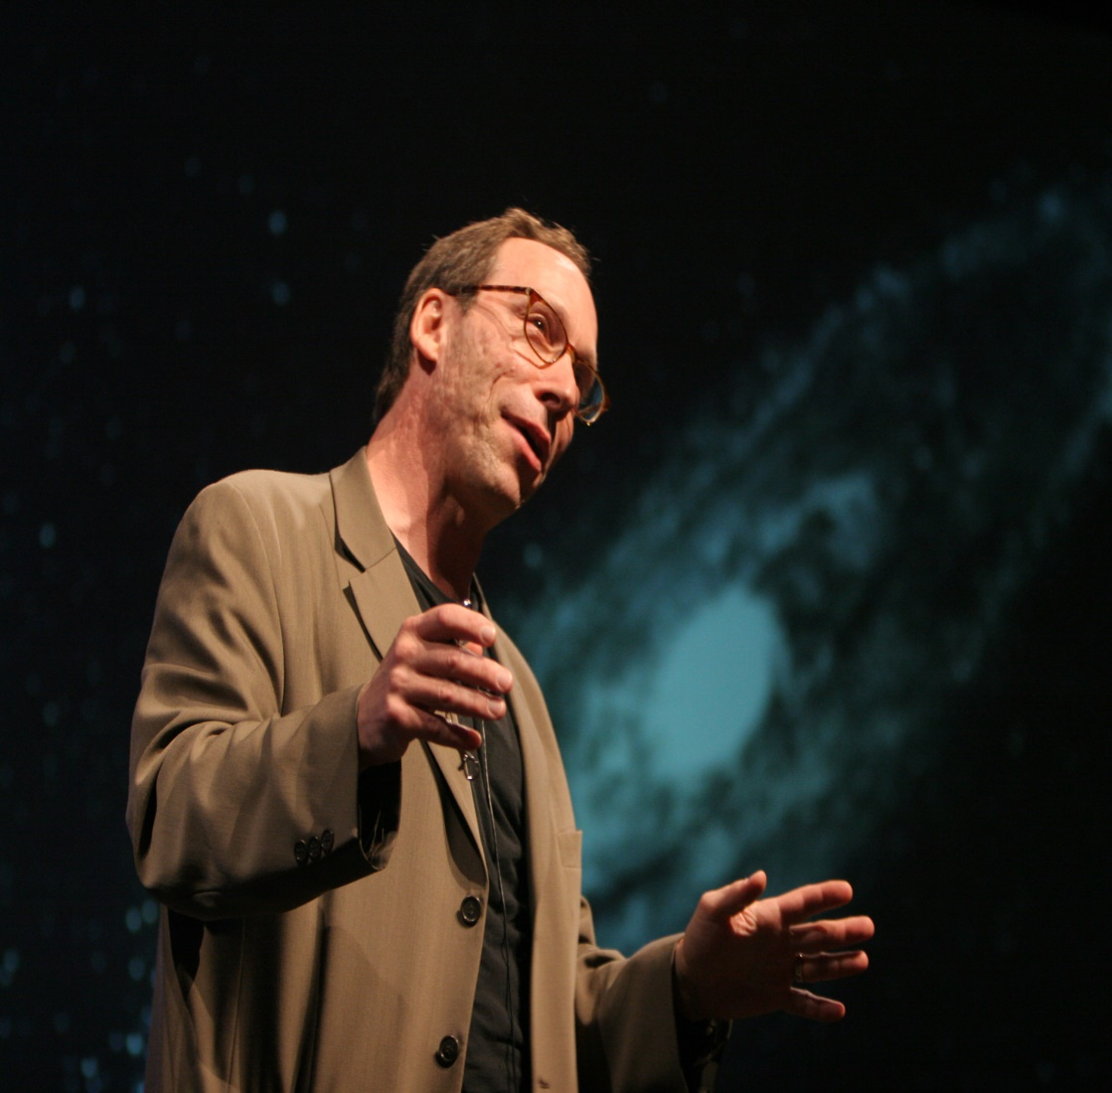
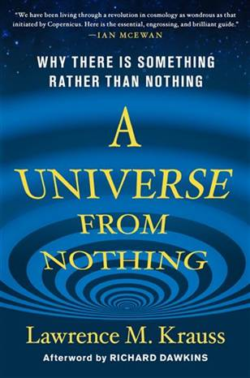
#1: Something Came From Nothing
Lawrence Krauss – “One of the things about quantum mechanics is not only can nothing become something, nothing always becomes something. Nothing is unstable. Nothing will always produce something in quantum mechanics.” (Chapter 10)
Notes:
Lawrence Krauss is another noted physicist and atheist who wrote a book called “A Universe From Nothing”. In this book, Krauss attempts to answer the question of why there is something rather than nothing. In other words, why is there such a thing as “existence”? He boldly claims that the cause of the universe is not God, but rather “nothing”, citing that there are things happening at the quantum level that dispense the need for God.
“One of the things about quantum mechanics is not only can nothing become something, nothing always becomes something. Nothing is unstable. Nothing will always produce something in quantum mechanics.” But, again, this begs the question: what does he mean by “nothing”? I’ll tell you what he means; he means “something” and he defines that something as occurring at the quantum level. I don’t understand the complexities of quantum physics. But I know there are properties and laws. And I don’t have to understand quantum physics to know that it is something. But he calls it nothing. And this is the game that some of the skeptics of our scientific community like to play, and its an irrational, logical fallacy.

Slide 8
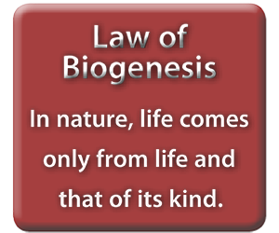
#2: Life Came From Non-Life

Slide 9
#2: Life Came From Non-Life
“The reasonable view was to believe in spontaneous generation; the only alternative, [is] to believe in a single, primary act of supernatural creation. There is no third position.” (“The Origin of Life” Scientific American, 191[2]:44-53, August 1954)

Slide 11
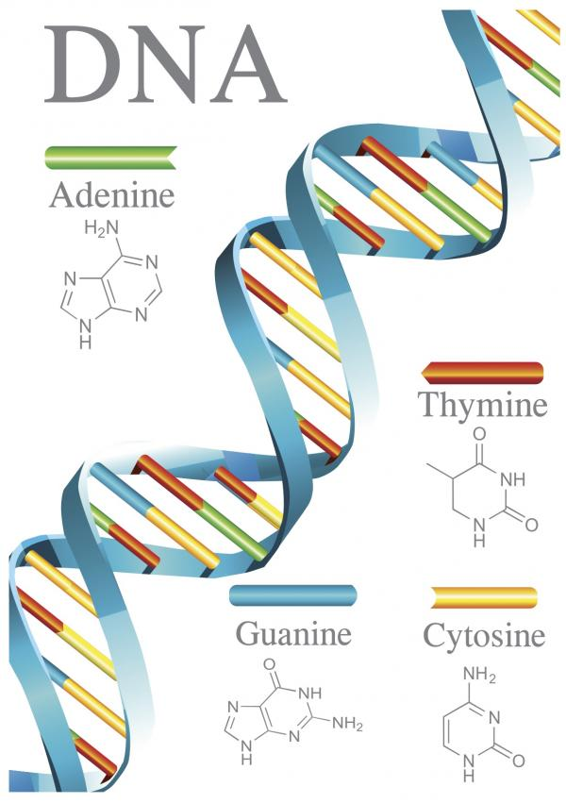
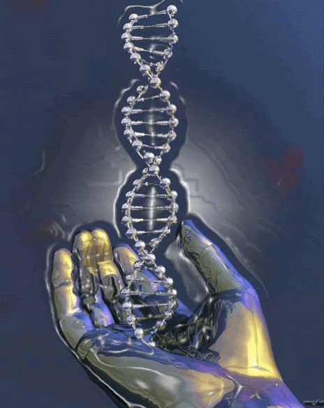
#3: Atoms Wrote Their Own Software
Micro digital (2 nanometers in diameter)
Info storage/retrieval (1 gram DNA: 455 billion GB, > 100 million DVDs)
Has its own inherent language convention
Self-assembly (disordered system => organized structure)
Redundant (contains multiple copies of same genetic sequence)
Error-correcting (cells identify and correct damage to DNA molecules)
Notes:
Let’s look at DNA. DNA stands for Deoxyribonucleic Acid and it is far more than just matter. DNA are large complex molecules that contain the blueprint and manufacturing instructions for all life. It is the densest information storage system on the face of this earth. One gram of DNA can store 455 billion gigabytes of data; that’s the content of more than 100 billion DVDs. Bioengineers have even figured out how to store large volumes of books and media within these DNA molecules and then come back later and reconstruct the information from the DNA. But more impressive is the fact that these DNA molecules aren’t blank. They already contain complex information within them. And one of the immutable laws of Information Science is that information never originates by itself. Anytime information is traced back to its source, it always gets back to a mind.
So in DNA, you have information that is already present and there is a programming language inherent in every DNA molecule that indicates a supremely intelligent designer was behind it. See, every single one of us began as a cell about the size of a period at the end of a sentence. So how does that cell know to build a body as large as ours with one hundred trillion cells of which there are thousands of different kinds of cells? It does so by the information contained in DNA which translates that information to the cell using its own language convention. Each one of our cells is composed of nano-chemical complex machinery that’s beyond our comprehension and DNA contains the intelligent information for how our cells build, how they replicate, and how they move. So within DNA are the manufacturing instructions on how to build and operate our incredible human bodies. And DNA itself is self-replicating – each molecule is able to construct an identical copy of itself both quickly and efficiently.
DNA even knows how to detect and correct replication errors. There are special proteins called enzymes that travel up and down the DNA molecule looking for and making repairs on a second by second basis. They’re like little editors reading a book and looking for errors by the author and making corrections along the way. These enzymes go up and down the DNA molecule making corrections in complex ways we can’t even fathom. Brethren, this is a sophisticated, complex technology that far exceeds mankind’s abilities. I can say that from experience because I’m a computer programmer. If mankind could figure out how to design software that knew how to correct itself, guys like me would be out of a job – or maybe we’d just be Bioengineers. But it’s incredible to think about. How does DNA know how to do all of this? How does it know how to correct itself, unless someone infinitely more intelligent than ourselves designed it that way?

Slide 12
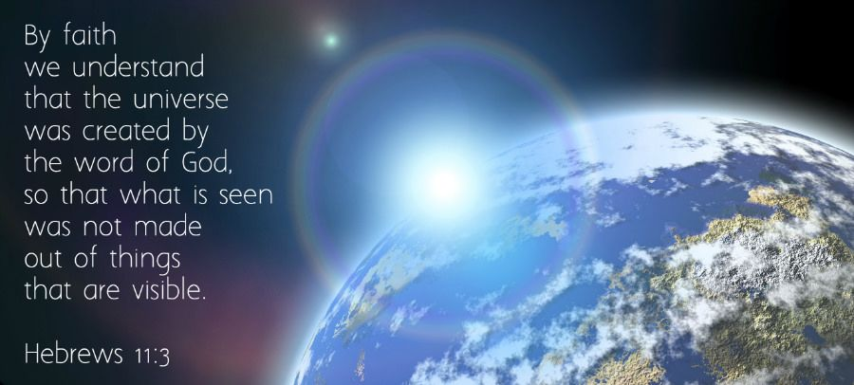

Slide 13
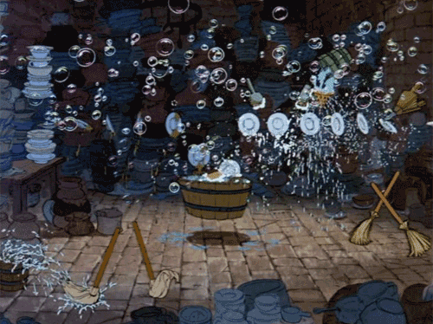
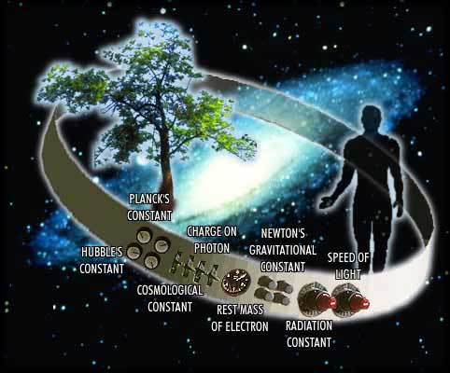
#4: Order Came From Chaos
Notes:
Let’s look at DNA. DNA stands for Deoxyribonucleic Acid and it is far more than just matter. DNA are large complex molecules that contain the blueprint and manufacturing instructions for all life. It is the densest information storage system on the face of this earth. One gram of DNA can store 455 billion gigabytes of data; that’s the content of more than 100 billion DVDs. Bioengineers have even figured out how to store large volumes of books and media within these DNA molecules and then come back later and reconstruct the information from the DNA. But more impressive is the fact that these DNA molecules aren’t blank. They already contain complex information within them. And one of the immutable laws of Information Science is that information never originates by itself. Anytime information is traced back to its source, it always gets back to a mind.
So in DNA, you have information that is already present and there is a programming language inherent in every DNA molecule that indicates a supremely intelligent designer was behind it. See, every single one of us began as a cell about the size of a period at the end of a sentence. So how does that cell know to build a body as large as ours with one hundred trillion cells of which there are thousands of different kinds of cells? It does so by the information contained in DNA which translates that information to the cell using its own language convention. Each one of our cells is composed of nano-chemical complex machinery that’s beyond our comprehension and DNA contains the intelligent information for how our cells build, how they replicate, and how they move. So within DNA are the manufacturing instructions on how to build and operate our incredible human bodies. And DNA itself is self-replicating – each molecule is able to construct an identical copy of itself both quickly and efficiently.
DNA even knows how to detect and correct replication errors. There are special proteins called enzymes that travel up and down the DNA molecule looking for and making repairs on a second by second basis. They’re like little editors reading a book and looking for errors by the author and making corrections along the way. These enzymes go up and down the DNA molecule making corrections in complex ways we can’t even fathom. Brethren, this is a sophisticated, complex technology that far exceeds mankind’s abilities. I can say that from experience because I’m a computer programmer. If mankind could figure out how to design software that knew how to correct itself, guys like me would be out of a job – or maybe we’d just be Bioengineers. But it’s incredible to think about. How does DNA know how to do all of this? How does it know how to correct itself, unless someone infinitely more intelligent than ourselves designed it that way?

Slide 14
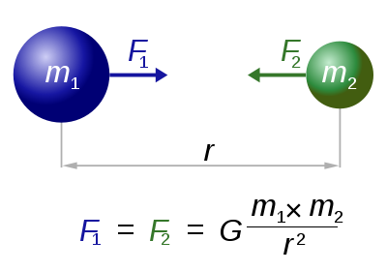
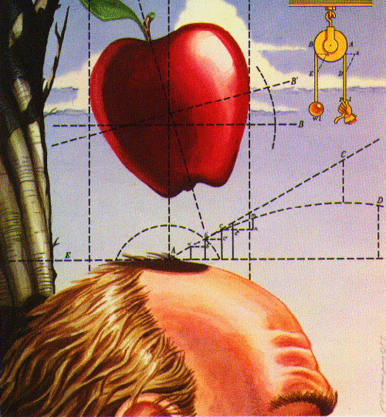
#4: Order Came From Chaos
Gravitational Constant: G ≈ 6.67428 x 10⁻¹¹m³kg⁻¹s⁻²
Allowable deviation:
1 / 10⁶⁰
Notes:
Let’s consider just one of these constants: Newton’s gravitational constant is G=6.673 x 10⁻¹¹ m³ kg⁻¹ s⁻². That looks crazy, I know. But here’s how fine-tuned this value is. If it were increased or decreased by merely 1/10⁶⁰ than none of us would exist. In other words, imagine a dial divided into 10⁶⁰ increments. If the gravitational constant had been out of tune by just one of these infinitesimally small increments, our universe would have either expanded and thinned out so rapidly that no stars could form and life couldn’t exist, or by going the other way, our universe would have collapsed back onto itself with the exact same results.
All 26 dimensionless constants present in our universe are balanced with this kind of razor precision, almost as if someone with a superlative mind behind the scenes set it all up.

Slide 15
Miracles aren’t “miracles” to God
Matt 19:26 – “With man this is impossible, but with God all things are possible.”
Philosophy is not evidence
Heb 11:1 – “Now faith is the assurance of things hoped for, the evidence of things not seen.”
I don’t have the faith to be an atheist
1 Pet 3:15 – “but sanctify Christ as Lord in your hearts, always being ready to make a defense to everyone who asks you to give an account for the hope that is in you, yet with gentleness and reverence”

