Slide 1
1 Cor 15:12-19
“¹²Now if Christ is preached, that He has been raised from the dead, how do some among you say that there is no resurrection of the dead? ¹³But if there is no resurrection of the dead, not even Christ has been raised; ¹⁴and if Christ has not been raised, then our preaching is vain, your faith also is vain. ¹⁵Moreover we are even found to be false witnesses of God, because we testified against God that He raised Christ, whom He did not raise, if in fact the dead are not raised. ¹⁶For if the dead are not raised, not even Christ has been raised; ¹⁷and if Christ has not been raised, your faith is worthless; you are still in your sins. ¹⁸Then those also who have fallen asleep in Christ have perished. ¹⁹If we have hoped in Christ in this life only, we are of all men most to be pitied.”
Notes:
1 Cor 15:12-19 – The observations that Paul makes in these verses couldn’t be more clear. If there is no resurrection, preaching Jesus Christ would be utterly senseless and without meaning. They’d be just empty words designed to make people feel guilty who already have enough problems to deal with as it is. If there is no resurrection, having faith in Christ would be completely useless. Even baptism would be pointless because it symbolizes an event that never took place. If there is no resurrection, then every witness from the 1st century to every preacher who followed would be liars. And not just liars, but the so-called witnesses would be fools for dying for a cause in which they claimed to be eye-witnesses of but knew to be false. If there is no resurrection, no one is redeemed from their sins and all those who have lived in former times believing such a lie have perished and we will never again see our loved ones who died in faith before us. If there is no resurrection, there is no judgment which means there is no justice in the world. Those who lived with impunity toward the Lord will never experience any divine justice and those who suffered trying to do what is right will never see any reward. And if there is no resurrection, let’s just be honest; we Christians would be the most pitiful people to have ever walked this earth because we rested our hope on that which is vain. In other words, look at us silly people and how we waste our time coming to these assemblies and putting such heart and effort into such a vain occasion.

Slide 2
Notes:
What Paul is stressing is this: the resurrection of Jesus Christ from the dead is the foundation upon which the entire system of Christianity is based. And it is because of this fact that men have attempted for years to discredit and disprove this historical event as nothing but a sham, an illusion derived from perverse minds seeking to deceptively win the hearts of the gullible. Because skeptics know that if they can find a breech in the logic, a fault in the conclusion, or a fallacy in the argument, they can destroy our faith and put this so-called resurrection to rest, pun intended. But if Jesus Christ was raised from the dead, it means He is the Son of God – Rom 1:4 – “[He] was declared the Son of God with power by the resurrection from the dead, according to the Spirit of holiness, Jesus Christ our Lord”.
And if He is the Son of God, everything He taught and claimed is an irrefutable truth that demands our fullest efforts and attention.
This study attempts to answer the question “Was Jesus really raised from the dead? Did this miraculous event in history actually take place?”

Slide 3
Outline
Prophecy
Notes:
The first thing important to note is that the resurrection of Christ was not something that should have surprised the Jews of the 1st century, because it had been prophesied about on several occasions long before it ever took place.

Slide 4
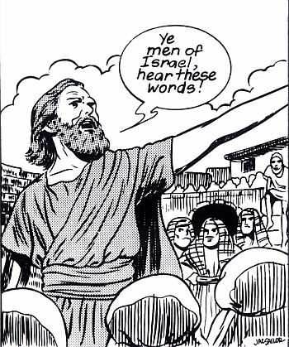
Prophecy
Acts 2:24-27 – “²⁴But God raised him from the dead, freeing him from the agony of death, because it was impossible for death to keep its hold on him. ²⁵David said about him: ‘I saw the Lord always before me. Because he is at my right hand, I will not be shaken. ²⁶Therefore my heart is glad and my tongue rejoices; my body also will live in hope, ²⁷because you will not abandon me to the grave, nor will you let your Holy One see decay…’”
Quotes Psa 16:10
Notes:
If you look in Acts 2, Peter, in his first gospel sermon, points to the fact that a 1000 years before Jesus was even born, David prophesied through the Holy Spirit that the Messiah would be raised from the dead by quoting the 16th Psalm. Acts 2:24-27 –Now when David said that God would not allow his Holy One to decay, we can be sure he wasn’t talking about himself. David died and he was buried and he was never raised from the dead. And Peter makes this point in his sermon, also pointing out that David’s tomb was still with them that very day. David is talking about the Messiah. And for a thousand years before Jesus was born, it was said of Him that His body would not be abandoned to the grave or allowed to experience decay.

Slide 5
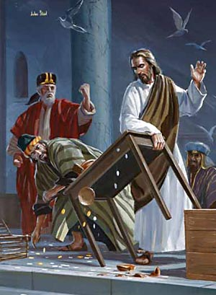
Prophecy
John 2:19-21 – “¹⁹Jesus answered them, ‘Destroy this temple, and I will raise it again in three days.’ ²⁰The Jews replied, ‘It has taken forty-six years to build this temple, and you are going to raise it in three days?’ ²¹But the temple he had spoken of was his body.”
Also Matt 16:21; Mark 8:31; Luke 9:22
Notes:
Secondly, Jesus talked about raising himself from the dead multiple times in His ministry. You’ll remember that in John 2, Jesus cleanses the temple of God by running out every vendor in the place hoping to make a quick buck off the Passover Feast. And when He did this, the Jews asked, “What sign do you show us for doing these things?” – John 2:19-21 – Jesus told His disciples the same thing in private in Matt 16:21 when He said He must suffer and be killed and then rise from the grave. And you’ll remember Peter took exception to this and Jesus had to rebuke Peter for tempting Him.

Slide 6
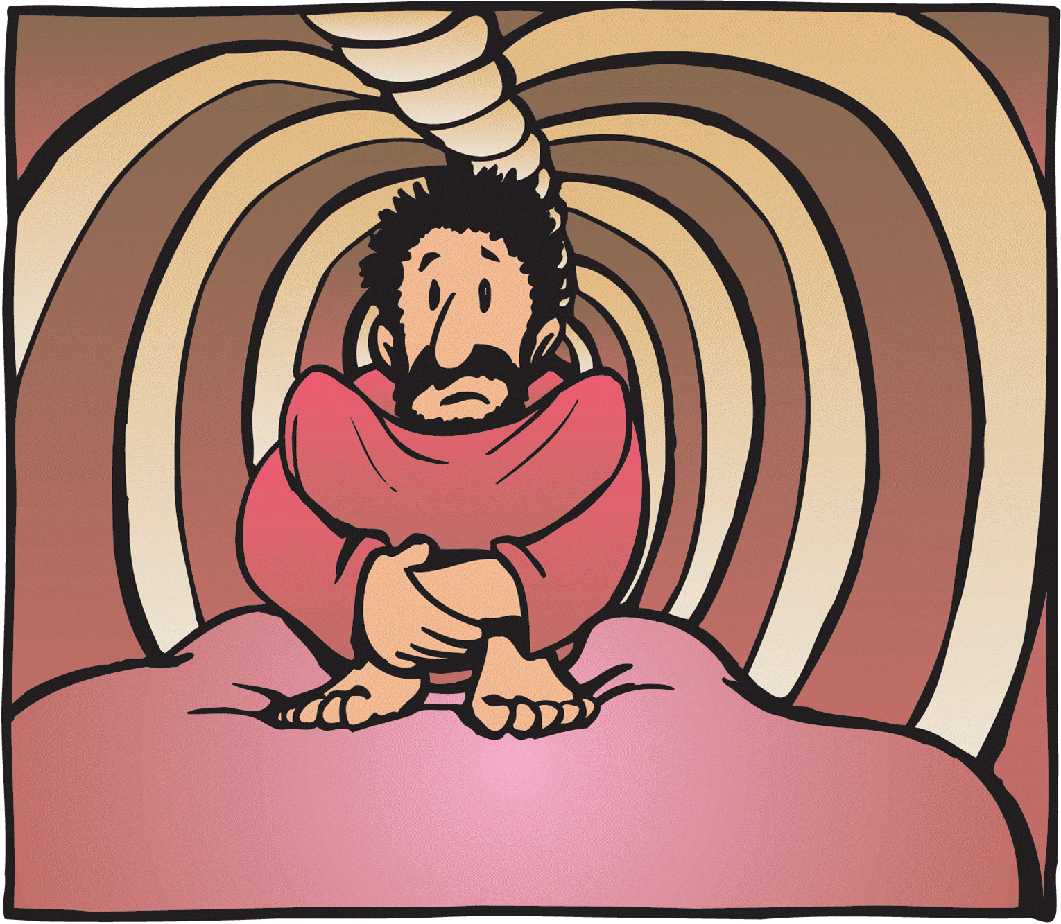
Prophecy
Matt 12:38-40 – “³⁸Then some of the scribes and Pharisees said to Him, ‘Teacher, we want to see a sign from You.’ ³⁹But He answered and said to them, ‘An evil and adulterous generation craves for a sign; and yet no sign will be given to it but the sign of Jonah the prophet; ⁴⁰for just as Jonah was three days and three nights in the belly of the sea monster, so will the Son of Man be three days and three nights in the heart of the earth.’”
Notes:
Matt 12:38-40 – Now notice here that Jesus is comparing what happened to Jonah to what would happen to Him, except whereas Jonah was in the belly of a fish for 3 days and was then released, Jesus would be in the belly of the grave for 3 days and then be released. It can’t merely be that He would go to the grave, as we all eventually will, because He gives a specific, limited amount of time that He would remain there.

Slide 7
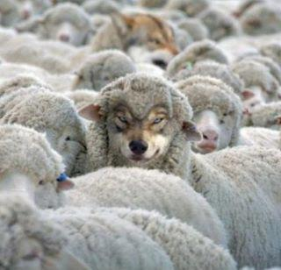
A Bold Move
Deut 18:22 – “When a prophet speaks in the name of the Lord, if the thing does not happen or come to pass, that is the thing which the Lord has not spoken; the prophet has spoken it presumptuously; you shall not be afraid of him.”
Notes:
What this means is that the resurrection wasn’t a last-minute change of plan. It shouldn’t have been a surprise. It was prophesied about in the OT and confirmed by Jesus in His ministry. Now that was a bold move on Jesus’ part, was it not? Every Jew knew from Deut 18 that the principal qualification for whether or not a prophet is from God will be determined by what He says vs. what actually takes place. And here is Jesus, this small-town carpenter from Nazareth, claiming He has the power not only to give His life, but to raise Himself up after dying. And if this did not happen, we would expect that Christianity should have never taken off. But alas, it did take off. And men gave their own lives testifying that they had seen it with their own eyes.
So if that is the case, what exactly do skeptics claim to be alternatives to Jesus being raised from the dead? Let’s look at the arguments and see whether or not any of them can actually stick.

Slide 8
Outline
Prophecy
Was Jesus Really Dead?
Notes:
First, some suggest that Jesus really didn’t die on the cross. This is sometimes referred to as the “swoon theory”. It is the suggestion that Jesus just sort of passed out on the cross and that those who were there thought He was dead and not knowing any better they just stuck Him in the tomb where He would later woke up. And it’s true that we’ll hear stories from time to time of a person who was thought to have died and then as soon as the mortician is about to begin his procedure, the body moves and its determined rather than being dead that the person was just in some sort of suspended animation or coma and has just now woken up. I think it was Edgar Allen Poe who told the story of a certain family who was scared of being buried alive because they had a medical disposition about them where they would enter some state where it appeared as though they were dead. I don’t question whether scenarios such as this have happened because they have happened, infrequent as they are. But the question for us is could this have happened to Jesus? Could Jesus have not really died, but laid in the tomb where He then awoke, came out of the tomb, gotten past the guards, and falsely convinced people He had raised Himself from the dead?

Slide 9
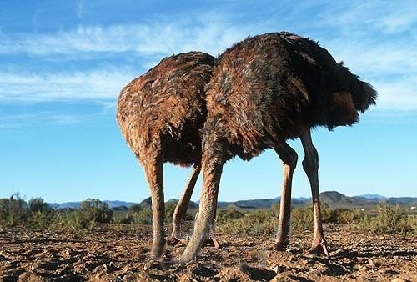
Was Jesus Really Dead?
There is no Roman or Jewish history that supports this. It took 1800 years for someone to actually suggest it
Notes:
The biggest problem w/this argument is that it took 1800 years before someone actually suggested it. And there was no plausible evidence ever given that would cause any thinking person to take it seriously; only biased skepticism. So when we hear things like this suggested that are 1800 years removed from the eyewitnesses themselves, it begs the question of who was in the better position to know what happened. Is it the biased skeptic 1800 years removed, or was it the eyewitnesses who were tortured to death confirming its validity? Who has more credibility?

Slide 10
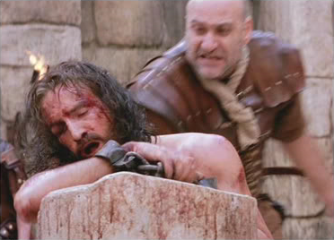
Was Jesus Really Dead?
He was scourged
John 19:1 – “Pilate then took Jesus and scourged Him.”
Notes:
Another problem with this theory is the condition of Jesus when He was laid in the tomb. He had been scourged by Pilate. This was no simple beating. Roman scourgings were so brutal it was not uncommon for a person to die from it alone before they even had opportunity to be crucified. The Jews would beat a man with 39 stripes because Deut 25:3 did not allow them to go over 40 and they were afraid they might miscount and so they stopped at 39. But the Romans had no such limit. They simply scourged a man until he was taught, laying the lashes to him on his front and back. And many times pieces of metal or bone were put in the lashes to lacerate the tissue, often down to the victims bones. Blood loss during scourging was exceptional, which led to additional trauma and weakness, and hypovolemic shock. And while we’re not given the minute particulars about Jesus’ scourging, we know it was brutal enough that the Romans had to solicit a man to help Jesus carry His cross for how weak He was. Then He was nailed to the cross, hanging there for at least 6 hours breathless as a result of ongoing suffocation, suffering from acidosis, dehydration, shock, tetanus, exposure, and most likely heart failure.

Slide 11
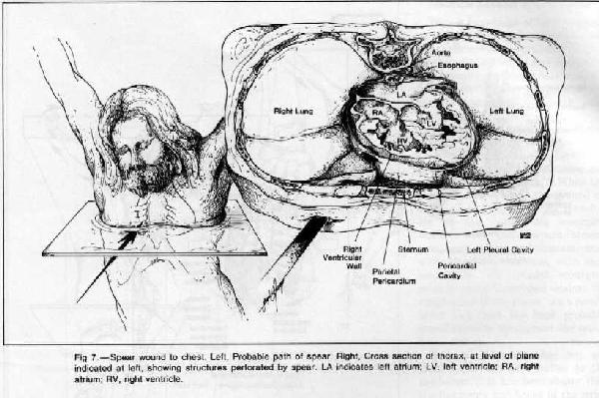
Was Jesus Really Dead?
Roman soldiers thrust spear in Jesus’ side to verify death
John 19:31-34 – “Then the Jews, because it was the day of preparation, so that the bodies would not remain on the cross on the Sabbath (for that Sabbath was a high day), asked Pilate that their legs might be broken, and that they might be taken away. So the soldiers came, and broke the legs of the first man and of the other who was crucified with Him; but coming to Jesus, when they saw that He was already dead, they did not break His legs. But one of the soldiers pierced His side with a spear, and immediately blood and water came out.”
Notes:
And then not knowing whether He was truly dead yet wanting to ensure it, John 19:34 tells us that Jesus had a spear thrust in His side by a soldier who knew exactly what it takes to kill a man.

Slide 12
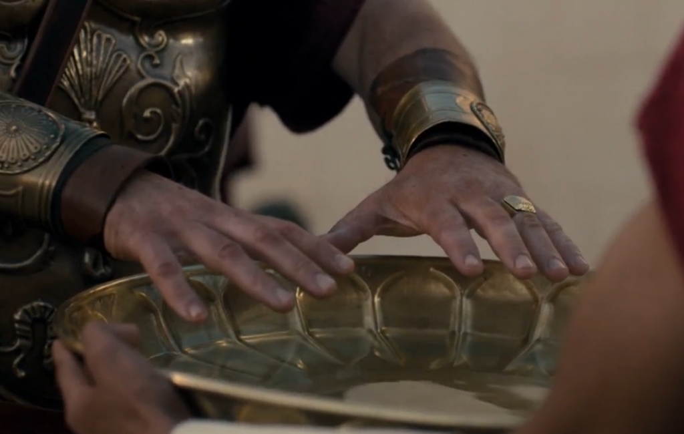
Was Jesus Really Dead?
Pilate certified Jesus’ death
Mark 15:44-45 – “Pilate wondered if He was dead by this time, and summoning the centurion, he questioned him as to whether He was already dead. And ascertaining this from the centurion, he granted the body to Joseph.”
Notes:
Add to that the fact that Mark 15 tells us Pilate Himself had Jesus’ death certified – Mark 15:44-45 – Was it in Pilate’s best interest that Jesus be dead? Even as I hear the words come out of my mouth, I realize what a complicated question that is. What I mean is, to avoid a rebellion from the Jews and keep the peace in Jerusalem, was it in Pilate’s best interest? And the answer is “yes”.

Slide 13
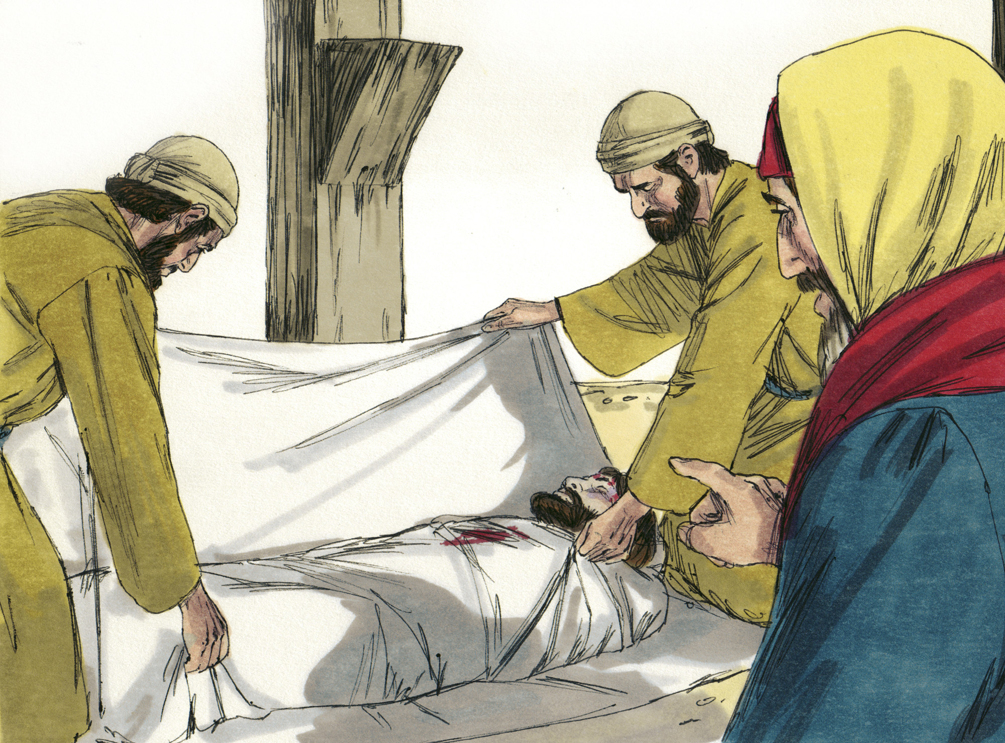
Was Jesus Really Dead?
Joseph of Arimathea, Nicodemus prepared body for burial
John 19:39-40 – “Nicodemus, who had first come to Him by night, also came, bringing a mixture of myrrh and aloes, about a hundred pounds weight. So they took the body of Jesus and bound it in linen wrappings with the spices, as is the burial custom of the Jews.”
Notes:
And the soldier, who had no other stake in this thing other than just to do his job, confirmed it to Pilate at which point we’re told in Matt 27 that he granted the body to Joseph of Arimathea.

Slide 14
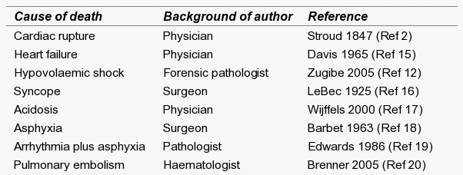
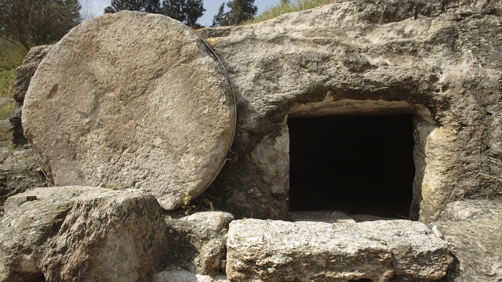
Was Jesus Really Dead?
A mortally wounded, dehydrated, and famished man could not have removed the stone by himself
Matt 27:59-60 – “And Joseph took the body and wrapped it in a clean linen cloth, and laid it in his own new tomb, which he had hewn out in the rock; and he rolled a large stone against the entrance of the tomb and went away.”
Notes:
Now this is interesting, look in Matt 27:59-60 – So not only did Joseph handle Jesus body personally, but he buried him in a tomb with a large stone covering the entrance.
So it begs the question: how could a man with tremendous blood loss and trauma, pierced through the side most likely through His lungs and heart because we’re told blood and water poured out, certified dead by Pilate, certified dead by Joseph, and then laid in a stone carved out of a rock that even a group of women could not push away, and yet Jesus is in there for 3 days in this condition without food and water, but somehow wakes up and manages to move that heavy stone and get past the guards who were there.
It’s inconceivable. That theory is more far-fetched than believing He was raised from the dead.

Slide 15
Outline
Prophecy
Was Jesus Really Dead?
Was Jesus’ Body Stolen?
Notes:
But even some skeptics who admit how inconceivable it is that He wasn’t actually dead will then suggest that perhaps His dead body was just stolen.

Slide 16
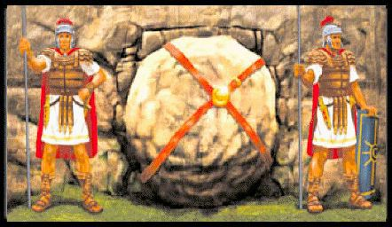
Was Jesus’ Body Stolen?
Conspiracy hatched because body missing
Matt 28:11-15 – “Now while they were on their way, some of the guard came into the city and reported to the chief priests all that had happened. And when they had assembled with the elders and consulted together, they gave a large sum of money to the soldiers, and said, “You are to say, ‘His disciples came by night and stole Him away while we were asleep.’ And if this should come to the governor’s ears, we will win him over and keep you out of trouble.” And they took the money and did as they had been instructed; and this story was widely spread among the Jews, and is to this day.”
How would they know if they were asleep?
Notes:
In fact, this is the story that unbelievers of that time attempted to propagate (Matt 28). In order to keep people from believing Jesus was raised from the dead, this is what they concocted – Matt 28:11-15 – Now how could they possibly know this if they were asleep? And if you’re ever wondering why that conspiracy didn’t take off like they hoped it would, that’s why. It was ridicules.
But let’s look at this argument. There are only 3 possible groups of people who could have stolen Jesus’ dead body from the tomb: the disciples, the Jews, or the Romans.

Slide 17
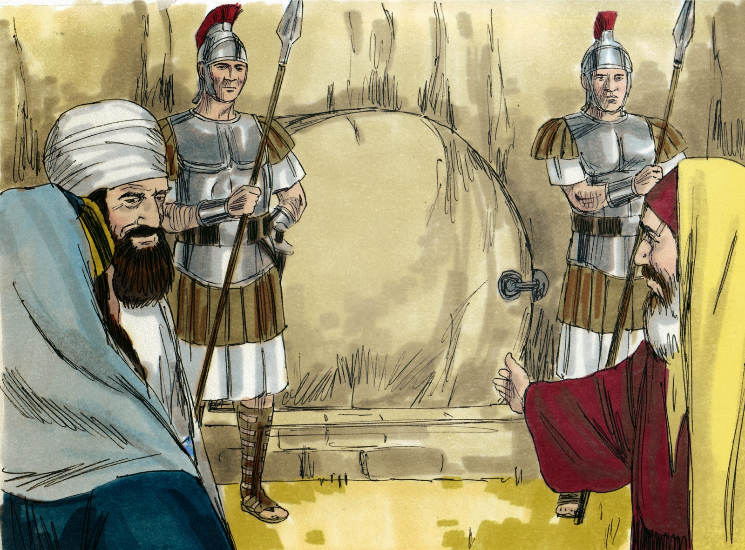
Was Jesus’ Body Stolen?
Did the disciples steal it?
Extensive measures were made to prevent it
Matt 27:62-66 – “Now on the next day, the day after the preparation, the chief priests and the Pharisees gathered together with Pilate, and said, “Sir, we remember that when He was still alive that deceiver said, ‘After three days I am to rise again.’ Therefore, give orders for the grave to be made secure until the third day, otherwise His disciples may come and steal Him away and say to the people, ‘He has risen from the dead,’ and the last deception will be worse than the first.” Pilate said to them, “You have a guard; go, make it as secure as you know how.” And they went and made the grave secure, and along with the guard they set a seal on the stone.”
Notes:
Did the disciples steal Jesus’ dead body from the tomb? If you’ll look in Matt 27, you’ll see that extensive measures were taken to ensure that this would not happen. Why? Because even the enemies of Jesus had heard Him say He would rise from the dead, proving, again, that this was a foretold event – Matt 27:62-66 – In other words, they knew Jesus said it, and they had ample time to prevent anyone from tricking them into falsely believing it.

Slide 18
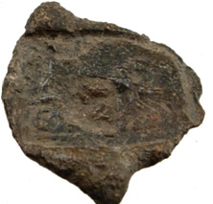
Was Jesus’ Body Stolen?
Did the disciples steal it?
A Roman seal was placed on the tomb
History tells us that Romans persistently apprehended anyone suspected of breaking a seal
Punishment was immediate execution
Point: If Roman authorities believed the disciples had done this, they would have been arrested
Notes:
Not only that, they had a Roman Seal placed on that tomb. If any person was suspected of breaking a Roman Seal, they would have been immediately apprehended; and punishment was immediate execution – history tells us upside down crucifixion. What this means is that if Roman authorities had even suspected that the disciples had done this, they would have been apprehended with the full force of the Empire – that they weren’t apprehended speaks volumes.

Slide 19
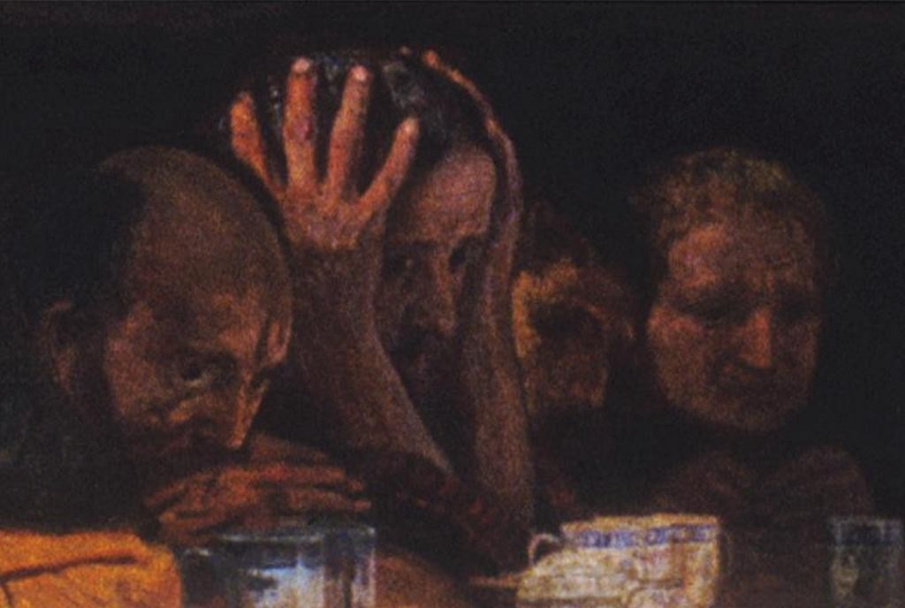
Was Jesus’ Body Stolen?
Did the disciples steal it?
Cowardice not consistent w/the boldness it would take to pull that off
John 20:19– “So when it was evening on that day, the first day of the week, and when the doors were shut where the disciples were, for fear of the Jews…”
Notes:
Let’s think about this too: is the cowardice of the disciples at Jesus’ arrest in harmony with the kind of boldness it would take to pull off something such as this? John 20:19 – This is after Jesus was raised from the dead. They were scared to death when Jesus was arrested and they were scared to death prior to seeing Him raised. There’s no courage in these men consistent with the kind of grit it would take to steal Jesus’ body away from a guarded tomb with a Roman Seal.

Slide 20
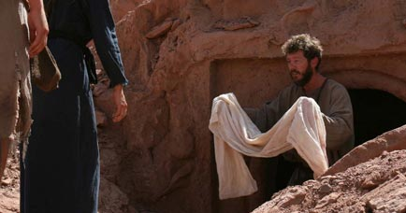
Was Jesus’ Body Stolen?
Did the disciples steal it?
The disciples were surprised when His tomb was found empty
Mark 16:11 – “When they heard that He was alive and had been seen by her, they refused to believe it.”
John 20:9 – “For as yet they did not understand the Scripture, that He must rise again from the dead.”
No motive; only imprisonment and execution
Notes:
In fact, the disciples were surprised when they rushed to his tomb and found it empty. They had been in denial about both His death and resurrection – Mark 16:11; John 20:9 – And so the disciples could not have stolen it. In fact, every single one of them save John was killed for proclaiming His resurrection to the masses. People will die for something they believe is true but will never die for something they know is false.

Slide 21
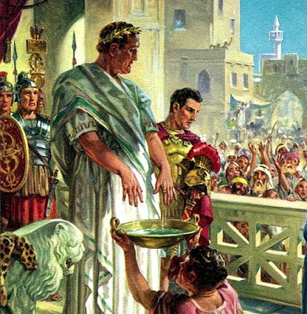
Was Jesus’ Body Stolen?
Did Roman authorities steal his body?
No motive
Desire was to preserve peace, not incur the anger of the Jews
Matt 27:24 – “When Pilate saw that he was accomplishing nothing, but rather that a riot was starting, he took water and washed his hands in front of the crowd, saying, “I am innocent of this Man’s blood; see to that yourselves.”
If stolen, they would’ve shown the body when Christianity disrupted their peace
Notes:
Did the Romans steal Jesus’ body from the tomb? Well, where is the motive? Their desire was to procure peace in the Empire, not sanction the growth of another religious movement that would incur the anger of the Jews. Pilate was so intent on avoiding any responsibility concerning Jesus that Matt 27:24 tells us he literally washed his hands of it. So why then would he perpetuate a movement that would cause him more problems?
One thing we can be sure of is that if the Romans had stolen Jesus’ bodily, they would have produced it as soon as the Christian movement started disrupting the empire. But they couldn’t because they didn’t have it, because He was not only raised from the dead but raised to be with God, to sit at His right hand in heaven.

Slide 22
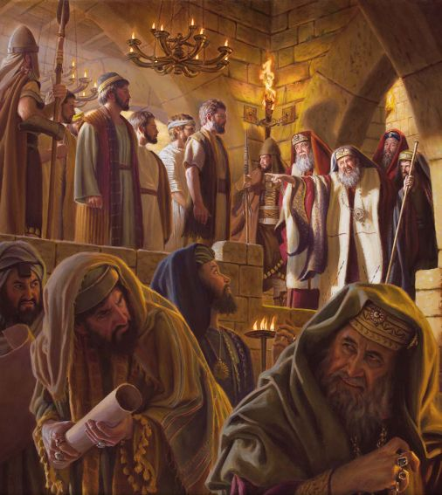
Was Jesus’ Body Stolen?
Did Jewish authorities steal his body?
Pushed for his crucifixion
Requested tomb be guarded
Matt 27:63-64 – “Sir, we remember that when He was still alive that deceiver said, ‘After three days I am to rise again.’ Therefore, give orders for the grave to be made secure until the third day, otherwise His disciples may come and steal Him away and say to the people, ‘He has risen from the dead,’ and the last deception will be worse than the first.”
Would have produced it when the disciples began preaching a resurrected Jesus (Acts 4)
Notes:
Did the Jews steal Jesus’ body from the tomb? Again, there was no motive for it. The Jews were the very ones pushing for His crucifixion and to put an end to the movement. And Matt 27:63 tells us that they were the ones who requested the tomb to be guarded. Would they have then broken the Roman Seal, removed the body, and brought condemnation upon themselves and their households?
You’ll remember in Acts 4:18 when the Sanhedrin commanded the Apostles to stop preaching in the name of Jesus that the Apostles didn’t obey them. Why? Acts 4:20 – “we cannot stop speaking about what we have seen and heard.” And then vs. 21 tells us that the Jews threatened them further. Why? Because that’s the best they had. They couldn’t produce a body. The Jews couldn’t produce a body because they didn’t have a body. They didn’t steal it.

Slide 23
Outline
Prophecy
Was Jesus Really Dead?
Was Jesus’ Body Stolen?
Was Jesus’ Tomb Empty?
Notes:
Was Jesus’ tomb really empty? In other words, maybe when the women first got there and looked in the tomb, Jesus’s body was there; they just didn’t see it the first time and so they ran away making a big deal out of nothing.

Slide 24
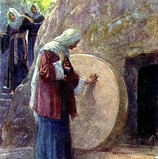
Was Jesus’ Tomb Empty?
Check the tomb!
Sanhedrin bribed soldiers knowing it was empty
Matt 28:11-13 – “Now while they were on their way, some of the guard came into the city and reported to the chief priests all that had happened. And when they had assembled with the elders and consulted together, they gave a large sum of money to the soldiers, and said, “You are to say, ‘His disciples came by night and stole Him away while we were asleep.’”
Notes:
This doesn’t require a grand response – it would have been a simple matter of the Jewish or Roman authorities checking the tomb. In fact, the soldiers were in the best possible position to confirm or deny, but Matt 28:11-13 tells us that they reported his body missing to the Jewish authorities at which point they were bribed to claim His disciples stole Him in the night.

Slide 25
Outline
Prophecy
Was Jesus Really Dead?
Was Jesus’ Body Stolen?
Was Jesus’ Tomb Empty?
Did They Go To The Wrong Tomb?
Notes:
Could the women have gone to the wrong tomb?

Slide 26
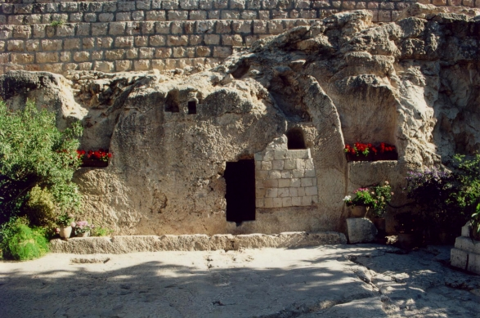
Did They Go To The Wrong Tomb?
Private burial ground
Matt 27:57-60 – “When it was evening, there came a rich man from Arimathea, named Joseph, who himself had also become a disciple of Jesus. This man went to Pilate and asked for the body of Jesus. Then Pilate ordered it to be given to him. And Joseph took the body and wrapped it in a clean linen cloth, and laid it in his own new tomb, which he had hewn out in the rock; and he rolled a large stone against the entrance of the tomb and went away.”
Disciples dashed off to verify women's’ claim, in broad daylight, and they saw the empty wrappings
John 20:1-10
Notes:
What we need to understand is that this wasn’t an ordinary burial place. It wasn’t like our modern-day cemeteries where graves are side by side and can number in the hundreds or thousands and be easily confused with one another – Matt 27:57-60
This tells us several things. First, this was a new tomb where no one had yet been buried. And it was common practice at that time for tombs to have multiple bodies buried in the same place. If you go to New Orleans today and tour the cemeteries, you’ll learn that many bodies are buried in certain particular tombs because of space issues and the ground water problems. And so if the women had went to the wrong tomb, an older tomb where a body was missing, the question would have been raised of whose body it was because there would have been more than one there. But this was a new tomb in which no man had ever been buried, a benefit only a rich man such as Joseph of Arimathea could afford, and therefore a rare thing indeed. The chances of the women getting the wrong tomb by stumbling upon another tomb with the same description we’ve read of here is small indeed. But you see, it would have been a simple matter of checking after the women, of which the disciples did in broad daylight. But the disciples saw the same thing the women did, the stone rolled away and the empty wrappings.

Slide 27
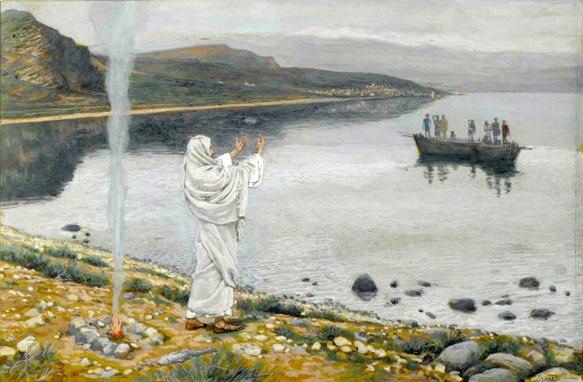
Did They Go To The Wrong Tomb?
The Romans and Jews would have immediately produced the body
How do you account for the numerous post-resurrection appearances?
1 Cor 15:5-6 – “And that He appeared to Cephas, then to the twelve. After that He appeared to more than five hundred brethren at one time, most of whom remain until now, but some have fallen asleep.”
Notes:
And even if both went to the wrong tomb, it would have been a simple matter of the Romans or the Jews producing the body to end all of this so-called nonsense of Jesus being raised from the dead. But they couldn’t do it. Neither the Jews or the Romans could counter the testimony of what Paul claims was over 500 witnesses. The best the Jews and the Romans could do to silence these witnesses was intimidation and threats of violence. But even that didn’t stop them. Because the disciples were serving the Cosmic Creator and put their lives in His hands.

Slide 28
Outline
Prophecy
Was Jesus Really Dead?
Was Jesus’ Body Stolen?
Was Jesus’ Tomb Empty?
Did They Go To The Wrong Tomb?
Were Eye-Witnesses Hallucinating?
Notes:
But then finally, some have actually suggested that these eye-witnesses Paul alluded to were merely hallucinating. You can’t make this stuff up. Skeptics bring these charges before Christians no matter how ludicrous they may sound. So what about it?

Slide 29
Were The Eye-Witnesses Hallucinating?
Over 500 people saw Him – 1 Cor 15:5-6
The ones who saw Him did so over a 40 day period, over a wide-geographical area, and under a variety of circumstances
Hallucinations are not contagious
Those who hallucinate see what they expect to see. The disciples did not expect Jesus to rise from the grave
There were 3 instances when Jesus was seen, but He wasn’t recognized – Luke 24:13-31; John 20:15; 21:4
Notes:
It’s not just the fact that over 500 people saw Him at one time, but many people saw Him over a 40 day period, over a wide geographical area, and in a variety of circumstances. Unless someone is going to go against known science and claim that hallucinations are contagious, this just doesn’t add up. Besides that, people who hallucinate see what they expect to see. It’s like the man walking through the desert thirsting for water. What is the first mirage he sees? Water. But with the disciples, they thought it was over. No one really believed He would be raised from the dead and so they weren’t expecting to see Him. And you’ll remember, there were several occasions where Jesus appeared to folks and they didn’t recognize Him at all. No, anyone who claims all these eye-witnesses were hallucinating are merely trying to hallucinate arguments from thin air.

Slide 30
Conclusion
Notes:
What this means is that Jesus indeed raised Himself from the dead. He said He was going to and He did it. The Romans knew He did it, the Jews knew He did, and His disciples knew He did it and they had the faith and courage to take that message to the known world at the very cost of their lives. And while we were not there, while none of us can ever claim to be witnesses of such a magnanimous event, 2000 years later the evidence is clear that our lives are not spent in senseless hoping after fairytales. And if you have not died with Christ in baptism, your life need not be in vain either.

