Slide 2
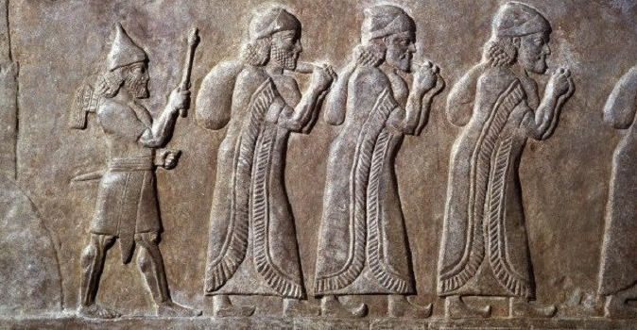
Evangelism in Exile

Slide 3
What Everybody Wants

Slide 4
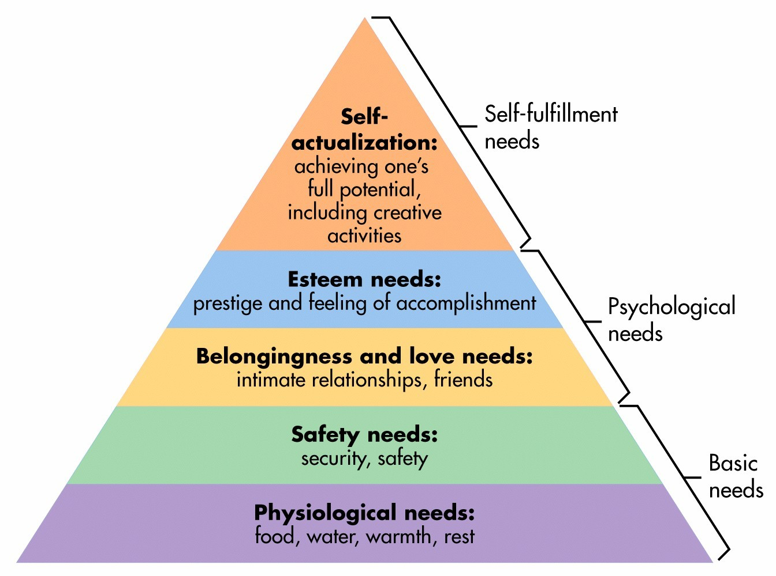

Slide 5
A Family
Blessed be the God and Father of our Lord Jesus Christ!
1 Peter 1:3

Slide 6
A Do-Over
…he has caused us to be born again…
1 Peter 1:3

Slide 7
Eternity
…to an inheritance that is imperishable, undefiled, and unfading, kept in heaven for you…
1 Peter 1:4

Slide 8
Security
…who by God’s power are being guarded through faith…
1 Peter 1:5

Slide 9
Purpose
…so that the tested genuineness of your faith—more precious than gold that perishes though it is tested by fire…
1 Peter 1:7

Slide 10
Glory
…may be found to result in praise and glory and honor at the revelation of Jesus Christ.
1 Peter 1:7

Slide 11
Joy
Though you do not now see him, you believe in him and rejoice with joy that is inexpressible and filled with glory…
1 Peter 1:8

Slide 12
Salvation
…obtaining the outcome of your faith, the salvation of your souls.
1 Peter 1:9

Slide 13
A Family
A Do-Over
Eternity
Security
Purpose
Glory
Joy
Salvation

