Slide 1
Notes:
Thus far in the SOTM, Jesus has said some shocking things. In the Beatitudes, He spoke of character traits that run against the grain of the common norms of society. And while people of this quality of character should be admired, He ends the Beatitudes by claiming that people of this nature will be viciously persecuted by those of the world who choose to pitch their tents in the darkness.
However, arguably one of the most shocking statements Jesus makes in this entire sermon is found in Matt 5:20 when He states that our righteousness must exceed that of the Pharisees if we’re to enter the kingdom of heaven. Its not as shocking to us because we have the benefit of hindsight. But to most Jews, the Pharisees stood out as the most religious. Even the Apostles were worried about offending them (Matt 15:12). While there were spiritually inclined Jews who probably saw through their plastic religious, most did not and looked up to them as a standard to attain to. Now Jesus is purposefully lowering people’s expectations of them and stressing a better and truer righteousness to strive after.
Who exactly were the Pharisees and what was their “righteousness”?

Slide 2
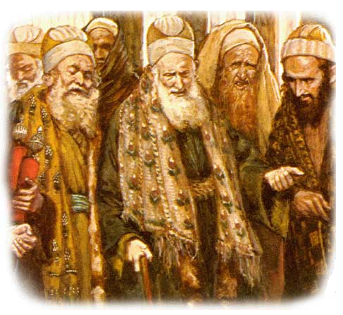
The Pharisees
Background
Pharisee – “Separated Ones”
Emerged from supporters of Judas Maccabean
Sought to avoid mistakes of their forefathers
Associated with scribes & lawyers (teachers/copiers of OT)
Biblically literate
Sanhedrin’s majority-rule
Notes:
The word “Pharisee” means “Separatists” or “Separated Ones”. It is similar in meaning to the word “saint” which means “one set apart”. The Pharisees called themselves this because they were wanting to set themselves apart to God.
They emerged from the supporters of Judas Maccabean, the leader of the Maccabean revolt that took place against the Seleucid Empire during what we call the 400 years of silence.
When God allowed His people to return to Jerusalem after 70 years of captivity, the concept of obedience had finally set in and idolatry was no longer a problem. The Pharisees were men intent on avoiding the extremisms of disobedience and idolatry they saw in their forefathers and therefore “separated” themselves for this purpose.
In the gospels, they are often named with the lawyers and scribes (teachers and copiers of scripture) and were the most biblically literate Jews of their days. Even Jesus recognized their knowledge of OT law (Matt 23:2-3a).
The Pharisees also made up the majority of the Sanhedrin council, the 70 group of men who governed the Jews. Summing it all up, the Pharisees were the most influential sect of Jesus’ day.

Slide 3
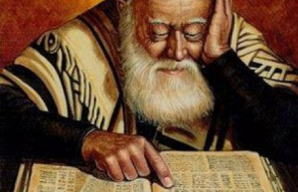
The Pharisees
Beliefs
Authority of the scriptures
Obedience
Disciplined Religion
Free Will
Supernatural
Heaven & Hell
Temple Worshippers
Tithers
A Messiah
Evangelistic
The Resurrection of the dead
Notes:
What were the beliefs of the Pharisees?
They believed in the inspiration and authority of scripture. Paul even describes Himself in this way in Acts 26:5. They were strict and conservative when it came to God’s law.
They believed in obedience, that you must obey God and His law at all costs. This they stressed repeatedly in an attempt to avoid the mistakes of their forefathers
They believed in strict discipline in their spirituality, and therefore attempted to “wear the part” with their long robes and phylacteries and tassels.
They believed in free will. We have old writings today where the Pharisees wrote about God’s sovereignty and that He uses His sovereign right to give man free-will.
They believed in the supernatural – angels, demons, miracles, etc.
They believed in a heaven and a hell, places reserved for mankind once they are resurrected from the dead.
They were temple worshippers. When Jesus mentions the Pharisee and tax collector praying in the temple, He does so knowing they were regular attenders of the temple.
They also tithed and were extraordinarily strict in seeing they did so according to the law (Matt 23:23) making sure to give of God from all of their possessions.
They believed in a messiah. Sometimes that surprises us given how they treated Jesus. They treated Him this way because He did not fit their concept of a messiah but they did believe one was coming according to OT prophesy.
The Pharisees were also very evangelistic. In Matt 23:15, Jesus acknowledges the extreme lengths they’d take to make a proselyte.
The Pharisees also believed in the resurrection from the dead, something they scuffled about with the Sadducees often. Paul mentions in Acts 23:6-7 that he was on trial for the resurrection of the dead which causes a dissension amongst the Pharisees and Sadducees who were at the trial.
On the surface, it sounds like the Pharisees were good people. They were not wrong because of anything we just listed, but for other reasons that Jesus hones in on.

Slide 4
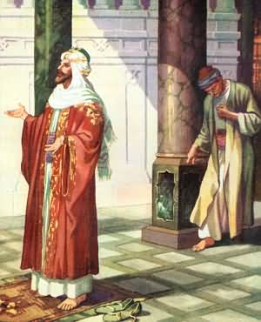
The Pharisees Righteousness
No Heart
Matt 15:8-9 – “⁸This people honors Me with their lips, but their heart us far away from me. ⁹But in vain do they worship me, teaching as doctrines the precepts of men.”
Luke 16:15 – “And He said to them, ‘You are those who justify yourselves in the sight of men, but God knows your hearts; for that which is highly esteemed among men is detestable in the sight of God.”
Matt 23:27-28 – “²⁷Woe to you, scribes and Pharisees, hypocrites! For you are like whitewashed tombs which on the outside appear beautiful, but inside they are full of dead men’s bones and all uncleanness. ²⁸So you, too, outwardly appear righteous to men, but inwardly you are full of hypocrisy and lawlessness.”
Notes:
They had a heart problem
To come to God, we must be wholly converted and born again – John 3:3. This is a monumental change that has to take place for every citizen of God’s kingdom. We are not citizens because of our genes or parents or culture or because we happen to attend a local church with “Church of Christ” on the sign. It is a birth of choice, of water and spirit, an internal change. We become different people.
The Pharisees were people who honored God outwardly (with their lips) but whose hearts were not converted (Matt 15:8-9). Therefore everything that they did of a religious nature was aimed at another object and source other than God. This made their worship vain and empty despite adherence to the outward requirements of the law.
We know that God knows the heart (Luke 16:15) and therefore we will not get away with non-conversion. It is futile to worship God outwardly without a transformed heart. Thus, we must make up our minds whether we are going to devote our entire being or practice vain worship that further widens our path to perdition.
Such vainness is so disgusting to God, He compares it to being full of dead men’s bones, uncleanness, hypocrisy, and lawlessness. We should never want to be reduced to this sort of shallow faith. Our only hope is to completely give ourselves over to God and lay every encumbrance and sin at the cross and be content to leave it there while fixing our eyes on Jesus whole heartedly.

Slide 5
Our Heart: 3 Options
Keep Our Heart For Ourselves
Experiencing hurt from people can cause us to protect our heart
We can build such walls around our heart that even God cannot penetrate
While man lies/deceives/hurts, God cannot and will not
Eph 1:18 – “I pray that the eyes of your heart may be enlightened, so that you will know what is the hope of His calling, what are the riches of the glory of His inheritance in the saints”
Notes:
There are 3 options we have when it comes to our heart.
First, we can choose to keep our heart for ourselves. This is when we choose to build walls around our heart. Typically this happens as a result of the lies and hurt mankind gives us. Determining never to experience this kind of hurt again, we choose indifference to protect ourselves.
The problem is that God does not do as man does. He will never leave us or forsake us. He is wholly trustworthy and dependable. Not only that, but He came as a man to experience the same rejection and hurt we experience magnified by His death on the cross. He understands.
Though it is wise to guard our heart to a degree, we should never do so at the expense of keeping God at a distance.

Slide 6
Our Heart: 3 Options
Give Our Heart To Man
Loyalty to the party
John 9:22 – “His parents said this because they were afraid of the Jews; for the Jews had already agreed that if anyone confessed Him to be Christ, he was to be put out of the synagogue”
John 12:42 – “Nevertheless many even of the rulers believed in Him, but because of the Pharisees they were not confessing Him, for fear that they would be put out of the synagogue”
Loyalty to men out of fear
Matt 21:26 – “But if we say, ‘From men,’ we fear the people; for they all regard John as a prophet.”
Matt 21:46 – “When they sought to seize Him, they feared the people, because they considered Him to be a prophet.”
Loyalty to men for praise
Matt 23:5a – “But they do all their deeds to be noticed by men”
Notes:
Second, we can choose to give our heart to man. In other words, we can become people-pleasers.
Sometimes it is the external pressure of a group of people that drive us a particular direction. If we’re not careful, our ideals can become such that align ourselves with a particular party. This is the shallowest of all faith – when our ambition is merely to be pleasing to the big names in the church or the most popular of brethren, this is the lowest of the low.
This is the righteousness of the Pharisees whose actions were often dictated not just by one another but also by fear of the people. We must never confuse loyalty to Christ with loyalty to a religious institution, loyalty to a religious name on the outside of a building, loyalty to a magazine, or loyalty to a big-name preacher.
When our heart is with men or an institution of men, the best our righteousness can be is that of the Pharisees. And such righteousness will not be enough to attain godliness.

Slide 7
Our Heart: 3 Options
Give Our Heart To God
Jer 31:31-34 – “³¹Behold, days are coming,” declares the Lord, “when I will make a new covenant with the house of Israel and with the house of Judah, ³²not like the covenant which I made with their fathers in the day I took them by the hand to bring them out of the land of Egypt, My covenant which they broke, although I was a husband to them,” declares the Lord. “³³But this is the covenant which I will make with the house of Israel after those days,” declares the Lord, “I will put My law within them and on their heart I will write it; and I will be their God, and they shall be My people. ³⁴They will not teach again, each man his neighbor and each man his brother, saying, ‘Know the Lord,’ for they will all know Me, from the least of them to the greatest of them,” declares the Lord, “for I will forgive their iniquity, and their sin I will remember no more.”
Matt 22:37-38 – “And He said to him, ‘You shall love the Lord your God with all your heart, and with all your soul, and with all your mind. ³⁸This is the great and foremost commandment.’”
Notes:
Jeremiah prophesied that the new covenant would incorporate people whose hearts contained God’s law. These would be true sons of God, members of God’s family. However, even in the OT we learn that the greatest of the commands is to love the Lord with all of our heart, soul, and mind. Every act of worship or devotion must stem from a heart devoted to God. Only then will we be fit for the kingdom.

