Slide 2
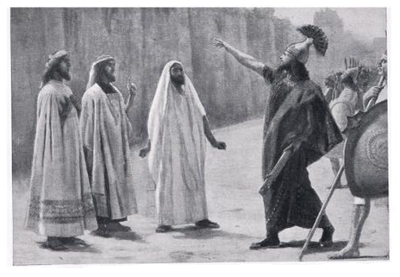
The Rabshakeh spirit

Slide 3
The Rabshakeh spirit
“You Can’t Win”
Isa 36:4b-5; 1 Cor 10:13
“I’ve Got Proof”
Isa 36:18-20; 37:12-13; Jas 4:7; Heb 12:4; Luke 18:1-8
Speaks Our Language
Isa 36:6-7,10-12; Prov 7:13-14
“Don’t Listen To Your Leader”
Isa 36:13-16a; Zech 13:7; Jude 8
Slavery Disguised As Blessing
Isa 36:16-17

