Slide 1
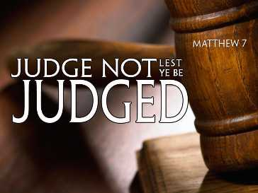
Notes:
In our study on the SOTM, we’ve talked about how chapter 5 predominantly dealt w/issues that would arise out of the 2nd greatest commandment – loving our neighbor as ourself. And then in chapter 6, we saw the focus shift more toward the 1st greatest commandment of loving God with all our heart, mind, soul, and strength. As we begin chapter 7, Jesus is going to shift back to applications concerning the second greatest command. The beginning of Matt 7 specifically turns our attention to how we see other people.
True leadership is a stewardship. It’s about leading by serving others and their interests and not our own. But the religious leaders of that era, the Pharisee, had an oppressive style of leadership. Rather than serving others, we see from the gospels how much the Pharisees looked down on and detested the commoner. They viewed the common people as ignorant, uneducated, and so far beneath them that they deemed them incapable of aspiring to their level of righteousness and piety. And oh, to be so honored as to be deemed unfit to of the righteousness of the Pharisees. That would be a compliment indeed.
But to prevent their leavening influence from spreading, Jesus is going to continue His sermon by addressing how we should and should not assess other people.

Slide 2
Most Misinterpreted Scripture
Matt 7:1-2 – “Judge not, that ye be not judged. For with what judgment ye judge, ye shall be judged: and with what measure ye mete, it shall be measured unto you.”
Those most ignorant of scripture know this verse
Twisted by many to justify doing whatever they want w/o criticism
All bible verses can be twisted out of context if that is where our heart is inclined – Matt 4:5-6
“Twist not the scriptures lest you be like Satan.”
Notes:
Matt 7:1-2 – There may not be a single bible verse that is argued over or taken out of context more than these verses.
You take the most ignorant person in the world regarding God’s word, and he will at the very least know the verse “judge not lest ye be judged.” Now why is this the case? Why would those who have no interest whatsoever in God’s word have these verses memorized?
Because by twisting this verse and taking it out of context, I can justify doing whatever I want to do, nullifying any and all criticism I might receive for my actions. People quote this verse and say, “See? Don’t you judge me, only God can judge me.” Translation? “Leave me alone so I can sin in peace.” Anyone and everyone who wants to live their life w/zero accountability for their decisions will love this verse, taken out of context.
But the truth is, if we’ve made up our minds to behave a certain way, we’ll always be able to find a verse in the bible to take out of context to plead our case because that is what Satan did to Jesus in the wilderness – Matt 4:5-6 – So even Satan knows how to quote scripture; he’s quoting Psa 91, which is a psalm about trust, misusing to try and get Jesus to force God’s hand and violate the very trust spoken about in the psalm. He does this by taking a figurative passage literally, a complete passage partially, and a conditional promise unconditionally. But Jesus comes right back and quotes Deut 6:16, which is literal not figurative.
So unless we become like Satan, twisting the scriptures to our own glory rather than God’s glory, we need to discover what is actually meant. Jesus meant something in Matt 7:1-2, and there were things he absolutely did not mean.

Slide 3
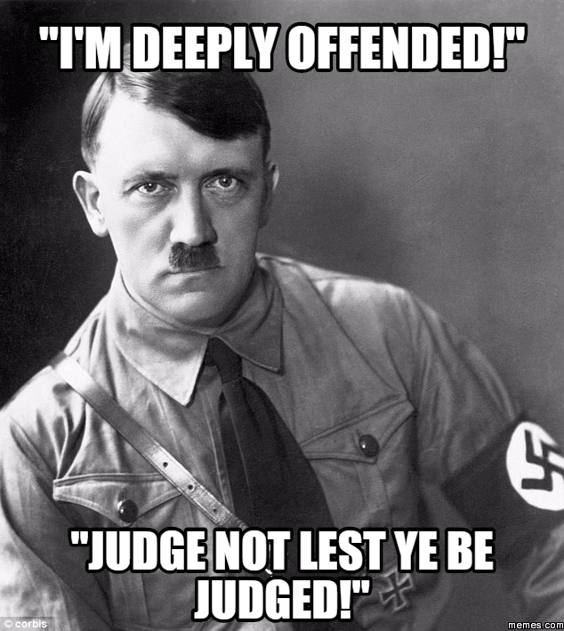
What It Does Not Mean
Does not mean all judgment is forbidden:
Can children say this to parents?
Can students say this to teachers?
Can cadets say this to drill sergeants?
Can athletes say this to coaches?
The hypocrisy: many who misuse this verse are quick to “judge”
“Intolerant”
“Hate Speech”
“Narrow-minded”
“Legalistic”
Notes:
First, this verse does not mean that all judging is forbidden in all circumstances.
Imagine the irresponsible culture we would raise if children were to get away w/telling their parents not to judge them when they make mistakes. If an engineering student did not accept constructive criticism from his professors, imagine how many bridges would be falling today? The same critics would never advise soldiers to say this to their drill sergeants or else we’d have a pathetic national defense. And if athletes quoted this verse to their coaches, there would be far more losses than wins for the team.
And what if as we were about to begin WW2, Adolf Hitler were to say, “How dare you, I’m deeply offended. Haven’t you read the verse ‘Judge not lest ye be judged?’” Ironically, though, godliness is a heaven/hell issue, a matter of eternal consequence, and critics want no part.
Many who would misuse this verse are not only worshipping the god of “freedom”, but they also become hypocritical in their application. If Christians dare to speak out against things such as abortion or homosexuality, we are labeled as intolerant, hateful, narrow-minded, and legalistic. Why am I not allowed to judge you, but you are allowed to judge me? And today, even being silent one way or the other is looked at as being complicit. You can’t win!

Slide 4
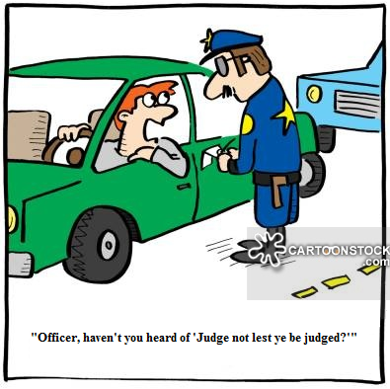
What It Does Not Mean
Does not mean judgment by civil government is wrong
Would you tell a police officer not to judge you for speeding? – Rom 13:1-4
Many, however, will protest up and down the streets against government law for judging their lifestyle as uncivil and judgmental
Government has the right to judge in matter of civil law because its been ordained by God that they do so
Notes:
Secondly, it does not mean judging performed by the civil government is wrong.
I have never heard of anyone telling a policeman who has pulled them over for speeding – “judge not lest ye be judged”.
Rom 13:1-4 – in other words, civil government has a right to judge in civil matters, and their authority to do so has been dictated by God.
But people will march up and down the street waving banners and signs condemning the government for judging their lifestyle as uncivil and judgmental while they go about their own judging and condemning – inconsistent as they can be.
Civil government has the right to judge in matters of civil law because it has been ordained by God for them to do so. And the same God who gave them this authority also said in Matt 7 “judge not lest ye be judged” and so there must be something more to what we see in Matt 7 than some try to make it out to be.

Slide 5
What It Does Not Mean
Does not mean we cannot judge those within the church
Church Discipline: 1 Cor 5:9-13 – “⁹I wrote you in my letter not to associate with immoral people; ¹⁰I did not at all mean with the immoral people of this world, or with the covetous and swindlers, or with idolaters, for then you would have to go out of the world. ¹¹But actually, I wrote to you not to associate with any so-called brother if he is an immoral person, or covetous, or an idolater, or a reviler, or a drunkard, or a swindler—not even to eat with such a one. ¹²For what have I to do with judging outsiders? Do you not judge those who are within the church? ¹³But those who are outside, God judges. Remove the wicked man from among yourselves.”
Conflict resolution: 1 Cor 6:5 – “ I say this to your shame. Is it so, that there is not among you one wise man who will be able to decide between his brethren”
Notes:
Third, it does not mean judging those within the church is wrong.
In 1 Cor 5, there was a member of that church in good standing with the brethren while at the same time having a sexual relationship with his father’s wife, a sin of such magnitude that Paul says even the Gentiles would not agree with that. Rather than the church being distressed about it, they were puffed up. They wouldn’t correct the matter – 1 Cor 5:9-13. The brethren are told by Paul to put this man out of the church which requires judgment being made. So how can Matt 7 be condemning all judgment?
Then in 1 Cor 6, Paul is rebuking them again because brethren were taking each other to court. He asks if there truly is not a wise man among them that could help decide cases between the brethren. This requires judgement. And so, if it is ok to judge those within the church in these ways, Matt 7 can’t be condemning all judgment.

Slide 6
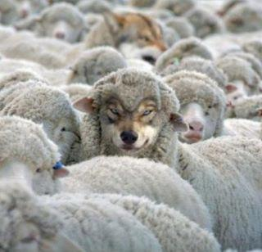
What It Does Not Mean
Does not mean we cannot judge who is teaching false doctrine
Matt 7:15 – “Beware of the false prophets, who come to you in sheep’s clothing, but inwardly are ravenous wolves.”
1 John 4:1 – “Beloved, do not believe every spirit, but test the spirits to see whether they are from God, because many false prophets have gone out into the world.”
How can we do this unless we take what is told and judge it against what the bible teaches?
Notes:
Fourth, it does not mean we cannot make judgements regarding what is true and false teaching.
Matt 7:15 – Anything interesting about where this verse is located relative to the topic at hand? It’s in the same chapter as “judge not lest ye be judged” and only 14 verses south. What about Matt 7:6? This is consistent w/Jesus who dealt with the scriptural mishandlings of the scribes and Pharisees of that day.
It is consistent with Paul, Peter, and the other apostles who warned against false teachers repeatedly in scripture – 1 John 4:1. To know whether a person is a wolf in sheep’s clothing, there is a degree of judgment we have to make as we take the teaching and compare it to what the bible teaches.
So how can we obey God in this regard while at the same time not judging anyone under any circumstance whatsoever? Something has to give.

Slide 7
What It Does Not Mean
Does not mean we cannot judge those who sin against us
Jesus makes it clear that when a brother sins against you, steps must be taken – Matt 18:15-17
Judgements involved:
Did he sin against me?
If so, did he listen to me and repent?
If not, did he listen to the 2 or 3 witnesses?
If not, did he listen to the church?
If not, should we withdraw from him?
Notes:
And fifth, it does not mean we cannot judge brethren who sin against us personally.
In Matt 18, Jesus commands that certain steps be taken in these situations – Matt 18:15-17.
So, consider all the judgements that must be made in these situations: I first have to judge whether they sinned against me. Everyone has a bad day. We want people to pick our battles, we want to give people the benefit of the doubt. Some sins are pretty obvious and others require judgment. But then if I’ve judged he has sinned again me, and I talk to him about it, did he listen to me? Meaning, did he agree and repent, or did he convince me that what he did/said was not really sin? If the matter is not solved, I’m commanded to take 1 or 2 witnesses w/me. Who will they be? That requires judgment. And whether or not he listened in that situation requires judgment because if I judge he hasn’t, I’m supposed to take it before the church. And then the entire church now has to make a judgment. That’s a lot of judging for people who are to supposedly never judge! I wouldn’t even know how to keep the 2nd greatest commandment to love my neighbor as myself unless I put this text into practice.

Slide 8
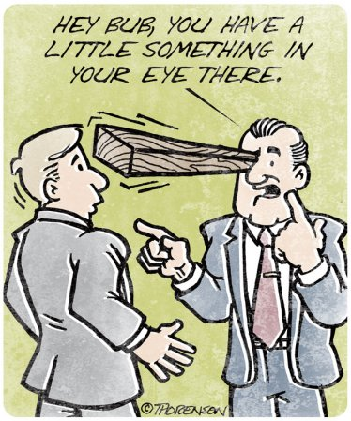
What It Does Mean
Hypocritical Judgment
Matt 7:3-5 – “³Why do you look at the speck that is in your brother’s eye, but do not notice the log that is in your own eye? ⁴Or how can you say to your brother, ‘Let me take the speck out of your eye,’ and behold, the log is in your own eye? ⁵You hypocrite, first take the log out of your own eye, and then you will see clearly to take the speck out of your brother’s eye.”
This is the kind of judging Pharisees liked to do – Matt 23:4, 24, 27-28
Pharisees = Blind Eye Surgeons
Notes:
So what does it mean? Like every verse, Matt 7 :1-2 needs context, and Jesus gives that context in Matt 7:3-5. What word did he use in vs. 5 that clues us in one what kind of judging is being condemned? “You hypocrite.”
This is thrust of the text, and it is the kind of judgment the Pharisees were often guilty of and Jesus condemns them for also in Matt 23:4,24,27-28. Pharisees loved to load up burdens on other people but would not lift a finger to help them overcome it. Pharisees strained at gnats but swallowed camels. They were white-washed walls that were full of dead men’s bones.
In other words, Pharisees were like blind eye surgeons forever pointing the finger at everyone else while oblivious to their own issues. Jesus condemned this behavior.

Slide 9
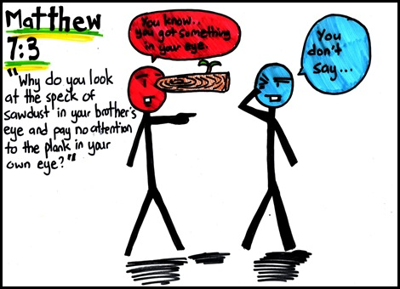
What It Does Mean
Hypocritical Judgment
Notes:
You know, in a local church arrangement, it’s virtually impossible in our associations to not make moral, ethical assessments about one another, isn’t it? We know each other’s strengths, we know each other’s weaknesses, it’s par for the course. But local churches have Christians w/logs in their eyes. Always have, always will. And those logs don’t completely blind us to other people’s specks, but it does obstruct our vision. It’s like looking through a keyhole. You can see a small part of the room, but there’s so much you can’t see because your perspective is so limited. Having a log in your eye will limit your perspective. It will cause you to put someone’s speck under a microscope where every annoying flaw, every weirdness about that person is just magnified. “That’s no speck, that’s the worst, most vile, most egregious area of weakness I’ve ever seen, it’s horrible, can you believe that person?” Well, every speck looks like a log to a person who has a big fat telephone pole sticking out of his eye that he refuses to address.
Logs don’t prevent me from seeing someone’s speck; we can be excellent diagnosticians of other people’s issues. It does rob me of accurately assessing their issue, it hinders me from righteously judging the severity of the issue, it causes me to major in another person’s minors, making specks out to be bigger than they really are. Or it could be that because I’m just so angry, I’m rushing to judgment about a person when I really just need to step back, take a deep breath, go to God in prayer, and take a 2nd look when I’ve calmed down a bit so I can be more objective in my assessment. What’s the purpose of pointing out another person’s weakness/sin if I’m not making a personal effort to help them? And how can I help them if I can’t even help myself? That’s the making of a career critic. When one has little to no introspection, they can spend their lives focused on other people’s faults, never having to deal with their own – “first take the log out of your own eye, and then you will see clearly to take the speck out of your brother’s eye”

Slide 10
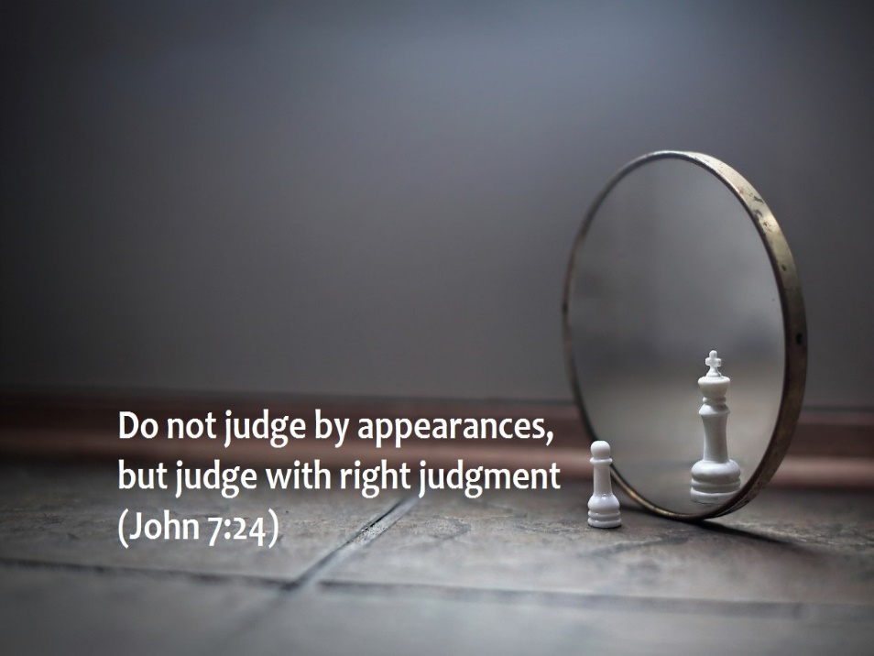
What It Does Mean
Self-righteous Judgment
Ever mindful of our own sin, we must show compassion towards others – Gal 6:1
Pharisee vs. tax-collector – Luke 18:10-14
We must guard against always talking about what “they” are doing wrong
Loving our neighbor as ourselves requires compassion and empathy
John 7:24 – “Do not judge according to appearance, but judge with righteous judgment.”
Notes:
But in additional to hypocritical judgement, we should not judge other people when we’re not living right period – this would be self-righteous judgment.
Gal 6:1 – What does this mean? It means, before I correct another brother, I need to look at my life and my credibility and ask, “Am I really the best person to correct him/her?” Only those who are spiritual should approach an erring brother (looking to himself). By being spiritual, his vision is clear enough to see the sin for what it is, know the solution and know how to lead the sinner toward righteousness.
Luke 18:10-14 – The Pharisee was not qualified to judge the tax collector because he wasn’t living right either. So rather than looking on him with compassion with a desire to lead him and help him, he is just glad he isn’t like him. This kind of judgement will condemn us.
We also need to guard ourselves from an excessive discussion of what everyone else in religious world is doing wrong. While we will need to make observations from time to time and discuss the mistakes in denominationalism that we must avoid, we can talk about it in such extraneous ways that it takes the focus off of ourselves and places it on others. Our bible studies, whether in class or in our preaching, must be applied to ourselves personally if we’re to reap the fruit of the spirit. This also applies to our brethren. They will act up. Which is better, to talk about them or talk to them? One stimulates my ego, the other stimulates godly character.
Also, how we confront a person’s shortcomings will tell a lot about whether we are being self-righteously judgmental – John 7:24. Are other people a distraction and inconvenience to me, or are they open doors? Am I ashamed of them or do I seek to help them? Do I truly love them as myself and show it through my fruits, or do I avoid them? Also, could the surface behavior be a reflection of something much deeper going on? Sin is sin, but the person who is able to identify the root rather than being distracted by the symptom will be more righteous in his judgment.

Slide 11
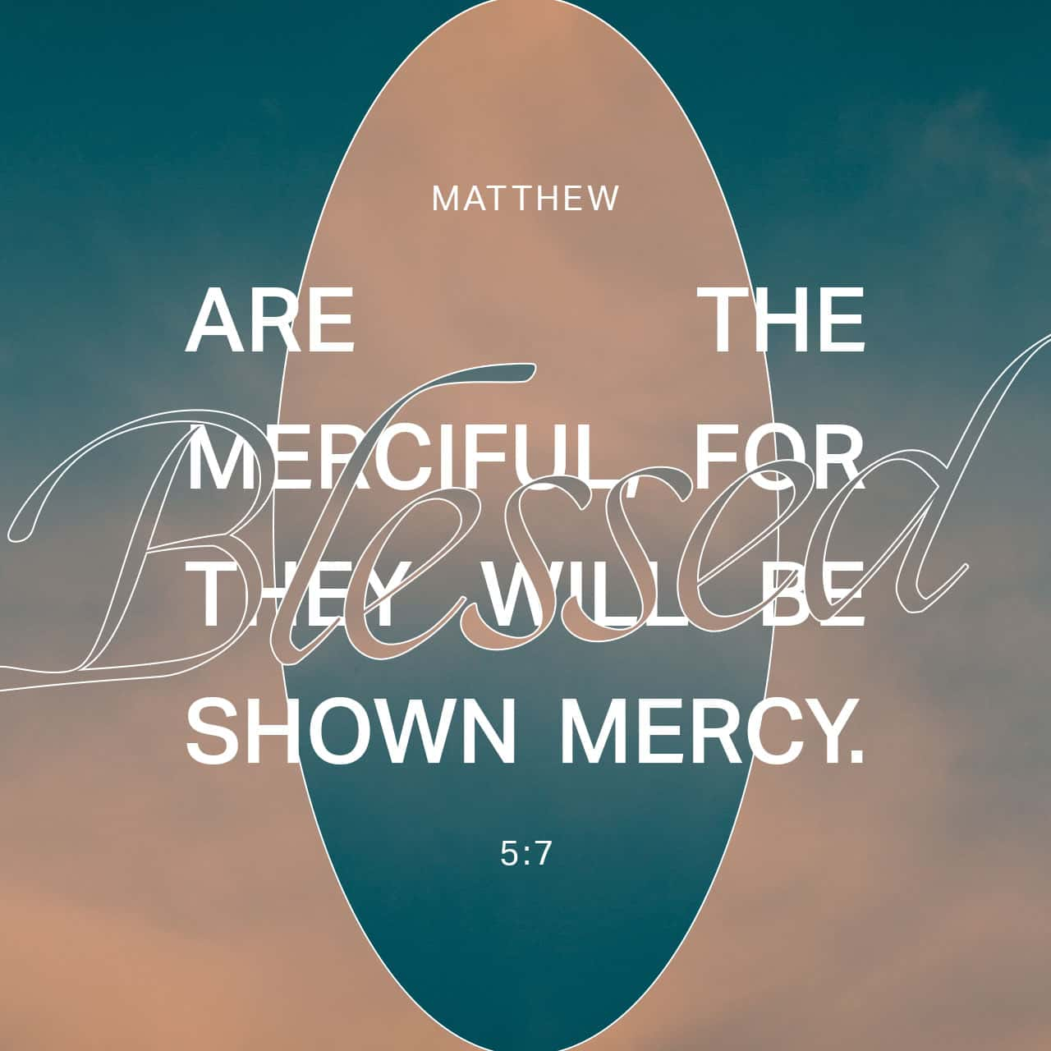
Why We Shouldn’t Judge
We’ll receive the same judgment we dish out
Matt 6:14-15 – “¹⁴For if you forgive others for their transgressions, your heavenly Father will also forgive you. ¹⁵But if you do not forgive others, then your Father will not forgive your transgressions.”
We’re not in the position to judge
1 Sam 16:7b – “God sees not as man sees, for man looks at the outward appearance, but the Lord looks at the heart.”
1 Cor 2:11 – “For who among men knows the thoughts of a man except the spirit of the man which is in him?”
Notes:
Finally, hypocritical and self-righteous judgment are wrong in and of themselves. But the consequence of judging in these ways is that vs. 2 tells us “with what measure ye mete, it shall be measured unto you.” On the other hand is – Matt 5:7. And so if the time does come where we need to approach another person about an issue, the more merciful we become, the more mercy we’ll receive when we most need it. Remember Matt 6:14-15. As we’re rounding 3rd on this sermon, the principles are starting to align with one another. Our character must be one of mercy, as shown in the beatitudes as well as the disposition we are to have in our prayers towards others sins against us. We cannot develop a character consistent with the kingdom of Christ while looking down on others in judgment.
And we’re not in a position to judge with self-righteous – God is the only one in a position to judge with any kind of righteous standard because He is the measure of it. So while we must make certain judgments as deemed by God pertaining to righteousness, we cannot see another person’s heart – 1 Sam 16:7. Only God knows the inner man. Sometimes, we can be too quick to judge another person for the little bit we see on the surface when in fact there is a whole lot more to the story we did not know.

