Slide 1
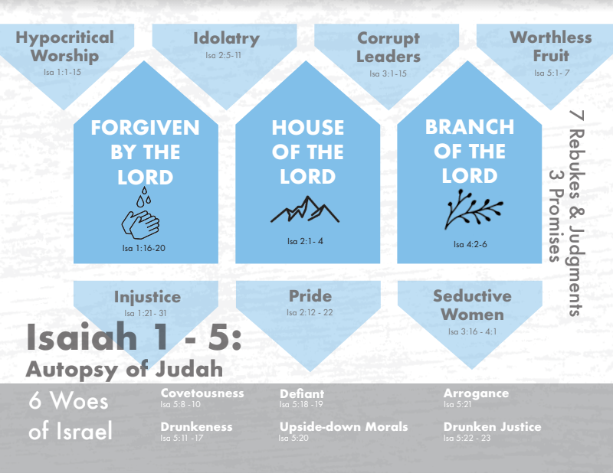
Notes:
The first 5 chapters of Isaiah are going to give us an overlook of just how bad Judah’s spiritual condition was. In fact, much of what he points out are seen in Amos and Hosea’s rebuke of the northern kingdom of Israel. This appears to suggest that Judah is now mimicking Israel’s unrighteous ways, which is something we’re going to see in more detail in chapter 28.
In these chapters, we’re going to look at 7 specific rebukes of sin followed by how God will judge them for these sins in order to help them learn to trust Him. After the 7th judgment in chapter 5, we find a list of 6 woes. And scattered through these five chapters are also 3 very significant and hopeful promises designed to assure Israel that though judgment is inevitable for their sins, though a purging is coming, greater days are ahead. In these first 5 chapters, that pendulum swing is in full affect,
Think of these first 5 chapters as Judah being a spiritually dead body, and Isaiah is performing an autopsy on this body. What does he find?

Slide 2
Rebuke & Judgment 1
Hypocritical worship
Isa 1:11-14 – “¹¹‘What are you multiplied sacrifices to Me?’ says the Lord. ‘I have had enough of burnt offerings of rams and the fat of fed cattle; and I take no pleasure in the blood of bulls, lambs or goats. ¹²When you come to appear before Me, who requires of you this trampling of My courts? ¹³Bring your worthless offerings no longer, incense is an abomination to Me. New moon and sabbath, the calling of assemblies—I cannot endure iniquity and the solemn assembly. ¹⁴I hate your new moon festivals and your appointed feasts, they have become a burden to Me; I am weary of bearing them.”
Quantity
Quality
To be seen
Vain
Bribing God
Notes:
Isa 1:10 – “Hear the word of the Lord, you rulers of Sodom; give ear to the instruction of our God, you people of Gomorrah.” – In other words, “I may have spared you Sodom and Gomorrah’s fate, but that doesn’t make you any less like Sodom and Gomorrah spiritually.” At the very least, their rulers were like the rulers of those 2 deplorable cities. And the first rebuke is going to focus on their hypocritical worship – Isa 1:11-14.
1) Quantity – They had never stopped offering sacrifices – vs. 11 says they were multiplying them. Some are amazed that wicked people would resort to religion. Yet many are willing to part w/their sacrifices if they can convince themselves that in doing so, they won’t have to part w/their sins. But nowhere in scripture did God instruct Israel that sacrifices were to be treated as indulgences. They were designed to represent the heart of the one making the offering; they were designed to change the worshipper.
2) Quality – Fed cattle would be cattle raised specifically for sacrifice, in which great care was given to keep them from defilement. They were very expensive monetarily and therefore the highest quality sacrifice. Yet who did Jesus honor more in their giving, the Pharisee who gave of their surplus or the widow w/her 2 mites?
3) To be seen – Seems they only came to be seen. This might remind us of Matt 6 in which the Pharisees always “worshipped” to be seen by men. But many will just show up simply to be deemed respectable even if not religious pious. I may come to church enough for the elders not to have to give me a call, but why am I here?
4) Vain – In other words, they offered what God told them to offer. It cost them “things”. But behind their sacrifices were shallow, hollow hearts. Their worship was a sham because it didn’t touch them or change them. And so, God takes no pleasure in it, its an abomination, He cannot endure it, he hates it, it is a burden to Him, and He is weary of it.
5) Bribing God – Why multiply sacrifices to God? Perhaps to bribe Him to spare their cities. But seeing there was no change in their behavior, God cannot endure them trying to cover their sin through “worship”. Sacrifices were supposed to convey contriteness. But when our worship is reduced to a checklist of things we have to do to be right, w/emphasis on how others are not doing those things, and then our heart is not engaged, we’ll find ourselves in the same position of God not accepting our worship.
May we search our hearts during our times to worship that we not follow after this same pattern.

Slide 3
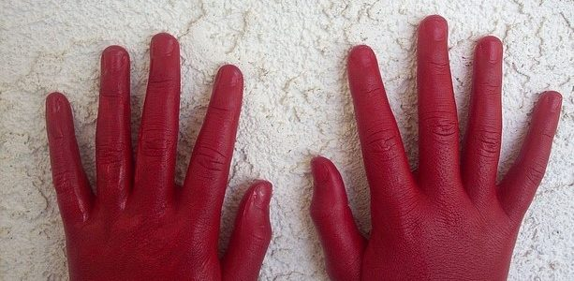
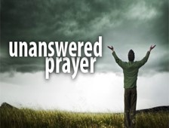
Rebuke & Judgment 1
Judgment
Isa 1:15 – “So when you spread out your hands in prayer, I will hide My eyes from you; yes, even though you multiply prayers, I will not listen. Your hands are covered with blood.”
Notes:
Here is the judgment – Isa 1:15 – In other words, every time they lifted their hands in prayer to God in prayer what did God see on their hands they kept Him from answering their prayers?
The blood in which they afflicted the innocent. Vain empty, hypocritical worship cannot hide the sin we commit. God sees. And sin is so hateful to God, it even makes our prayer and worship hateful to Him – Psa 66:18 – “If I regard wickedness in my heart, the Lord will not hear.” This is a severe judgment because the people needed God now more than ever and worship and prayer was how they would make their appeals. But w/hands covered in blood, what is to become of them? How can God help them in their sin-sick state if the very worship they perform is so empty and meaningless? Before the book of Isaiah ends, He’s going to reveal a sacrifice in which the Lord does delight. And through that sacrifice, it is going to produce worshippers who no longer appear before God because they “have to”, but because they want to. Stay tuned for that, theme alert.

Slide 4
Promise 1
Repent and be forgiven
Isa 1:16-20 – “¹⁶Wash yourselves, make yourselves clean; remove the evil of your deeds from My sight. Cease to do evil, ¹⁷learn to do good; seek justice, reprove the ruthless, defend the orphan, plead for the widow. ‘Come now, and let us reason together,’ says the Lord, ‘Though your sins are as scarlet, they will be as white as snow; though they are red like crimson, they will be like wool. ¹⁹If you consent and obey, you will eat the best of the land; ²⁰But if you refuse and rebel, you will be devoured by the sword.’ Truly, the mouth of the Lord has spoken.”
Notes:
Scattered throughout five chapters rebuke, judgments and woes are some pretty awesome promises, which gives us the complete picture of who our God is. He is not simply a God of judgment, but a God who wants to bless us. And the first promise we see is in Isa 1:16-20 – Summary: “Yes you’ve sinned, yes I hate your worship. But you don’t have to be a lost cause. Repent, learn to do good, and you’ll be forgiven. Those bloody hands I see every time you lift them up to me in prayer, they can be washed as white as snow.” Matthew Henry pointed out the following – “The God of heaven condescends to reason the case w/those that contradict him and find fault with his proceedings”. So, for example, when someone hurts us, we don’t want to go to them to tell them we want to work it out; we’re the offended party; they hurt us, so, we expect them to take the initiative.
Not God. They sinned against Him, caught “red-handed”, and He is the one saying, “Let’s talk”. He’s offering free pardon and life. Who does something like that?!?!? God. This is a wonderful promise that speaks to just how unworthy we are of God, by virtue of His wonderful grace.

Slide 5
Promise 1
Repent and be forgiven
Isa 1:16-20 – “¹⁶Wash yourselves, make yourselves clean; remove the evil of your deeds from My sight. Cease to do evil, ¹⁷learn to do good; seek justice, reprove the ruthless, defend the orphan, plead for the widow. ‘Come now, and let us reason together,’ says the Lord, ‘Though your sins are as scarlet, they will be as white as snow; though they are red like crimson, they will be like wool. ¹⁹If you consent and obey, you will eat the best of the land; ²⁰But if you refuse and rebel, you will be devoured by the sword.’ Truly, the mouth of the Lord has spoken.”
Stop
Learn
Do good
Correct
Stand up for
Notes:
But we have to do out part, which is repentance. What does repentance and its fruit entail?
1) Stop – This is a decisive abandonment of old ways and habits. They’ve got to go – Psa 26:6 – “I shall wash my hands in innocent, and I will go about Your altar, O Lord”. In every one of us, there is an old man, and that old man needs to kick the bucket.
2) Learn – Develop a new mind, a new way of thinking. Rom 12:2a – “And do not be conformed to this world, but be transformed by the renewing of your mind”
3) Do good – We have new objectives and priorities. We’re no longer living to please ourselves, but to serve others – Eph 2:10 – “For we are His workmanship, created in Christ Jesus for good works, which God prepared beforehand so that we would walk in them.”
4) Correct – Meaning, put right those who used to do what you did. Someone helped you become a better person, return the favor – Jas 5:19-20 – “My brethren, if any among you strays from the truth and one turns him back, let him know that he who turns a sinner from the error of his way will save his soul from death and will cover a multitude of sins.”
5) Stand up for – Defend those in need, especially the weak who cannot fend for themselves – Prov 31:9 – “Open your mouth, judge righteously, and defend the rights of the afflicted and needy.”

Slide 6
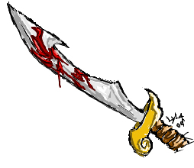
Promise 1
Repent and be forgiven
Isa 1:16-20 – “¹⁶Wash yourselves, make yourselves clean; remove the evil of your deeds from My sight. Cease to do evil, ¹⁷learn to do good; seek justice, reprove the ruthless, defend the orphan, plead for the widow. ‘Come now, and let us reason together,’ says the Lord, ‘Though your sins are as scarlet, they will be as white as snow; though they are red like crimson, they will be like wool. ¹⁹If you consent and obey, you will eat the best of the land; ²⁰But if you refuse and rebel, you will be devoured by the sword.’ Truly, the mouth of the Lord has spoken.”
Notes:
And then in vs. 19 he lays out the condition: consent and obey, eat the best of the land. Refuse and rebel, you’ll be devoured by the sword. These are the blessings and curses we read about in Lev 26 and Deut 28. Either we eat the word, or we’ll be eaten by a real sword. Either, way they’re going to eat something, what they eat is entirely up to them. Vs. 20 assures them that since God has spoken, this promise is absolutely sure. And we know which of these God would prefer for us.

Slide 7
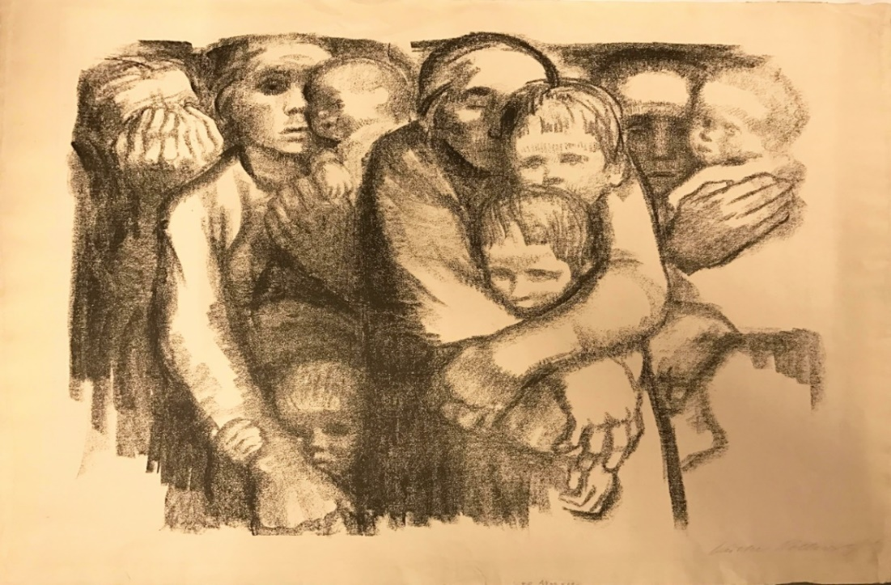
Rebuke & Judgment 2
No Justice Or Righteousness
Isa 1:21-23 – “²¹How the faithful city has become a harlot, she who was full of justice! Righteousness once lodged in her, but now murderers. ²²Your silver has become dross, your drink diluted with water. ²³Your rulers are rebels and companions of thieves; everyone loves a bribe and chases after rewards. They do not defend the orphan, nor does the widow’s plea come before them.”
Notes:
In verse 21, we find the 2nd rebuke, the fact that there was no justice or righteousness left in Judah – Isa 1:21-23.
Notice God is contrasting what was vs. what is. The word picture is of a once faithful, devoted wife who has now completely sold herself to whoredom. In what way? In another word picture in vs. 22, Judah is compared to silver, which represents purity. But now they’re more like the scum and slag that you’d typically skim off the surface of molten metal, completely worthless. Unfermented wine was representative of blessing, a refreshing alternative to water. This is who they used to be as a nation, but now they’re influence has been weakened through dissolution.
So, the reality represented by these word pictures is revealed in vs. 23. Judah is now a nation that loves bribes, chases after reward, and those responsible for restraining thieves had become the thieves themselves. Therefore, the widows and orphans and the powerless were neglected. Because now when the wealthy wants to defraud them and the poor, who has very little money and influence, takes them to court, the wealthy could just bribe the judge w/that ole “Chicago handshake” and win the case. Israel of all people should have remembered their slavery in Egypt.

Slide 8
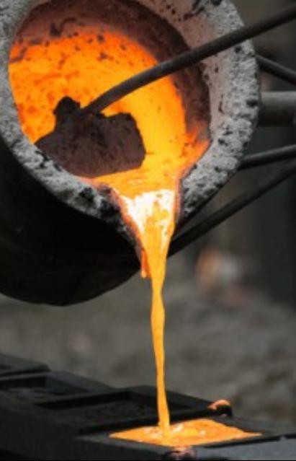
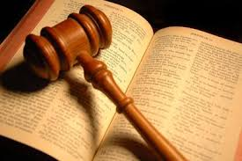
Rebuke & Judgment 2
Judgment
Isa 1:24-31 – “²⁴Therefore the Lord God of hosts, the Mighty One of Israel, declares, ‘Ah, I will be relieved of My adversaries and avenge Myself on My foes. ²⁵I will also turn My hand against you, and will smelt away your dross as with lye and will remove all your alloy. ²⁶Then I will restore your judges as at the first, and your counselors as at the beginning; after that you will be called the city of righteousness, a faithful city. ²⁷Zion will be redeemed with justice and her repentant ones with righteousness. ²⁸But transgressors and sinners will be crushed together, and those who forsake the Lord will come to an end. ²⁹Surely you will be ashamed of the oaks which you have desired, and you will be embarrassed at the gardens which you have chosen. ³⁰For you will be like an oak whose leaf fades away or as a garden that has no water. ³¹The strong man will become tinder, his work also a spark. Thus they shall both burn together and there will be none to quench them.”
Notes:
How will God judge them?
1) Isa 1:24-25 – In other words, He’s going to purge them of all the impurities as one would purge impurities from metal in a furnace. The nation could have done this herself, but they wouldn’t. So, God, who has the power to do so, will make good on this promise. The dross and alloy of vs. 22 that kept them from being pure is going to be completely stripped away. This is a judgment of purification so the people can be what they need to be. How will God do this? Chapters 5 will tell us, so stay tuned.
2) Isa 1:26-27 – What will He do after purging the nation of evil? He’ll restore the righteous so they can become what they once were. The troublemakers will be removed, and then justice and righteousness, which is another very prominent theme throughout this book, will be achieved. Through what means? This is another theme alert, stay tuned.
3) Isa 1:28-30 – Oaks are what they made their gods from. Gardens were one of the places they put them. He’s probably saying that the idolators will be put to shame. This is an interesting statement here because He is going to address idolatry further in the next rebuke. So why mention idolatry here as a connection to injustice and unrighteousness? Because anytime a nation turns to idolatry, injustice always follows. In idolatry, we’re not acknowledging God’s holiness. This is turn leads to a failure to embrace His concern for the disenfranchised. Idolatry and injustice have always been twin sins. – the idols are lifeless, doing nothing for others, and their worshippers become like them. So, if justice is going to be restored to the nation, idolatry must be eliminated. How will that happen? Stay tuned, we’re still just performing the autopsy.
4) Isa 1:31 – Meaning, all their works, the fruits of their labors and efforts in which they find security, will be destroyed. And why shouldn’t they? Most of what they accomplished came about by taking advantage of the marginalized. And our God is a God who teaches by causing us to reap what we sow.

Slide 9
Isa 1:21-26 Chiasm
Past – Faithful to Faithless (21a)
B. Injustice reigns (21b)
C. Morality downgraded (22)
D. Princes’ injustice toward needy (23)
D’. King’s justice toward princes (24)
C’. Morality upgraded (25)
B’. Justice restored (26a)
A’. Future – Faithless to Faithful (26b)
Notes:
Chiasms (sandwich parallelism) are common in any Hebrew poetry and there are many in Isaiah. Recognizing them can help w/outlining the thoughts of the passage, especially as you pay attention to the middle of the sandwich (the meat) as the primary point, and the ends of the sandwich (the bread) as the secondary points.

Slide 10
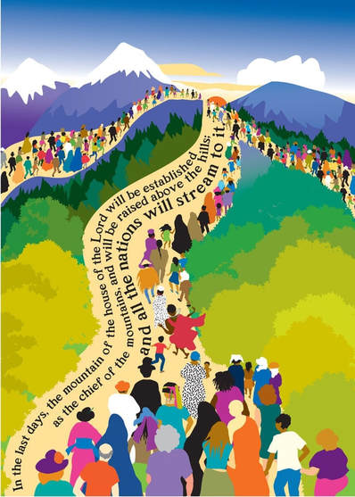
Promise 2
The Mountain of the House of the Lord
Isa 2:2-4 – “²Now it will come about that in the last days the mountain of the house of the Lord will be established as the chief of the mountains, and will be raised above the hills; and all the nations will stream to it. ³And many peoples will come and say, ‘Come, let us go up to the mountain of the Lord, to the house of the God of Jacob; that He may teach us concerning His ways and that we may walk in His paths.’ For the law will go forth from Zion and the word of the Lord from Jerusalem. ⁴And He will judge between the nations, and will render decisions for many peoples; and they will hammer their swords into plowshares and their spears into pruning hooks. Nation will not lift up sword against nation, and never again will they learn war.”
Notes:
Isa 2:1 begins similarly to Isa 1:1 – its another vision given to Isaiah concerning Judah and Jerusalem, and the pendulum swings again because this is promise #2. Though the coming judgment upon Judah will render them little more than a shelter in a vineyard, He looks ahead to brighter days for God’s people – Isa 2:2-4

Slide 11
Promise 2
The Mountain of the House of the Lord
Isa 2:2-4 – “²Now it will come about that in the last days the mountain of the house of the Lord will be established as the chief of the mountains, and will be raised above the hills; and all the nations will stream to it. ³And many peoples will come and say, ‘Come, let us go up to the mountain of the Lord, to the house of the God of Jacob; that He may teach us concerning His ways and that we may walk in His paths.’ For the law will go forth from Zion and the word of the Lord from Jerusalem. ⁴And He will judge between the nations, and will render decisions for many peoples; and they will hammer their swords into plowshares and their spears into pruning hooks. Nation will not lift up sword against nation, and never again will they learn war.”
Messianic
“Mountain”
Notes:
This is the first of many Messianic promises in Isaiah. Not every Messianic promise refers to the Messiah Himself. Some refer to what the age of the Messiah will look like. And the term “last days” is the Messianic age – Heb 1:1-2a – “God, after He spoke long ago to the fathers in the prophets in many portions and in many ways, in these last days has spoken to us in His Son”
“Mountain” is often used in the bible as a word picture of governments/nations (Jer 21:25). See, literal Jerusalem was located on Mt. Zion, which is not the highest mountain in all the earth. It’s not even the highest mountain in the region. Just across the Kidron Valley is the Mount of Olives which is higher. Yet one day it will be so exalted that many nations will stream to it, hence the term “chief of the mountains” – Dan 2:44 – “In the days of those kings the God of heaven will set up a kingdom which will never be destroyed, and that kingdom will not be left for another people; it will crush and put an end to all these kingdoms, but it will itself endure forever.” This is the OT version of Matt 16:18 where Jesus says, “Upon this rock I will build my church and the gates of Hades will not prevail against it.” Since God’s kingdom is built on high ground, it cannot be overcome by any opposition.

Slide 12
Promise 2
The Mountain of the House of the Lord
Isa 2:2-4 – “²Now it will come about that in the last days the mountain of the house of the Lord will be established as the chief of the mountains, and will be raised above the hills; and all the nations will stream to it. ³And many peoples will come and say, ‘Come, let us go up to the mountain of the Lord, to the house of the God of Jacob; that He may teach us concerning His ways and that we may walk in His paths.’ For the law will go forth from Zion and the word of the Lord from Jerusalem. ⁴And He will judge between the nations, and will render decisions for many peoples; and they will hammer their swords into plowshares and their spears into pruning hooks. Nation will not lift up sword against nation, and never again will they learn war.”
Messianic
“Mountain”
Rendezvous Point
Uphill Trek
Notes:
It will be the rendezvous point of all the spiritual seed of Abraham where the gospel will be preached openly for all to hear. The phrase “stream to it” is interesting because streams flow downhill, not uphill. This will not be the first time we see Isaiah talking about aspects of Creation doing things its not supposed to do. We’re going to read later animals dwelling together who are usually opponents, trees clapping hands, the moon shining as bright as the sun, etc. Why? Because this is “new heavens and a new earth”, a theme to be later developed. But practically speaking, it means in this verse that God’s people will swim up stream, not downstream w/the rest of the society. They won’t go with the grain, they’ll run against it in character – see the Beatitudes. God’s people are living paradoxes, living radically different lives. Why? Because there is a supernatural magnetism about God that draws a certain kind of people to be willing to climb as high as they need to reach Him.
The fact they will “go up” implies it may be an uphill battle to get there. But once there, you will be encouraged by those who have already arrived and have a burning desire for you to join them – Psa 122:1 – “I was glad when they said to me, ‘Let us go to the house of the Lord.’” And before the gospel can ever be “everywhere spoken against”, it has to be everywhere spoken of.

Slide 13
Promise 2
The Mountain of the House of the Lord
Isa 2:2-4 – “²Now it will come about that in the last days the mountain of the house of the Lord will be established as the chief of the mountains, and will be raised above the hills; and all the nations will stream to it. ³And many peoples will come and say, ‘Come, let us go up to the mountain of the Lord, to the house of the God of Jacob; that He may teach us concerning His ways and that we may walk in His paths.’ For the law will go forth from Zion and the word of the Lord from Jerusalem. ⁴And He will judge between the nations, and will render decisions for many peoples; and they will hammer their swords into plowshares and their spears into pruning hooks. Nation will not lift up sword against nation, and never again will they learn war.”
Messianic
“Mountain”
Rendezvous Point
Uphill Trek
Teaching
Hungry
Notes:
Why would they embark on such a tiring exhaustive trek? Because they’re going there to learn a new way of doing things. Idolatry was practiced on high places in the past, but this high place will surpass them all. Every religion will be proven inferior to the gospel. So, while physical Jerusalem my have been the pilgrimage of Israel in OT days, spiritual Jerusalem will be the pilgrimage of people from all nations who will abandon their idolatry and false beliefs to the more superior way – Eph 2:19 – “So then you are no longer strangers and aliens, but you are fellow citizens with the saints, and are of God’s household”. And so, this new kingdom will transcend nationalism.
They are hungry for God’s teaching, willing to climb the steepest cliffs to hear His words – Acts 2:42a – “They were continually devoting themselves to the apostles’ teaching”. What a contrast to Judah of who Isaiah said in Isa 1:3 – “does not know [God]”. But its not mere knowledge they are looking for, the teaching is just a means to an end. Their true desire from vs. 3 is to “walk in His paths.” This is practical knowledge that produces righteousness. Just as standing on the mountain top provides the clearest, most beautiful views of Creation, understanding God’s ways provides the clearest perspectives about life, spiritually speaking.

Slide 14
Promise 2
The Mountain of the House of the Lord
Isa 2:2-4 – “²Now it will come about that in the last days the mountain of the house of the Lord will be established as the chief of the mountains, and will be raised above the hills; and all the nations will stream to it. ³And many peoples will come and say, ‘Come, let us go up to the mountain of the Lord, to the house of the God of Jacob; that He may teach us concerning His ways and that we may walk in His paths.’ For the law will go forth from Zion and the word of the Lord from Jerusalem. ⁴And He will judge between the nations, and will render decisions for many peoples; and they will hammer their swords into plowshares and their spears into pruning hooks. Nation will not lift up sword against nation, and never again will they learn war.”
Messianic
“Mountain”
Rendezvous Point
Uphill Trek
Teaching
Hungry
Justice & righteousness
Peace
Notes:
When they get there, they’ll find that justice and righteousness that had been lacking for so long, because God Himself will be there to assure that justice is rendered according to His own righteous standards. Again, this is a theme that will be developed throughout the book.
And then Jews and Gentiles, who once were at far w/one another, will flock to this mountain together and be at peace, for this is a kingdom of peacemakers. They will no longer learn the arts of war, and their prior instruments of war would be converted to instruments of husbandry for sowing the seed of the kingdom, which is a kingdom of peace. The gospel is designed for peace; only the lusts of men produce war. And part of the teaching of the gospel is to rid this lust from men’s hearts and compel us to love one another in return.

