Slide 1
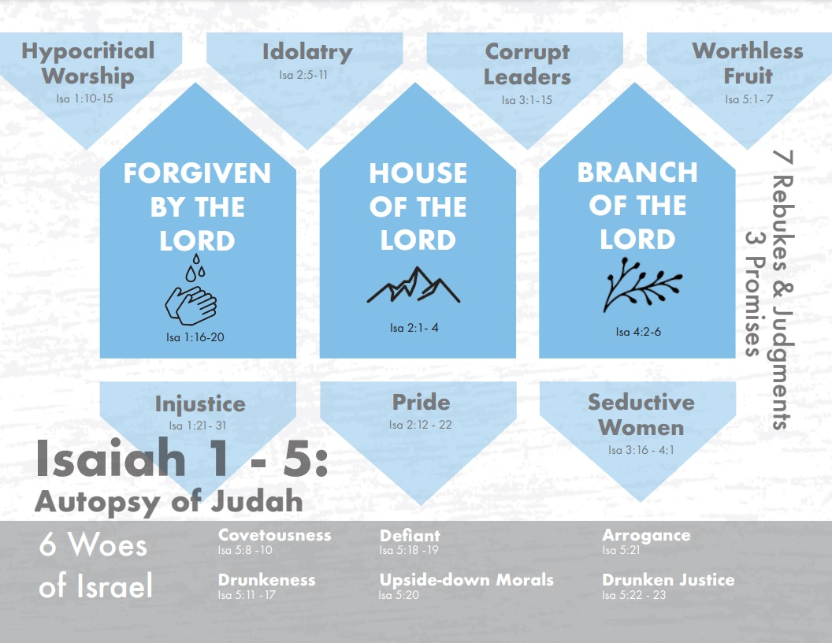
Notes:
As we finish chapters 1 – 5, there are a few things we need to remember before we leave it. These chapters describe God’s assessment of Judah’s sinfulness situation. They are a nation given over to hypocritical worship, injustice, idolatry, pride, corruption in leadership, seductive women, and worthless fruit, all of which share the common theme of man trusting in man rather than trusting God. These 7 rebukes are followed by 7 judgments, which share the common theme that God is going to have to remove those things in which they clung to in order to restore trust in Him. But despite how low society had gotten, mingled within the rebukes and judgments are promises of greater things to one day come. God has not forgotten what He promised Abraham, that through His seed all nations of the earth would be blessed. And one day, this seed is going to spring from a stump and become a branch. It will be set on a mountain so great, all nations would climb to it. And through this Branch, forgiveness of sins can be achieved as we repent of those sins.
Remembering these themes are important for the rest of our study as each one of these sins will be addressed again, and God will reveal how He will fix these problems.

Slide 2
New Living Translation – “What sorrow for you…”
Contemporary English Version – “You are in for trouble!”
Good News Translation – “You are doomed!”
Good Word Translation – “How horrible it will be for you…”
International Standard Bible – “How terrible it will be for you…”
NET Bible – “[You] are as good as dead…”
Notes:
After the 7 judgments of Isa 1 – 5, we find in Isa 5:8-23 a list of 6 woes. What is a “woe”? Most of the more literal translations we use translate it as “woe”, but when you look at some of the paraphrased bibles, they show some interesting takes on what it really means:
New Living Translation – “What sorrow for you…”
Contemporary English Version – “You are in for trouble!”
Good News Translation – “You are doomed!”
Good Word Translation – “How horrible it will be for you…”
International Standard Version – “How terrible it will be for you…”
NET Bible – “[You] are as good as dead…”
These are all great renderings of the idea that is behind the concept of “woe”, because it is the idea of “impending doom”, an upcoming sorrow of such magnitude that escaping judgment is seemingly impossible. And so, because words fail us, all that can be said is “woe”. The NET bible’s rendering of “you are as good as dead” is very accurate, and in modern days terms we would express this as “oh no”. The idea is that God’s cup of wrath has almost reached to the top and He’s ready to pour it out. In fact, in Rev 8, when those 7 trumpet judgments are announced that precede Judgment Day, the Apostle John refers to the last 3 of those trumpets as “woes”, and he announces them in Rev 8:13 by saying “woe, woe, woe”, which is only one of 3 instances in scripture where a word is repeated 3 times. One is in Rev 4:8. What is the other time? Isa 6:3 = “holy, holy, holy”. There’s a connection – stay tuned for next week. Suffice it to say, these 6 woes are pronounced against Judah due to the bitter, offensive crop produced, some of the worthless, sour grapes from Isa 5:1-7 that they have rendered as a nation. What are these sour grapes?

Slide 3
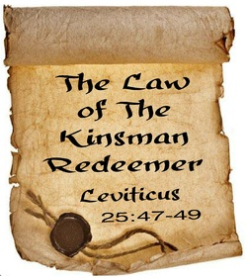
6 Woes
Covetousness
Isa 5:8-10 – “⁸Woe to those who add house to house and join field to field, until there is no more room, so that you have to live alone in the midst of the land! ⁹In my ears the Lord of hosts has sworn, ‘Surely many houses shall become desolate, even great and fine ones, without occupants. ¹⁰For ten acres of vineyard will yield only one bath of wine, and a homer of seed will yield but an ephah of grain.’”
Notes:
Woe #1 is against the covetous, the greedy – Isa 5:8 – Now, what’s so wrong w/being an enterprising land developer? Nothing in and of itself. But this land belonged to God, not the people, and it was allocated to tribes and families within those tribes as a gift from God. But if you were a Jew who found themselves in extreme poverty, you could sell your land to someone else, a rich person who could snatch it up and add “house to house”, which literally means “causing house to touch house”, implying that when they would buy a house, they would continue to add to create this large estate from which the prior occupants had been evicted. And so, the owner would become a “squire”, living alone in the midst of the land at the expense of other people. To use the language of the vineyard, these people were a greedy vine sapping up all nourishment for themselves, but giving nothing back in return. Nothing was ever enough, they had to have more and more. Now, just because a Jew in extreme poverty could sell his land didn’t mean that sale was permanent. There was another law of Moses that required someone to purchase it back from the buyers. What was he called? Lev 25:23-25.
What is this nearest relative called? The redeemer. And if there was no kinsman-redeemer, Lev 25 also teaches that at the Jubilee, all debts were to be forgiven and the land returned to its original owner. This was one of the laws God designed to prevent both intergenerational poverty and covetousness. But during this time, there was no redeemer stepping up and putting a stop to this behavior. So what will God do to fix this? Is there a Redeemer to do something about this? Rather than saying “stay tuned”, here is something to look forward to later in Isaiah. When the people eventually go into captivity because God allows Babylon to take their land from them, one of their kinsmen is going to buy that land back from them in a sense. Who is it going to be? Jesus. And what is He called? The Redeemer, a word that appears 23 times in 40 – 66. Their punishment? – Isa 5:9-10 – Meaning, by the time God gets done w/them, none of those houses or fields will be occupied. He’ll bring a curse on their land and possessions, as Moses said would happen in Lev 26 and Deut 28. And in the meantime, their land would not yield the fruit they expected. The measurements in vs. 10 work out to a tenth. I like how vs. 9 says “In my ears the Lord of hosts has sworn” – I may be making too much of this, but in my mind’s eye, I imagine Isaiah looking out on these grand estates while God is whispering in His ear, “They’re gonna get it.”

Slide 4
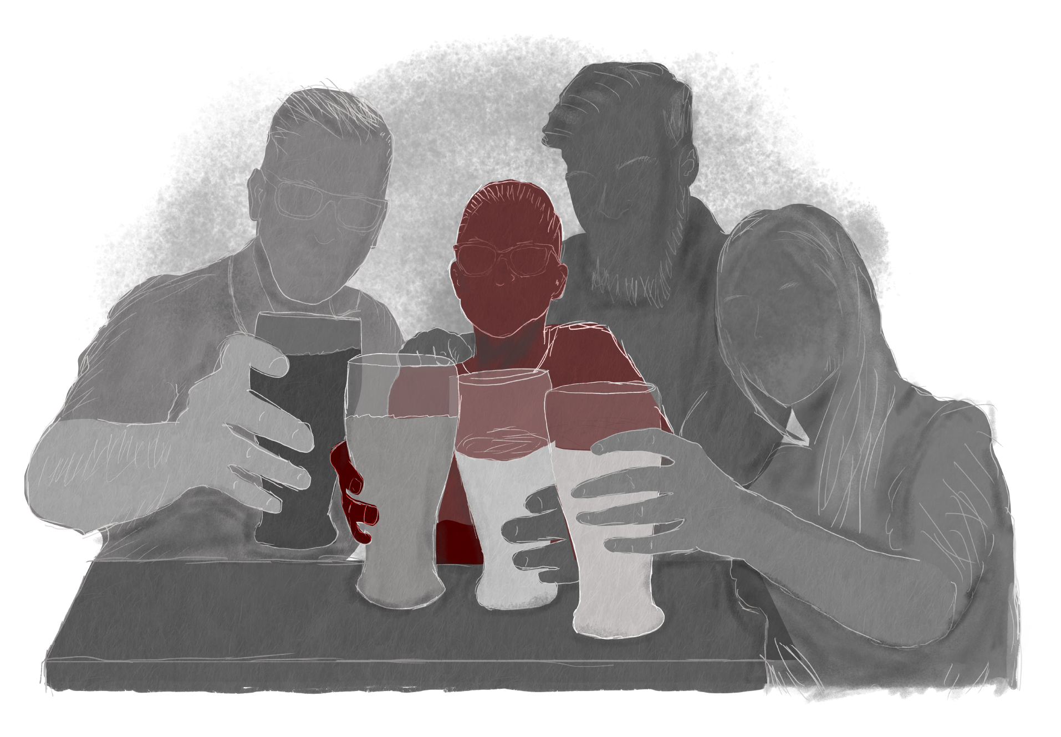
6 Woes
Drunkenness
Isa 5:11-12 – “¹¹Woe to those who rise early in the morning that they may pursue strong drink, who stay up late in the evening that wine may inflame them! ¹²Their banquets are accompanied by lyre and harp, by tambourine and flute, and by wine; but they do not pay attention to the deeds of the Lord, nor do they consider the work of His hands.”
Notes:
Woe #2 is against their drunkenness – Isa 5:11-12 – Here is some irony: in Acts 2, after the Apostles are baptized with the Holy Spirit, and they’re speaking w/other tongues, Acts 2:13 says that some of onlookers were mocking the Apostles saying, “They are full of sweet wine.” And Peter’s reply in Acts 2:15 – “…these men are not drunk, as you suppose, for it is only the third hour of the day” which would be 9am. But if he had made that argument to this generation, it wouldn’t have made much sense to them because the first thing these guys do when they get up is start sucking back on grandpa’s ole cough medicine. Alcohol has completely taken over their life to the point that it’s the #1 reason for getting them out of bed in the morning and the #1 reason for keeping them from going to bed at night – they want as much time to drink as they can. And since music is typically an emotional experience, you often find the two together seeing as how one can more easily surrender to the emotions given alcohol’s ability to depress your inhibitions.
Notice vs. 12 – “But they do not pay attention…to the Lord”. Have you ever been in a restaurant where people are drinking? You can tell they’re drinking even if you don’t see the glass. Why? Because they’re talking so loud and they’re clueless to it. There is no discretion whatsoever because alcohol dulls the senses. So how could they ever expect to have the spiritual perception to the Lord’s deeds and the works of His hands?

Slide 5
6 Woes
Drunkenness
Isa 5:13-17 – “¹³Therefore My people go into exile for their lack of knowledge; and their honorable men are famished, and their multitude is parched with thirst.¹⁴Therefore Sheol has enlarged its throat and opened its mouth without measure; and Jerusalem’s splendor, her multitude, her din of revelry and the jubilant within her, descend into it. ¹⁵So the common man will be humbled and the man of importance abased, the eyes of the proud also will be abased. ¹⁶But the Lord of hosts will be exalted in judgment, and the holy God will show Himself holy in righteousness. ¹⁷Then the lambs will graze as in their pasture, and strangers will eat in the waste places of the wealthy.”
Notes:
Isaiah extends this woe through the few verses – Isa 5:13 – So having been robbed of their senses and unable to consider the Lord and His ways, God has no choice but to send them into exile, despite the fact He is still calling them “My people”. Don’t jump too far ahead to the Babylonian captivity just yet, because as we’ll discuss more in chapter 7, when Ahaz became king, exile became a reality for many who lived in Judah. 2 Chron 28 mentions many nations who were allowed to come into Judah and take its people captive because of Ahaz’s sinfulness. They needed knowledge of God’s works, but it’s hard to gain the knowledge we need when our only desire is to satisfy the senses.
Isa 5:14 – In other words, “the party’s over”. Notice the irony w/vs. 14 – these people only lived to satisfy their appetites, but in the end, there will be only one appetite that is met, only one mouth filled: Sheol, the abode of the dead. As has been the pattern in these first 5 chapters, they will lose the very things they lived for. Their feasting and drinking ironically leads to hunger and thirst. We sin because of the “good” we think it brings, but it only brings the opposite. Hell will be full of people who gave into sensuality and revelry.
Isa 5:15-16 –We’ve already seen these verses 3 other times, in 2:9,11,17, and it forms an inclusio to emphasize what is behind this revelry they’re engaged in: pride; and there’s hardly a sin that can’t be traced back to this. Pride causes us to want to possess more than we need. Pride causes us to seek more pleasure. And notice too how vs. 15 says “the eyes of the proud”, meaning this is coming about due to the lust of the flesh, the lust of the eyes, and the pride of life, that which the Apostle John refers to in 1 John 2:16 as “of the world”. God will not only humble the prideful, He will also reveal His holiness through His righteous judgments.
Isa 5:17 – Lambs likely not literal, but figurative of the meek, who Jesus says in Matt 5:5 will inherit the earth. The prideful will be removed from the earth, the meek will inherit it. Strangers could be alluding to Gentiles, who will inherit the blessings that so many of the Jews squandered. How is that going to happen? Stay tuned.

Slide 6
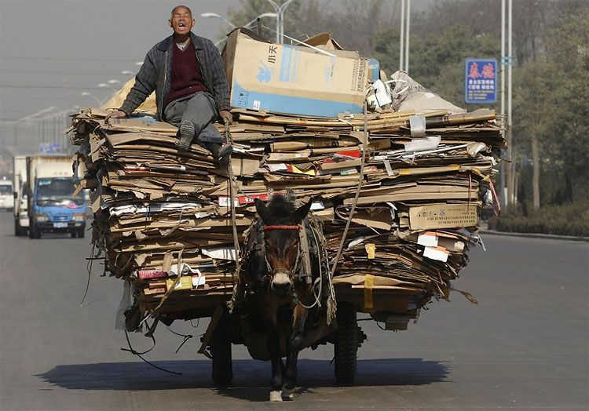
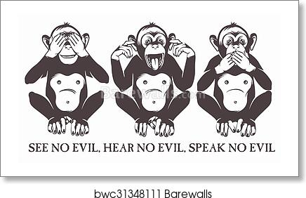
6 Woes
Defiant
Isa 5:18-19 – “¹⁸Woe to those who drag iniquity with the cords of falsehood, and sin as if with cart ropes; ¹⁹Who say, “Let Him make speed, let Him hasten His work, that we may see it; and let the purpose of the Holy One of Israel draw near and come to pass, that we may know it!””
Upside-down morals
Isa 5:20 – “²⁰Woe to those who call evil good, and good evil; who substitute darkness for light and light for darkness; who substitute bitter for sweet and sweet for bitter!”
Notes:
Woe #3 mentions the defiant, the confidently corrupt – Isa 5:18-19 – The idea is that they have harnessed themselves to sin, hitched their wagon to sin, and it is no accident, it is intentional. These aren’t people who have “fallen” into sin, they’re like a yoked beast dragging their sins behind them, holding on desperately to it, and taking great pains to do so. It’s making them slaves to corruption, and they don’t mind that one bit. And as they do so, they’re boastfully challenging and defying God to do His worse, in essence denying that He is really there. And the fact they are brazenly using the phrase “Holy One of Israel” to refer to Him may be a personal taunt to Isaiah himself for God to show Himself if He is in fact there. But they have no idea what they’re asking. With people such as this, it doesn’t matter that their arguments against the existence of God have no strength as long as they are able to lie to themselves. They walk by sight, not by faith. Such cynicism is high-handed sin of the Levitical sacrifices could not atone for.
When we get to vs. 20, we’re going to see 3 uninterrupted woes, very reminiscent of Rev 8:13. It’s almost as if to suggest that God’s cup of wrath is almost filled to the brink. Woe #4 addresses the upside-down morals of that day – Isa 5:20 – These are people so defiantly sinful, they naturally want to overthrow distinctions between good and evil, not only calling certain sins “good”, but sugarcoating what is bad in order to make certain sins seem respectable and dignified, and creating prejudice toward those who say otherwise. How might one do this? Oh I don’t know, how about abortion, which is nothing short of murder, being given the pleasant-sounding phrase “termination of pregnancy”. Drunkenness, of which the bible says in no uncertain terms will condemn a person, is now referred to as “alcoholism”. Fornication and adultery are now referred to as “pre-marital” and “extra-marital” affairs, respectively. More eloquent right? Takes some of the sting off doesn’t it? Homosexuality, or as the bible refers to it “sodomy”, is called an “alternative lifestyle”. The world ridicules the absolute, irreversible truth of the bible and gives it the intellectual label called “pluralism”. We’ve exploited the poor and called it “lottery” and rewarded the laziness of some and called it “welfare”. We’ve neglected to discipline our children and called it “building self-esteem”. We’ve relentlessly abused our power and have called it “politics”. We’ve coveted our neighbors’ possessions and called it “ambition”. We’ve polluted the air with profanity and pornography and called it “freedom of expression”. And lest we shake our head at the world, we need to remember that this was something going on in in Judah among God’s people, “My people.”

Slide 7
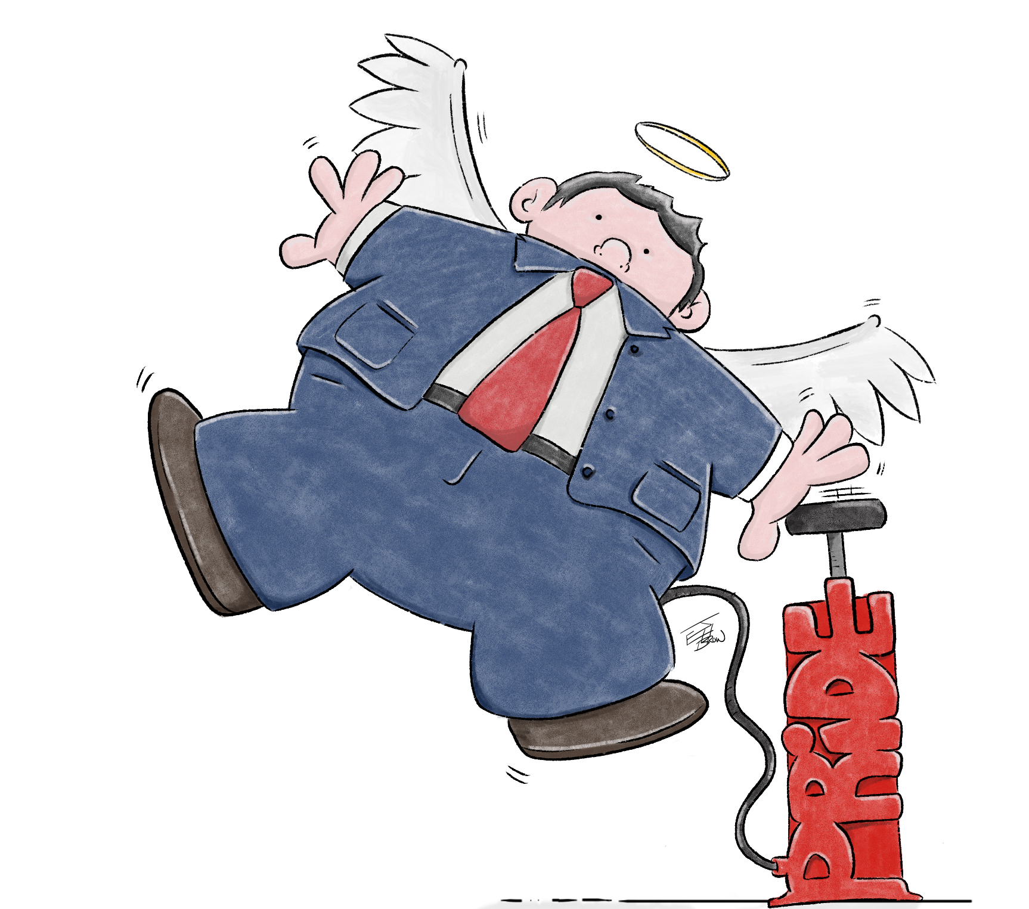
6 Woes
Arrogance
Isa 5:21 – “²¹Woe to those who are wise in their own eyes and clever in their own sight!”
Drunken justice
Isa 5:22-23 – “²²Woe to those who are heroes in drinking wine and valiant men in mixing strong drink, ²³who justify the wicked for a bribe, and take away the rights of the ones who are in the right!”
Notes:
Woe #5 is toward the arrogant and self-conceited, which we’ve already seen in chapter 2, only magnified here – Isa 5:21 – Whenever God is dismissed from one’s life, we will inevitably make ourselves the standard. And they were making huge mistakes in their reasoning, but because they held their opinions in such high regard, they were unable to see just how wrong they were, and the consequences that it was leading to. Prov 3:7 – “Do not be wise in your own eyes; fear the Lord and turn away from evil.” There’s a connection between this and the prior woe. Anytime self-interest causes one’s moral compass to turn upside down, great pains will be taken by the offender to justify their behavior, leading to dishonest conversation. They’re too wise in their own eyes, too clever in their own sight.
And then woe #6 refers to drunken justice – Isa 5:22-23 – At first glance, this woe looks like a repetition of the second. But there is this difference: the drinkers in the present verse do not remain at the banquet all day, but proceed to the business of their lives, attend courts and judge cases, but with their minds muddied and their moral vision obscured. And so, they are easily persuaded to pervert justice on receipt of a bribe. They’re glorying in their ability to hold their liquor, boasting in their power to resist its usual influence and go about normal business. Their strength comes in serving heir lusts, not the Lord and His people. They’re defining “courage” as someone who can drink a lot w/o becoming intoxicated. See the upset down morals from woe #4? How does our society define courage? Stepping out of the closest, etc. These legislators then proceed to justify the wicked while denying the rights of the right – Prov 17:15 – “He who justifies the wicked and he who condemns the righteous, both of them alike are an abomination to the Lord.” So here is the great men of the nation, but they’re only great behind a bar. These grapes are so bitter, so spoiled, no amount of human sophistry can make them sweet, and it’s easy to now see why God was planning to completely destroy the vineyard.

Slide 8
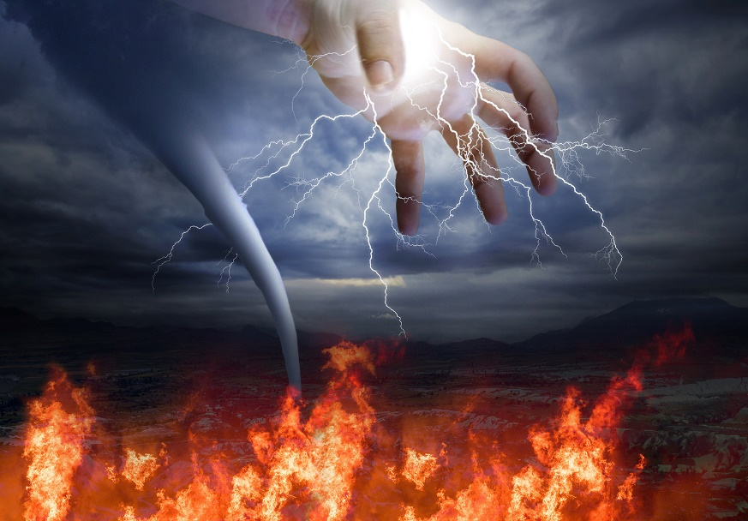
Judgment
Fire
Isa 5:24 – “²⁴Therefore, as a tongue of fire consumes stubble and dry grass collapses into the flame, so their root will become like rot and their blossom blow away as dust; for they have rejected the law of the Lord of hosts and despised the word of the Holy One of Israel.”
Notes:
Now, in scripture the #6 is incomplete. 7 represents completeness. And rather than pronouncing a 7th woe, Isaiah goes right into pronouncing judgment over these sins – Isa 5:24 – Don’t think of this as a literal fire. Fire is a figure of speech for God’s wrath. There is nothing to be done to the vineyard except to destroy it. No plant is self-sustaining. If the conditions for life are not met for it, destruction and decay are all that’s left. And so, the punishment fits the crime. They invited God in vs. 19 to hasten and make speed. And they were doing this while possessing the very word of God, and this is the reason for their condemnation at its basic level. Their coveting, lusting, revamped moral code, and their arrogance were just symptoms of a greater problem. What we see in this verse and back in vs. 13 is that root of their problem is they rejected God’s word, rejected His law. That word “law” means the actual speech of God Himself, and they had despised it to go their own way. So, like a forest fire, God will destroy all their works in proportion to their sin.

Slide 9
Judgment
Fire
Isa 5:24 – “²⁴Therefore, as a tongue of fire consumes stubble and dry grass collapses into the flame, so their root will become like rot and their blossom blow away as dust; for they have rejected the law of the Lord of hosts and despised the word of the Holy One of Israel.”
Earthquake
Isa 5:25 – “²⁵On this account the anger of the Lord has burned against His people, and He has stretched out His hand against them and struck them down. And the mountains quaked, and their corpses lay like refuse in the middle of the streets. For all this His anger is not spent, but His hand is still stretched out.”
“a great earthquake shook the ground, and a rent was made in the temple, and the bright rays of the sun shone through it; and fell upon the King’s face; insomuch that the leprosy seized upon him immediately. And before the city, at a place called Eroge, half the mountain broke off from the rest on the west” – Josephus, “Antiquities of the Jews, Book IX 10:4
Notes:
Isa 5:25 – (Amos 1) Amos was a prophet to the northern kingdom of Israel, and he was a contemporary of Isaiah’s and he mentions an earthquake in Amos 1:1 – “The words of Amos, who was among the sheepherders from Tekoa, which he envisioned in visions concerning Israel in the days of Uzziah king of Judah, and in the days of Jeroboam son of Joash, king of Israel, two years before the earthquake.” (Zech) Many years later, the prophet Zechariah describes the same earthquake – Zech 14:5 – “You will flee by the valley of My mountains, for the valley of the mountains will reach to Azel; yes, you will flee just as you fled before the earthquake in the days of Uzziah king of Judah. Then the Lord, my God, will come, and all the holy ones with Him!” Well, there are a lot of earthquakes that happen in the Levant region, but this one during Uzziah’s day appears to have been a big one that everyone knew about, seeing as how two prophets allude to it, Zechariah many years after the fact.
Well, in Josephus’ “Antiquity of the Jews”, he describes this same earthquake – “a great earthquake shook the ground, and a rent was made in the temple, and the bright rays of the sun shone through it; and fell upon the King’s face; insomuch that the leprosy seized upon him immediately. And before the city, at a place called Eroge, half the mountain broke off from the rest on the west” (“Antiquities of the Jews, Book IX 10:4). What he’s saying is that when Uzziah’s pride got the best of him and he went into the temple to offer incense, in addition to God striking Uzziah w/leprosy, in God’s anger over the people’s sin infecting one of Judah’s greatest kings, He sent a large earthquake on the land. According to Josephus, this earthquake cracked Solomon’s temple, broke half a mountain, and killed a ton of people. And archeologists have found indeed found evidence of a destruction level event from that same time period whose evidence points toward destruction by an earthquake before external invasion came. Now, while Josephus’ testimony is extra-biblical in origin, Amos and Zechariah’s mention of a notable earthquake is not. But if Josephus is correct, God sent this earthquake out of anger and as a warning hoping deter Judah from sin.
But did it work? Nope. And so, “His anger is not spent but His hand is still stretched out.” This statement is going to appear again in chapters 9 and 10 in a section on judgment against the northern kingdom of Israel, and it will form an inclusio in those chapters. But this substantiates what we’ve already read in 1:5a – “Where will you be stricken again, as you continue in your rebellion?” = “How harder do I have to spank you to persuade you to rise from ashes of your sin?”

Slide 10
Judgment
Invasion
Isa 5:26-30 – “²⁶He will also lift up a standard to the distant nation, and will whistle for it from the ends of the earth; and behold, it will come with speed swiftly. ²⁷No one in it is weary or stumbles, none slumbers or sleeps; nor is the belt at its waist undone, nor its sandal strap broken. ²⁸Its arrows are sharp and all its bows are bent; the hoofs of its horses seem like flint and its chariot wheels like a whirlwind. ²⁹Its roaring is like a lioness, and it roars like young lions; it growls as it seizes the prey and carries it off with no one to deliver it. ³⁰And it will growl over it in that day like the roaring of the sea. If one looks to the land, behold, there is darkness and distress; even the light is darkened by its clouds.
God’s doing
Unimpeded
Prepared
In their prime
Takes captive
None can help
Destruction
Notes:
So, then what else does God have in store for them? Isa 5:26-30 – What’s he alluding to here? Foreign invasion.
1) God’s doing – Just as God once used Israel as his instrument of judgment to invade Canaan and destroy the sinful nations, now God is going to allow a foreign nation to come in and destroy them. And he used many nations for these purposes in the past, such as Rome, Greece, Persia, and Babylon, who is the nation reaching the peak of its power now who God is going to use? Assyria, who God calls “the rod of My anger” in Isa 10:5. And we’ll discuss Assyria a bit more when we get to chapter 10. Suffice it to say, this will be no accident. It is all God’s doing. And He doesn’t have to blow a trumpet or beat a drum to call them; He simply has to wave a banner and whistle. They asked in vs. 19 for God to come speedily, and so He is.
2) Unimpeded – And they’re ready to go. No one’s stumbling, no one’s sleeping, they are bright-eyed and busy tailed, ready and focused. Though the march would be long, rough, and uphill, none will stumble. They won’t unbuckle their belt to relax. Their shoes won’t wear out (remind you of Israel’s wanderings?). Nothing will impede their march.
3) Prepared – They’re prepared. Their ammunition will be sharp enough. Their horses’ hooves will not break, and their chariots will be fit for war. The chariot wheels will need no repair. Their equipment is effective.
4) In their prime – “young lions” are not cubs, they are lions in their prime. And when a lion in it’s prime decides to attack, no one can do anything about. If we’re not going to heed the loving whisper of God’s word, we’ll be subject to the roar of the lion.
5) Takes captive – And the lion he is sending is not coming just to destroy, but to take captive it’s prey. And this was the policy of Assyria as we’ll look at in more detail in a couple weeks, to transplant the people into a foreign nation and bring in foreigners to populate your country.
6) None can help – And when they’re taken captive, there will be none to save them but God alone. They will be completely at the mercy of their captives, forced into a new language, new customs, new traditions, new religions, forced to start over in an unfamiliar land.
7) Destruction – It’s like the sailor who is trying to escape the roaring of the sea only to approach land and see it on fire. There is no escape. It’s possible the clouds is actually smoke from the devastation left by the Assyrians, which is darkening the sun, making it turn red. Contrast this nation who is streaming to bring disaster w/Isa 2:2-4.

