Slide 1
Notes:
In the 2nd part of the oracle against Babylon, it is written in the form of a taunt that rejoices over its fall. Because Babylon is so prideful, and because pride is such an abomination to God, the poem personifies Babylon’s destruction very graphically. But God does more than simply judge them for their pride against God. He judges them because in their arrogance, they held back people in the world God promised to both bless and redeem, Israel or otherwise. And so, there are 2 ways to look at this poem: it is negative in that it judges their sin, but it is positive in that through this judgment, it removes Babylon as a barrier that was preventing people from coming to God.
However, remember that this judgment does not just apply to Babylon itself personally, but to all political ideologies that choose to mimic her. Any nation in the future who exalts itself after the manner of Babylon and who attempts to prevent the world from coming to Zion will face the same judgment.

Slide 2
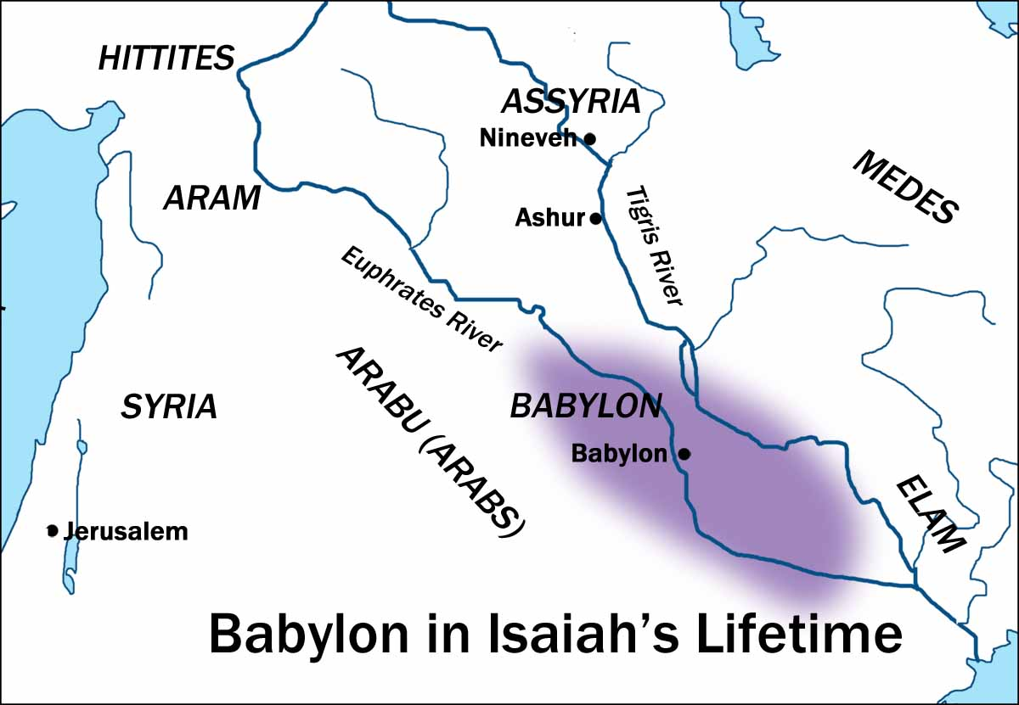
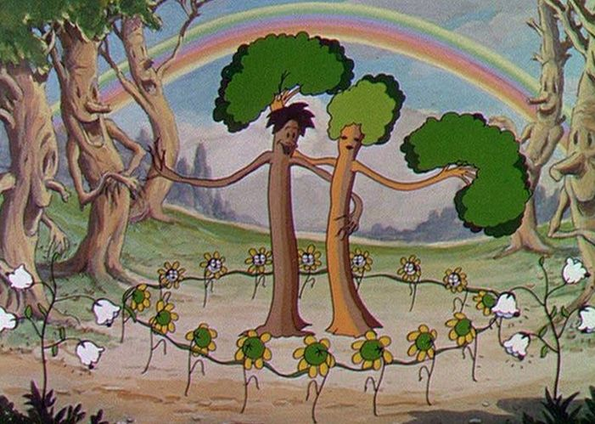
Babylon
Taunt against Babylon
Isa 14:3-6 – “³And it will be in the day when the Lord gives you rest from your pain and turmoil and harsh service in which you have been enslaved, ⁴that you will take up this taunt against the king of Babylon, and say, ‘How the oppressor has ceased, and how fury has ceased! ⁵The Lord has broken the staff of the wicked, the scepter of rulers ⁶which used to strike the peoples in fury with unceasing strokes, which subdued the nations in anger with unrestrained persecution.’”
Creation’s reaction
Isa 14:7-8 – “⁷The whole earth is at rest and is quiet; they break forth into shouts of joy. ⁸Even the cypress trees rejoice over you, and the cedars of Lebanon, saying, ‘Since you were laid low, no tree cutter comes up against us.’”
Notes:
Isa 14:3-4a – Common phrase: “If only I knew then what I know now”. God is telling them now so it will affect their actions and thinking now. Though far in the future, He will eventually give them rest from the trials oppressive nations like Babylon bring, irrespective of the pain of the present. This section begins a taunt by Israel, which is in the disguise of a lament, and is regarded by Hebrew scholars as one of the finest Hebrew poems ever written, though its style is lost in translation. But thought a taunt by Israel against Babylon, it is not a rejoicing over other peoples’ suffering, but a rejoicing over the work of God.
Isa 14:4b-6 – Babylon would make life very hard for the Jews, but those days would be numbered. The scepter represents power and the staff is what was used to guide – Babylon had wielded both against Israel, metaphorically, known for being excessively oppressive toward its captives, unrestrained in her cruelty. Hab 1:5-17 describes this in detail. But their power would be no match for God’s; He would take these symbols of authority (staff and scepter) and break them like matchsticks.
Beginning in vs. 7, we’re going to see 5 different reactions to Babylon’s judgment. Creation, Sheol, heaven, earth, and God’s reactions – Isa 14:7-8 – There won’t just be rest for God’s people, but for the whole earth, and it breaks out in shouts of joy. Songs of joy cannot be repressed, so this will be enduring. Babylon practically deforested Israel and Lebanon for fuel and lumber for its building projects. Even the Creation is delivered from the bondage of man’s corruption – Rom 8:21 – “the creation itself also will be set free from its slavery to corruption into the freedom of the glory of the children of God.”

Slide 3
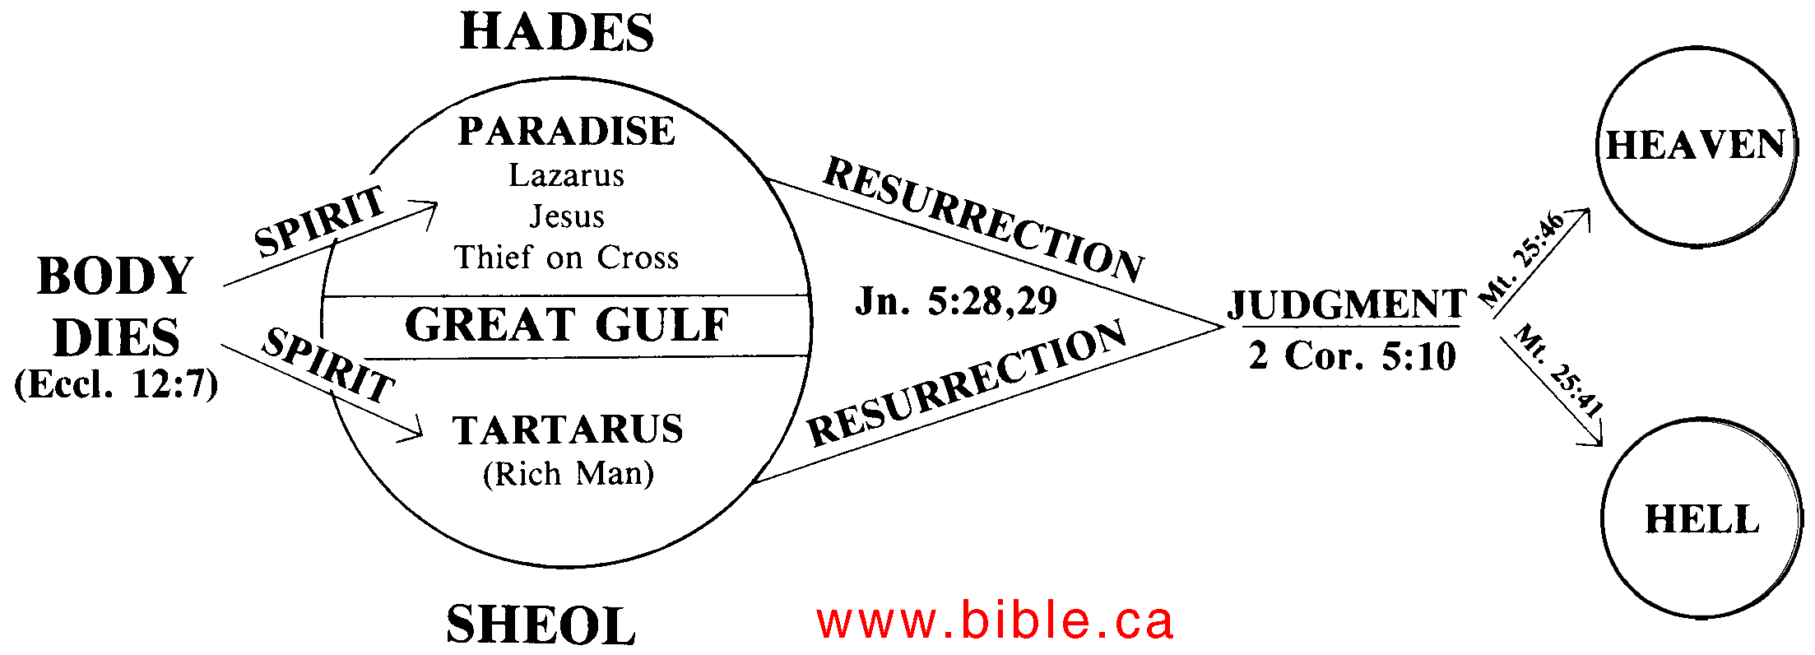
Babylon
Sheol’s reaction
Isa 14:9-11 – “⁹Sheol from beneath is excited over you to meet you when you come; it arouses for you the spirits of the dead, all the leaders of the earth; it raises all the kings of the nations from their thrones. ¹⁰They will all respond and say to you, ‘Even you have been made weak as we, you have become like us. ¹¹Your pomp and the music of your harps have been brought down to Sheol; maggots are spread out as your bed beneath you and worms are your covering.’”
Notes:
While the earth is quiet and at rest, the spirits of Sheol, which is the same thing as “Hades”, the abode of the dead, are stirred up, anxiously awaiting to welcome their permanent tenant, to torture the one who tortured so many – Isa 14:9-10 – Babylon will join a group of former kings already there, who await in expectation the one nation who caused so much trouble for the world. While the kings of earth arise form “thrones”, they’re not paying homage; they arise to mock and ridicule him as no better off than themselves. Though once at the peak of power, Babylon is now as weak and ineffectual as every other dead spirit. And so, Babylon is no longer the standard of comparison for other nations; they are the standard of comparison for her. This adds extra “umph” to Isa 2:22 – “Stop regarding man, whose breath of life is in his nostrils; for why should he be esteemed?” Mortality is the great equalizer.
Isa 14:11 – This is a disgusting, degrading demotion after such a lavish, extravagant lifestyle. In Dan 3, Nebuchadnezzar used music to entice Shadrach, Meshach, and Abed-nego toward idolatry. Not anymore. Their pillows and soft beds have now become maggots and worms. What a contrast!
Sheol is the same thing as “Hades” in the NT, the Greek word “tartarus”, and the NT teaches is the temporal realm of the departed. It is different from hell, which Rev 20 teaches is permanent, we learn from Luke 16 in the story of the rich man and Lazarus that it is the abode of both the righteous and unrighteous, though a gulf separates the two – Luke 16:26. We know from the same story, and other verses that there is consciousness while there – Psa 18:5; 30:3; 139:8; Amos 9:2; Ezek 32:21; Jon 2:2. And come Judgment Day, the unrighteous will be raised and cast into hell while the righteous will be raised to dwell in heaven w/God. While an exhaustive study of Sheol is beyond the scope of this class, it is safe to say that Babylon would be on the losing end of this judgment.

Slide 4
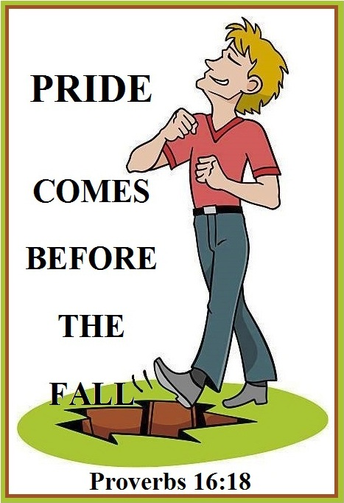
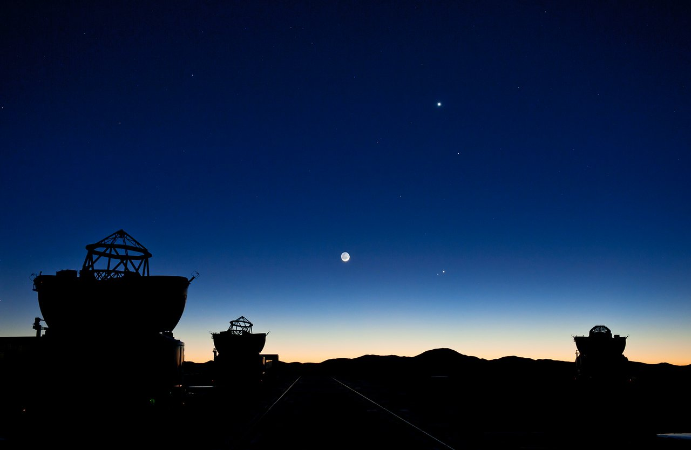
Babylon
Heaven’s reaction
Isa 14:12-15 – “¹²How you have fallen from heaven, O star of the morning, son of the dawn! You have been cut down to the earth, you who have weakened the nations! ¹³But you said in your heart, ‘I will ascend to heaven; I will raise my throne above the stars of God, and I will sit on the mount of assembly in the recesses of the north. ¹⁴I will ascend above the heights of the clouds; I will make myself like the Most High.’ ¹⁵Nevertheless you will be thrust down to Sheol, to the recesses of the pit.”
Notes:
Now notice heaven’s reaction – Isa 14:12-15.
These verses are all about human pride, a secret ambition that seeks self-deification. It describes the brilliance of the oppressive king, full of pomp and vainglory, who quickly fell from his exalted position. Though it sounds like a paradox, nothing makes one less like God than the urge to be His equal. But Babylon was no more suitable for heaven than she was suitable for earth. Her place was Sheol. Though she thought she could storm heaven and take God’s throne as easily as she had taken the thrones of earthly nations, her plans weren’t realized because only one can rule in heaven. And while it was bad enough Babylon exalted itself to God, it brought down others w/them, weakening the nations who esteemed Babylon higher than any man should esteem another. By obscuring the image of the one true God in those under subjection to her, encouraging sin and rebellion and lording it over them in the guise of “Most High”, those immersed in such a culture would be distracted from seeking the Savior. This “Babylonian spirit” began in the garden (“you shall be like God”) and continues in our culture today. But there is a stark contrast between her ambition and the reality. Babylon is not just brough down to Sheol, but to its recesses, its deepest parts. Just as the serpent’s promise was empty and death followed, Sheol will follow for those whose prideful hearts can’t be tamed.
In vs. 12, the KJV and NKJV and translates “star of the morning” as “Lucifer”, and some take this to refer to Satan and his fall from heaven, presumably because of its similarity to Luke 10:18a – “I was watching Satan fall from heaven like lightning…”. But vs. 4 and 22 make it clear that Babylon is who is under consideration. This is merely a battle for supremacy between prideful humans and God, and God will win. The Hebrew word probably refers to the planet Venus which is really visible as the sun begins to rise, but then you can’t see it anymore. That’s the idea – faded glory. “Lucifer” is from the Latin translation, which is how it got translated that way in the KJV and NKJV.

Slide 5
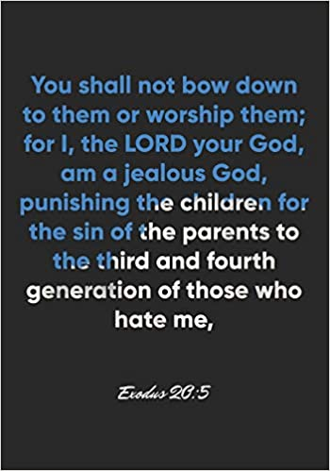
Babylon
Earth’s reaction
Isa 14:16-21 – “¹⁶Those who see you will gaze at you, they will ponder over you, saying, ‘Is this the man who made the earth tremble, who shook kingdoms, ¹⁷who made the world like a wilderness and overthrew its cities, who did not allow his prisoners to go home?’ ¹⁸All the kings of the nations lie in glory, each in his own tomb. ¹⁹But you have been cast out of your tomb like a rejected branch, clothed with the slain who are pierced with a sword, who go down to the stones of the pit like a trampled corpse. ²⁰You will not be united with them in burial, because you have ruined your country, you have slain your people. May the offspring of evildoers not be mentioned forever. ²¹Prepare for his sons a place of slaughter because of the iniquity of their fathers. They must not arise and take possession of the earth and fill the face of the world with cities.”
Notes:
Now earth’s reaction – Isa 14:16-17 – This is very similar to Sheol’s reaction in verses 9 – 11, but from earth’s perspective. Babylon, now an unburied corpse, becomes the object of everyone’s fervent stare. Everything else is shut out of view as they contemplate this unbelievable surprise, that mighty Babylon is just as subject to weaknesses of the flesh as any ordinary man, taking her place beside the lowliest of the earth. People would be amazed that one now brought so low once had so much power. She once made the earth and all its kingdoms tremble w/fear. But that is a rite reserved only for God (13:13a). God’s desire was that man multiply and fill the earth, but Babylon killed men and made the land a wilderness, preferring it to be a desert in her own hands then a garden in someone else’s (envy). Babylon didn’t make earth her home. She was content only to make it her plaything.
Isa 14:18-20 – Even common men regarded burials as proper, and monarchs were deemed important enough for honorable burials, including monuments. Those kings who Babylon had slain had likely received such. But as we saw in vs. 11, Babylon only gets a bed of maggots and a blanket of worms. Vs. 19 seems to indicate that though she had been laid in a tomb, she’ll be cast back out of it to her shame. She’s called a “rejected branch”, whose dynasty will not continue, in contrast to the Branch of Jesse from 6:13; 11:1. That she’s a trampled corpse implies she misses burial altogether because she will be like the rest of the carnage on the battlefield. There will be no honor or dignity in her death. She will be stripped of her royal robe w/nothing to clothe her but the slain of the field, heaped atop of her. She will also not be succeeded by family members and she won’t be remembered. She’ll be nameless and humiliated. The only reason we even remember Babylon is so God can show us what the epitome of wickedness looks like so we will avoid being influenced by it, though we may physically dwell in “Babylon”. Babylon’s thirst for conquest led to her own people being killed in war, and the resources of her land spent.
Isa 14:21 – In other words, the king’s descendants will be killed because of the sins of the king. They too would be wicked and must not be allowed to carry on their family’s legacy. The Lord wants the earth to be filled w/righteousness, not cities modeled after Babylon. This is pride’s ultimate end. It seeks to leave its mark on this earth, but all its works and her memory will be destroyed in death.

Slide 6
Babylon
God’s reaction
Isa 14:22-27 – “‘²²I will rise up against them,’ declares the Lord of hosts, ‘and will cut off from Babylon name and survivors, offspring and posterity,’ declares the Lord. ²³I will also make it a possession for the hedgehog and swamps of water, and I will sweep it with the broom of destruction,” declares the Lord of hosts. ²⁴The Lord of hosts has sworn saying, ‘Surely, just as I have intended so it has happened, and just as I have planned so it will stand, ²⁵to break Assyria in My land, and I will trample him on My mountains. Then his yoke will be removed from them and his burden removed from their shoulder. ²⁶This is the plan devised against the whole earth; and this is the hand that is stretched out against all the nations. ²⁷For the Lord of hosts has planned, and who can frustrate it? And as for His stretched-out hand, who can turn it back?’”
Notes:
The tail end of the taunt now switches to the 1st person – God’s reaction:
Isa 14:22 – Loss of descendants is seen as a great shame, and this would be Babylon’s curse. Babylon will not arise from the ashes. Israel had a remnant in which to put is confidence, but Babylon would have none.
Isa 14:23 – No, w/no name, no survivor, no offspring, no posterity. What will she have? Nothing. Desert animals will dwell there, swamps where only animals can dwell. The broom of destruction is a vivid image in that it removes every last vestige. Brooms are typically used to clean and make better, but the only thing that would make the world better is if Babylon is not in it.
Now, as we get to vs. 24, some of your bibles will treat this as a new oracle against Assyria. That is not the case at al. Isa 14:24-27 is a summary of everything said in the chapter up to this point – Isa 24:24-25 – This is one of 3 times in the book of Isaiah in which God swears by His own name (45:23; 62:8). And the promise is this: just as what he said would happen to Assyria happened, what He is saying will happen to Babylon will just as surely happen. Assyria’s fall is simply a model of Babylon’s future fall.
Isa 24:26-27 – So what He’s going to do to Assyria and Babylon is are really what God has in store for all hostile and opposing powers. Isa 24 – 27 lays this out further. If God stretches out His hand in anger toward all sin, as He did w/Israel and Judah, how much more will He stretch it out toward pagan nations? There is no earthly force or human pride which can successfully thwart God’s plans. The same “outstretched hand” that once smacked around Judah and Israel will be turned to those enemies who oppress her and would dare to prevent God’s plan from being fulfilled through her.

Slide 7
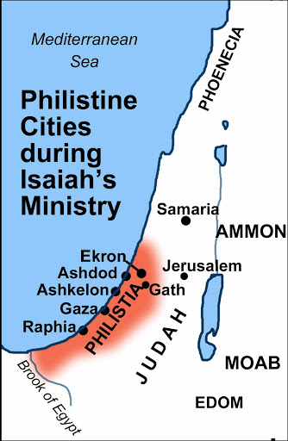
Philistia
Oracle against Philistia
Isa 14:28-32 – “²⁸In the year that King Ahaz died this oracle came: ²⁹‘Do not rejoice, O Philistia, all of you, because the rod that struck you is broken; for from the serpent’s root a viper will come out, and its fruit will be a flying serpent. ³⁰Those who are most helpless will eat, and the needy will lie down in security; I will destroy your root with famine, and it will kill off your survivors. ³¹Wail, O gate; cry, O city; melt away, O Philistia, all of you; for smoke comes from the north, and there is no straggler in his ranks. ³²How then will one answer the messengers of the nation? That the Lord has founded Zion, and the afflicted of His people will seek refuge in it.’”
Notes:
The 2nd oracle of this section begins in vs. 28, and it involves Philistia. Philistia was a small, elevated nation on the Mediterranean coast just west of Judah and south of Israel. It was made up of 5 main cities: Gaza, Ashdod, Ashkelon, Ekron and Gath. There had been numerous conflicts not only between Philistia and God’s people, but between Philistia and Assyria. In 734BC, the city of Gath refused to pay tribute to Assyria, and they were sacked. Then in 720BC, after the Syro-Ephramaite War failed, Philistia looked to Egypt for help and Sargon II responded by defeating Egypt at Gaza and then taking out Ashkelon and Gath. Then in 711BC, Ashdod played part in a western Palestinian revolt, which was quelled by Assyria. Then in 705BC, Ashkelon rebelled and was overtaken by Sennacherib in 701BC. It’s during this rebellion by Ashkelon that we believe this oracle was written, and it occurs in the year of a pretty significant event.
Isa 14:28 – This fact, along w/the beginning of verse 32, “How then will one answer the messengers of the nation?”, helps us understand the context behind the oracle. It appears as though the nation of Philistia had sent a delegation to Judah’s new king, Hezekiah, to suggest that they join forces against Assyria. Remember from our study about the Syro-Ephraimite war that it wasn’t just a coalition of Israel and Syria, but Edom as well as Philistia had joined the cause. And while Ahaz had refused to join the coalition, which led to the Syro-Ephraimite War, Syria and Israel are now gone and Philistia has been hung out to dry. It is likely that though Ahaz had denied an alliance w/them, they believe his death may allow them to influence his young son Hezekiah to do so. But while Ahaz’s death seemed like a minor victory, what’s coming to Philistia is worse than what they thought they had beaten.

Slide 8
Philistia
Oracle against Philistia
Isa 14:28-32 – “²⁸In the year that King Ahaz died this oracle came: ²⁹‘Do not rejoice, O Philistia, all of you, because the rod that struck you is broken; for from the serpent’s root a viper will come out, and its fruit will be a flying serpent. ³⁰Those who are most helpless will eat, and the needy will lie down in security; I will destroy your root with famine, and it will kill off your survivors. ³¹Wail, O gate; cry, O city; melt away, O Philistia, all of you; for smoke comes from the north, and there is no straggler in his ranks. ³²How then will one answer the messengers of the nation? That the Lord has founded Zion, and the afflicted of His people will seek refuge in it.’”
Premature rejoicing – 14:29
Contrast #1: Destinies
Judah: security – 14:30ab
Philistia: destruction – 14:31cd
Contrast #2: Fortunes
Philistia: affliction – 14:31
Judah: refuge – 14:32
Notes:
But notice God’s message to Philistia – Isa 14:29a – In other words, their rejoicing over Ahaz’s death, and the opportunity that it likely afforded them, was premature.
Isa 14:29b – The rod is likely the household of David. No other king was so consistently victorious against Philistia than David and it was in the midst of these battles in 2 Sam 5 – 8 that Zion was established. So, should they rejoice when David’s descendant is dead? Premature – the Lord has plans for David’s seed. “flying” simply means “rapid movement”. Just as in Ex 7, when that measly rod in Moses’ hand changed into a snake and ate the snakes of the false magicians, Philistia would ultimately be put in subjection to God’s people.
He then delivers two contrasts to them. The first contrast are the destinies of Judah & Philistia – Isa 14:30 – In a quiet picture of sheep in a pasture, the helpless and needy of Judah will find security in Zion as they eat and lie down in safety. Philistia has no such hope. They will be totally destroyed. There will be no root for them, nor survivors. They will starve like a besieged city.
The second contrasts are the present fortunes – Isa 14:31 – Philistia, and its gates it was very famous for, would be breached by an army coming from the north, which could be Assyria or Babylon, and they would make mincemeat of Philistia. But the afflicted of Judah would find refuge in Zion.
Isa 14:32 – This reply to the Philistine delegation is in keeping with the overall theme of Isaiah – trust in God and not in alliances w/other nations. What is founded on the rock of Zion will be what lasts. Zion does not need Philistia to survive; Philistia needs Zion.

