Slide 1
Notes:
In Isaiah 13 – 27, Isaiah has expanded upon the more regional crisis we read about in chapters 6 – 12 by bringing attention to God’s world vision for the coming Messianic kingdom. In order for God’s people, both Jew and Gentile, to stream up to the mountain of the house of the Lord that we studied in chapter 2, there are things that are going to have to happen worldwide.
First, both Babylon and any nation that adopts its worldview must be judged. The Babylonian worldview is one of excessive pride, ruthless violence, and insistence on a conformity to its ways. In fact, while we think of Babylon as the nation who would keep the Jews in physical captivity for 70 years, what was far worse was the philosophical captivity, and the oppression of the likes that we see in the book of Daniel. An enduring Babylon would only be a stumbling block for God’s Messianic plans. So, as we studied in chapters 13 and 14, they must go.
Philistia was the subject of the second oracle. They thought just because Ahaz had died and his young son Hezekiah had become king, that perhaps they could tempt him to form an alliance w/them against Assyria. Isaiah’s message in the very last verse of the chapter is simple: “Zion doesn’t need your help; you need Zion’s help. And if you want to survive, seek refuge in it.”
In the 3rd oracle, the subject is Moab. The language of this oracle is a bit obscure, which makes it difficult to follow. We’ll do our best to make the most out of it, but there will be some inferences made that may not be “necessary” inferences.

Slide 2
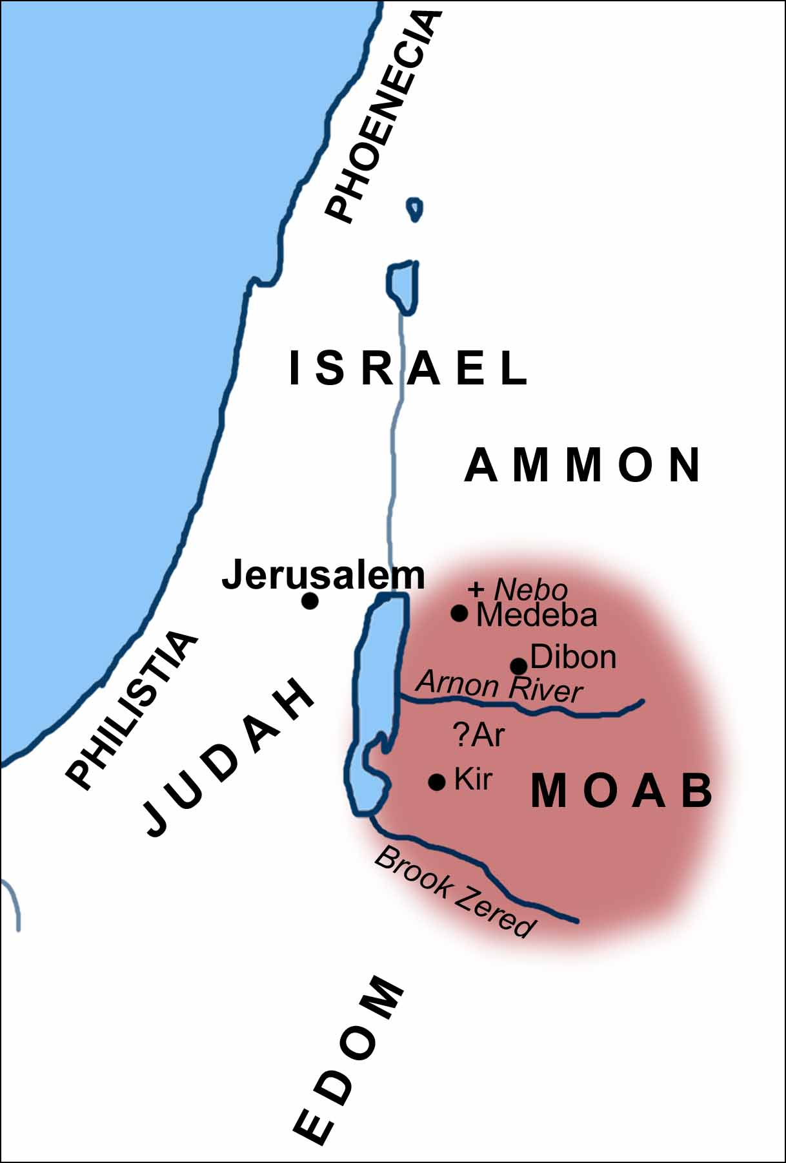
Notes:
So, who was Moab? This nation was born from the union of Lot and his two daughters in Gen 19 after they fled from Sodom and Gomorrah. Moab was born from the eldest daughter. And like Israel, they became a nation, and God blessed them as such for Lot’s sake, allowing them to depose a people called the Emim that lived in the plains southeast of Israel, what is now modern-day Jordan. Besides Lot, there are 2 other notable biblical connections. When Moses died in Deut 34, he was buried by God on Mt. Nebo which is in the plains of Moab. Also, King David was 1/8 Moabite because of his great-grandmother Ruth. In fact, when David was on the run from Saul, we’re told in 1 Sam 22:4-5 that David left his parents in the care of the King of Moab. And so, there were connections w/Israel, and there were times when Israel and Moab were on very friendly terms. But there were also times when they were fierce enemies. In Num 22, Moab’s king Balak hired Balaam to curse Israel. In Judg 3, Moab’s king Eglon oppressed Israel for 18 years. When David became king, though, he placed them firmly under his control. And so, despite being related, and despite being neighbors, the relationship was complicated.

Slide 3
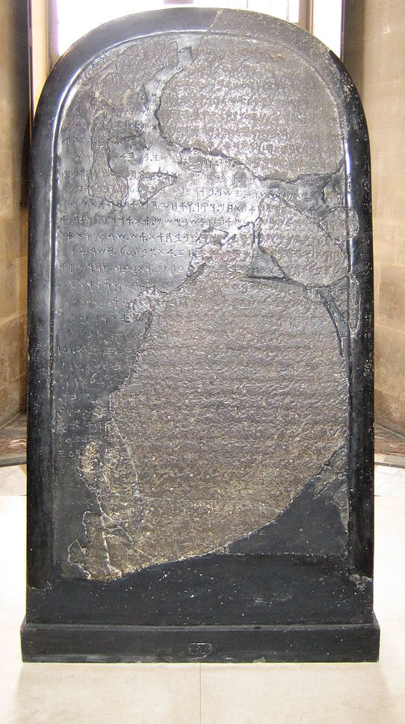
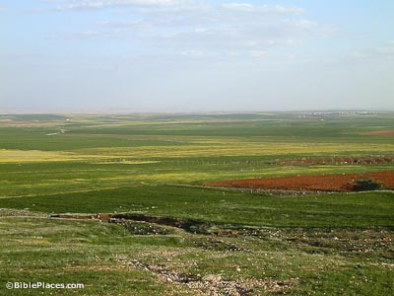
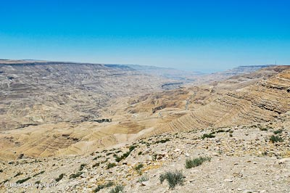
Notes:
One notable story we need to introduce, because we’ll be referring to it a few times, is in 2 Kings 3. When Jehoshaphat was king of Judah and Ahab’s son Jehoram was king of Israel, the Moabite king Mesha rebelled and stopped paying tribute to Israel. So, both kings recruit Edom and then go to war against Moab. But they run out of water and ask Elisha for help, who advises them to dig trenches, and that in the morning, they would be full of water, and that’s what happened. But when the Moabites arose the next morning, they saw the trenches, too, and the way the sun was reflecting on the water made it look like blood and they assumed Judah, Israel, and Edom had slain one another fighting. So, they rush in to take the spoil only to be caught off guard by the fact they were very much alive. Mesha and his men were soundly defeated. This picture on the left is probably the most famous of Moabite finds; it is called the Mesha Stele. It was discovered ~1865 among the ruins of Dibon. It was apparently written by King Mesha, chronicling how the Moabites had been oppressed by King Omri and his son, presumably Ahab, as the result of the anger of their god Chemosh. He then talks about his victory over Omri’s son and other wars as well as building projects. All of it collaborates the bible story. This is currently housed at the Louvre and is definitely worth seeing.
The pictures on the right shows parts of Moab today that are still very fertile, and parts that are rather barren such as the Arnon valley in the bottom right that divided Israel and Moab. And being so close in proximity, as well as a nation that was within Judah’s sphere of influence, Isaiah has an oracle for them.

Slide 4
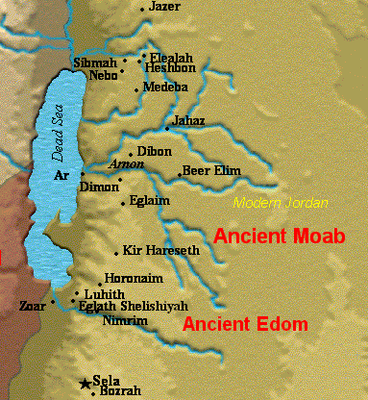
Moab
Certain, Sudden Ruin
Isa 15:1-4 – “¹The oracle concerning Moab. Surely in a night Ar of Moab is devastated and ruined; surely in a night Kir of Moab is devastated and ruined. ²They have gone up to the temple and to Dibon, even to the high places to weep. Moab wails over Nebo and Medeba; everyone’s head is bald and every beard is cut off. ³In their streets they have girded themselves with sackcloth; on their housetops and in their squares everyone is wailing, dissolved in tears. ⁴Heshbon and Elealeh also cry out, their voice is heard all the way to Jahaz; therefore the armed men of Moab cry aloud; his soul trembles within him.”
Notes:
The oracle begins by assuming some kind of distress, likely an attack by Assyria, and the effect it was having on Moab.
Isa 15:1 – So something terrible is happening to Moab, described as devastation and ruin, and it’s happening suddenly because that phrase “surely in a night” is repeated twice. Interestingly, the word “ruin” is the same word Isaiah used in 6:5 when describing his own sinful state before God. And in what direction is it happening? Remember to look for patterns when there are lists of cities. Ar and Kir were both powerful stronghold cities, Ar being in the north and Kir being in the south. Apparently, Ar is hit first, then Kir. So, north then south, as if somebody is coming from the north and proceeding south that would devastate the land. And who would be doing this in keeping w/the present distress? Assyria.
Isa 15:2-4 – Lots of cities here. What’s the pattern? I’m not sure there is one because when you look where all these cities are located, it’s everywhere in the northern part of Moab. Imagine if the emergency broadcast system announced, “ISIS has bombed Los Angeles, and now they’ve hit New York, now Dallas, now Tampa, now Atlanta, now Detroit…” we’d assume they were hitting everywhere. That’s probably the idea. Isaiah is giving us a general picture to show that destruction extended to the entire country.

Slide 5
Moab
Grief of the People
Isa 15:1-4 – “¹The oracle concerning Moab. Surely in a night Ar of Moab is devastated and ruined; surely in a night Kir of Moab is devastated and ruined. ²They have gone up to the temple and to Dibon, even to the high places to weep. Moab wails over Nebo and Medeba; everyone’s head is bald and every beard is cut off. ³In their streets they have girded themselves with sackcloth; on their housetops and in their squares everyone is wailing, dissolved in tears. ⁴Heshbon and Elealeh also cry out, their voice is heard all the way to Jahaz; therefore the armed men of Moab cry aloud; his soul trembles within him.”
Lamentations
Religious
National
Military
Notes:
We are given lamentations by three groups of people in vs. 2-4.
1) Religious lamentation – Isa 15:2 – Dibon was the native city of the famous Moabite king Mesha that we read about in 2 Kings 3, where his stele was found. But more importantly, it was where the high place of the Moabite god Chemosh was located. And though they’re climbing the high place of Chemosh to weep and to wail, their false god cannot deliver them.
2) National lamentation – Isa 15:3-4a – This judgment is so devastating, the weeping and mourning is widespread. It’s become local and domestic. Heshbon and Elealah are the furthest northern cities mentioned so far. And their weeping is heard all the way from Jahaz.
3) Military lamentation – Isa 15:4b – This tragedy is so overwhelming that even the military, who should be fearless and dressed and ready to defend, turn to just helpless sorrow.

Slide 6
Moab
Isaiah’s heart cries out
Isa 15:5-9 – “⁵My heart cries out for Moab; his fugitives are as far as Zoar and Eglath-shelishiyah, for they go up the ascent of Luhith weeping; surely on the road to Horonaim they raise a cry of distress over their ruin. ⁶For the waters of Nimrim are desolate. Surely the grass is withered, the tender grass died out, there is no green thing. ⁷Therefore the abundance which they have acquired and stored up they carry off over the brook of Arabim. ⁸For the cry of distress has gone around the territory of Moab, its wail goes as far as Eglaim and its wailing even to Beer-elim. ⁹For the waters of Dimon are full of blood; surely I will bring added woes upon Dimon, a lion upon the fugitives of Moab and upon the remnant of the land.”
Notes:
The oracle then turns very personal – Isa 15:5 – We’ll come back to that first phrase. Zoar is where Lot and his daughters fled from Sodom and Gomorrah. Eglath-shelishiyah means “a 3-year old heifer”, suggesting it had never come under the yoke of oppression as it would now, something Jer 48:11 collaborates, and it may be a play on words based on what we will read in 16:14. General direction is southwest toward Edom, as well as Luhith and Horonaim, but we don’t know their exact location. Why? Because they’re gone. God judged them.
Isa 15:6 – The plains of Moab were wonderful grazing land. But God controls the weather, and He brings abundance to the faithful and withholds agricultural blessing from the wicked. So not only does Moab face invasion, but also a lack of food. The waters of Nimrim flow into the Jordan north of the Dead Sea, but they will dry up.
Isa 15:7 – So, because there is no more oasis, they can’t stop to feed their flocks that they’re taking w/them. The brook of Arabim likely bordered Moab and Edom, and they’re likely racing to get there as fast as they can to water their flocks before they die. Now, back to vs. 5, whose heart is crying out, Isaiah’s or God’s? We’re not told. But God’s judgments are not thoughtless and uncaring. We are His creation, and He deeply grieves as He smites. And the prophets delivering the message were not mindless robots; they often had emotional responses to tough messages of judgment, and we’re going to see this come up again in the next chapter as well as chapter 21. But why should this hurt Isaiah? Why should it hurt us?

Slide 7
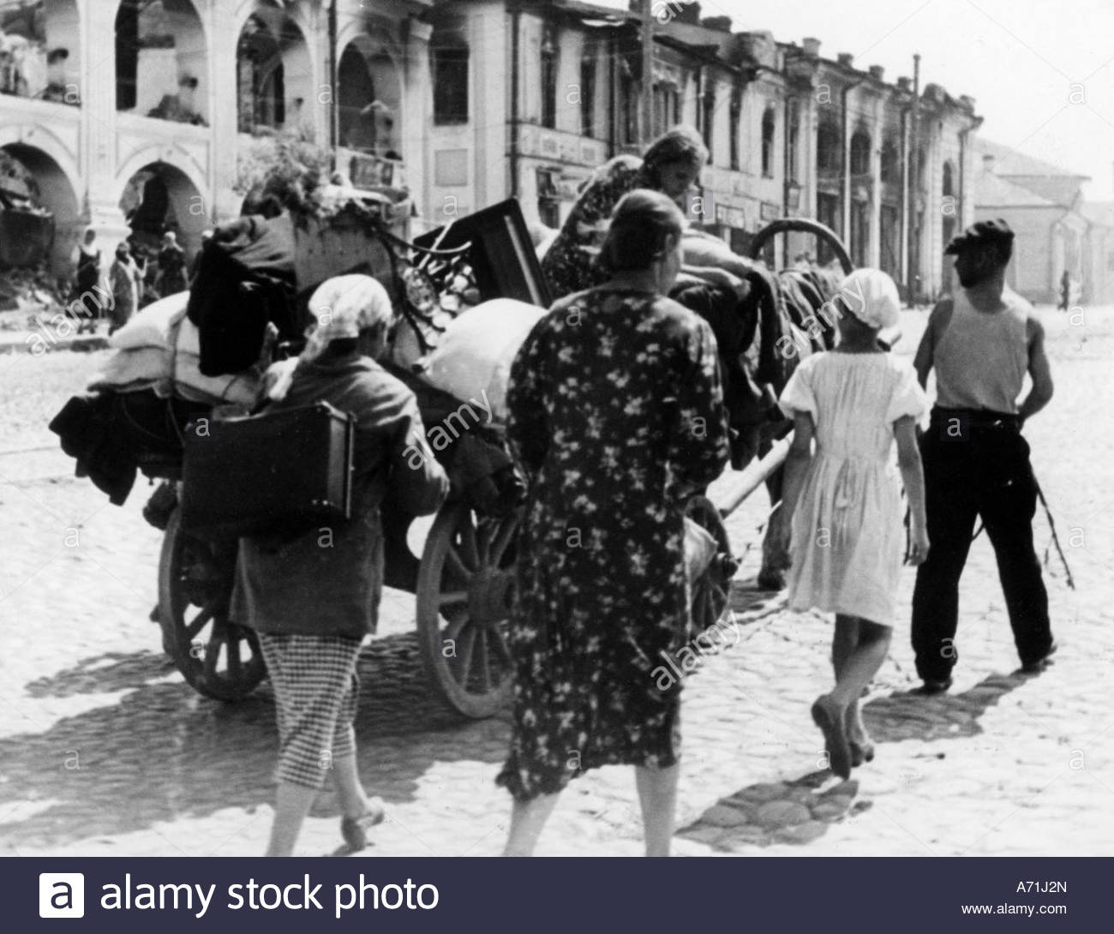
Moab
Isaiah’s heart cries out
Isa 15:5-9 – “⁵My heart cries out for Moab; his fugitives are as far as Zoar and Eglath-shelishiyah, for they go up the ascent of Luhith weeping; surely on the road to Horonaim they raise a cry of distress over their ruin. ⁶For the waters of Nimrim are desolate. Surely the grass is withered, the tender grass died out, there is no green thing. ⁷Therefore the abundance which they have acquired and stored up they carry off over the brook of Arabim. ⁸For the cry of distress has gone around the territory of Moab, its wail goes as far as Eglaim and its wailing even to Beer-elim. ⁹For the waters of Dimon are full of blood; surely I will bring added woes upon Dimon, a lion upon the fugitives of Moab and upon the remnant of the land.”
Notes:
Well, why do pictures of Germans fleeing their homeland in the 1940s hurt us? Because we’re watching citizens become refugees, scattering from their homes never to see them again, frantic to save those precious belongings they’ve spent their entire lives acquiring. This is a sad common occurrence of war. You go to the Holocaust Museum, and you’ll cry seeing what these people went through. And Assyria would put Moab through something very similar. Isaiah’s heart cried out just as ours does.
Isa 15:8 – Everyone in Moab sees God’s judgment against them. Cries can be heard from Eglaim in the north to Beer-elim, which some suggest would be much further south than this map shows. This could be the “Dan to Beersheba” of Moab to express the entire length of the land.
Isa 15:9 – It is “Dibon” in most translations, and that is correct. It no longer flows clear; it is full of “blood”, a likely an allusion to the story in 2 Kings 3:22 where they once saw a mirage of blood in the water that ended in their doom at the hands of the Israelites. But now the blood is real, and God is not done. More judgment is needed, and so He will send lions to finish off the fugitives who got away. When God decides to judge, we simply cannot escape.
So, summarizing this short chapter: the Assyrians have attacked, and the Moabites have become fugitives fleeing for their life. Their environment has become uninhabitable, their attempts to salvage what they can is greatly hindered, and there is still more judgment to come. The chapter began w/statements of devastation and ruin, and now we see the extent of it.

Slide 8
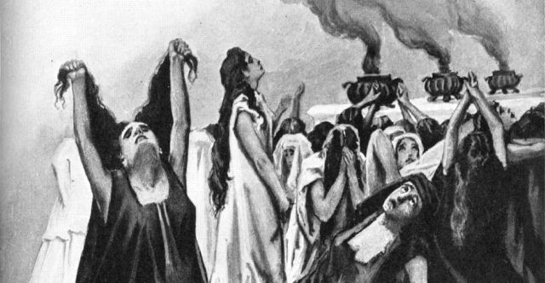
Moab
Plea to Judah
Isa 16:1-5 – “Send the tribute lamb to the ruler of the land, from Sela by way of the wilderness to the mountain of the daughter of Zion. ²Then, like fleeing birds or scattered nestlings, the daughters of Moab will be at the fords of the Arnon. ³‘Give us advice, make a decision; cast your shadow like night at high noon; hide the outcasts, do not betray the fugitive. ⁴Let the outcasts of Moab stay with you; be a hiding place to them from the destroyer.’ For the extortioner has come to an end, destruction has ceased, oppressors have completely disappeared from the land. ⁵A throne will even be established in lovingkindness, and a judge will sit on it in faithfulness in the tent of David; moreover, he will seek justice and be prompt in righteousness.”
Notes:
So, as chapter 16 begins, it seems as if Isaiah is advising them what they need to do about this – Isa 16:1 – Interestingly, this is a very similar scenario to 2 Kings 3. The Moabite King Mesha once sent 100k lambs and 100k rams to Israel as tribute, but when Ahab died, they rebelled, and so Jehoram of Israel, Jehoshaphat king of Judah, and the king of Edom went to Moab, annihilated them, and Mesha took the remaining 700 soldiers to Edom to break through to it just to survive. Now, the Moabites, having fled southwest toward Edom, find themselves as refugees in Sela (Petra today) once again, and it seems as if Isaiah is encouraging Moab to resume doing what they had done when Mesha was king, to send sacrificial tribute to the Davidic ruler to secure his help.
Isa 16:2 – Refugees of war are a pathetic sight, but women refugees suffered cruel fates. And like hens flushed from their roosting place, the women flutter about confused and helpless under God’s judgment, gathered at the Arnon awaiting their fate.
And it seems as if the refugees are sending word through them to Judah – Isa 16:3-4 – This appears to be a request to Judah to render a decision on whether they will become a shelter for the Moabite fugitives, refusing all requests from Assyria for extradition. The irony of their request is that they’d once been one of Israel’s greatest enemies. But now they insist they are no longer destroyers, executioners, and oppressors as they had been toward Israel in the past. They want to renew the relationship they once enjoyed w/Israel and stay w/them so they too can once again be blessed. And if they needed counsel, they’d come to the right place because as we learned in 9:6, Zion’s Ruler would be called “Wonderful Counselor”.
The answer? – Isa 16:5 – This sounds like a random statement, not a response. But I believe it is a response. Isaiah is saying, “Despite what you’ve experienced, there is a throne in the tent of David that is secure.” And since the Messiah is full of lovingkindness, faithfulness, justice, and righteousness, no oppression could possibly be found if they’ll put their trust in Zion. And so, it appears Moab is being invited to find refuge in this monarchy rather than its own, because as we studied in Isa 2, Zion will be the place in which all nations one day go to learn about the one true God. The question is, will Moab accept the terms, or will they continue to go their own way?

Slide 9
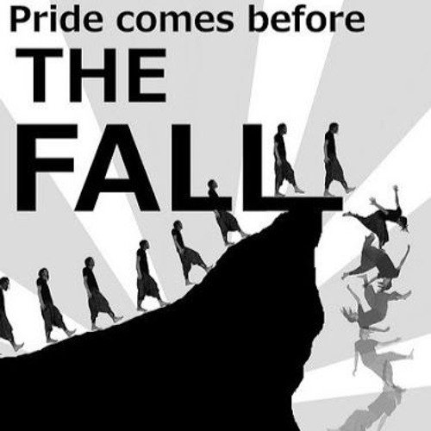
Moab
Pride & Conseqeunces
Isa 16:6-8 – “⁶We have heard of the pride of Moab, an excessive pride; even of his arrogance, pride, and fury; his idle boasts are false. ⁷Therefore Moab will wail; everyone of Moab will wail. You will moan for the raisin cakes of Kir-hareseth as those who are utterly stricken. ⁸For the fields of Heshbon have withered, the vines of Sibmah as well; the lords of the nations have trampled down its choice clusters which reached as far as Jazer and wandered to the deserts; its tendrils spread themselves out and passed over the sea.”
Notes:
The text then pivots right back to judgment, almost as if to expose Moab’s fatal flaw ultimately keeping her from Zion, and it’s the same sin God has called out in Judah, Israel, Syria, Assyria, and Babylon: pride – Isa 16:6 – Amos and Jeremiah also talk about Moab’s pride. They might have been smaller and more insignificant than Assyria and Babylon, but this shows that even the small can be prideful. Moab had LMS (little man’s syndrome). This was going to keep them from submitting to Zion’s king, because pride would keep them from recognizing that only the one true King of Zion can save. If Moab had merely been asked to pay money for entrance to Zion, they would have gladly done so because it would have allowed them to keep their pride intact. But the mountain of the house of the Lord was going to require total submission, and their pride was keeping them from it.
They just couldn’t bring themselves to submit to the Davidic demand, hence their unrelieved misery – Isa 16:7-8 – Heshbon and Sibmah were known for their prolific vines, and they would create raison cakes from the grapes. These were the highly valuable, prized products of Moab, and were often exported to Judah, Arabia, and other nations, not only providing Moab w/a healthy economy, but a strong reach, hence the word “tendrils”. But when pride can’t be broken by humility, it has to be broken by justice. She’ll be deprived of them as the lords of the nations, the Assyrians, trample them down. Moab will only be left to howl in grief and lament for herself.

Slide 10
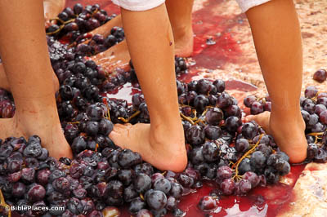
Moab
Pride & Conseqeunces
Isa 16:9-12 – “⁹Therefore I will weep bitterly for Jazer, for the vine of Sibmah; I will drench you with my tears, O Heshbon and Elealeh; for the shouting over your summer fruits and your harvest has fallen away. ¹⁰Gladness and joy are taken away from the fruitful field; in the vineyards also there will be no cries of joy or jubilant shouting, no treader treads out wine in the presses, for I have made the shouting to cease. ¹¹Therefore my heart intones like a harp for Moab and my inward feelings for Kir-hareseth. ¹²So it will come about when Moab presents himself, when he wearies himself upon his high place and comes to his sanctuary to pray, that he will not prevail.”
Notes:
And once again, Isaiah grieves over their judgment – Isa 16:9 – These same 3 towns were just named in vs. 8, but now they’re named again in reverse order, meaning that the shouts of joy that once signaled Moab’s prosperity at the summer harvest is now the sound of its ruin.
Isa 16:10 – A harvest is concluded by the gathering of grapes, and either drying into raisins or pressing it out into grape juice. In fact, isn’t it interesting that what the bible calls “wine” in this passage in this instance would have been the unfermented juice of the grape? The term “wine” today is exclusively a fermented beverage, but the bible uses it to describe both fermented and unfermented. If the yield from their harvest had been great, it was a time of exuberance and relaxation before the next cycle of harvest was to begin. But now a deadly quiet has settled on a once joyous countryside. Why? Because pride truly goes before destruction.
Isa 16:11 – The idea is that as the harp strings vibrate at the touch of the musician’s hand, Isaiah’s heart vibrates w/sympathy. The word “heart” literally means “bowels, inward parts”, which is where the Hebrews figuratively represented the seat of emotions. This was a soul-stirring, stomach-churning emotion that resulted from a deep affliction of spirit over their judgment.
Isa 16:12 – Babylon’s judgment ended w/a song of taunt. Moab’s ends w/a requiem, because Moab’s response to her distress is not to seek the true king in Zion, but to pray at her high place. She’s looking to the wrong place. Their rituals toward Chemosh would not produce its desired result, just weariness.

Slide 11
Moab
Timeframe
Isa 16:13-14 – “¹³This is the word which the Lord spoke earlier concerning Moab. ¹⁴But now the Lord speaks, saying, ‘Within three years, as a hired man would count them, the glory of Moab will be degraded along with all his great population, and his remnant will be very small and impotent.””
Jer 48:46-47 – “⁴⁶‘Woe to you, Moab! The people of Chemosh have perished; for your sons have been taken away captive and your daughters into captivity. ⁴⁷Yet I will restore the fortunes of Moab in the latter days,’ declares the Lord.”
Zeph 2:9 – “…Surely Moab will be like Sodom and the sons of Ammon like Gomorrah–a place possessed by nettles and salt pits, and a perpetual desolation. The remnant of My people will plunder them and the remainder of My nation will inherit them.”
Notes:
So, in conclusion – Isa 16:13 – So if this had been spoken earlier, there was no excuse. Moab had known what the Lord required for some time.
Isa 16:14 – But now there is a definitive time period of judgment. 3 years are the years of a hireling, perhaps a play on Eglath-shelishiyah (3-year heifer – 15:5). Moab’s payday has been fixed.
Jer 48:45-47 tells us that a remnant was indeed spared, but when Babylon invaded, Zeph 2:9 says that Moab would be as Sodom. This assured God’s people that He would deal w/the nations worse than He had dealt w/them. And Moab was indeed invaded in 715BC by Assyria, so this could have been written in 718BC.
The purpose of this oracle is to discourage God’s people from joining up w/prideful Moab for purposes of mutual security because they will be reduced to hopeless circumstances and will be forced herself to rely on the Messiah.

