Slide 1
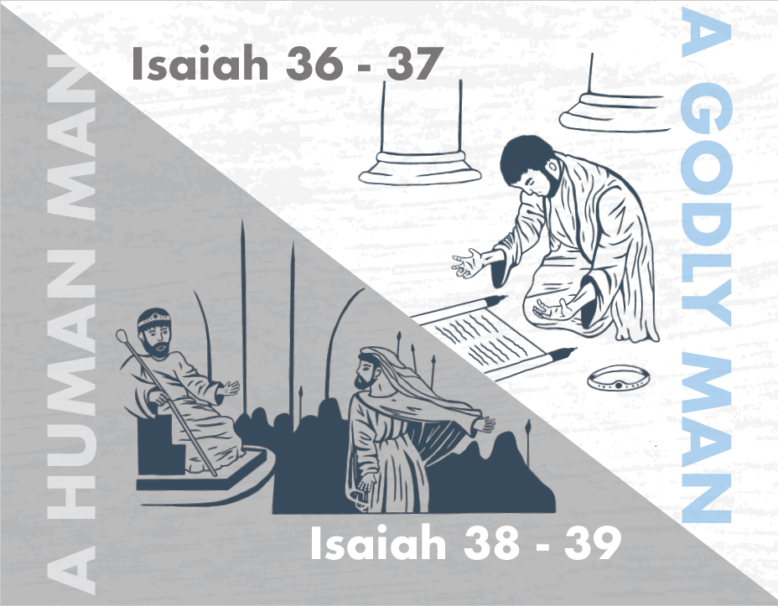
Notes:
One of the designs of Isaiah 7 – 37 is to show the contrast between Ahaz and Hezekiah. Both men were given equal opportunity to trust God over men. But Ahaz failed by putting his trust in Assyria, and Hezekiah succeeded by putting his trust in the Lord. And because Hezekiah was a faithful man, decades of turmoil and fear over Assyria is put to an end in one very simple statement that one angel slew 185,000 Assyrian troops overnight.
As mentioned in the previous study, the narrative of chapters 36 – 39 form a sort of pivot point for the entire book. Chapters 36 – 37, that we just finished, is the conclusion to the first part of the book, and chapters 38 – 39 are the very fitting introduction to chapters 40 – 66.
One of the parallel accounts of this next section occurs in 2 Kings 20, and we actually learn that the events of Isaiah 38 occurred before Sennacherib’s attempted besieging of Jerusalem, which is interesting because Isaiah appears to place this event afterwards. And so, it appears that Hezekiah gets sick as Assyria’s army is marching toward Jerusalem. Wouldn’t it be nice to only have to deal w/one problem at a time? It rarely works out that way. But one of the things to keep in mind, which we discussed back in chapter 6, is that Isaiah tends to prefer a theological rendering to a chronological one. And I believe Isaiah includes this episode in this particular spot for this reason: despite being shown so much divine privilege, even a faithful man like Hezekiah has flaws; even faithful men like Hezekiah struggle to maintain an enduring faith. And so, what then can be done to avoid a repeat cycle of God’s judgment?

Slide 2
Hezekiah’s Illness
Prognosis
Isa 38:1 – “¹In those days Hezekiah became mortally ill. And Isaiah the prophet the son of Amoz came to him and said to him, ‘Thus says the Lord, ‘Set your house in order, for you shall die and not live.’”
Notes:
To set the stage for these 2 chapters, we learn that Hezekiah is ill, and Isaiah informs him that it is terminal.
Isa 38:1 – Hezekiah is still quite young; he is about 39/40. And he is a righteous king. He isn’t perfect, but he certainly doesn’t deserve the hammer of judgment like some other kings. And the nation really needs him right now. They don’t need Hezekiah on his death bed. And if you compare the chronologies, Hezekiah doesn’t have a male heir at this point which means he is also looking at the end of his line of the Davidic dynasty. And so, he’s actually facing a very similar challenge that Abraham faced when he was told to sacrifice his heir Isaac on Mt. Moriah. This is a sobering reminder that illness and death can strike any one of us at any time, no matter how young, how righteous, or how needed. Anyone at anytime can hear the words, “Set your house in order.” But in Hezekiah’s case, there is kindness in what God is telling him because most people aren’t even given this much of a heads-up. But Hezekiah wouldn’t have seen it this way. He likely would’ve regarded this as God being displeased w/him. But Hezekiah now has time to assure that his estate and last wishes are in order. Why would God end Hezekiah’s life so early? We’re not explicitly told, and on the surface it seems so random. It could have been a test, or it could be what Eccl 9:11 teaches, that time and chance happen to all of us. But here’s another possibility: does God know the future? Absolutely, and chapters 40 – 48 is going to make that abundantly clear. When God adds 15 years to Hezekiah’s life, who was born during that time? Manasseh, arguably the most wicked king to ever reign. It’s speculative, but could the reason why Hezekiah was going to die so young be because God knew what would happen if Manasseh was allowed to be born? Perhaps this is God’s way of seeing the big picture where we often can’t. There are things we yearn for so fervently, but how often does God say “no” because He sees the bad things that will happen if He grants our petition?

Slide 3
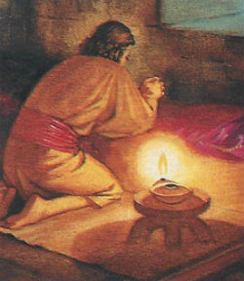
Hezekiah’s Illness
Prayer
Isa 38:2-3 – “²Then Hezekiah turned his face to the wall and prayed to the Lord, ³and said, ‘Remember now, O Lord, I beseech You, how I have walked before You in truth and with a whole heart, and have done what is good in Your sight.’ And Hezekiah wept bitterly.”
Notes:
Keep that in your brain, but don’t let it distract you from the main thrust of these chapters. Notice how Hezekiah’s first response to this diagnosis is prayer.
Isa 38:2 – Some people suggest he turns his face to the wall so no one can see him, because he is so ashamed and sad.
Or this could be in tune w/what Jesus said in Matt 6:6, the idea being to shut out the world so that he could focus on the matter at hand.
But here’s the prayer – Isa 38:3 – So here we have Hezekiah pouring out a wounded heart. And on the surface, it may appear as if he is relying on the bargaining power of his good works. And his record had indeed been impressive. But I’d suggest that these are simply the words of a man beside himself, and that he knew that the God he served is one who is always ready to be entreated and that the prayer of a righteous man can change the course of events.

Slide 4
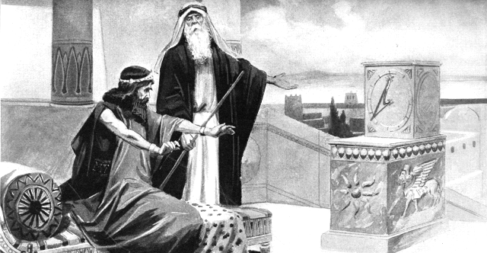
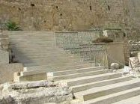
Hezekiah’s Illness
God’s response
Isa 38:4-8 – “⁴Then the word of the Lord came to Isaiah, saying, ‘⁵Go and say to Hezekiah, “Thus says the Lord, the God of your father David, ‘I have heard your prayer, I have seen your tears; behold, I will add fifteen years to your life. ⁶I will deliver you and this city from the hand of the king of Assyria; and I will defend this city.’” ‘⁷This shall be the sign to you from the Lord, that the Lord will do this thing that He has spoken: ⁸Behold, I will cause the shadow on the stairway, which has gone down with the sun on the stairway of Ahaz, to go back ten steps.’”’ So the sun’s shadow went back ten steps on the stairway on which it had gone down.”
Notes:
Now, God’s response begins in vs. 4. But if you look at the parallel account in 2 Kings 20:4, it tells us that Isaiah had not even gone out of the middle court before the word of the Lord came to Him. Hezekiah’s prayer touched God that much.
Isa 38:4-5 – Vs. 5 indicates God keeps His promises, because He is the “God of his father David”, having made promises to David. See how a sincere prayer can change history itself?
Isa 38:6 – Remember, Hezekiah is dealing w/the Assyrian invasion at the same time he is sick. And now God is saying that just as He’ll spare Hezekiah’s life, He’ll spare Jerusalem’s as well. And while his recovered health and additional 15 years should be all the evidence that he needed not to fear Assyria for the rest of his life, God is going to give him an additional sign.
Isa 38:7-9 – Now, the parallel account in 2 Kings 20 tells us that Hezekiah requested this particular sign. But this is a fitting sign because it occurred on Ahaz’s staircase, which some scholars suggest was actually designed to be a sun dial. So, the significance of this particular sign would be that if God can add more time in the day, he can add more time to Hezekiah’s life. And let’s also add this to the list of similarities/contrasts between Ahaz and Hezekiah, because when Ahaz was given the choice of a sign in chapter 7, he refused. So, this would also be a reminder of his success where his father failed.

Slide 5
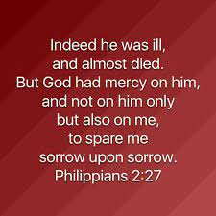
Hezekiah’s Illness
Illness lamentation
Isa 38:9-14 – “⁹A writing of Hezekiah king of Judah after his illness and recovery: ¹⁰I said, ‘In the middle of my life I am to enter the gates of Sheol; I am to be deprived of the rest of my years.’ ¹¹I said, ‘I will not see the Lord, the Lord in the land of the living; I will look on man no more among the inhabitants of the world. ¹²Like a shepherd’s tent my dwelling is pulled up and removed from me; as a weaver I rolled up my life. He cuts me off from the loom; from day until night You make an end of me. ¹³I composed my soul until morning. Like a lion—so He breaks all my bones, from day until night You make an end of me. ¹⁴Like a swallow, like a crane, so I twitter; I moan like a dove; my eyes look wistfully to the heights; O Lord, I am oppressed, be my security.’”
Notes:
Now, in vs. 9 – 20 is a psalm that Hezekiah wrote after he was healed. And in this psalm, he reveals full awareness of the peril he was in, how prayer delivered him, and his responsive commitments. Vs. 19 – 14 are the thoughts going through his mind before Isaiah told him he would be healed:
Isa 38:9-11 – Sheol is the OT word for the realm of the dead. And long before the resurrection of Jesus, before Jesus brought “life and immortality to light through the gospel” (2 Tim 1:10), the picture of death we see most often in the OT is this shadowy world whose existence is very vague. And so, when Hezekiah should have been enjoying the prime of his life, he’s feeling this sense of helplessness and gloom of having to go to this place. Brethren, we get one life, and it has a preciousness about it that even the light of immortality can’t take away. We were made for God and each another, but he sees himself as being deprived of this, as being separated from life as he’s known it. The intimate fellowship of worship on this earth would no longer be experienced, and the associations he longed for in mankind would be over.
Adding on to verse 10, he begins vs. 12 by mentioning the brevity of his life – Isa 38:12a – Shepherds didn’t stay in one place; they were constantly on the move looking for green pastures to feed their flocks. Tents are temporary by nature, but a shepherd's tent much more, and that is how Hezekiah was seeing his life.
Isa 38:12b – This represents a decisive end, as a person who has finished weaving a pattern, then cuts it from the loom, and rolls it up. Except here, God is the one who decided when the weaving was done. Death removes in a moment what seemed to be permanent.
Isa 38:13 – Hezekiah sees himself as a sick man who has gotten through another day, settling in for a long night, hoping for recovery, only for Isaiah’s declaration that he’d die to leave him crushed. What I want us to see from this is that it is natural to grieve at such news. Remember in Phil 2, when Paul mentions Epaphroditus being sick? He says God showed mercy not only toward Epaphroditus, but toward Paul as well in order to spare Paul sorrow upon sorrow. God doesn’t expect us to remain stoic in these circumstances. It is natural to grieve in the face of terminal illness and death. Even when Jesus knew He’d raise Lazarus, we’re still told He wept.
Isa 38:14 – “Swallow/crane/dove” represents the feebleness of prayer. It’s to paint us a picture of an exhausted king on whose mind being bombarded no only w/the pressing affairs of the state as his nation is in peril, but of the physical toll of his health, and the the emotional toll it is taking on him. And the strain of prayer was likely an additional burden to him in his sickness. But he kept on praying anyway. Though death seemed certain, Hezekiah kept his faith in God, asking Him to take responsibility for his defense knowing that the same God who appears to be crushing his bones also cares for him.

Slide 6
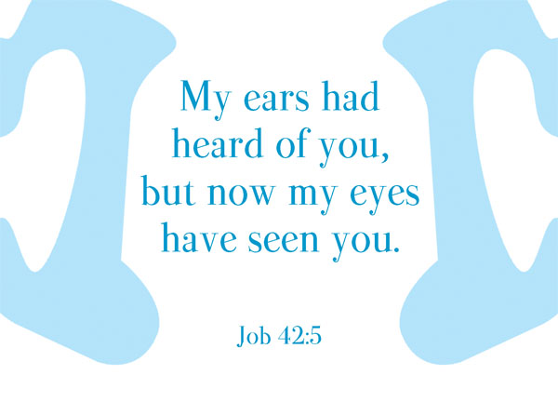
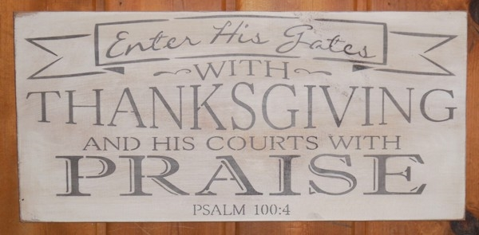
Hezekiah’s Illness
Reminisces deliverance
Isa 38:15-20 – “¹⁵‘What shall I say? For He has spoken to me, and He Himself has done it; I will wander about all my years because of the bitterness of my soul. ¹⁶O Lord, by these things men live, and in all these is the life of my spirit; O restore me to health and let me live! ¹⁷Lo, for my own welfare I had great bitterness; it is You who has kept my soul from the pit of nothingness, for You have cast all my sins behind Your back. ¹⁸For Sheol cannot thank You, death cannot praise You; those who go down to the pit cannot hope for Your faithfulness. ¹⁹It is the living who give thanks to You, as I do today; a father tells his sons about Your faithfulness. ²⁰The Lord will surely save me; so we will play my songs on stringed instruments all the days of our life at the house of the Lord.””
Notes:
But though as weak as a bird’s song, his prayer prevailed over the power of death. And it is great to know that God hears even the feeblest of prayers. Vs. 15 indicates Hezekiah is now at a loss for words.
Isa 38:15-16 – He came out of danger so abruptly, only God could have done it. And now, he’s determined that this past experience will govern his future life. And as we walk through the rest of the psalm, keep track of all of Hezekiah’s good intentions. Notice first how he wants others to take note of his experience and order their lives accordingly; he’ll set the example himself. He knows his survival is only God’s doing, fitting the theme of the book, that God alone is sovereign, and He alone is trustworthy.
Isa 38:17 – In other words, Hezekiah has come to realize that his suffering was intended for his good. So now he sees that all the anguish was worth it; it allowed him to experience God’s love, God’s rescue, and God’s forgiveness. Therefore, he’s seeing God from a new vantage point, as Job once did (Job 42:5). He no longer had to worry about dying before having his sins atoned for. God has turned adversity into a blessing (Rom 8:28). Does this mean every time someone is sick, it’s because they’ve sinned? No. But sometimes sickness/difficulty does come due to sin, and Hezekiah seems to believe that’s what had happened.
Isa 38:18-19 – Even w/o a good understanding of life after death, Hezekiah still cannot imagine how the dead can praise or celebrate God’s glory, nor how His deeds of faithfulness could possibly reach them there. To him, the shut gates of Sheol sealed off that realm of any devotion toward God. But because 15 years have been added to his life, that is 15 more years to praise Him. Sometimes we try to scare people into conversion by saying, “What if you die tonight?” But maybe what we need to be asking one another is, “What if we don’t die tonight? What are we going to do w/all this extra time God is giving us?” Hezekiah pledges personal devotion. But then in vs. 19, he pledges domestic devotion. He’s determined that his children will know God’s goodness. Again, keep track of all these good intentions he has.
And having been spared the gates of Sheol, he promises to enter the gates of thanksgiving – Isa 38:20 – Ahaz had closed these doors. Hezekiah had opened them back up. And now w/his life extended, Assyria’s defeat guaranteed, and true worship restored, Hezekiah’s life could now be what it should be. Hezekiah is promising that for as he lived, he would never get over his gratitude to God. And in 2 Kings 20, Isaiah told him that on the 3rd day he would indeed go to the temple.

Slide 7
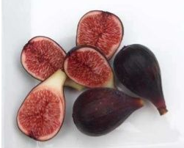
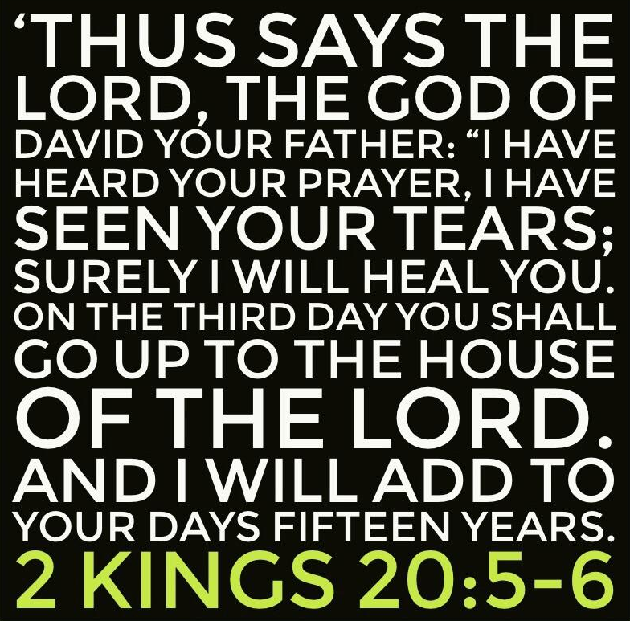
Hezekiah’s Illness
Healing
Isa 38:21-22 – “²¹Now Isaiah had said, ‘Let them take a cake of figs and apply it to the boil, that he may recover.’ ²²Then Hezekiah had said, ‘What is the sign that I shall go up to the house of the Lord?’”
Notes:
Isa 38:21-22 – So whatever the disease may have been, one of its symptoms was boils. The miracle of healing, though by God, was achieved by applying figs. So, here’s a question: what healed Hezekiah, God or the figs? The answer is “both”. Hezekiah was healed by God when he applied the figs. When God asks us to wash away our sins in baptism, what saves us, God or water baptism? Both. God saves us when we are baptized.

Slide 8
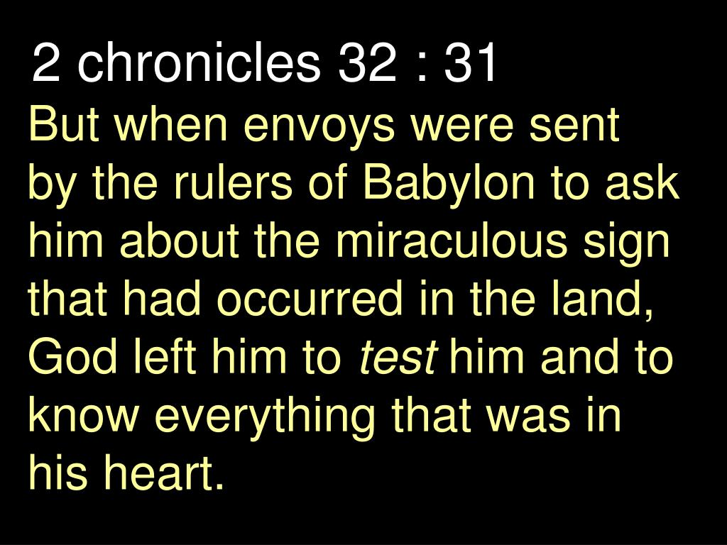
The Emissary of Babylon
Babylon visits
Isa 39:1-2 – “¹At that time Merodach-baladan son of Baladan, king of Babylon, sent letters and a present to Hezekiah, for he heard that he had been sick and had recovered. ²Hezekiah was pleased, and showed them all his treasure house, the silver and the gold and the spices and the precious oil and his whole armory and all that was found in his treasuries. There was nothing in his house nor in all his dominion that Hezekiah did not show them.”
Notes:
Now, chapter 38 is important for the background of chapter 39.
Isa 39:1 – If you study the parallel account in 2 Chron 32:23, we learn that it wasn’t just Hezekiah’s recovery that prompted such honor from the nations, but also what God had done to the Assyrian empire – 2 Chron 32:22-23. And if you look in 2 Chron 32:31, we’re told Babylon specifically came calling because of the miraculous sign that had occurred. Whether this was the miraculous destruction of Assyria or the miracle that occurred on Ahaz’s staircase, we don’t know, but remember that though Babylon is still inferior to Assyria at this point in history, they are no insignificant nation. Remember from previous studies that Merodach-baladan had successfully taken back Babylon twice from Assyria, the first time holding it for a decade, so this is a man of prominence sending emissaries to Hezekiah. And what was God looking for from Hezekiah in this situation? The end of 2 Chron 32:31 says he was testing Hezekiah to see what was in his heart. Testing him how? Think about everything Isaiah has been teaching so far. God is w/Zion, not the other nations. He will severely judge the other nations who do not submit to Zion. Therefore, Zion doesn’t need the other nations; they need Zion. God has just proved this in several miraculous ways – healing Hezekiah of his terminal illness, causing the shadow to walk back on Ahaz’s staircase, and wiping out 185,000 Assyrian troops overnight. And we’re not told how long this event occurs after all this, but remember that God was also going to allow the devastated land to miraculously bear fruit for 3 years. 2 Chron 32:23 tells us Hezekiah and Jerusalem were now exalted in the sight of all nations, something Isaiah had predicted in chapters 13 – 27. And so, as the Babylonian emissaries approach, this should have been a time for Hezekiah to glorify God before pagan Babylon. And God is testing Hezekiah to see if he will do just that, all those things he promised to do in his psalm.
But what was in his heart? – Isa 39:2 – All the lessons of chapters 7 – 35, to not delight in human or national power, are forgotten. What is happening here is that Hezekiah is hoping a display of his wealth will gain Babylon as an ally, once again trusting in nations. This is a complete about-face to his psalm. He is flattered, and 2 Chron 32:25 tells us it made his heart proud. So, this is a low moment for Hezekiah and the nation of Jerusalem.

Slide 9
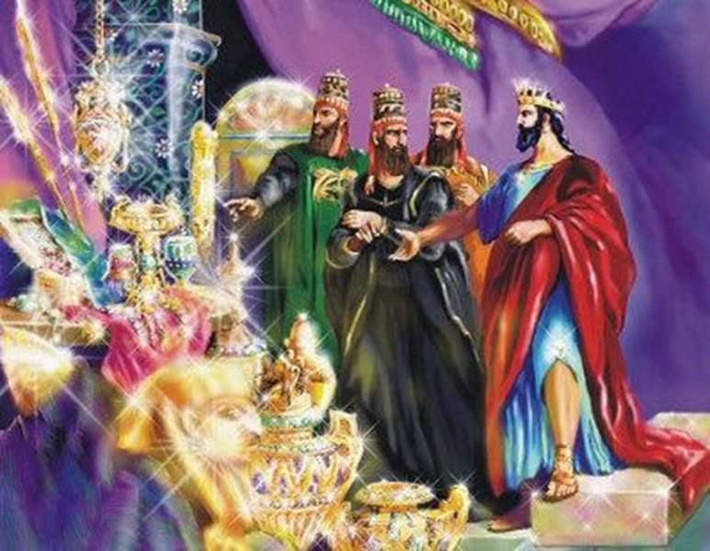
The Emissary of Babylon
Isaiah questions Hezekiah
Isa 39:3-4 – “³Then Isaiah the prophet came to King Hezekiah and said to him, ‘What did these men say, and from where have they come to you?’ And Hezekiah said, ‘They have come to me from a far country, from Babylon.’ ⁴He said, ‘What have they seen in your house?’ So Hezekiah answered, ‘They have seen all that is in my house; there is nothing among my treasuries that I have not shown them.’”
Notes:
So, Isaiah is going to approach Hezekiah about this, and he’s going to ask him 2 questions
Isa 39:3 – Notice that Hezekiah does not answer that first question, “What did they say?”, and that likely implies a concealed agenda. That he does answer the question, “from where have they come to you?”, reeks w/pride. “From a far country, even Babylon” is an obvious boast. This is a small-town man awed by the attention of a big-city delegation. But I don’t believe Isaiah is asking Hezekiah these questions in order to receive answers, but to help Hezekiah see his error for himself.
Isa 39:4 – Now, does he realize his error and answer honestly, or does he realize he can’t win w/Isaiah and so answers back defiantly: “There is nothing they haven’t seen!” There is no way to see the tone from the text. But either way, what Hezekiah did here was a crucial mistake. Because from this point on, access to Judean wealth is going to be a primary concern for Mesopotamian powers.

Slide 10
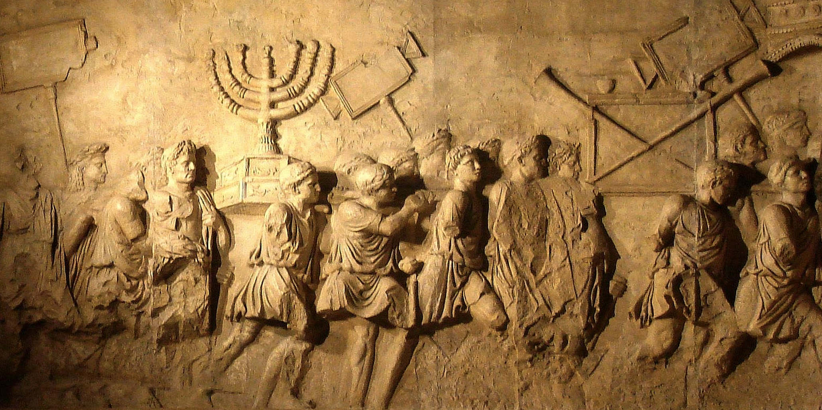
The Emissary of Babylon
Isaiah’s prophecy
Isa 39:5-7 – “⁵Then Isaiah said to Hezekiah, ‘Hear the word of the Lord of hosts, “⁶Behold, the days are coming when all that is in your house and all that your fathers have laid up in store to this day will be carried to Babylon; nothing will be left,’ says the Lord. ⁷And some of your sons who will issue from you, whom you will beget, will be taken away, and they will become officials in the palace of the king of Babylon.”’”
Notes:
It seems Isaiah had already been given God’s message. As he previously denounced Ahaz’s alliance w/Assyria, so now he must denounce Hezekiah’s desire to ally w/Babylon.
Isa 39:5-6 – Now, Hezekiah’s sin wasn’t the cause of captivity, but it is the occasion for bringing it up. God is saying, “If you love them so much, rest assured your relatives will be going there.” Because refusing trust in God, he’s thrown his lot in w/Babylon. Those seducing Judah as friends would be their conquerors in less than 100 yrs, and everything he’d stored up, all the gifts being brought by the surrounding nations, would be for naught.
And to make matters worse – Isa 39:7 – Hezekiah’s own sons would become eunuchs, emasculated to do Babylon’s bidding, lacking zero freedom. And I would suggest that the fact He says Babylon and not Assyria would take them captive is evidence of inspiration, given the fact that Assyria is still the juggernaut and Babylon is yet to rise to preeminence.

Slide 11
The Emissary of Babylon
Hezekiah’s response
Isa 39:8 – “⁸Then Hezekiah said to Isaiah, ‘The word of the Lord which you have spoken is good.’ For he thought, ‘For there will be peace and truth in my days.’”
Hezekiah’s Good Intentions
Healing to govern future (38:15)
An example to others (38:16)
Domestic devotion (38:19)
Spiritual devotion (38:20)
Notes:
And what does Hezekiah think about this?
Isa 39:8 – Now, did he say this because it was a fitting punishment for his pride, or did his pride lead to self-satisfaction that replaced concern for others? I will say that it is odd that this oracle didn’t produce the tears in Hezekiah that the oracle about his terminal illness did. The reaction was different when his own demise was imminent. And if you ever wonder who was the greater king between Hezekiah and his great grandson Josiah, at least when Josiah got the news of Jerusalem’s inevitable destruction, he did everything he could to turn the nation back to God. Hezekiah seems to be relieved that though Jerusalem is going down, at least he won’t be around to see it.
Now, a couple conclusions we need to make from this chapter. First, despite Hezekiah’s good intentions from chapter 38, the evidence is strong he did not fulfill them. In 38:15, he pledged that his healing would govern his future life. He forgot that when Babylon came calling. In 38:16, he pledges to be an example others can follow. Yet when Isaiah told him what would happen to Jerusalem, he shows none of the remorse he did over his terminal illness. In 38:19, he pledged domestic devotion. Whether or not he did his part as a parent, his son Manasseh became arguably the worst king to ever rule. And in 38:20, he pledged singular focus on spiritual things, but when Babylon comes knocking, he seems distracted by his riches. Point: despite Hezekiah’s good intentions, despite his overall godly disposition, he is a sinful, human man. 2 Chron 32:25 – “But Hezekiah gave no return for the benefit he received, because his heart was proud; therefore wrath came on him and on Judah and Jerusalem.” Hezekiah therefore cannot be ultimate the Savior of Jerusalem. Something, someone more is needed.
And the brings us to main point of this chapter, and that is that it provides for us the segway to chapters 40 – 66. Despite God demonstrating his trustworthiness through prophecy and miracles and providence, perfect servanthood could not be realized even in Jerusalem’s finest men. And what that means is that not only is Jerusalem doomed to repeat the sordid history of the first 35 chapters, something has to be done about the root issue. And what was the root issue for all the problems Judah and Israel experienced? Sin. What can be done about sin? That is the point of chapters 40 – 66.

